Slide 1

CS164: Shape Registration
Leonidas Guibas
Computer Science Dept.
Stanford University
TexPoint fonts used in EMF.
Read the TexPoint manual before you delete this box.: AAA

Slide 2
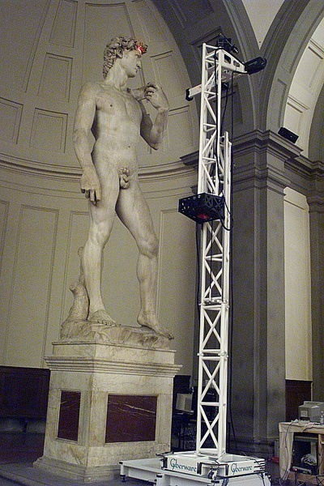


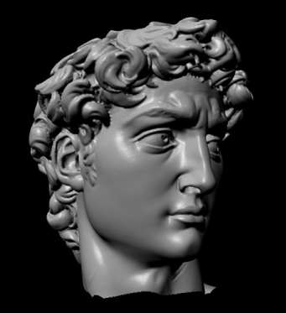
Aligning and Matching
(Partial or Entire) Shapes
The need to align and match shapes arises in many domains
A classic example is shape acquisition through a 3D scanner

Slide 3
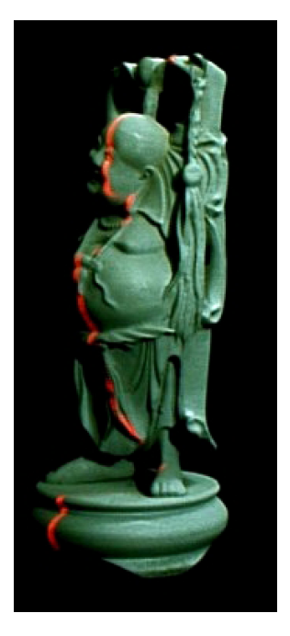
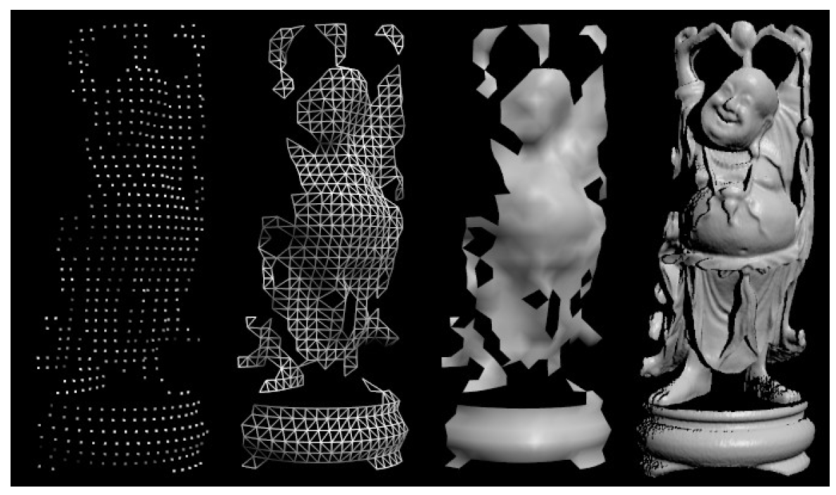
Range Image Registration

Slide 4
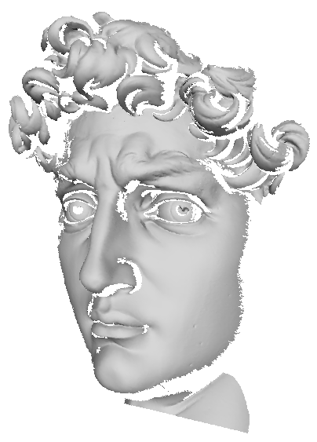
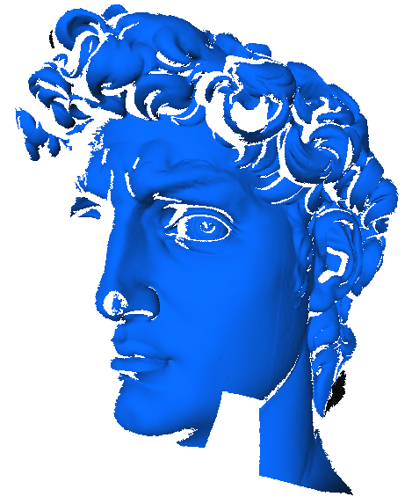
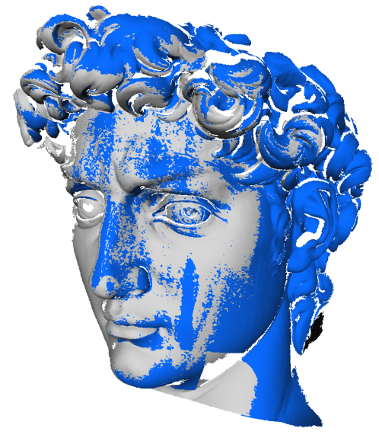
The Registration Problem
Given:
Two shapes A and B which partially overlap
Goal:
Using only rigid transforms, register B against A by minimizing a measure of distance between A and B
A
B

Slide 5
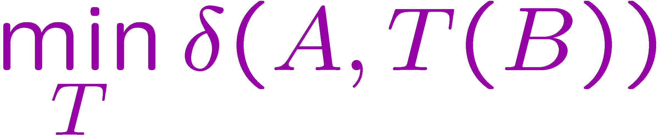
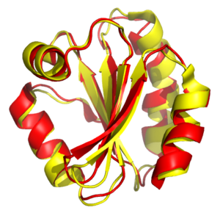
Distance or Similarity of Shapes
Given two shapes A and B, we are interested in defining a distance or (dis-)similarity measure
[extrinsic]
Such measures are crucial in shape similarity search, shape classification, etc.
As another example, shape registration
and matching is very important in modern structural biology
Human (red) and fly (yellow) thierodoxins, compared

Slide 6

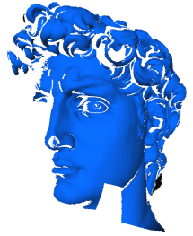

Issues about Similarity Measures
f
We are familiar with function norms (L₂, etc.). The common parametrization establishes correspondences. We don’t have that for structures or shapes.
Partial matches need to be considered -- notion of support σ for the match.
What group of aligning transforms is to be considered?
Is the resulting distance or similarity a metric?
g
Not for
partial matches

Slide 7
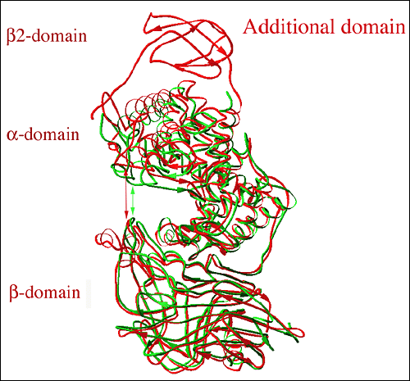
Simultaneous Estimation
We are given two shapes A and B, each in its own coordinate system
We must establish correspondences between certain parts (the alignment supports) of A and B
We must find an optimal transform that best aligns the supports of A and B
We must score this choice of supports and transform to produce a (dis-) similarity measure δ
In computing the score, how do we
aggregate distances?
trade-off larger supports for larger aggregate distance?

Slide 8
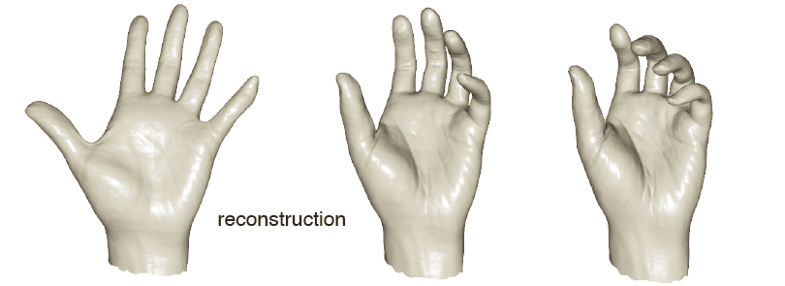
Degrees of Freedom
Transform estimation
  A rigid motion has 6 degrees of freedom (3 for translation and 3 for rotation)
  We typically estimate the motion using many more pairs of corresponding points, so the problem is overdetermined (which is good, given noise, outliers, etc)
  More general transforms require more degrees of freedom. When shape deformations are allowed, the degrees of freedom can grow rapidly

Slide 9
Shape Alignment and Registration

Slide 10
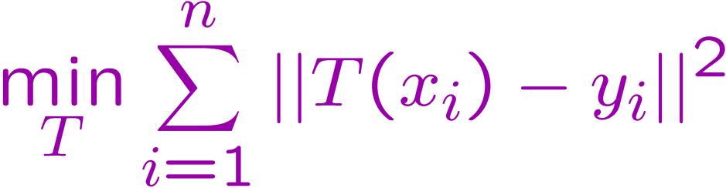
Simplest Case: Rigid Alignment,
Given Correspondences
We are given two sets of corresponding points x₁, x₂, ..., x_{n} and y₁, y₂, ..., y_{n} in E³. We wish to compute the rigid transform T that best aligns x₁ to y₁, x₂ to y₂, ..., and x_{n} to y_{n}.
We define the error to be minimized by
Old Problem:
  Known and solved as the orthogonal Procrustes problem in Factor Analysis (Statistics) [Shönemann, 1966]
  Known and solved as the absolute orientation problem in Photogrammetry [Horn, 1986]
  Also in robotics, graphics, medical image analysis, statistical theories of shape, etc ...
MSE error, RMS distance, …

Slide 11
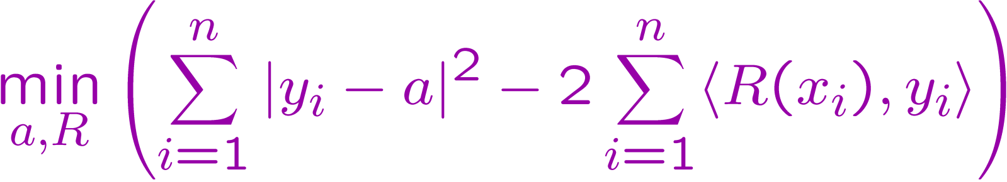
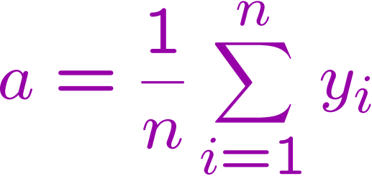
SVD-Based Solution
A rigid motion T is a combination of a translation a and a rotation R, so that T(x) = R(x) + a.
If we place the origin of our coordinate system at the mean of the x_{i}’s, then the quantity to be minimized simplifies to (up to some constants):
Note that the translational and rotational parts factor. The translational part a can easily be seen to be
T
R
The centroids of the two
point sets have to be
aligned!

Slide 12
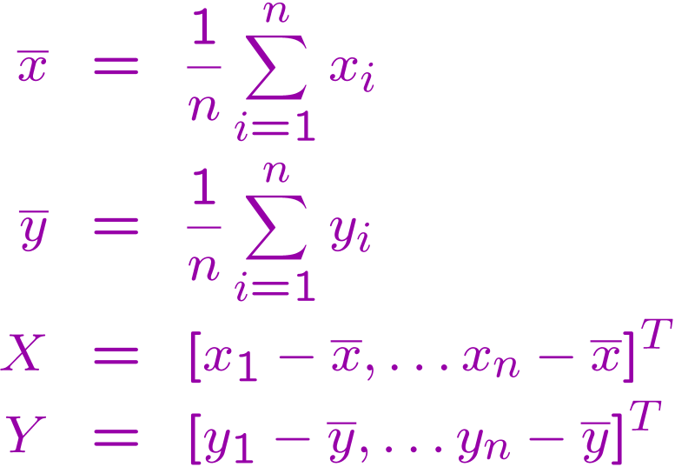

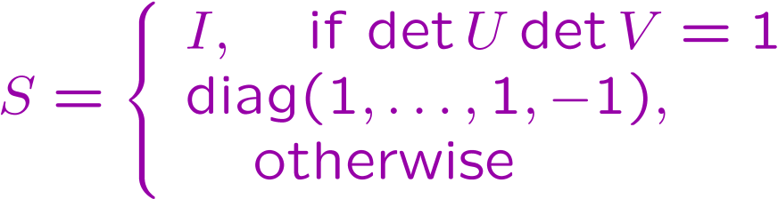


The Rotation Part
Define
Here X and Y are 3 by n matrices.
Now compute the SVD*
U and V are 3 by 3 orthogonal matrices, and D is a diagonal matrix with decreasing non-negative entries along the diagonal (the singular values).
Define S by
Then
X
Y^{T}
O(n) algorithm!
*SVD = singular value decomposition

Slide 13
How to Get Correspondences?
A chicken-and-egg problem: if we knew the optimal aligning transform, then we could get correspondences by proximity (possibly with the aid of some global adjustment, e.g., dynamic programming)
Transform
Correspondences
Guess one, estimate the other, and iterate!
EM like
Correspondences from proximity (Iterated Closest Pair)
Correspondences from local shape descriptors (Shape Features)
Transform from voting schemes (Geometric Hashing)
Combinations

Slide 14
Aligning 3D Data

Slide 15
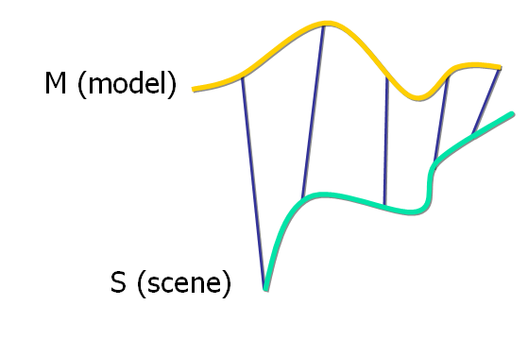
Point Set Alignment
Let M be a model point set
Let S be a scene point set
In the simplest setting:
N_{M} = N_{S}
Each point S_{i} corresponds to M_{i}

Slide 16
MSE Objective Function
The MSE objective function is:
The optimal alignment is given by:

Slide 17
Aligning 3D Data
As we saw, if correct correspondences are known, we can find optimal rotation/translation in essentially closed form

Slide 18
Aligning 3D Data
How to find correspondences: User input? Feature detection? Local shape signatures?
Simplest alternative: assume closest points correspond – makes a lot of sense when A and B are partial scans of the same stationary object
A
B

Slide 19
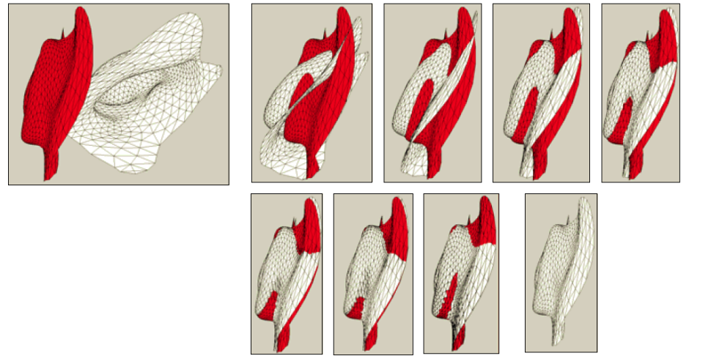
Aligning 3D Data
Align the A points to their closest B neighbors, then repeat
Converges, if starting positions are “close enough”
Successive iterations bring the objects closer together

Slide 20
Closest Points
Given two points r₁ and r₂ , their Euclidean distance is:
Given a point r₁ and set of points A , the Euclidean distance is:

Slide 21
Finding Matches
The scene shape S is aligned to be in the best alignment with the model shape M
The distance of each point s of the scene from the model is :

Slide 22
Finding Matches
C – the closest point operator
Y – the set of closest points to S

Slide 23
Finding Matches
Finding each match is performed in O(N_{M}) time, in the worst case.
Given Y we can calculate optimal alignment
S is then updated to be :

Slide 24
The Iterated Closest Pair (ICP) Algorithm
[Besl & McKay, ‘92]
Init the error to ∞
Y = CP(M,S),e
Calculate correspondence
(rot,trans,d)
Calculate alignment
S’= rot(S)+trans
Apply alignment
d’ = d
Update error
If error > threshold

Slide 25
The Algorithm in Code
function ICP(Scene,Model)
begin
E’ ← + ∞;
(Rot,Trans) ← In Initialize-Alignment(Scene,Model);
repeat
E ← E’;
Aligned-Scene ← Apply-Alignment(Scene,Rot,Trans);
Pairs ← Return-Closest-Pairs(Aligned-Scene,Model);
(Rot,Trans,E’) ← Update-Alignment(Scene,Model,Pairs,Rot,Trans);
Until |E’- E| < Threshold
return (Rot,Trans);
end

Slide 26
Convergence Theorem
The ICP algorithm always converges monotonically to a local minimum with respect to the MSE distance objective function
  Correspondence step improves error bound – because of nearest neighbor computation
  Rotation/Translation step improves error bound – because of transform optimization

Slide 27
Convergence Theorem
Correspondence error :
Alignment error:

Slide 28
Time Analysis
Each iteration includes three main steps
A. Finding the closest points:
O(N_{M}) per point
O(N_{M}*N_{S}) total
B. Calculating the optimal alignment: O(N_{S})
C. Updating the scene: O(N_{S})
Fast nearest-neighbor data structures can be
very helpful here

Slide 29
ICP Variants
Variants on the following stages of ICP
have been proposed:
Selecting sample points (from one or both meshes)
Matching to points in the other mesh
Weighting the correspondences
Rejecting certain (outlier) point pairs
Assigning an error metric to the current transform
Minimizing the error metric w.r.t. transformation

Slide 30
Performance of Variants
Can analyze various aspects of performance:
  Speed
  Stability
  Tolerance of noise and/or outliers
  Maximum initial misalignment tolerated

Slide 31
ICP Variants
Selecting sample points (from one or both shapes)
  Use all available points [Besl 92]
  Uniform subsampling [Turk 94]
  Random sampling in each iteration
  [Masuda 96]
  Ensure that samples have normals distributed as uniformly as possible [Rusinkiewicz 01]

Slide 32
Selection of Points
Uniform Sampling
Normal-Space Sampling
Slippage motions and stability of ICP

Slide 33
ICP Variants
Matching to points in the other mesh
  Closest point in the other mesh [Besl 92]
  Normal shooting [Chen 91]
  Reverse calibration [Blais 95]
  Restricting matches to compatible points (color, intensity, normals , curvature ..) [Pulli 99]

Slide 34
Point Matching
Closest point :

Slide 35
Point Matching
Normal Shooting

Slide 36
Point Matching
Projection (reverse calibration)
Project the sample point onto the destination mesh , from the point of view of the destination mesh’s camera.

Slide 37
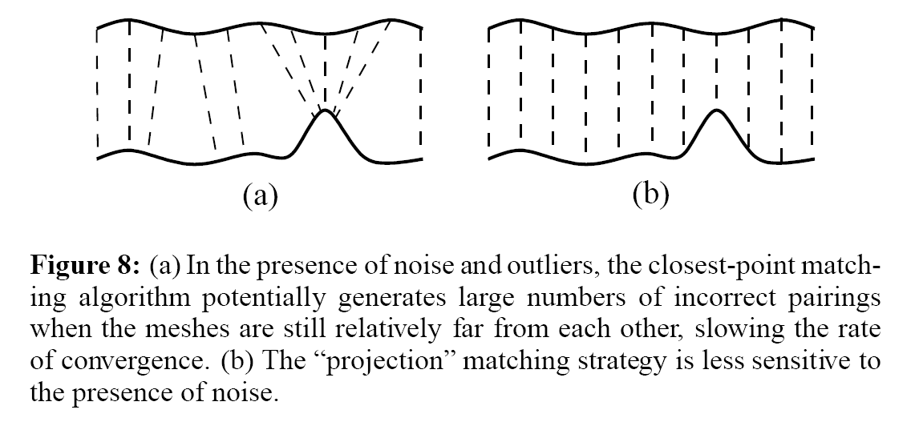
Point Matching

Slide 38
ICP Variants
Weighting the correspondences
  Constant weight
  Assigning lower weights to pairs with greater point-to-point distance:
  Weighting based on compatibility of normals:
  Scanner uncertainty

Slide 39
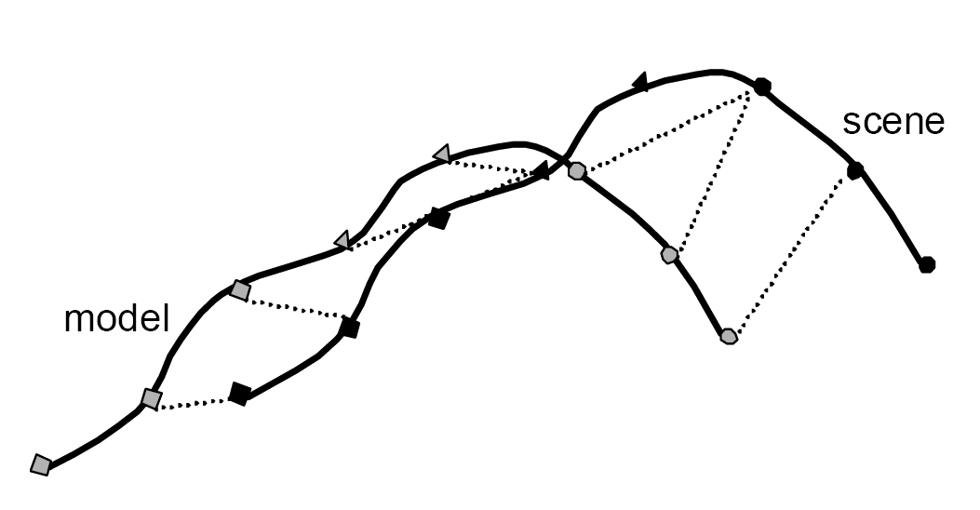
Weighting of Pairs
The rectangles and circles
indicate the scanner
reflectance value

Slide 40
ICP Variants
Rejecting certain (outlier) point pairs
Corresponding points with point to point distance higher than a given threshold
Rejection of worst n% pairs based on some metric
Pairs containing points on end vertices
Rejection of pairs whose point to point distance is higher than n*σ
Rejection of pairs that are not consistent with their neighboring pairs [Dorai 98]:
(p₁,q₁) , (p₂,q₂) are inconsistent iff

Slide 41
Rejecting Pairs
Distance thresholding

Slide 42
Rejecting Pairs
Points on end vertices

Slide 43
Rejecting Pairs
Inconsistent Pairs
q1
q2
p2
p1

Slide 44
ICP Variants
Assigning an error metric to the current transform
Minimizing the error metric w.r.t. transformation

Slide 45
Error Metric and Minimization
Sum of squared distances from each sample point to the plane containing the destination point (“Point to Plane”) [Chen 91]
No closed form solution available

Slide 46
Error Metric and Minimization
Using point-to-plane distance instead of point-to-point lets flat regions slide along each other [Chen & Medioni 91]

Slide 47
Error Metric and Minimization
Closest Point

Slide 48
Error Metric and Minimization
Point to plane
Works well when spacing of shapes is less
than the sampling density

Slide 49
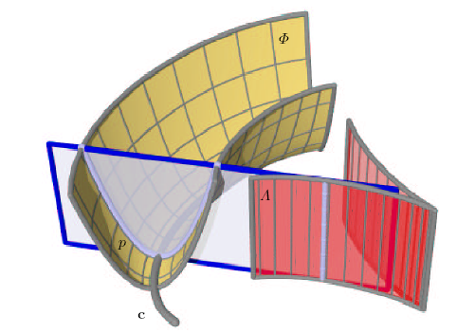
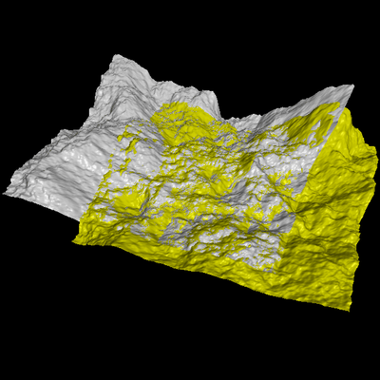
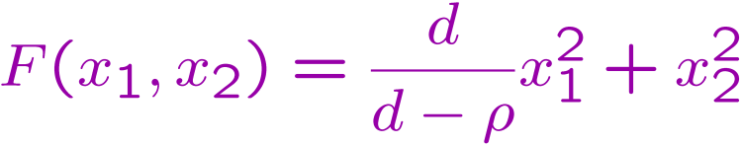
ICP Without Correspondences
ICP without correspondences
  define a quadratic approximant to the square distance function
  perform iterative gradient-descent in this field
  point to foot-point distance
    case d ! 1 : classical ICP
    case d ! 0: point-to-plane ICP
[Pottman & Hofer, 02]
curvature

Slide 50
Shape Models and Shape Variability

Slide 51
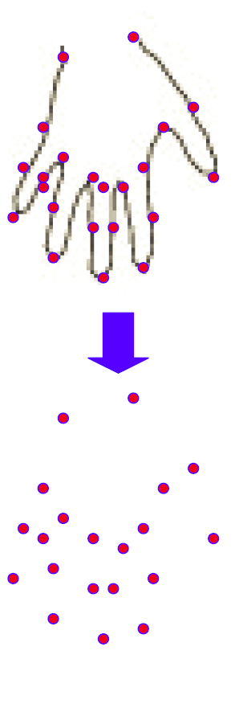
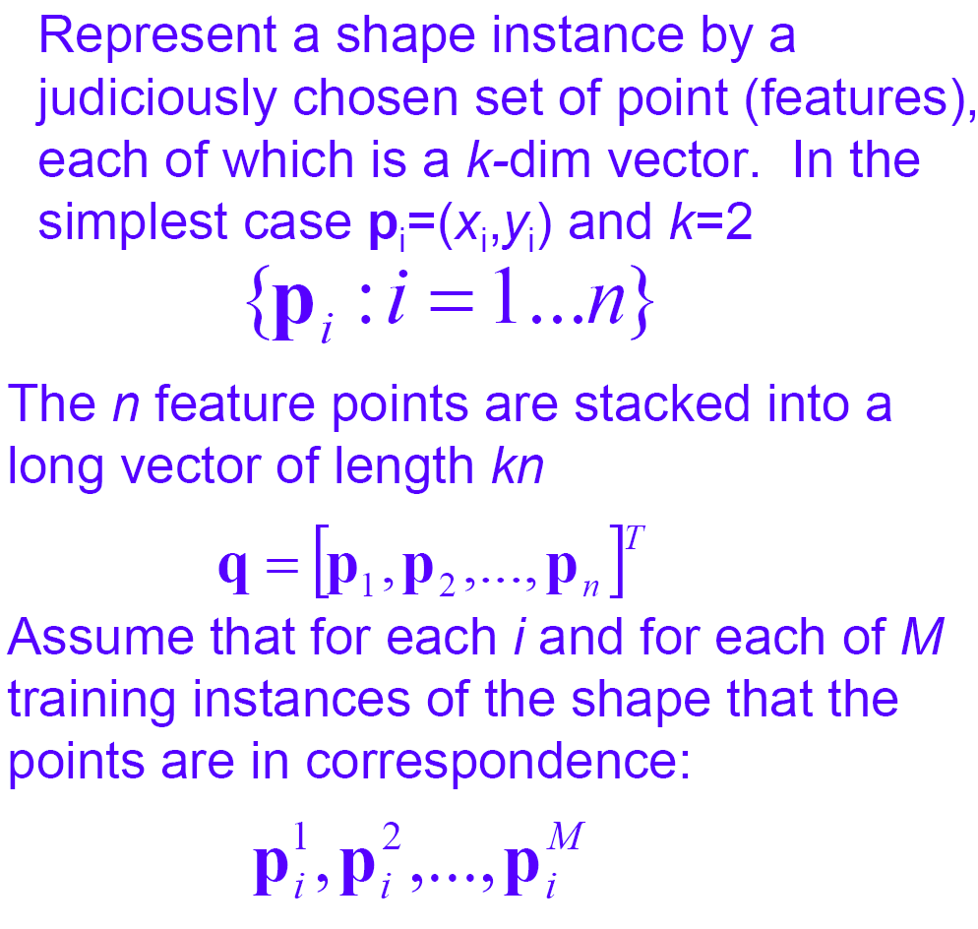
Shape Models and
Shape Variability
Point Distribution Models

Slide 52
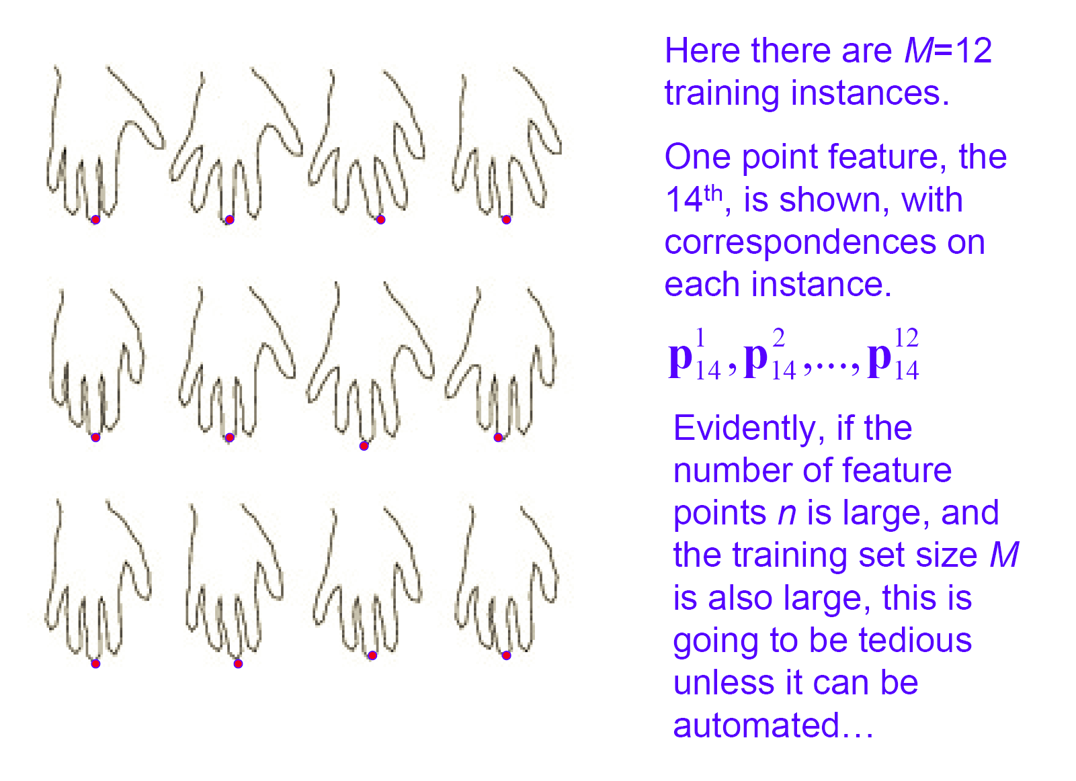
Learning a Shape Family

Slide 53
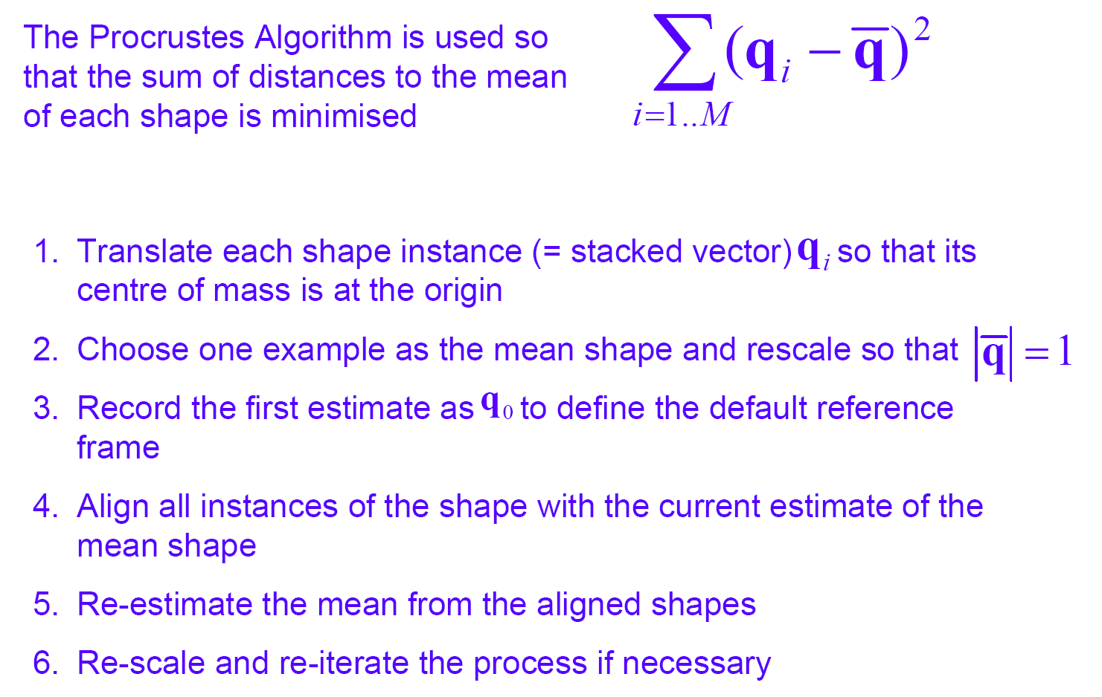
Aligning Shape Instances

Slide 54
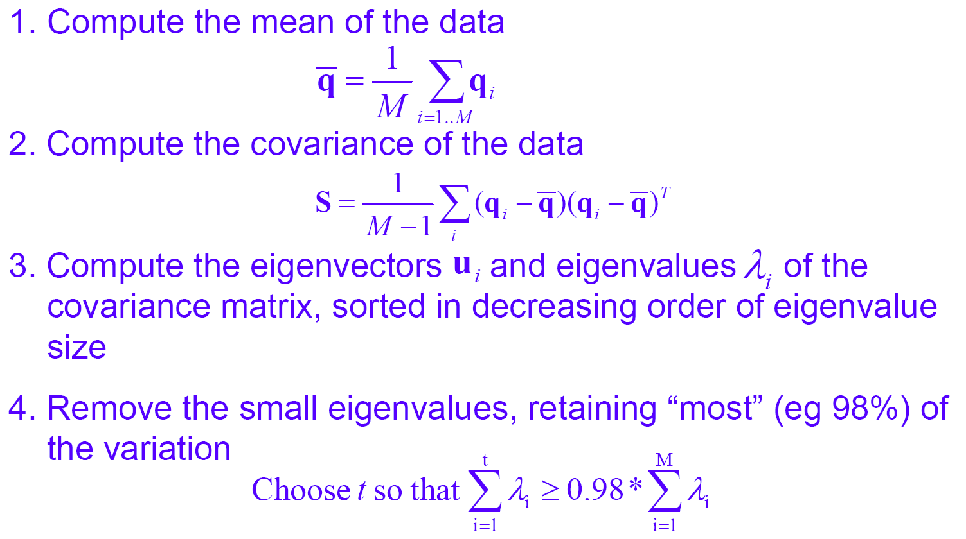
PCA Models of Shape Variability
PCA = Principal Component Analysis

Slide 55
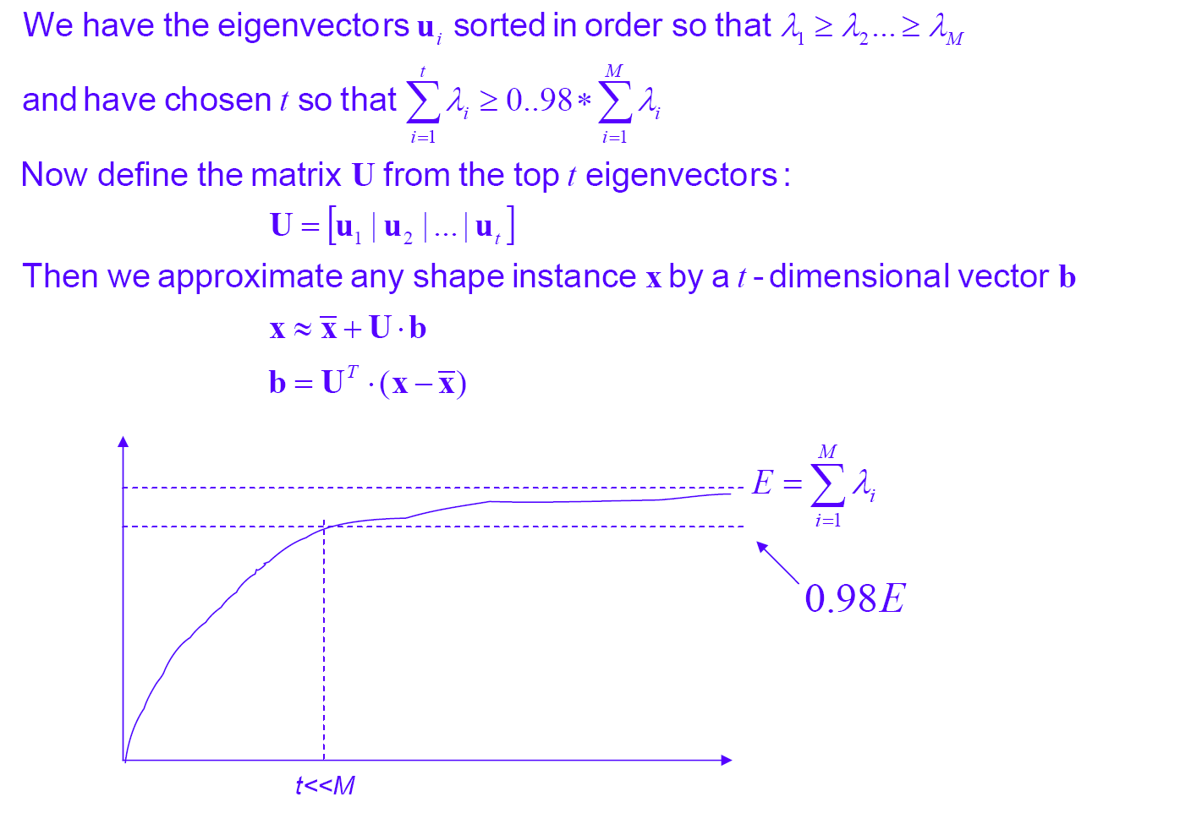
PCA Analysis

Slide 56
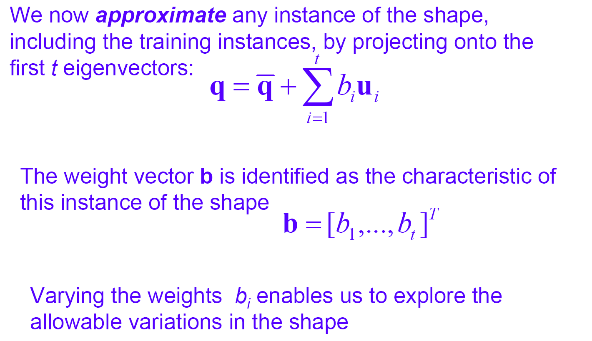
Shape Approximation

Slide 57
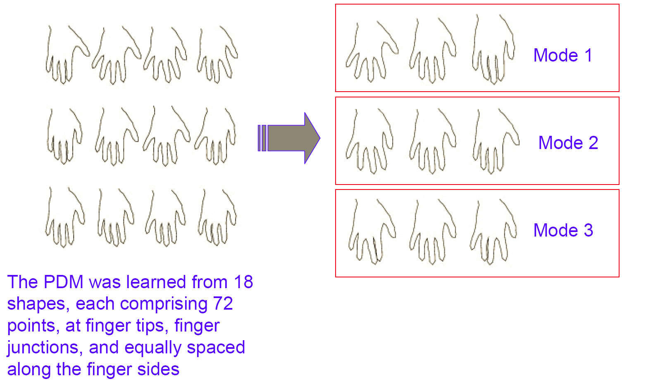
Example: Hand Shapes

Slide 58
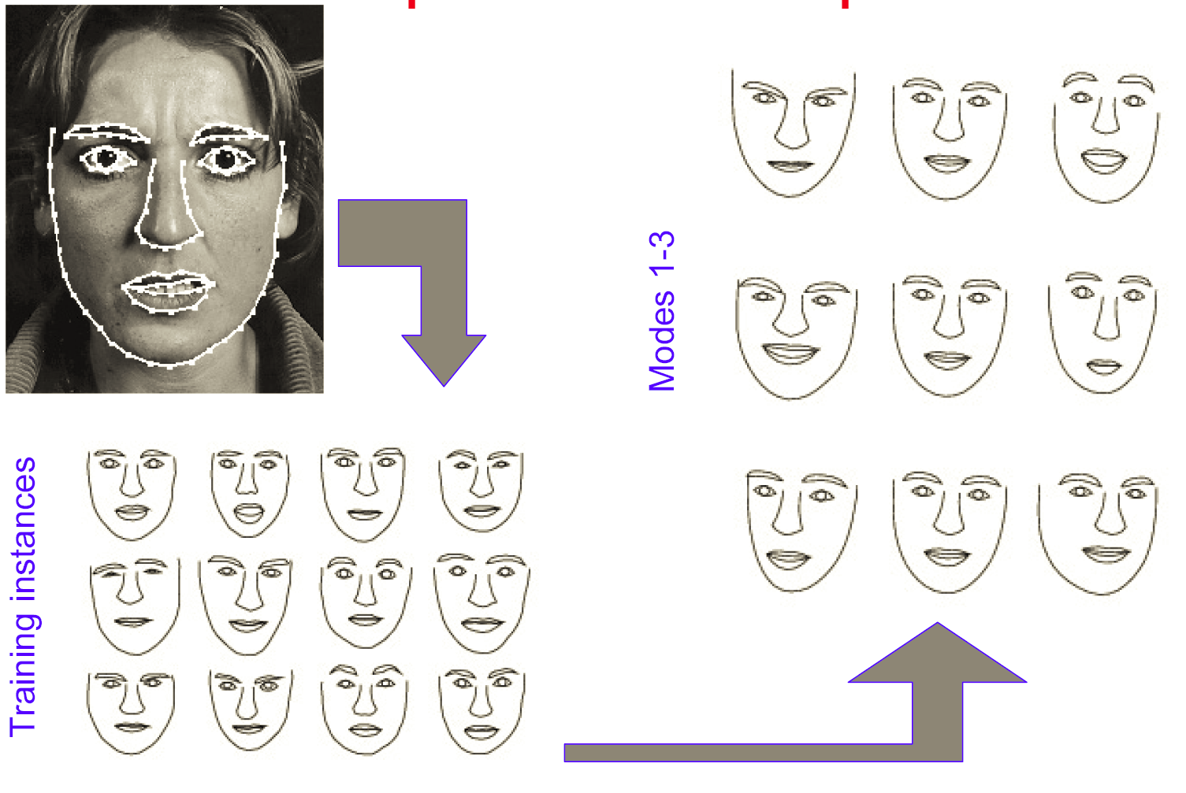
Example: Face Shapes

Slide 59
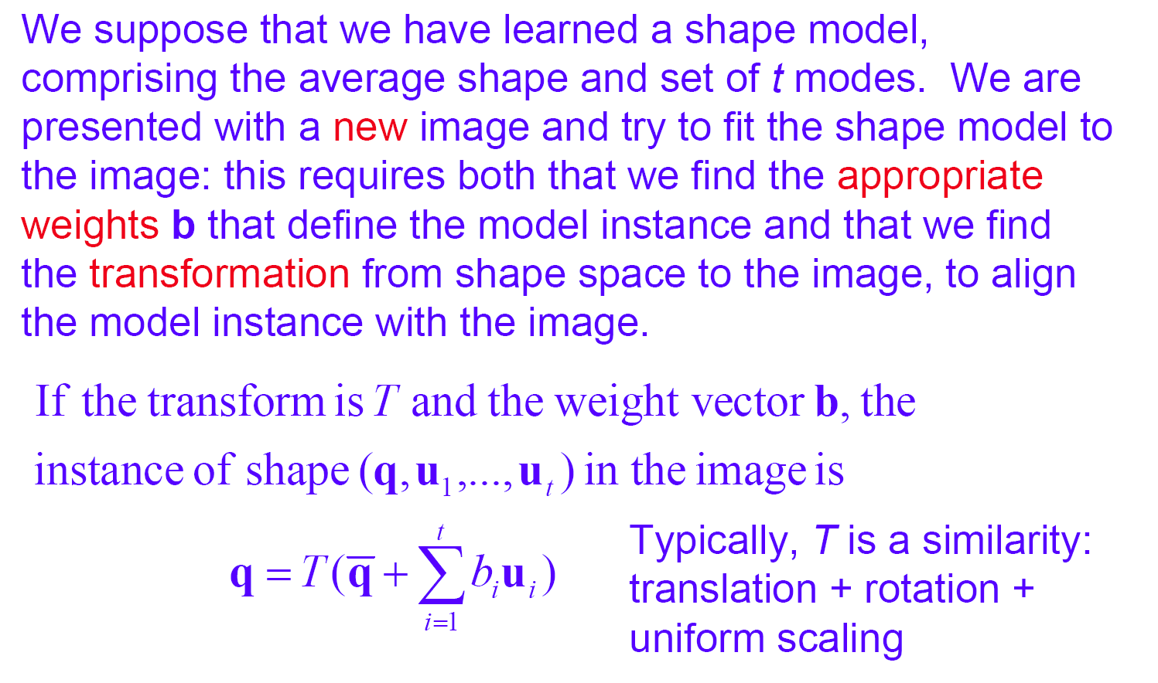
Finding a Shape in an Image

Slide 60
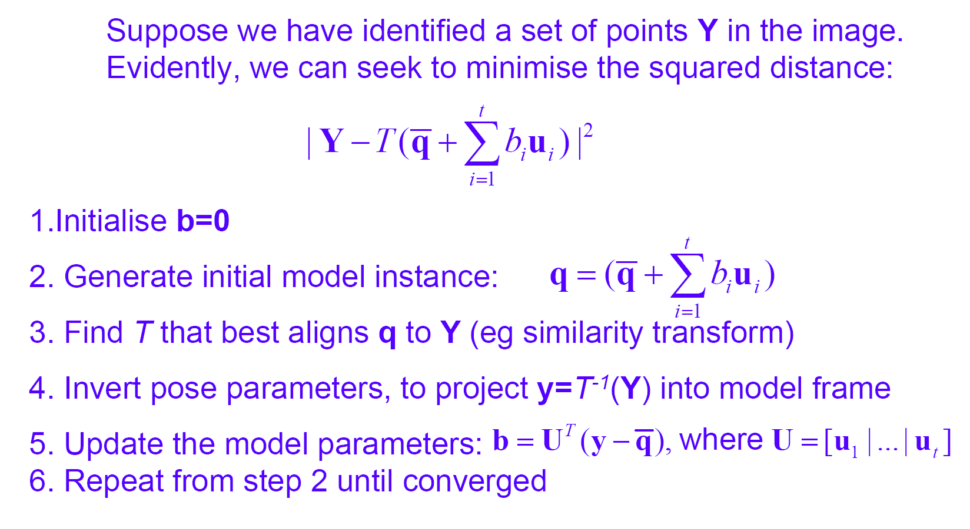
Fitting Pose and Parameters

Slide 61
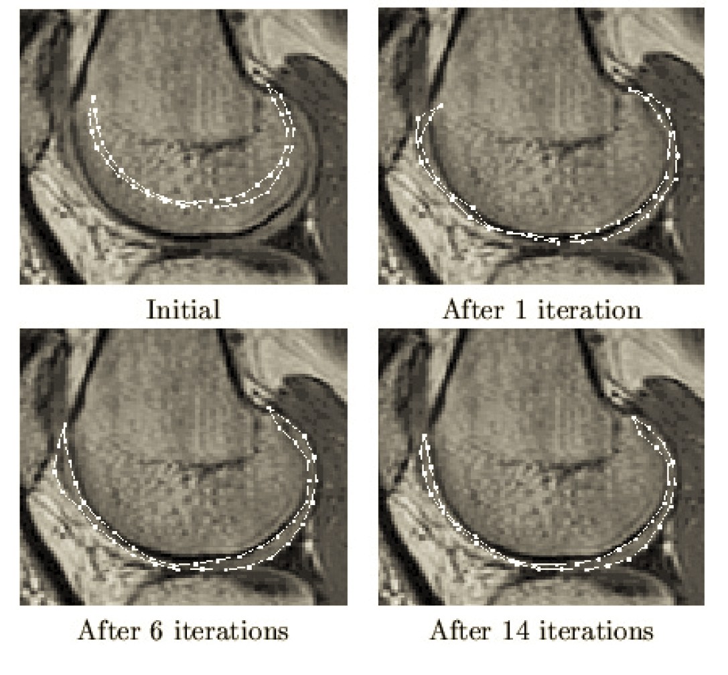
Kee Cartilege in MRI Images

Slide 62
Correspondences from Proximity (ICP)
Associate with a sample of points of A their closest point of B.
This defines a set of corresponding points.
Compute the best rigid alignment, and iterate.
Works if A and B are close (but can get stuck in local minima).
Relatively slow convergence (linear).
Can go especially wrong in flat regions
RMSD
decreases
A
B
Iterated Closest Pair (ICP),
[Besl & McKay, 92]

Slide 63
Shape Models
The variability in a set of related shapes can be captured through PCA analysis of sets of corresponding points
Fitting such shape models requires the simultaneous estimation of pose and transform

Slide 64
The End

