Slide 1
CS164: Topology
Leonidas Guibas
Computer Science Dept.
Stanford University
[Slides: Afra Zomorodian]
TexPoint fonts used in EMF.
Read the TexPoint manual before you delete this box.: AAA

Slide 2
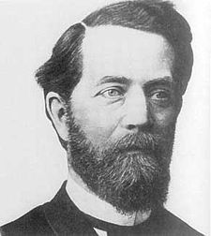
Erlangen Program
Geometry and topology study invariances of spaces under certain transformation groups
rigid motions: Euclidean geometry
continuous deformations: topology
Felix Klein
1849-1925

Slide 3
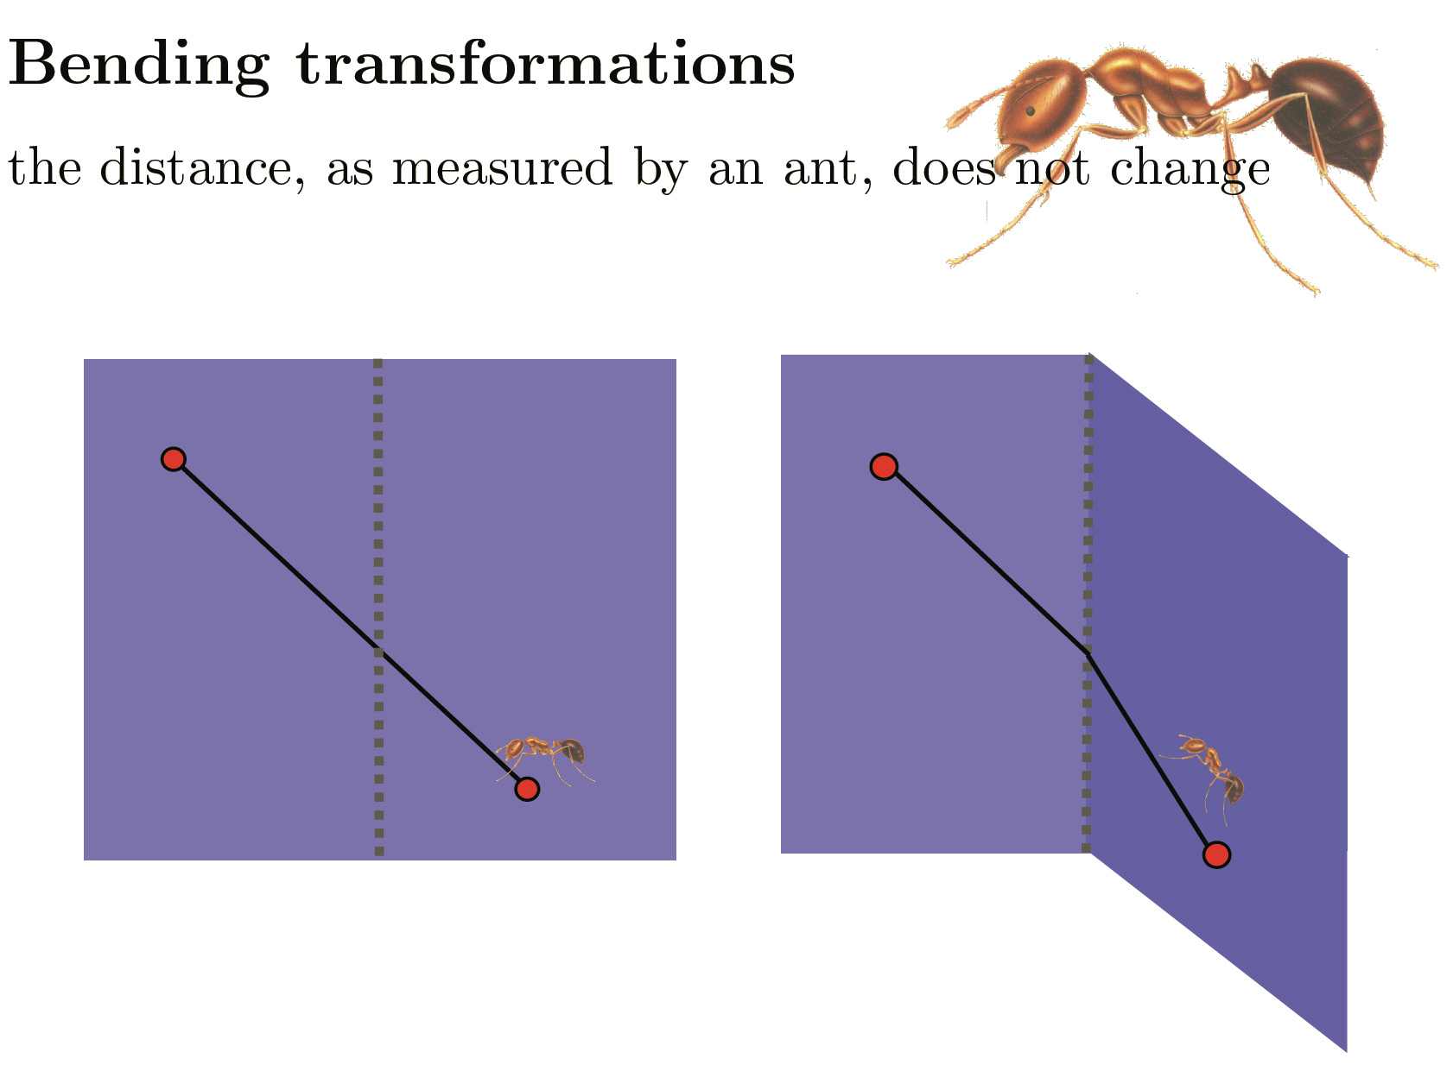
Intrinsic vs. Extrinsic

Slide 4
2-Manifold Classification

Slide 7
M. C. Escher

Slide 8
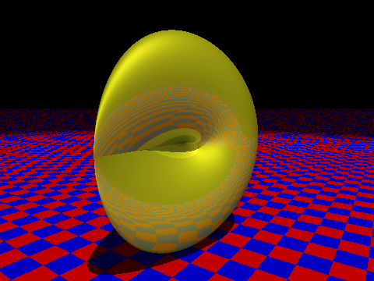
Möbius + cap = RP²

Slide 10
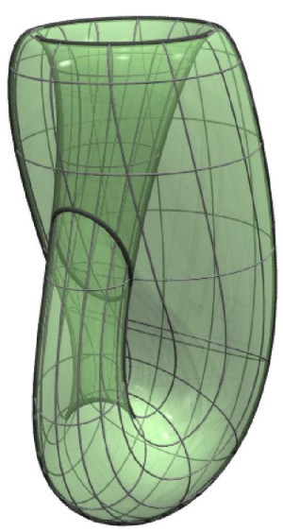

Slide 11
Möbius + Möbius = Klein

Slide 13
John Horton Conway
1937-

Slide 14
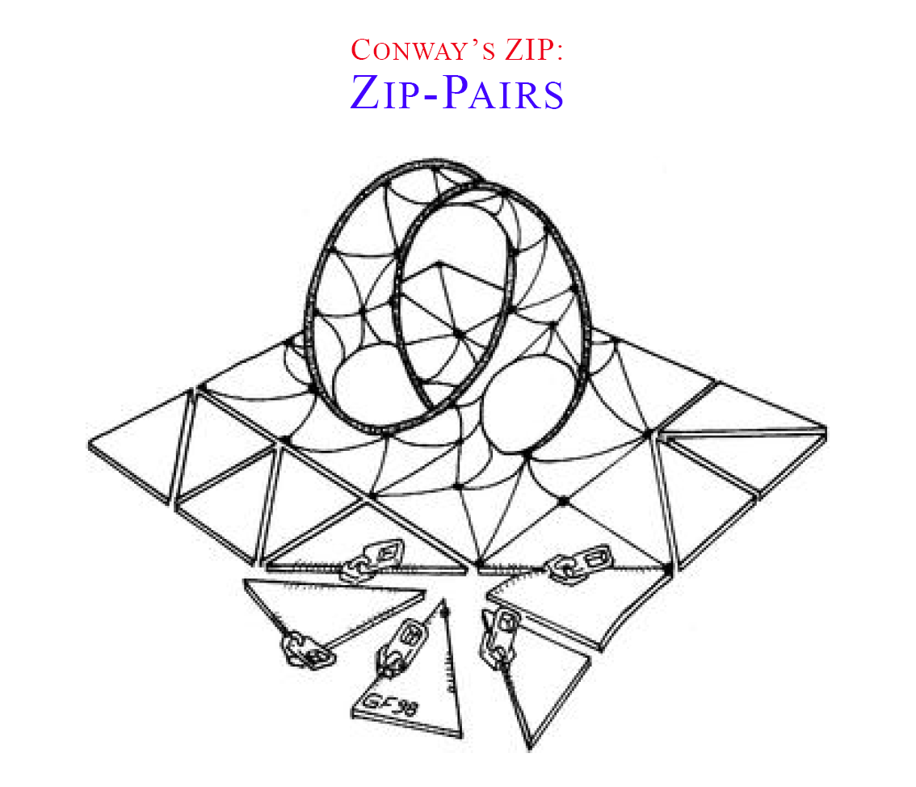

Slide 16
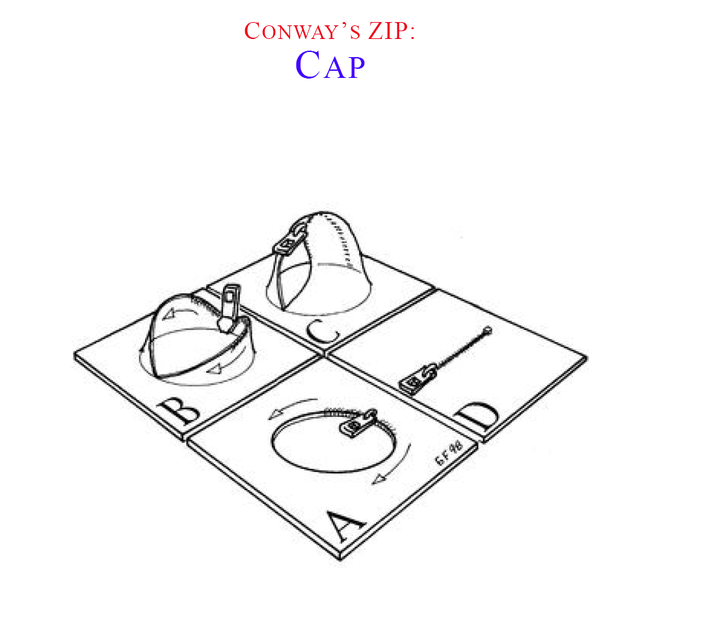

Slide 17
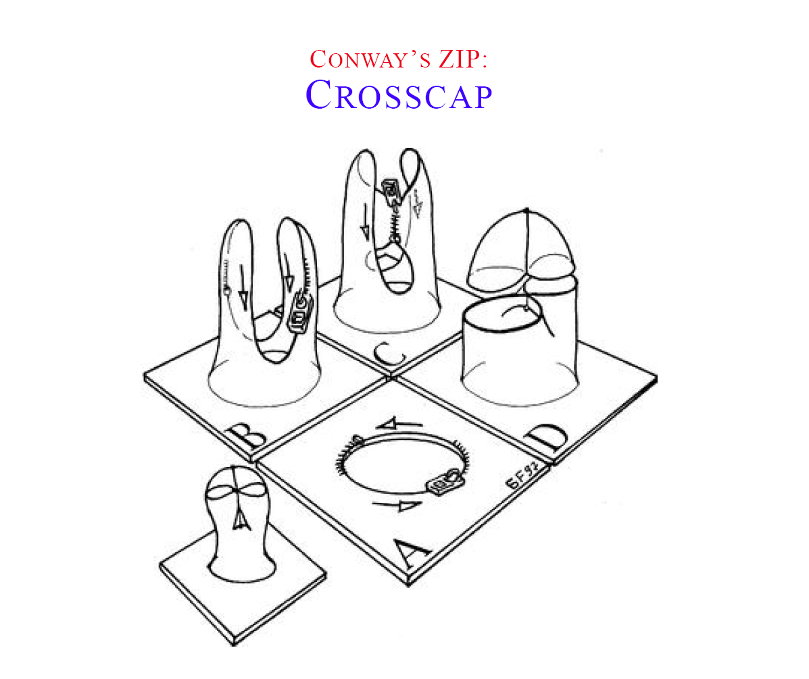

Slide 18
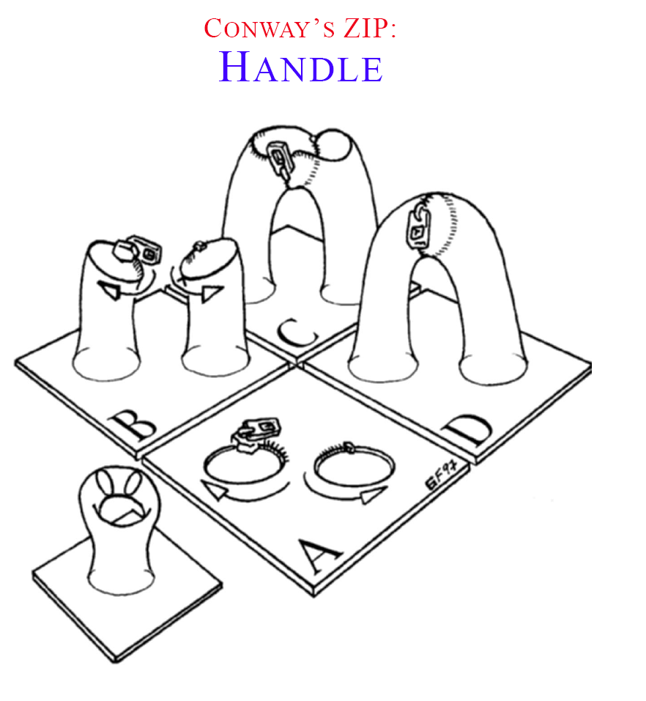

Slide 19
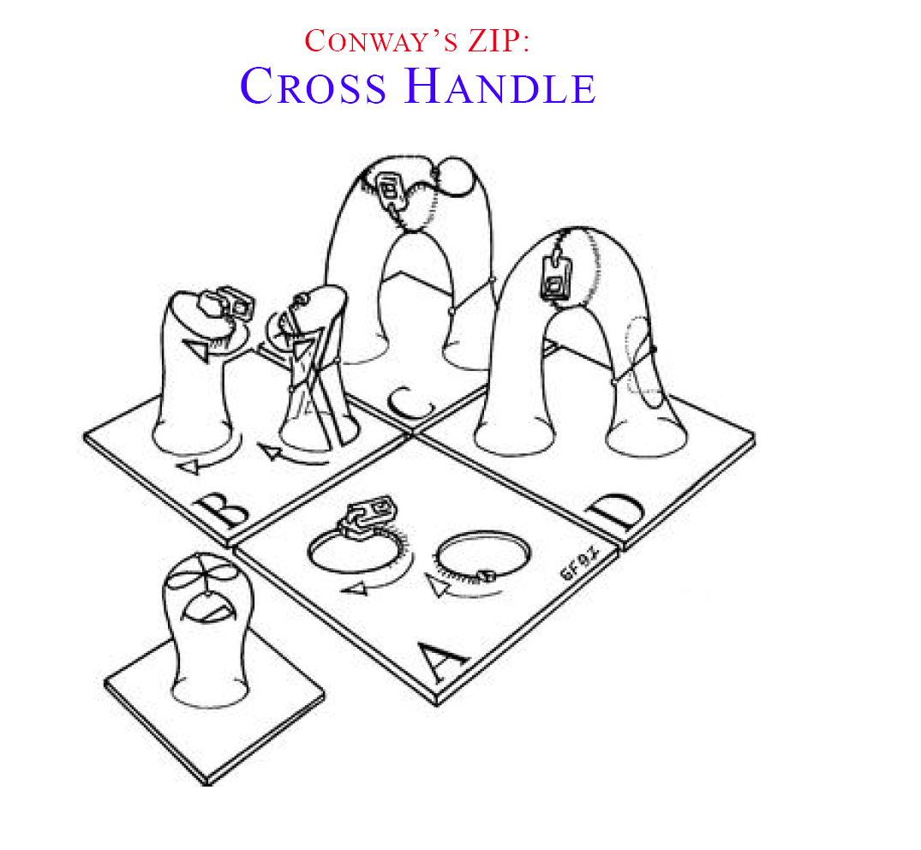

Slide 22
Manifolds w. boundary = the above, plus perforations

Slide 23
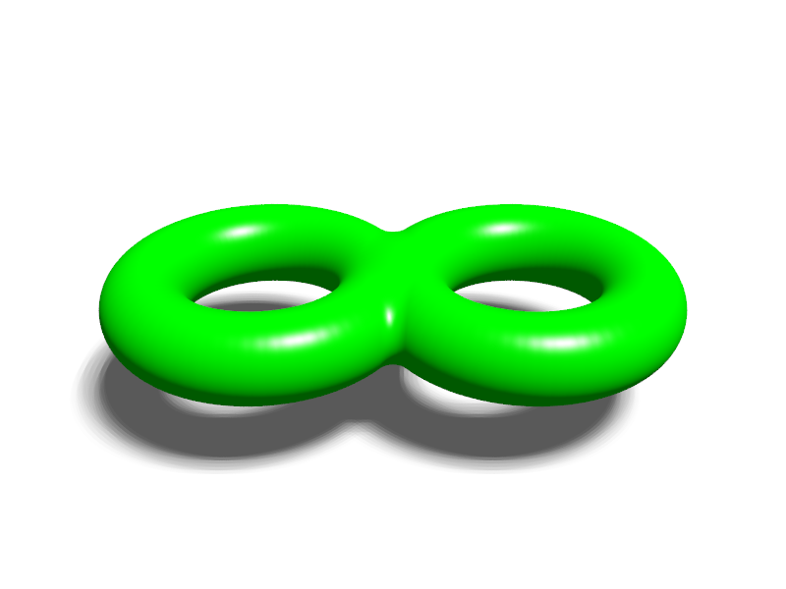
Spheres with handles and cross caps is all there is …

