Slide 1
Randomized Incremental Algorithm for Delaunay Triangulation (DT) CS 268 @ Gates 219 October 19, 3:00 – 4:20 Richard Zhang (for Leo G.)
Disclaimer: All figures in the slides are for illustration only. Best approximations were attempted, but preciseness or correctness of the geometric constructions should not be assumed.

Slide 2
Striving for simplicity
Reference: Guibas, Knuth, and Sharir, “Randomized Incremental Construction of Delaunay and Voronoi Diagrams,” Algorithmica, 1992.
The incremental algorithm is simple to code
Adding randomization is a trivial matter
Point location idea is also meant for simplicity
No complex search data structures
But simple algorithm ≠ simple analysis

Slide 3
Basic incremental algorithm for DT
Insert one new site into the current DT at a time
Update the DT and repeat

Slide 4
Key step: point insertion
1. Point location: locate triangle “hit” by new point p
Why are these edges Delaunay?
p
Delaunay property of suspect (dashed) edges need to be examined

Slide 5
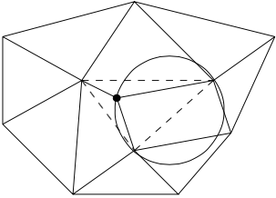
Incremental point insertion
2. Test D-hood of suspect edges and flip if needed
p
Use the inCircle predicates

Slide 6
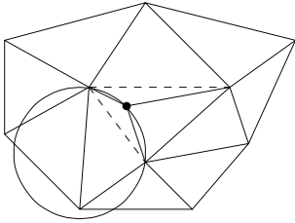
Incremental point insertion
2. Test D-hood of suspect edges and flip if needed
p

Slide 7
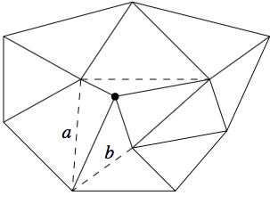
Incremental point insertion
A flip adds two suspect edges and two new triangles
p
A newly created edge (via flip) is always connected to p, the newly inserted site. This new edge is Delaunay and will stay so regardless of further flips. Note: edge flips do not change the Delaunay-hood of any edge.

Slide 8
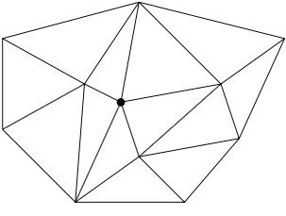
Incremental point insertion
After resolving a “wave of suspicions” around p, all Delaunay properties are restored
p
Figures taken from Graphics Gem by Dani Lischinski [1993]

Slide 9
A detail: what is the first triangle
A very large triangle that encloses all sites but is exterior to all circumcircles

Slide 10
A detail: what is the first triangle
A very large triangle that encloses all sites but is exterior to all circumcircles

Slide 11
Time complexity
Lemma 32: When a new site is inserted, no edge is tested more than once.
Any current Delaunay edge, that has a circle witness after insertion of p, is tested at most once
If tested edge is not Delaunay, it is flipped to become (and stay to be) Delaunay; it is never tested again.
Each insertion is O(n), so overall O(n²)
p
p

Slide 12
Can we reach quadratic time?
Yes. Imagine cases of DTs and insertions that require a lot of flips. Here are specific about both the site locations and insertion orders.

Slide 13
Randomization
To achieve good expected running time
Only need to randomize the point insertion order — a trivial matter
No assumptions made on site locations except for general positioning

Slide 14
Randomization
To achieve good expected running time
Only need to randomize the point insertion order — the one liner
No assumptions made on site locations except for general positioning
To analyze the expected running time
Estimate the expected total number of structural changes (the updates) needed after point insertion — proportional to total number of Delaunay triangles that will ever arise
Estimate the time needed for all point location tests

Slide 15
Estimate number of D-△
Introduce the notion of scope of a △XYZ:
w(△XYZ) = number of points interior to the circumcircle of △XYZ
Let T_{j} be the number of triangles with scope j. Then we need to bound
Rewrite over scope:

Slide 16
Estimate number of D-△
Need to bound τ
Probability that a △ with scope j appears in the r-set. This is the same as the probability that the r-set contains three vertices of the △ but none of the j sites enclosed by the circumcircle of the △.
To bound , the rest is algebraic manipulation …

Slide 17
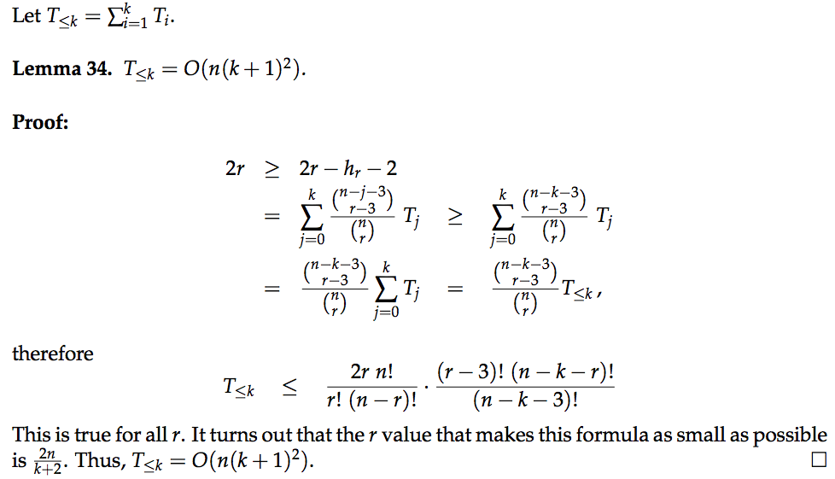
To bound

Slide 18
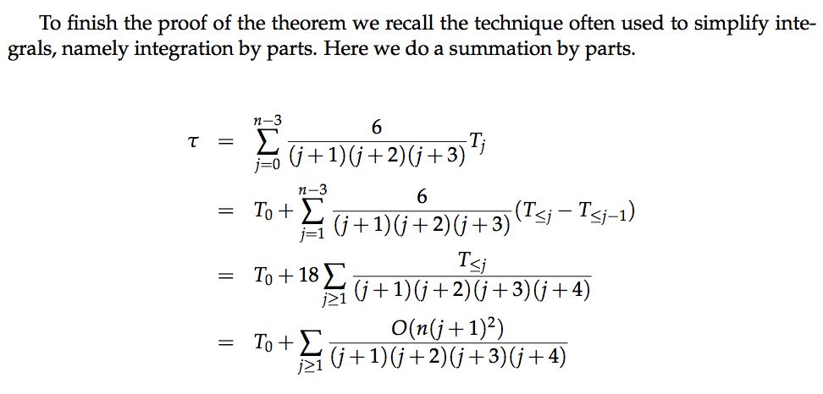
To bound

Slide 19
A looser bound for : 9n +1
Count how many new triangles are expected to be created per step
At each step, when a new site p is inserted
Three new triangles are created by a split
Two new triangles are created by a flip
Each flip leads to one new edge to p
Total number of new triangles ≤ 2(k – 3) + 3, where k is the expected valence of a site in a DT. Exercise: k = 6.
p
p

Slide 20
Point location: the elegant idea
Keep track of all triangles arising during the whole process
Maintain pointers between old and newly created triangles
To locate a point, trace in “top-down” manner the stacked triangles in chronological order
Like stacking paper triangles on top of each other

Slide 21
Stacking the triangles
If a new site is inserted, there are three new triangles
new
old
new
new

Slide 22
Stacking the triangles
If a new site is inserted, there are three new triangles
When an edge is flipped, two new triangles
new
old
new
new
old
new
new
old

Slide 23
Search for triangle
Start with the largest triangle which contains all sites
At each step of chronological trace
Test two or three triangles for containment
Then recurse
Each step only involves constant number of tests
Need to estimate the total number of triangles tested

Slide 24
Amortized bound of total search cost
Key is to relate the #triangles tested to their scopes
There are n sites, but one site may be counted in multiple scopes
Let p be an inserted site for △ location. Let △XYZ be one of the △’s tested. We only need to count △XYZ’s that contain p. Two cases:
△XYZ is in the final DT: there are O(n) such △’s in total

Slide 25
Amortized bound of total search cost
Key is to relate the #triangles tested to their scopes
There are n sites, but one site may be counted in multiple scopes
Let p be an inserted site for △ location. Let △XYZ be one of the △’s tested. We only need to count △XYZ’s that contain p. Two cases:
△XYZ is in the final DT: there are O(n) such △’s in total
△XYZ was destroyed at some time during construction process

Slide 26
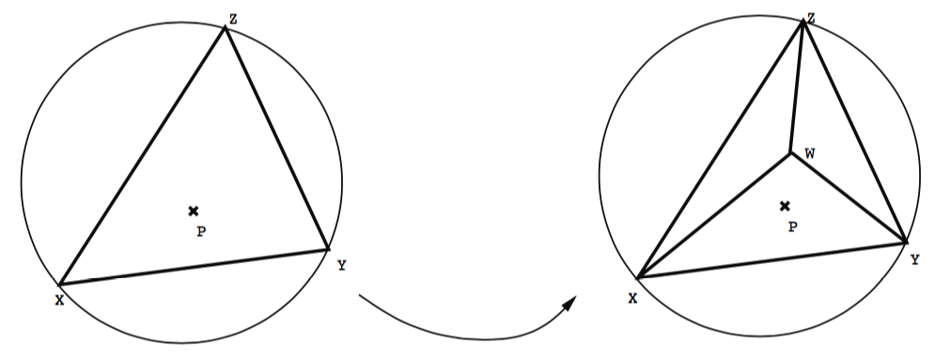
Case 1: △XYZ was split into three
Before △XYZ was destroyed, it was Delaunay.
Since p lies inside △XYZ, it lies inside the circumcircle of △XYZ
We count/charge △XYZ to this site p which accounted for the scope measure of △XYZ.

Slide 27
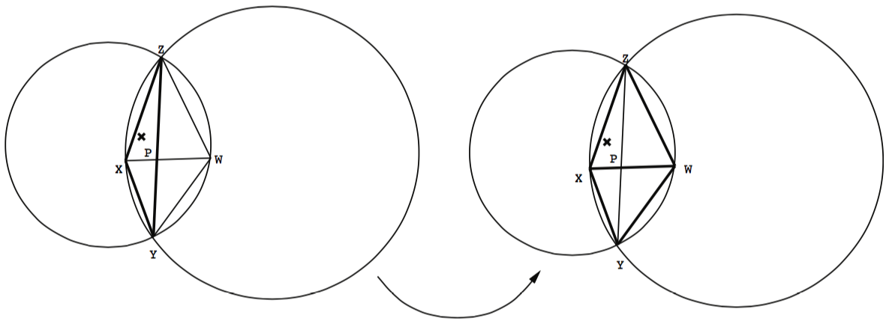
Case 2: △XYZ was replaced in a flip
The flip involves △XYZ and its adjacent △, say △WYZ. Before △XYZ was destroyed (by the flip), two possibilities:
△XYZ was Delaunay. So charge △XYZ to p which accounted for △XYZ’s scope.

Slide 28
Case 2: △XYZ was replaced in a flip
Hence, X must be in the circumcircle of △WYZ. It follows that △XYZ is in the circumcircle of △WYZ, and so is p. So charge △XYZ’s to p which accounted for △WYZ’s scope.
The flip involves △XYZ and its adjacent △, say △WYZ. Before △XYZ was destroyed (by the flip), two possibilities:
△XYZ was Delaunay. So charge △XYZ to p which accounted for △XYZ’s scope.
△XYZ was not Delaunay, then △WYZ must be Delaunay and X was a newly inserted site and its insertion invalidated △WYZ’s Delaunay-hood.

Slide 29
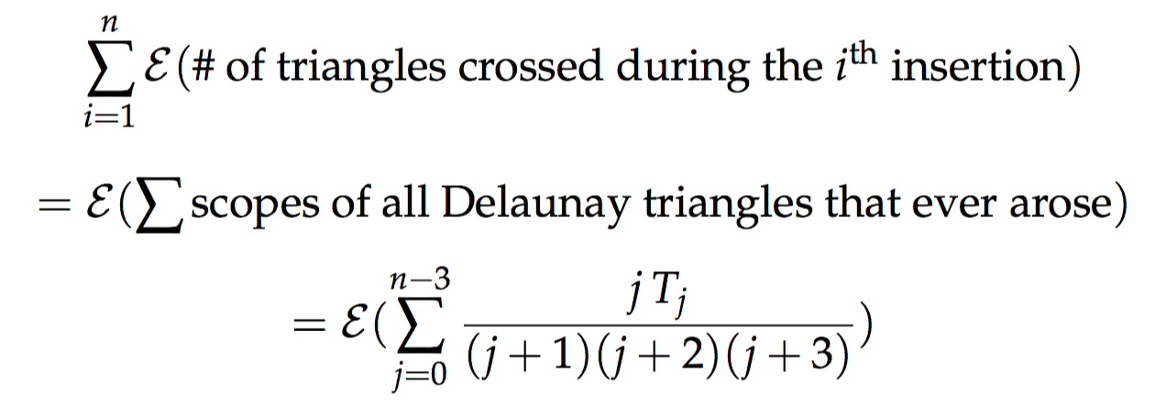
Concluding the amortized analysis
Each tested triangle can be charged to a site which accounted for the scope measure of one of the Delaunay triangles that ever arose
Each site in each scope is charged at most once
So the total number of tested triangles is in the order of
That is O(n log n)!
+ n
6

Slide 30
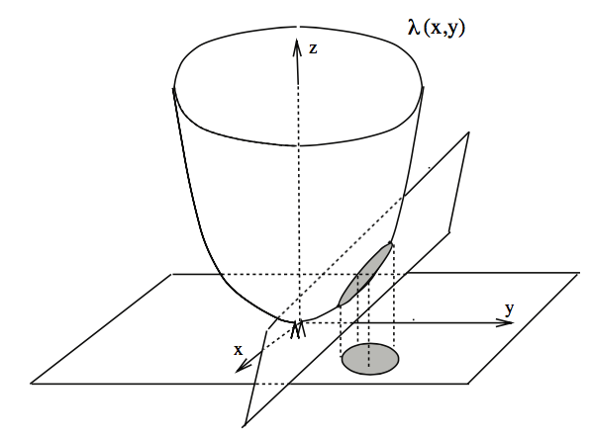
DT and convex hull
Mapping from plane to paraboloid: A = (x, y) ↦ A’ = (x, y, x² + y²)
Points A, B, C, D co-circular iff points A’, B’, C’, D’ are co-planar
B’
C’
A’
D’
C
B
D
A

Slide 31
DT and convex hull
Mapping from plane to paraboloid: A = (x, y) ↦ A’ = (x, y, x² + y²)
If a point P is inside circle, then P’ is below the plane
Finding a DT in the plane is equivalent to finding a lower convex hull on the paraboloid
B’
C’
A’
D’
C
B
D
A

Slide 32
Applications
Closest pair of points in n sites
That edge is Delaunay – so find shortest edge in DT
Finding all nearest neighbors
Edge connecting to nearest neighbor is Delaunay
Euclidean minimum spanning tree (EMST)
EMST must be subgraph of DT – so find DT first
If a point P is inside circle, then P’ is below the plane

Slide 33
Minimal roughness of terrain
Given a set of points in 3D
How to connect them to form a smooth terrain?

Slide 34
Minimal roughness of terrain
Given a set of points in 3D
How to connect them to form a smooth terrain?
Project points onto plane

Slide 35
Minimal roughness of terrain
Given a set of points in 3D
How to connect them to form a smooth terrain?
Project points onto plane
Delaunay triangulation in the plane
Connect 3D points based on DT

Slide 36
Low dilation
g(p, q)
Dilation of graph
Low-dilation graphs are useful in sensor networks
DT (non-obtuse triangulations!!!) are low-dilation
p
q

