Slide 1
Mesh Simplification
Global and Local Methods:
Decimation of Triangle Meshes (Shroeder, Zarge, Lorenson) - 1992
Re-Tiling Polygonal Surfaces (Greg Turk) - 1992

Slide 2
Summary
Overview of Mesh Simplification
Local Simplification – Decimation
Global Simplification – Re-Tiling
Interpolation for Smooth Transitioning

Slide 3
Overview of Mesh Simplification
LOD technique for reducing the number of polygons that need to be rendered
Seeks to preserve appearance while removing as many vertices as possible
Usually attempts to preserve topology
Multiple LOD versions generated offline
Some sort of interpolation technique used to transition between detail levels

Slide 4
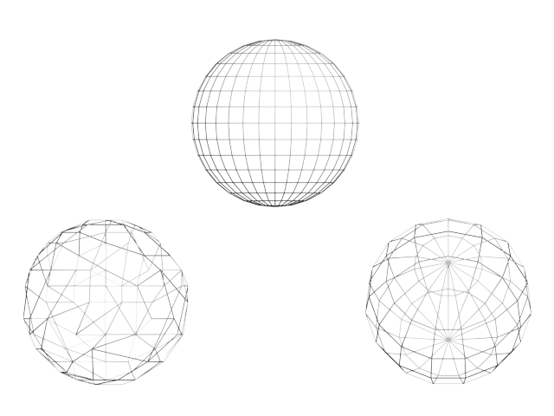
Global and Local Approaches
Global – assumes underlying surface, throws out existing vertices and starts over
Local – takes existing vertices and retains some subset
Local
Global

Slide 5
Decimation of Triangle Meshes
Simple local approach
Repeatedly removes vertices which score low on certain metrics until the desired number of vertices is reached
After a vertex is removed, the resulting hole needs to be re-triangulated

Slide 6
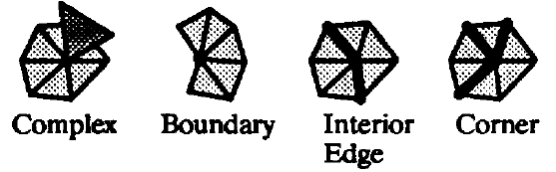
Classifying Vertices
Vertices are classified as:
  Interior edge
  (Interior) corner
  Boundary
  Complex
Complex vertices cannot be removed
Different metric used for corners and edges/boundaries

Slide 7
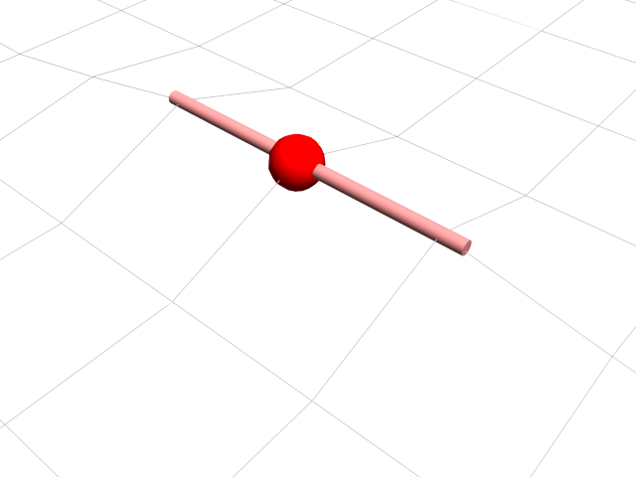
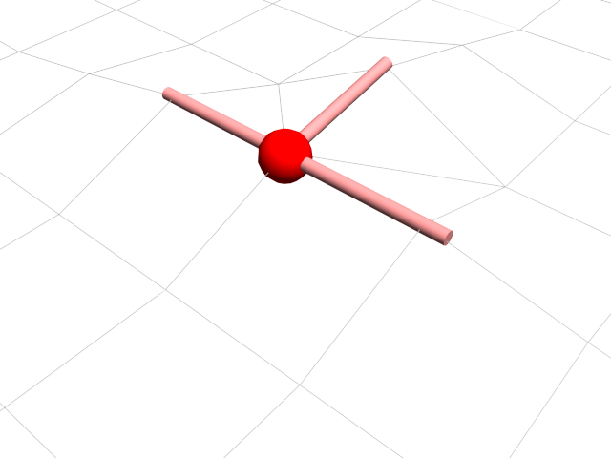
Interior Edges
Determined by dihedral angle between nearby triangles – sharp angles (above threshold) mean the presence of edges

Slide 8
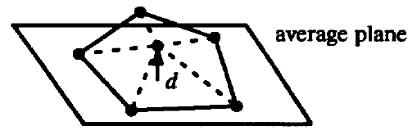
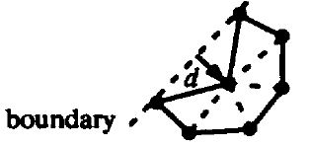
Vertex Removal Criteria
Corners: use distance to plane test to remove vertices which do not deviate highly from the average plane of surrounding triangles
Edges/boundaries: use distance to line formed by the two remaining edge vertices, or the distance to plane test depending on mesh “noise”

Slide 9
Re-Triangulation
Uses recursive loop splitting to triangulate the hole defined by all vertices adjacent to vertex being removed
Triangulation may fail in particularly complex shapes, in which case the vertex is not removed

Slide 10
Iteration
Multiple passes made over entire model until a specific percentage of the vertices are removed
Decimation criteria may be modified between passes – for example, the first pass might only remove vertices which lie in almost exactly the same plane as their neighbors

Slide 11
Advantages
Simple, predictable (though irregular)
Allows the user some degree of control by specifying regions or vertices as non-removable
Never adds new vertices
Likely to preserve both shape and topology

Slide 12
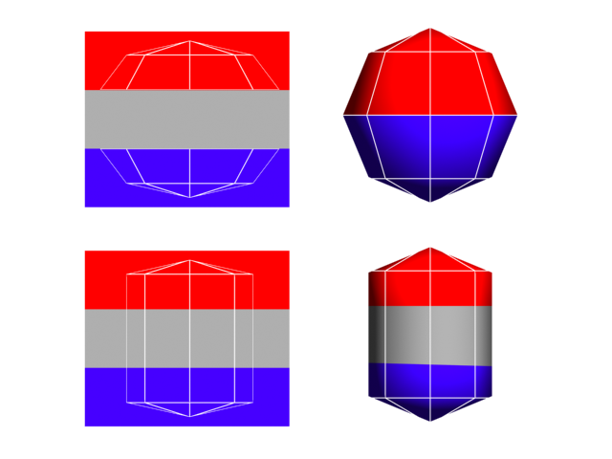
Disadvantages
Does not handle non-continuous texture mapping
Produces irregular tessellation

Slide 13
Re-Tiling Polygonal Surfaces
Global approach which attempts to distribute a specified number of vertices over the mesh surface
Attempts to place more vertices in areas of high curvature
Mesh must be completely re-triangulated for every level of detail

Slide 14
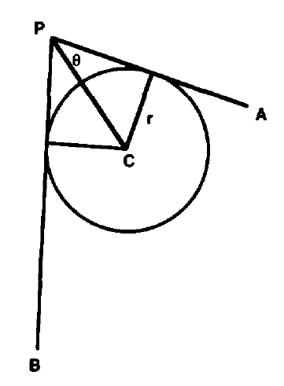
Determining Curvature
Fits a sphere of radius ri with center along vertex normal to the inside of the surface, such that it is tangent to an edge Ei at its midpoint
The smallest of the ri values for the vertex is selected as its curvature

Slide 15
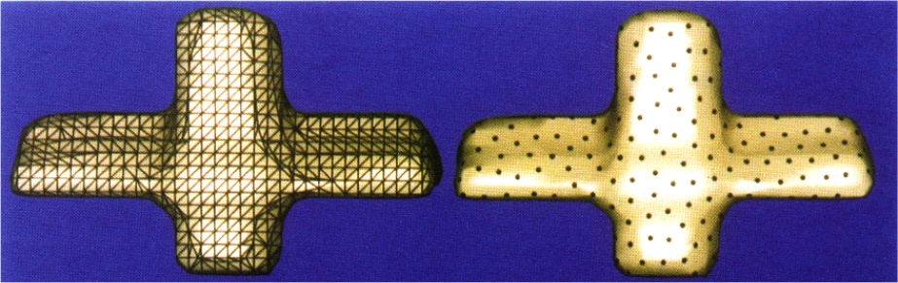
Distributing Vertices
Vertices distributed randomly across the surface of the model, with higher probability of placing vertices in areas of high curvature
Vertices then repulse each other until they are evenly distributed (high curvature areas repulse less)

Slide 16
Triangulation
To simplify triangulation, a composite model is created which contains all of the old vertices and all of the new ones
The new vertices are incorporated into the polygon they occupy, using greedy triangulation

Slide 17
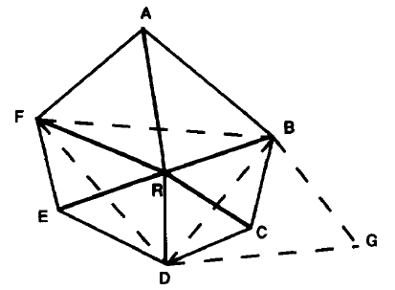
Removing Old Vertices
Old vertices are removed one by one, and the resulting hole is triangulated
If topology check fails, the vertex is retained
Fails if surrounding edges intersect in every planar projection
Fails if removing vertex causes front of mesh to touch the back

Slide 18
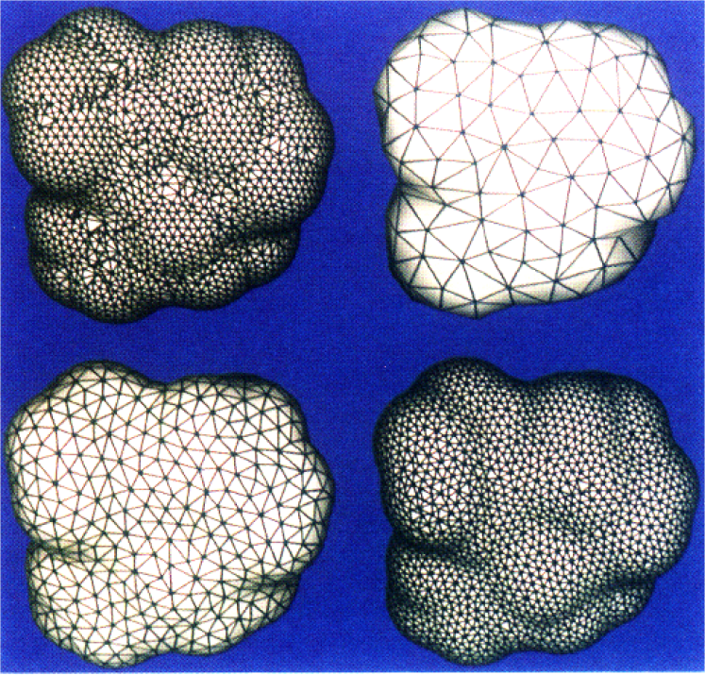
Advantages
Creates an even distribution of vertices weighed by curvature
Likely to preserve both shape and topology

Slide 19
Disadvantages
Does not handle non-continuous texture mapping
Assumes original model is a good approximation of the desired surface
Does not handle sharp corners
A little ahead of its time – works well on high-polygon models, but may not work well on low-polygon models

Slide 20
Interpolation for Smooth Transitioning
Must have smooth transition between two detail levels
Meshes must be able to “morph” between high and low detail versions
Accomplished by interpolating vertices between two different positions

Slide 21
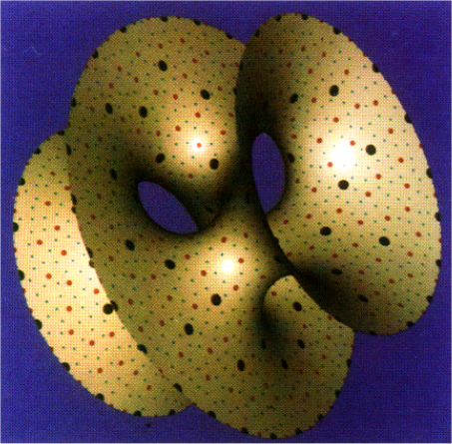
What to Interpolate
High-detail versions add new vertices
In low-poly version, these vertices lie in the plane of another polygon and are “invisible”
In high-poly version, they take up their position in the original surface
Interpolation provides smooth transition
Must know which polygon high-detail vertex must lie in in the low-poly version

Slide 22
Selecting Polygon
High-detail model is a super-set of the vertices of the low-detail model
Must track removed vertices of high-detail polygons when they are re-triangulated into low-polygon model
Each time a vertex is removed, it is projected onto the new triangles to determine which one contains it

Slide 23
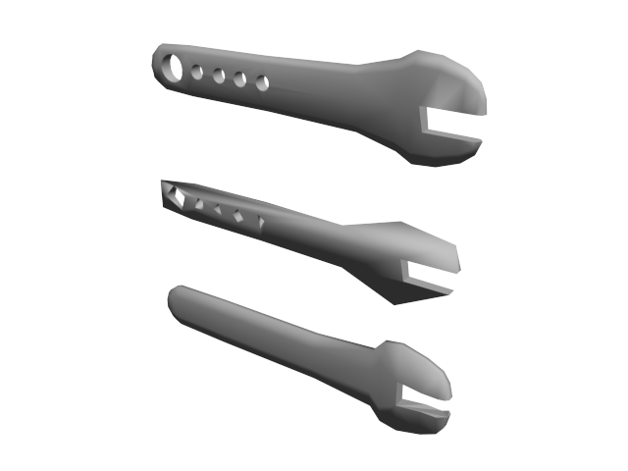
Discussion
Problems: non-continuous texture mapping, pre-processing times
Is always preserving topology useful?

