Slide 1
Design Tools for
Variations and Alternatives
Björn Hartmann (bjoern@cs.stanford.edu)
stanford · 1 August 2007
Notes:
This is half-baked and speculative (should have been a gcafe).
Please disagree with me.

Slide 2
“The best way to have a good idea is to have lots of ideas.”
-Linus Pauling
Notes:
Linus Carl Pauling (February 28, 1901 – August 19, 1994) was an American quantum chemist and biochemist. He was also acknowledged as a crystallographer, molecular biologist, and medical researcher. Pauling is widely regarded as the premier chemist of the twentieth century. He pioneered the application of quantum mechanics to chemistry, and in 1954 was awarded the Nobel Prize in chemistry for his work describing the nature of chemical bonds.

Slide 3

Prototypes for the
Microsoft mouse
From Moggridge,
Designing Interactions, Ch2
Notes:
Paul Bradley: “We built about eighty foam models, quickly exploring different
possibilities and directions.”

Slide 4
“…a designer that pitched only one idea would probably be fired. I'd say 5 is an entry point for an early formal review (distilled from 100's). Oh, and if you are pushing one particular design you will be found out, and also fired.”
Alistair Hamilton, quoted in
Tohidi et al. , CHI 2006

Slide 5

Notes:
Architect Michael Wilford from Brian Lawson’s How Designers Think
– alternative plans for a university campus that he discusses with clients

Slide 6
Counterpoint
“You have to let an idea run and proceed with it to be convinced… of course you criticize it and you may leave it and start again with something new, but it is not a question of options, it is always a linear process.”
- Santiago Calatrava,
quoted in Lawson, 1997
Notes:
While I am going to take the rest of the talk arguing from the position that alternatives matter, want to point out that that’s not without contention and that there are very successful designers who don’t ascribe to the church of multiplicity.

Slide 7
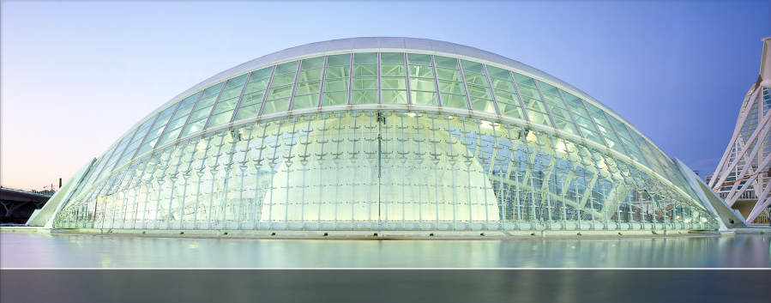
calatrava.com

Slide 8
Multiplicity matters,
but how?

Slide 9
Why and how do alternatives matter?
To support creative action
  Creativity is non-sequential, bouncy – tools need to support working with alternatives to get out of the way; “near-term experimentation”(Terry)
For exploration:
  “Mapping the territory” (Lawson)
  “…to understand the range of [products] that might evolve” (Gaver)
Notes:
* Coping strategies: (terry) undo-redo, duplicate files

Slide 10
Why and how do alternatives matter?
For justification: design rationale
To get more information from 3rd parties:
  During critique
  During testing (Tohidi, CHI06)
  During client meetings (Lawson)

Slide 11

Tohidi et al, CHI 2006
Notes:
Beyond practitioner reports, here’s “CHI proof” that alternatives matter during evaluation.
Tohidi, Buxton et al

Slide 12
Tohidi et al., Hypotheses
H1: Participants will rate designs lower when all alternatives are seen, compared to when they see only one.
H2: Participants exposed to alternative designs will be less pressured to be positive, expressing fewer positive comments than those who only see one.
H3: Participants who see alternative designs will provide more suggestions for improvement compared to those who only see one.
Notes:
Upshot is: participants less swayed to be “nice”..
If you show only one thing, criticism is personal
Someone said: “I cannot critique a single design”

Slide 13
Disentangling Definitions
Alternatives: offer choice; pertain to the design problem domain
Variations: changes to a common base; pertain to the implementation domain
Iterations: Instances of the same solution at different points of revision (from Terry)
Notes:
So: variations can be alternatives for a given design problem, but alternatives don’t have to come from variations

Slide 14
What tools are out there, and what problems do they solve?
Design Galleries (Marks, SIGGRAPH 97)
SideViews & Parallel Pies (Terry, 2002 & 04)
Subjunctive Interfaces (Lunzer, various)
Linked Editing (Toomim, VL/HCC 2004)

Slide 15
Design Galleries (DG)
Domain: graphics rendering; simulation of physical phenomena (light transport, particle systems) with lots of parameters
Characteristics:
  High computational cost
  (can’t do realtime adjustment)
  Unquantifiable output qualities
  (need human judge)

Slide 16
Design Galleries (DG)
Given formal description of
  input vector (set of parameters to tweak)
  method to create output (rendering, simulation)
  output vector (relevant qualities of image)
  distance metric
generate space-spanning set of variations with maximum dispersion along with a UI for structured browsing of solutions

Slide 17
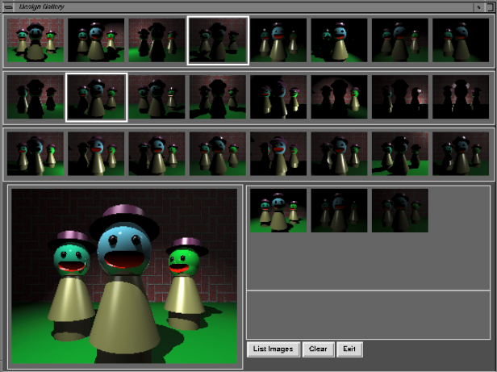
Notes:
Describe what input, output vectors are:
Light selection and placement
The goal is to explore different ways of lighting the scene, so the input vector
includes a light position, a light type, and a light direction if needed.
Output vector is luminance information of down-sampled thumbnails
Distance is Manhattan
Dispersion is a specifically designed algorithm
Explores 4000 different images

Slide 18
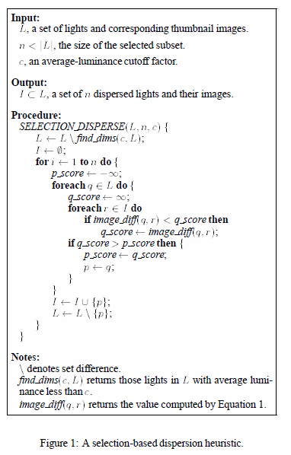
Notes:
Challenge: for each problem, lots of application-specific details to be worked out (like discarding dim lights here)
Easy for user to use DG, but non-trivial to come up with for each particular instance
Output vector most difficult (approximate perceptual saliency with set of parameters)

Slide 19
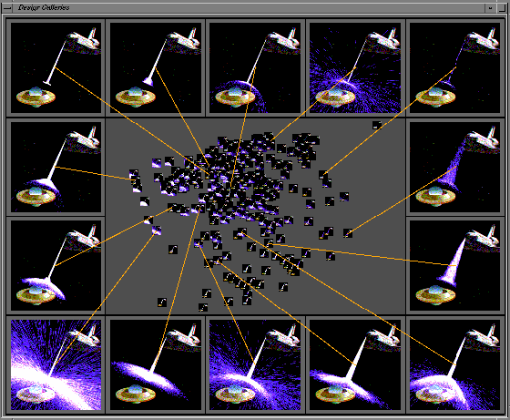
Notes:
Particle System
A useful particle system editor might have 40 or more parameters that the animator
can set, so achieving desired effects can be tedious.
Input: the mean and variance of particle velocities, particle acceleration, rate of particle production, particle
lifetime, resilience and friction coefficient of collision surfaces, and perturbation vectors for surface normals.
Output: subsampled (every 500th particle) The output vector comprises measures of the number of particles,
their average distance from the origin and the individual variation
in this distance, their spread from the average beam, the average
velocity of the entire system, and the individual variation from this
Average at two different points in simulation time.

Slide 20
Side Views & Parallel Pies
Domain: 2D graphic design (still images)
“What If Tools” for ill-defined problems
Get beyond Single State Document Model
  A bag of tricks to support trying out multiple alternatives in parallel:
  Fast previews
  Multiple previews
  Make previews stick persistent & composable
Notes:
perform simultaneous comparisons of multiple
commands;
• compare multiple instantiations of the same command,
thus aiding in the efficient and informed selection of a
command and its parameters;
• create alternative visualizations of their data;
• experiment with possibilities without committing to any
changes to the original data (“what-if” tools);
• customize the interface to enhance workflow; and
• serendipitously discover viable alternatives to a planned
course of action.

Slide 21
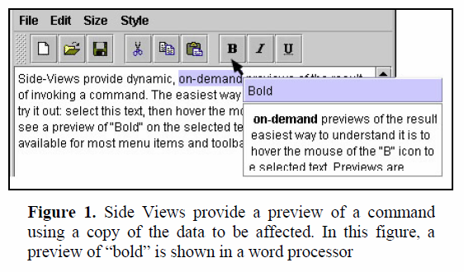
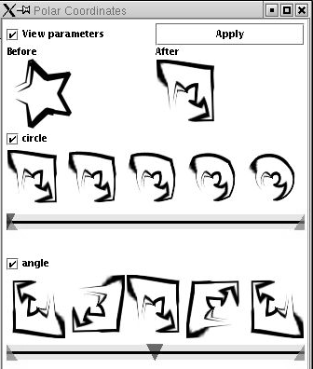
Side View
Parameter Spectrum
Notes:
Side View: Preview in a Tooltip (implemented in Office 2007)
Parameter Spectrum: Show multiple parameter instances
Persistent: can drag them free from palette; stay around; update as active document changes
Parameter spectrums show a series of previews
across the range of values for each parameter.

Slide 22
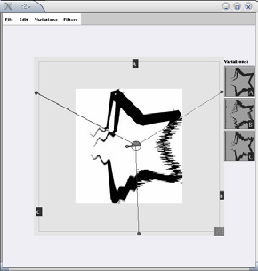
Parallel Pie
Terry et al,
CHI 2004
Notes:
Parallel Pies, a user interface mechanism
developed for image manipulation tasks that allows users
to: easily create solution alternatives as they interact with a
command; embed the alternatives in the same workspace;
manipulate the alternatives independently or simultaneously
as if they were the same object; and perform side-by-side
comparisons of each.

Slide 23
Subjunctive Interfaces
Domain: Information retrieval (e.g., booking a flight)
Problem: tasks require many related queries, but only single requests are supported
Idea:
  Multiple scenarios can co-exist (e.g., alternative input values)
  User can view scenarios side-by-side
  User can adjust scenarios in parallel
Notes:
Problem: Poor support for covering a range of requests.
Poor support for comparing results.
The concept was inspired by Hofstadter’s [4] playful notion of a Subjunc-TV – a magical television whose
tuning knobs would provide access to alternative versions of a given broadcast,
based on arbitrarily different circumstances chosen by the viewer.
Before going any further, we should clarify our use of the term

Slide 24
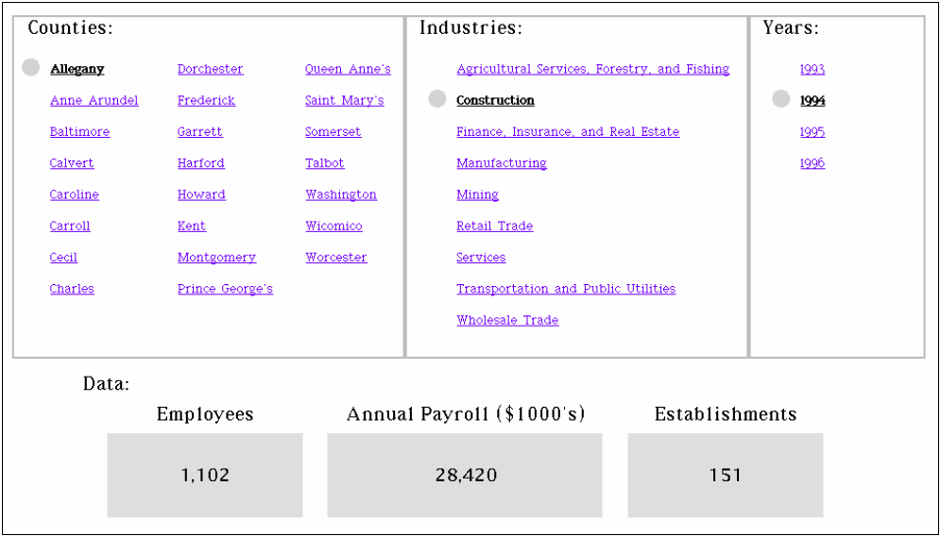
Lunzer, 2004
Notes:
A ‘simultaneous menus’ style of exploration interface for census data, after Hochheiser, Shneiderman.
For each combination of County, Industry and Year specified on the three ‘menus’ of
links, the dataset contains the three statistics that are retrieved and displayed across
the lower part of the browser.
Fig.

Slide 25
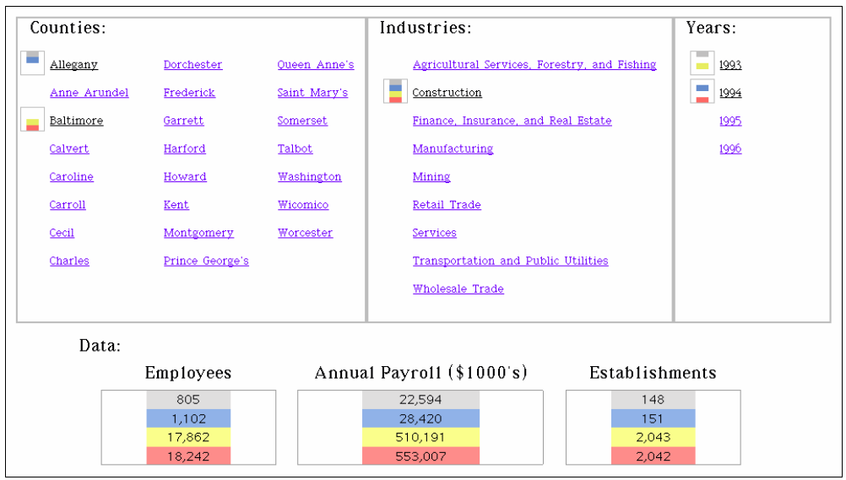
Lunzer, 2004
Notes:
A subjunctive-interface version of the browser in Fig. 1. The browser is showing
four scenarios corresponding to the Construction statistics for both Allegany and Baltimore,
in 1993 and 1994. Correspondence between menu selections and result values
is indicated with position and colour cues in the result displays and in the markers
next to menu items; for example, the values 805, 22594 and 148 at the top of the result
displays are for Allegany in 1993.

Slide 26
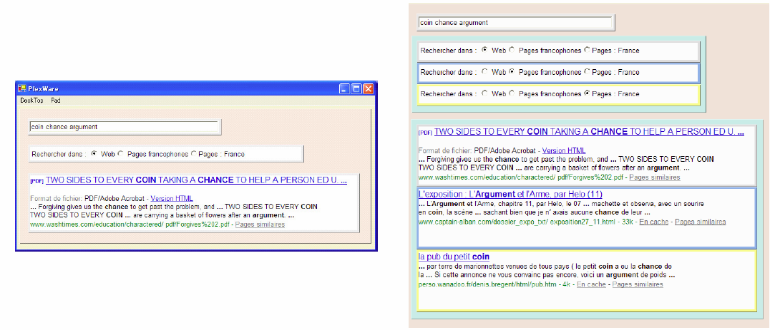
Clip Connect Clone
Notes:
Clipping. By drag-and-drop manipulation, a user can select and extract input
and result elements from the pages of a Web application. Placing the elements
on a substrate called a C3Sheet turns them into cells that work as
viewports onto the original Web pages. Clipped input elements continue to
support user input, and clipped result elements display the Web application’s
corresponding results. Thus the user can create compact, customised
applications based on processing facilities offered over the Web.
Connecting. A single C3Sheet can hold input and result cells taken from multiple
Web applications. For any input cell that takes a text-string value,
the user can define a formula to derive its value from the values of other
cells – typically, cells that hold results from other applications. This allows
independent applications to be connected in user-specified ways.
Cloning. The user can set up multiple scenarios – i.e., different settings for
the Web-application inputs, leading to different results – to be shown at
the same time. Each cell displays, side by side, its contents in the various
scenarios. This provides an efficient way for a user to explore and compare
the different results available through a given Web application, or the user’s
own custom-built application combinations.
Use of multiple scenarios in C3W. Left: A user has set up three cells containing
elements extracted from a search at www.google.fr: the keyword input field; the switch
that selects whether the search should cover the whole Web, just pages in French, or
just pages in France; and the top result (showing page name and keyword context)
from a sample search. Right: The user has cloned the switch cell to create three
instances, and has given each instance a different setting. Because the state of this
switch potentially affects the value for the top result, that cell has automatically been
cloned too. Entering new search keywords into the keyword cell will therefore execute
three Google queries with different scopes, and display the three respective top results.

Slide 27
Linked Editing
Domain: programming
Problem: code clones:
tedious to edit, unobservable inconsistencies, overhead to maintain, hard to understand…
However, “programmers will write duplicated code — let’s support the practice and mitigate its disadvantages.”
Idea: clones are linked together in editor, similarities and differences visualized, editing possible in parallel or individually

Slide 28
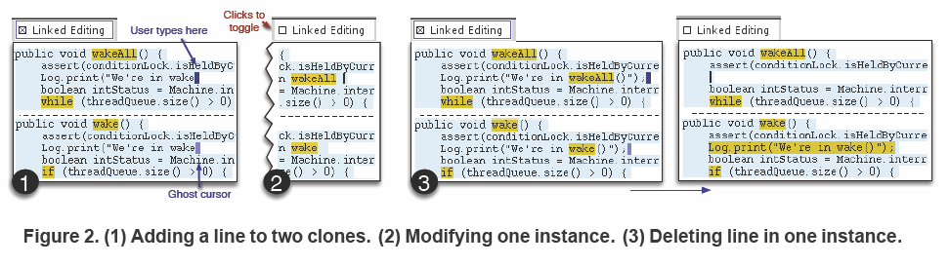
Linked Editing
Toomim, VL/HCC 2004
Notes:
Solves the problem: how to you keep two separate instances of code that are mostly identical in sync while allowing flexibility of editing each individually?
Highlight two corresponding sections of code
Toggle between linked mode, in which all copies are affected, and unlinked mode, in which changes are local and discrepancies are highlighted across sections

Slide 29
Tunables
Domain: multimedia programming in Processing
Problem: parameter values have to be set at compile time whose effect can only be observed at runtime
Examples: rendering style, cv color tracking
Idea: from source code, automatically generate control interface to let programmers change parameters at runtime; record changes and re-integrate found parameters into source

Slide 30
“Enlightened trial and error outperforms the planning of flawless intellect.”
- David Kelley,
quoted in Winograd, 2006

Slide 31
Tunables Video

Slide 32
Pilot Study Feedback
Physical, spatially multiplexed control interface is a big win in terms of attention and parallel control
Wanted support for parameter variation, as well as alternative execution paths

Slide 33
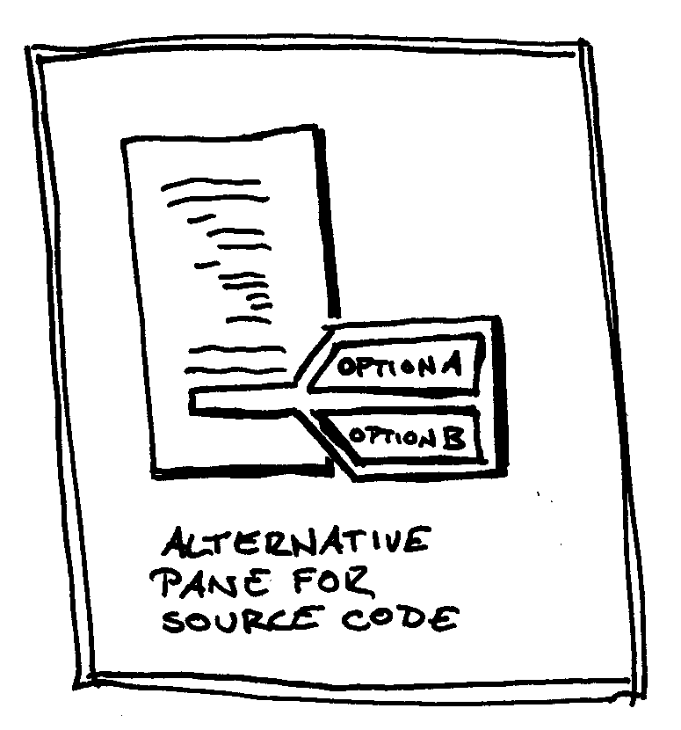

Slide 34
Discussion
DG, Side Views, Tohidi study, Tunables:
Human provides “goodness” rating
Things get interesting when there are multiple variations of multiple parameters
Do you show alternatives in parallel or in sequence?
Time to effect changes matters (next slide)

Slide 35
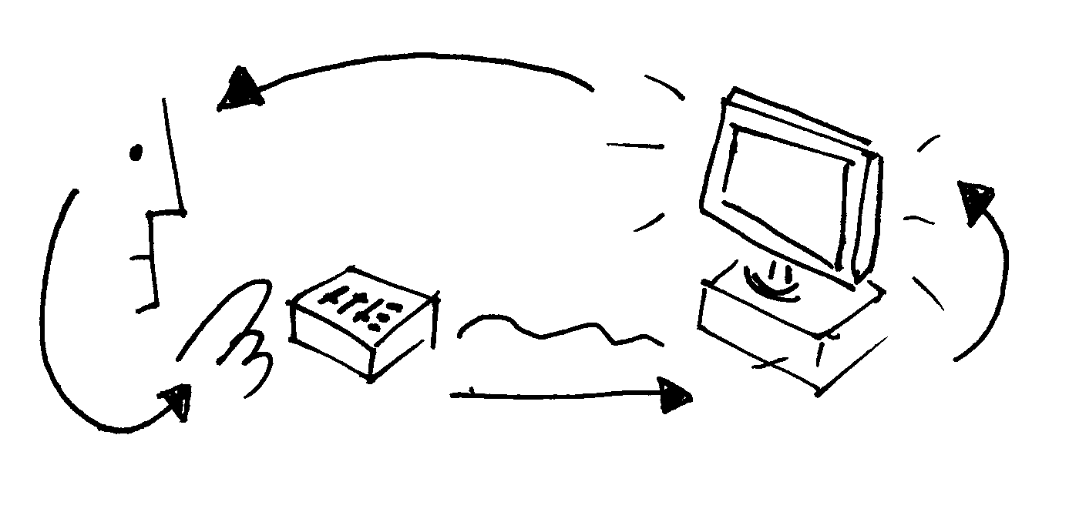
Real-time adjustment (Tunables, SideViews) requires immediate feedback
from application

Slide 36
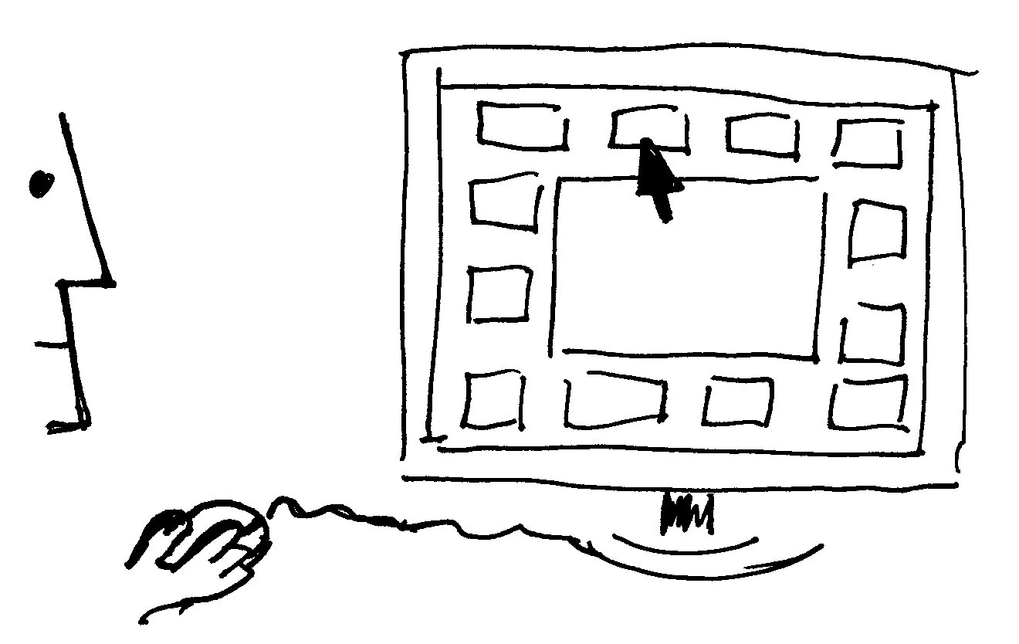
If real-time feedback is not possible, pre-compute and select from options

Slide 37
Where is the opportunity?
Neither DG nor Side Views nor Subjunctive Interfaces have interactive artifacts at their core – they are based on “documents”
Relationship of input to output is that of a pipeline, not a feedback system

Slide 38
Defining how the “transitions” of interaction design happen is still programming
Linked editing is about code, but only about code as text, not about what happens when it runs

Slide 39
Tangent: Coding as Performance
Examples:
  ChucK/Audicle (Ge Wang, Princeton, now CCRMA)
  Impromptu
  http://hackety.org/2007/05/22/runningWhilstEditing.html (mov)
Notes:
Idea: changes are so rapid, you’ll try out many, even though only one version is active at a given time

Slide 40
On-the-fly programming
On-the-fly programming (or live coding) is a style of programming in which the programmer/performer/composer augments and modifies the program while it is running, without stopping or restarting, in order to assert expressive, programmable control for performance, composition, and experimentation at run-time.

Slide 41
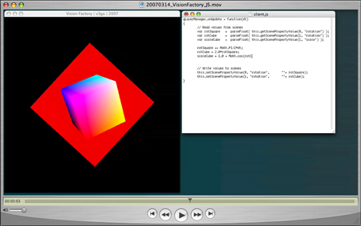

Slide 42
Where do People matter?
 | Aimed at Lone Designer | Aimed at Performer+Audience | Do people provide real-time input? | Do people create parameter values? | Do people create Input->Output mapping?
Design Galleries | x |  | No - Document (3D world) | No; Algorithm does | No; expert programs it
Side Views | x |  | No -Document (Image) | Mixed | Mixed - library implements primitives; people compose
Playing a Synthesizer |  | x | Human Performance | Yes | No (set in hardware)
Laptop Live Performance |  | x | No - Document (Score) | Yes | Yes (Beforehand)
"Chucking" |  | x | No -Document (code) | Yes | Yes (Live)
Tunables for Interaction Design | x | x | Mixed: Document+Human Performance | Yes | Yes (Beforehand)
Tohidi & Buxton Study |  | x | Yes? Paper prototype | no; separate implementations

Slide 43
 | When are alternatives…
 |  | CREATED
 |  | Design Time | "Release" Time
VIEWED | Design Time | Exploration by Designer | X
 | "Release" Time | Client Presentation | Participatory Design

Slide 44
http://hci.stanford.edu
Notes:
For more information on d.tools, please visit our web site. Thank you.

Slide 45
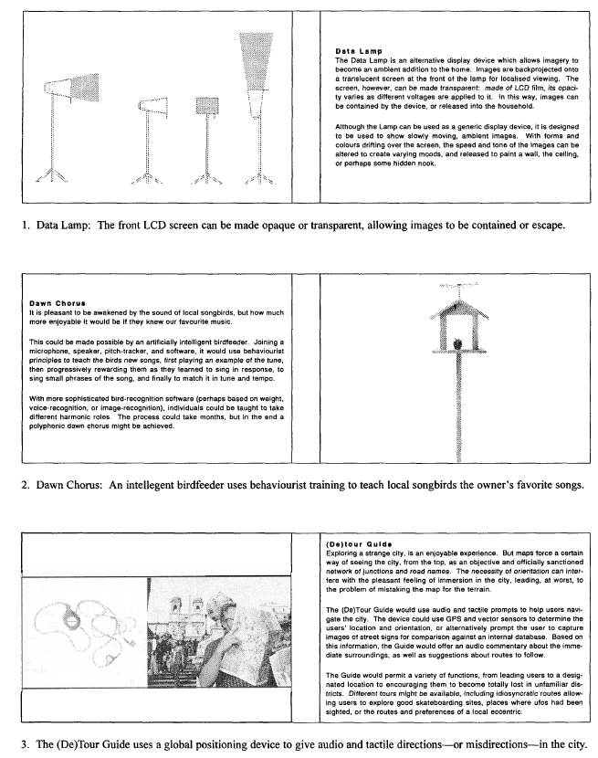
Counterpoint
Do we need implementations?
Gaver, CHI 2000
Notes:
Counterpoint:
Do we need implementations?
Gaver’s workbook of alternatives for information appliances is “deliberately noncommital about the exact technologies” –
The prototype “works” when it successfully captures experience of using a given device, not when the technology has been implemented.

Slide 46
Design Histories
Work within paradigm of Single State Document Model. There is a single active state, but you can review the history of previous states; recall a previous state; and possibly change a previous state to affect all subsequent states

Slide 47
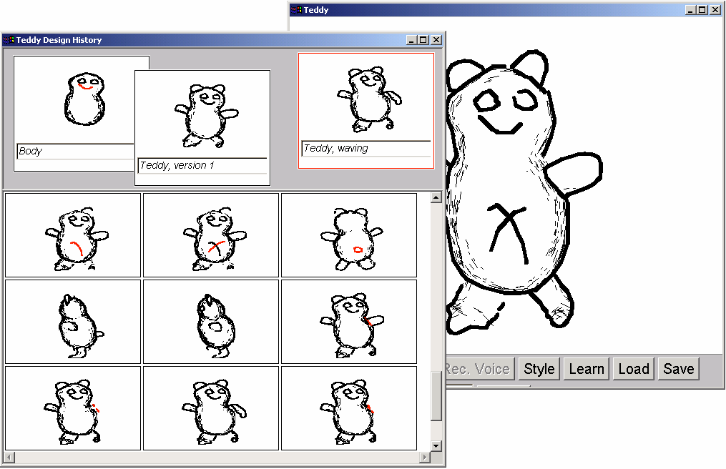
Verlinden et al, 2002

Slide 48
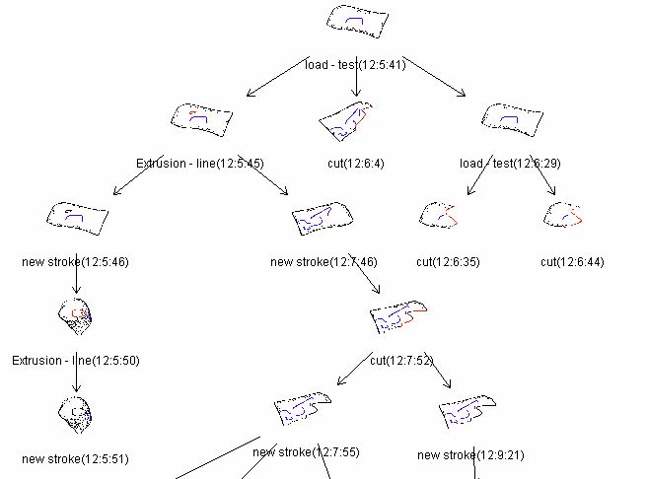
Verlinden et al, 2002

Slide 49
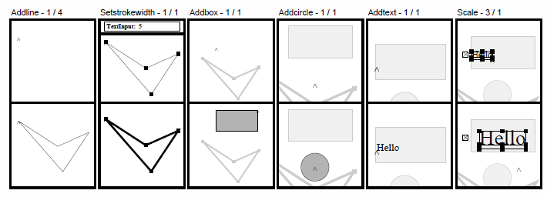
Kurlander, CHIMERA. 1990

Slide 50
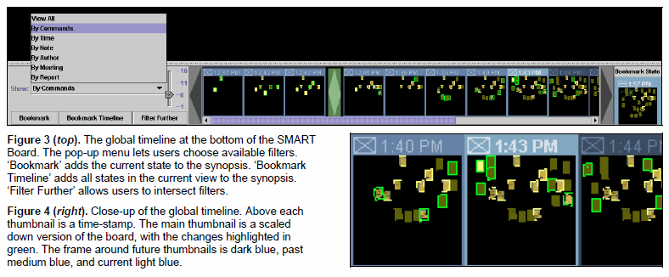
Klemmer, CHI 2002

