Slide 1
Designing Interface Alternatives
with Parallel Exploration and Runtime Tuning
bjoern@cs.stanford.edu
stanford · 14 January 2008
Notes:
This is half-baked and speculative (should have been a gcafe).
Please disagree with me.

Slide 2
“The best way to have a good idea is to have lots of ideas.”
-Linus Pauling
Notes:
Linus Pauling is widely regarded as the premier chemist of the twentieth century. He pioneered the application of quantum mechanics to chemistry, and in 1954 was awarded the Nobel Prize in chemistry for his work describing the nature of chemical bonds.
What his work shares with that of professional de signers is the practice of succeeding by trying out multiple alternative ideas, approaches, solution strategies. (rewrite)
There are three specific ways in which construction of multiple alternatives is important in design:

Slide 3

Prototypes for the
Microsoft mouse
From Moggridge,
Designing Interactions, Ch2
Notes:
First, designers may build dozens of prototypes to get a more complete understanding of a design space.
Paul Bradley, at IDEO, for example built about eighty foam models for the original Microsoft mouse, to quickly explore different directions.

Slide 4

Notes:
Second, Discussing multiple prototypes also allows project stakeholders to more effectively communicate their requirements.
Architect Michael Wilford created these alternative plans for a university campus for the purpose of scaffolding discussions with clients.

Slide 5

Tohidi et al, CHI 2006
Notes:
Third, comparing between multiple alternatives has been shown to be important during testing of prototypes to keep participants honest:
Tohidi et al showed, among other things, that Participants will rate designs lower when multiple alternatives are seen, compared to when they see only one. And that
Participants exposed to alternative designs will be less pressured to be positive, expressing fewer positive comments than those who only see one.

Slide 6
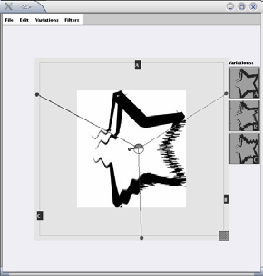
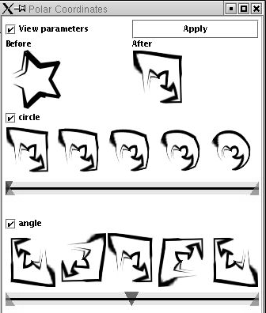
Terry et al,
CHI 2004
Notes:
Despite the importance of constructing alternatives, historically, design tools for user interfaces have focused on the design of single artifacts. (click)
The notable exception is Michael Terry’s for supporting exploration of alternatives within graphics programs.

Slide 7

Notes:
However, such solutions do not yet exist for designing interactive behavior. A recent survey of designers by Brad Myers et al found that designers lack the tools to iterate on behaviors and to compare such interaction designs side by side. (this paper has not been published!)
(Click) One of the central reasons it that design of interactive behavior, even for prototypes, often happens in textual code.

Slide 8
Juxtapose
Notes:
The primary difference between image manipulation and programming — for this discussion — is that programmers have to work with two distinct representations: source code, where changes are authored; (click) and the running program, where changes are observed.

Slide 9
Juxtapose
Notes:
Our work on Juxtapose enables designers to interactively create and manipulate multiple alternatives of programmed interactive behaviors.
Juxtapose demonstrates a novel environment for constructing multiple design alternatives through (selectively) parallel editing of behavior source code.

Slide 10
Juxtapose
Notes:
These source alternatives can then be executed in parallel, allowing rapid comparison between them.

Slide 11
Juxtapose
Notes:
Juxtapose also introduces a mechanism to automatically generate a control interface to interactively “tune”
parameters of the designed interaction at runtime. Arriving at a
satisfying user experience often depends on adjusting
interrelated application parameters. In Juxtapose, such
variables can be adjusted through a tuning UI for a single
alternative, or for all running alternatives in parallel.

Slide 12
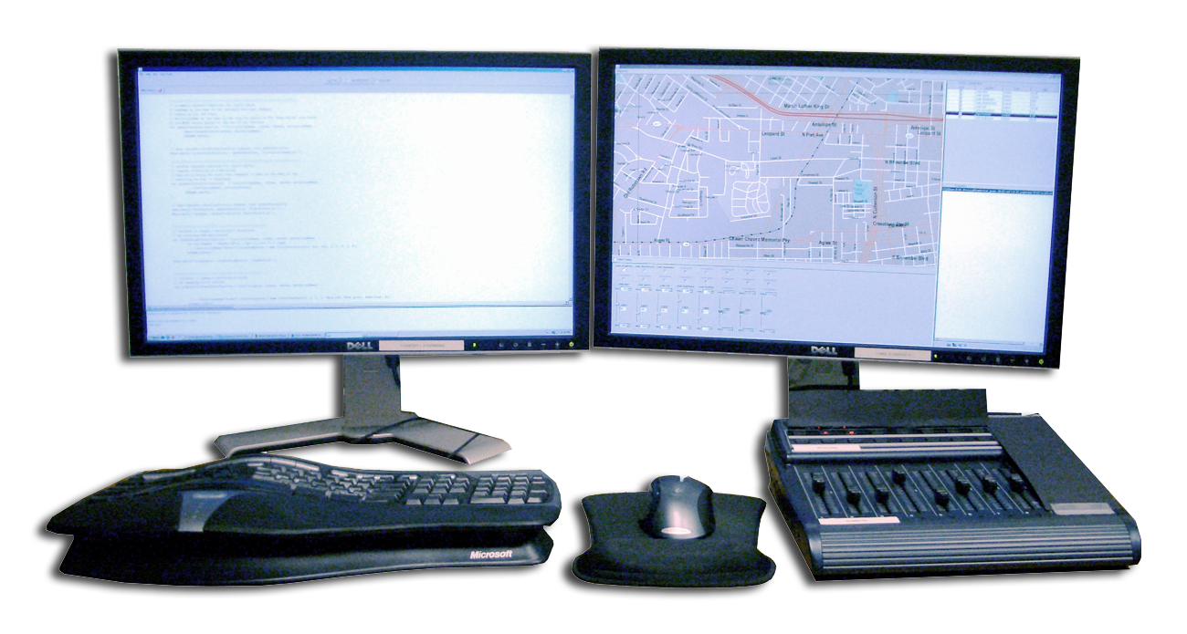

Slide 13
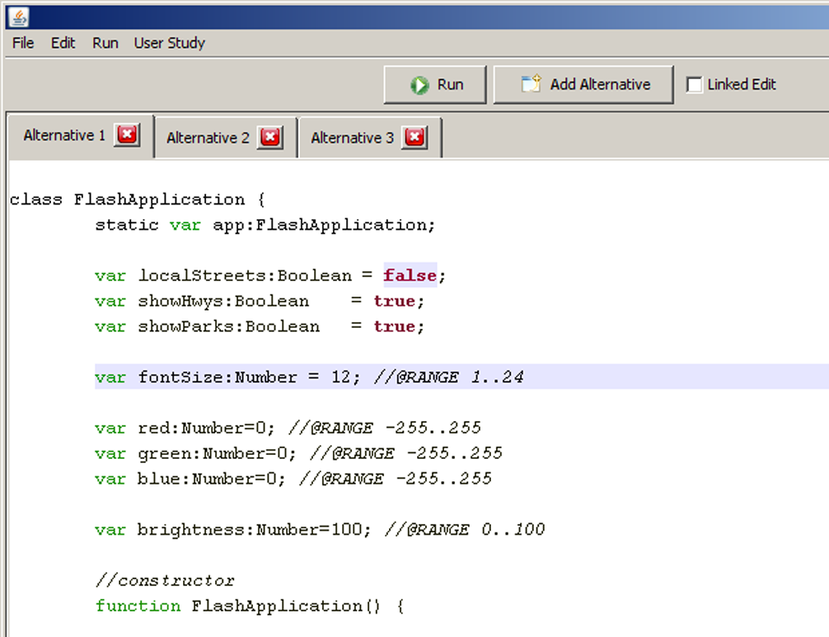
Notes:
* TODO: Runtime UI Overview here

Slide 14
Notes:
* TODO: Runtime UI Overview here

Slide 15
Notes:
* TODO: Runtime UI Overview here

Slide 16
Notes:
* TODO: Runtime UI Overview here

Slide 17
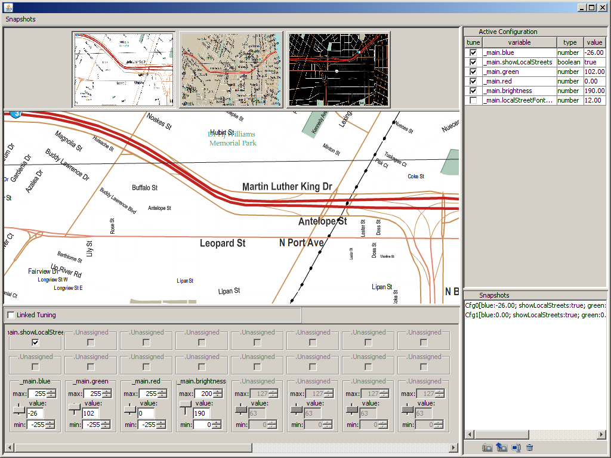
Notes:
So far, we have implemented Juxtapose as a design environment and runtime interface for
developing GUIs written in ActionScript.

Slide 18
Notes:
So far, we have implemented Juxtapose as a design environment and runtime interface for
developing GUIs written in ActionScript.

Slide 19
Notes:
So far, we have implemented Juxtapose as a design environment and runtime interface for
developing GUIs written in ActionScript.

Slide 20
Notes:
So far, we have implemented Juxtapose as a design environment and runtime interface for
developing GUIs written in ActionScript.

Slide 21
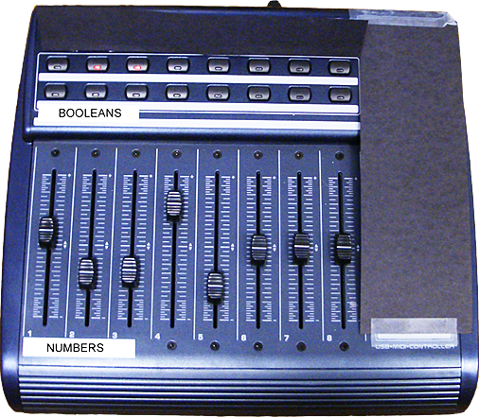
Notes:
A dedicated hardware controller with physical faders for
variable tuning has three benefits. First, spatiallymultiplexed
input enables users to modify multiple parameters
simultaneously. Fitzmaurice and Buxton found that
spatially-multiplexed input schemes outperform timemultiplexed
schemes in a tracking experiment [11]. Second,
with mouse control, tuning is mainly a hand-eye coordination
task — with a dedicated control board, it turns into a
prehension task that leaves the eyes free to focus on the
application being tuned. Third, moving the tuning UI to a
dedicated controller allows for tuning of interactions that
require mouse and keyboard input, e.g., adjusting the rate at
which mouse wheel movement magnifies a document.

Slide 22
Video Goes in here
Notes:
* Coping strategies: (terry) undo-redo, duplicate files

Slide 23
Evca
23
N=18
Notes:
* Coping strategies: (terry) undo-redo, duplicate files
23

Slide 24
Extensions
24
Juxtapose mobile
  Insert preview
Notes:
* Coping strategies: (terry) undo-redo, duplicate files
24

Slide 25
http://hci.stanford.edu
Notes:
For more information on d.tools, please visit our web site. Thank you.

