Slide 1
Designing Interface Alternatives
with Parallel Exploration and Runtime Tuning
bjoern@cs.stanford.edu
stanford · 14 January 2008
Notes:
This is half-baked and speculative (should have been a gcafe).
Please disagree with me.

Slide 2
“The best way to have a good idea is to have lots of ideas.”
-Linus Pauling
Notes:
Linus Pauling is widely regarded as the premier chemist of the twentieth century. He pioneered the application of quantum mechanics to chemistry, and in 1954 was awarded the Nobel Prize in chemistry for his work describing the nature of chemical bonds.
What his work shares with that of professional de signers is the practice of succeeding by trying out multiple alternative ideas, approaches, solution strategies. (rewrite)
There are three specific ways in which construction of multiple alternatives is important in design:

Slide 3

Prototypes for the
Microsoft mouse
From Moggridge,
Designing Interactions, Ch2
Notes:
First, designers may build dozens of prototypes to get a more complete understanding of a design space.
For example, Paul Bradley at IDEO built about eighty foam models for the original Microsoft mouse to quickly explore different directions.

Slide 4

Notes:
Second,dDiscussing multiple prototypes also allows project stakeholders to more effectively communicate their requirements.
Architect Michael Wilford created these alternative plans for a university campus for the purpose of scaffolding discussions with clients.

Slide 5

Tohidi et al, CHI 2006
Notes:
Third, comparing between multiple alternatives has been shown to be important during testing of prototypes to keep participants honest:
Tohidi et al showed, among other things, that Participants will rate designs lower when multiple alternatives are seen, compared to when they see only one. And that
Participants exposed to alternative designs will be less pressured to be positive, expressing fewer positive comments than those who only see one.

Slide 6
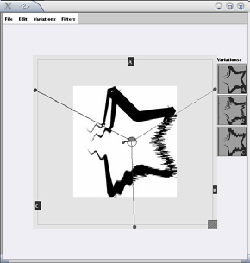
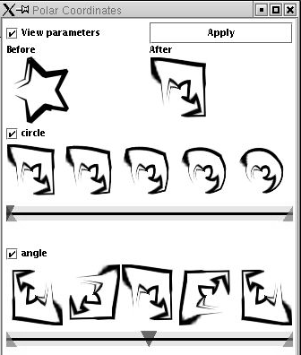
Terry et al,
CHI 2004
Notes:
Despite the importance of constructing alternatives, historically, design tools for user interfaces have focused on the design of single artifacts. (click)
The notable exception is Michael Terry’s for supporting exploration of alternatives within graphics programs.

Slide 7

Notes:
However, such solutions do not yet exist for designing interactive behavior. A recent survey of designers by Brad Myers et al found that designers lack the tools to iterate on behaviors and to compare such interaction designs side by side. (this paper has not been published!)
(Click) One of the central reasons it that design of interactive behavior, even for prototypes, often happens in textual code.

Slide 8
Notes:
The unique aspect of programmed interactions — for this discussion — is that there are two distinct representations involved: source code, where changes are authored; (click) and the running program, where changes are observed.

Slide 9
Juxtapose
Notes:
Our work on Juxtapose enables designers to interactively create and manipulate multiple alternatives of programmed interactive behaviors.

Slide 10
Juxtapose
Notes:
Juxtapose demonstrates a novel environment for constructing multiple design alternatives through (selectively) parallel editing of behavior source code.

Slide 11
Juxtapose
Notes:
These source alternatives can then be executed in parallel, allowing rapid comparison between them.

Slide 12
Juxtapose
Notes:
Juxtapose also introduces a mechanism to automatically generate a control interface to interactively “tune”
parameters of the designed interaction at runtime. Arriving at a
satisfying user experience often depends on adjusting
interrelated application parameters.

Slide 13

Juxtapose
Notes:
For parameter tuning, Juxtapose supports the use of a dedicated, spatially multiplexed hardware controller. Such a controller enables users to modify multiple parameters
simultaneously; leaves the eyes free to focus on the application being tuned; and allows for tuning of interactions that require concurrent mouse and keyboard input.

Slide 14

Notes:
Currently, Juxtapose supports creation of interaction designs written in Actionscript. Behind the scenes, these projects are compiled into Flash files using the open source MTASC compiler.<click>
Users can create alternatives to their current code using the add alternative button…

Slide 15

Notes:
Alternatives are shown as tabs in the user interface. The alternative documents are “linked” by default – which means that changes in one alternative are propagated to all other alternatives.

Slide 16

Notes:
When the linked edit box is unchecked, code changes are now local to the currently active alternative document.

Slide 17

Notes:
Parts of the code that are unique to the active alternative are shown in a different background color to highlight the differences. This technique of linked editing was introduced by Toomim in 2004 for working with code duplicates. We extend his work here by integrating linked editing with the Juxtapose runtime environment.

Slide 18
Notes:
When the user hits run, Juxtapose compiles the set of all alternatives and launches the runtime environment.

Slide 19

Notes:
In the runtime environment, one Alternative has focus in the central canvas.

Slide 20
Notes:
In the runtime environment, one Alternative has focus in the central canvas. Users can switch between alternatives using the buttons above the canvas

Slide 21

Notes:
In the runtime environment, one Alternative has focus in the central canvas. Users can switch between alternatives using the buttons above the canvas

Slide 22
Notes:
To tune application behavior at runtime, Juxtapose automatically extracts a list of all static variables through reflection and presents a list of those variables on the right hand side.
Users can check variables to assign

Slide 23
Notes:
To tune application behavior at runtime, Juxtapose automatically extracts a list of all static variables through reflection and presents a list of those variables on the right hand side.
Users can check variables to assign the variables to control widgets. The layout of the control widget area mirrors the

Slide 24
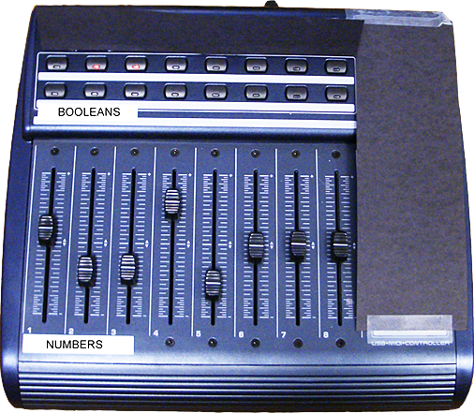
Notes:
To tune application behavior at runtime, Juxtapose automatically extracts a list of all static variables through reflection and presents a list of those variables on the right hand side.
Users can check variables to assign the variables to control widgets. The layout of the control widget area mirrors the physical layout of the supported external controller.

Slide 25
Eval
25
N=18
Notes:
* Coping strategies: (terry) undo-redo, duplicate files
25

Slide 26
Extensions
26
Juxtapose mobile
  Insert preview
Notes:
* Coping strategies: (terry) undo-redo, duplicate files
26

Slide 27
http://hci.stanford.edu
Notes:
For more information on d.tools, please visit our web site. Thank you.

Slide 28
