Slide 1
Designing Interface Alternatives
with Parallel Exploration and Runtime Tuning
bjoern@cs.stanford.edu
stanford · 14 January 2008

Slide 2
“The best way to have a good idea is to have lots of ideas.”
-Linus Pauling
Notes:
Linus Pauling is widely regarded as the premier chemist of the twentieth century. He pioneered the application of quantum mechanics to chemistry, and in 1954 was awarded the Nobel Prize in chemistry for his work describing the nature of chemical bonds.
Pauling stressed the importance of exploring multiple alternative ideas, approaches, solution strategies in science.
The same is true in product design.
There are three specific ways in which construction of multiple alternatives is important in design:

Slide 3

Prototypes for the
Microsoft mouse
From Moggridge,
Designing Interactions, Ch2
Notes:
First, designers may build dozens of prototypes to get a more complete understanding of a design space.
For example, Paul Bradley at IDEO built about eighty foam models for the original Microsoft mouse to quickly explore different directions.

Slide 4

Notes:
Second,discussing multiple prototypes allows project stakeholders to more effectively communicate their requirements.
Architect Michael Wilford created these alternative plans for a university campus for the purpose of scaffolding discussions with clients.

Slide 5

Tohidi et al, CHI 2006
Notes:
Third, comparing between multiple alternatives has been shown to be important during testing of prototypes to keep participants honest: Tohidi et al showed, among other things, that Participants exposed to alternative designs will be less pressured to be positive, expressing fewer positive comments than those who only see one.

Slide 6
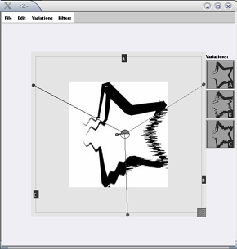
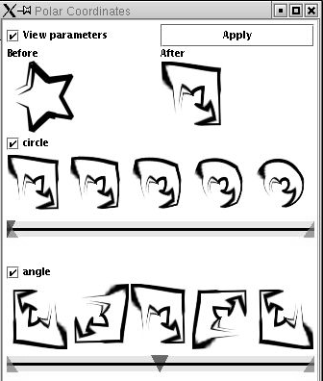
Terry et al,
CHI 2004
Notes:
Despite the importance of constructing alternatives, historically, design tools for user interfaces have focused on the design of single artifacts. (click)
The notable exception is Michael Terry’s work for supporting exploration of alternatives within graphics programs.

Slide 7

Notes:
However, such solutions do not yet exist for designing interactive behavior. A recent survey of designers by Brad Myers et al found that designers lack the tools to iterate on behaviors and to compare such interaction designs side by side.
(Click) One of the central reasons it that design of interactive behavior, even for prototypes, often happens in textual code.

Slide 8
Notes:
Programming interactions involvesworking with two distinct representations: source code, where changes are authored; (click) and the running program, where changes are observed.

Slide 9
Juxtapose
Notes:
Our work on Juxtapose enables designers to interactively create and manipulate multiple alternatives of programmed interactive behaviors.

Slide 10
Juxtapose
Notes:
Juxtapose demonstrates a novel environment for constructing multiple design alternatives through selectively parallel editing of behavior source code.

Slide 11
Juxtapose
Notes:
These source alternatives can then be executed in parallel, allowing rapid comparison between them.

Slide 12
Juxtapose
Notes:
Juxtapose also introduces a mechanism to automatically generate a control interface to interactively “tune” parameters of the designed interaction at runtime. Arriving at a
satisfying user experience often depends on adjusting
interrelated application parameters.

Slide 13

Juxtapose
Notes:
For parameter tuning, Juxtapose supports the use of a dedicated, spatially multiplexed hardware controller. Such a controller enables users to modify multiple parameters
Simultaneously. it leaves the eyes free to focus on the application being tuned; and allows for tuning of interactions that require concurrent mouse and keyboard input.

Slide 14

Notes:
Currently, Juxtapose supports creation of interaction designs written in Actionscript. Behind the scenes, these projects are compiled into Flash files using the open source MTASC compiler.<click>
Users can create alternatives to their current code using the add alternative button…

Slide 15

Notes:
Alternatives are shown as tabs in the user interface. The alternative documents are “linked” by default – which means that changes in one alternative are propagated to all other alternatives.

Slide 16

Notes:
When the linked edit box is unchecked, code changes are now local to the currently active alternative document.

Slide 17

Notes:
Parts of the code that are unique to the active alternative are shown in a different background color to highlight the differences. This technique of linked editing was introduced by Toomim in 2004 for working with code duplicates. We extend his work here by integrating linked editing with the Juxtapose runtime environment.

Slide 18
Notes:
When the user hits run, Juxtapose compiles the set of all alternatives and launches the runtime environment.

Slide 19

Notes:
In the runtime environment, one Alternative has focus in the central canvas.

Slide 20
Notes:
In the runtime environment, one Alternative has focus in the central canvas.

Slide 21

Notes:
Users can switch between alternatives using the buttons above the canvas

Slide 22
Notes:
To tune application behavior at runtime, Juxtapose automatically extracts a list of all static variables through reflection and presents a list of those variables on the right hand side.

Slide 23
Notes:
Users can check variables to assign the variables to control widgets.

Slide 24

Notes:
The layout of the control widget area mirrors the physical layout of the supported external controller.

Slide 25
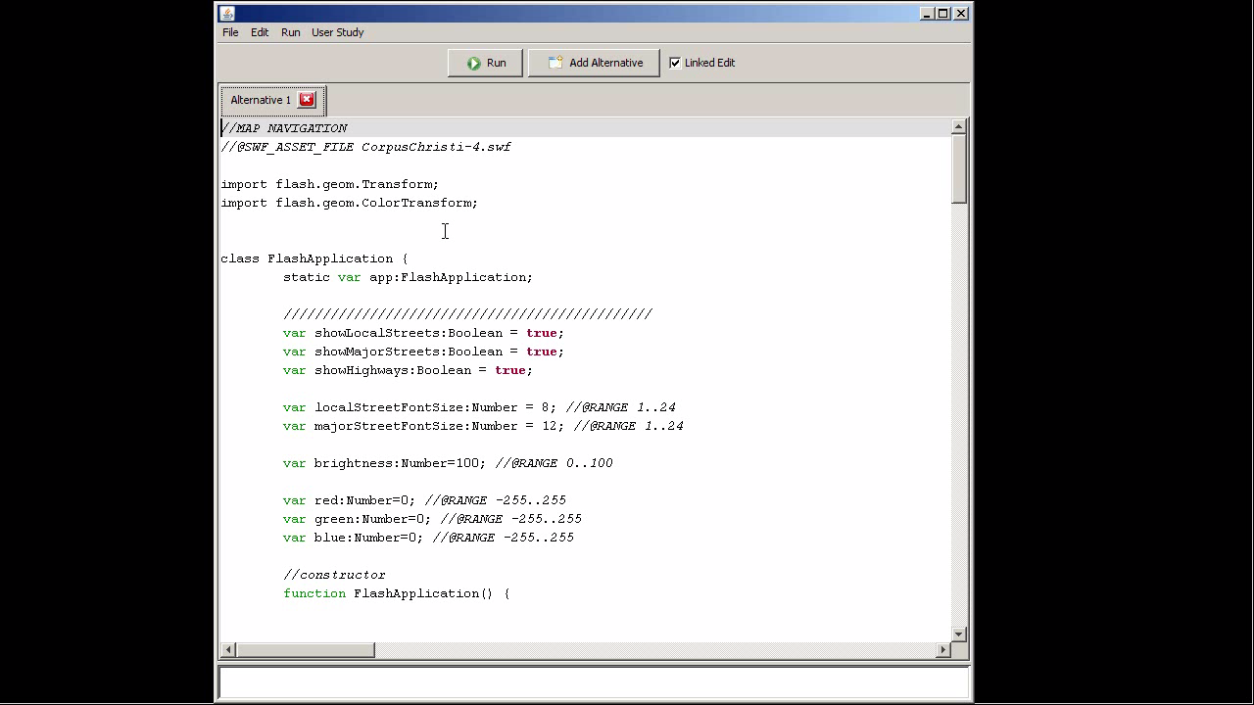
Notes:
In this video clip, you can see how a designer might rapidly try interaction and visualization alternatives in Juxtapose:
She creates an alternative tab to create a code duplicate, and unchecks linked edit to perform local changes. She thenexecutes both alternatives and can modify variables in her program that Juxtapose automatically extracted through a GUI interface or a physical controller.

Slide 26
Evaluation
26
N=18, 12male, 6 female, ages 20-32, students
75-90 minute sessions, three tasks: warm-up, matching, designing map navigation
Notes:
We conducted a summary suability evaluation in our lab with 18 participants. Sessions lasted 75-90 minutes.
All participants had at least a working knowledge of procedural programming (10 were computer science majors), although some had had little experience with writing ActionScript code.
26

Slide 27



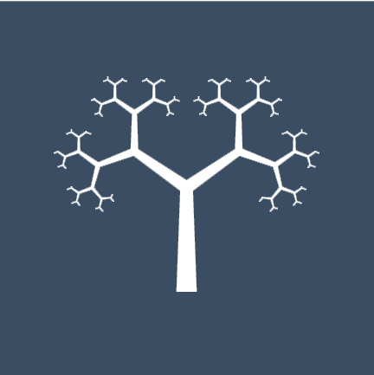

Tree Matching Task
27
Search in 4D parameter space. Given recursive drawing code code for this:
Produce these:
Notes:
A matching task provided participants with code that recursively draws a tree. Participants were asked to adjust four parameters of the tree drawing routine to match four specific tree shapes given in the task description.For two trees, this task was accomplished using the full Juxtapose interface. For the other two, participants were given the same editor without the possibility of creating alternatives or tuning variables
at runtime. Order of assignment between Juxtapose and control conditions was counterbalanced and a random tree order was generated for each participant.
27

Slide 28
p<0.001 (paired two-tailed Student’s t)

Slide 29
not
significant
not
significant
p<0.01
p~0.01

Slide 30
Notes:
Reason for the speedup: 24 fold increase in the number of parameters explored.
So not only were our subjects faster, but they also explored significantly more parts of the design space.

Slide 32
Mapping Task
32
Given Actionscript code that loads a multilayered map, develop navigation options for a handheld GPS prototype for pedestrians and car drivers.
Notes:
In our open-ended design task, participants were provided with a
working ActionScript program that loaded a multi-layer map, as seen in the video. Participants
were given 30 minutes to create two map navigation alternatives for a hpyothetical GPS unit – one suitable for pedestrians, and one for drivers.
Participants had to modify and add to the source to either hardcode design decisions into the source code, explore code changes through alternatives, or to set up tunable parameters.
32

Slide 33
Qualitative Results
33
Conceptually, linked editing and tuning were well understood and applied by all participants.
Many commented positively on reduced iteration time.
Alternative tabs were used as a lightweight versioning mechanism and starting point for code experiments.
Notes:
33

Slide 34
Qualitative Results
34
Areas for improvement:
  Runtime changed should be reflected back in source code.
  Additional callback functions are sometimes needed to update application state based on variable tuning.
  Determining correspondence between GUI parameters and hardware sliders error-prone.
Notes:
34

Slide 35
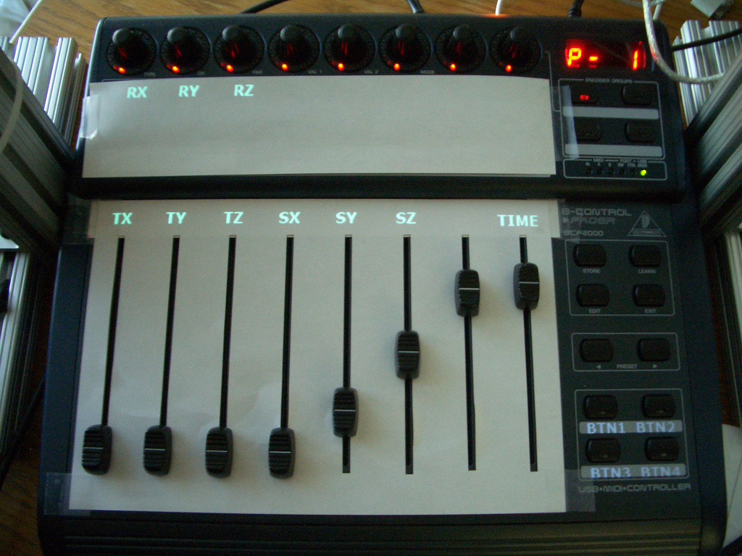
Notes:
One design response to the study was to add dynamic projection of parameter names onto the physical control interface. In our prototype, we use a projector mounted above the mixer.
For the case when no external hardware is availabe, we are currently improving the layout of control widgets.
We are also extending Juxtapose for authoring mobile applications and embedded interaction code on microcontrollers. In these two domains, the cost of making and testing changes is significantly higher than in standard GUI development, so tools like Juxtapose that enable fast iteration and exploration can present substantial benefits.

Slide 36
http://hci.stanford.edu
Notes:
For more information on d.tools, please visit our web site. Thank you.

Slide 37
