Slide 1
Designing
Pervasive Computing
Scott R. Klemmer
Brigham Young University
17 January 2007

Slide 2
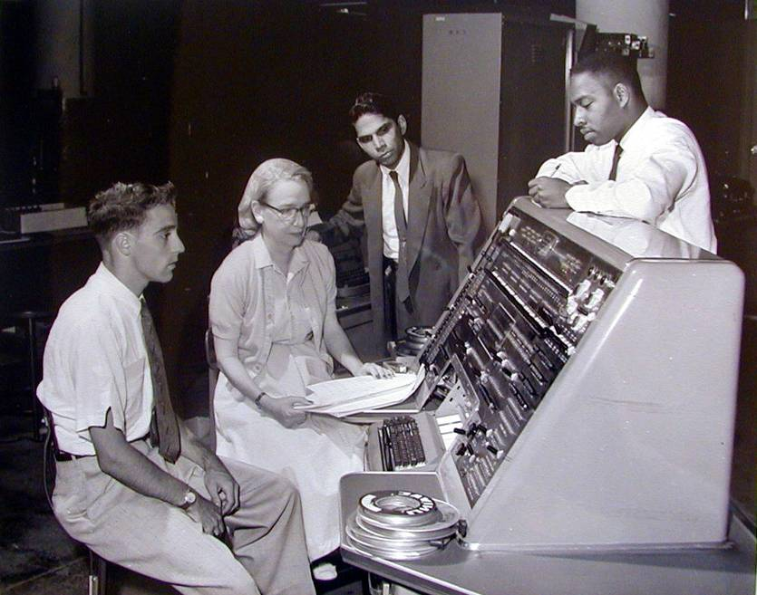
Toward Design Thinking
Notes:
Now, this idea of creating tools to empower users has a long and storied history, beginning with Grace Hopper’s invention in the early 1950s of the first compiler. What’s inspirational for me is that she conceptualized how improved tools could provide a much wider audience with access to computation.
In the intervening years, good programming environments for the desktop and web enabled legions of developers to create the content that helped put a PC on every desk, and the goal of my group’s research is to enable an analogous success for ubiquitous computing. Specifically, our interest lies in the move from tools for technology experts toward tools for domain experts, designers.

Slide 3
Opportunistic Design
Alpha Applications
# of Lines of Code
Situational Applications
Applications
Notes:
* The majority of mobile and ubiquitous computing systems lie in the “long tail” of the application space.
Compared to “killer applications”, such as operating systems or office suites, many mobile systems contain relatively small amounts of code. However, the total number of these systems is quite large, suggesting that this area is ripe for domain expert programming.
* By domain expert programming, I mean programming by individuals who are experts in a particular domain relevant to the application at hand outside of the ubiquitous computing domain.
* Examples of domain experts include scientists, Web 2.0 programmers, ubicomp designers, hobbyists, and so forth.
* This distinction between big software and the long tail is obviously overly crisp, and much lies in the middle, such as the many enterprise applications for vertical markets.
* Our group’s main goal is to support design and development in the long tail of ubiquitous computing.
By enabling domain experts through programming models and tool support, we greatly increase the number of people able to work towards Weiser’s vision.
* one particularly important aspect here is prototyping and designers, and much of our work has concentrated on this area.

Slide 4
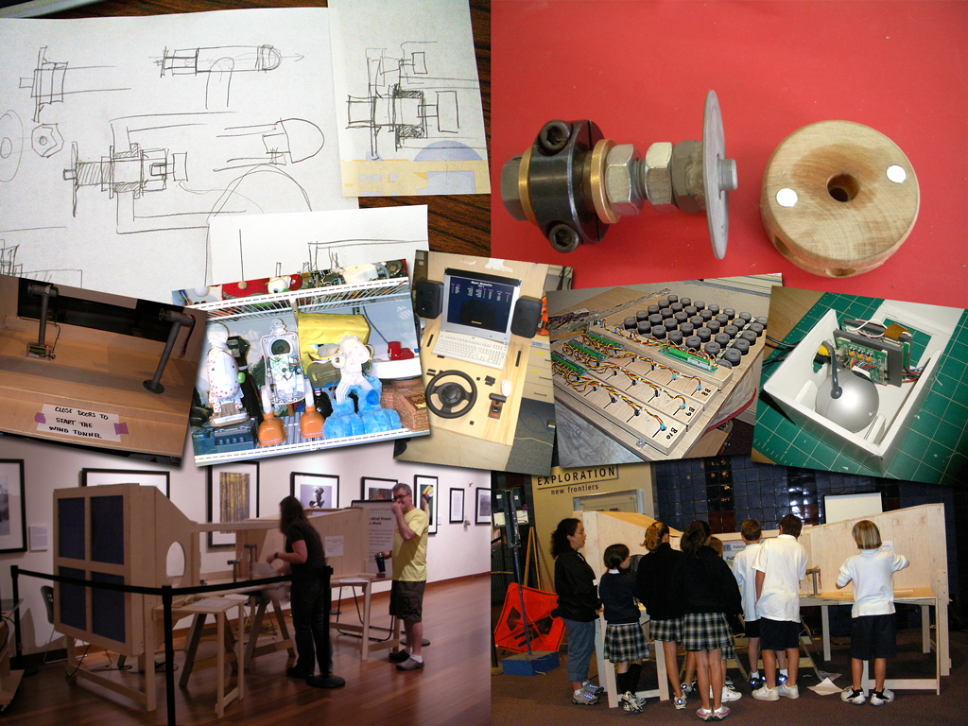
Thinking Through Prototyping
Colleagues
Clients
Users
Ourselves
Notes:
Prototyping is the pivotal activity that structures innovation, collaboration, and creativity in design. Prototypes embody design hypotheses and enable designers to test these hypotheses. Successful designs result from a series of “conversations with materials,” as Donald Schoen called them.
The goal in prototyping is not the artifact – it’s feedback and iteration: you build some prototypes, evaluate them, and use what you learned to drive the next design.
There are four audiences.
Different representations teach us different things and have different goals
Some are useful contemporaneously with the design; others are primarily useful for later.

Slide 5
Big Picture:
Schoen, Schrage, Polanyi

Slide 6
Problem Solving as Representation
“Solving a problem simply means representing it so as to make the solution transparent”
—Herbert Simon, The Sciences of the Artificial

Slide 7
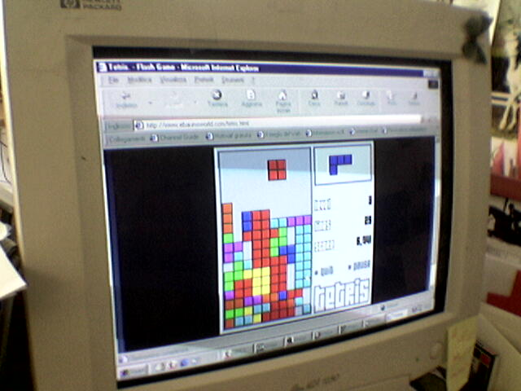
thinking through doing
Epistemic Action
Notes:
Making Computations Cheap
Epistemic Action (Maglio&Kirsh): Reducing the memory, number of steps, or probability in error in mental computation
These differ from Pragmatic Actions, which simple bring one closer to a goal state

Slide 8
Pragmatic v. Epistemic Activity
START
GOAL
B
???
?
?
?
A
START
[Kirsh, Maglio 1994]
[Klemmer, Hartmann, Takayama 2006]
Notes:
Another lens for understanding he role of prototyping is the distinction is between pragmatic and epistemic design activity.
Pragmatic actions are those related to directly accomplishing a task with a known goal.
Broadly speaking, much prior work in software tools has been concerned with the pragmatic activity of getting things built.
But prototyping also serves an important epistemic function: design problems are ill-structured, meaning part of the designer’s job is to figure out what the space of solutions is in the first place . The goal itself is unclear.
We are particularly interested in this epistemic design activity.

Slide 9
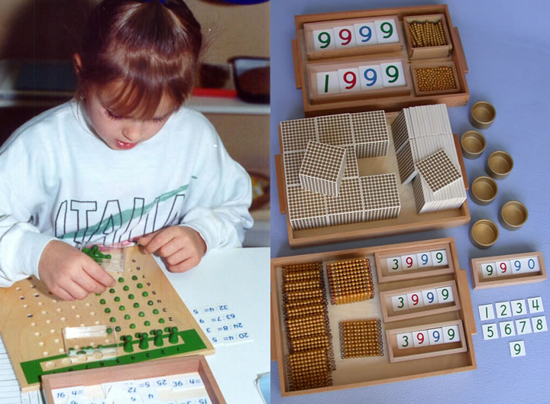
Thinking Through Doing
Notes:
Piaget posited that cognitive structuring benefits from physical activity, and that physical interaction in the world facilitates cognitive development.

Slide 10

[O’Sullivan]
Notes:
This is a drawing by Dan O’Sullivan. It shows how the mental model, if you will, that my current PC has of me. My computer knows I have an eye – but only one – it does know that I have two ears. It knows I have a finger – but only one, maybe two – and it has no idea that I have a body. Given the richness our human experience in the physical world, it’s shocking that our experience in the digital world is so limited.

Slide 11

Invisibility
visibility
Notes:
One of the most sweeping — and unintended — transformations that the desktop computing paradigm has brought about is the extent to which the physical performance of work has homogenized.
As an example of how the invisibility of work practice that the GUI has brought about inhibits peripheral participation, the first author was in a laundromat, working on his laptop. A child sat next to him while he was working, and looked at him, watching him work. After a few minutes, the child pulled from his backpack a game device with a similar clamshell form factor. The child watched to see what the author was doing, and then proceeded to copy those motions on the gaming device. With the graphical interface, there is no mechanism to be aware of the practices of experts; it all looks the same.

Slide 12

IDEO Camera
Notes:
Explain this prototype.
this is particularly important as computing moves off the desktop and into our pockets, homes, and environments, where interaction models and use cases are emerging

Slide 13
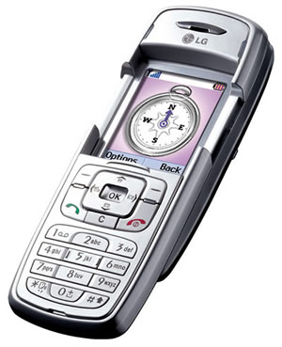
Notes:
As computing expands beyond the developed world, it can be of particular value to both enable and understand how technology is being appropriated and adapted for local contexts. Genevieve Bell, an ethnographer at Intel, pointed me to a small example of this, that in Malaysia, there is now a mobile phone with an integrated compass. Why an integrated compass? To find Mecca of course! This phone does cultural work almost unimaginable in a western context.

Slide 14
?
Notes:
What techniques and representations can most effectively enable users to design interactive systems? Contemporary software tools — the user interface for specifying interaction — largely employ approaches that were designed decades ago, when cost and performance limitations implied a quite different tradeoff between machine efficiency and human effectiveness. Additionally, while many of these decisions were made in light of excellent computer science, few were made with a deep understanding of human science. Improving the design environments gains particular importance in a ubiquitous computing era, where concerns — such as device ensembles, wireless communication, and recognition-based interaction — further resist rapid prototyping. My group’s human-computer interaction research investigates this issue through three main thrusts:
The way I see mobile & ubiquitous computing, it’s about creating systems that are more deeply integrated into the practical logic of the routine world.
This is a significantly new user experience, and a significantly new design experience. In order to make progress, we need to build a culture of prototyping. PROTOTYPING IS HARD, and prototyping a ubicomp system is much harder than prototyping in traditional design areas. The challenge for computer science researchers is to build tools that better support a culture of prototyping.

Slide 15
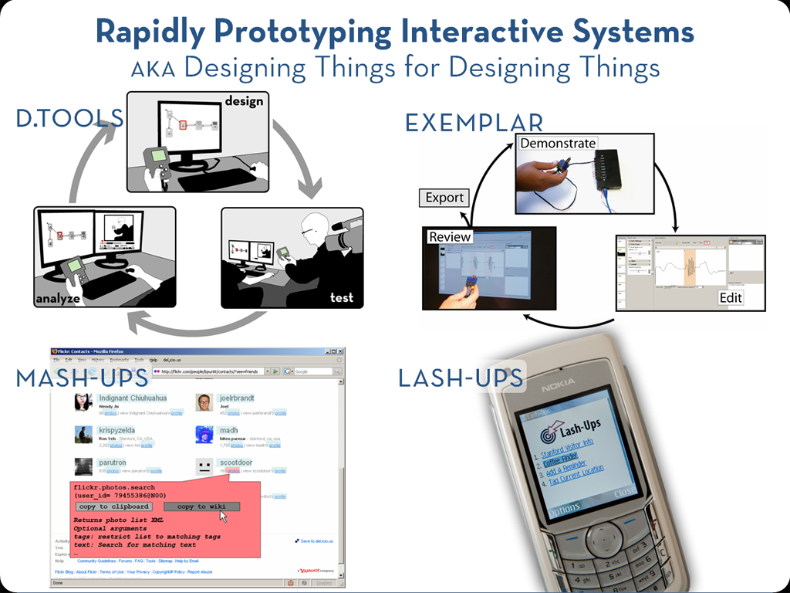
Notes:
In the past three years, we’ve built several systems in my group that explore these issues, and I’ll provide an overview of a few of them today. In the interest of time, and to provide the big picture that I think will be most valuable for our project today, I’ll stay at a fairly high level, but please feel free to ask questions during the talk or afterwards about the details.

Slide 16
Fieldwork: Prototyping Today
Comprehensive prototypes are being built,
but only for presentation.
Video recording is pervasive,
but revisiting video is too expensive.
Notes:
To learn about opportunities for prototyping tools in the domain of information appliances, we conducted interviews with eleven product designers at three design companies. I also served as a physical computing consultant for one of the companies. I want to highlight two key insights from our field work. We found that
Professional design companies do have access to resources and expertise to create integrated functional prototypes – however, these prototypes are generally expensive one-offs used only for presentation.
Today’s prototyping tools are not flexible enough to create functional prototypes as tools for design thinking itself.
2) For documentation purposes, many test sessions with prototypes are video recorded. However, revisiting this video material is often too costly in terms of work hours so tapes just end up on the shelf.

Slide 17

d.tools
[uist 2006]
Notes:
Our recent work on d.tools has explored how to more rapidly create and evaluate information appliances that incorporate rich physical interactions.

Slide 18
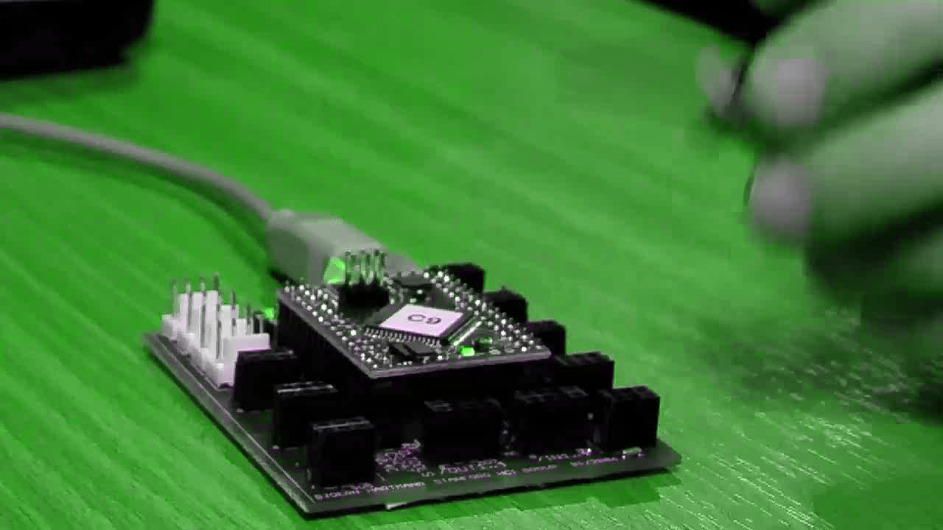
Notes:
As a designer plugs physical components such as sensors into the d.tools hardware interface, virtual counterparts appear in the d.tools authoring environment on the PC.
The DESIGNER then authors interactions by creating visual states, which encapsulate output, and by linking them through transitions, which get triggered by input events.
d.Tools facilitates turning continuous sensor data into discrete events through an interactive demonstration and thresholding technique.
In d.tools, the interaction model is always live and can be tried out at any point.
To increase the complexity of prototypes, designers with programming knowledge can attach Java to visual states.
In this example, Java code remote controls the Google Earth application. This is an example of how d.tools can be used to create mash-up prototypes.

Slide 19
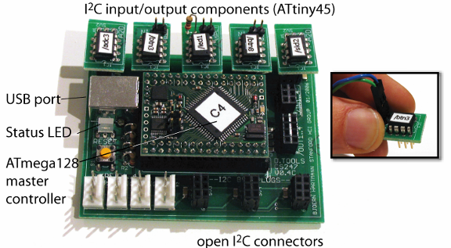
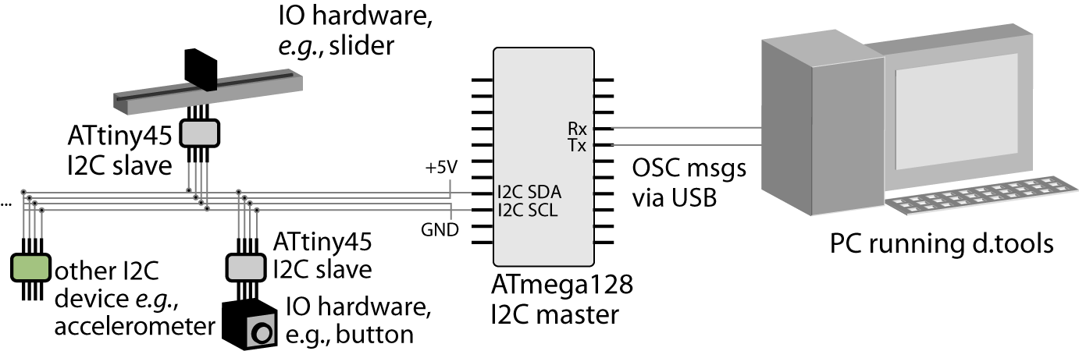
Smart Hardware
Notes:
This research introduces three hardware extensibility at the hardware-to-PC interface, the intra-hardware
communication level, and the circuit level.

Slide 20
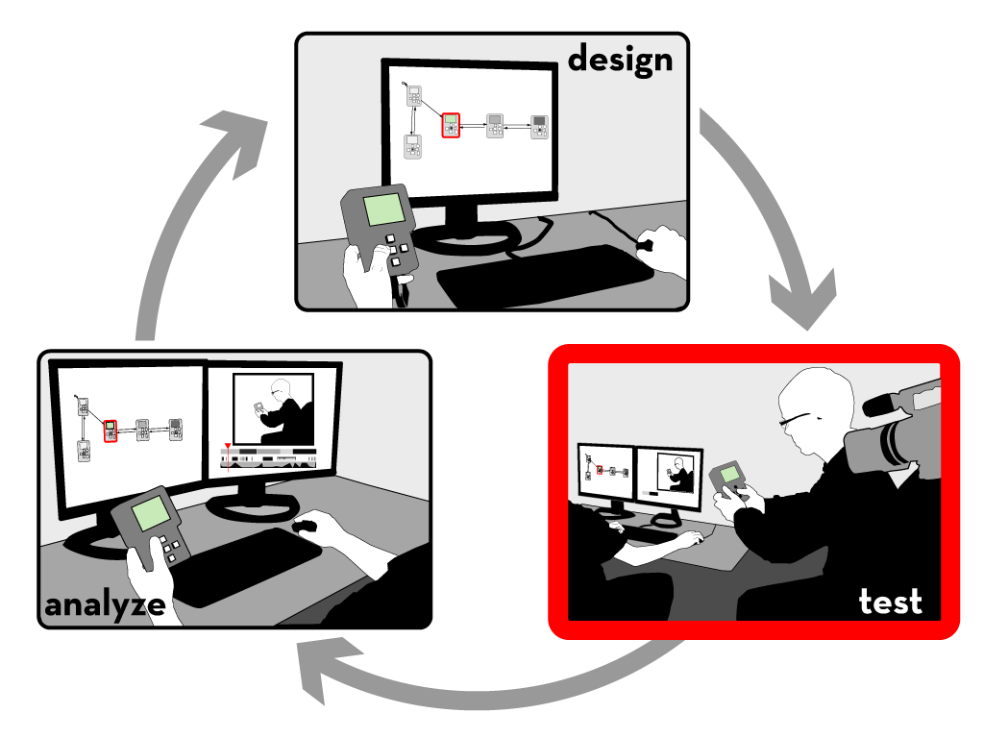
Notes:
Let’s move on to test mode

Slide 21

Notes:
A camera is pointed at the tester.
The live video from the camera is recorded and annotated in real-time with state transitions and input events.
In addition to events generated by the prototype itself, the experimenter can also add annotations with a video console.

Slide 22

Notes:
After a test session is completed, designers can leverage tight synchronization between the graphical interaction model, the recorded video, and the recorded event traces in analyze mode.

Slide 23
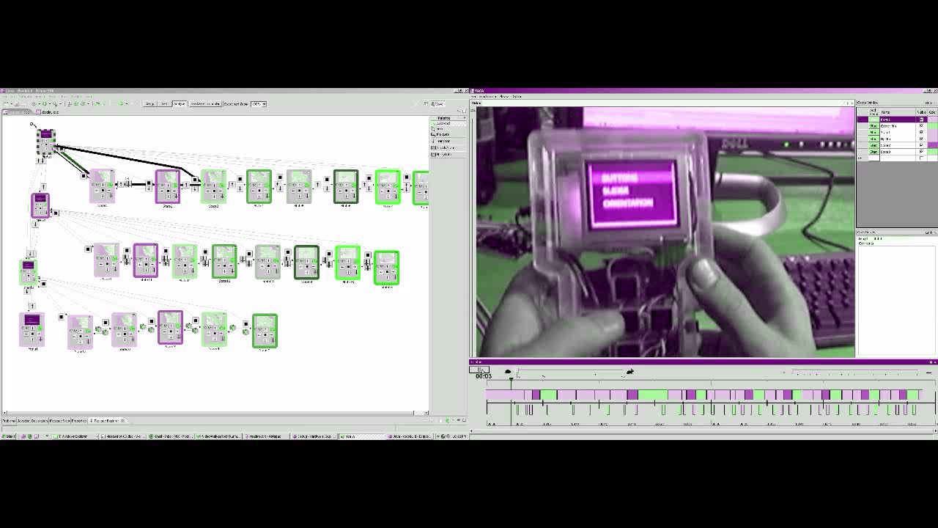
Notes:
In analyze mode, video playback is synchronized with a visualization that highlights active states.
In the other direction, designers can select states in the statechart to access corresponding video clips.
Designers can query for video sequences matching input by demonstrating that input on the prototype itself.
Multiple test sessions can be combined into a video spreadsheet, which can be used for rapid comparative evaluation.

Slide 24
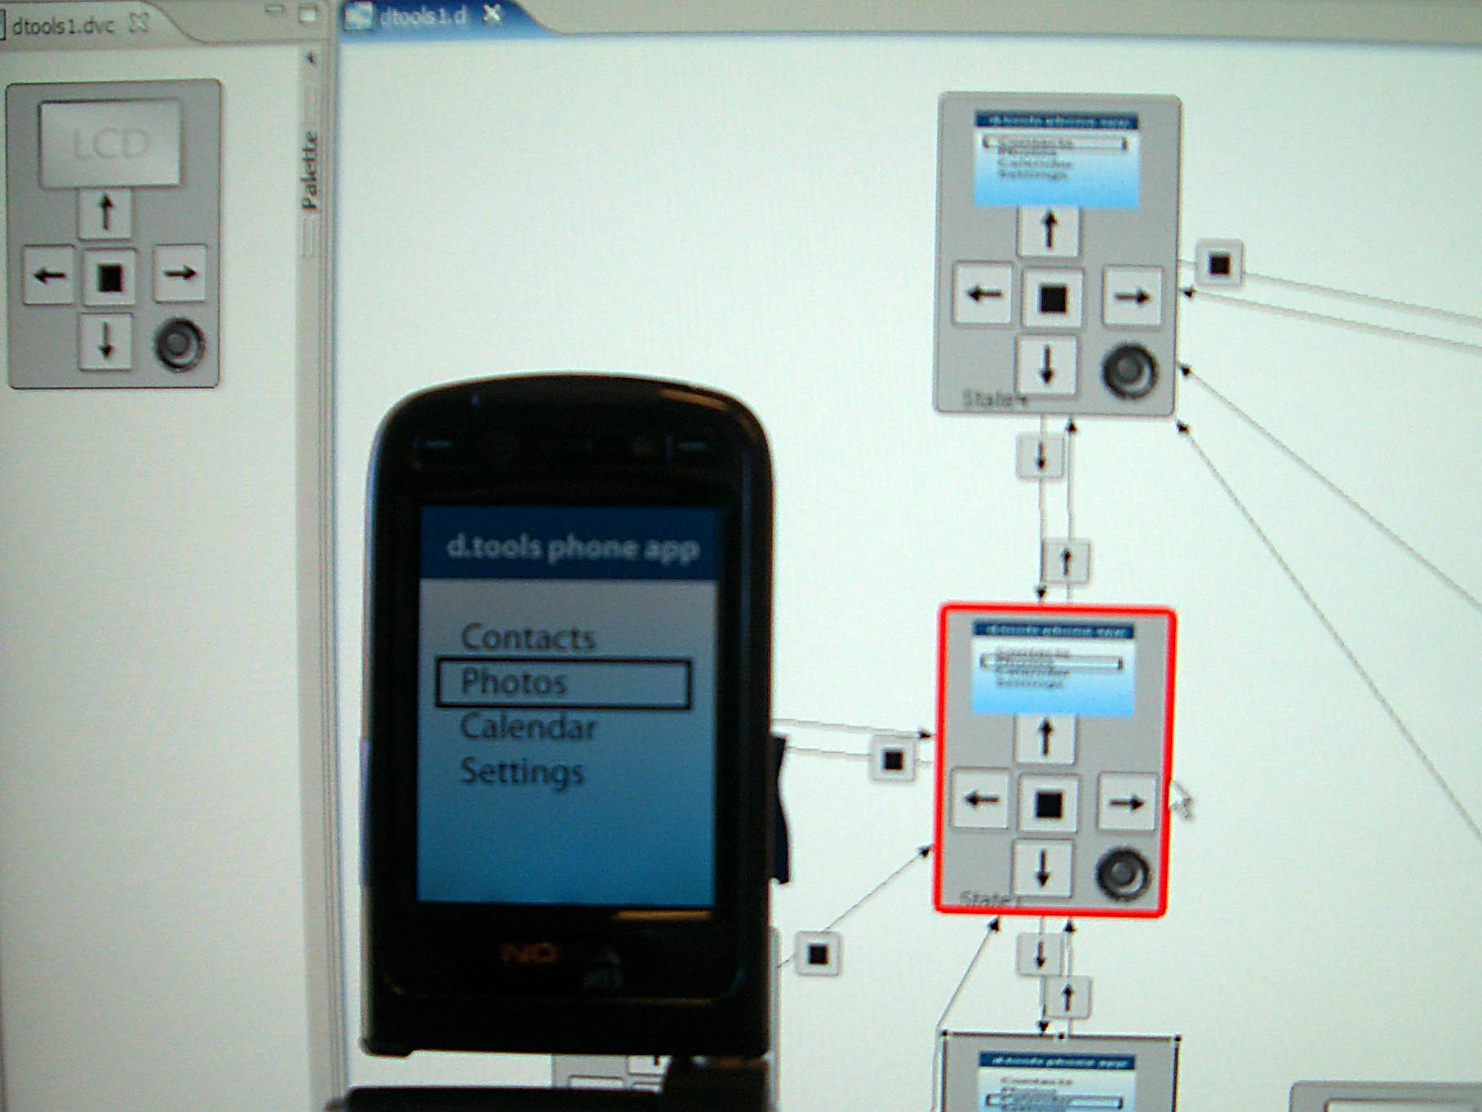
Notes:
Client application written in Python
All communication is wireless
Phone sends input events to dtools
Application logic is handled on the desktop
Dtools send commands back to phone to display images and play sounds

Slide 25
Designing Sensor-based Interactions
PROTOTYPE APPLICATION LOGIC
SPECIFY RELATIONSHIP
BETWEEN SENSOR DATA
AND APPLICATION LOGIC
SPECIFY RELATIONSHIP
BETWEEN SENSOR DATA
AND APPLICATION LOGIC
PROVIDE SOFTWARE ABSTRACTION
FOR HARDWARE
Notes:
Reflecting on our experience, we see sensor-based interaction design comprising three distinct steps: choosing and connecting the appropriate hardware, creating application logic, and specifying the relationship between sensor values and application logic.
d.tools, as well as prior work, provides software abstractions that make connecting hardware easy. D.tools also enables designers to rapidly prototype and evaluate the application logic. However, our experience has shown that specifying the relationship between sensor values and logic often remains problematic.

Slide 26

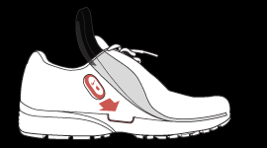
How would you prototype…
…a workout monitoring system?
[Apple, Nike]
Notes:
Let me start by introducing our domain of concern: tools for off-the-desktop interaction design. What kind of authoring tools would you need to prototype a fitness monitoring system which measures the rhythm of your steps and adjusts music playback accordingly?

Slide 27
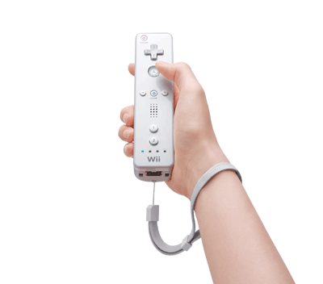
How would you explore…
…motion-based game controllers?
[Nintendo]
Notes:
Or imagine you are a game designer. What kind of tools would you need to prototype an accelerometer based control for an existing game in less than 30 minutes?

Slide 28

Representation Matters
Accelerometer X axis
Accelerometer Y axis
//detect accelerometer peaks
//read data sample
xVal[t++]=readA2DValue(xPin);
//look for changes in derivative
if(((xVal[t]-xVal[t-1]) >= 0
&& (xVal[t-1]-xVal[t-2]) < 0) ||
(((xVal[t]-xVal[t-1]) < 0
&& (xVal[t-1]-xVal[t-2]) >= 0)) {
//peak detected
//send message
oscSendMessageInt("/x/peak",1);
} else {
//no peak
}
Notes:
As Herb Simon and Don Norman have pointed out, the representation of a problem is an important factor determining how we can manipulate that problem.
For tasks like sensor-based interactions, an individual's performance of the input they would like to recognize is a very different activity from symbolically specifying that input. The motivation of our work is to leverage the embodied performance to actually do the work of specifying the computation.

Slide 29
Expand “Representation Matters” section

Slide 30
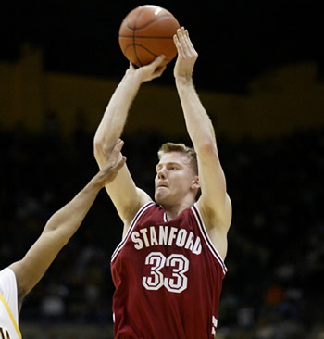
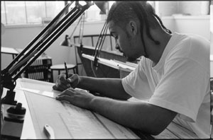
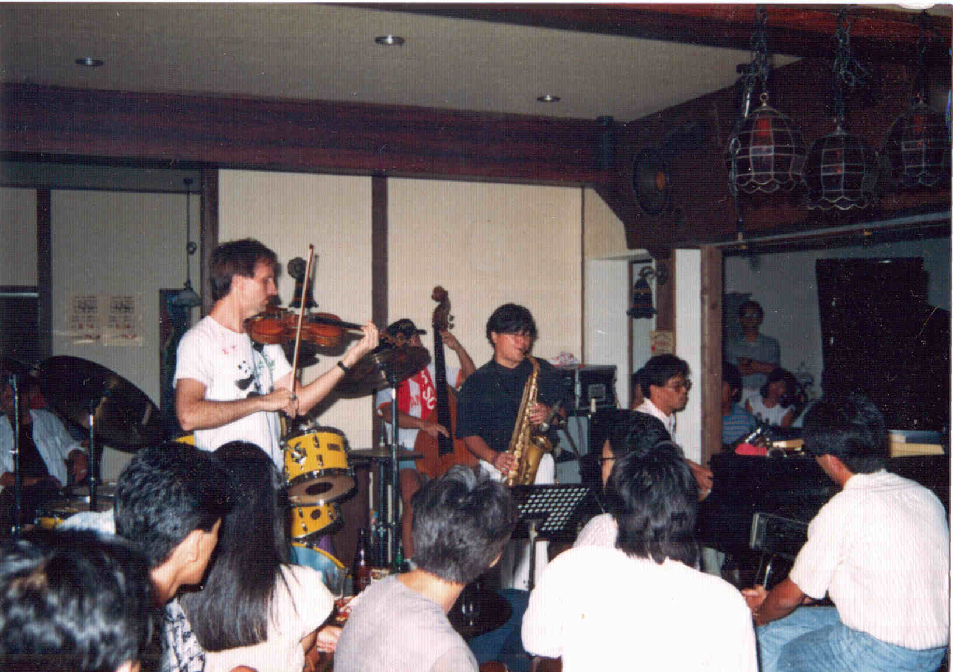
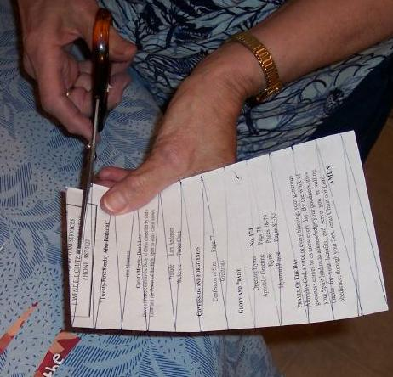
Tacit Knowledge
Notes:
This allows designers to leverage their tacit knowledge of the task domain without having to produce a formal representation of the task from scratch. As Michael Polanyi put it (SLOW) “we know more than we can tell” (PAUSE) –PBD can aid designers by substituting “doing” for “telling”.

Slide 31
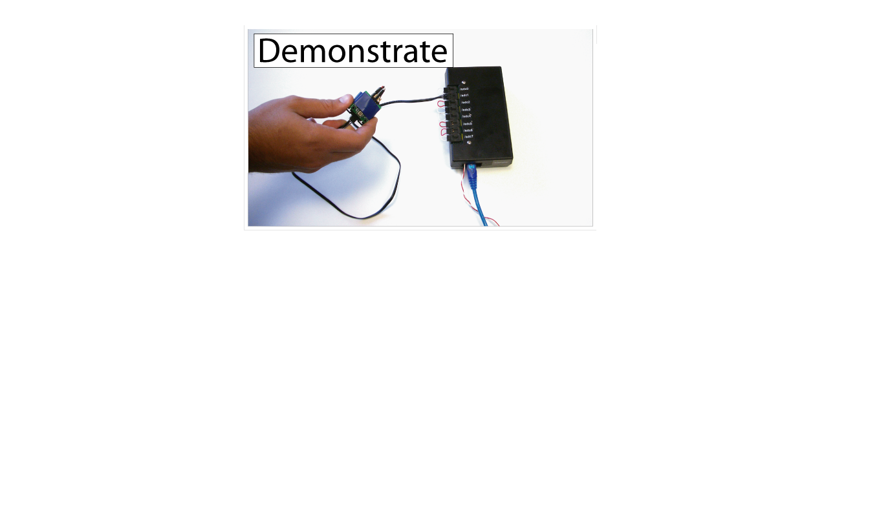
Exemplar
[chi 2007]
Notes:
We constructed Exemplar to investigate such an approach.
With Exemplar, a designer first demonstrates a sensor-based interaction to the system (e.g., by shaking an accelerometer).

Slide 32
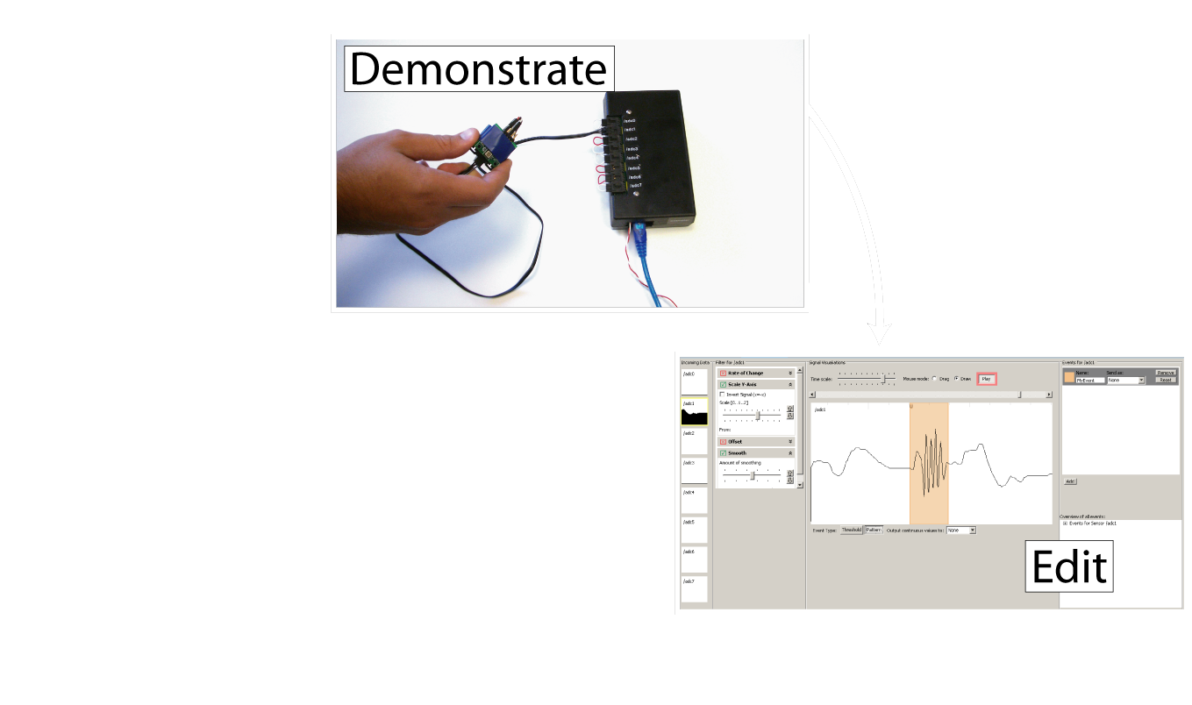
Exemplar
[chi 2007]
Notes:
The design then edits a visual representation of the action by marking it up,

Slide 33
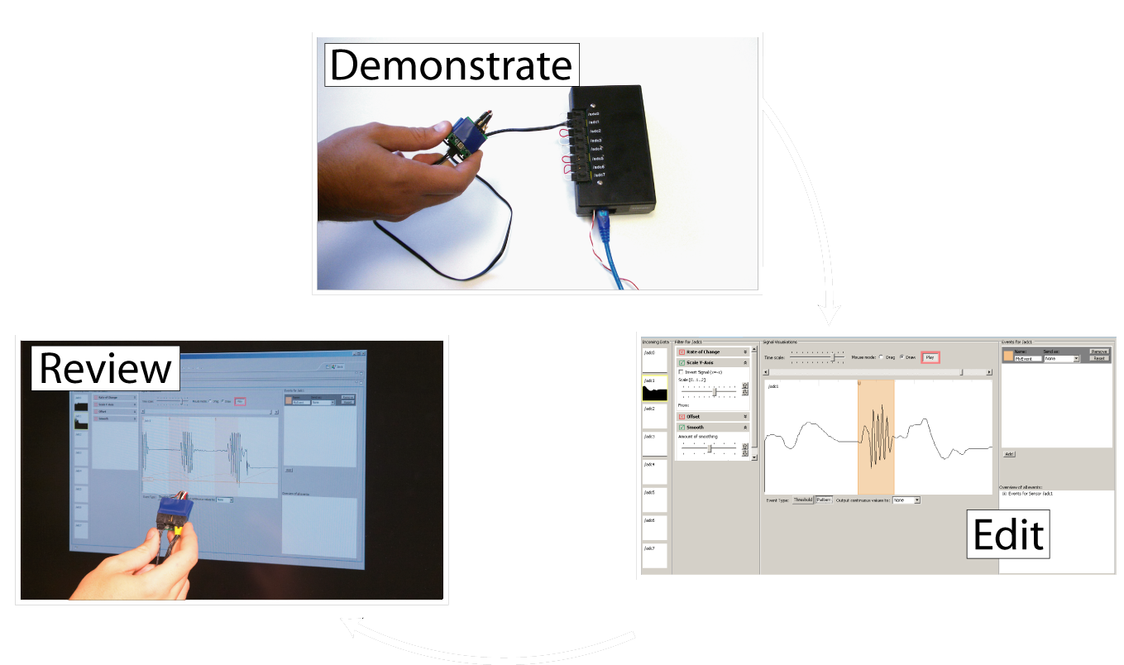
Exemplar
[chi 2007]
Notes:
and reviews (or tests) the result by performing the action again.

Slide 34
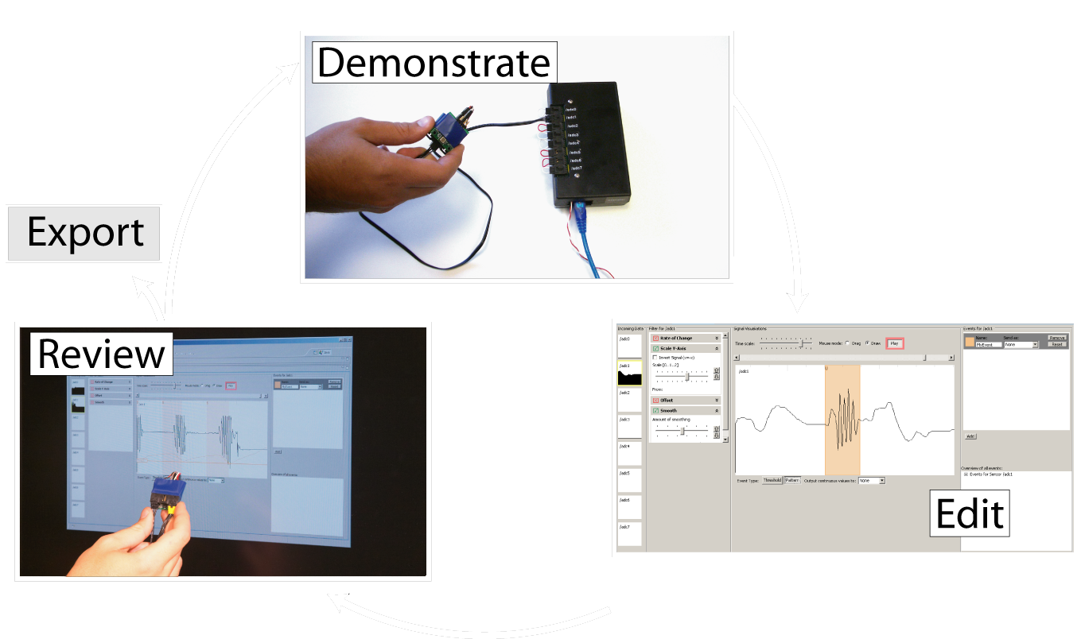
Exemplar
[chi 2007]
Notes:
Through iteration based on real-time feedback, the designer can refine the recognized action and link it with other prototyping applications.
A short video scenario will outline the main functionality of Exemplar.

Slide 35
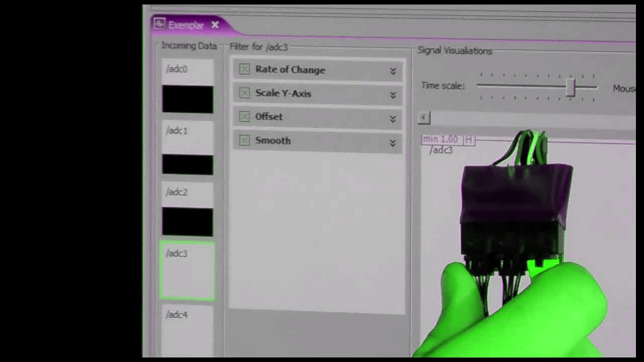

Slide 36
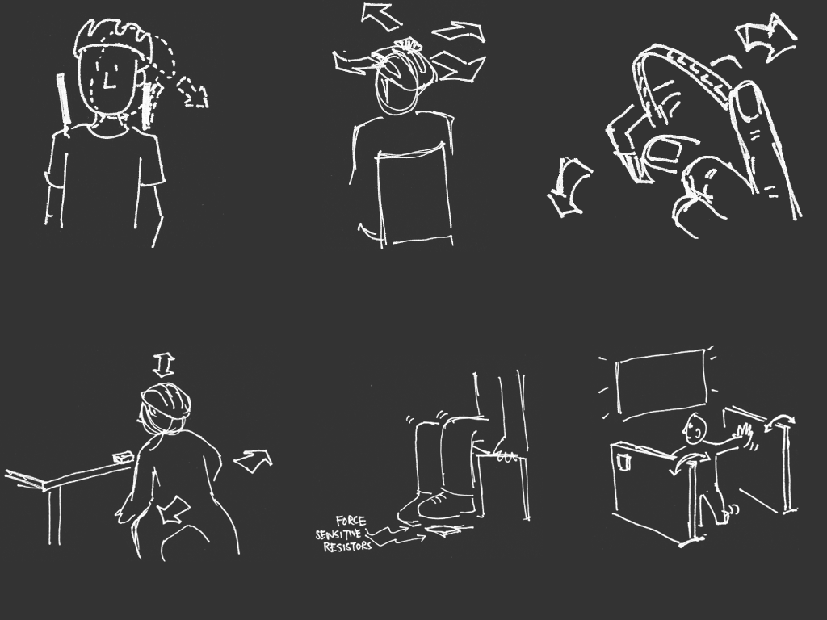
Lab Study
26 min
18 min
27 min
47 min
22 min
31 min
[sketches by Wendy Ju]
Notes:
We were positively surprised by the wide range of game control designs our participants came up with. The rapid feedback cycle in Exemplar enabled participants to explore up to four different control schemes for a given game in less than 45 minutes. The slide shows task completion times for some of the game controls. The takeaway point here is that even novices could rapidly and successfully complete the design exercises.
Let me show you three of the creative solutions our participants came up with.

Slide 37
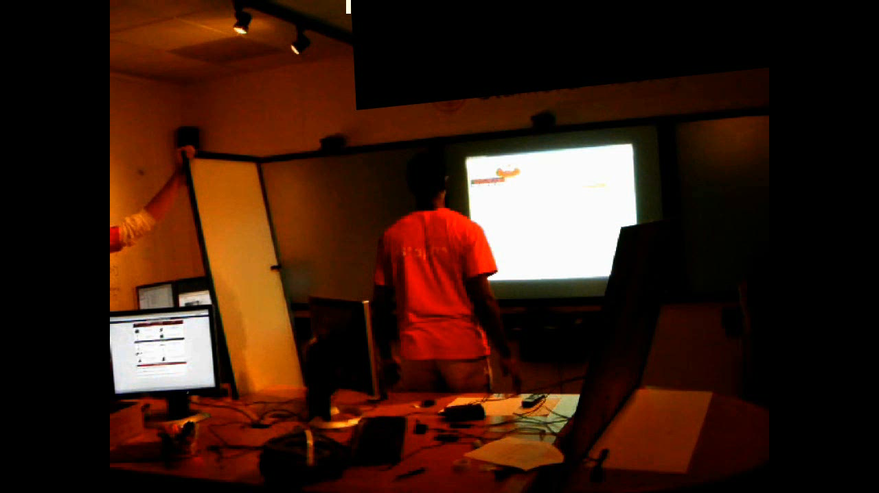
Notes:
One participant created a make shift booth - hitting walls and stomping on the floor navigated a spaceship.
Another participant modified the bicycle helmet example so that the accelerometer on his helmet would detect him ducking down to fire rocket thrusters.
A third participant used the signal generated by the flicking of a bend sensor to trigger shooting of rubber bands.

Slide 38
D.Tools related
Network:
  Tom Igoe book, ThingM, Shared Phidgets
Other prototyping tools:
  Eyepatch, iStuff Mobile, Momento
Does the Control Freka work (w/ Haiyan fit in anywhere?)
Design/test/think: Dave Akers’ work

Slide 39
Fieldwork: Building Community Relationships
Need a two-way road, not just visit+leave
E.g.: our ties into design community; joel at the exploratorium

Slide 40
“The best way to have a good idea is to have lots of ideas.”
-Linus Pauling
Notes:
Linus Pauling is widely regarded as the premier chemist of the twentieth century. He pioneered the application of quantum mechanics to chemistry, and in 1954 was awarded the Nobel Prize in chemistry for his work describing the nature of chemical bonds.
What his work shares with that of professional de signers is the practice of succeeding by trying out multiple alternative ideas, approaches, solution strategies. (rewrite)
There are three specific ways in which construction of multiple alternatives is important in design:

Slide 41

Prototypes for the
Microsoft mouse
From Moggridge,
Designing Interactions, Ch2
Notes:
First, designers may build dozens of prototypes to get a more complete understanding of a design space.
For example, Paul Bradley at IDEO built about eighty foam models for the original Microsoft mouse to quickly explore different directions.

Slide 42

Tohidi et al, CHI 2006
Notes:
Third, comparing between multiple alternatives has been shown to be important during testing of prototypes to keep participants honest:
Tohidi et al showed, among other things, that Participants will rate designs lower when multiple alternatives are seen, compared to when they see only one. And that
Participants exposed to alternative designs will be less pressured to be positive, expressing fewer positive comments than those who only see one.

Slide 43

Notes:
However, such solutions do not yet exist for designing interactive behavior. A recent survey of designers by Brad Myers et al found that designers lack the tools to iterate on behaviors and to compare such interaction designs side by side. (this paper has not been published!)
(Click) One of the central reasons it that design of interactive behavior, even for prototypes, often happens in textual code.

Slide 44
Notes:
The unique aspect of programmed interactions — for this discussion — is that there are two distinct representations involved: source code, where changes are authored; (click) and the running program, where changes are observed.

Slide 45
Juxtapose
Notes:
Our work on Juxtapose enables designers to interactively create and manipulate multiple alternatives of programmed interactive behaviors.

Slide 46
Juxtapose
Notes:
Juxtapose demonstrates a novel environment for constructing multiple design alternatives through (selectively) parallel editing of behavior source code.

Slide 47
Juxtapose
Notes:
These source alternatives can then be executed in parallel, allowing rapid comparison between them.

Slide 48
Juxtapose
Notes:
Juxtapose also introduces a mechanism to automatically generate a control interface to interactively “tune”
parameters of the designed interaction at runtime. Arriving at a
satisfying user experience often depends on adjusting
interrelated application parameters.

Slide 49

Juxtapose
Notes:
For parameter tuning, Juxtapose supports the use of a dedicated, spatially multiplexed hardware controller. Such a controller enables users to modify multiple parameters
simultaneously; leaves the eyes free to focus on the application being tuned; and allows for tuning of interactions that require concurrent mouse and keyboard input.

Slide 50

Notes:
Currently, Juxtapose supports creation of interaction designs written in Actionscript. Behind the scenes, these projects are compiled into Flash files using the open source MTASC compiler.<click>
Users can create alternatives to their current code using the add alternative button…

Slide 51

Notes:
Alternatives are shown as tabs in the user interface. The alternative documents are “linked” by default – which means that changes in one alternative are propagated to all other alternatives.

Slide 52

Notes:
When the linked edit box is unchecked, code changes are now local to the currently active alternative document.

Slide 53

Notes:
Parts of the code that are unique to the active alternative are shown in a different background color to highlight the differences. This technique of linked editing was introduced by Toomim in 2004 for working with code duplicates. We extend his work here by integrating linked editing with the Juxtapose runtime environment.

Slide 54
Notes:
When the user hits run, Juxtapose compiles the set of all alternatives and launches the runtime environment.

Slide 55

Notes:
In the runtime environment, one Alternative has focus in the central canvas.

Slide 56
Notes:
In the runtime environment, one Alternative has focus in the central canvas. Users can switch between alternatives using the buttons above the canvas

Slide 57

Notes:
In the runtime environment, one Alternative has focus in the central canvas. Users can switch between alternatives using the buttons above the canvas

Slide 58
Notes:
To tune application behavior at runtime, Juxtapose automatically extracts a list of all static variables through reflection and presents a list of those variables on the right hand side.
Users can check variables to assign

Slide 59
Notes:
To tune application behavior at runtime, Juxtapose automatically extracts a list of all static variables through reflection and presents a list of those variables on the right hand side.
Users can check variables to assign the variables to control widgets. The layout of the control widget area mirrors the

Slide 60

Notes:
To tune application behavior at runtime, Juxtapose automatically extracts a list of all static variables through reflection and presents a list of those variables on the right hand side.
Users can check variables to assign the variables to control widgets. The layout of the control widget area mirrors the physical layout of the supported external controller.

Slide 61
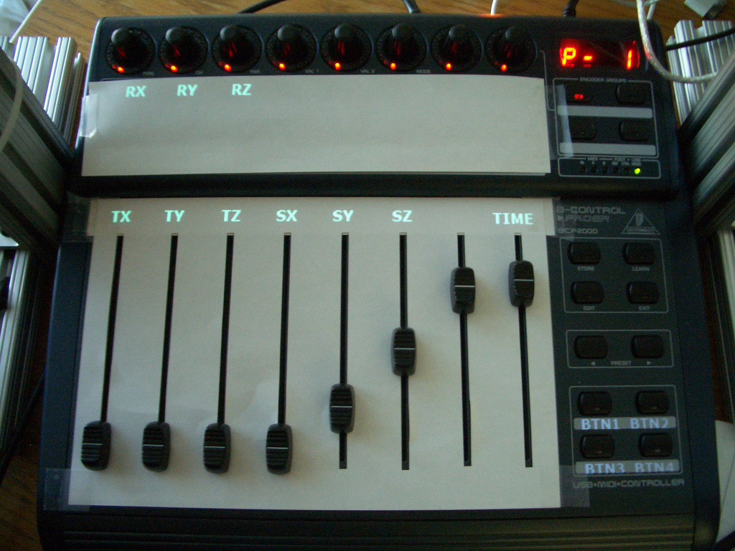
Notes:
Design Response: optimize for either GUI only or slider only use. For external control hardware, displaying parameters directly onto the control interface. In our prototype, we use a projector mounted above the mixer.
For GUI only use, we are currently improving the layout of control widgets.

Slide 62
Juxtapose for Ubicomp (1 slide)
Notes:
We conducted a summary suability evaluation in our lab with 18 participants. Sessions lasted 75-90 minutes.
All participants had at least a working knowledge of procedural programming (10 were computer science majors), although some had had little experience with writing ActionScript code.
62

Slide 63
Evaluation: What’s the point?
Notes:
We conducted a summary suability evaluation in our lab with 18 participants. Sessions lasted 75-90 minutes.
All participants had at least a working knowledge of procedural programming (10 were computer science majors), although some had had little experience with writing ActionScript code.
63

Slide 64
Participatory design
Preview study?
P.D. is now mandatory in Japanese classrooms

Slide 65
Distributed particip design – what role do crowds have to play?
Buxton diagram (fig 56)

Slide 66
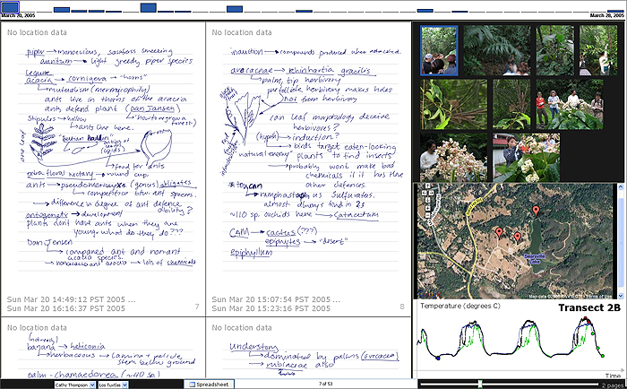
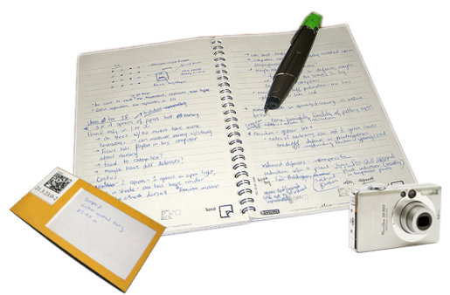
Integrating Paper and Digital Interactions
Notes:
We extended our augmented biology tool into our first application, ButterflyNet….
ButterflyNet supports the existing practice of capturing heterogeneous data in the field… including photographs, map data, sensor logs, specimens, and handwritten notes.
In this discussion I will just concentrate on photographs.

Slide 67
Goals and Metrics for Toolkit
Support a large variety of applications
  Rapid Design & Testing
Minimize required expertise to create apps
  Less Coding → Better
Do not restrain experts from exploring
  Flexible / Modular Design
Notes:
To determine success for this toolkit… it should support a large variety of applications…
Minimize the expertise required to build these apps….
And try not to restrain experts from exploring the design space.

Slide 68
Paper Toolkit
Takes inspiration from GUI toolkits but with important distinctions:
User may not desire immediate feedback
Paper cannot provide graphical updates

Slide 69
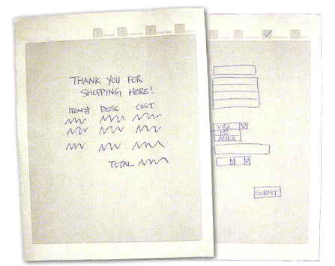
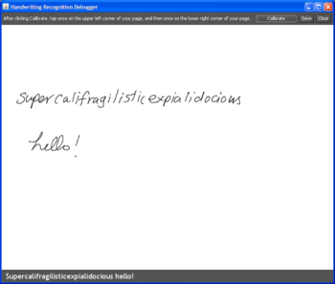

Class Deployment Overview
Introductory hci class at uc Berkeley
69 undergrads in 17 teams used it for 6 weeks
All Novices to Paper Applications
Paper UI Construction
Pen Input Handling
Swing GUI Integration
Also used at insitu lab Paris, TU Darmstadt, Universität Siegen, Stanford Semlab
Notes:
We introduced the toolkit to Java programmers, the 69 students in the introductory HCI class at UC Berkeley. All of these students were novices to Paper Applications, and many were novices to GUI programming as well.
To be clear, we provided the core parts of PaperToolkit … without any of the experimental interactions we were researching at the time. The core included the abstractions for constructing paper UIs, rendering PDFs for printing, handling pen input, displaying ink in Java Swing GUIs, and exporting Ink to XML and Images.
The 17 teams used it for 6 weeks to create working applications…

Slide 70
Questions for Class Deployment
Threshold Usability of Architecture & api
Walls Support a Variety of Designs
Ceiling Go Beyond What is Provided
Notes:
For this class deployment, We’d like to know whether the architecture and API are useful and memorable to novices… Does the toolkit support creativity; a wide variety of designs? Also, can any of these students go beyond what we provided?

Slide 71
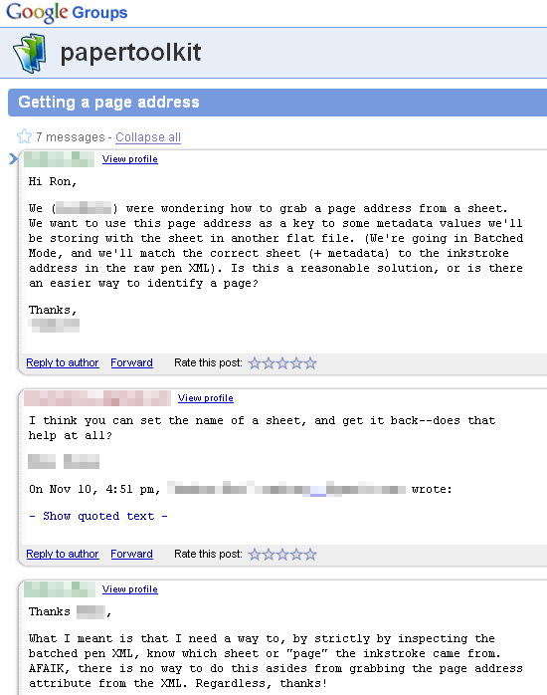
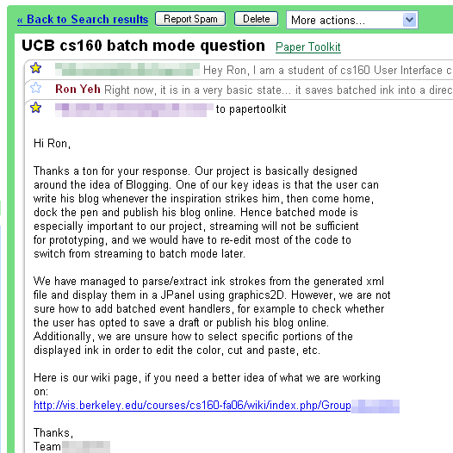
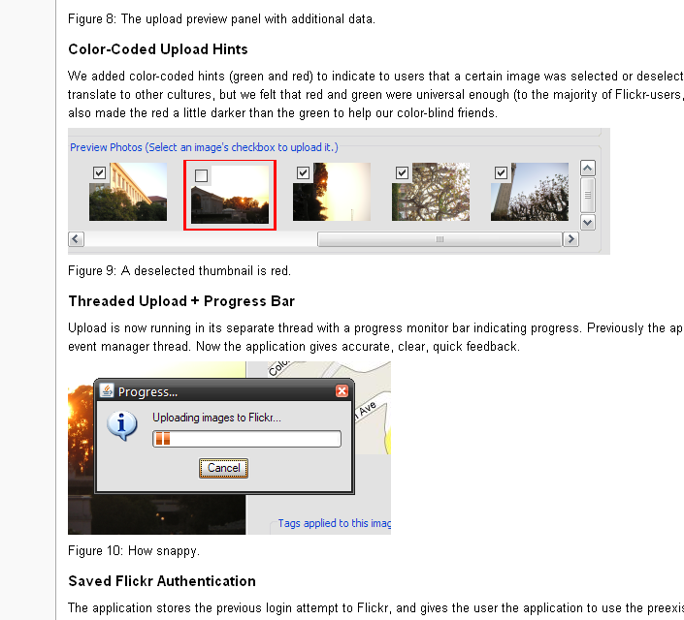
Data Collected
Newsgroup and Email Questions
Project Reports
Source Code of Projects
Notes:
To collect data on this experience, we monitored the newsgroup and provided email support. We also read their midterm and final reports to learn about how the toolkit was used. Finally, we collected the source code for all 17 projects.

Slide 72
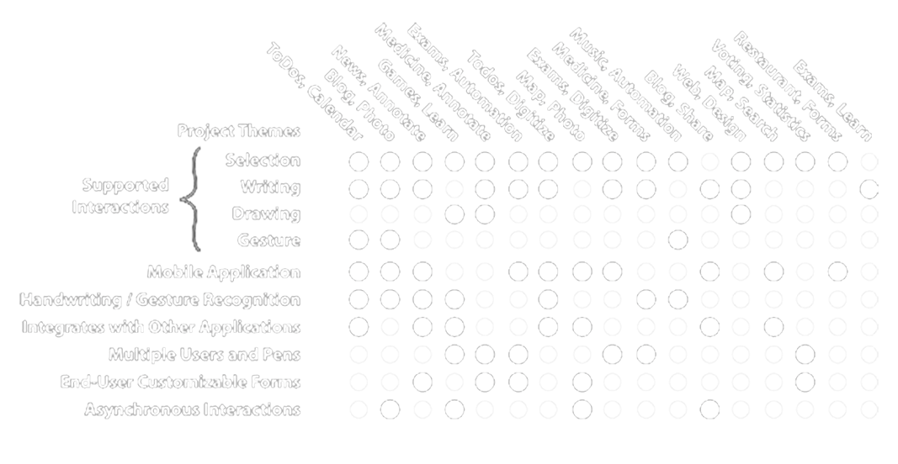
17 Projects
Notes:
We organized the results into a grid describing each project… such as the interactions they supported, and other tags of interest, such as whether they designed for multiple users.

Slide 73
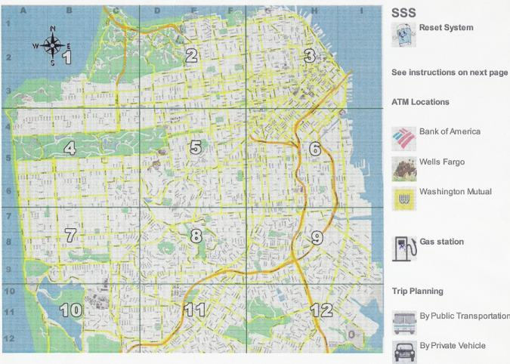
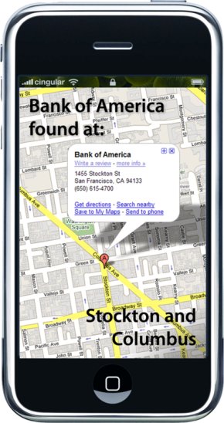
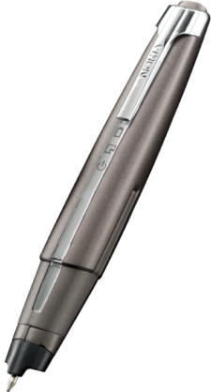
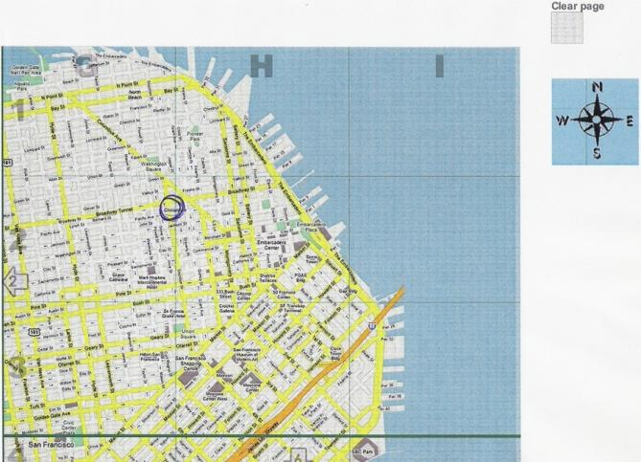

Location-Based Search
Selection
Notes:
The first is location based search. The user draws a circle to SELECT an area on a paper map. The gas station or ATM location is transported to his mobile phone.

Slide 74
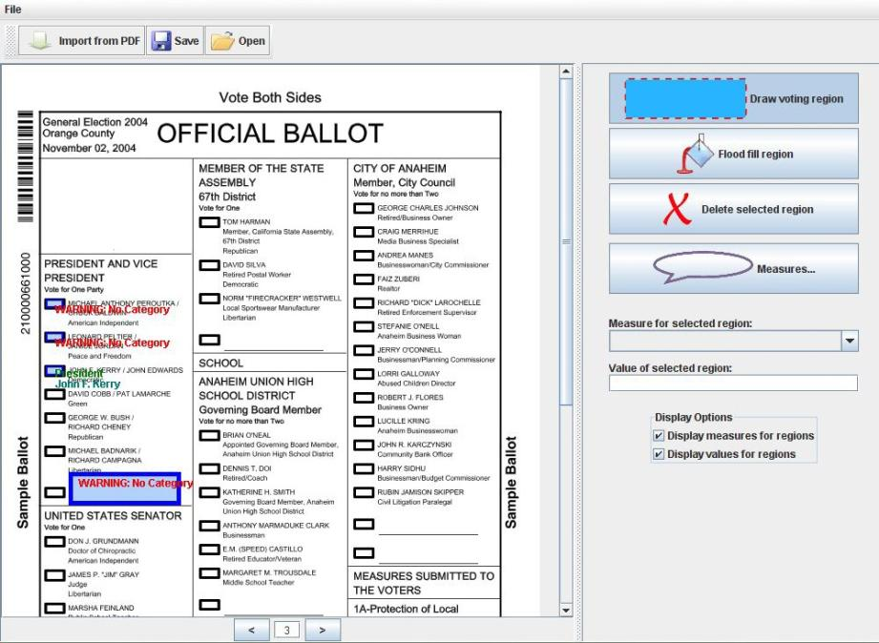
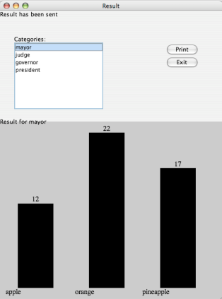
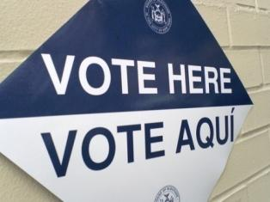
Automated Ballots
Multiple Users
Notes:
Automated Ballots. Voters tick the box next to the person they wish to elect. The votes are tallied immediately, but provide a paper backup.

Slide 75
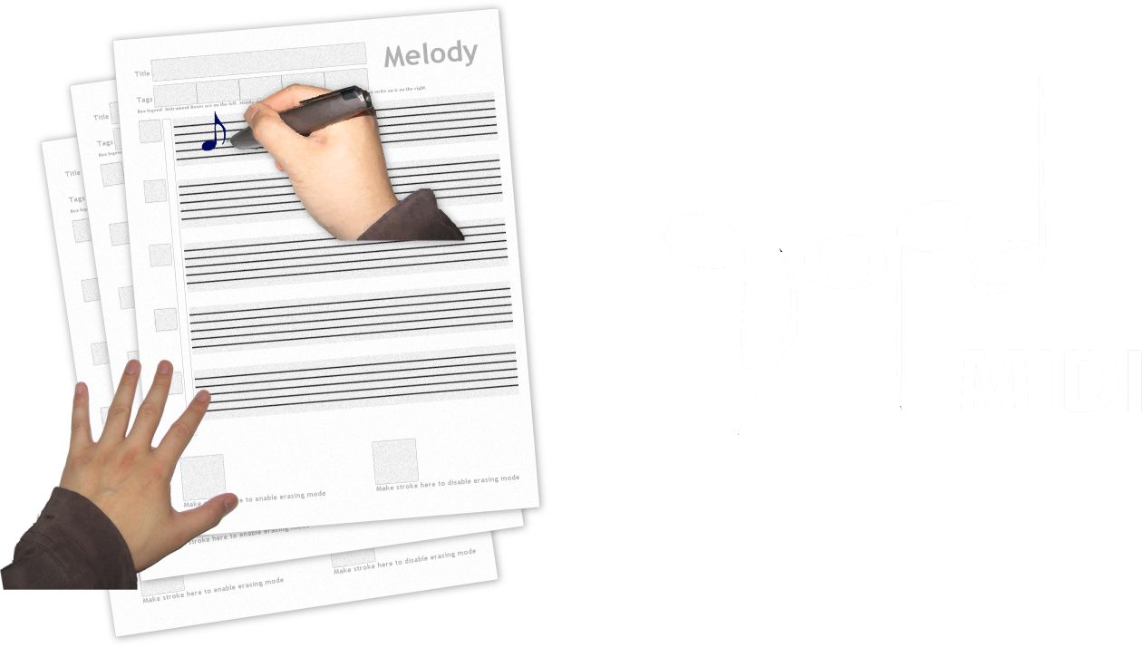
Music Composition
Gestures
Notes:
Finally, Music Composition. Users write musical notes on staff paper… This is translated automatically into a MIDI sound file.

Slide 76
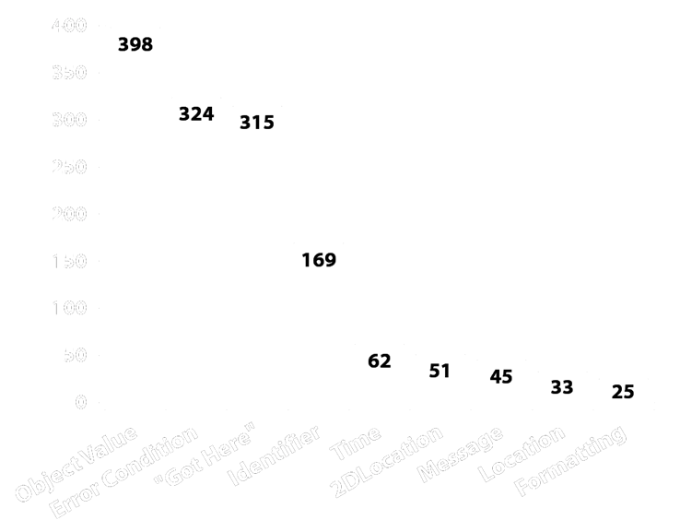
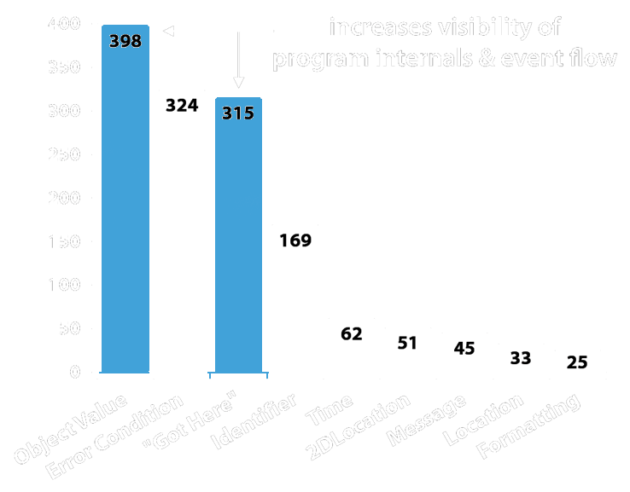
Visibility of System Internals
How did students debug their applications?
number of
print statements
what was printed
Notes:
A second observation was in how students debugged their applications.
We found that students used a tremendous number of print statements to visualize the object values in their system, and also when event handlers were fired.
In fact, the second blue bar shows the number of GOT HERE statements… which are print statements that provide no information other than the fact that a certain handler was fired.

Slide 77
Visibility of System Internals
Track Event Handlers
System.out.println("We get here!");
System.out.println("This is on MapRegion");
Make Internal Values Visible
System.out.println("animate() called: " + animInkIdx);
System.out.println("Photo taken: " + timeOfCapture);
Notes:
Here are a few examples… They printed out “We Get Here!” Or internal values of the application.

Slide 78
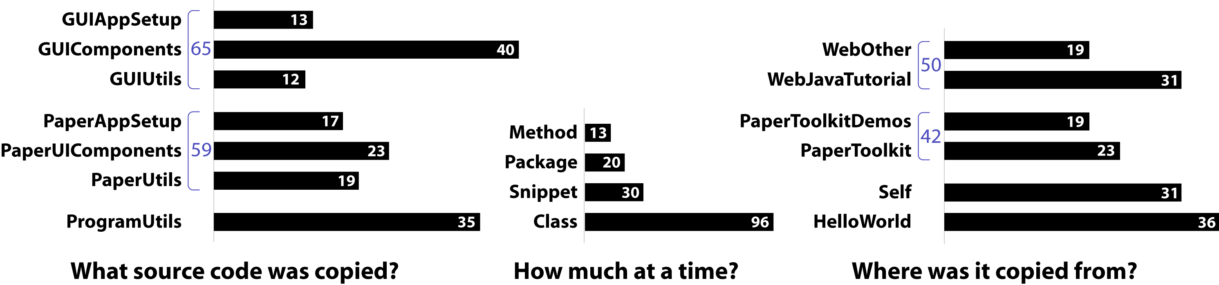

Slide 79
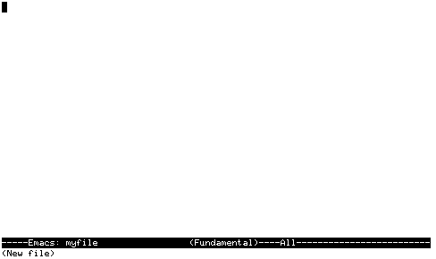
Notes:
If one looks at today’s design and development tool, there seems to be an implicit belief that software is designed tabula rasa. That we start with a blank canvas and create a bunch of code.
However, what we’ve seen both in our fieldwork and in our conversations with industry is that it’s much more common for software to be created by example modification. Find something on the web, in example files, or in the source tree that provides an example that’s “kind of like” what the developer is interested in.

Slide 80
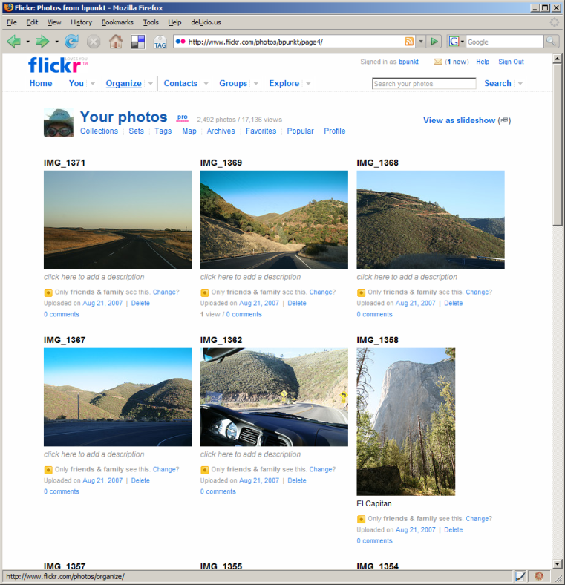
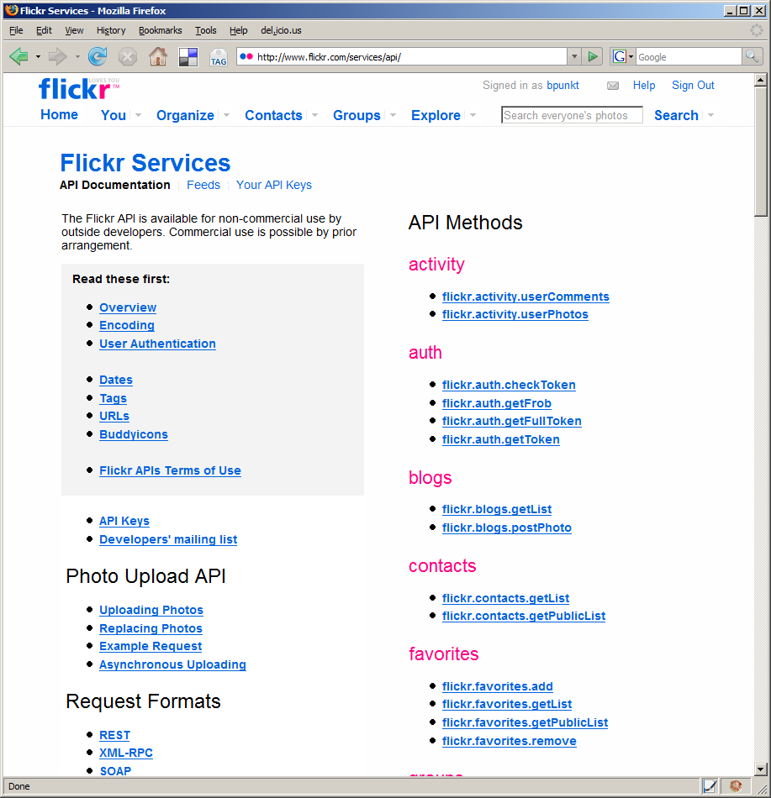
Web sites and their APIs are correlated…
≈
…let’s leverage that fact!
[flickr.com]
Notes:
To bridge this chasm, we note that web sites and their APIs are correlated.
For example, I can both look at the set of images taken on my last trip to Yosemite on the flickr website, AND I can retrieve the same set of images by calling an appropriate method in the flickr API.
The site and its API offer complementary views of the same underlying functionality.
In essence, the web site is the largest functional example of what can be accomplished with an API.
Our present work seeks to leverage the value that can be achieved by coordinating these representations.

Slide 81
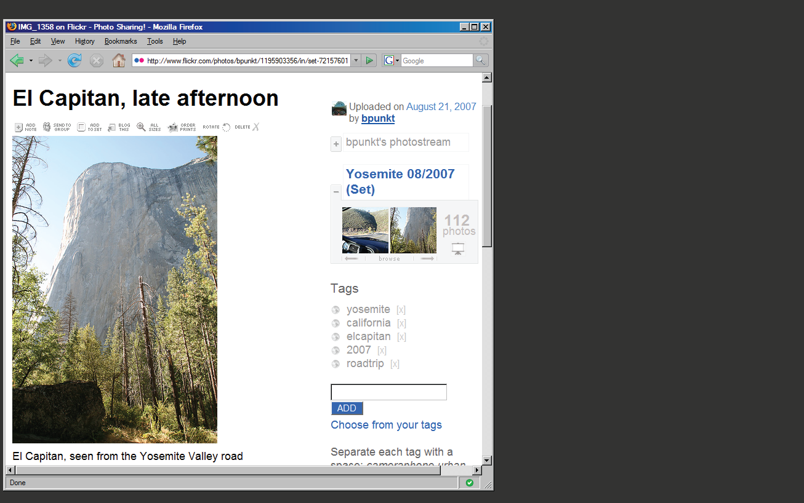
Notes:
Let me illustrate the process of creating a site-to-service map with a concrete example.
Here is a single photo page from flickr.com.

Slide 82
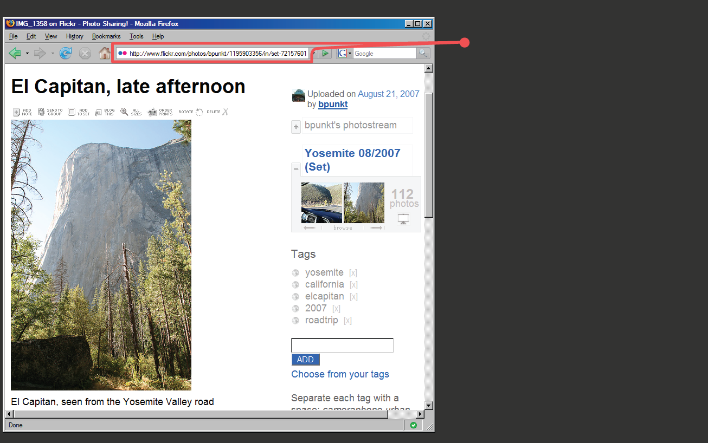
Page URL:
flickr.com/
photos/
<username>/
<photoid>/…
Regular Expression:
%r{flickr.com//?photos/
[^/]+/\d+/?&script}
Notes:
First, we note that photo pages have a consistent URL structure.
Thus, we can define a regular expression that detects similar photo pages,
And a set of expressions that furthermore classify pages into distinct page “types”.

Slide 83

Photo Title
Image URL
Tag Search
Notes:
Here are three items of interest: a photo’s title, the URL for an image, and a way to run a tag search (SPACE, SPACE)

Slide 84

Photo Title
(doc/"#title_div")
Image URL
(doc/"div.photoImgDiv")
Tag Search
(doc/"div.TagList")
Notes:
Each of these items can be accessed by searching the DOM, the document object model.
d.mix uses a combination of CSS and XPath selectors to identify elements, highlight them, and add a context-menu handler to each element.
For any given item on the page, there may be multiple matching web service calls that return that element. For example (SPACE), one can either sample “the first image in a photo set” or “this particular image”. d.mix generates multiple entries in the context menu to let the user guide the generalization process.

Slide 85
flickr.photos.getInfo(
photo_id = “298655528”).title
info = flickr.photos.getInfo(
photo_id = “298655528”)
URL = “http://farm”+ info.farm-id
+ “.static.flickr.com/”
+ info.server-id
+ “/” + info.attributes[”id”]
+ “_”
+ info.secret
+ “.jpg”
Extracted from page source:
Within <div> for all tags:
tag=div.at("a.Plain").inner_html
flickr.photos.search(
tags = “yosemite ...”)
Notes:
The site-to-service map then specifies how to connect each of these items to a source code snippet.
For example (SPACE) to perform a tag search, one needs to pass in the appropriate tag to a specific method. These arguments are also extracted using CSS and XPath selectors.

Slide 86


Active Wiki
Wiki editor provides syntax-highlighting for Ruby script
Sandboxed execution runs
script with limited capabilities
Libraries facilitate invoking
web services and
manipulating results
Notes:
After code is copied or appended to wiki pages, programs can be modified directly in the active wiki
(SPACE)
Programs are then run in a sandboxed execution model. For example, a program may make a web service call, but it does not have read/write access to the wiki server’s file system.
(SPACE)
The active wiki also provides libraries that faciliate calling web services and transforming the results.

Slide 87

d.mix Proxy Architecture
Rewritten page
with API annotations
Original Page
Proxy Server
Site-to-Service Map
(hosted on d.mix wiki)
Notes:
This diagram describes the d.mix architecture for sampling content from web pages.
d.mix uses a programmable HTTP proxy that rewrites the original web site, adding API annotations. Each API annotation contains an associated snippet of code that generates a working web service call in the Ruby programming language.
The programmable proxy knows how to annotate web pages by using the site-to-service map. (space) This map defines the correspondence between web sites and their associated web services.

Slide 88



Authoring the Site-to-Service Map
…Without Help From the Site Owner
1 Map URL to Page Type
2 Identify visual elements in page to annotate
3 Extract arguments for service calls from page source
Bind arguments to web service code snippet
API | Supported Actions | Site-to-Service map code size
 | Get images from a user’s photo stream, with or without meta data Get images from an image set Get images from individual photo pages Get images matching tags, global or per user, from tag clouds and photo pages Get images by global image id Get images from full-text search | 355 lines
 | Single web search result Web search result set | 54 lines
 | Retrieve a user’s videos Retrieve most recent videos Single search result Search result set | 115 lines
Notes:
How does a 3rd party developer author a site-to-service map? (space)
First, a developer maps web page URLs to web “page types”. (space)
For any given “page type”, a developer defines a combination of XPath and CSS selectors that identify the visual elements to be annotated (space)
They then define selectors that infer web service arguments given the markup on a page. (space)
Finally, these arguments are bound to a web service code snippet
Note that it is easier for site owners to provide this mapping, as they do not need to infer these relationships programmatically through scraping. We hope that in the future, site owners will provide such site-to-service mappings for the larger web developer community.
To evaluate the authoring approach embodied in d.mix, we wrote a prototype site-to-service library that supports three web sites and their services:
Flickr, Yahoo! web search, and the YouTube video site.
For each site, our library supports a subset of the API.
For example, the library provides methods to perform full-text and tag searches
and copy images from Flickr, but it does not support extraction of user profile information.

Slide 89

Beyond the Desktop Browser
Notes:
A proxy that can be programmed with code hosted on wiki pages is a flexible, general tool for prototyping web applications. For example, we have used the d.mix architecture to create an application that reformats web content to better fit mobile devices. It extracts only essential information — here, movie names and show times — from
a cluttered web page. This application took half an hour to build using the d.mix system.

Slide 90



d.mix users
Site owners or lead users define mappings between sites and services (once).
Lead Users
Web Developers
End Users
Notes:
There are several classes of users that work with d.mix.
First, lead users manually establish the correlation between sites and their services.
Alternatively, webmasters at sites such as Flickr, Yahoo, or Amazon.com could easily provide such mappings.

Slide 91
Web developers create d.mix applications
Lead Users
Web Developers
End Users
Notes:
After a small number of lead users author these mappings, many more web developers can create applications in d.mix and quickly prototype web-based mashups.

Slide 92
End-users run (and tailor) applications
in the d.mix wiki.
Lead Users
Web Developers
End Users
Notes:
Finally, end-users can run applications written in d.mix, by visiting them from any browser.
End-users can also tailor applications created in d.mix, by copy and pasting code from one d.mix wiki page to another.

Slide 93
Sharing Should be Built Into Tools
Acknowledge community of users (possibly with multiple roles?)
Right now we have separate tools for sharing (flickr, instructables) but no integration.
Koala is an example of going in this directions, as is Processing

Slide 94

Total lines of code | 54
Written by participant | 13
Generated by d.mix | 41
Generated lines modified by participant | 4
Notes:
SHORTEN
With this library, we then conducted a first-use evaluation study with eight participants, aged 25 to 46. (SPACE)
We recruited participants with some programming and web development experience,
but only half had programmed in Ruby before. (SPACE)Also, only half worked with web APIs before.
(SPACE) We first demonstrated d.mix’s interface to participants. Next, we gave them three tasks to perform.
The first task tested the overall usability of our approach:
participants were asked to find media files, send
content to the wiki, and change simple parameters of there, e.g., how many images to show from a
photo stream.
The second design task was similar to our scenario — it asked participants to create an information
dashboard for a magazine’s photography editor to track image submissions by photographers. This required
combining data from multiple users on the Flickr site and formatting the results.
This image is a solution one of our participants created. The exciting result here is that everyone successfully built web applications in a very short amount of time. (SPACE)

Slide 95


Lessons Learned
Offer multiple ways to sample information.
Sample from link to content
Sample content directly
Notes:
Some participants were also confused by two different approaches to sampling employed inconsistently:
For example, to specify a query for a set of Flickr images matching a specific tag, in d.mix, the user currently
must sample from the link to the image set, not the results.
However, to select images from a photo stream, the user must sample from the set of images itself, not the link. (SPACE)
This suggests that example-based programming tools for the web should consistently enable sampling from both the source and from the target page to support both interaction styles.

Slide 96
Different Target Users
Working with Designers, Scientists, Engineers as clients – different self-understanding of community; responsibility towards clients for consultants

Slide 97

Opportunistic Programmers
Experts at the
programming process
Start as novices with the
“right” tools for the job
Work with Joel Brandt, Philip Guo, and Joel Lewenstein
Notes:
Who are they?
-- Museum exhibit developers
-- Scientists who need to hook their mass spectrometer up to their gas chromatograph
-- Web 2.0 innovators
-- Tell 15 second story of del.icio.us founder – started out as a quick perl hack because that was the easiest way for Joshua Schachter (the founder) to share his bookmarks
-- ANYONE WHO PROTOTYPES (functional prototypes, that is)
What are some characteristics?
-- Learn the tools, languages, etc. as they go, picking them up opportunistically – whatever looks best for the problem at hand is what they’ll use
-- Often program by bricolage: combining many languages, each with different attributes amenable to the goal
-- The web is a great example here: HTML, CSS, PHP, JS, SQL all in one app!
But right now, programming tools are largely either for outright professionals who do one thing, or for outright novices.
How do we build tools that support the opportunistic programming process?

Slide 98

Lab Study
20 participants (11 undergrad, 4 masters, 5 Ph.D.)
Have “Basic knowledge” of PHP, JS, and HTML
Build an AJAX chatroom with PHP, JS, and MySQL in 2.5 hours
Allowed to use any external resources
Notes:
“any” external resources means they could download any code from the internet, use any books, etc. basically anything goes.

Slide 99
Chatroom Specifications
Set username
Post messages
AJAX updating
Messages have timestamp
Limited chat history
Notes:
Users should be able to set their username on the chat room page (application does not need to support account management)
Users should be able to post messages
The message list should update automatically without a complete page reload
Each message should be shown with the username of the poster and a timestamp
When the user first opens a page, they should see the last 10 messages sent in the chat room, and when the chat room updates, only the last 10 messages should be seen.

Slide 100
Self-Rated Competence
Javascript
Backend
AJAX
 |  |  |  |  |  |  |  |  |  |  |  |  |  |  |  |  |  |  |  |  |  |  |  |  |  |  |  |  |  |  |  |  |  |  | 
 |  |  |  |  |  |  |  |  |  |  |  |  |  |  |  |  |  |  |  |  |  |  |  |  |  |  |  |  |  |  |  |  |  |  | 
 |  |  |  |  |  |  |  |  |  |  |  |  |  |  |  |  |  |  |  |  |  |  |  |  |  |  |  |  |  |  |  |  |  |  | 
 |  |  |  |  |  |  |  |  |  |  |  |  |  |  |  |  |  |  |  |  |  |  |  |  |  |  |  |  |  |  |  |  |  |  | 
 |  |  |  |  |  |  |  |  |  |  |  |  |  |  |  |  |  |  |  |  |  |  |  |  |  |  |  |  |  |  |  |  |  |  | 
 |  |  |  |  |  |  |  |  |  |  |  |  |  |  |  |  |  |  |  |  |  |  |  |  |  |  |  |  |  |  |  |  |  |  | 
 |  |  |  |  |  |  |  |  |  |  |  |  |  |  |  |  |  |  |  |  |  |  |  |  |  |  |  |  |  |  |  |  |  |  | 
 |  |  |  |  |  |  |  |  |  |  |  |  |  |  |  |  |  |  |  |  |  |  |  |  |  |  |  |  |  |  |  |  |  |  | 
 |  |  |  |  |  |  |  |  |  |  |  |  |  |  |  |  |  |  |  |  |  |  |  |  |  |  |  |  |  |  |  | 
 |  |  |  |  |  |  |  |  |  |  |  |  |  |  |  |  |  |  |  |  |  |  |  |  |  |  |  |  |  |  |  |  |  |  | 
 |  |  |  |  |  |  |  |  |  |  |  |  |  |  |  |  |  |  |  |  |  |  |  |  |  |  |  |  |  |  |  |  |  |  | 
 |  |  |  |  |  |  |  |  |  |  |  |  |  |  |  |  |  |  |  |  |  |  |  |  |  |  |  |  |  |  | 
 |  |  |  |  |  |  |  |  |  |  |  |  |  |  |  |  |  |  |  |  |  |  |  |  |  |  |  |  |  |  |  |  |  |  | 
 |  |  |  |  |  |  |  |  |  |  |  |  |  |  |  |  |  |  |  |  |  |  |  |  |  |  |  |  |  |  |  |  |  |  | 
 |  |  |  |  |  |  |  |  |  |  |  |  |  |  |  |  |  |  |  |  |  |  |  |  |  |  |  |  |  |  | 
 |  |  |  |  |  |  |  |  |  |  |  |  |  |  |  |  |  |  |  |  |  |  |  |  |  |  |  |  |  |  |  |  |  |  | 
 |  |  |  |  |  |  |  |  |  |  |  |  |  |  |  |  |  |  |  |  |  |  |  |  |  |  |  |  |  |  |  |  |  |  | 
 |  |  |  |  |  |  |  |  |  |  |  |  |  |  |  |  |  |  |  |  |  |  |  |  |  |  |  |  |  |  |  |  |  |  | 
 |  |  |  |  |  |  |  |  |  |  |  |  |  |  |  |  |  |  |  |  |  |  |  |  |  |  |  |  |  |  |  |  |  |  | 
 |  |  |  |  |  |  |  |  |  |  |  |  |  |  |  |  |  |  |  |  |  |  |  |  |  |  |  |  |  |  |  |  |  |  | 
Notes:
In “backend”, unfilled circles mean that they claimed that competence level in a language OTHER than PHP, and claimed to not know PHP very well at all

Slide 101
post message
Self-Rated Competence
username
AJAX update
timestamp
history
Javascript
Backend
AJAX
 |  |  |  |  |  |  |  |  |  |  |  |  |  |  |  |  |  |  |  |  |  |  |  |  |  |  |  |  |  |  |  |  |  |  | 
 |  |  |  |  |  |  |  |  |  |  |  |  |  |  |  |  |  |  |  |  |  |  |  |  |  |  |  |  |  |  |  |  |  |  | 
 |  |  |  |  |  |  |  |  |  |  |  |  |  |  |  |  |  |  |  |  |  |  |  |  |  |  |  |  |  |  |  |  |  |  | 
 |  |  |  |  |  |  |  |  |  |  |  |  |  |  |  |  |  |  |  |  |  |  |  |  |  |  |  |  |  |  |  |  |  |  | 
 |  |  |  |  |  |  |  |  |  |  |  |  |  |  |  |  |  |  |  |  |  |  |  |  |  |  |  |  |  |  |  |  |  |  | 
 |  |  |  |  |  |  |  |  |  |  |  |  |  |  |  |  |  |  |  |  |  |  |  |  |  |  |  |  |  |  |  |  |  |  | 
 |  |  |  |  |  |  |  |  |  |  |  |  |  |  |  |  |  |  |  |  |  |  |  |  |  |  |  |  |  |  |  |  |  |  | 
 |  |  |  |  |  |  |  |  |  |  |  |  |  |  |  |  |  |  |  |  |  |  |  |  |  |  |  |  |  |  |  |  |  |  | 
 |  |  |  |  |  |  |  |  |  |  |  |  |  |  |  |  |  |  |  |  |  |  |  |  |  |  |  |  |  |  |  | 
 |  |  |  |  |  |  |  |  |  |  |  |  |  |  |  |  |  |  |  |  |  |  |  |  |  |  |  |  |  |  |  |  |  |  | 
 |  |  |  |  |  |  |  |  |  |  |  |  |  |  |  |  |  |  |  |  |  |  |  |  |  |  |  |  |  |  |  |  |  |  | 
 |  |  |  |  |  |  |  |  |  |  |  |  |  |  |  |  |  |  |  |  |  |  |  |  |  |  |  |  |  |  | 
 |  |  |  |  |  |  |  |  |  |  |  |  |  |  |  |  |  |  |  |  |  |  |  |  |  |  |  |  |  |  |  |  |  |  | 
 |  |  |  |  |  |  |  |  |  |  |  |  |  |  |  |  |  |  |  |  |  |  |  |  |  |  |  |  |  |  |  |  |  |  | 
 |  |  |  |  |  |  |  |  |  |  |  |  |  |  |  |  |  |  |  |  |  |  |  |  |  |  |  |  |  |  | 
 |  |  |  |  |  |  |  |  |  |  |  |  |  |  |  |  |  |  |  |  |  |  |  |  |  |  |  |  |  |  |  |  |  |  | 
 |  |  |  |  |  |  |  |  |  |  |  |  |  |  |  |  |  |  |  |  |  |  |  |  |  |  |  |  |  |  |  |  |  |  | 
 |  |  |  |  |  |  |  |  |  |  |  |  |  |  |  |  |  |  |  |  |  |  |  |  |  |  |  |  |  |  |  |  |  |  | 
 |  |  |  |  |  |  |  |  |  |  |  |  |  |  |  |  |  |  |  |  |  |  |  |  |  |  |  |  |  |  |  |  |  |  | 
 |  |  |  |  |  |  |  |  |  |  |  |  |  |  |  |  |  |  |  |  |  |  |  |  |  |  |  |  |  |  |  |  |  |  | 
Notes:
Here’s what they completed. Most everybody got most everything.
In the section on specifications completed, the unfilled circle means that the specification was almost met

Slide 102
post message
built from scratch
Self-Rated Competence
username
AJAX update
timestamp
history
Javascript
Backend
AJAX
 |  |  |  |  |  |  |  |  |  |  |  |  |  |  |  |  |  |  |  |  |  |  |  |  |  |  |  |  |  |  |  |  |  |  | 
 |  |  |  |  |  |  |  |  |  |  |  |  |  |  |  |  |  |  |  |  |  |  |  |  |  |  |  |  |  |  |  |  |  |  | 
 |  |  |  |  |  |  |  |  |  |  |  |  |  |  |  |  |  |  |  |  |  |  |  |  |  |  |  |  |  |  |  |  |  |  | 
 |  |  |  |  |  |  |  |  |  |  |  |  |  |  |  |  |  |  |  |  |  |  |  |  |  |  |  |  |  |  |  |  |  |  | 
 |  |  |  |  |  |  |  |  |  |  |  |  |  |  |  |  |  |  |  |  |  |  |  |  |  |  |  |  |  |  |  |  |  |  | 
 |  |  |  |  |  |  |  |  |  |  |  |  |  |  |  |  |  |  |  |  |  |  |  |  |  |  |  |  |  |  |  |  |  |  | 
 |  |  |  |  |  |  |  |  |  |  |  |  |  |  |  |  |  |  |  |  |  |  |  |  |  |  |  |  |  |  |  |  |  |  | 
 |  |  |  |  |  |  |  |  |  |  |  |  |  |  |  |  |  |  |  |  |  |  |  |  |  |  |  |  |  |  |  |  |  |  | 
 |  |  |  |  |  |  |  |  |  |  |  |  |  |  |  |  |  |  |  |  |  |  |  |  |  |  |  |  |  |  |  | 
 |  |  |  |  |  |  |  |  |  |  |  |  |  |  |  |  |  |  |  |  |  |  |  |  |  |  |  |  |  |  |  |  |  |  | 
 |  |  |  |  |  |  |  |  |  |  |  |  |  |  |  |  |  |  |  |  |  |  |  |  |  |  |  |  |  |  |  |  |  |  | 
 |  |  |  |  |  |  |  |  |  |  |  |  |  |  |  |  |  |  |  |  |  |  |  |  |  |  |  |  |  |  | 
 |  |  |  |  |  |  |  |  |  |  |  |  |  |  |  |  |  |  |  |  |  |  |  |  |  |  |  |  |  |  |  |  |  |  | 
 |  |  |  |  |  |  |  |  |  |  |  |  |  |  |  |  |  |  |  |  |  |  |  |  |  |  |  |  |  |  |  |  |  |  | 
 |  |  |  |  |  |  |  |  |  |  |  |  |  |  |  |  |  |  |  |  |  |  |  |  |  |  |  |  |  |  | 
 |  |  |  |  |  |  |  |  |  |  |  |  |  |  |  |  |  |  |  |  |  |  |  |  |  |  |  |  |  |  |  |  |  |  | 
 |  |  |  |  |  |  |  |  |  |  |  |  |  |  |  |  |  |  |  |  |  |  |  |  |  |  |  |  |  |  |  |  |  |  | 
 |  |  |  |  |  |  |  |  |  |  |  |  |  |  |  |  |  |  |  |  |  |  |  |  |  |  |  |  |  |  |  |  |  |  | 
 |  |  |  |  |  |  |  |  |  |  |  |  |  |  |  |  |  |  |  |  |  |  |  |  |  |  |  |  |  |  |  |  |  |  | 
 |  |  |  |  |  |  |  |  |  |  |  |  |  |  |  |  |  |  |  |  |  |  |  |  |  |  |  |  |  |  |  |  |  |  | 
Notes:
In the section on built from scratch, the unfilled circle means they made extensive use of libraries, but otherwise did not use large bodies of outside code
“I know that there are libraries, but I don’t understand at all how this AJAX stuff works, so I can’t use a library this time, I’m gonna do it from scratch.”

Slide 103

post message
built from scratch
Self-Rated Competence
username
AJAX update
timestamp
history
Javascript
Backend
AJAX
Frequency of Testing
 |  |  |  |  |  |  |  |  |  |  |  |  |  |  |  |  |  |  |  |  |  |  |  |  |  |  |  |  |  |  |  |  |  |  | 
 |  |  |  |  |  |  |  |  |  |  |  |  |  |  |  |  |  |  |  |  |  |  |  |  |  |  |  |  |  |  |  |  |  |  | 
 |  |  |  |  |  |  |  |  |  |  |  |  |  |  |  |  |  |  |  |  |  |  |  |  |  |  |  |  |  |  |  |  |  |  | 
 |  |  |  |  |  |  |  |  |  |  |  |  |  |  |  |  |  |  |  |  |  |  |  |  |  |  |  |  |  |  |  |  |  |  | 
 |  |  |  |  |  |  |  |  |  |  |  |  |  |  |  |  |  |  |  |  |  |  |  |  |  |  |  |  |  |  |  |  |  |  | 
 |  |  |  |  |  |  |  |  |  |  |  |  |  |  |  |  |  |  |  |  |  |  |  |  |  |  |  |  |  |  |  |  |  |  | 
 |  |  |  |  |  |  |  |  |  |  |  |  |  |  |  |  |  |  |  |  |  |  |  |  |  |  |  |  |  |  |  |  |  |  | 
 |  |  |  |  |  |  |  |  |  |  |  |  |  |  |  |  |  |  |  |  |  |  |  |  |  |  |  |  |  |  |  |  |  |  | 
 |  |  |  |  |  |  |  |  |  |  |  |  |  |  |  |  |  |  |  |  |  |  |  |  |  |  |  |  |  |  |  | 
 |  |  |  |  |  |  |  |  |  |  |  |  |  |  |  |  |  |  |  |  |  |  |  |  |  |  |  |  |  |  |  |  |  |  | 
 |  |  |  |  |  |  |  |  |  |  |  |  |  |  |  |  |  |  |  |  |  |  |  |  |  |  |  |  |  |  |  |  |  |  | 
 |  |  |  |  |  |  |  |  |  |  |  |  |  |  |  |  |  |  |  |  |  |  |  |  |  |  |  |  |  |  | 
 |  |  |  |  |  |  |  |  |  |  |  |  |  |  |  |  |  |  |  |  |  |  |  |  |  |  |  |  |  |  |  |  |  |  | 
 |  |  |  |  |  |  |  |  |  |  |  |  |  |  |  |  |  |  |  |  |  |  |  |  |  |  |  |  |  |  |  |  |  |  | 
 |  |  |  |  |  |  |  |  |  |  |  |  |  |  |  |  |  |  |  |  |  |  |  |  |  |  |  |  |  |  | 
 |  |  |  |  |  |  |  |  |  |  |  |  |  |  |  |  |  |  |  |  |  |  |  |  |  |  |  |  |  |  |  |  |  |  | 
 |  |  |  |  |  |  |  |  |  |  |  |  |  |  |  |  |  |  |  |  |  |  |  |  |  |  |  |  |  |  |  |  |  |  | 
 |  |  |  |  |  |  |  |  |  |  |  |  |  |  |  |  |  |  |  |  |  |  |  |  |  |  |  |  |  |  |  |  |  |  | 
 |  |  |  |  |  |  |  |  |  |  |  |  |  |  |  |  |  |  |  |  |  |  |  |  |  |  |  |  |  |  |  |  |  |  | 
 |  |  |  |  |  |  |  |  |  |  |  |  |  |  |  |  |  |  |  |  |  |  |  |  |  |  |  |  |  |  |  |  |  |  | 
Time between successive tests:
< 30 seconds
30 seconds – 1 minute
1 minute – 2 minutes
2 minutes – 5 minutes
5 minutes – 10 minutes
> 10 minutes
Notes:
Did a bunch of analysis of the apache logs – the web server they were running.
Looked at how frequently they were iterating on testing.
Scale is logarithmic.
Most people, for most of their testing, were iterating on the <30second scale.
Graph is normalized.
Desire to work at a rule-based level rather than a knowledge-based level encourages both copy-and-paste and fast test iterations.

Slide 104
It is difficult to build up the mental models necessary to successful leveraging large bodies of existing code

Slide 105
Mental Models
“A text processor is a typewriter”
“The models that learners spontaneously form are incomplete, inconsistent, unstable in time, and often rife with superstition” – Olson and Carroll
Notes:
Consider the above metaphor model that someone might hold. It’s been found that the aspects of a system that match the metaphor are learned quickly, but those that don’t take a lot longer.

Slide 106

Notorious Example

Slide 107
The art in design…
…is to translate users cognitive capabilities and existing mental models into interfaces that work!

Slide 108

Example (good)
Mercedes S500 Car Seat Controller
Source: http://www.lilviv.com/motoring/cars/s500/seatcont.jpg

Slide 109


Slide 110
Programmers forage for code
Notes:
- people hesitant to trust code at first, want confirmation that it is safe
- once they find a source for code (a website) that seems trustworthy, they stick with it
- have much more faith in their own code than code on the internet
Observation: the first thing _everyone_ does when they get to a webpage they believe will be helpful is scroll _very_ quickly through it to see if a. it provides example code, and b. if that example code is well delineated from the prose

Slide 111


₁₀⁷ (months) SOCIAL Social Behavior
₁₀⁶ _{(weeks)}
₁₀⁵ _{(days)}
₁₀⁴ (hours) RATIONAL Adaptive Behavior
₁₀³
₁₀² _{(minutes)}
₁₀¹ _{COGNITIVE Immediate Behavior}
₁₀⁰ _{(seconds)}
₁₀⁻¹
₁₀⁻² _{BIOLOGICAL}
₁₀⁻³ _{(msec)}
₁₀⁻⁴
_{Meg}
_{Stewart}

Slide 112

SENSE MAKING TASKS
Characteristics
  Massive amounts of data
  Ill-structured task
  Organization, interpretation, insight needed
  Output, decision, solution required
Examples
  Understanding a health problem and making a medical decision
  Buying a new laptop
  Weather forecasting
  Producing an intelligence report

Slide 113

OPTIMALITY THEORY
_{Optimal Foraging Theory}
_{Information Foraging Theory}
_{Energy}
_{Information}
[
]
[
]
_{Energy}
_{Time}
_{Useful info}
_{Time}
_{Max}
_{Max}

Slide 114
We’ll stay in a patch longer…
When a patch is highly profitable
As distance between patches increases
When the environment as a whole is less profitable

Slide 115

WITHIN-PATCH ENRICHMENT:
INFORMATION SCENT
perception of value and cost of a path to a source based on proximal cues

Slide 116


Slide 117




Typical Design Task Interface
Notes:
This is a screenshot of a basic WYSIWYG web page builder. Users can edit the page contents by hand.
Oftentimes in designing a web page, a user will consult examples of other web pages.
Finding a good example web page is not a straightforward process.
One way is to use Google.
Find a random homepage.
Keep looking until you find one you like, and copy it.

Slide 118

Example-Augmented Interface
Notes:
What if a web page builder had a built-in space for examples? Users could browse inspirational items directly in the tool itself.
The central research question here is: How can we automatically find and display an interesting subset of available materials?

Slide 119




Adaptive Ideas
Web page builder with automatic display of example web pages
Distance functions over design facets
Subset selection algorithms
[Lee, Srivastava, Klemmer, Brafman, in submission]
Notes:
To investigate proactive display of examples in a concrete system, we developed Adaptive Ideas.
Adaptive Ideas is a web page builder which augments a traditional editor with automatic display of example web pages.
It uses facet-based distance functions and selection algorithms in order to find interesting sets of examples to display.
I will first outline the architecture of our implementation, and then describe a laboratory study of the tool in action.
---------------
Previous work has tried simple heuristics (flagged importance (*), recency) [Hsieh 2006]; we’re interested in other ways that facets can enhance this process
It’s not necessarily beneficial to just bombard users with examples, but we hope to select items in such a way that the examples chosen are meaningful and useful to the task at hand.

Slide 120
Content & Attributes
Content drawn from corpus of example design resources
Content elements have attributes (facets)
In this work, we focus on visual properties as attributes
  Background color, text color
  Font face
  Density of visual elements
Notes:
Content elements have attributes, which are facets.
In this work, we focus on visual properties
Concrete properties such as color and font
Abstract properties such as the density of visual elements on the page
--------------
Auto-generated (e.g., timestamps)
User-generated (e.g., tags)
Visual properties
Aesthetic

Slide 121
Similarity
121
Notes:
Find a subset of n elements most similar to a given element for a given design attribute axis or axes
Select n elements that are closest (least distant) from given element
Similar concept: relevance algorithms
(search, etc.)

Slide 122
Variety (naïve)
122
Notes:
An naïve variety algorithm that chooses randomly would contain mostly (whatever the cluster above is).
----------
(tries to represent the distribution of the dataset)

Slide 123
Variety (spaced)
ε
123
Notes:
In the “spaced stochastic” approach, the system picks a random example from the dataset as a starting point. Next, a random example is selected from the remaining elements in the dataset which are at least ε distance away from all of the elements selected thus far, where ε is a spacing function defined on a per-attribute basis.
The choice of ε has significant influence on the behavior of the spaced stochastic algorithm. When ε is zero or small relative to the design space, this algorithm degenerates to the completely random case (previous slide). As ε gets larger relative to the space, the algorithm has fewer elements from which to choose, and thus risks not filling up the space. We select a large ε, such that the theoretical maximum number of elements chosen is close to n.
This variety of possible values may be more desirable, allowing users to see the full design space. On the other hand, such an algorithm may emphasize outliers or unusual points in the design space.

Slide 124

Adaptive Ideas Architecture
124
Notes:
Here is the architecture of our implementation of the Adaptive Ideas approach.
Takes information as inputs:
User focus/current task
Content elements (corpus of data)
Interactive elements
Valuation functions
Fed into an interface generator
Example Subset Manager perform a subset selection
Interface generator performs an optimization-based search (2d knapsack)
Interfaces generable in user-interactive timeframes
Generates HTML specification, output is web page

Slide 125

Example-Based Web Page Builder
wysiwyg web
page editor
Example in focus
Browse for similar items, or variety
Examples
Notes:
To evaluate the usefulness of the approach, we constructed an example-augmented tool for a concrete design task: building a web page.
Three parts:
Web editor area
Users are initially presented with a variety of items to emphasize the design space
Can choose to browse items similar to the focus item by selecting a design feature

Slide 126


Example-Based Web Page Builder
Cut-and-paste
feature reuse

Slide 127
Comparative Lab Study
study methods (1 of 2)
Comparative laboratory study (n=9)
Two conditions: Adaptive browsing vs.
random subset of examples
  “Random” selection of examples models the finding-examples-via-Google approach
Notes:
To assess the usefulness of the approach, we conducted a comparative lab study.
We invite 9 people…

Slide 128


Design for Persona
study methods (2 of 2)
128
Notes:
Participants

Slide 129

Examples are Helpful
study results (1 of 4)
Proactive example display (μ=4.5, σ=0.53) and variety browsing tool (μ=4.4, σ=1.01) were helpful in finding desirable examples

Slide 130
Adaptive > Random
study results (2 of 4)
Participants found variety and similarity tools easier to navigate than random display (μ=3.7, σ=1.22)

Slide 131
Novices vs. Experts
study results (3 of 4)
Novices particularly appreciated having examples integrated into design tool
(display μ=4.7, σ=0.49, variety μ=4.8, σ=0.38)
Notes:
Averages for both of these was higher than overall average

Slide 132
Novices vs. Experts
study results (3 of 4)
Expert opinions were mixed
  Augmentation distracted from task at hand by adding to screen clutter, wasting screen space
  Augmentation aided building strategy by proactively offering examples and searches organized along relevant design axes
Requests for ability to sort along aesthetic or social attributes (e.g., fun vs. academic)
Notes:
Two self-rated experts gave distinctly different opinions of example-augmented browsing.
One expert did not like the use of examples in general.
The other expert felt that the example-aug browser aided their building strategy
This expert and other participants requested the ability to sort and browse along other axes…
--------------
DO WE HAVE WRITTEN ANECDOTES FOR THIS???

Slide 133
Efficient Browsing
study results (4 of 4)
Participants browsed 50.6% less when browsing with “spaced stochastic” variety
(95.8 vs. 194 images viewed, on average)
Theory: variety- and similarity-based browsing allows designers to more efficiently form “mental model” of design space
Notes:
Quantitative result:
(Observations and server logs) participants browsed 50.6% fewer items when using the Adaptive Ideas system.
Avg 194 vs. 95.8

Slide 134
Study Conclusions
Augmenting tools with examples is a promising technique for providing information and inspiration in design
Proactive presentation and facet-oriented browsing of examples can aid designers by facilitating discovery and exploration of design alternatives
Notes:
We believe that, done intelligently, augmenting tools with examples is a promising technique…
Proactive pres and agile browsing of examples aids the discovery and exploration of design alternatives.

Slide 135
Evaluation: Science and HCI Research
Lab studies, field work, longitudinal deployment: What do they tell you? What don’t they tell you? Outline challenges + opportunities for each.

Slide 136
Future Directions
More on integrating phys+digital? OR:
Moving forward, focus on the web? (Ronny Kohavi example?)

Slide 137
Relationship between Research and Teaching
Deploying research projects as class tools:
  D.tools worked well (in what respects? From which perspective? Of researcher, student, …)?
  Other projects more challenging (lots of work, what do you get in return?)

Slide 138
HCI Education at Stanford
What’s up with the d.school?
How we run courses – successes & failures
Bill Verplank’s framework
Tutorials

Slide 139

Create a Good Conclusion Slide
Notes:
Mobile and Ubiquitous computing is likely to be dominated by many small applications. To enable this, we need design tools that democratize application creation. To pull this off, one needs to lower the threshold. Doing this requires an attention to how computation is represented.
* State structure can be authored and presented as storyboards
* Sensor input -- and other actions that are difficult to specify symbolically -- can be handled through demonstration
* Finding an effective example is often easier than writing this from scratch -- we can leverage this as a paradigm for software creation!

Slide 140

UC Berkeley
IDEO
Intel
Leapfrog
NASA Ames
Nokia
PARC
SAP
Art
Biology
Education
Comp. Sci.
Mech. Eng.
Notes:
One thing that we're very committed to is learning from how our tools are used in the wild. External organizations that are currently using our tools include ... Within Stanford, our tools are currently being used in ... We’ve found there to be three types of usage and collaboration with these folks
- Lead users and platforms for research (art, biology, external organizations). Both as fieldwork sites, and as depolyment sites. Longitudinal rah rah. (Pull from HCIJ paper?). And because this is open source and the software is available on the web, there are likely many more users than we're aware of. For example, my student Ron Yeh got an email from Germany last week asking a really technical question about the bowels of his toolkit -- who knew!
- Teaching (CS, ME)
- Disciplinary Knowledge (Within CS, in the database group and with Phil Levis on sensor networks -- and externally in Education, ME, and MS&E. Helping with fieldwork and longitudinal evaluation.) In some cases, these organizations have given back to us by strengthening thte quality of our tools. LeapFrog, for example, has a richer infrastructure for board fabrication than my group has, and so they donated their time to improve the d.tools board designs, and fabricated a set of boards for our use in teaching and research
d.Tools for everything from children’s toys to medical devices. ButterflyNet has been to Alaska Toolik Field Station, Death Valley, England, Australia, Ghana.

Slide 141

Leith Abdulla
Michael Bernstein
Joel Brandt
Brandon Burr
Scott Carter
Kevin Collins
Jennifer Gee
François Guimbretière
Bjoern Hartmann
Wendy Ju
Boyko Kakaradov
Brian Lee
Chunyuan Liao
Heidy Maldonado
Jennifer Mankoff
Tara Matthews
Manas Mittal
Avi Robinson-Mosher
Andreas Paepcke
Roy Pea
Jeannie Stamberger
Leila Takayama
Leslie Wu
Ron Yeh
Notes:
And of course, the research that I shared today isn't mine alone or even mine mostly. This is an image of much of my group at my house after we went rock climbing at the end of last summer. I'm fortunate to work with a truly fantastic group of graduate and undergraduate students. I'd like to thank all of my collaborators on this work, whose names are listed here. And while I think we're all aware of the strength of PhD students, I'd in particular like to point out the contributions of the undergraduates. Thanks to the efforts of Daphne Koller and others, Stanford is building up an excellent tradition of undergraduate research, and undergraduate alumni of my group are now pursuing graduate careers at MIT, Berkeley, CMU, and many other top schools.

Slide 142
http://hci.stanford.edu
Notes:
For more information on d.tools, please visit our web site. Thank you.

