Slide 1
Enlightened
Trial & Error
Björn Hartmann
University of Pennsylvania
25 February 2007
Notes:
Let me start with a bit of personal history that’ll illuminate how I ended up working in human computer interaction.

Slide 2
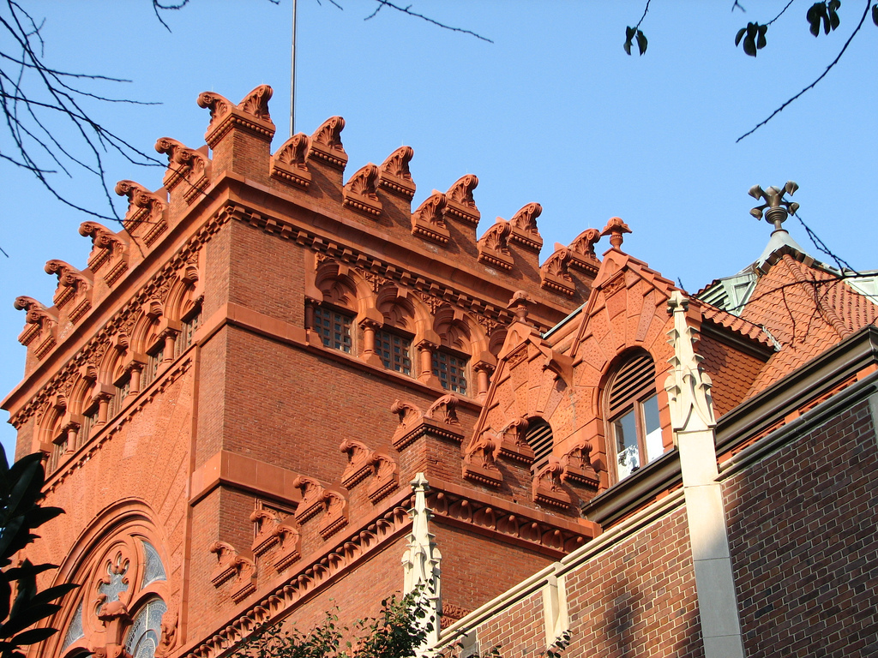
[Flickr photo (cc) chrisinphilly]
Notes:
I came to Penn in 1997 fresh out of high school and started out as a Communications major. After my freshman year I transferred into this brand new program called Digital Media Design that was just starting then. Things may have been a bit chaotic at the beginning as we figured how this new program would work, but I liked it so much that I staid on an extra year and a half to do a master’s program. Of course there was no Computer Graphics & Game Technology program around so I enrolled in Computer and Information Science. This allowed to keep working with Amy, Norm, the DMD students and the folks at HMS and dip my toes into research on the simulation of virtual humans.

Slide 3

Notes:
My real passion outside school was electronic music and in 2000, while still at Penn, I started a record label called Tuning Spork.
As graduation drew close, after 5.5 years in school, I felt it was time for a change.

Slide 4
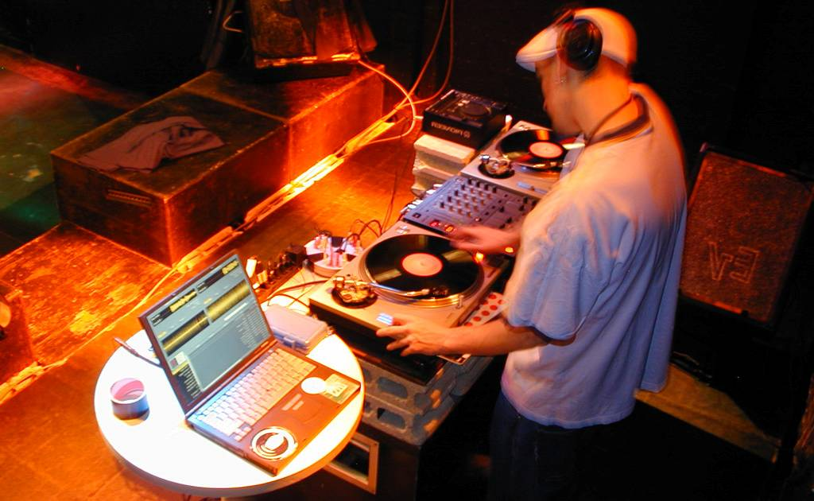
Notes:
So after graduation, I became a full time musician, record label manager, and touring DJ. One thing that struck me about my experience as a musician was the the really different role that computation and electronics played in my musical work as opposed to my prior academic life. This a shot I took on tour in a club in Japan. You can see my label partner behind the equipment of choice of professional DJs worldwide: Two Technics turntables a multi-channel Mixer. The turntables and mixer are in essence the user interface for DJs. So what is the laptop doing in the picture? It is running Final Scratch, a software that allows a DJ to work with MP3 files through traditional turntables by using special records that contain a timecode, which is then analyzed to control playback of digital files.
So while my course work had focused on 3D graphics and virtual reality – this was my first brush with what Mark Weiser dubbed embodied virtuality – where computation moves out of its traditional gray box and starts to become more closely integrated with objects in the real world. This was fascinating stuff! So when I reapplied to graduate school, I decided to learn more about tangible interfaces, ubiquitous computing, and human computer interaction.

Slide 5
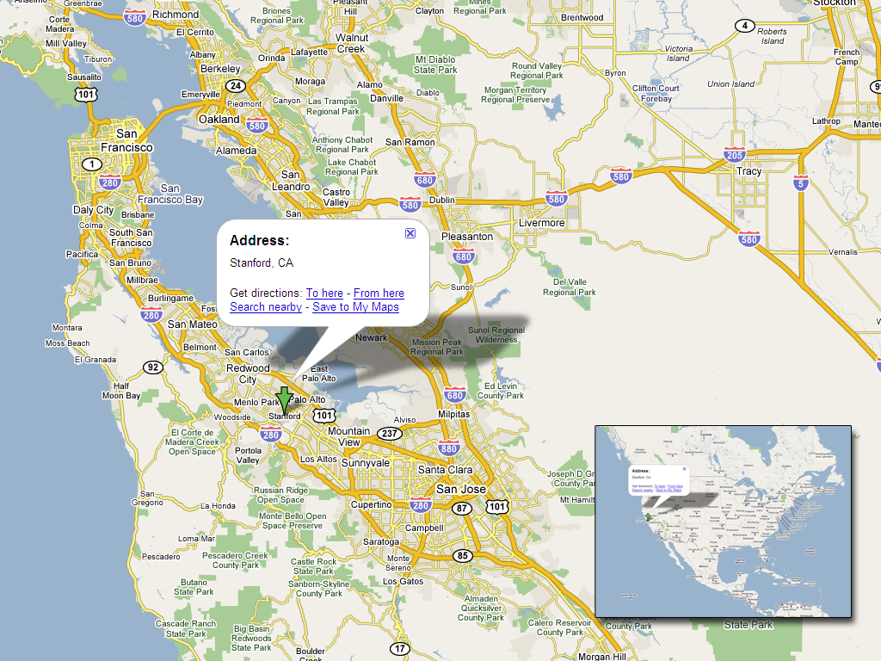
Notes:
My journey brought me to Stanford, which sits right between Silicon Valley to the south and San Francisco in northern California.

Slide 6
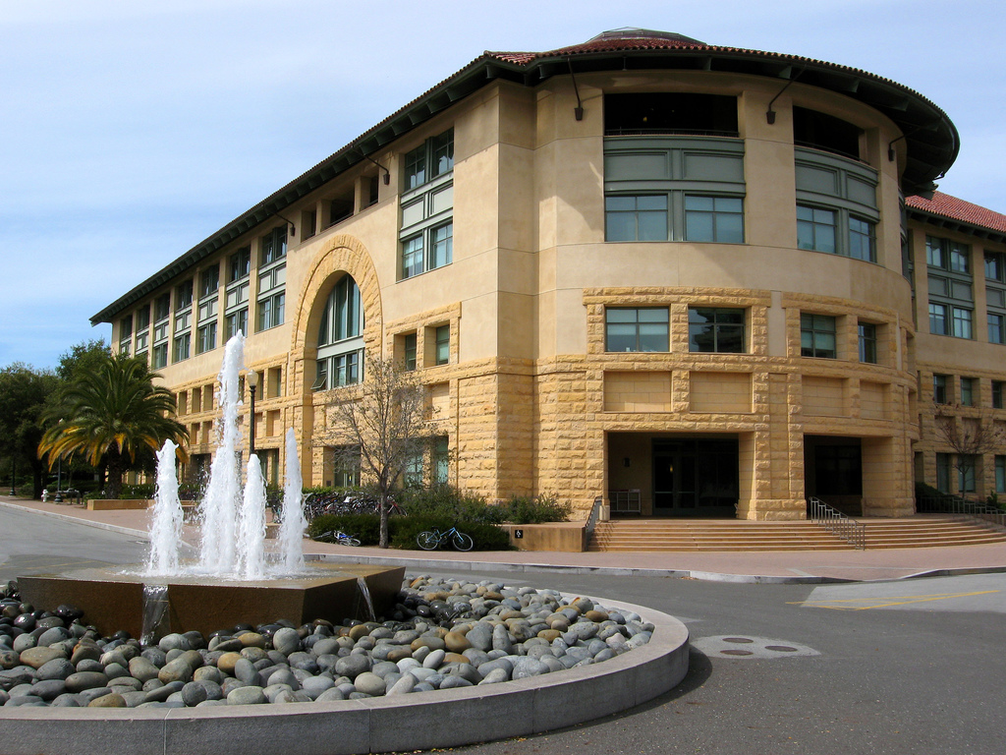
Stanford
Computer Science
[Photo by Adam Barth]
Notes:
More precisely, I ended up in the William Gates building where Human Computer Interaction is a research group within the Computer Science department.
Broadly, HCI research is the study of the user experience of information technology. Or, to put it a bit more formally, it’s the design and evaluation of information technologies where the goal is user experience based. <click>
You can think of doing HCI research as doing Computer Science research with a different set of metrics: Where in many areas of computer science success is measured on system properties – execution speed, algorithm complexity, security - in HCI success is measured along user experience metrics. But the work of building and evaluating is similar in structure to computer systems research, and the skills required to conceive of and implement significant working systems is also analogous.

Slide 7
Computer Science
Design
Applied Psychology
Notes:
So what does our field bring to the table intellectually?
Beyond computer science, the academic traditions that HCI is embedded in include Design and Applied Psychology.
These multiple strands sometimes proceeding in parallel, and sometimes cross-fertilize each other.

Slide 8
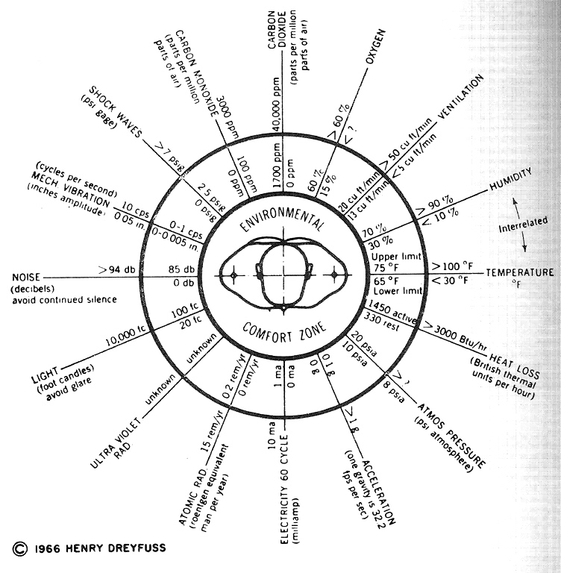
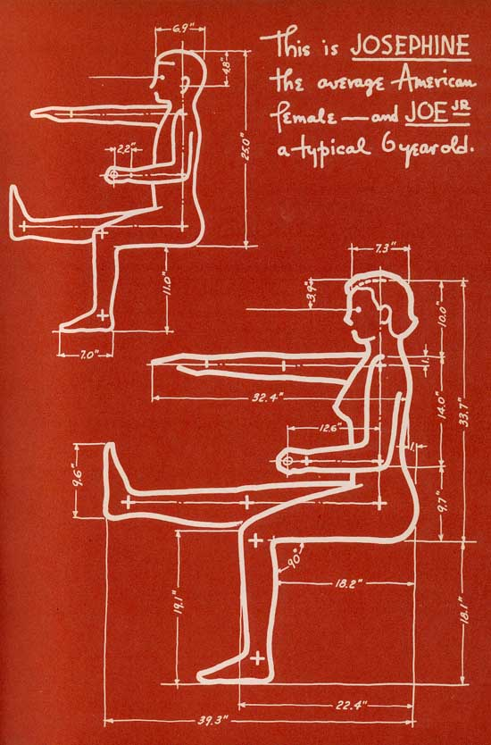
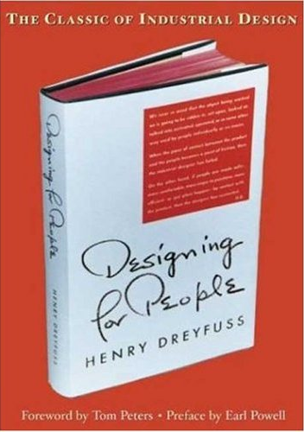
Notes:
The field of design contributes a focus on, and empathy for the human user. This human factors focus is maybe best exemplified by the work of industrial designer Henry Dreyfuss and his statistical models of Joe and Josephine developed in the 1960s. <click>These models allowed Dreyfuss to make his products fit the human form and human capabilities. If you are interested in the history of Industrial Design, I recommend the re-released version of his book “Designing for People.”

Slide 9
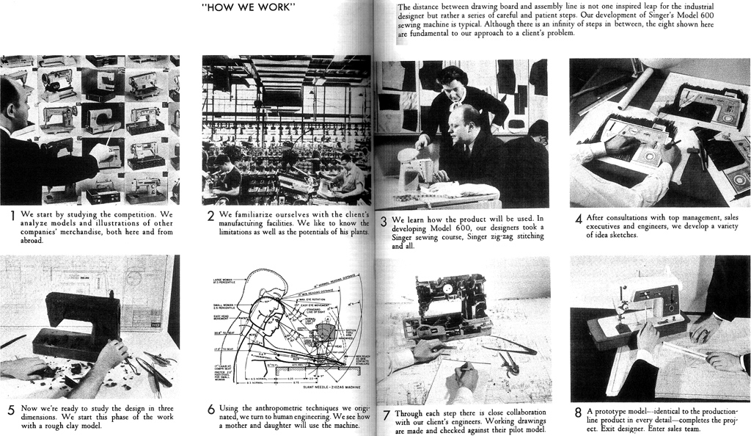
Henry Dreyfuss
Notes:
Second is a focus on process – how we go about creating new artifacts in a way that maximizes the utility and success of those artifacts. Dreyfuss outlined one such process, based on observation and fieldwork, followed by development of many sketches and prototypes, which are tested, analyzed, and iteratively improved. While there are many other design methods, they all seem to share a core tenet:

Slide 10
Design Cycle
Design
Evaluate
Prototype
Notes:
That design is something that happens iteratively, in cycles. One cannot solve a design problem by thinking hard about it. Of course applying your smarts is a prerequisite, but so is creating concrete artifacts that embody your ideas, testing them with real people, and letting the feedback drive the next iteration.

Slide 11
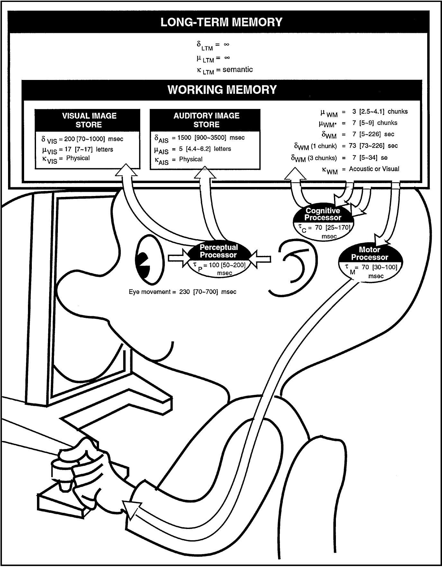
Notes:
Next to design, Applied psychology provides experimental methods for rigorous evaluation of user experience claims. It also contributes theoretical models of human cognition and information processing that can predict task performance for some classes of tasks, like information foraging on the web.

Slide 12
HCI at Stanford
CS147: Introduction to HCI (~100 Students)
CS247: Interaction Design Studio (~50 Students)
CS376: HCI Research (~30 Students)
CS547: Weekly Seminar (televised)
Topic courses (phenomenology, mobile interaction, computer vision for HCI, …)
Qualitative methods
(Management Science)
Quantitative methods
(Psychology, Communication)
Design Thinking
(d.school – Institute of Design)
Perception, Cognition
(Psychology)
Electrical, Mechanical Engineering, Art
Notes:
This multi-disciplinary heritage is reflected in the courses an HCI student will take at Stanford.
While there is no HCI major (yet), there are undergraduate and graduate concentrations in HCI. In each case, students will go through a series of core courses:
The first course is a broad introduction to HCI concepts - Usability and affordances, direct manipulation, conceptual models, interface metaphors, human cognitive and physical ergonomics, design tools and environments.
The follow-up Interaction Design Studio course uses a series of projects to provide an environment for experiential learning, covering needs analysis, user observation, idea sketching, concept generation, scenario building, storyboards, and usability analysis
Research Topics in HCI is a graduate-level introduction to based on reading and critique of seminal papers in the field.
A weekly speaker series, the HCI Seminar is available freely on line, and is watched by a large number of people outside of Stanford. Over the past 15 years more than 400 speakers have participated.
This core of courses is then supplemented by many offerings in other departments such as Psychology, Communication, and the Institute of Design at Stanford.

Slide 13
HCI Research Areas
(Desktop Interaction Techniques)
Web
  Human-Information Interaction
  Computer Supported Cooperative Work
Ubiquitous computing
  Tangible & Haptic Interaction
  Multi-touch, multi-user Interfaces
  Mobile & location-aware Applications
Notes:
Once you move beyond coursework and into research, there are a couple of areas of particular interest to the community right now.
Interaction techniques for graphical user interfaces used to be a large focus of the field, but this area is fairly well mined and software and input devices have largely ossified on the desktop.
However, for software that leverages the web, this is not true. Human-information interaction is the study of how people search and navigate for information. Computer supported cooperative work studies how people can collaborate on tasks, for example through simultaneous document editing or other shared environments.
Ubiquitous computing looks at the shift in user experience when computation moves off the desktop and into your pocket, or into smart spaces and smart objects. With new form factors come new possibilities for interaction, such as tangible interfaces, active haptic feedback, and multi-touch devices. Different form factors also open entirely different contexts of use – the tasks you perform on a smart phone are simply different form the tasks you perform on your desktop.

Slide 14
Design Tools
(making things for making things)
Notes:
If you have questions about HCI in general and HCI teaching at Stanford, I’d be happy to answer those at the end of the talk.
I’d like to transition now to the particular research that I have been undertaking as part of my PhD.
<click>
Broadly, I am interested in design tools <click> – hardware and software that can facilitate, improve, enable the process of designing new artifacts.

Slide 15
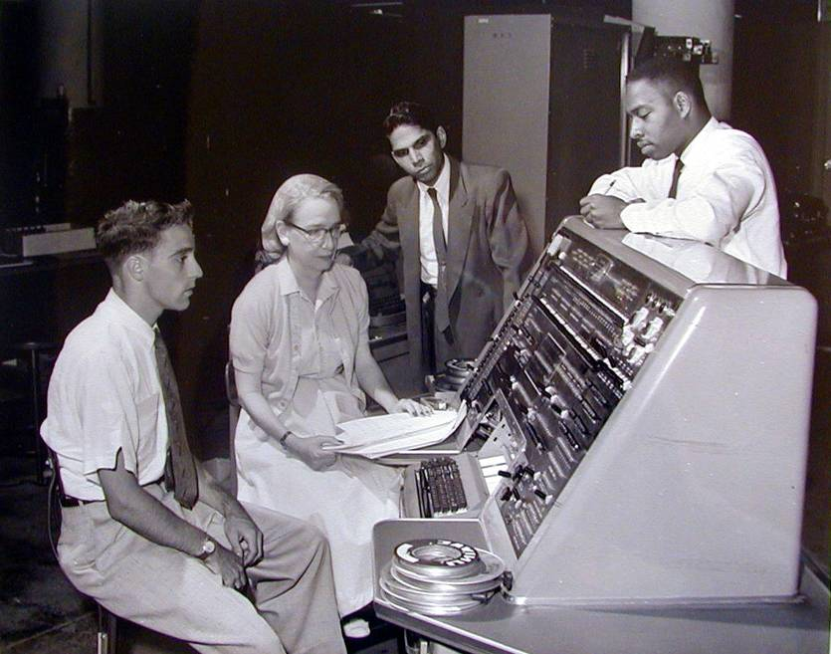
Toward Design Tools
Notes:
Now, this idea of creating tools to empower users has a long and storied history in computer science, beginning with Grace Hopper’s invention in the early 1950s of the first compiler. What’s inspirational for me is that she conceptualized how improved tools could provide a much wider audience with access to computation. So where are the frontiers in need of tool support today?

Slide 16

[O’Sullivan]
Notes:
This is a drawing by Dan O’Sullivan. It shows how mental model, that my current PC has of me. My computer knows I have an eye – but only one – it does know that I have two ears. It knows I have a finger – but only one, maybe two – and it has no idea that I have a body. Given the richness our human experience in the physical world, it’s shocking that our experience in the digital world is so limited.
For traditional desktop applications that target one-finger-man, good programming environments exist that have enabled legions of developers to create the content that helped put a PC on every desk. The goal of our group’s research is to enable an analogous success for ubiquitous computing. Specifically, our interest lies in the move from tools for technology experts toward tools for domain experts, designers.
One particularly important aspect here is prototyping, and much of our work has concentrated on this area.

Slide 17
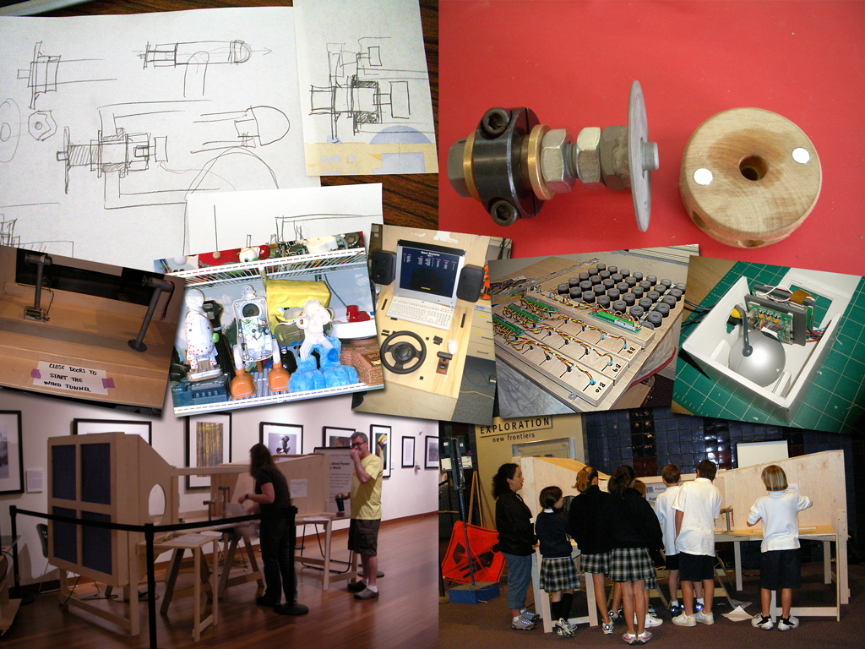
Thinking Through Prototyping
Colleagues
Clients
Users
Ourselves
Notes:
Prototyping is the pivotal activity that structures innovation, collaboration, and creativity in design.
Prototypes embody design hypotheses and enable designers to test these hypotheses. Successful designs result from a series of “conversations with materials,” as Donald Schoen called them.
The goal in prototyping is not the artifact – it’s feedback and iteration: you build some prototypes, evaluate them, and use what you learned to drive the next design.
And prototypes serve four distinct audiences: colleagues, clients, users and ourselves.

Slide 18
“Enlightened trial and error outperforms the planning of flawless intellects.”
Notes:
The importance of prototyping to succecssful design is underscored by the favorite quote of IDEO founder David Kelley, that Enlightened trial and error outperforms the planning of flawless intellects.

Slide 19

IDEO Camera
Notes:
Take this prototype of a digital camera developed at IDEO in the mid 1990s, when such Cameras had not yet broken into the consumer space. IDEO was tasked to find a way to make sense of possible digital camera interactions – what were the fundamental modes of use? To explore, designers built this mockup of a camera back – it’s clearly not to scale, and it’s tethered by a thick umbilical to a desktop computer that drives the graphics and application logic. What matters though is that it has the right set of inputs and colocation of input and output which allows users to experience the artifact as if it was a camera.
Exploring such experience questions through prototypes is particularly important as computing moves off the desktop and into our pockets, homes, and environments, where interaction models and use cases are emerging.
(p 261 and following in moggridge book)

Slide 20
Pragmatic v. Epistemic Activity
START
GOAL
B
???
?
?
?
A
START
[Kirsh, Maglio 1994]
[Klemmer, Hartmann, Takayama 2006]
Notes:
A theoretic lens for understanding the role of prototyping is the distinction is between pragmatic and epistemic design activity.
Pragmatic actions are those related to directly accomplishing a task with a known goal.
Broadly speaking, much prior work in software tools has been concerned with the pragmatic activity of getting things built.
But prototyping also serves an important epistemic function: design problems are ill-structured, meaning part of the designer’s job is to figure out what the space of solutions is in the first place . The goal itself is unclear.
We are particularly interested in this epistemic design activity.

Slide 21
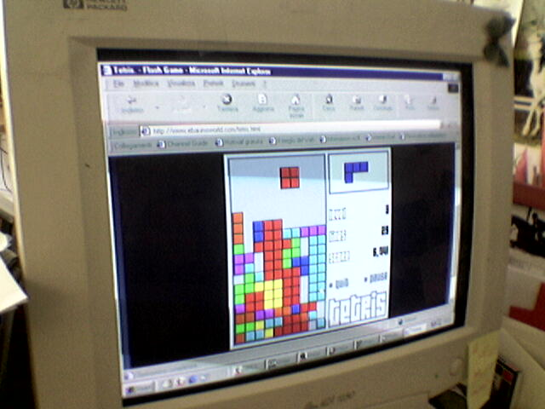
thinking through doing
Epistemic Action
Notes:
The notion of epistemic action was introduced into HCI by Kirsh and Maglio, who studied people playing Tetris. They noticed a curious phenomenon – expert players would make more seemingly unnecessary rotations than novice players. The rationale is that performing actions such as piece rotation in the real world is actually more efficient than doing that task mentally in your head. Thinking through doing is effective whenever actions in the real world can reduce the memory required, number of steps, or probability in error in mental computation.

Slide 22
?
Notes:
My particular research question is What techniques and representations can most effectively enable users to design interactive systems?
PROTOTYPING IS HARD, and prototyping a ubicomp system is much harder than working in traditional design areas. The challenge for computer science researchers is to build tools that better support a culture of prototyping.

Slide 23
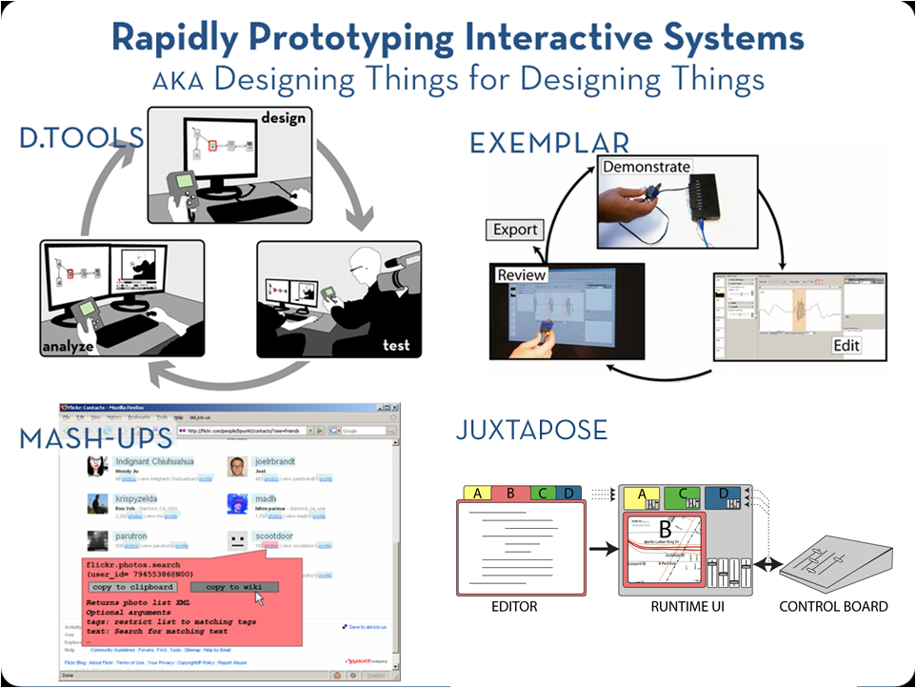
Notes:
In the past three years, we’ve built several systems in that explore these issues, and I’ll provide an overview of a few of them today. In the interest of time, and to provide the big picture that I think will be most, I’ll stay at a fairly high level, but please feel free to ask questions during the talk or afterwards about the details.

Slide 24
Fieldwork: Prototyping Today
Comprehensive prototypes are being built,
but only for presentation.
Video recording is pervasive,
but revisiting video is too expensive.
Notes:
To learn about opportunities for prototyping tools in the domain of information appliances, we conducted interviews with eleven product designers at three design companies. I also served as a consultant for one of the companies. I want to highlight two key insights from our field work. We found that
Professional design companies do have access to resources and expertise to create integrated functional prototypes – however, these prototypes are generally expensive one-offs used only for presentation.
Today’s prototyping tools are not flexible enough to create functional prototypes as tools for design thinking itself.
2) For documentation purposes, many test sessions with prototypes are video recorded. However, revisiting this video material is often too costly in terms of work hours so tapes just end up on the shelf.

Slide 25

d.tools
[uist 2006]
Notes:
Our work on d.tools has explored how to more rapidly create and evaluate information appliances that incorporate rich physical interactions
The key contribution of d.tools, is the integration design, test, and analysis of information appliances in a single toolkit

Slide 26
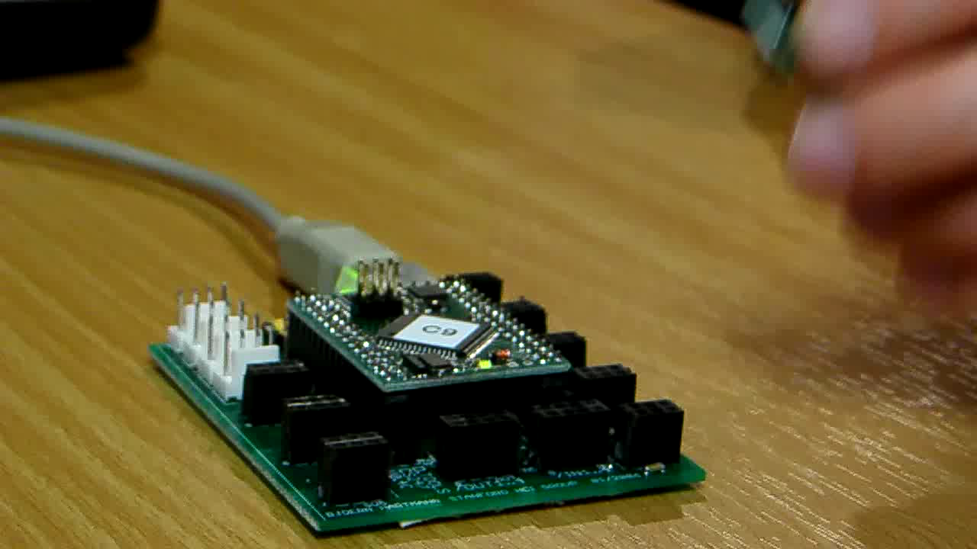
Notes:
As a designer plugs physical components such as sensors into the d.tools hardware interface, virtual counterparts appear in the d.tools authoring environment on the PC.
The DESIGNER then authors interactions by creating visual states, which encapsulate output, and by linking them through transitions, which get triggered by input events. The control flow interface is based on designers familiarity with storyboards.
d.Tools facilitates turning continuous sensor data into discrete events through an interactive demonstration and thresholding technique.
In d.tools, the interaction model is always live and can be tried out at any point.
To increase the complexity of prototypes, designers with programming knowledge can attach Java to visual states.
Here, Java code remote controls the Google Earth application. This is an example of how d.tools can be used to create mash-up prototypes.

Slide 27
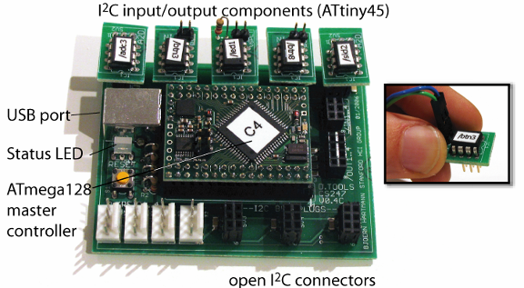
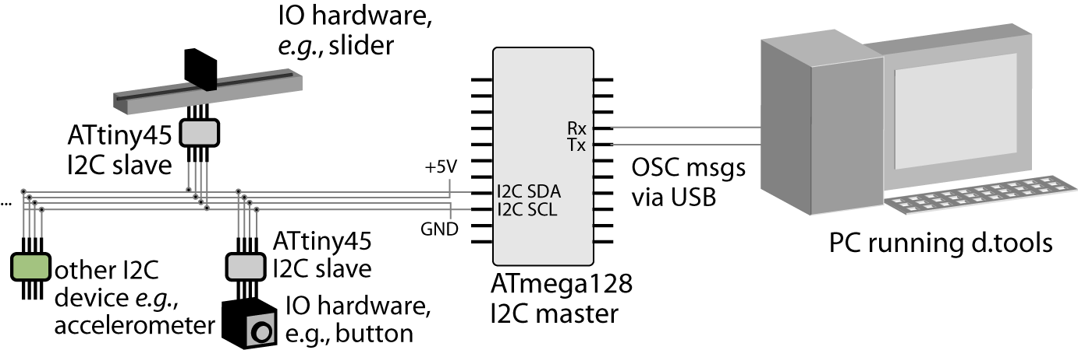
Smart Hardware
Notes:
To be able to raise the complexity ceiling of what can be built with d.tools, we designed our micrcocontroller-based hardware platform that enables plug-and-play at the level of a single component. This research introduces three levels of hardware extensibility: at the hardware-to-PC interface, the intra-hardware communication level, and the circuit level.

Slide 28
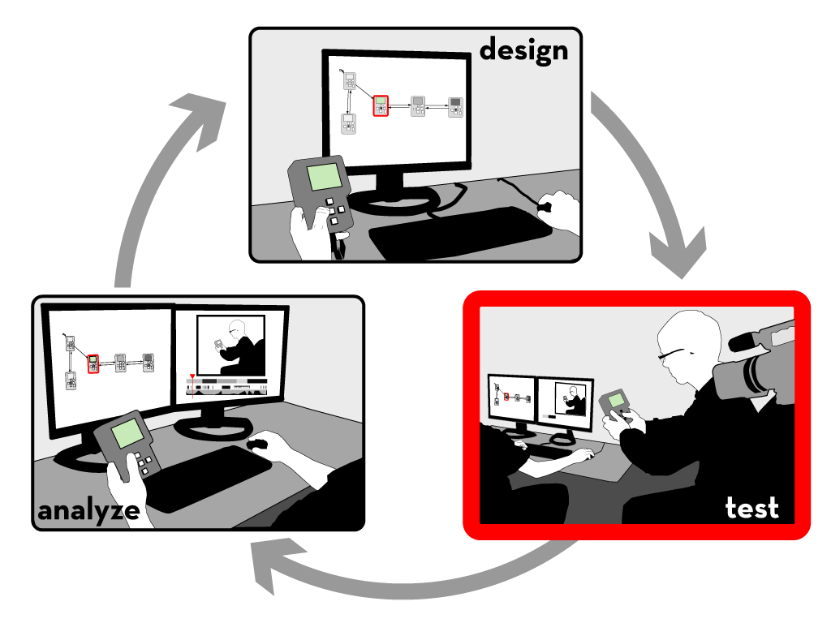
Notes:
Let’s move on to test mode

Slide 29

Notes:
A camera is pointed at the tester.
The live video from the camera is recorded and annotated in real-time with state transitions and input events.
In addition to events generated by the prototype itself, the experimenter can also add annotations with a video console.

Slide 30

Notes:
After a test session is completed, designers can leverage tight synchronization between the graphical interaction model, the recorded video, and the recorded event traces in analyze mode.

Slide 31

Notes:
In analyze mode, video playback is synchronized with a visualization that highlights active states.
In the other direction, designers can select states in the statechart to access corresponding video clips.
Designers can query for video sequences matching input by demonstrating that input on the prototype itself.
Multiple test sessions can be combined into a video spreadsheet, which can be used for rapid comparative evaluation.

Slide 32
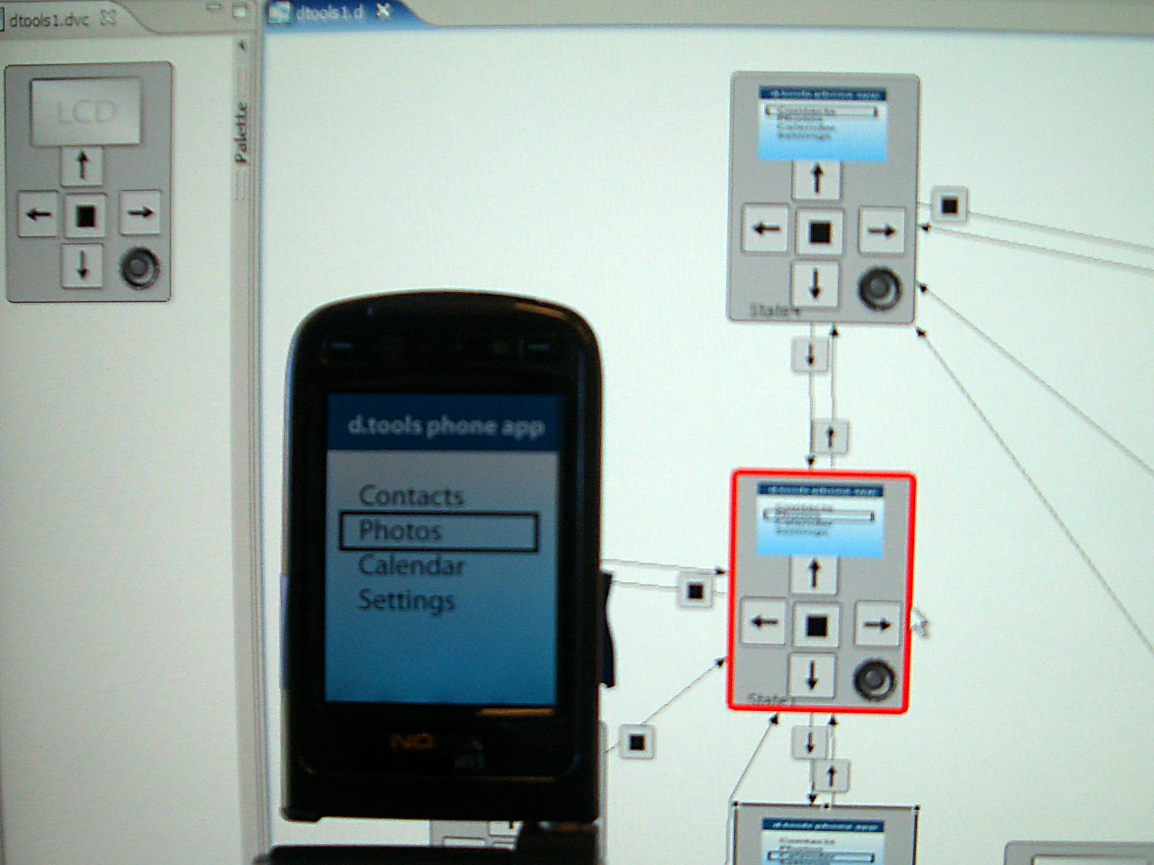
Notes:
More recently we have collaborated with Nokia design San Francisco to extend the d.tools authoring approach to mobile phone prototypes. A d.tools client application runs on the Nokia phone; and sends all input events from the phone to a PC.
All communication is wireless here.
The Application logic is handled in a d.tools storyboard on the desktop and
dtools sends commands back to phone to display images and play sounds.

Slide 33

Class Deployment
Notes:
In addition to traditional evaluation methods such as lab studies, we also deployed d.tools to students. We hand-manufactured a dozen kits which we distributed student teams in a masters level HCI design course in 2006 and 2007.
This image shows a color mixing interface designed with d.tools in which users can “pour” color from tangible buckets onto an LCD screen and then draw with those mixed colors on a tabled; this project took part in the Microsoft Design Expo in Redmond in 2006.
Kits have also been distributed to various bay area design consultancies and product companies such as Leapfrog, Frog design, and Ideo.

Slide 34
Designing Sensor-based Interactions
PROTOTYPE APPLICATION LOGIC
SPECIFY RELATIONSHIP
BETWEEN SENSOR DATA
AND APPLICATION LOGIC
SPECIFY RELATIONSHIP
BETWEEN SENSOR DATA
AND APPLICATION LOGIC
PROVIDE SOFTWARE ABSTRACTION
FOR HARDWARE
Notes:
Reflecting on our experience with d.tools, we see sensor-based interaction design comprising three distinct steps: choosing and connecting the appropriate hardware, creating application logic, and specifying the relationship between sensor values and application logic.
d.tools, as well as prior work, provides software abstractions that make connecting hardware easy. D.tools also enables designers to rapidly prototype and evaluate the application logic. However, our experience has shown that specifying the relationship between sensor values and logic often remains problematic.

Slide 35

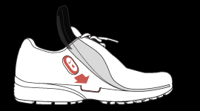
How would you prototype…
…a workout monitoring system?
[Apple, Nike]
Notes:
What kind of authoring tools would you need to prototype a fitness monitoring system which measures the rhythm of your steps and adjusts music playback accordingly?

Slide 36
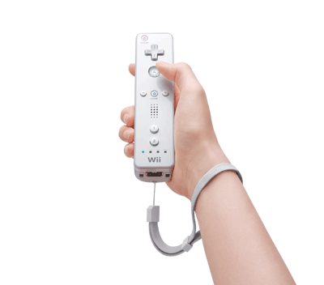
How would you explore…
…motion-based game controllers?
[Nintendo]
Notes:
Or imagine you are a game designer. What kind of tools would you need to prototype an accelerometer based control for an existing game in less than 30 minutes?

Slide 37
Problem Solving as Representation
“Solving a problem simply means representing it so as to make the solution transparent”
—Herbert Simon, The Sciences of the Artificial
Notes:
As Herb Simon and Don Norman have pointed out, the representation of a problem is an important factor determining how we can manipulate that problem.

Slide 38

Representation Matters
Accelerometer X axis
Accelerometer Y axis
//detect accelerometer peaks
//read data sample
xVal[t++]=readA2DValue(xPin);
//look for changes in derivative
if(((xVal[t]-xVal[t-1]) >= 0
&& (xVal[t-1]-xVal[t-2]) < 0) ||
(((xVal[t]-xVal[t-1]) < 0
&& (xVal[t-1]-xVal[t-2]) >= 0)) {
//peak detected
//send message
oscSendMessageInt("/x/peak",1);
} else {
//no peak
}
Notes:
For tasks like sensor-based interactions, an individual's performance of the input they would like to recognize is a very different activity from symbolically specifying that input. The motivation of our work is to leverage the embodied performance to actually do the work of specifying the computation.

Slide 39
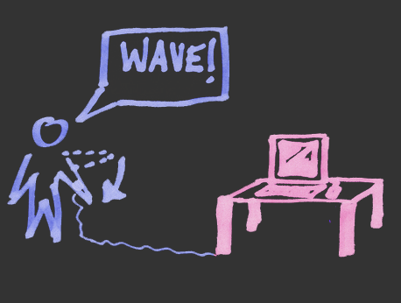
Idea: Programming by Demonstration
Notes:
We achieve this by applying programming by demonstration to the domain of sensor-based interaction design.

Slide 40
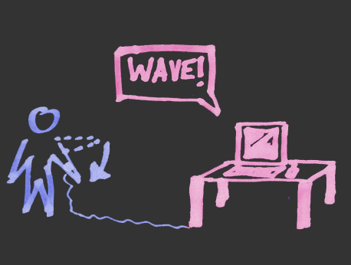
Idea: Programming by Demonstration
Notes:
40
Programming by demonstration (PBD) is the process of inferring general program logic from observation of examples of that logic.
Our research builds upon the idea of using actions performed in physical space as the example input.

Slide 41
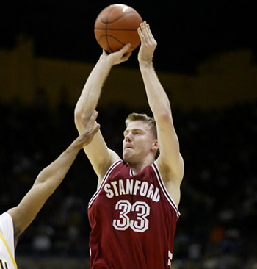
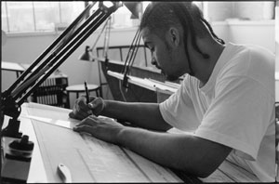
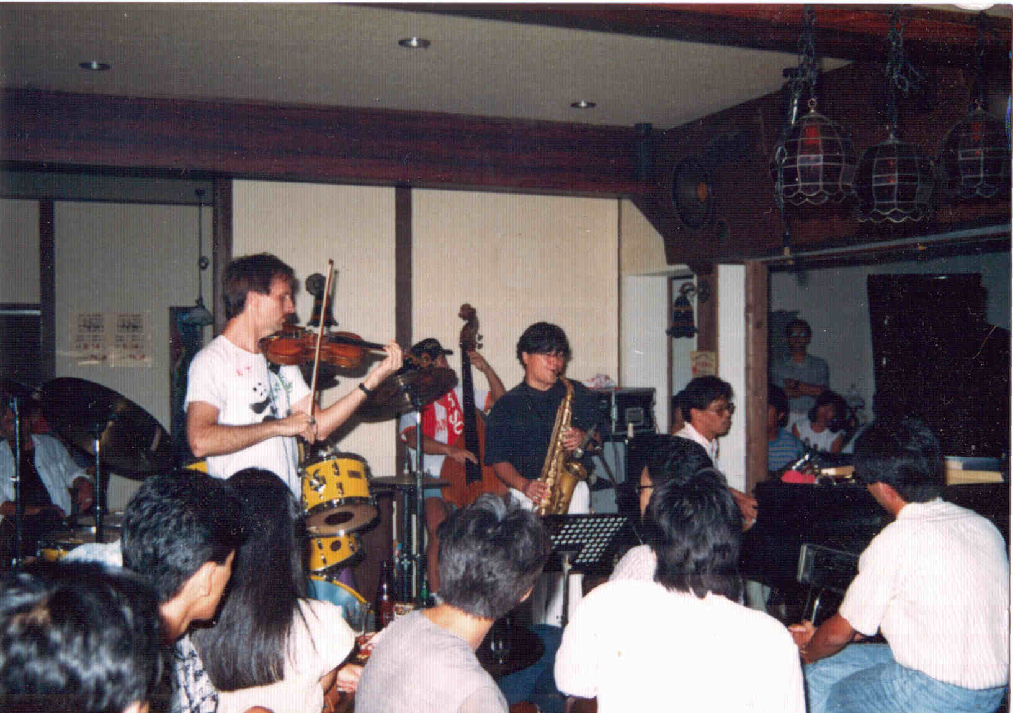
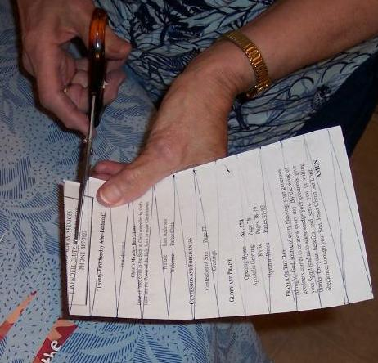
Tacit Knowledge
Notes:
This allows designers to leverage their tacit knowledge of the task domain without having to produce a formal representation of the task from scratch. As Michael Polanyi put it (SLOW) “we know more than we can tell” (PAUSE) –PBD can aid designers by substituting “doing” for “telling”.

Slide 42
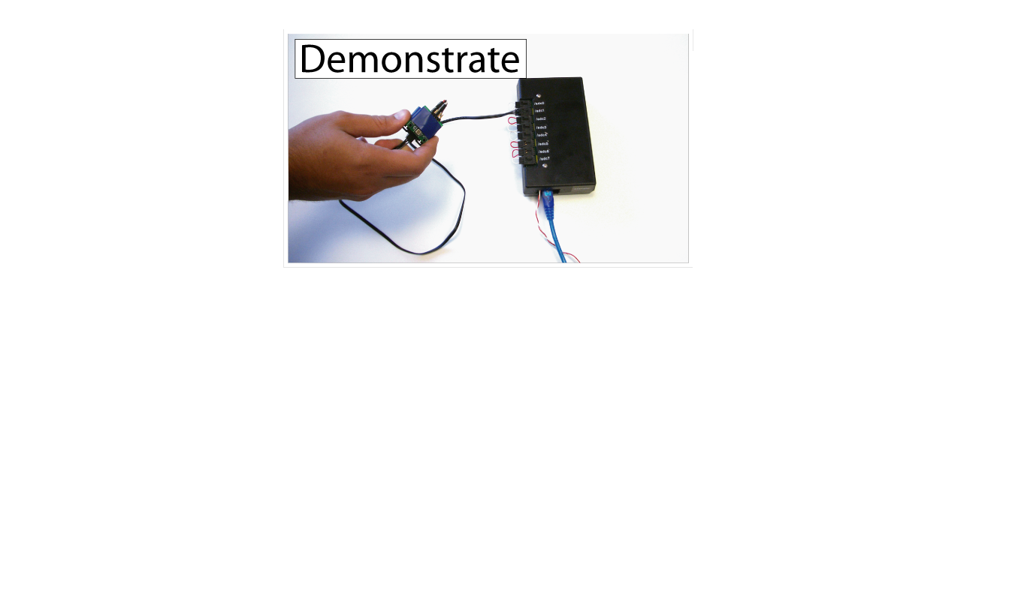
Exemplar
[chi 2007]
Notes:
We constructed Exemplar to investigate such an approach.
With Exemplar, an interaction designer first demonstrates a sensor-based interaction to the system (e.g., by shaking an accelerometer).

Slide 43
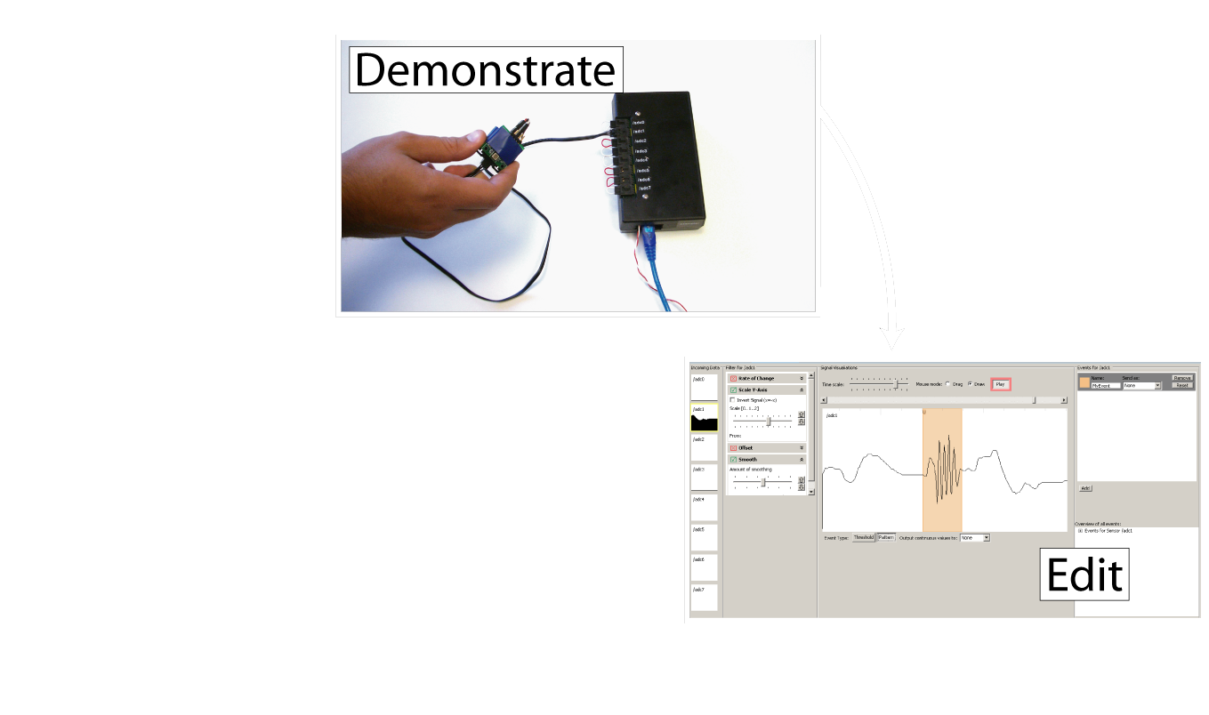
Exemplar
[chi 2007]
Notes:
The designer then edits a visual representation of the action by marking it up,

Slide 44
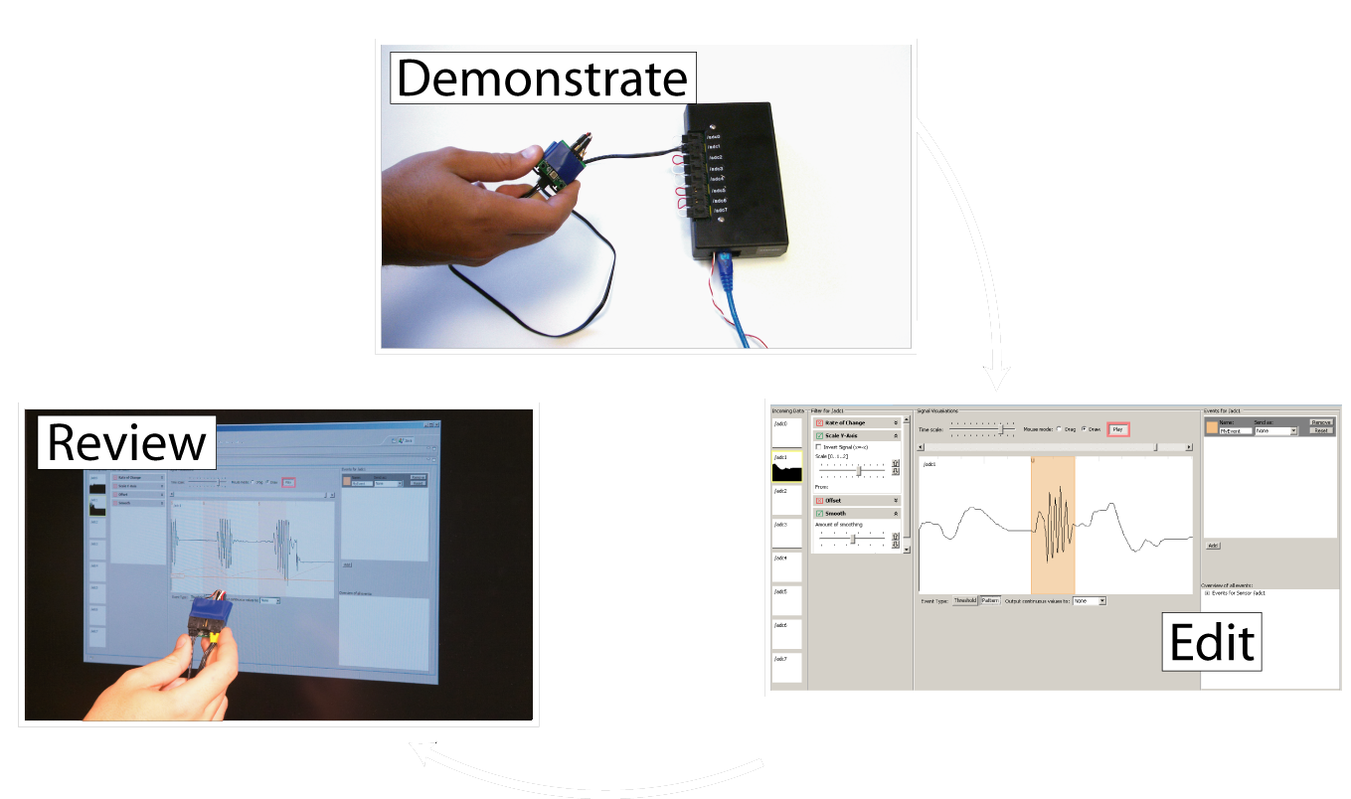
Exemplar
[chi 2007]
Notes:
and reviews (or tests) the result by performing the action again.

Slide 45
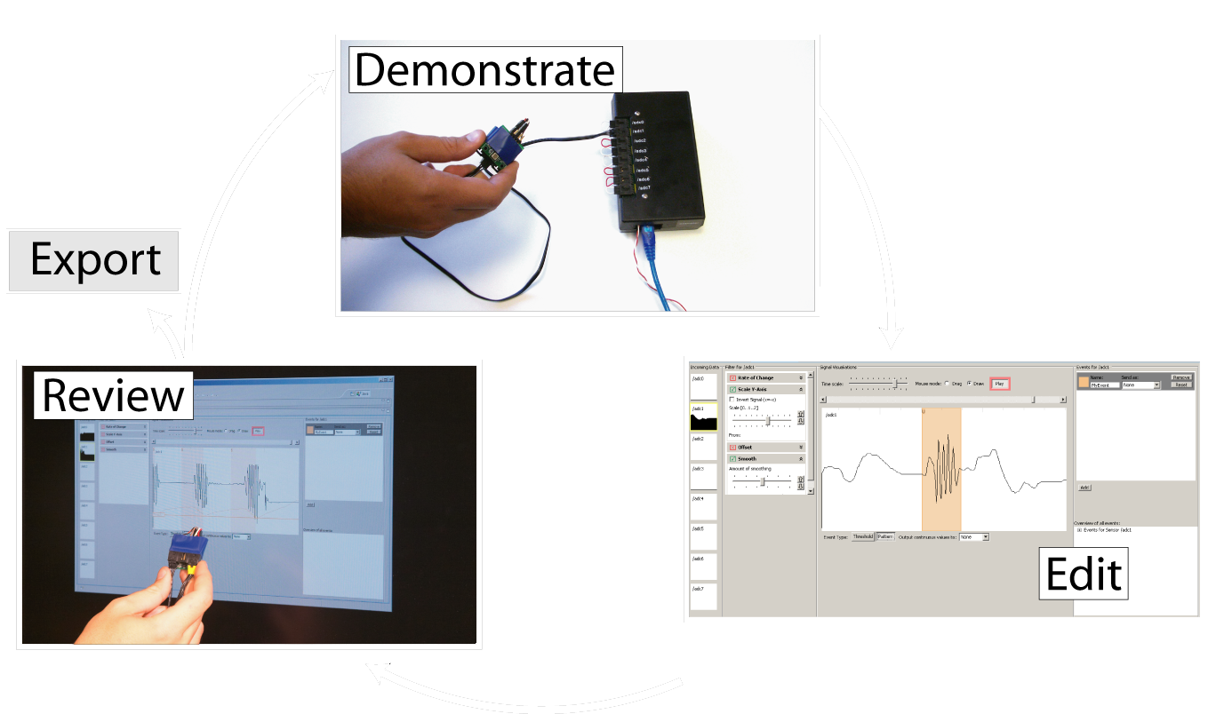
Exemplar
[chi 2007]
Notes:
Through iteration based on real-time feedback, the designer can refine the recognized action and link it with other prototyping applications.
A short video scenario will outline the main functionality of Exemplar.

Slide 46
Notes:
This scenario shows how Dan, an interaction designer, prototypes a bicycle helmet with blinkers that signal when the helmet is tilted. This example was inspired by Ted Selker’s smart helmet built at the media lab.
Our designer picks a accelerometer and connects it to a compatible hardware interface. Data from all inputs is shown simultaneously in Exemplar in small preview windows. Previews light up when sensor data changes rapidly to attract attention.
This overview allows him to discover pertinent signals.
Dan brings one accelerometer output into focus, then demonstrates examples of the action he wants to recognize.He reviews and marks up the sensor signal to define the regions that contains his action.
Here Exemplar generalizes from the examples by calculating thresholds of the highlighted region
In addition to drawing regions, Dan can also use a foot pedal to define examples while he performs them. Dan can immediately test his design to see if it works. Exemplar shows a visualization of sensor signal regions that match the demonstration. Exemplar will then generate events based on matching regions in two ways: first the software can send System Mouse and Keyboard events to remote control other applications
Or, Exemplar can send events to d.tools. Dan can refine the learned interaction model through direct manipulation. For example through filters that transform the incoming sensor data.
Exemplar offers two generalization techniques:
Thresholds, which compares a single data point to fixed limits.
And pattern matching, which enables recognition of actions characterized by a change over time, such as gestures.

Slide 47
Dynamic Time Warping
Demonstration Signal
Matching Input Signal
int DTWDistance(char s[1..n], char t[1..m], int d[1..n,1..m]) {
declare int DTW[0..n,0..m]
declare int i, j, cost
for i := 1 to m
DTW[0,i] := infinity
for i := 1 to n
DTW[i,0] := infinity
DTW[0,0] := 0
for i := 1 to n
for j := 1 to m
cost := d[s[i],t[j]]
DTW[i,j] := cost + minimum(DTW[ i-1, j ], // insertion
DTW[ i , j-1 ], // deletion
DTW[ i-1, j-1 ]) // match
return DTW[n,m]
}
[Sakoe, H. Chiba, S. ‘78]
Notes:
47
47
Let me highlight one technical feature here. For our pattern matching algorithm, we employ Dynamic Time Warping or DTW.
DTW was originally used in the area of speech recognition. This algorithm uses dynamic programming for a sequence comparison and outputs an error metric describing how much one signal has to be warped in time or space to match another. We then let the user interactively threshold against that error metric – thus both simple thresholding and pattern recognition have a unified control structure in the user interface.

Slide 48
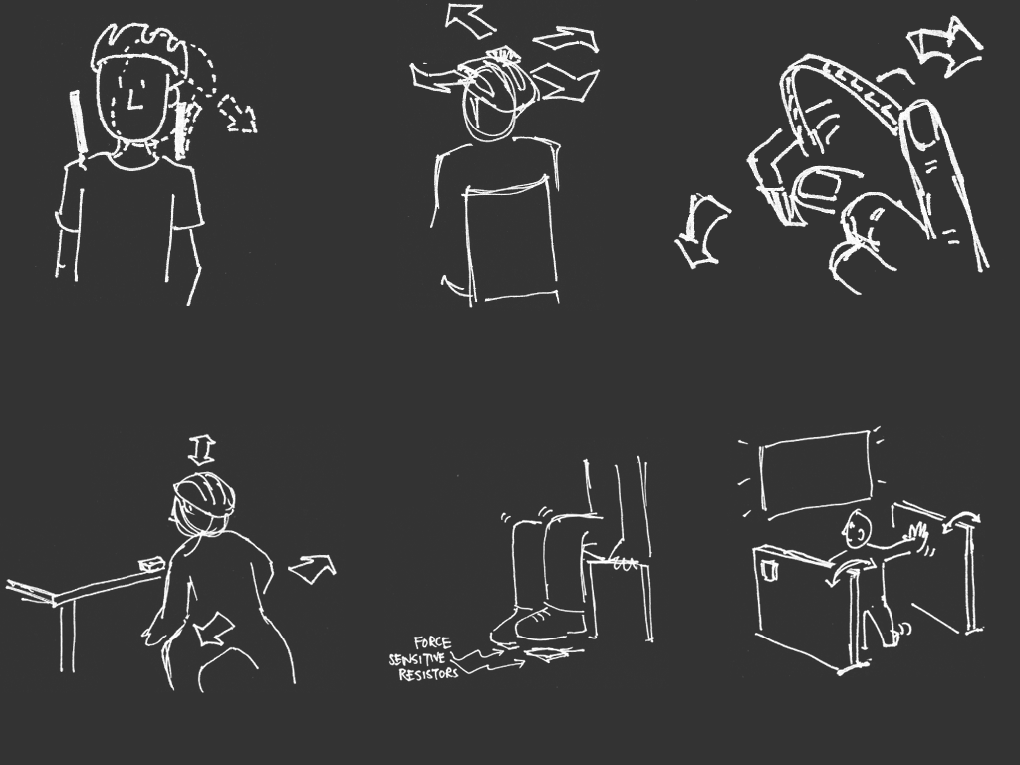
Lab Study
26 min
18 min
27 min
47 min
22 min
31 min
[sketches by Wendy Ju]
Notes:
In a lab evaluation, We were positively surprised by the wide range of game control designs our participants came up with. The rapid feedback cycle in Exemplar enabled participants to explore up to four different control schemes for a given game in less than 45 minutes. The takeaway point here is that even novices could rapidly and successfully create novel controls.
Let me show you three of the creative solutions our participants came up with.

Slide 49

Notes:
One participant created a make shift booth - hitting walls and stomping on the floor navigated a spaceship.
Another participant modified the bicycle helmet example so that the accelerometer on his helmet would detect him ducking down to fire rocket thrusters.
A third participant used the signal generated by the flicking of a bend sensor to trigger shooting of rubber bands.

Slide 50
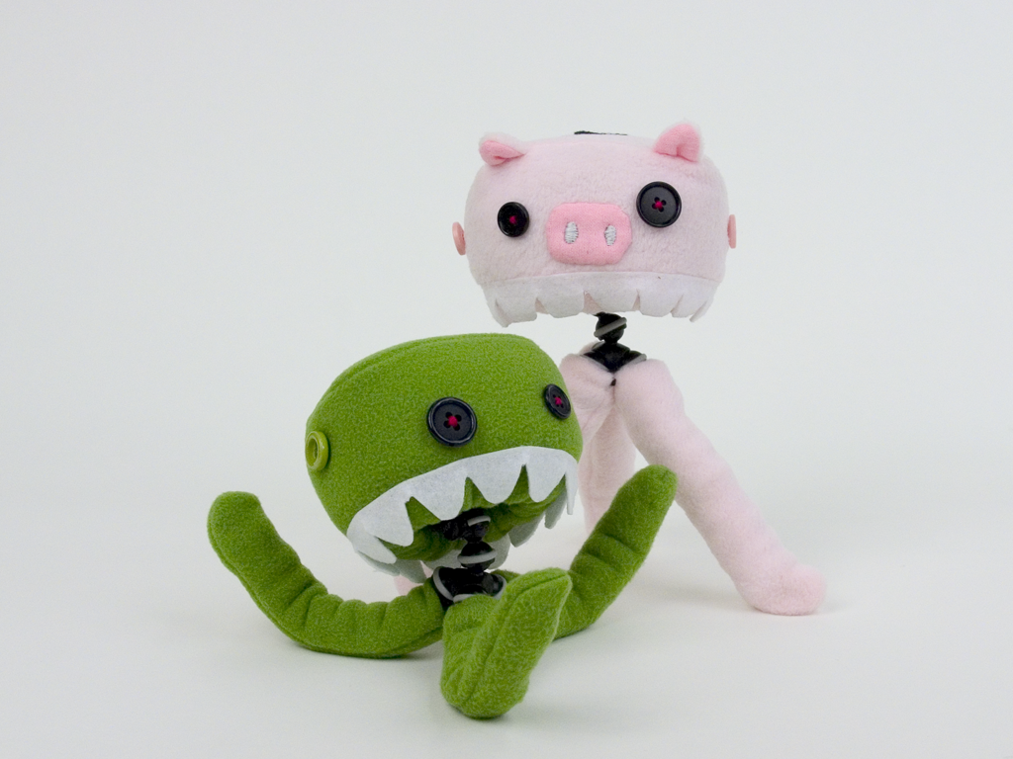
CHI Interactivity
[Control Freaks by Haiyan Zhang]
Notes:
We also used Exemplar as the back end for a wireless gaming system on display on CHI2007.

Slide 51
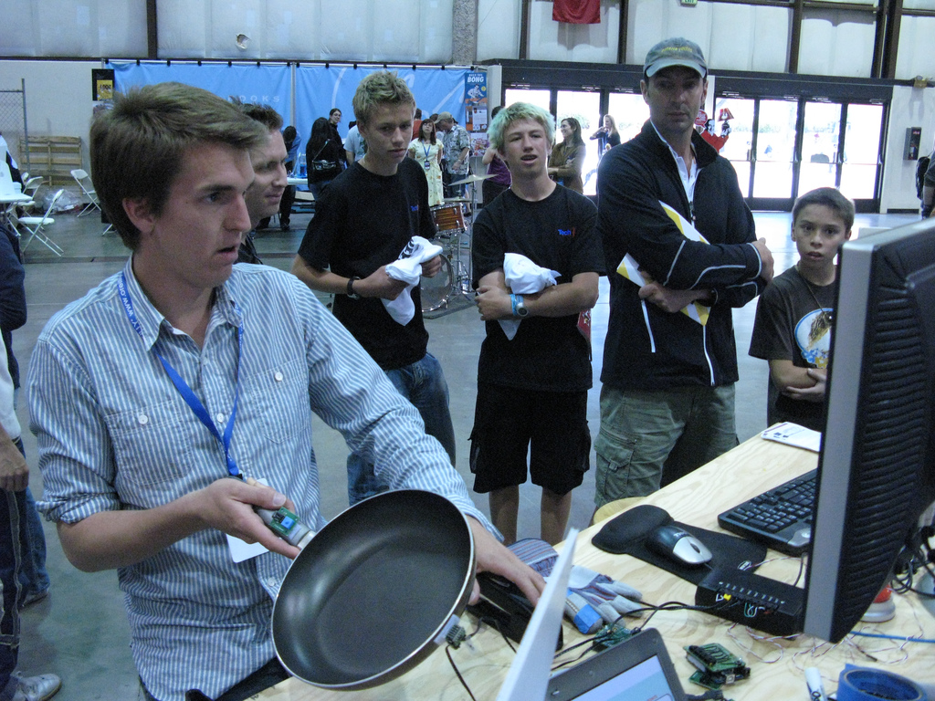
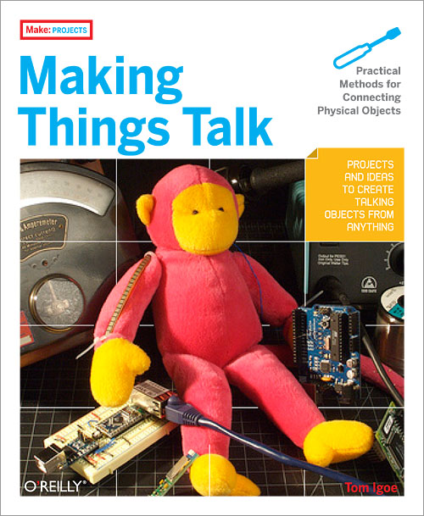
Notes:
As with d.tools, we have made Exemplar available as open source software. Last year, we demonstrated exemplar at the Maker Faire, a Bay Area DIY event with 40,000 visitors. At our stand, hundreds of visitors built their own game controllers from household objects such as garden gloves, staplers and frying pans. Exemplar has also been discussed in Tom Igoe’s recent book on physical computing.

Slide 52
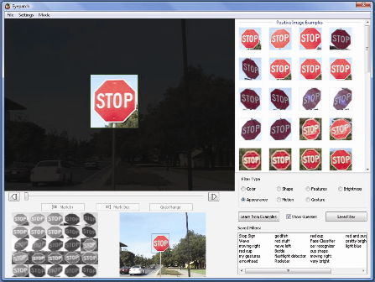
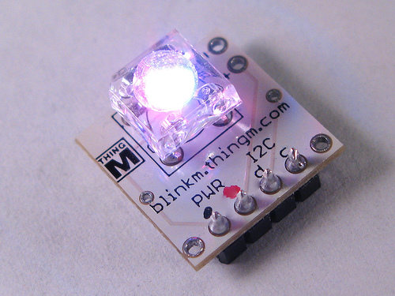
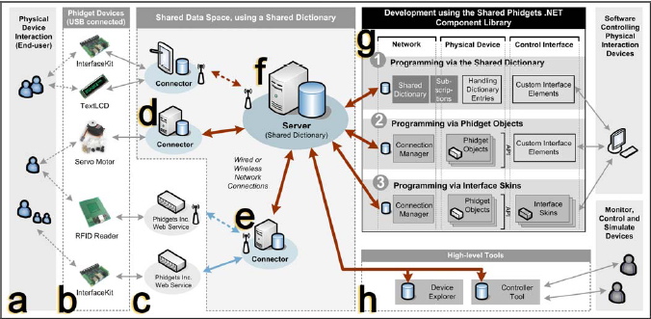
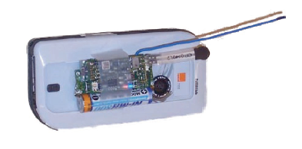
Notes:
There are now a number of other interesting projects in the physical computing prototyping space that share inspiration or even system internals with our research.
At Stanford, Dan Maynes-Aminzades Eyepatch enables rpadi prototyping of vision-based interactions.
D.tool’s smart component architecture has found its way into the commercially available BlinkM smart LED product; iStuff from the University of Aachen more closely integrates the domains of sensor input and mobile applications; with Shared Phidgets from the University of Calgary prototypes can be distributed among many devices and smart environments.

Slide 53
Notes:
I’m going to switch gears a bit now to two ongoing projects that investigate designing with alternatives and programming by modifying existing examples.

Slide 54
“The best way to have a good idea is to have lots of ideas.”
-Linus Pauling
Notes:
Linus Pauling may be the premier chemist of the twentieth century. He was awarded the Nobel Prize for his work on describing the nature of chemical bonds.
What his work philosophy shares with that of professional de signers is the practice of trying out multiple alternative ideas, approaches, solution strategies. (rewrite)
There are three specific ways in which construction of multiple alternatives is important in design:

Slide 55

Prototypes for the
Microsoft mouse
From Moggridge,
Designing Interactions, Ch2
Notes:
First, designers may build dozens of prototypes to get a more complete understanding of a design space.
For example, Paul Bradley at IDEO built about eighty foam models for the original Microsoft mouse to quickly explore different directions.

Slide 56

Notes:
Second,discussing multiple prototypes allows project stakeholders to more effectively communicate their requirements.
Architect Michael Wilford created these alternative plans for a university campus for the purpose of scaffolding discussions with clients.

Slide 57

Tohidi et al, CHI 2006
Notes:
Third, comparing between multiple alternatives is important during user testing to keep participants honest:
Tohidi et al showed, that Participants will rate designs lower when multiple alternatives are seen, compared to when they see only one. And that Participants exposed to alternative designs will be less pressured to be positive.

Slide 58

[Adobe Flash]
Notes:
Our software tools should support lightweight and rapid experimentation with alternative design options. However, such solutions do not yet exist for designing interactive behavior. A recent survey of designers by Brad Myers et al found that designers lack the tools to iterate on behaviors and to compare interaction designs side by side.
(Click) One of the central reasons it that design of interactive behavior, even for prototypes, often happens in textual code.

Slide 59
Notes:
There are two distinct representations involved in programmed interactions: source code, where changes are authored; (click) and the running program, where changes are observed.

Slide 60
Juxtapose
Notes:
Our ongoing work on Juxtapose enables designers to interactively create and manipulate multiple alternatives of programmed interactive behaviors.

Slide 61
Juxtapose
Notes:
Juxtapose demonstrates a novel environment for constructing multiple design alternatives through (selectively) parallel editing of behavior source code.

Slide 62
Juxtapose
Notes:
These source alternatives can then be executed in parallel, allowing rapid comparison between them.

Slide 63
Juxtapose
Notes:
Juxtapose also introduces a mechanism to automatically generate a control interface to interactively “tune”
parameters of the designed interaction at runtime. Arriving at a
satisfying user experience often depends on adjusting
interrelated application parameters.

Slide 64

Juxtapose
Notes:
For such parameter tuning, Juxtapose supports the use of a dedicated, spatially multiplexed hardware controller. As Fitzmaurice showed in 1995, such spatially multiplexed input devices outperform mouse and keyboard input for multivariate control tasks.
The controll board enables users to modify multiple parameters simultaneously; leaves the eyes free to focus on the application being tuned; and allows for tuning of interactions that require concurrent mouse and keyboard input.

Slide 65

Notes:
Currently, Juxtapose supports creation of interaction designs written in Actionscript..<click>
In our editor Users can create alternatives to their current code using the add alternative button…

Slide 66

Notes:
Alternatives are shown as tabs in the user interface. These tabs “linked” by default – which means that changes in one alternative are propagated to all other alternatives.

Slide 67

Notes:
When the linked edit box is unchecked, code changes are now local to the currently active tab

Slide 68

Longest Common
Subsequence
Notes:
Parts of the code that are unique to the active alternative are shown in a different background color to highlight the differences. This technique of linked editing was introduced by Toomim in 2004 for working with code duplicates. We extend his work here by integrating linked editing with the Juxtapose runtime environment.
On a technical level, linked editing uses an algorithm to compute the longest common subsequences between alternatives, like the diff utility, after every keystroke or copy-paste command

Slide 69
Notes:
When the user hits run, Juxtapose compiles the set of all alternatives and launches the runtime environment.

Slide 70

Notes:
In the runtime environment, Users can now switch between alternatives using the buttons above the canvas

Slide 71


Slide 72
Notes:
To tune application behavior at runtime, Juxtapose automatically extracts a list of all global variables through language.
Users can check variables in this list

Slide 73
Notes:
to assign the variables to control widgets. The layout of the control widget area mirrors the

Slide 74

Notes:
the physical layout of the supported external controller.

Slide 75
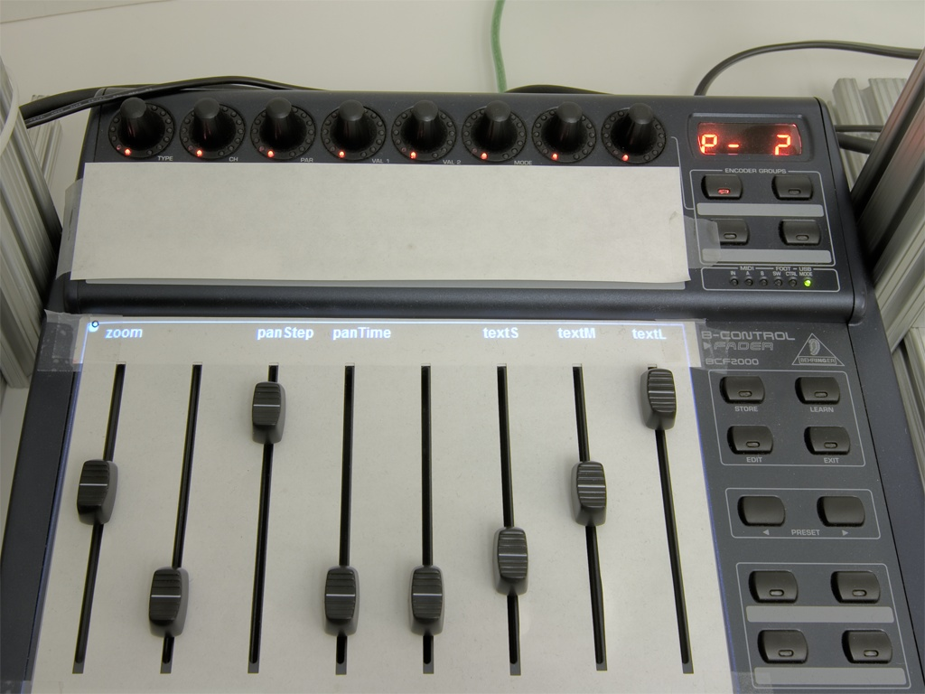
Notes:
To facilitate mapping variable controls from the screen UI to the physical interface, we added variable name display directly onto the hardware control surface.

Slide 76
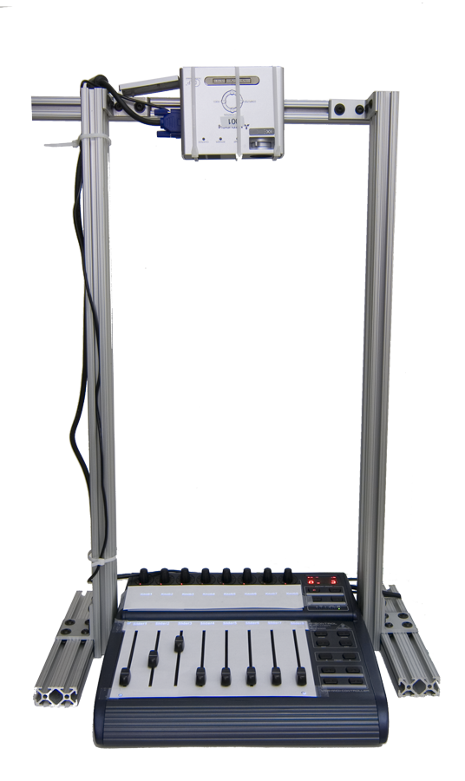
Pocket projector
Notes:
Currently, this happens by using top projection. <click> This is clearly just a research prototype – another option would be to pick commercially available hardware that integrates text LCDs above every control.

Slide 77




Juxtapose Extensions
A
B
C
D
Juxtapose Editor +
Runtime on PC
Juxtapose Wrapper
User’s Application
on Phone
Control messages
Notes:
The benefits of Juxtapose are amplified for development off the desktop, where the cost of edit-compile-test cycles is much higher. In mobile development, coding happens on the PC -- because of the rich toolset available there -- while testing happens on device -- to get the user experience in context.
mobile phones are commodity hardware, and mobile developers already test on multiple handsets. We extended Juxtapose to leverage these device collections by executing different alternatives on different handsets. You write your alternatives on the PC, and the compiled applications are then distributed to a collection of handsets. A designer can thus rapidly switch between alternatives by putting one phone down and picking another one up. <click>
Our prototype works for FlashLite applications that target Nokia N93 phones. To allow remote control of application variables, we wrap the user’s application with an RPC interface behind the scenes.
77

Slide 78

Juxtapose Extensions
Bootloader
Juxtapose Editor +
Runtime on PC
Application Binaries
Juxtapose Wrapper
User’s Application
Control messages
Notes:
As we saw with d.tools, embedded microcontrollers are the tool of choice for working with sensors and actuators. d.tools treated the hardware as an I/O interface and kept all application logic on a PC. Such an approach is not always possible, for example, for wearable computing, and haptics, which requires very tight feedback loops. Microcontroller programming in those areas can be arduous. Even seasoned veterans often resort to debugging by blinking LEDs or printing statements to serial ports. We extended Juxtapose to support authoring for the popular Arduino microcontroller platform.<click>
building custom hardware, is expensive, so designer are likely to embed multiple different opportunities for interaction into the same prototype. Hence, Juxtapose for Arduino exports and runs only one code alternative on one attached board at a time. When the designer switches between alternatives, Juxtapose then transparently replaces the binary running on the microcontroller .

Slide 79
Compile Source
Notes:
One of the technical problems here was to add a degree of reflection to programs written in embedded C, which does not natively support reflection.

Slide 80
Parse Source
Extract variable definitions
Emit variable table & access methods into source
Compile modified sources
Notes:
Here we leveraged techniques from compiler construction. We first parse a user’s source code, extract variable definitions, then emit a variable table with names and points back into the user’s source and compile this modified source.

Slide 81
Notes:
The last project I’d like to share with you today is abot designing by modifying existing examples.

Slide 82
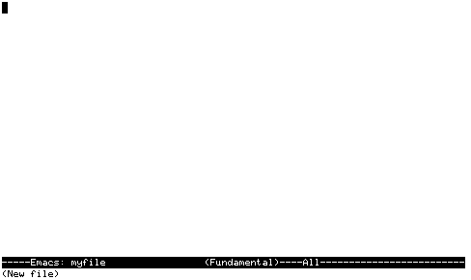
Notes:
If one looks at today’s design and development tools, there seems to be an implicit belief that software is designed tabula rasa. That we start with a blank canvas and create a bunch of code.
However, what we’ve seen both in our fieldwork and in our conversations with industry is that it’s much more common for software to be created by example modification. Find something on the web, in example files, or in the source tree that provides an example that’s “kind of like” what the developer is interested in.

Slide 83
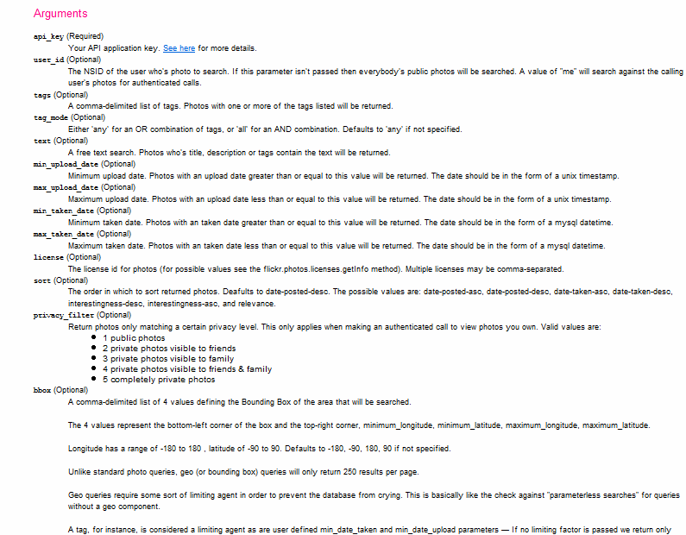
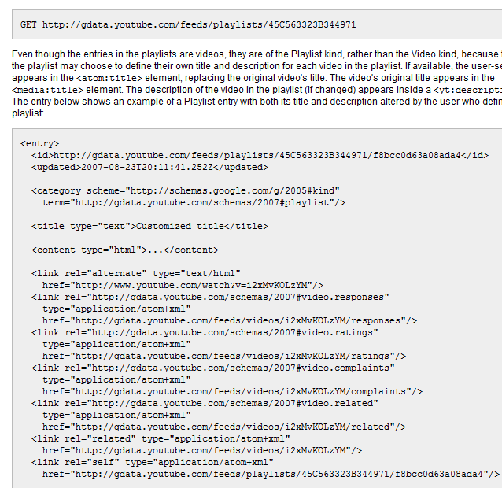
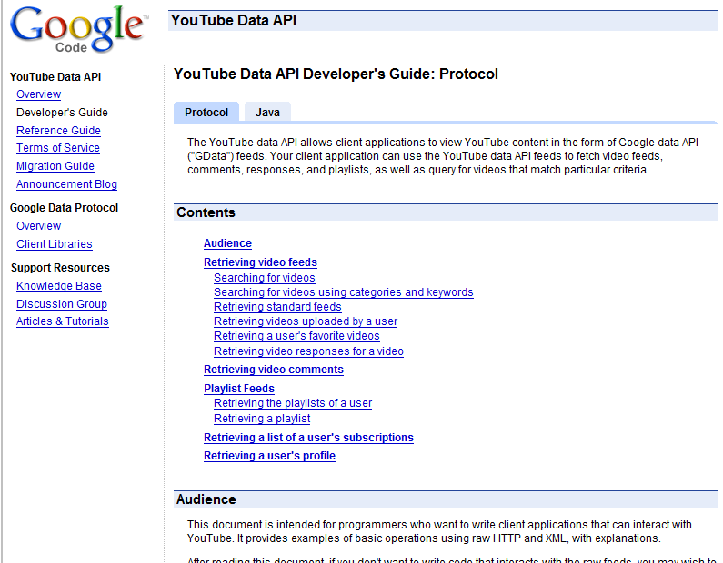
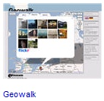
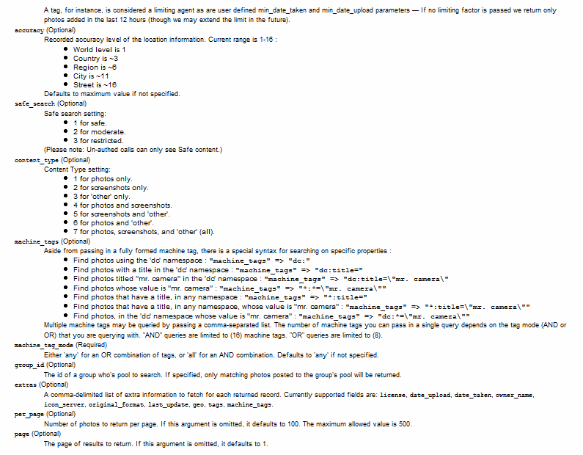
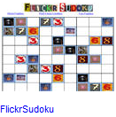
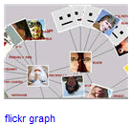
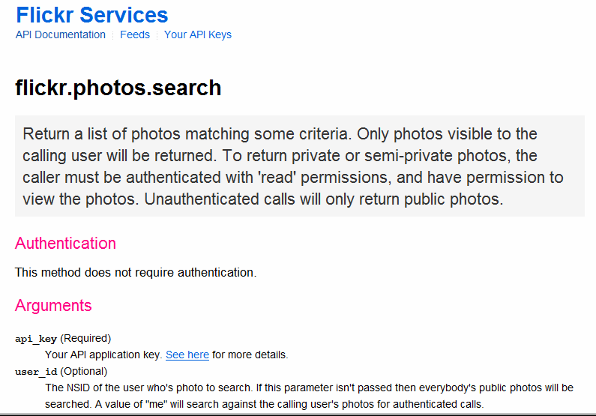
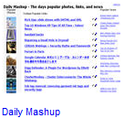








It’s easy to understand the sites,
but not their services.
[programmableweb.com]
Notes:
“Programming by google search” is especially relevant in the growing area of working with web service APIs.
There are currently more than 500 public web-service APIs available, offered by most big internet companies: Yahoo, Google, Microsoft, Amazon, eBay, and AOL.
This issue of example modification is NOT unique to web application development, however web applications offer a distinct upportunity to address this modern development challenge.
<click>
One frustrating problem of programming the web today is that programming models and documentation conventions vary widely – there is no global type hierarchy to rely on, and there is no javadoc for web services.
<click>
So while it’s easy to understand the web sites, it is much harder to understand their services.

Slide 84


Web sites and their APIs are correlated…
≈
…let’s leverage that fact!
[flickr.com]
Notes:
To bridge this chasm, we note that web sites and their APIs are correlated.
For example, I can both look at the set of images taken on my last trip to Yosemite on the flickr website, AND I can retrieve the same set of images by calling an appropriate method in the flickr API.
The site and its API offer complementary views of the same underlying functionality.
In essence, the web site is the largest functional example of what can be accomplished with an API.
Our present work seeks to leverage the value that can be achieved by coordinating these representations.

Slide 85

Give me the code for this!
Notes:
d.mix models the correspondence between html pages and api calls to let users create program code by sampling content from a web page. (space)
It co-locates two different kinds of information on one page: examples of what functionality a web site offers,

Slide 86
To retrieve this image, use:
flickr.photos.getInfo(
user_id = '73866493@N00', photo_id= ‘3208312’)
Notes:
together with information how one would obtain this information programmatically.
With d.mix. users can generate working code examples by selecting the information on the web site itself.
This selection technique allows users to remain in the domain of their task goal, in this case retrieving images.

Slide 87

Scenario
Notes:
This scenario will clarify the main interaction techniques of d.mix:
A group of rock climbers would like to create a photo page for the group,

Slide 88

Notes:
Which should always show the latest iamges from the groups’ trips without requiring manual updates.

Slide 89

Notes:
Drew keeps his images on Flikckr where he aggregates them in an image set.
Jane begins by navigating to drew’s flickr page and clicks on the “sample this” button in her browser.
The page now shows dashed borders around items she can retrieve through the site’s API.
By right-clicking she can copy drew’s climbing image set into her sampling bin.
From the sampling bin, she sends selected items to the d.mix active wiki.
Because d.mix performed a deep copy of the images by generating web API calls,
Jane can edit parameters of those calls through a property sheet.
Here she sets that only the two most recent images for th second set should be returned.
Jane can also change the source code that d.mix generated for her.
In the source view, she can add static HTML to the page or edit the web API calls made to retrieve images from flickr.

Slide 90

d.mix Proxy Architecture
Rewritten page
with API annotations
Original Page
Proxy Server
Site-to-Service Map
(hosted on d.mix wiki)
Notes:
d.mix uses a programmable HTTP proxy that rewrites the original web site, adding API annotations. Each API annotation contains an associated snippet of code that generates a working web service call in the Ruby programming language.
The programmable proxy knows how to annotate web pages by using a site-to-service map.

Slide 91


d.mix active wiki
Source code generated by d.mix
Rendered Page
is executed in the active wiki
Notes:
The source code generated through sampling with d.mix
Can then be copied to an active wiki, a server-side code environment, where it can be edited and safely executed in sandbox with restricted security privileges. (click) The
active wiki provides a configuration-free environment for
rapid experimentation.

Slide 92

Notes:
Let me illustrate the process of how one may create a site-to-service map with a concrete example.
Alternatively, webmasters at sites such as Flickr, Yahoo, or Amazon.com could easily provide such mappings, but I’ll show you that this is still possible without support from these companies.
Here is a single photo page from flickr.com.

Slide 93

Page URL:
flickr.com/
photos/
<username>/
<photoid>/…
Regular Expression:
%r{flickr.com//?photos/
[^/]+/\d+/?&script}
Notes:
First, we note that photo pages have a consistent URL structure.
Thus, we can define a regular expression that detects similar photo pages,
And a set of expressions that furthermore classify pages into distinct page “types”.

Slide 94

Photo Title
Image URL
Tag Search
Notes:
Here are three items of interest: a photo’s title, the URL for an image, and a way to run a tag search (SPACE, SPACE)

Slide 95

Photo Title
(doc/"#title_div")
Image URL
(doc/"div.photoImgDiv")
Tag Search
(doc/"div.TagList")
Notes:
Each of these items can be accessed by searching the DOM, the document object model.
d.mix uses a combination of CSS and XPath selectors to identify elements, highlight them, and add a context-menu handler to each element.

Slide 96
flickr.photos.getInfo(
photo_id = “298655528”).title
info = flickr.photos.getInfo(
photo_id = “298655528”)
URL = “http://farm”+ info.farm-id
+ “.static.flickr.com/”
+ info.server-id
+ “/” + info.attributes[”id”]
+ “_”
+ info.secret
+ “.jpg”
Extracted from page source:
Within <div> for all tags:
tag=div.at("a.Plain").inner_html
flickr.photos.search(
tags = “yosemite ...”)
Notes:
The site-to-service map then specifies how to connect each of these items to a source code snippet.
For example (SPACE) to perform a tag search, one needs to pass in the appropriate tag to a specific method. These arguments are also extracted using CSS and XPath selectors.

Slide 97

Beyond the Desktop Browser
Notes:
A proxy that can be programmed with code hosted on wiki pages is a flexible, general tool for prototyping web applications. For example, we have used the d.mix architecture to create an application that reformats web content to better fit mobile devices. It extracts only essential information — here, movie names and show times — from
a cluttered web page.

Slide 98



d.mix users
Site owners or lead users define mappings between sites and services (once).
Lead Users
Web Developers
End Users
Notes:
One of the takeaway points of this project is There are several classes of users that work with d.mix. And such a division into user classes likely extends to other design tools as well.
First, LEAD users establish the correlation between sites and their services.

Slide 99
Web developers create d.mix applications
Lead Users
Web Developers
End Users
Notes:
After a small number of lead users author these mappings, many more web developers can create applications in d.mix and quickly prototype web-based mashups.

Slide 100
End-users run (and tailor) applications
in the d.mix wiki.
Lead Users
Web Developers
End Users
Notes:
Finally, end-users can run applications written in d.mix, by visiting them from any browser.

Slide 101
Contributions
Search for programming examples in the solution domain, not the code domain.
d.mix instantiates this idea for web service APIs through a site-to-service map.
Integration of page annotation and script hosting enables rapid experimentation.
Notes:
In summary, the underlying research idea of our work is to search for programming examples in solution space, instead of code space, and then map back from application output to code that can generate that output.
(SPACE)
d.Mix is an instance of this idea for programming with data-centric web service APIs.
Conceptually, d.mix is enabled by a mapping from HTML pages to the API calls in a site-to-service map.
(SPACE)
On a technical level, we introduced a prototyping environment for web service code through the integration of
a programmable proxy and a wiki to safely execute scripts.

Slide 102

Integrate Design, Test, and Analysis
Leverage Programming by Demonstration
Support Alternative Design Choices
Enable Programming by Example Modification
Notes:
Web-based, Mobile and Ubiquitous computing is likely to be dominated by a much wider variety of applications and usage contexts than traditional desktop software. To enable design and development in these areas, we need design tools that lower the threshold and democratize application creation. Doing this successfully requires attention to how computation is represented. I’ve shared four projects with you today that embody the strategies we believe will get us there.
* d.tools showed how State structure can be authored and presented as storyboards and how those storyboards in turn can facilitate analysis of user test data.
* Sensor input -- and other actions that are difficult to specify symbolically -- can be handled through demonstration, as we experienced with Exemplar.
* Design is about choice between alternatives and tools should better support the enumeration and manipulation of alternatives. Juxtapose is a first step towards working with alternatives and options for interactive behavior.
* Finally, Finding an effective example is often easier than writing thing from scratch -- we can leverage this as a paradigm for software creation!

Slide 103

UC Berkeley
IDEO
Intel
Leapfrog
NASA Ames
Nokia
PARC
SAP
Art
Biology
Education
Comp. Sci.
Mech. Eng.
Notes:
One thing that we're very committed to is learning from how our tools are used in the wild. External organizations that are currently using our tools include ... Within Stanford, our tools are currently being used in ... In some cases, these users have given back to us by strengthening the quality of our tools. LeapFrog, for example, has a richer infrastructure for board fabrication than my group has, and so they donated their time to improve the d.tools board designs, and fabricated a set of boards for our use in teaching and research.

Slide 104

Leith Abdulla
Michael Bernstein
Brandon Burr
Kevin Collins
Jennifer Gee
Wendy Ju
Scott R. Klemmer
Manas Mittal
Avi Robinson-Mosher
Leila Takayama
Loren Yu
Leslie Wu
Notes:
And of course, the research that I shared today isn't mine alone or even mine mostly. This is an image of much of our group at my advisor Scott Klemmer’s house at the end of last summer. I'm fortunate to work with a truly fantastic group of graduate and undergraduate students. I'd like to thank all of my collaborators on the work I presented today, whose names are listed here. I'd in particular like to point out the contributions of the undergraduates. Stanford is building up an excellent tradition of undergraduate research, and undergraduates who have worked with me on research projects are now pursuing or planning graduate careers at MIT and other top schools.

Slide 105
http://hci.stanford.edu
Notes:
For more information on HCI research at Stanford, please visit our web site. Thank you.

Slide 106

Notes:
In this video clip, you can see how a designer might rapidly try interaction and visualization alternatives in Juxtapose:
She creates an alternative tab to create a code duplicate, and unchecks linked edit to perform local changes. She thenexecutes both alternatives and can modify variables in her program that Juxtapose automatically extracted through a GUI interface or a physical controller.

Slide 107

Total lines of code | 54
Written by participant | 13
Generated by d.mix | 41
Generated lines modified by participant | 4
Notes:
SHORTEN
With this library, we then conducted a first-use evaluation study with eight participants, aged 25 to 46. (SPACE)
We recruited participants with some programming and web development experience,
but only half had programmed in Ruby before. (SPACE)Also, only half worked with web APIs before.
(SPACE) We first demonstrated d.mix’s interface to participants. Next, we gave them three tasks to perform.
The first task tested the overall usability of our approach:
participants were asked to find media files, send
content to the wiki, and change simple parameters of there, e.g., how many images to show from a
photo stream.
The second design task was similar to our scenario — it asked participants to create an information
dashboard for a magazine’s photography editor to track image submissions by photographers. This required
combining data from multiple users on the Flickr site and formatting the results.
This image is a solution one of our participants created. The exciting result here is that everyone successfully built web applications in a very short amount of time. (SPACE)

Slide 108


Lessons Learned
Offer multiple ways to sample information.
Sample from link to content
Sample content directly
Notes:
Some participants were also confused by two different approaches to sampling employed inconsistently:
For example, to specify a query for a set of Flickr images matching a specific tag, in d.mix, the user currently
must sample from the link to the image set, not the results.
However, to select images from a photo stream, the user must sample from the set of images itself, not the link. (SPACE)
This suggests that example-based programming tools for the web should consistently enable sampling from both the source and from the target page to support both interaction styles.

Slide 109



Authoring the Site-to-Service Map
…Without Help From the Site Owner
1 Map URL to Page Type
2 Identify visual elements in page to annotate
3 Extract arguments for service calls from page source
Bind arguments to web service code snippet
API | Supported Actions | Site-to-Service map code size
 | Get images from a user’s photo stream, with or without meta data Get images from an image set Get images from individual photo pages Get images matching tags, global or per user, from tag clouds and photo pages Get images by global image id Get images from full-text search | 355 lines
 | Single web search result Web search result set | 54 lines
 | Retrieve a user’s videos Retrieve most recent videos Single search result Search result set | 115 lines
Notes:
How does a 3rd party developer author a site-to-service map? (space)
First, a developer maps web page URLs to web “page types”. (space)
For any given “page type”, a developer defines a combination of XPath and CSS selectors that identify the visual elements to be annotated (space)
They then define selectors that infer web service arguments given the markup on a page. (space)
Finally, these arguments are bound to a web service code snippet
Note that it is easier for site owners to provide this mapping, as they do not need to infer these relationships programmatically through scraping. We hope that in the future, site owners will provide such site-to-service mappings for the larger web developer community.
To evaluate the authoring approach embodied in d.mix, we wrote a prototype site-to-service library that supports three web sites and their services:
Flickr, Yahoo! web search, and the YouTube video site.
For each site, our library supports a subset of the API.
For example, the library provides methods to perform full-text and tag searches
and copy images from Flickr, but it does not support extraction of user profile information.

Slide 110
Surface Computing as a Design Environment
Leverage the Web for Testing Alternatives
…
Notes:
Future directions of our research are

Slide 111
Different Target Users
Working with Designers, Scientists, Engineers as clients – different self-understanding of community; responsibility towards clients for consultants

Slide 112
Evaluation: Science and HCI Research
Lab studies, field work, longitudinal deployment: What do they tell you? What don’t they tell you? Outline challenges + opportunities for each.

Slide 113
Relationship between Research and Teaching
Deploying research projects as class tools:
  D.tools worked well (in what respects? From which perspective? Of researcher, student, …)?
  Other projects more challenging (lots of work, what do you get in return?)

Slide 114


Slide 115

Notes:
Go out in the world, observe, and learn from users

Slide 116

Notes:
Students are expected to get their hands dirty and we provide facilities
Hands-on tutorial, for example for electronics prototyping

Slide 117

Notes:
And we also share facilities across campus like the Stanford machine shop to realize the physical aspects of our projects.

Slide 118


Course Goals
Notes:
There are a couple of skills that I hope the course will help you learn. When I started at Stanford in 2004, I created this course with four goals.

Slide 119
HCI Education at Stanford
What’s up with the d.school?
How we run courses – successes & failures
Bill Verplank’s framework
Tutorials

Slide 120
Sharing Should be Built Into Tools
Acknowledge community of users (possibly with multiple roles?)
Right now we have separate tools for sharing (flickr, instructables) but no integration.
Koala is an example of going in this directions, as is Processing

