Slide 1
Design As Exploration
Software Tools for Sampling and Modifying Interaction Designs
Björn Hartmann, Joel Brandt,
Scott R. Klemmer
Adobe SF, 10 March 2008

Slide 2
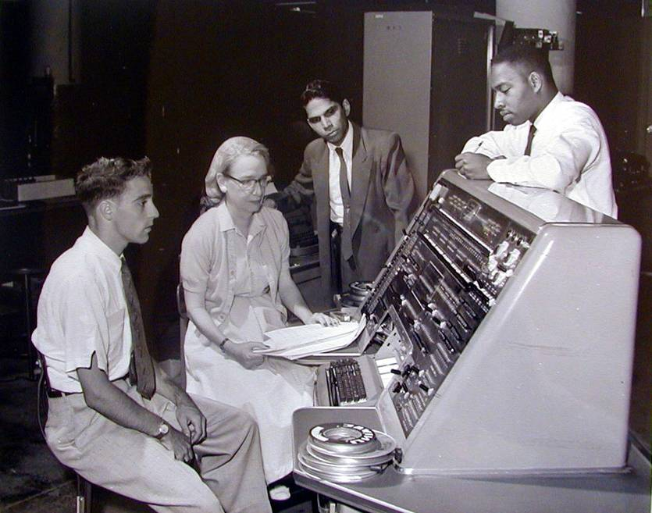
Design Tools
Notes:
Our research group's goal is to create the tools that will enable designers and end users to design interactive systems for the era of pervasive computing.
The idea of creating tools to empower users has a long and storied history in computer science, beginning with Grace Hopper’s invention in the early 1950s of the first compiler. What’s inspirational for me is that she conceptualized how improved tools could provide a much wider audience with access to computation.
As computation moves beyond the traditional desktop and software packages for individuals, there are two frontiers for design tools today : one is development with and for the web, the other is ubiquitous computing with new form factors.

Slide 3
The Long Tail of Software
Alpha Applications
# of Lines of Code
Situational Applications
Applications
Notes:
The majority of web-based and ubiquitous computing systems lie in the “long tail” of the application space.
Compared to “killer applications”, such as operating systems or office suites, many mobile systems contain relatively small amounts of code. However, the total number of these systems is quite large, which suggests that this area is ripe for domain expert programming.
Examples of domain experts include scientists, Web 2.0 programmers, ubicomp designers, hobbyists, and so forth.
Our group’s main goal is to support design and development in the long tail of ubiquitous computing.
By enabling domain experts through programming models and tool support, we greatly increase the number of people able to work towards a vision of ubiquitous computing.
One particularly important aspect here is prototyping of applications, and much of our work has concentrated on this area.

Slide 4

Prototyping
Notes:
Take this prototype of a digital camera developed at IDEO, at a time when such Cameras had not yet broken into the consumer space. IDEO was tasked to find a way to make sense of possible digital camera interactions – what were the fundamental modes of use? To explore, designers built this mockup of a camera back – it’s clearly not to scale, and it’s tethered by a thick umbilical to a desktop computer that drives the graphics and application logic. What matters though is that it has the right set of inputs and co-location of input and output which allows users to experience the artifact as if it was a camera.
Exploring user experience questions through prototypes is particularly important as we design for computing in our pockets, homes, and environments, where interaction models and use cases are still emerging.

Slide 5
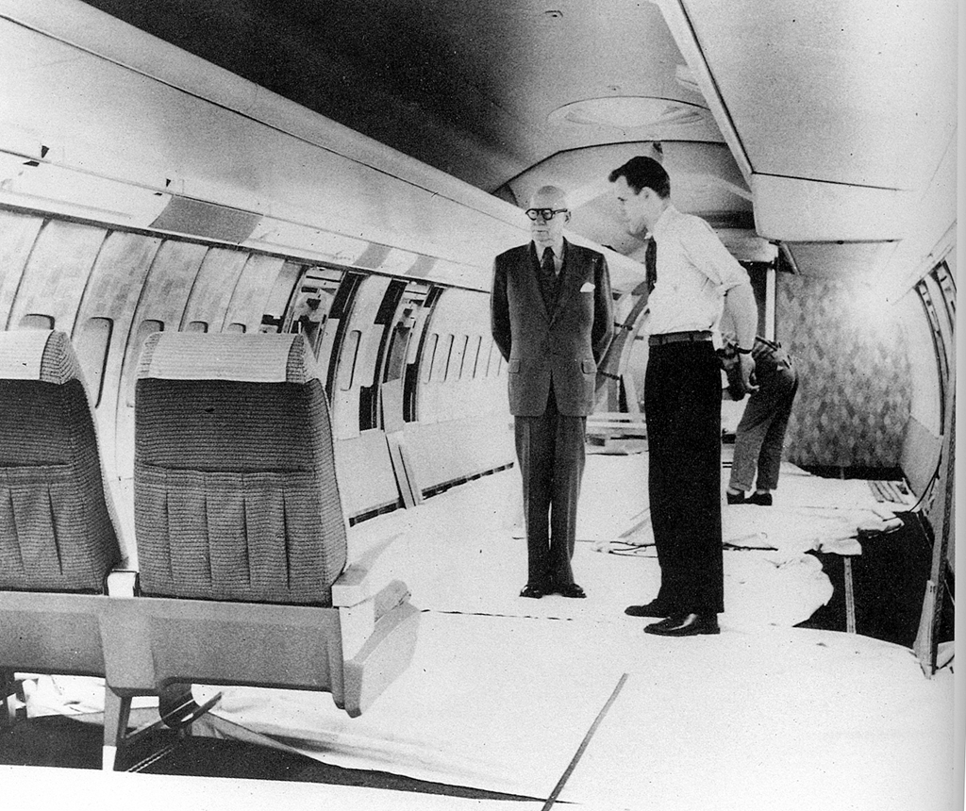
Prototyping
Notes:
Of course, prototyping has its own history. How do create a comfortable environment for intercontinental flights?
Build a full-scale mockup in a warehouse. This is a prototype for the interior design of a Boeing 707, the first commercially successful jet liner, 1950s.
Walter Dorwin Teague, one of the industrial design pioneers that introduced modern design process

Slide 6
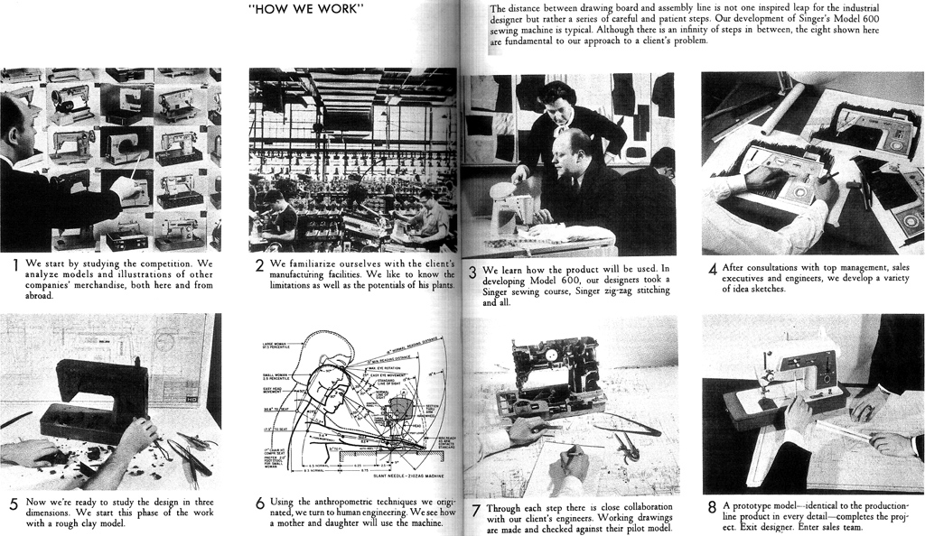
Design Process
Notes:
Henry Dreyfuss, one of Teague’s main competitors, captured the process by which industrial design creates new artifacts in a way that maximizes the utility and success in the 1950 book “Designing for People”. Dreyfuss’ process was based on observation and fieldwork, followed by development of many sketches and prototypes, which are tested, analyzed, and iteratively improved. While user-centered design as a whole still follows this process, I’d like to suggest that there are some important differences in how prototyping happens today.

Slide 7
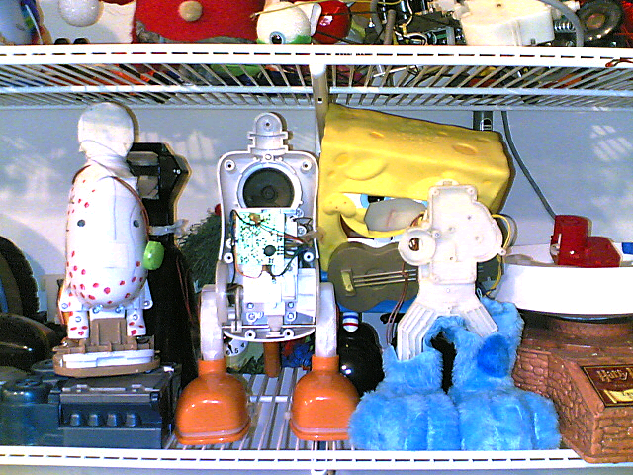
Design by Example Modification
Notes:
One of those differences is that, in our life in the Plentitude, as Rich Gold called it, we’re surrounded by an awful lot of existing stuff. And those artifacts are often used as jumping off points for new design. For example, in an interview study with professional toy designers that we conducted a while ago, all of our participnts reported that prototypes for new toys often start by cannibalizing the mechanisms and electronics of existing toys, and hot-gluing and hot-wiring them together. In fact, shopping for interesting mechanisms at Toys’R’Us is considered part of their job.

Slide 8
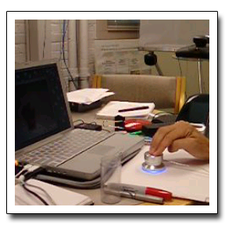
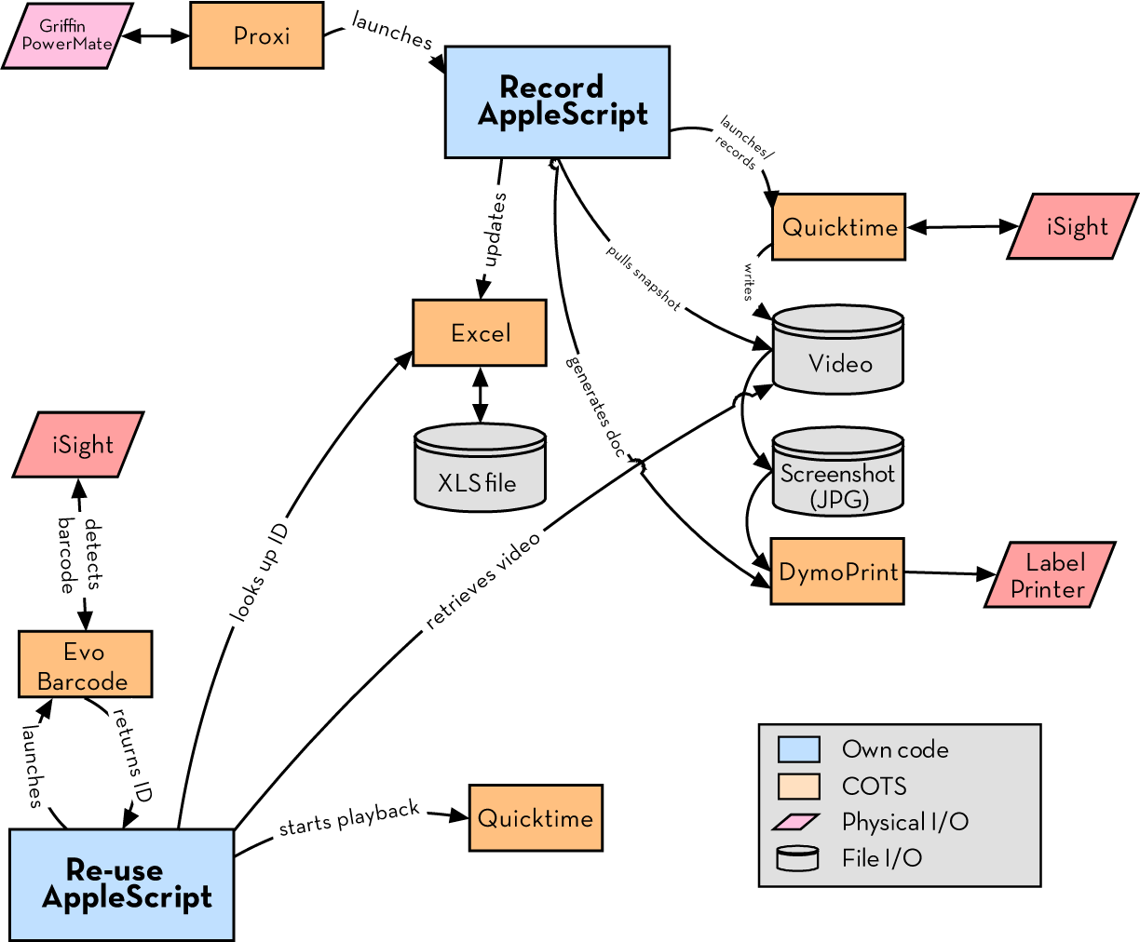
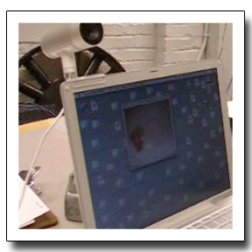
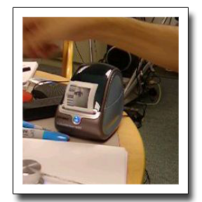
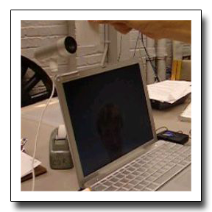
Button
initiates recording
Record
video message
Print barcode
Scan barcode
to retrieve message
Notes:
Sure enough, we find analogous practices in software. Prototypes may combine off-the-shelf software packages and copy-pasted code. Here’s an example of a document annotation prototype we saw in that same study. The purpose of the system is for design teams to annotate printed documents with video snippets using bar code stickers. This system used five different off the shelf apps, glued together with AppleScript found on the web and then modified. As the creator commented: “The main task (in his prototyping practice) was finding a match between his requirements and existing stuff.” (rewrite)

Slide 9
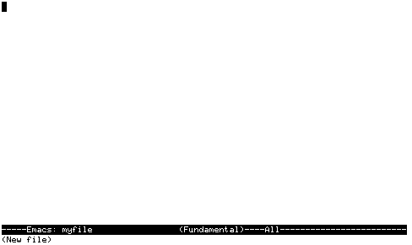
Notes:
If one looks at today’s design and development tools though , there seems to be an implicit belief that software is designed tabula rasa. That we start with a blank canvas and create a bunch of code.
How should design tools change if it’s much more common for software to be created by example modification? If designers and developers find something on the web, in example files, or in the source tree that provides an example that’s “kind of like” what the developer is interested in and then modify it?

Slide 10
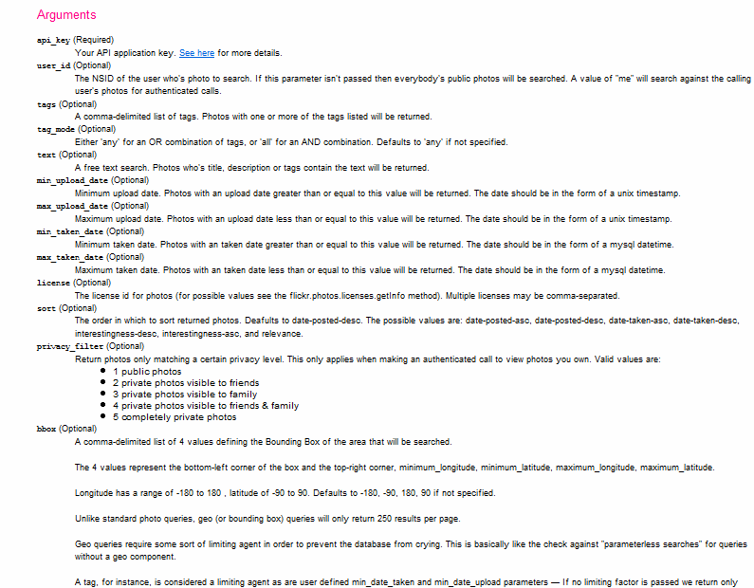
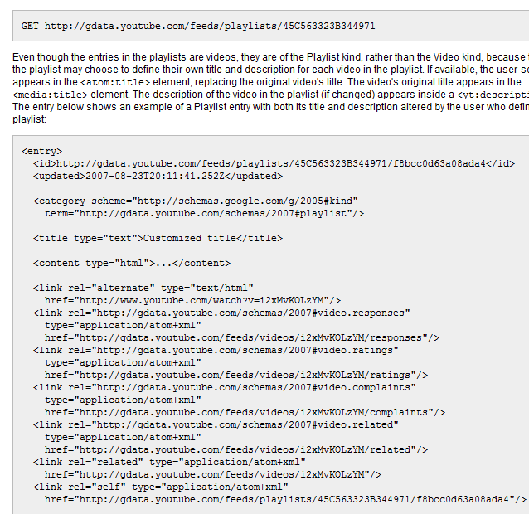
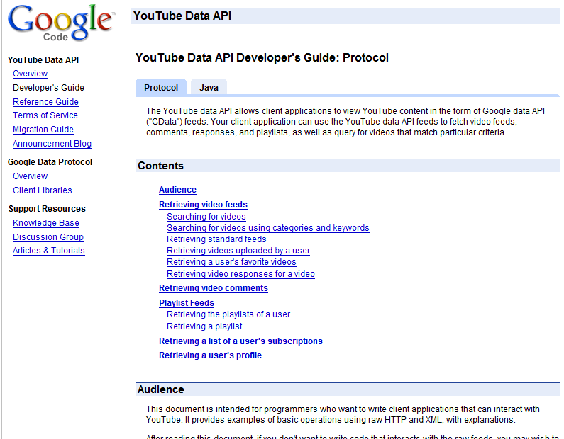
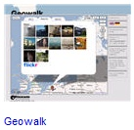
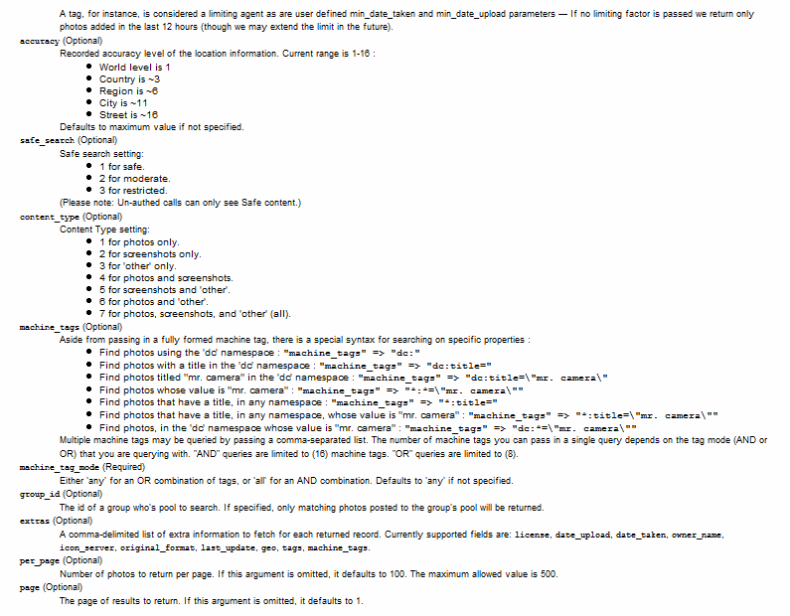
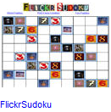
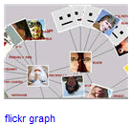
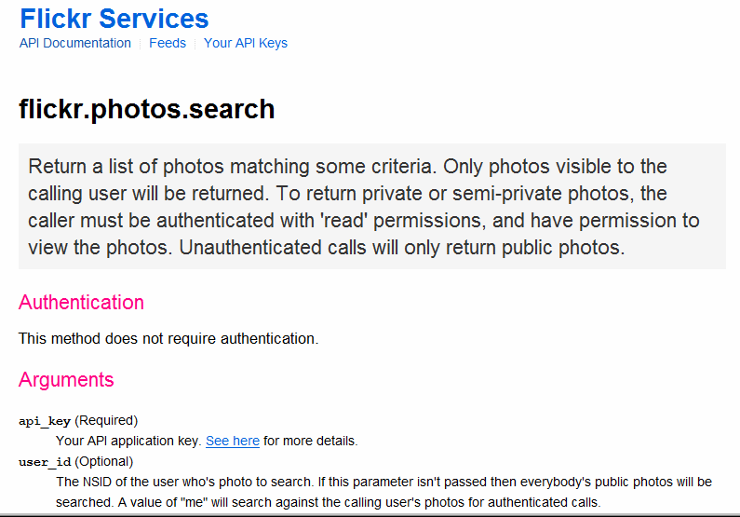
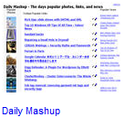
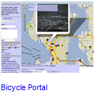
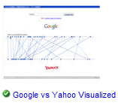
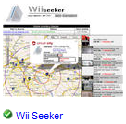
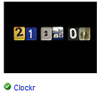
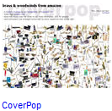
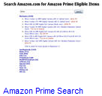
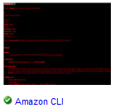
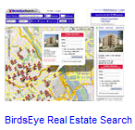
It’s easy to understand the sites,
but not their services.
[programmableweb.com]
Notes:
One strategy is to help people find good examples to work off.
“Programming by google search” is especially relevant in the growing area of working with web service APIs.
There are currently more than 500 public web-service APIs available, offered by most big internet companies: Yahoo, Google, Microsoft, Amazon, eBay, and AOL.
This issue of example modification is NOT unique to web application development, however web applications offer a distinct upportunity to address this modern development challenge.
<click>
One frustrating problem of programming the web today is that programming models and documentation conventions vary widely – there is no global type hierarchy to rely on, and there is no javadoc for web services.
<click>
So while it’s easy to understand the web sites, it is much harder to understand their services.

Slide 11
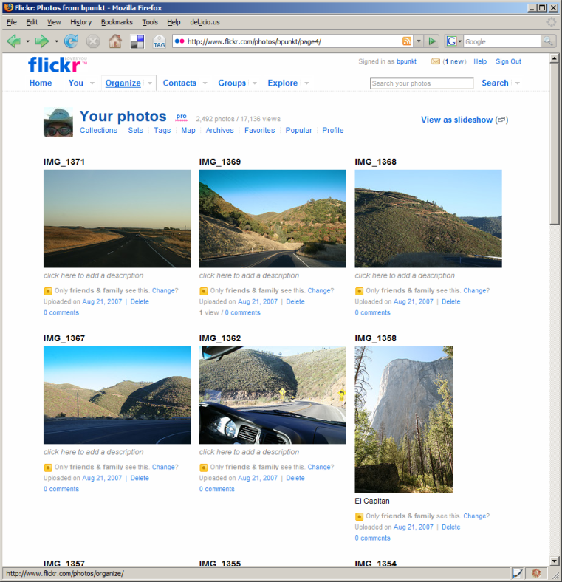
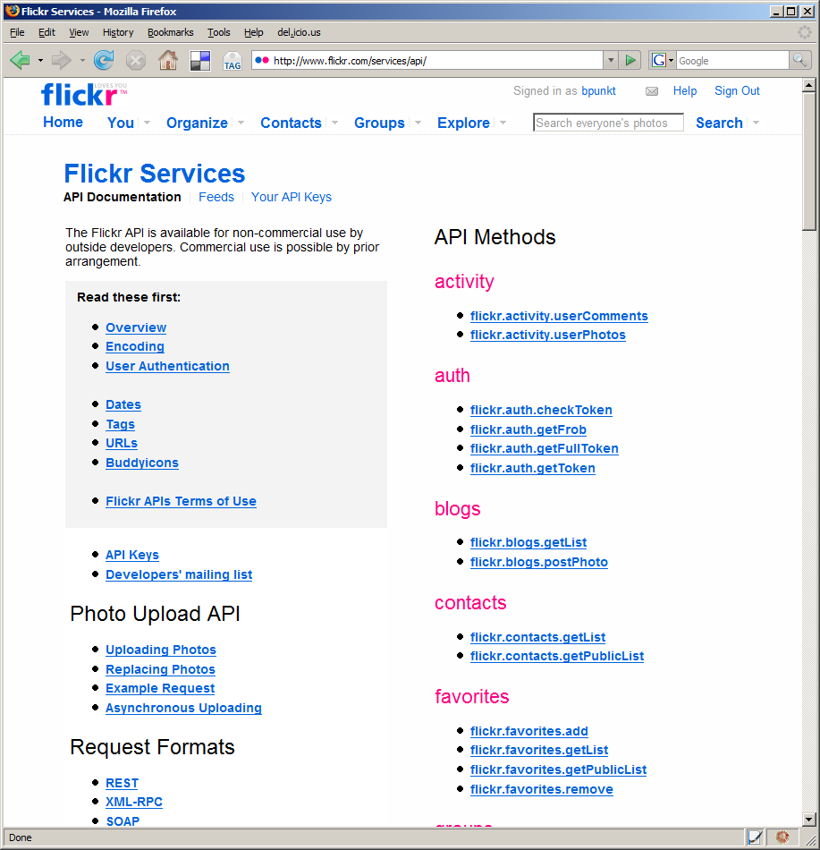
Web sites and their APIs are correlated…
≈
…let’s leverage that fact!
[flickr.com]
Notes:
To bridge this chasm, we note that web sites and their APIs are correlated.
For example, I can both look at the set of images taken on my last trip to Yosemite on the flickr website, AND I can retrieve the same set of images by calling an appropriate method in the flickr API.
The site and its API offer complementary views of the same underlying functionality.
In essence, the web site is the largest functional example of what can be accomplished with an API.
Our work on d.mix seeks to leverage the value that can be achieved by coordinating these representations.

Slide 12
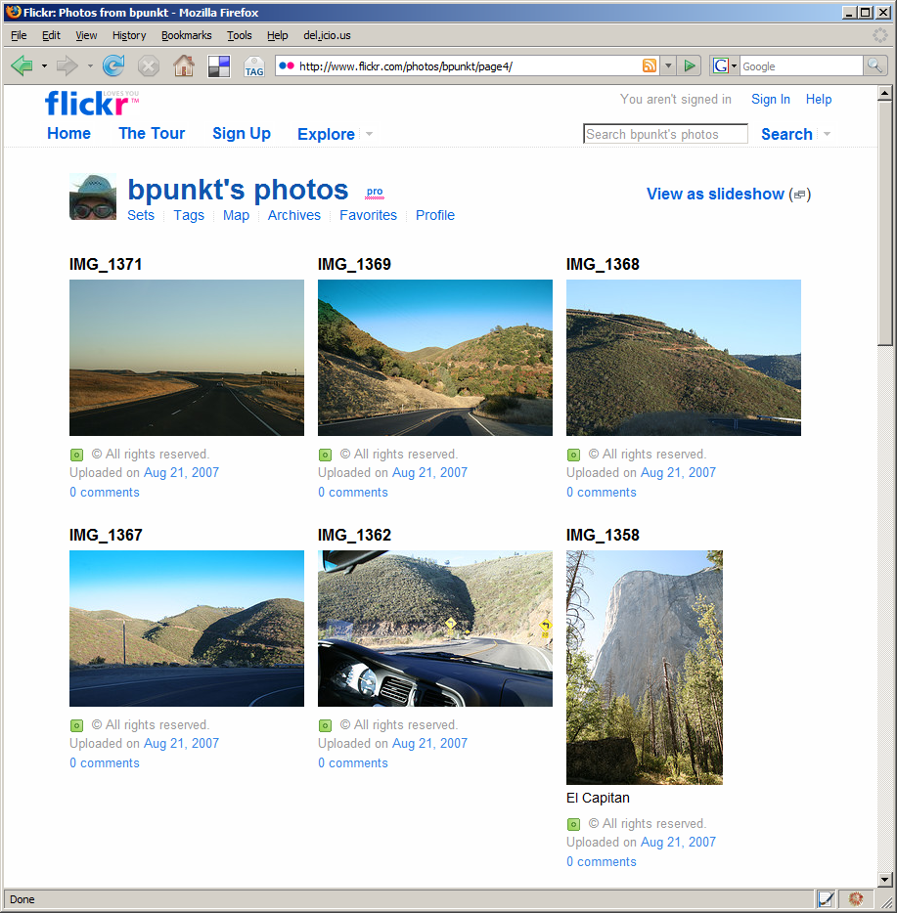
Give me the code for this!
Notes:
d.mix models the correspondence between html pages and api calls to let users create program code by sampling content from a web page. (space)
It co-locates two different kinds of information on one page: examples of what functionality a web
site offers,

Slide 13
To retrieve this image, use:
flickr.photos.getInfo(
user_id = '73866493@N00', photo_id= ‘3208312’)
Notes:
together with information how one would obtain this information programmatically.
With d.mix. users can generate working code examples by selecting the information on the web site itself.
This selection technique allows users to remain in the domain of their task goal, in this case retrieving images.

Slide 14
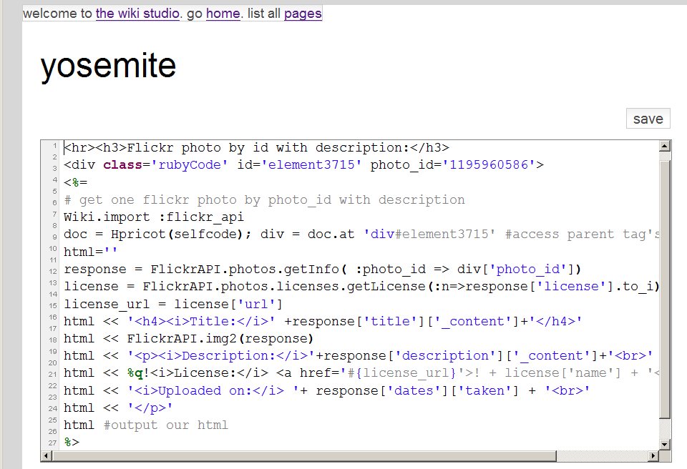
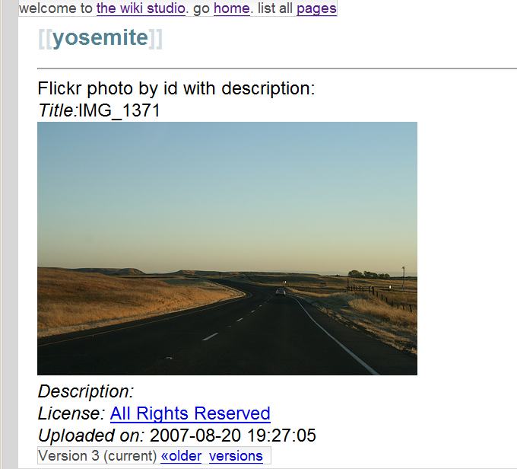
d.mix active wiki
Source code generated by d.mix
is executed in the active wiki
Notes:
The source code generated through sampling with d.mix
Can then be copied to an active wiki, a server-side code environment, where it can be edited and safely executed. (click) The
active wiki provides a configuration-free environment for
rapid experimentation.

Slide 15
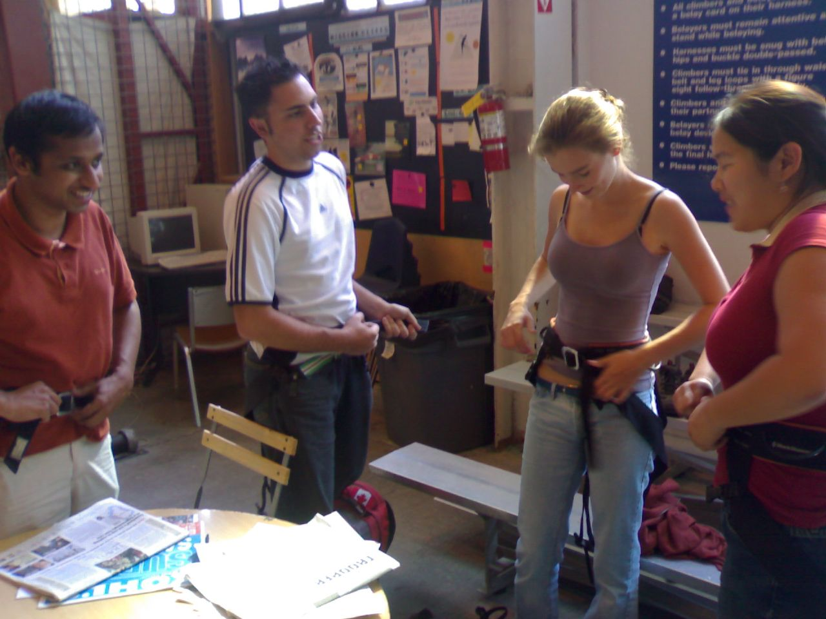
Scenario
Notes:
This scenario will clarify the main interaction techniques of d.mix:
A group of rock climbers would like to create a photo page for the group,

Slide 16
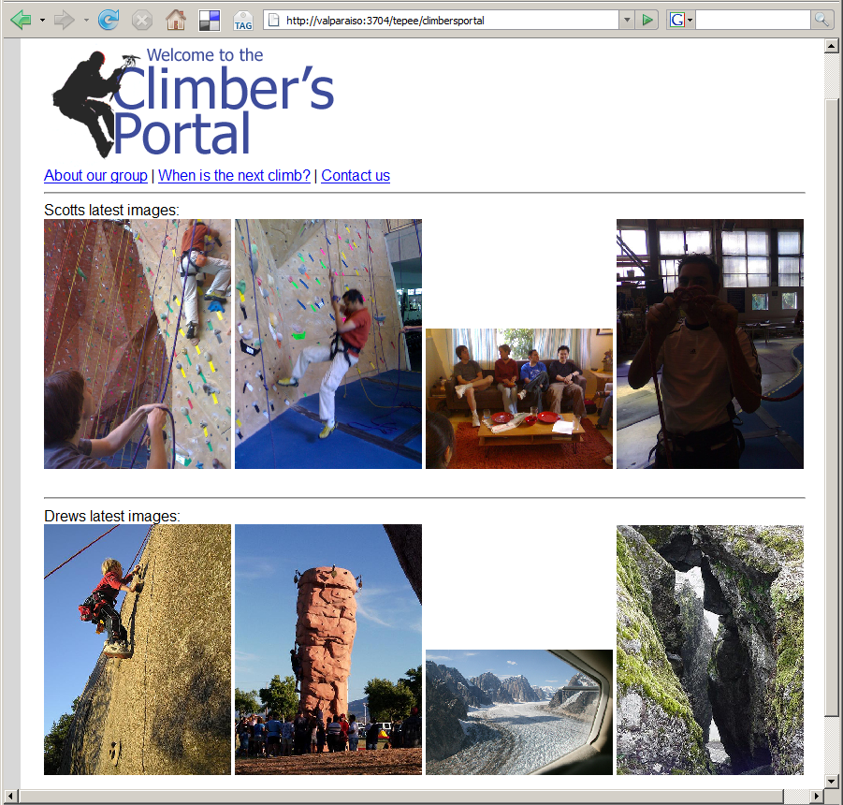
Notes:
Which should always show the latest iamges from the groups’ trips without requiring manual updates.

Slide 17
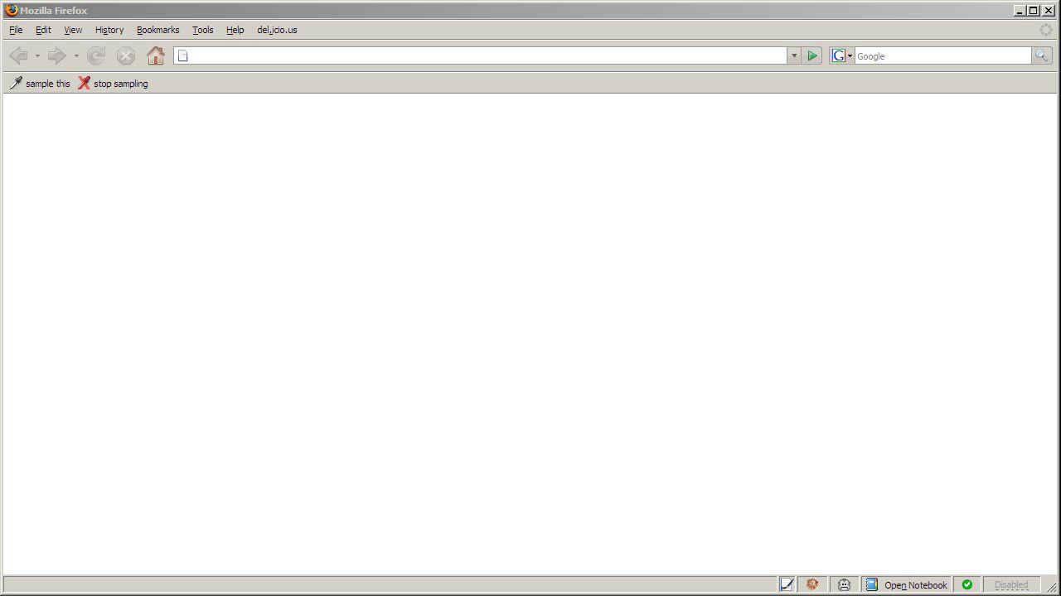
Notes:
Drew keeps his images on Flikckr where he aggregates them in an image set.
Jane begins by navigating to drew’s flickr page and clicks on the “sample this” button in her browser.
The page now shows dashed borders around items she can retrieve through the site’s API.
By right-clicking she can copy drew’s climbing image set into her sampling bin.
From the sampling bin, she sends selected items to the d.mix active wiki.
Because d.mix performed a deep copy of the images by generating web API calls,
Jane can edit parameters of those calls through a property sheet.
Here she sets that only the two most recent images for one of the image sets should be returned.
Jane can also change the source code that d.mix generated for her.
In the source view, she can add static HTML to the page or edit the web API calls made to retrieve images from flickr.

Slide 18
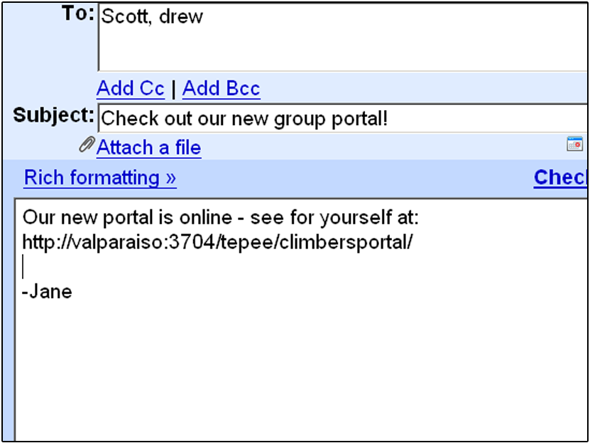
Notes:
When Jane is satisfied with the rendered view of her page, she can share the URL of the page she created with her group members.

Slide 19
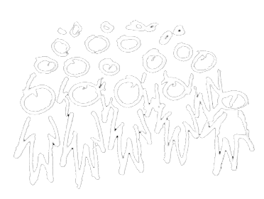

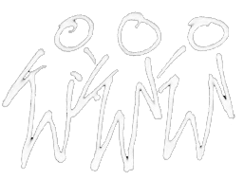
d.mix users
Site owners or lead users define mappings between sites and services (once).
Lead Users
Web Developers
End Users
Notes:
There are several classes of users that work with d.mix.
First, lead users manually establish the correlation between sites and their services.
Alternatively, webmasters at sites such as Flickr, Yahoo, or Amazon.com could easily provide such mappings.

Slide 20
Web developers create d.mix applications
Lead Users
Web Developers
End Users
Notes:
After a small number of lead users author these mappings, many more web developers can create applications in d.mix and quickly prototype web-based mashups.

Slide 21
End-users run (and tailor) applications
in the d.mix wiki.
Lead Users
Web Developers
End Users
Notes:
Finally, end-users can run applications written in d.mix, by visiting them from any browser.
End-users can also tailor applications created in d.mix, by copy and pasting code from one d.mix wiki page to another.

Slide 22
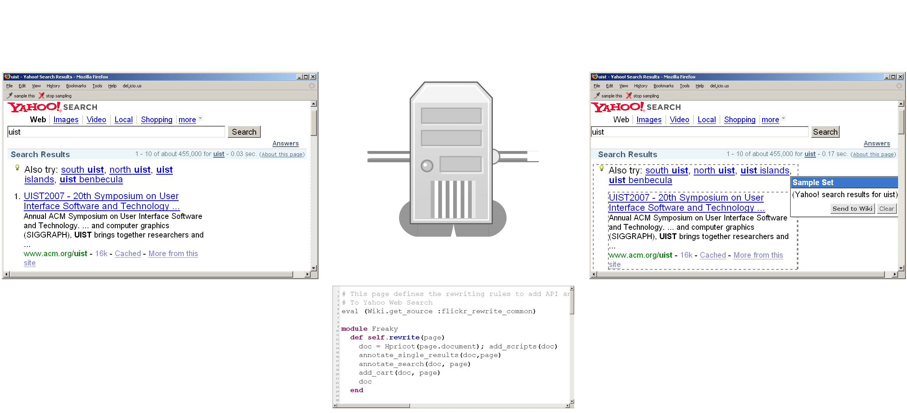
d.mix Proxy Architecture
Rewritten page
with API annotations
Original Page
Proxy Server
Site-to-Service Map
(hosted on d.mix wiki)
Notes:
d.mix uses a programmable HTTP proxy that rewrites the original web site, adding API annotations. Each API annotation contains an associated snippet of code that generates a working web service call, in our case in the Ruby programming language.
The programmable proxy knows how to annotate web pages by using asite-to-service map. (space)

Slide 23
Authoring the Site-to-Service Map
…Without Help From the Site Owner
1 Map URL to Page Type
2 Identify visual elements in page to annotate (using XPath/CSS selectors)
3 Extract arguments for service calls from page source
Bind arguments to web service code snippet
Notes:
How does a 3rd party developer author a site-to-service map? (space)
First, a developer maps web page URLs to web “page types”. (space)
For any given “page type”, a developer defines a combination of XPath and CSS selectors that identify the visual elements to be annotated (space)
They then define selectors that infer web service arguments given the markup on a page. (space)
Finally, these arguments are bound to a web service code snippet
Note that it is easier for site owners to provide this mapping, as they do not need to infer these relationships programmatically through scraping. We hope that in the future, site owners will provide such site-to-service mappings for the larger web developer community.

Slide 24
Why Not Just Scrape?
Scraping at design-time rather than
at run-time minimizes brittleness
Web service calls can be parameterized
Scraping at run-time can lead to lock-out
Notes:
So why not rely solely on scraping, without trying to generate web service code?
(space) Web site content and markup change quickly. Thus, programs based on scraped content can be brittle.
web service APIs are more stable. Since applications are authored once, but executed many more times, scraping once at “application design time” is preferable to scraping at execution time.
(space)
Furthermore, web service calls can be meaningfully parameterized by changing the arguments used to call them. This is not possible with scraped content.
(space)
Finally, scraping may not scale. Many sites monitor their traffic and actively lock out clients that request a large number of pages in a short amount of time.

Slide 25
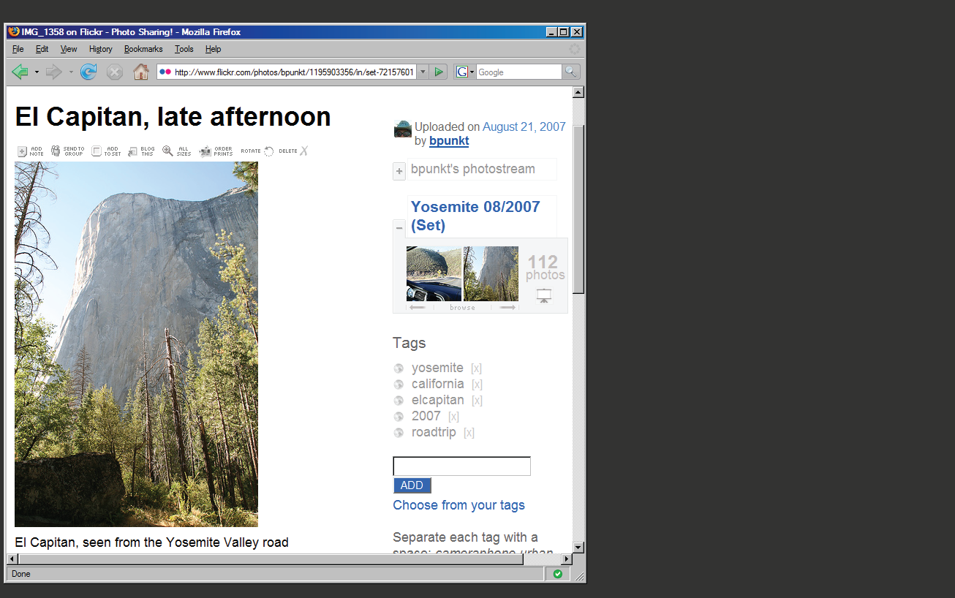
Notes:
Let me illustrate the process of creating a site-to-service map with a concrete example.
Here is a single photo page from flickr.com.

Slide 26
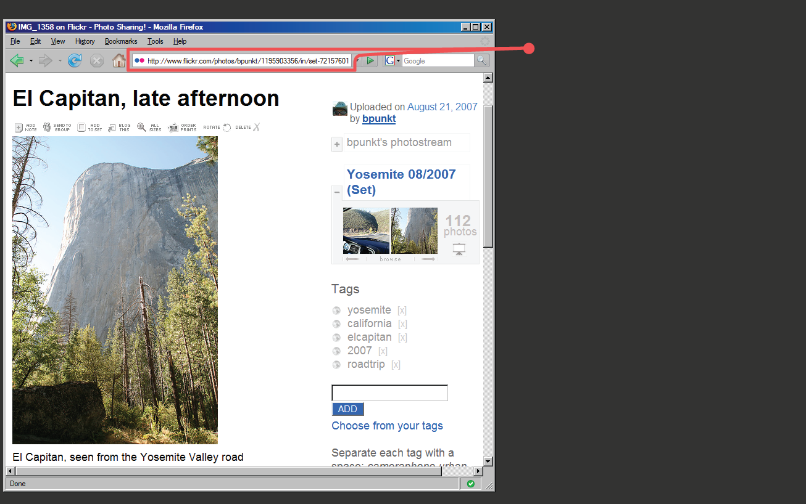
Page URL:
flickr.com/
photos/
<username>/
<photoid>/…
Regular Expression:
%r{flickr.com//?photos/
[^/]+/\d+/?&script}
Notes:
First, we note that photo pages have a consistent URL structure.
Thus, we can define a regular expression that detects similar photo pages,
And a set of expressions that furthermore classify pages into distinct page “types”.

Slide 27
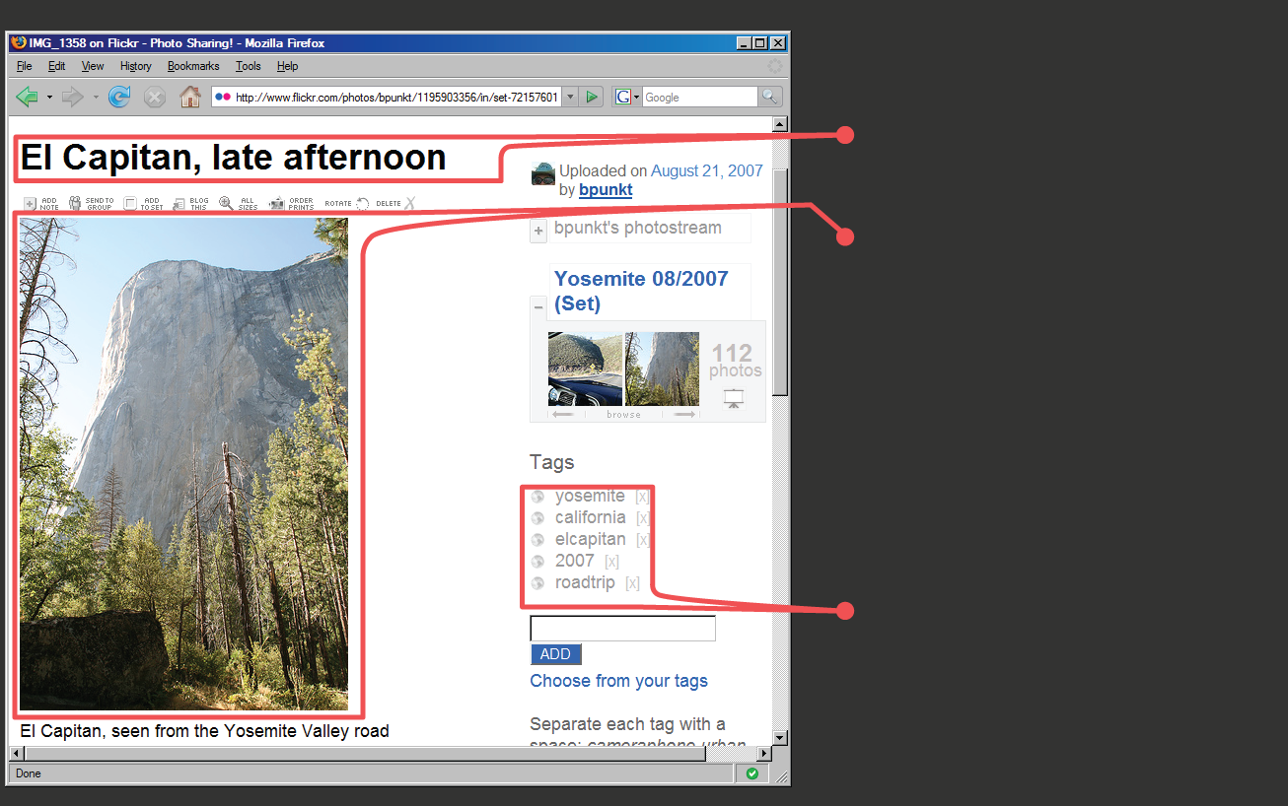
Photo Title
Image URL
Tag Search
Notes:
Here are three items of interest: a photo’s title, the URL for an image, and a way to run a tag search (SPACE, SPACE)

Slide 28

Photo Title
(doc/"#title_div")
Image URL
(doc/"div.photoImgDiv")
Tag Search
(doc/"div.TagList")
Notes:
Each of these items can be accessed by searching the DOM, the document object model.
d.mix uses a combination of CSS and XPath selectors to identify elements, highlight them, and add a context-menu handler to each element.
For any given item on the page, there may be multiple matching web service calls that return that element. For example (SPACE), one can either sample “the first image in a photo set” or “this particular image”. d.mix generates multiple entries in the context menu to let the user guide the generalization process.

Slide 29
flickr.photos.getInfo(
photo_id = “298655528”).title
info = flickr.photos.getInfo(
photo_id = “298655528”)
URL = “http://farm”+ info.farm-id
+ “.static.flickr.com/”
+ info.server-id
+ “/” + info.attributes[”id”]
+ “_”
+ info.secret
+ “.jpg”
Extracted from page source:
Within <div> for all tags:
tag=div.at("a.Plain").inner_html
flickr.photos.search(
tags = “yosemite ...”)
Notes:
The site-to-service map then specifies how to connect each of these items to a source code snippet.
For example (SPACE) to perform a tag search, one needs to pass in the appropriate tag to a specific method. These arguments are also extracted using CSS and XPath selectors.

Slide 30
Putting it all together…
def self.annotate_photopage_tags(doc)
(doc/"div").reject{…}.each do |div|
tag = div.at("a.Plain").inner_html
src = generate_tag_search_source (...)
doc.at("body").inner_html +=
make_context_menu(div.at("a.Plain"),
["Images matching tag #{tag}"],[src])
end
Notes:
Continuing this example, here is an abbreviated form of the Ruby code that defines part of the site-to-service map for Flickr.com.
To summarize, it…

Slide 31
Putting it all together…
def self.annotate_photopage_tags(doc)
(doc/"div").reject{…}.each do |div|
tag = div.at("a.Plain").inner_html
src = generate_tag_search_source (...)
doc.at("body").inner_html +=
make_context_menu(div.at("a.Plain"),
["Images matching tag #{tag}"],[src])
end
Extract tag name
Notes:
…extracts tag names

Slide 32
Putting it all together…
def self.annotate_photopage_tags(doc)
(doc/"div").reject{…}.each do |div|
tag = div.at("a.Plain").inner_html
src = generate_tag_search_source (...)
doc.at("body").inner_html +=
make_context_menu(div.at("a.Plain"),
["Images matching tag #{tag}"],[src])
end
Instantiate Source Example
Notes:
…instantiates working examples for each different tag

Slide 33
Putting it all together…
def self.annotate_photopage_tags(doc)
(doc/"div").reject{…}.each do |div|
tag = div.at("a.Plain").inner_html
src = generate_tag_search_source (...)
doc.at("body").inner_html +=
make_context_menu(div.at("a.Plain"),
["Images matching tag #{tag}"],[src])
end
Add annotation to original page
Notes:
…and adds code examples as annotations on the original page

Slide 34
Dataflow Summary
d.mix design time
sends
code to
d.mix run time
adds
annotation
invokes
Web site
Web service
Notes:
After adding annotations, working code examples can be sent to the d.mix active wiki. (SPACE)
The active wiki enables quick testing and modification of generated code. (SPACE)
The code then queries the original web site programmatically.

Slide 35
Active Wiki
Wiki editor provides syntax-highlighting for Ruby script
Sandboxed execution runs
script with limited capabilities
Libraries facilitate invoking
web services and
manipulating results
Notes:
After code is copied or appended to wiki pages, programs can be modified directly in the active wiki
(SPACE)
Programs are then run in a sandboxed execution model. For example, a program may make a web service call, but it does not have read/write access to the wiki server’s file system.
(SPACE)
The active wiki also provides libraries that faciliate calling web services and transforming the results.

Slide 36
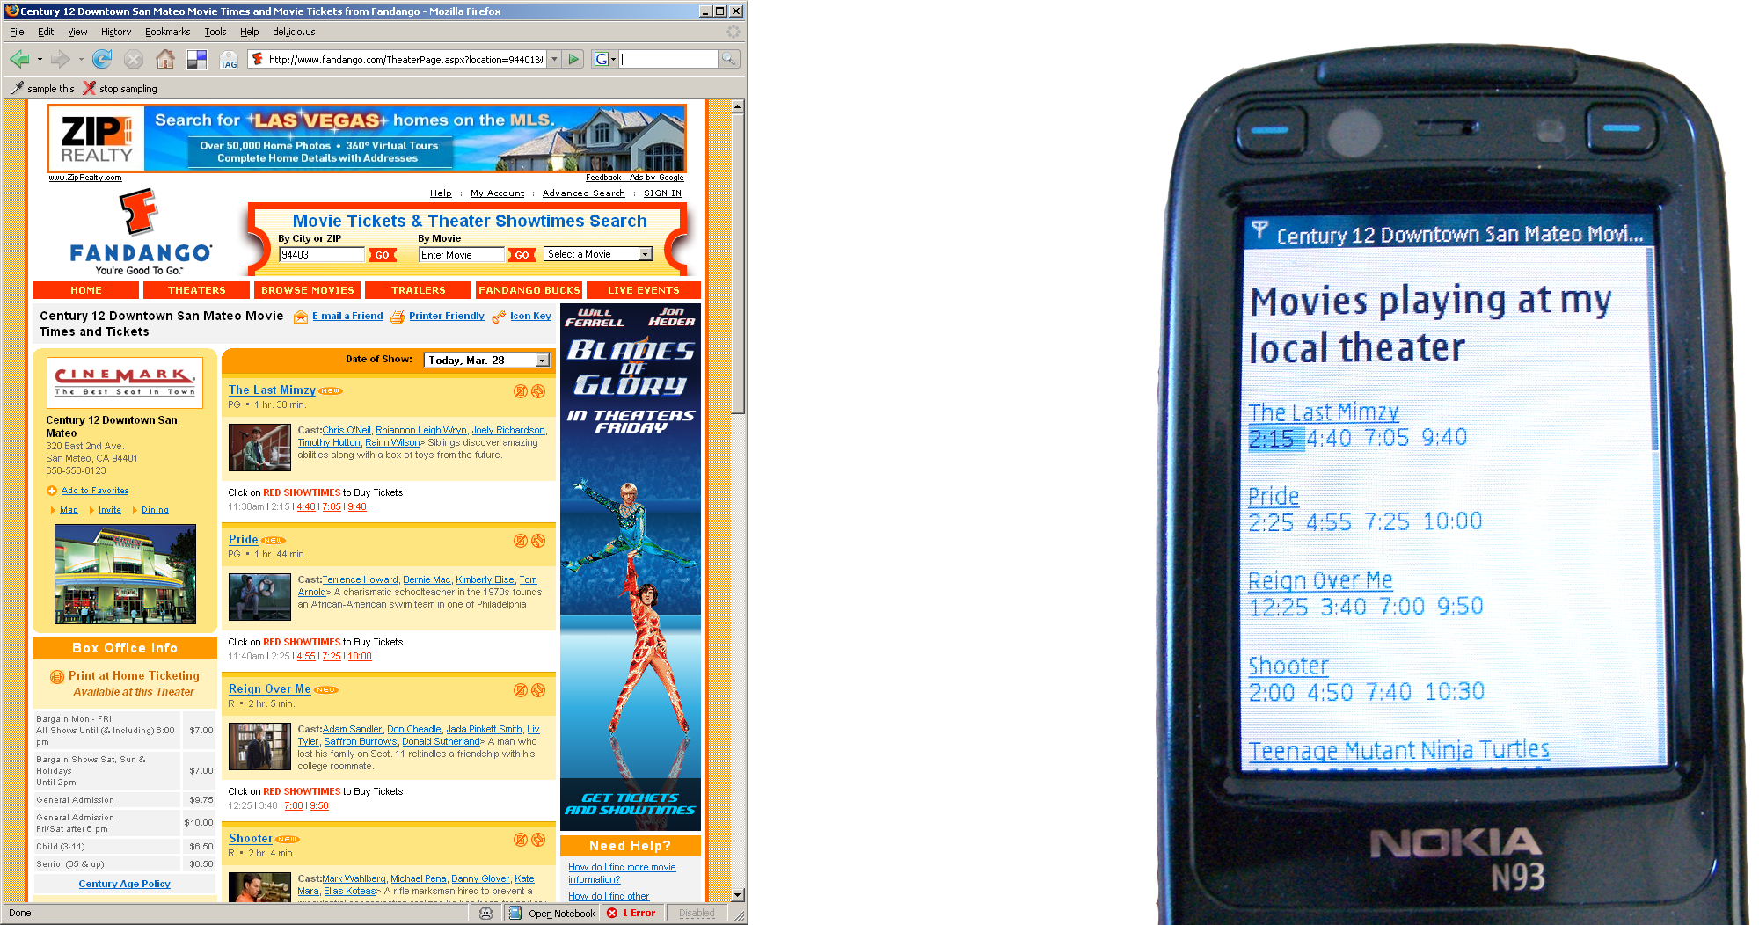
Beyond the Desktop Browser
Notes:
A proxy that can be programmed with code hosted on wiki pages is a flexible, general tool for prototyping web applications. For example, we have used the d.mix architecture to create an application that reformats web content to better fit mobile devices. It extracts only essential information — here, movie names and show times — from
a cluttered web page. This application took half an hour to build using the d.mix system.

Slide 37
What we borrowed and what we wrote
Front end
Yahoo! UI
(annotation UI)
JQuery (selectors)
Back end
MouseHole (proxy)
Tepee (wiki)
Freakyfreakysandbox (safe execution)
Hpricot (selectors)
Bookmarklet
Annotation code
d.mix library
Site-to-service map
API wrappers
UI logic
Notes:
(PAUSE)
d.Mix builds on a number of freely available open source toolkits which facilitate front-end and back-end development on the web. In particular, d.mix takes an existing programmable HTTP proxy, the mouseHole, among other software, and adds logic to annotate pages and author site-to-service mappings.

Slide 38



Prototype Site-to-Service Library
API | Supported Actions | Site-to-Service map code size
 | Get images from a user’s photo stream, with or without meta data Get images from an image set Get images from individual photo pages Get images matching tags, global or per user, from tag clouds and photo pages Get images by global image id Get images from full-text search | 355 lines
 | Single web search result Web search result set | 54 lines
 | Retrieve a user’s videos Retrieve most recent videos Single search result Search result set | 115 lines
Notes:
(Switch to Bjoern here)
To evaluate the authoring approach embodied in d.mix, we wrote a prototype site-to-service library that supports three web sites and their services:
Flickr, Yahoo! web search, and the YouTube video site.
For each site, our library supports a subset of the API.
For example, the library provides methods to perform full-text and tag searches
and copy images from Flickr, but it does not support extraction of user profile information.

Slide 39
First-use Lab Study (n=8)
All participants had some programming experience, knew HTML
Four had no experience with web APIs
75 minute sessions:
Demonstration, warm-up, two design tasks
Notes:
With this library, we then conducted a first-use evaluation study with eight participants, aged 25 to 46. (SPACE)
We recruited participants with some programming and web development experience,
but only half had programmed in Ruby before. (SPACE)Also, only half worked with web APIs before..

Slide 40
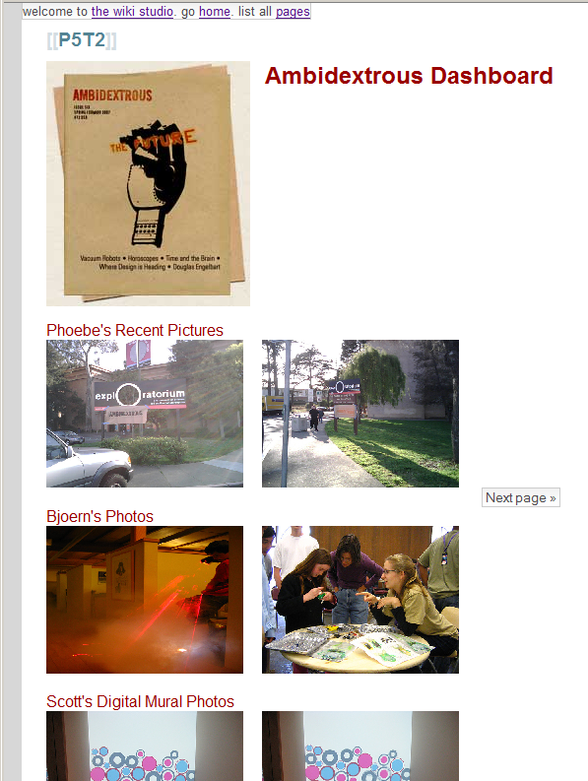
Total lines of code | 54
Written by participant | 13
Generated by d.mix | 41
Generated lines modified by participant | 4
Notes:
One design task was similar to our scenario — it asked participants to create an information
dashboard for a magazine’s photography editor to track image submissions by photographers. This required
combining data from multiple users on the Flickr site and formatting the results.
This image is a solution one of our participants created. The exciting result here is that everyone successfully built web applications in a very short amount of time. (SPACE)

Slide 41
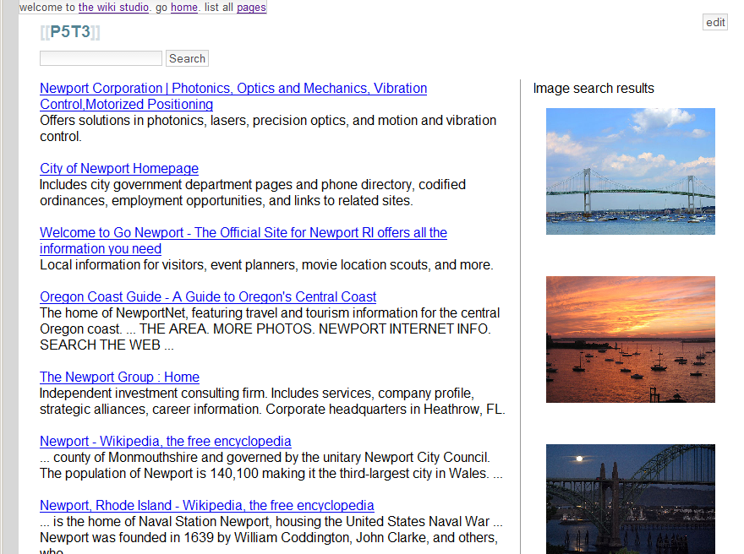
Notes:
The other task asked participants to create a meta-search engine by querying at least two different web
services and combining search results from both on a single page. This image also shows a page created in the study.
While participants were generally not familiar with the particular APIs involved in this task,
they did successfully modify the code generated by d.mix.
In addition, many leveraged their existing web design experience to add formatting commands such as CSS styles to the generated code.

Slide 42
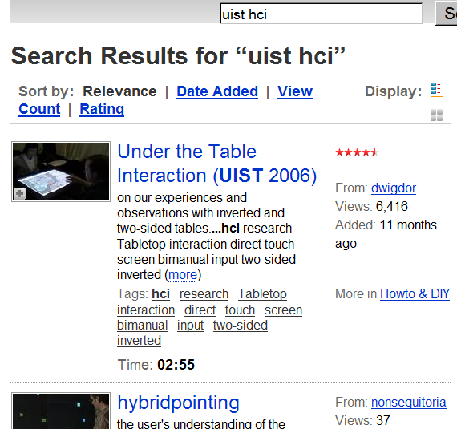
Lessons Learned
How do I know what I can sample?
?
Notes:
The user study also uncovered some important design suggestions for the future. d.mix users would first navigate to a page, then turn on annotation thorugh the sample this button.

Slide 43
Lessons Learned
How do I know what I can sample?
Notes:
However, because only some page items were supported by our limited library, participants would then discover that the desired data were not retrievable by d.mix.
A straightforward solution would be to proxy every single page request. Since annotating pages currently introduces a delay of a second or more, engineering for better performance is required to make this tractable.

Slide 44
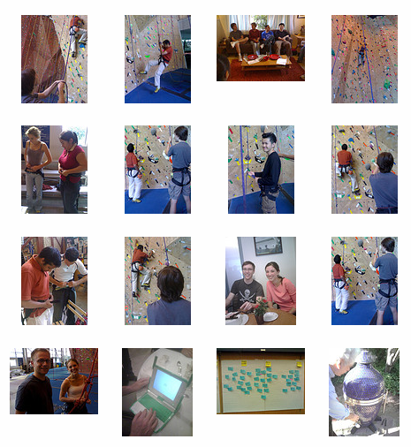
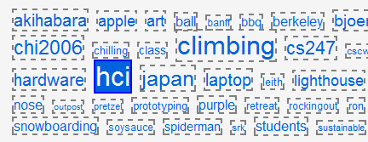
Lessons Learned
Offer multiple ways to sample information.
Sample from link to content
Sample content directly
Notes:
Some participants were also confused by two different approaches to sampling employed inconsistently:
For example, to specify a query for a set of Flickr images matching a specific tag, in d.mix, the user currently
must sample from the link to the image set, not the results.
However, to select images from a photo stream, the user must sample from the set of images itself, not the link. (SPACE)
This suggests that example-based programming tools for the web should consistently enable sampling from both the source and from the target page to support both interaction styles.

Slide 45
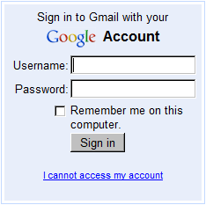
Limitations
Proxying the logged-in web is challenging
Notes:
There are also some architectural limitations of d.mix that we would like to acknowledge.
The logged-in web –, web-based email, online banking, -- relies on state maintained in the browser.
the current d.mix HTTP proxy does not handle cookies of remote sites as a client browser would.
So d.mix cannot currently sample content from the pages that require authentication beyond basic API keys.

Slide 46
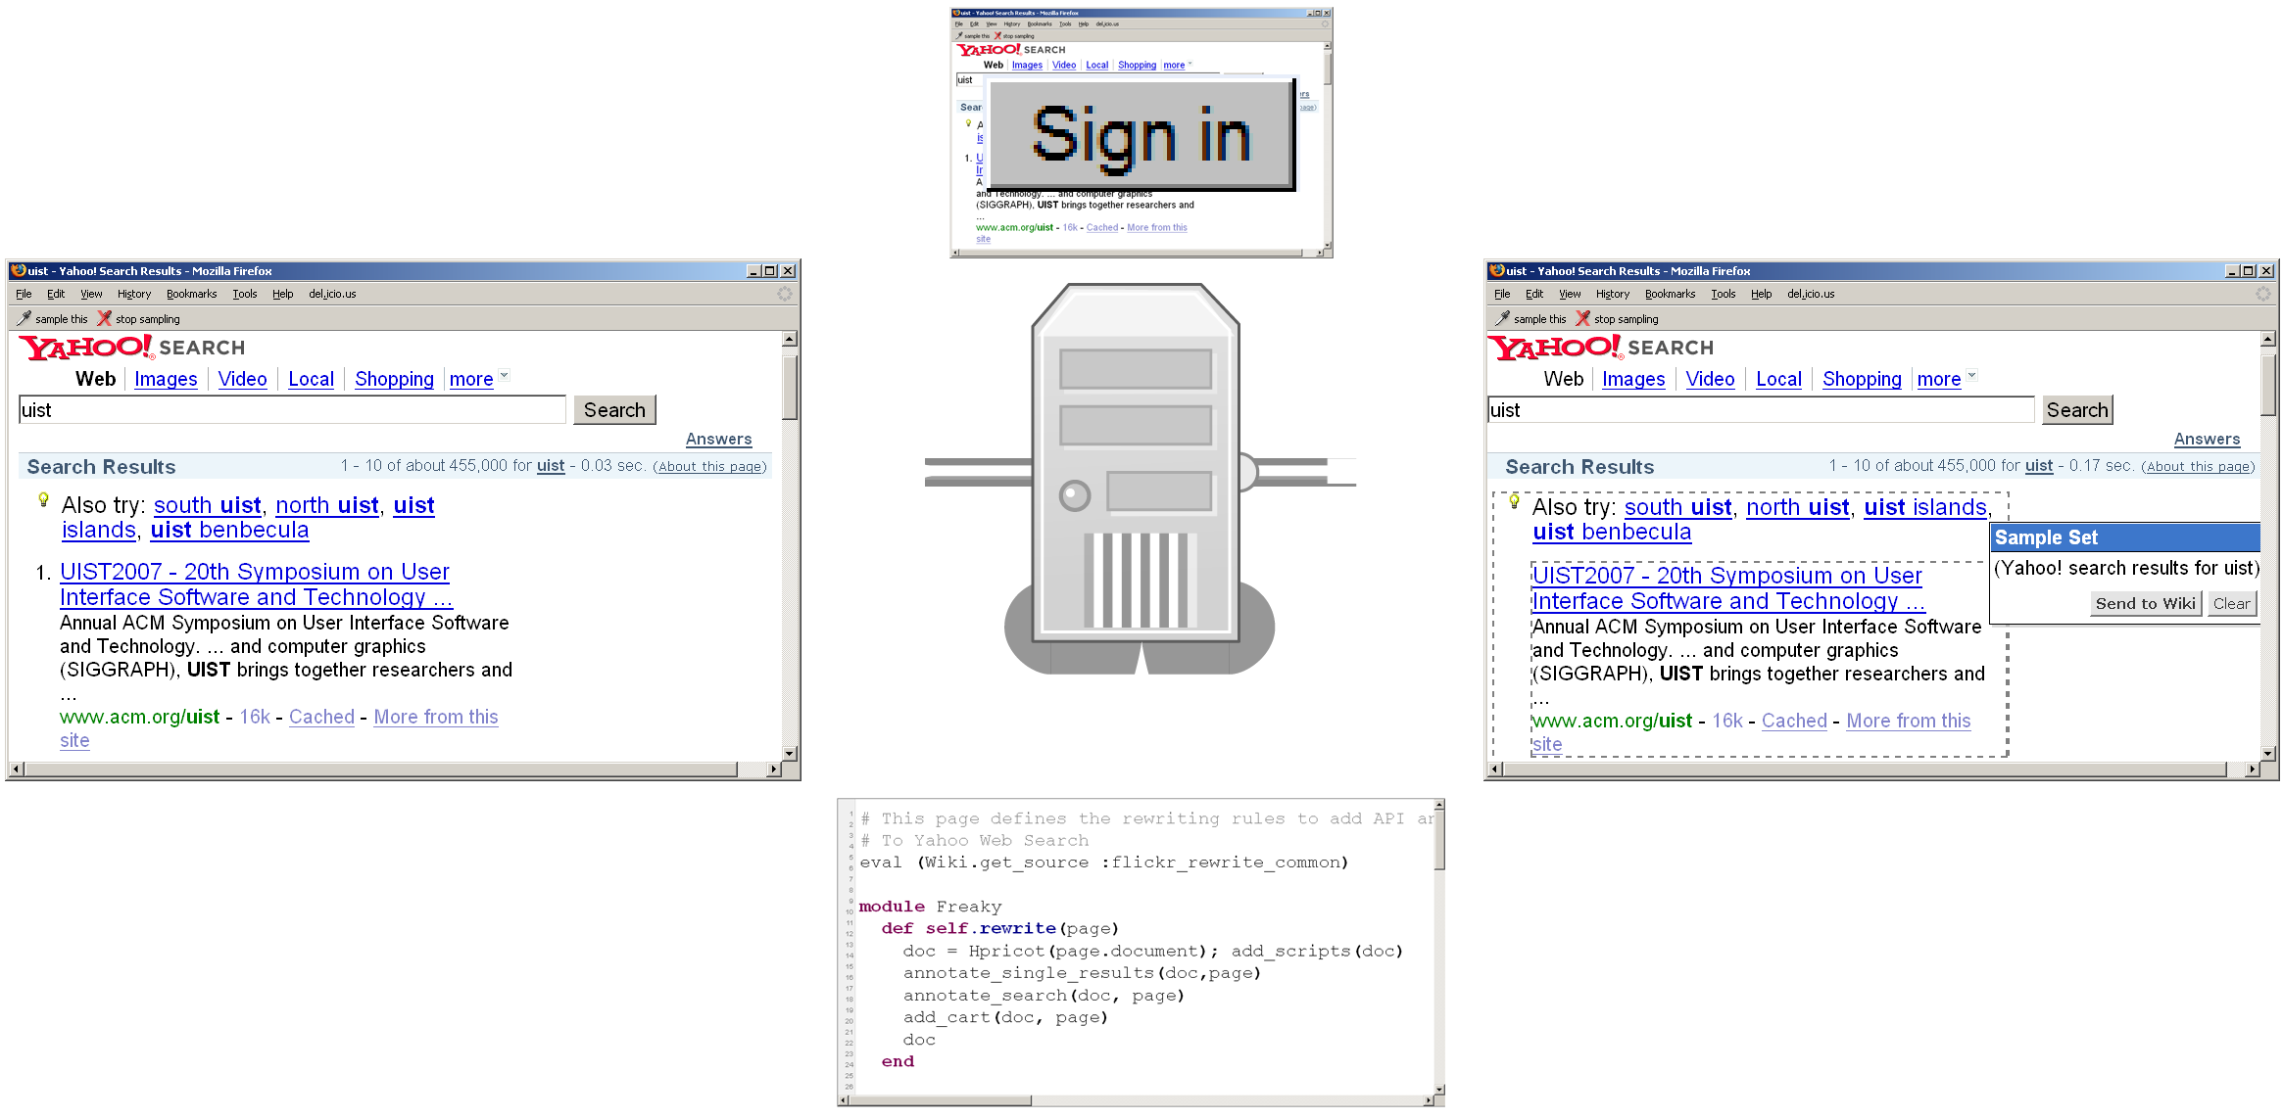
Limitations
Proxying the logged-in web is challenging
Notes:
The most promising solution to this problem is to co-locate a server-side “headless” browser (space) that can handle cookies with our proxy. We have some preliminary results that suggest this is a possible way forward.

Slide 47

Limitations
How can one sample APIs that provide interactive widgets intead of data?
Notes:
Third, the examples we have shown focused on sampling content: photos, text, videos. Other web services offer rich interaction widgets, for example for building user interface components and for map navigation. We have not yet addressed how the principal action of selecting annotated items would extend to such services.

Slide 48
Contributions
Search for programming examples in the solution domain, not the code domain.
d.mix instantiates this idea for web service APIs through a site-to-service map.
Integration of page annotation and script hosting enables rapid experimentation.
Notes:
In summary, the underlying research idea of our work is to search for programming examples in solution space, instead of code space, and then map back from application output to code that can generate that output.
(SPACE)
d.Mix is an instance of this idea for programming with data-centric web service APIs.
Conceptually, d.mix is enabled by a mapping from HTML pages to the API calls in a site-to-service map.
(SPACE)
On a technical level, we introduced a prototyping environment for web service code through the integration of
a programmable proxy to annotate pages and a wiki to safely execute scripts.

Slide 49
“The best way to have a good idea is
to have lots of ideas.”
-Linus Pauling
Notes:
Let me change gears now to an ongoing project that may be of interest to you.
Linus Pauling may be the premier chemist of the twentieth century. He was awarded the Nobel Prize for his work on describing the nature of chemical bonds.
What his work philosophy shares with that of professional de signers is the practice of trying out multiple alternative ideas, approaches, solution strategies. (rewrite)

Slide 50

Design as Divergence & Convergence
[Buxton, Sketching User Experiences]
Notes:
Bill Buxton and many other reflective designers see the core of design as consisting of two activities: generating multiple possible solutions to a problem (divergence), followed by a selection of desirable solutions from that set (or convergence).

Slide 51

[Buxton, Sketching User Experiences]
Notes:
Alternating between Divergent and convergent steps happen at different granularities throughout a design process. While initially you may survey a range of very different concepts, the scope of experimentation narrows as a product becomes more well defined.

Slide 52

Prototypes for the
Microsoft mouse
From Moggridge,
Designing Interactions, Ch2
Notes:
There are three specific ways in which construction of multiple alternatives is important in design:
First, designers may build dozens of prototypes to get a more complete understanding of a design space.
For example, Paul Bradley at IDEO built about eighty foam models for the original Microsoft mouse to quickly explore different directions.

Slide 53

Notes:
Second,discussing multiple prototypes allows project stakeholders to more effectively communicate their requirements.
Product design firm Altitude created these alternative renderings for a heating controller campus for the purpose of scaffolding discussions with their client, Malden Mills.

Slide 54

Tohidi et al, CHI 2006
Notes:
Third, comparing between multiple alternatives is important during user testing to keep participants honest:
Tohidi et al showed, that Participants will rate designs lower when multiple alternatives are seen, compared to when they see only one. And that Participants exposed to alternative designs will be less pressured to be positive.

Slide 55

[Adobe Flash]
Notes:
Our software tools should support lightweight and rapid experimentation with alternative design options. However, such solutions do not yet exist for designing interactive behavior. A recent survey of designers by Brad Myers et al found that designers lack the tools to iterate on behaviors and to compare interaction designs side by side.
(Click) One of the central reasons it that design of interactive behavior, even for prototypes, often happens in textual code.

Slide 56
Notes:
There are two distinct representations involved in programmed interactions: source code, where changes are authored; (click) and the running program, where changes are observed.

Slide 57
Juxtapose
Notes:
Our ongoing work on Juxtapose enables designers to interactively create and manipulate multiple alternatives of programmed interactive behaviors.

Slide 58
Juxtapose
Notes:
Juxtapose demonstrates a novel environment for constructing multiple design alternatives through (selectively) parallel editing of behavior source code.

Slide 59
Juxtapose
Notes:
These source alternatives can then be executed in parallel, allowing rapid comparison between them.

Slide 60
Juxtapose
Notes:
Juxtapose also introduces a mechanism to automatically generate a control interface to interactively “tune”
parameters of the designed interaction at runtime. Arriving at a
satisfying user experience often depends on adjusting
interrelated application parameters.

Slide 61

Juxtapose
Notes:
For such parameter tuning, Juxtapose supports the use of a dedicated, spatially multiplexed hardware controller. As Fitzmaurice showed in 1995, such spatially multiplexed input devices outperform mouse and keyboard input for multivariate control tasks.
The controll board enables users to modify multiple parameters simultaneously; leaves the eyes free to focus on the application being tuned; and allows for tuning of interactions that require concurrent mouse and keyboard input.

Slide 62

Notes:
Currently, Juxtapose supports creation of interaction designs written in Actionscript..<click>
In our editor Users can create alternatives to their current code using the add alternative button…

Slide 63

Notes:
Alternatives are shown as tabs in the user interface. These tabs “linked” by default – which means that changes in one alternative are propagated to all other alternatives.

Slide 64

Notes:
When the linked edit box is unchecked, code changes are now local to the currently active tab

Slide 65

Longest Common
Subsequence
Notes:
Parts of the code that are unique to the active alternative are shown in a different background color to highlight the differences. This technique of linked editing was introduced by Toomim in 2004 for working with code duplicates. We extend his work here by integrating linked editing with the Juxtapose runtime environment.
On a technical level, linked editing uses an algorithm to compute the longest common subsequences between alternatives, like the diff utility, after every keystroke or copy-paste command

Slide 66
Notes:
When the user hits run, Juxtapose compiles the set of all alternatives and launches the runtime environment.

Slide 67

Notes:
In the runtime environment, Users can now switch between alternatives using the buttons above the canvas

Slide 68


Slide 69
Notes:
To tune application behavior at runtime, Juxtapose automatically extracts a list of all global variables through language.
Users can check variables in this list

Slide 70
Notes:
to assign the variables to control widgets. The layout of the control widget area mirrors the

Slide 71

Notes:
the physical layout of the supported external controller.

Slide 72

Notes:
To facilitate mapping variable controls from the screen UI to the physical interface, we added variable name display directly onto the hardware control surface.

Slide 73

Pocket projector
[Crider et al, GI 2007]
Notes:
Currently, this happens by using top projection, an idea proposed by Crider and colleagues at Graphics Interface last year. <click> This is clearly just a research prototype – another option would be to pick commercially available hardware that integrates text LCDs above every control.

Slide 74




Juxtapose Extensions
A
B
C
D
Juxtapose Editor +
Runtime on PC
Juxtapose Wrapper
User’s Application
on Phone
Control messages
Notes:
The benefits of Juxtapose are amplified for development off the desktop, where the cost of edit-compile-test cycles is much higher. In mobile development, coding happens on the PC -- because of the rich toolset available there -- while testing happens on device -- to get the user experience in context.
mobile phones are commodity hardware, and mobile developers already test on multiple handsets. We extended Juxtapose to leverage these device collections by executing different alternatives on different handsets. You write your alternatives on the PC, and the compiled applications are then distributed to a collection of handsets. A designer can thus rapidly switch between alternatives by putting one phone down and picking another one up. <click>
Our prototype works for FlashLite applications that target Nokia N93 phones. To allow remote control of application variables, we wrap the user’s application with an RPC interface behind the scenes.
74

Slide 75

Juxtapose Extensions
Bootloader
Juxtapose Editor +
Runtime on PC
Application Binaries
Juxtapose Wrapper
User’s Application
Control messages
Notes:
As we saw with d.tools, embedded microcontrollers are the tool of choice for working with sensors and actuators. d.tools treated the hardware as an I/O interface and kept all application logic on a PC. Such an approach is not always possible, for example, for wearable computing, and haptics, which requires very tight feedback loops. Microcontroller programming in those areas can be arduous. Even seasoned veterans often resort to debugging by blinking LEDs or printing statements to serial ports. We extended Juxtapose to support authoring for the popular Arduino microcontroller platform.<click>
building custom hardware, is expensive, so designer are likely to embed multiple different opportunities for interaction into the same prototype. Hence, Juxtapose for Arduino exports and runs only one code alternative on one attached board at a time. When the designer switches between alternatives, Juxtapose then transparently replaces the binary running on the microcontroller .

Slide 76
Evaluation
N=18, 12male, 6 female, ages 20-32, students
75-90 minute sessions, three tasks: warm-up, matching, designing map navigation
76
Notes:
We conducted a summary usability evaluation of Juxtapose for desktop development in our lab with 18 participants. Sessions lasted 75-90 minutes.
All participants had at least a working knowledge of procedural programming (10 were computer science majors), although some had had little experience with writing ActionScript code.
76

Slide 77
Mapping Task
Given Actionscript code that loads a multilayered map, develop navigation options for a handheld GPS prototype for pedestrians and car drivers.
77
Notes:
In our open-ended design task, participants were provided with a
working ActionScript program that loaded a multi-layer map, as seen in the video. Participants
were given 30 minutes to create two map navigation alternatives for a hpyothetical GPS unit – one suitable for pedestrians, and one for drivers.
Participants had to modify and add to the source to either hardcode design decisions into the source code, explore code changes through alternatives, or to set up tunable parameters.
77

Slide 78
Qualitative Results
Participants had clear conceptual model of linked editing and tuning and applied both.
Alternative tabs were used as a lightweight versioning mechanism and starting point for code experiments.
78
Notes:
78

Slide 79
Qualitative Results
Areas for improvement:
  Runtime changed should be reflected back in source code.
  Additional callback functions are sometimes needed to update application state based on variable tuning.
79
Notes:
79

Slide 80





Tree Matching Task
Search in 4D parameter space. Given recursive drawing code code for this:
Produce these:
80
Notes:
A matching task provided participants with code that recursively draws a tree. Participants were asked to adjust four parameters of the tree drawing routine to match four specific tree shapes given in the task description.For two trees, this task was accomplished using the full Juxtapose interface. For the other two, participants were given the same editor without the possibility of creating alternatives or tuning variables
at runtime. Order of assignment between Juxtapose and control conditions was counterbalanced and a random tree order was generated for each participant.
80

Slide 81
p<0.001 (paired two-tailed Student’s t)
Notes:
We found a significant different in the time it took to match a tree- participants using Juxaptose’s tuning interface took about 1.5 minutes less on average

Slide 82
not
significant
not
significant
p<0.01
p~0.01
Notes:
The results get more interesting when we look at which this result by tree.
For trees 1 and 2, participants

Slide 83
Notes:
Reason for the speedup: 24 fold increase in the number of parameters explored.
So not only were our subjects faster, but they also explored significantly more parts of the design space.

Slide 85

Enable Programming by Example Modification
Support Alternative Design Choices
Notes:
Web-based, Mobile and Ubiquitous computing is likely to be dominated by a much wider variety of applications and usage contexts than traditional desktop software. To enable design and development in these areas, we need design tools that lower the threshold and democratize application creation. Doing this successfully requires attention to how computation is represented. I’ve shared two projects with you today that embody the strategies we believe will get us there.
* Design is about choice between alternatives and tools should better support the enumeration and manipulation of alternatives. Juxtapose is a first step towards working with alternatives and options for interactive behavior.
* Finally, Finding an effective example is often easier than writing thing from scratch -- we can leverage this as a paradigm for software creation!

Slide 86

Abel Allison
Leith Abdulla
Kevin Collins
Scott Doorley
Wendy Ju
Michel Krieger
Leslie Wu
Loren Yu
Notes:
And of course, the research that I shared today isn't mine alone or even mine mostly. This is an image of much of our group at my advisor Scott Klemmer’s house at the end of last summer. I'm fortunate to work with a truly fantastic group of graduate and undergraduate students. I'd like to thank all of my collaborators on the work I presented today, whose names are listed here. I'd in particular like to point out the contributions of the undergraduates. Stanford is building up an excellent tradition of undergraduate research, and undergraduates who have worked with me on research projects are now pursuing or planning graduate careers at MIT and other top schools.

Slide 87

Opportunistic Programming
to prototype,
ideate, and
discover
Notes:
Who are they?
-- Museum exhibit developers
-- Scientists who need to hook their mass spectrometer up to their gas chromatograph
-- Web 2.0 innovators
-- Tell 15 second story of del.icio.us founder – started out as a quick perl hack because that was the easiest way for Joshua Schachter (the founder) to share his bookmarks
-- ANYONE WHO PROTOTYPES (functional prototypes, that is)
What are some characteristics?
-- Learn the tools, languages, etc. as they go, picking them up opportunistically – whatever looks best for the problem at hand is what they’ll use
-- Often program by bricolage: combining many languages, each with different attributes amenable to the goal
-- The web is a great example here: HTML, CSS, PHP, JS, SQL all in one app!
But right now, programming tools are largely either for outright professionals who do one thing, or for outright novices.
How do we build tools that support the opportunistic programming process?

Slide 88
Opportunistic Programming
Emphasizes speed and
ease of development
over code robustness and maintainability
Notes:
Who are they?
-- Museum exhibit developers
-- Scientists who need to hook their mass spectrometer up to their gas chromatograph
-- Web 2.0 innovators
-- Tell 15 second story of del.icio.us founder – started out as a quick perl hack because that was the easiest way for Joshua Schachter (the founder) to share his bookmarks
-- ANYONE WHO PROTOTYPES (functional prototypes, that is)
What are some characteristics?
-- Learn the tools, languages, etc. as they go, picking them up opportunistically – whatever looks best for the problem at hand is what they’ll use
-- Often program by bricolage: combining many languages, each with different attributes amenable to the goal
-- The web is a great example here: HTML, CSS, PHP, JS, SQL all in one app!
But right now, programming tools are largely either for outright professionals who do one thing, or for outright novices.
How do we build tools that support the opportunistic programming process?

Slide 89
What skills and approaches make someone successful at opportunistic programming?
How can we design tools that make opportunistic programming faster and easier?

Slide 90
Lab Study
20 participants (11 undergrad, 4 masters, 5 Ph.D.)
Have “Basic knowledge” of PHP, JS, and HTML
Build a functional prototype of a web chat room with PHP, JS, and MySQL in 2.5 hours
Allowed to use any external resources
Notes:
“any” external resources means they could download any code from the internet, use any books, etc. basically anything goes.

Slide 91

Exploratorium
Fieldwork

Slide 92
Five Characteristics
Build software from scratch using
high-level tools

Slide 93


Slide 94


Slide 95
post message
built from scratch
username
AJAX update
timestamp
history
 |  |  |  |  |  |  |  |  |  |  |  |  |  |  |  |  |  |  |  |  |  |  |  |  | 1 |  |  |  |  |  |  |  |  |  | 
 |  |  |  |  |  |  |  |  |  |  |  |  |  |  |  |  |  |  |  |  |  |  |  |  | 2 |  |  |  |  |  |  |  |  |  | 
 |  |  |  |  |  |  |  |  |  |  |  |  |  |  |  |  |  |  |  |  |  |  |  |  | 3 |  |  |  |  |  |  |  |  |  | 
 |  |  |  |  |  |  |  |  |  |  |  |  |  |  |  |  |  |  |  |  |  |  |  |  | 4 |  |  |  |  |  |  |  |  |  | 
 |  |  |  |  |  |  |  |  |  |  |  |  |  |  |  |  |  |  |  |  |  |  |  |  | 5 |  |  |  |  |  |  |  |  |  | 
 |  |  |  |  |  |  |  |  |  |  |  |  |  |  |  |  |  |  |  |  |  |  |  |  | 6 |  |  |  |  |  |  |  |  |  | 
 |  |  |  |  |  |  |  |  |  |  |  |  |  |  |  |  |  |  |  |  |  |  |  |  | 7 |  |  |  |  |  |  |  |  |  | 
 |  |  |  |  |  |  |  |  |  |  |  |  |  |  |  |  |  |  |  |  |  |  |  |  | 8 |  |  |  |  |  |  |  |  |  | 
 |  |  |  |  |  |  |  |  |  |  |  |  |  |  |  |  |  |  |  |  |  |  |  |  | 9 |  |  |  |  |  |  | 
 |  |  |  |  |  |  |  |  |  |  |  |  |  |  |  |  |  |  |  |  |  |  |  |  | 10 |  |  |  |  |  |  |  |  |  | 
 |  |  |  |  |  |  |  |  |  |  |  |  |  |  |  |  |  |  |  |  |  |  |  |  | 11 |  |  |  |  |  |  |  |  |  | 
 |  |  |  |  |  |  |  |  |  |  |  |  |  |  |  |  |  |  |  |  |  |  |  |  | 12 |  |  |  |  |  | 
 |  |  |  |  |  |  |  |  |  |  |  |  |  |  |  |  |  |  |  |  |  |  |  |  | 13 |  |  |  |  |  |  |  |  |  | 
 |  |  |  |  |  |  |  |  |  |  |  |  |  |  |  |  |  |  |  |  |  |  |  |  | 14 |  |  |  |  |  |  |  |  |  | 
 |  |  |  |  |  |  |  |  |  |  |  |  |  |  |  |  |  |  |  |  |  |  |  |  | 15 |  |  |  |  |  | 
 |  |  |  |  |  |  |  |  |  |  |  |  |  |  |  |  |  |  |  |  |  |  |  |  | 16 |  |  |  |  |  |  |  |  |  | 
 |  |  |  |  |  |  |  |  |  |  |  |  |  |  |  |  |  |  |  |  |  |  |  |  | 17 |  |  |  |  |  |  |  |  |  | 
 |  |  |  |  |  |  |  |  |  |  |  |  |  |  |  |  |  |  |  |  |  |  |  |  | 18 |  |  |  |  |  |  |  |  |  | 
 |  |  |  |  |  |  |  |  |  |  |  |  |  |  |  |  |  |  |  |  |  |  |  |  | 19 |  |  |  |  |  |  |  |  |  | 
 |  |  |  |  |  |  |  |  |  |  |  |  |  |  |  |  |  |  |  |  |  |  |  |  | 20 |  |  |  |  |  |  |  |  |  | 
Notes:
In “backend”, unfilled circles mean that they claimed that competence level in a language OTHER than PHP, and claimed to not know PHP very well at all
In the section on specifications completed, the unfilled circle means that the specification was almost met
In the section on built from scratch, the unfilled circle means they made extensive use of libraries, but otherwise did not use large bodies of outside code

Slide 96
Five Characteristics
Build software from scratch using
high-level tools
Iterate more rapidly than in
traditional development

Slide 97

post message
built from scratch
username
AJAX update
timestamp
history
Frequency of Testing
 |  |  |  |  |  |  |  |  |  |  |  |  |  |  |  |  |  |  |  |  |  |  |  |  | 1 |  |  |  |  |  |  |  |  |  | 
 |  |  |  |  |  |  |  |  |  |  |  |  |  |  |  |  |  |  |  |  |  |  |  |  | 2 |  |  |  |  |  |  |  |  |  | 
 |  |  |  |  |  |  |  |  |  |  |  |  |  |  |  |  |  |  |  |  |  |  |  |  | 3 |  |  |  |  |  |  |  |  |  | 
 |  |  |  |  |  |  |  |  |  |  |  |  |  |  |  |  |  |  |  |  |  |  |  |  | 4 |  |  |  |  |  |  |  |  |  | 
 |  |  |  |  |  |  |  |  |  |  |  |  |  |  |  |  |  |  |  |  |  |  |  |  | 5 |  |  |  |  |  |  |  |  |  | 
 |  |  |  |  |  |  |  |  |  |  |  |  |  |  |  |  |  |  |  |  |  |  |  |  | 6 |  |  |  |  |  |  |  |  |  | 
 |  |  |  |  |  |  |  |  |  |  |  |  |  |  |  |  |  |  |  |  |  |  |  |  | 7 |  |  |  |  |  |  |  |  |  | 
 |  |  |  |  |  |  |  |  |  |  |  |  |  |  |  |  |  |  |  |  |  |  |  |  | 8 |  |  |  |  |  |  |  |  |  | 
 |  |  |  |  |  |  |  |  |  |  |  |  |  |  |  |  |  |  |  |  |  |  |  |  | 9 |  |  |  |  |  |  | 
 |  |  |  |  |  |  |  |  |  |  |  |  |  |  |  |  |  |  |  |  |  |  |  |  | 10 |  |  |  |  |  |  |  |  |  | 
 |  |  |  |  |  |  |  |  |  |  |  |  |  |  |  |  |  |  |  |  |  |  |  |  | 11 |  |  |  |  |  |  |  |  |  | 
 |  |  |  |  |  |  |  |  |  |  |  |  |  |  |  |  |  |  |  |  |  |  |  |  | 12 |  |  |  |  |  | 
 |  |  |  |  |  |  |  |  |  |  |  |  |  |  |  |  |  |  |  |  |  |  |  |  | 13 |  |  |  |  |  |  |  |  |  | 
 |  |  |  |  |  |  |  |  |  |  |  |  |  |  |  |  |  |  |  |  |  |  |  |  | 14 |  |  |  |  |  |  |  |  |  | 
 |  |  |  |  |  |  |  |  |  |  |  |  |  |  |  |  |  |  |  |  |  |  |  |  | 15 |  |  |  |  |  | 
 |  |  |  |  |  |  |  |  |  |  |  |  |  |  |  |  |  |  |  |  |  |  |  |  | 16 |  |  |  |  |  |  |  |  |  | 
 |  |  |  |  |  |  |  |  |  |  |  |  |  |  |  |  |  |  |  |  |  |  |  |  | 17 |  |  |  |  |  |  |  |  |  | 
 |  |  |  |  |  |  |  |  |  |  |  |  |  |  |  |  |  |  |  |  |  |  |  |  | 18 |  |  |  |  |  |  |  |  |  | 
 |  |  |  |  |  |  |  |  |  |  |  |  |  |  |  |  |  |  |  |  |  |  |  |  | 19 |  |  |  |  |  |  |  |  |  | 
 |  |  |  |  |  |  |  |  |  |  |  |  |  |  |  |  |  |  |  |  |  |  |  |  | 20 |  |  |  |  |  |  |  |  |  | 
Time between successive tests:
< 30 seconds
30 seconds – 1 minute
1 minute – 2 minutes
2 minutes – 5 minutes
5 minutes – 10 minutes
> 10 minutes
Notes:
For EVERYONE, 50% < 1 minute, 80% < 5 minute
These times are much shorter than those commonly reported by professional programmers; in a 2006 O’reilly technical blog article, a Java developer estimates that an average cycle takes 31 minutes and a short cycle takes 6.5 minutes

Slide 98
Five Characteristics
Build software from scratch using
high-level tools
Iterate more rapidly than in
traditional development
Add functionality via copy-and-paste

Slide 99
Five Characteristics
Build software from scratch using
high-level tools
Iterate more rapidly than in
traditional development
Add functionality via copy-and-paste
Consider code to be impermanent

Slide 100


Slide 101
Five Characteristics
Build software from scratch using
high-level tools
Iterate more rapidly than in
traditional development
Add functionality via copy-and-paste
Consider code to be impermanent
Face unique debugging challenges

Slide 102
Five Characteristics
Build software from scratch using
high-level tools
Iterate more rapidly than in
traditional development
Add functionality via copy-and-paste
Consider code to be impermanent
Face unique debugging challenges

Slide 103
http://hci.stanford.edu
Notes:
For more information on HCI research at Stanford, please visit our web site. Thank you.

Slide 104

End-user Page
Modification &
Automation
Greasemonkey
Chickenfoot
[Bolin, UIST2005]
Koala [Little, CHI2007]
Notes:
A good example of research concerned with browser automation is Koala.
In Koala, users compose scripts that automate browser sessions by demonstration, e.g. following links or entering form information.
d.mix shares with Koala the use of programming-
by-demonstration techniques to generate working examples.
Both systems also use the social-
software mechanism of sharing scripts server-side on a
wiki page.
d.mix distinguishes itself in two important
ways. First, Koala shields users from the underlying representation.
d.mix uses visual representations when they are expedient, yet also provides
access to source code.
Second, Koala and similar systems focus on automating web
browsing and changing web pages solely through the DOM — they do not interact with web service APIs
directly.

Slide 105

End-user
AuTHORING TOOLS
Yahoo! Pipes
Open Kapow
Marmite [Wong, CHI2007]
IBM QEDWiki
Intel MashMaker
[Ennals, SIGMOD2007]
Relations, Cards, and
Search Templates
[Dontcheva, UIST2007]
Notes:
There are several end-user autoring tools that lower the expertise threshold required to create applications that
synthesize data from multiple pre-existing sources.
Yahoo pipes for instance introduces a visual node-and-link editor for
manipulating web data sources.
Pipes and similar systems like Kapow are used to themselves create web
services meant for programmatic consumption. The output is an RSS feed, not a user-facing application.
The main advantage of d.mix over such work is the integration of site and service in a single page that d.mix offers.

Slide 106

API SEARCH
TOOLS
Assieme
[Hoffmann, UIST2007]
Mica
[Stylos, VL/HCC2006]
Notes:
Programmers often create new functionality by finding examples online.
Assieme is one example of an augmented search interface to support search for example-based programming.
In particular, Assieme integrates information from Web-accessible (JAR) files, API documentation, and pages that include
explanatory text and sample code.
d.Mix differs form this work by searching in solution the solution domain, rather than the code domain:
Users find examples of the kind of output they would like to create and generate matching code from those examples.
d.Mix additionally offers a lightweight execution environment to test the code it generated.

