Slide 1
Design As Exploration
Software Tools for Prototyping Interaction Designs
Björn Hartmann, Joel Brandt,
Scott R. Klemmer
Adobe SF, 10 March 2008

Slide 2
Outline
Juxtapose
(with Loren Yu, Abel Allison, Yeonsoo Yang)
Understanding Input Devices
(with Sean Follmer)
Time-Shifting & Simulating Input Traces
(with Marcello Bastea-Forte, Timothy Cardenas)

Slide 3
juxtapose
(with Loren Yu, Abel Allison, Yeonsoo Yang)

Slide 4

Design as Divergence & Convergence
[Buxton, Sketching User Experiences]
Notes:
Bill Buxton and many other reflective designers see the core of design as consisting of two activities: generating multiple possible solutions to a problem (divergence), followed by a selection of desirable solutions from that set (or convergence).

Slide 5
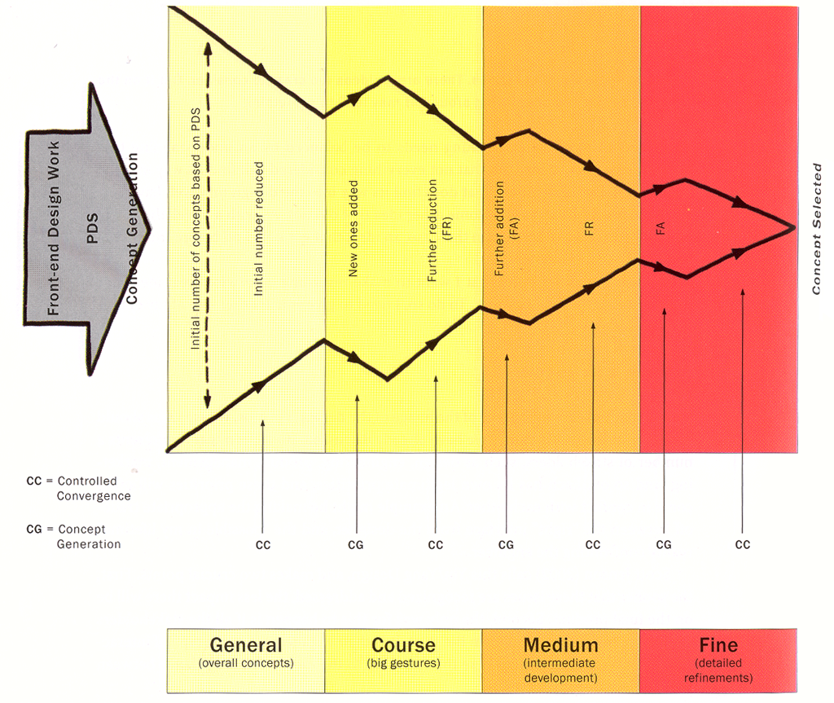
[Buxton, Sketching User Experiences]
Notes:
Alternating between Divergent and convergent steps happen at different granularities throughout a design process. While initially you may survey a range of very different concepts, the scope of experimentation narrows as a product becomes more well defined.

Slide 6

Prototypes for the
Microsoft mouse
From Moggridge,
Designing Interactions, Ch2
Notes:
There are three specific ways in which construction of multiple alternatives is important in design:
First, designers may build dozens of prototypes to get a more complete understanding of a design space.
For example, Paul Bradley at IDEO built about eighty foam models for the original Microsoft mouse to quickly explore different directions.

Slide 7
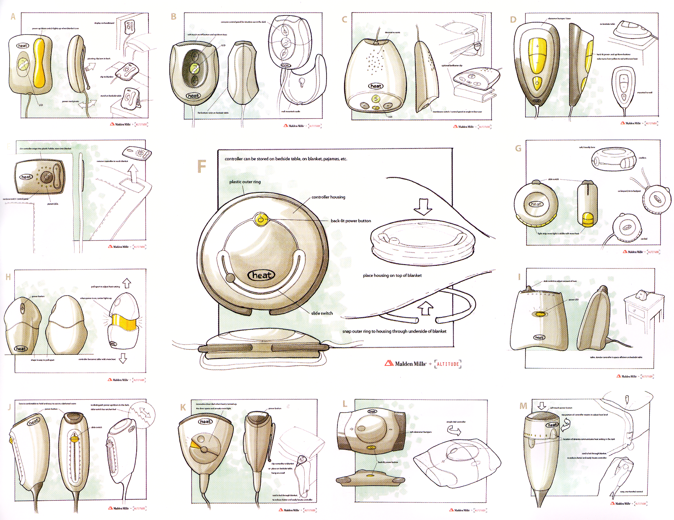
From Design Secrets: Products 2
Notes:
Second,discussing multiple prototypes allows project stakeholders to more effectively communicate their requirements.
Product design firm Altitude created these alternative renderings for a heating controller campus for the purpose of scaffolding discussions with their client, Malden Mills.

Slide 8

Tohidi et al, CHI 2006
Notes:
Third, comparing between multiple alternatives is important during user testing to keep participants honest:
Tohidi et al showed, that Participants will rate designs lower when multiple alternatives are seen, compared to when they see only one. And that Participants exposed to alternative designs will be less pressured to be positive.

Slide 9

[Adobe Flash]
Notes:
Our software tools should support lightweight and rapid experimentation with alternative design options. However, such solutions do not yet exist for designing interactive behavior. A recent survey of designers by Brad Myers et al found that designers lack the tools to iterate on behaviors and to compare interaction designs side by side.
(Click) One of the central reasons it that design of interactive behavior, even for prototypes, often happens in textual code.

Slide 10
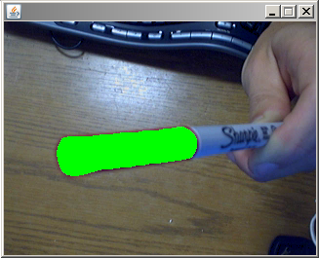
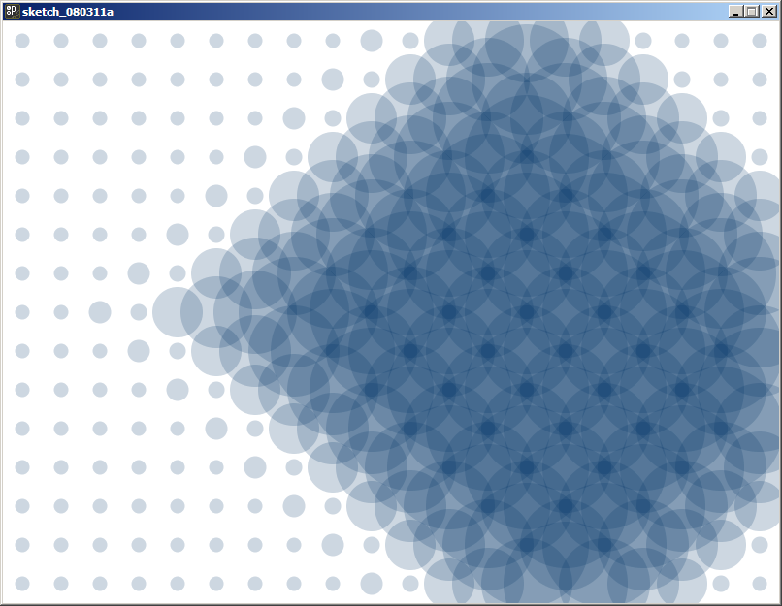
Alternatives are expressed both in control flow and parameter values
…
jMyron.track(
red, green, blue, tolerance);
…
…
codePathA();
//codePathB();
…
Notes:
We conducted interviews at the outset of our project and asked participants to bring in code examples.
In these examples, Alternatives were expressed both in control flow and parameter values.
On the left you see an app that visualizes color tracking. To build a sharpie detector from that algorithm, you need to search the space of parameter values.
On the right is a cellular automata animation for a museum installation. In the code, we found multiple alternative algorithms within a single function body.

Slide 11
Alternatives are authored in one representation, observed in another
Notes:
There are two distinct representations involved in programmed interactions: source code, where changes are authored; (click) and the running program, where changes are observed.

Slide 12
Juxtapose
Notes:
Our ongoing work on Juxtapose enables designers to interactively create and manipulate multiple alternatives of programmed interactive behaviors.

Slide 13
Juxtapose
Notes:
Juxtapose demonstrates a novel environment for constructing multiple design alternatives through (selectively) parallel editing of behavior source code.

Slide 14
Juxtapose
Notes:
These source alternatives can then be executed in parallel, allowing rapid comparison between them.

Slide 15
Juxtapose
Notes:
Juxtapose also introduces a mechanism to automatically generate a control interface to interactively “tune”
parameters of the designed interaction at runtime. Arriving at a
satisfying user experience often depends on adjusting
interrelated application parameters.

Slide 16

Notes:
Currently, Juxtapose supports creation of interaction designs written in Actionscript..<click>
In our editor Users can create alternatives to their current code using the add alternative button…

Slide 17

Notes:
Alternatives are shown as tabs in the user interface. These tabs “linked” by default – which means that changes in one alternative are propagated to all other alternatives.

Slide 18

Notes:
When the linked edit box is unchecked, code changes are now local to the currently active tab

Slide 19

Longest Common
Subsequence
Notes:
Parts of the code that are unique to the active alternative are shown in a different background color to highlight the differences. This technique of linked editing was introduced by Toomim in 2004 for working with code duplicates. We extend his work here by integrating linked editing with the Juxtapose runtime environment.
On a technical level, linked editing uses an algorithm to compute the longest common subsequences between alternatives, like the diff utility, after every keystroke or copy-paste command

Slide 20
Notes:
When the user hits run, Juxtapose compiles the set of all alternatives and launches the runtime environment.

Slide 21

Notes:
In the runtime environment, Users can now switch between alternatives using the buttons above the canvas

Slide 22


Slide 23
Notes:
To tune application behavior at runtime, Juxtapose automatically extracts a list of all global variables through language.
Users can check variables in this list

Slide 24
Notes:
to assign the variables to control widgets. The layout of the control widget area mirrors the

Slide 25
Notes:
to assign the variables to control widgets. The layout of the control widget area mirrors the

Slide 26

Juxtapose
Notes:
For such parameter tuning, Juxtapose supports the use of a dedicated, spatially multiplexed hardware controller. As Fitzmaurice showed in 1995, such spatially multiplexed input devices outperform mouse and keyboard input for multivariate control tasks.
The controll board enables users to modify multiple parameters simultaneously; leaves the eyes free to focus on the application being tuned; and allows for tuning of interactions that require concurrent mouse and keyboard input.

Slide 27

Notes:
the physical layout of the supported external controller.

Slide 28
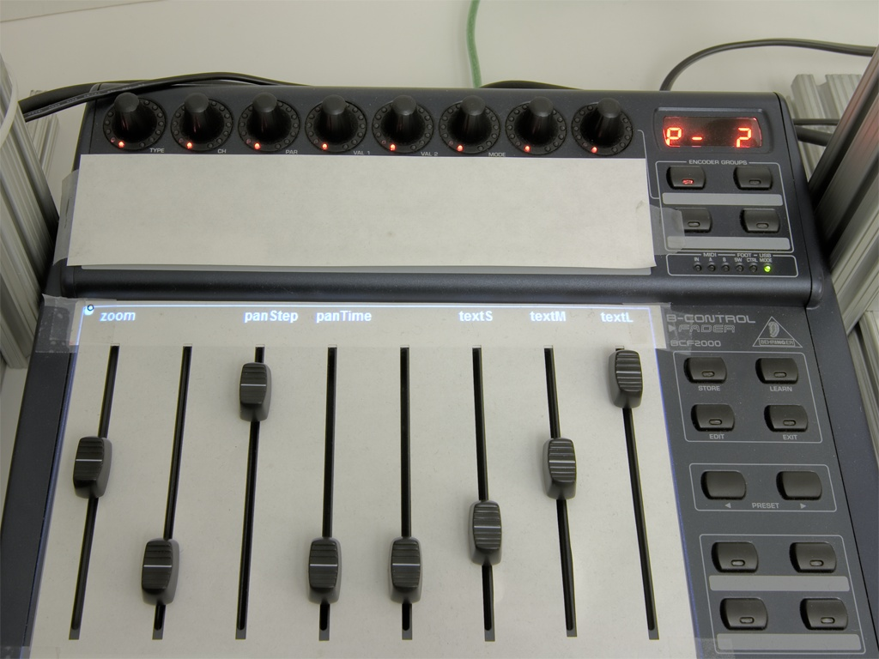
Notes:
To facilitate mapping variable controls from the screen UI to the physical interface, we added variable name display directly onto the hardware control surface.

Slide 29
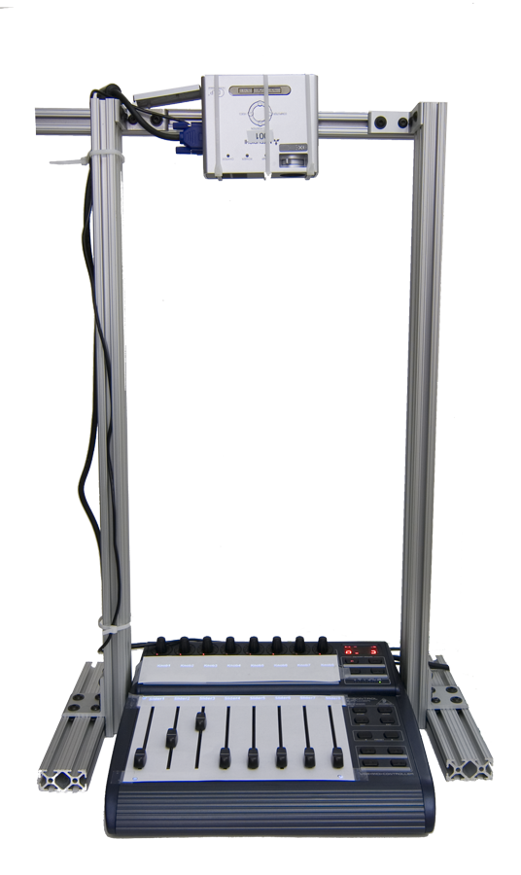
Pocket projector
[Crider et al, GI 2007]
Notes:
Currently, this happens by using top projection, an idea proposed by Crider and colleagues at Graphics Interface last year. <click> This is clearly just a research prototype – another option would be to pick commercially available hardware that integrates text LCDs above every control.

Slide 30
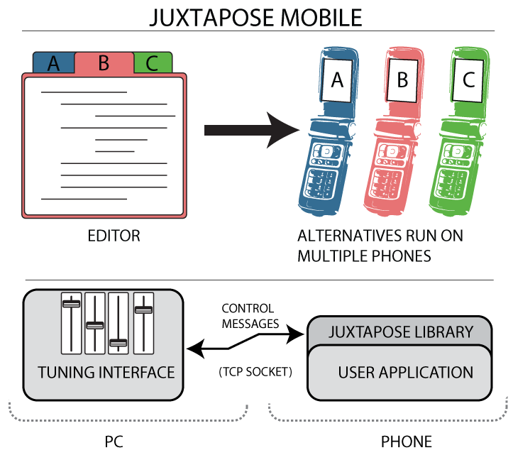
Notes:
The benefits of Juxtapose are amplified for development off the desktop, where the cost of edit-compile-test cycles is much higher. In mobile development, coding happens on the PC -- because of the rich toolset available there -- while testing happens on device -- to get the user experience in context.
mobile phones are commodity hardware, and mobile developers already test on multiple handsets. We extended Juxtapose to leverage these device collections by executing different alternatives on different handsets. You write your alternatives on the PC, and the compiled applications are then distributed to a collection of handsets. A designer can thus rapidly switch between alternatives by putting one phone down and picking another one up. <click>
Our prototype works for FlashLite applications that target Nokia N93 phones. To allow remote control of application variables, we wrap the user’s application with an RPC interface behind the scenes.

Slide 31
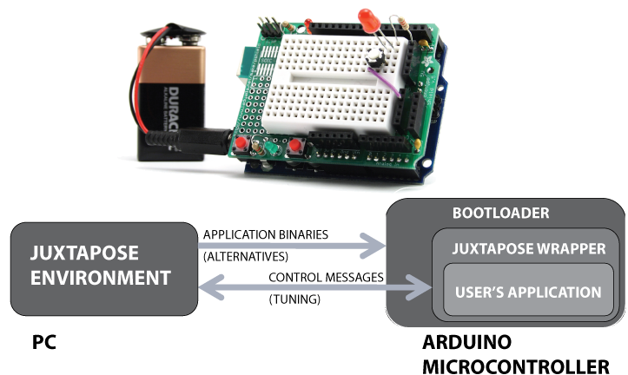
Notes:
As we saw with d.tools, embedded microcontrollers are the tool of choice for working with sensors and actuators. d.tools treated the hardware as an I/O interface and kept all application logic on a PC. Such an approach is not always possible, for example, for wearable computing, and haptics, which requires very tight feedback loops. Microcontroller programming in those areas can be arduous. Even seasoned veterans often resort to debugging by blinking LEDs or printing statements to serial ports. We extended Juxtapose to support authoring for the popular Arduino microcontroller platform.<click>
building custom hardware, is expensive, so designer are likely to embed multiple different opportunities for interaction into the same prototype. Hence, Juxtapose for Arduino exports and runs only one code alternative on one attached board at a time. When the designer switches between alternatives, Juxtapose then transparently replaces the binary running on the microcontroller .

Slide 32
Participatory Design Study
Extending Tohidi et al.’s results, conduct user tests with modifiable vs. non-modifiable prototypes
Hypotheses:
  Higher # of suggestions in modifiable condition
  More ground covered by those suggestions
Reasoning:
  Modifiability makes prototype feel less finished
  Participants can get feedback on their suggestions immediately
Also observe: how many suggestions were we able to implement?

Slide 33
Other Steps to Take
Fix up the UI!
Integrate alternatives for graphics + code
Notes:
(who wants to write a graphical editor?)

Slide 34
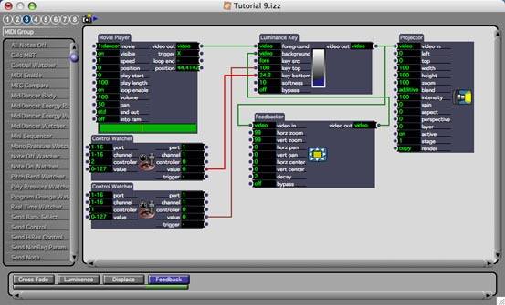
Related things we found at Adobe and UIUC
Troikatronix Isadora

Slide 35
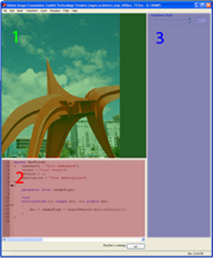
Related things we found at Adobe and UIUC
Adobe Image Foundations Toolkit

Slide 36
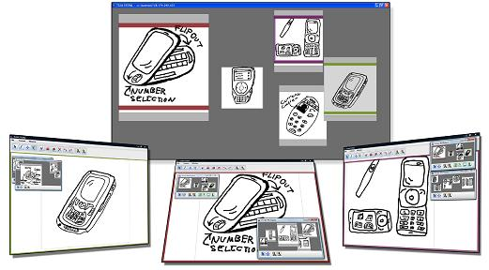
Related things we found at Adobe and UIUC
Team Storm, UIUC

Slide 37
Understanding input devices
(with Sean Follmer)

Slide 38
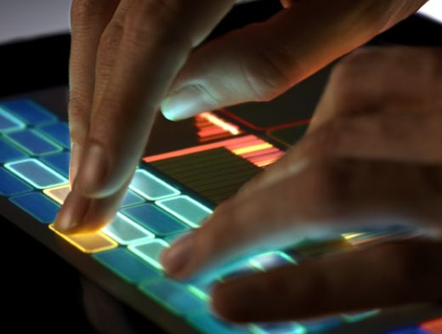
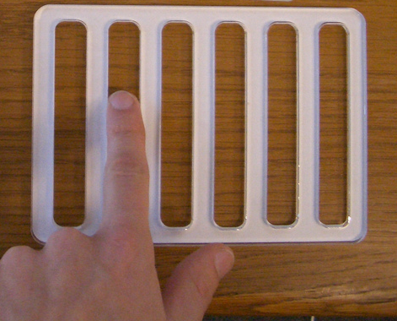
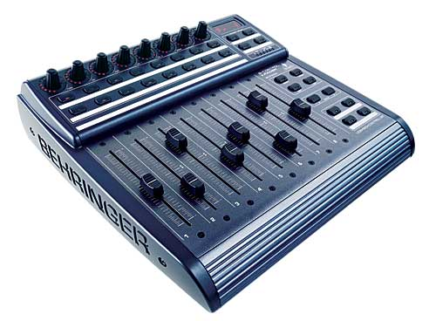
Motivation: Beyond Multitouch
JazzMutant Lemur
Behringer BCF2000
Multitouch Overlays
Notes:
how do you combine the best aspects of a physical sliders – passive haptic feedback, etc – with the best aspects of multitouch – reconfigurability
developed physical overlays for multitouch displays
Allows for passive haptic feedback, easy use without looking – for secondary hand operation

Slide 39
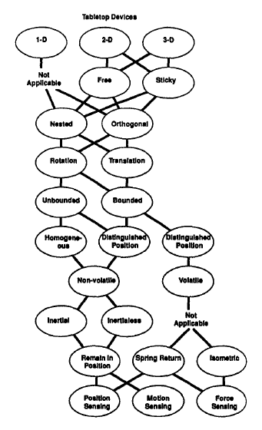
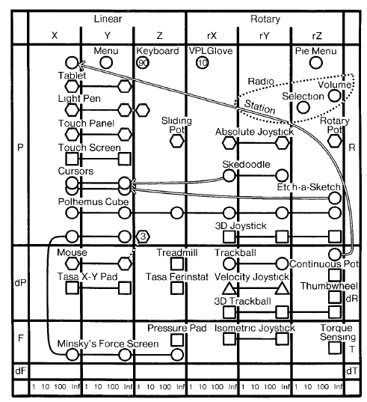
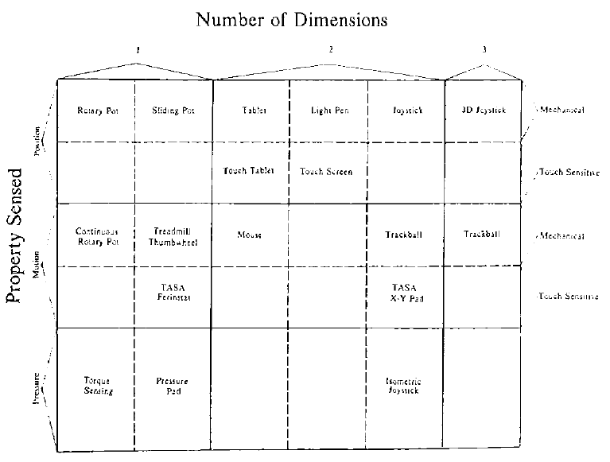
State of the Art in Input Taxonomies:
15 years old?
Lipscomb, J. S. and Pique, M. E. 1993. Analog input device physical characteristics.
SIGCHI Bull. 25, 3
Card, S. K., Mackinlay, J. D., and Robertson, G. G. 1991. A morphological analysis
of the design space of input devices. ACM Trans. Inf. Syst. 9, 2
Buxton, W. 1983. Lexical and pragmatic considerations of input structures. SIGGRAPH Comput. Graph. 17, 1
Notes:
What we discovered was that the taxonomies that exist could not descibe what we were creating and many other devices
taxonmies, such as Card, and Buxton are all from the early 90s and have an implicit assumption that the device will be used for desktop computing
Current input taxonomies don’t describe input devices well
From the top down ( software )
From the bottom up ( physical properties - )

Slide 40
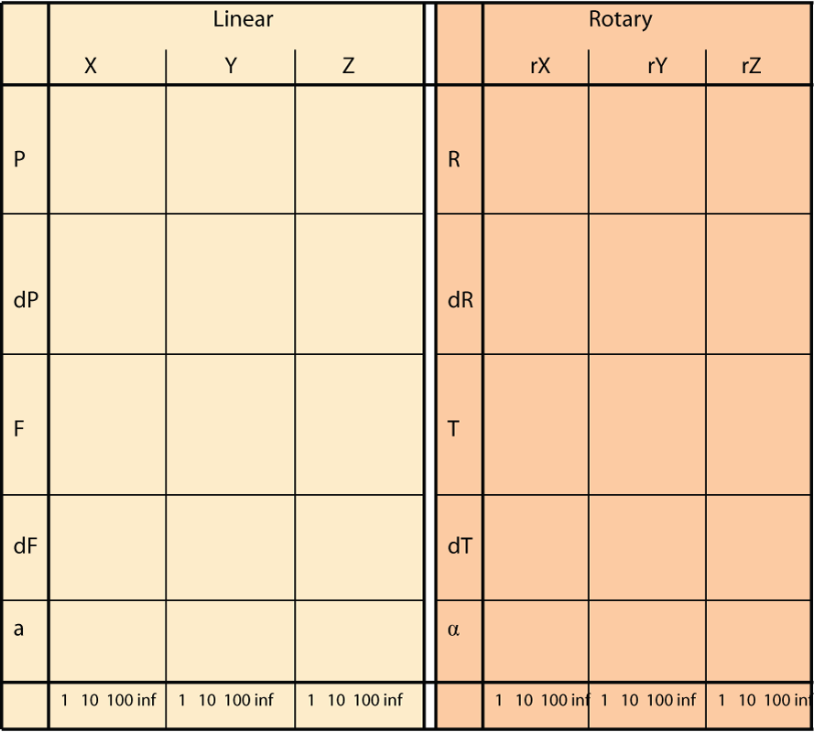
Notes:
First attempts at expanding taxonomies
Add in the older expanded card model
It was able to descibe a lot more input devices but not in an elegant way that shed light on seeing new areas for discovery, wouldn’t allow for comparison easily because it was too visually busy with many lines and connections, it also left every thing on the same level and didn’t really break it down from the hardware side and the software side.

Slide 41
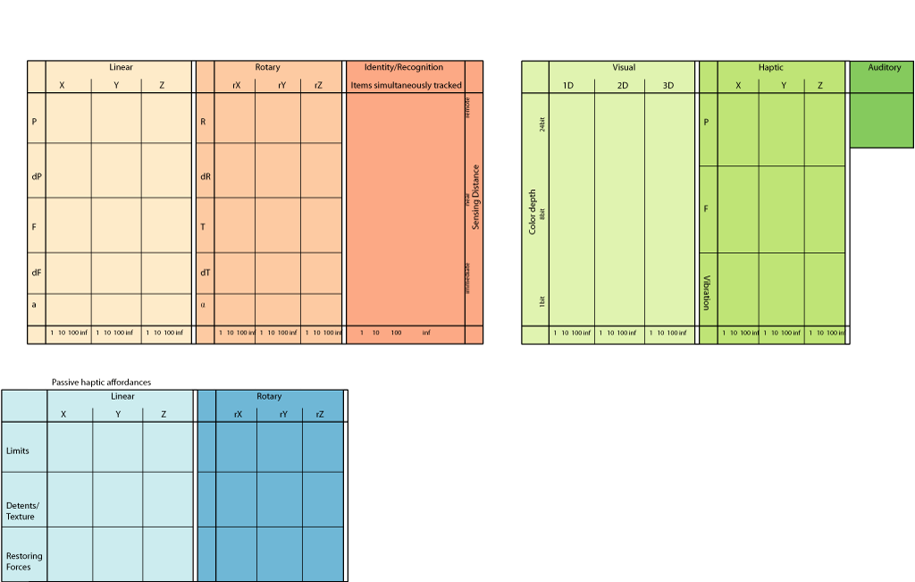
INPUT
ACTIVE OUTPUT
PASSIVE PROPERTIES
Notes:
First attempts at expanding taxonomies
Add in the older expanded card model
It was able to descibe a lot more input devices but not in an elegant way that shed light on seeing new areas for discovery, wouldn’t allow for comparison easily because it was too visually busy with many lines and connections, it also left every thing on the same level and didn’t really break it down from the hardware side and the software side.

Slide 42


Slide 43
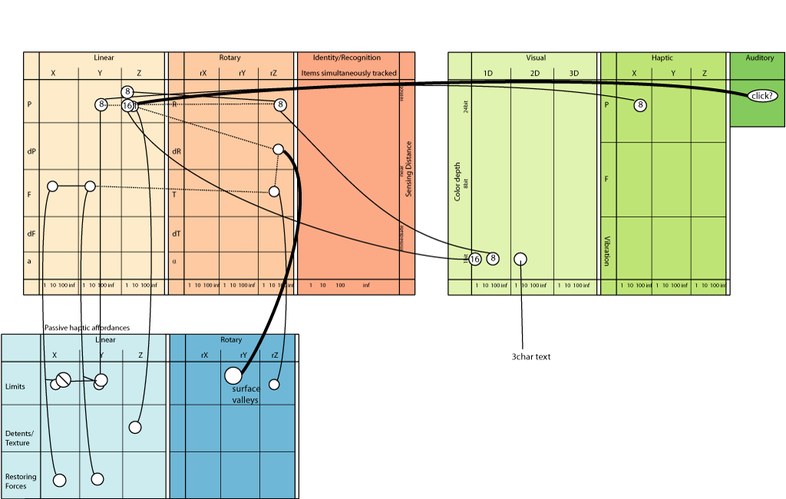
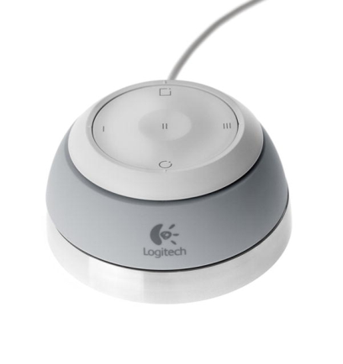
INPUT
ACTIVE OUTPUT
BIG MESS!
PASSIVE PROPERTIES

Slide 44
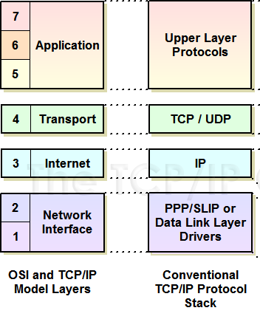
Analogy: Network Stacks
Notes:
Insert tcp/ip stack diagram

Slide 45
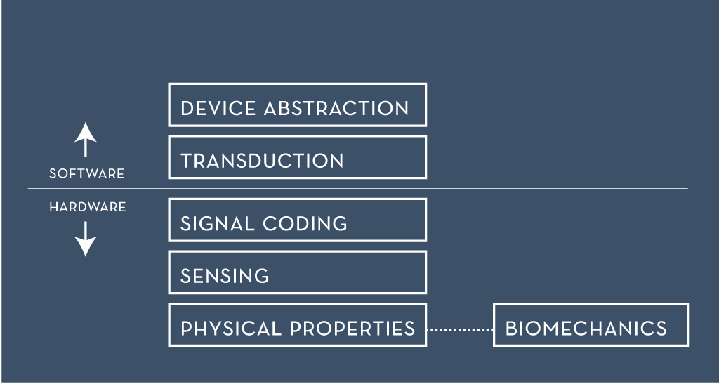

Slide 46
Issues/Next Steps
Successful as a tool for structuring conversation
But: too much like a white paper, onerous to work out details for a given device
Output not captured well
Notes:
Nail down the parameters for each acatagory
Represent then in a database
Then create an interactive information visualization of devices

Slide 47
Example: Actuated Mixer

Slide 48
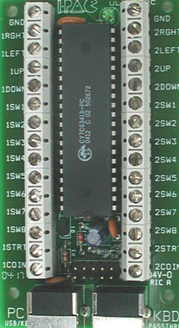
Example: Ultimarc Keyboard Encoder
Unspecified – Left up to user

Slide 49
Example: Ultimarc Keyboard Encoder
32 discrete digital switches

Slide 50
Example: Ultimarc Keyboard Encoder
Transform switch to ASCII key code

Slide 51
Example: Ultimarc Keyboard Encoder
Keyboard BIOS routines – key repeat

Slide 52
Example: Ultimarc Keyboard Encoder
Keycode Press, release

Slide 53
Time-shifting & simulating input traces
(with Marcello Bastea-Forte, Timothy Cardenas)

Slide 54
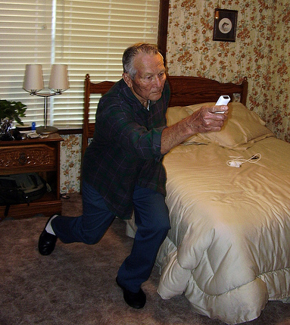
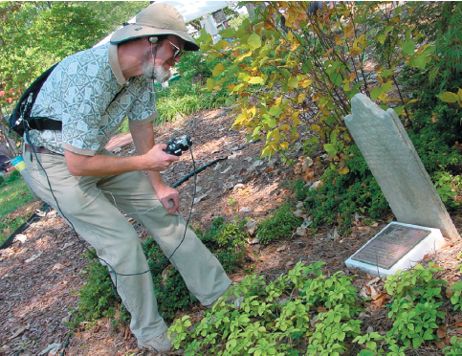
Motivation
Testing non-WIMP interaction code is essential but hard
  Real-time data may not be available due to hardware/context constraints (e.g., GPS)
  Generating data may require leaving the desk, or skilled/time-consuming actions (e.g., Wii Bowling)
  Reliable interactions need to be tested on many cases (unit tests)
Cc Michael T Gilbert

Slide 55
Robots to the Rescue!
Wizards: humans who do the work of
(recognition) algorithms
Robots: algorithms that emulate human
input (e.g. java.awt.robot)
Notes:
Used for GUI stress testing

Slide 56
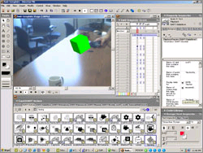
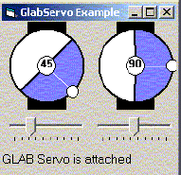
Where does the data come from?
Real data
Normal
case
DART
Realtime
Offline
(Before)
When is the data generated?
?
Phidgets
Simulated Data
(Proxied Data)
Notes:
4th quadrant: data needs some massaging
Contribution here is to find an underlying architecture and UI for managing all possible cases in a single tool

Slide 57
Needs for a richer device abstraction
Visualize/monitor data that is presented to application
Record/replay of traces
Realtime simulation of data
Editing (=offline simulation) of data

Slide 58


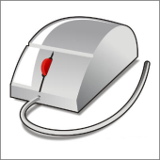
Concept
Live Data from Input Device
Device
Abstraction in Application

Slide 59
Concept
Control UI Widgets
Visualization
On/Off
Simulated Data
Live Data from Input Device
Device
Abstraction in Application
Recorded
Data
Memory/ Disk
Editor

Slide 60
Prototype
Library replaces input device abstraction classes in Processing
General architecture; current implementation support Mouse, Keyboard, Arduino, Video input

Slide 61
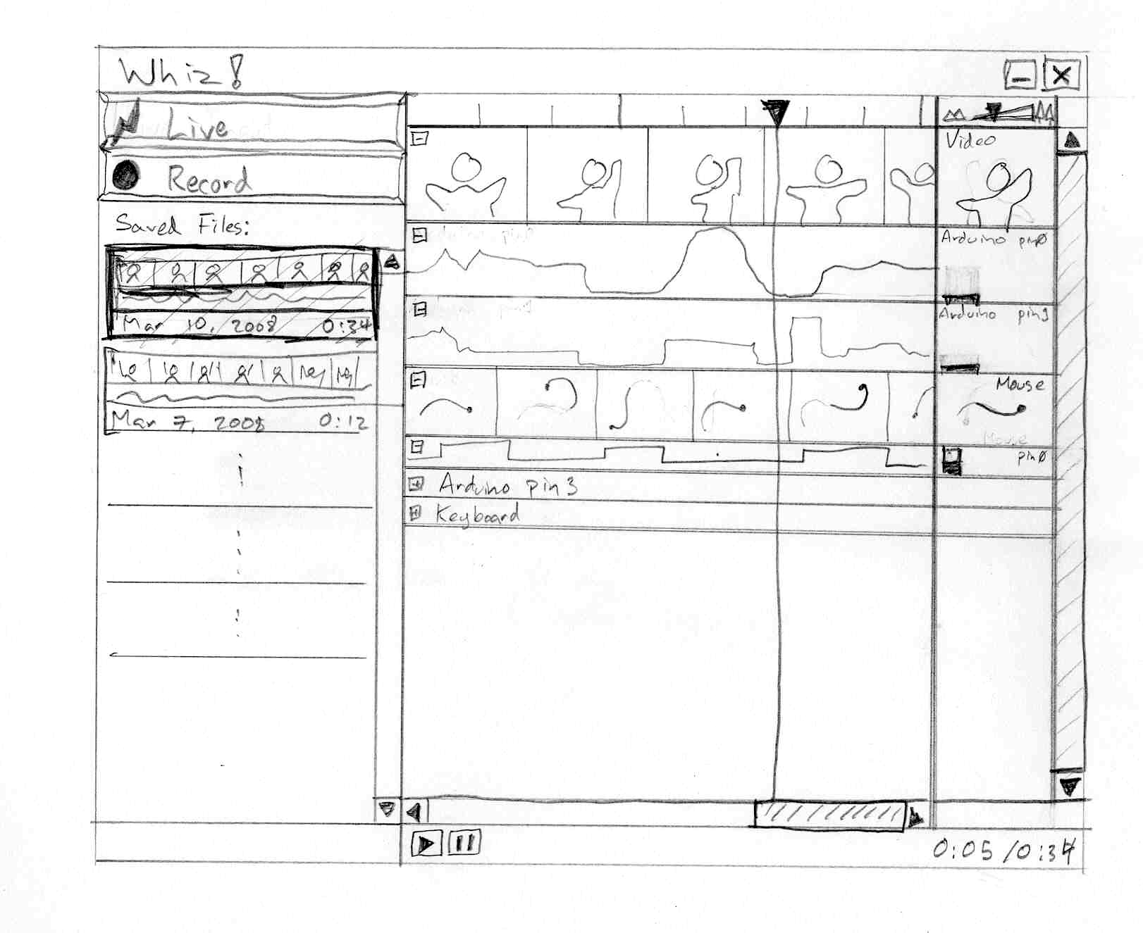
Video
Input
Channels

Slide 62
Video
Current
State

Slide 63
Video
History
(editable in place)

Slide 64
Video
Toggle between
Live & time-shifted modes

Slide 65
Video
Toggle between
live & time-shifted modes

Slide 66
Video
List of recorded sessions

Slide 67
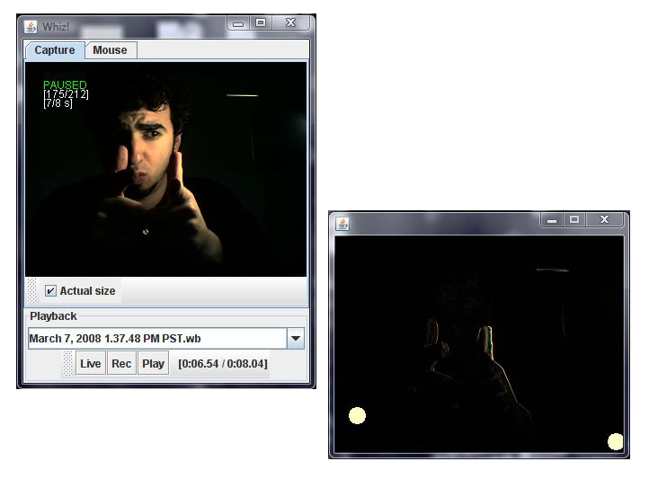
Video
Playing
back
previously
recorded
video
Processing
Sketch

Slide 68
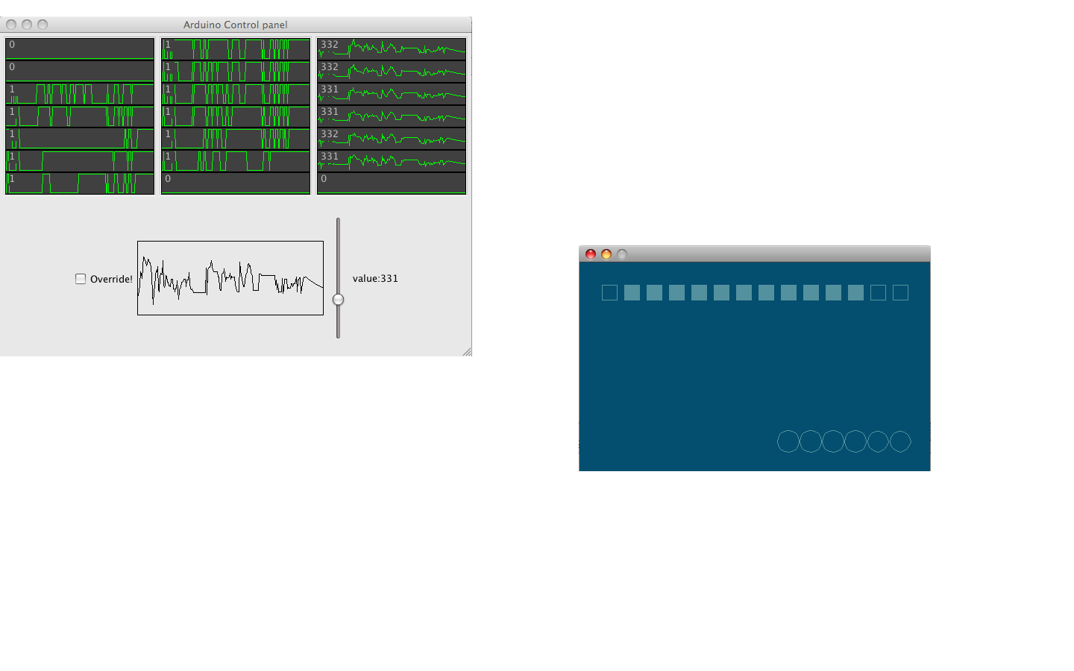
Arduino
Visualization
Processing sketch

Slide 69
http://hci.stanford.edu
Notes:
For more information on HCI research at Stanford, please visit our web site. Thank you.

Slide 70
Evaluation
N=18, 12male, 6 female, ages 20-32, students
75-90 minute sessions, three tasks: warm-up, matching, designing map navigation
70
Notes:
We conducted a summary usability evaluation of Juxtapose for desktop development in our lab with 18 participants. Sessions lasted 75-90 minutes.
All participants had at least a working knowledge of procedural programming (10 were computer science majors), although some had had little experience with writing ActionScript code.
70

Slide 71
Mapping Task
Given Actionscript code that loads a multilayered map, develop navigation options for a handheld GPS prototype for pedestrians and car drivers.
71
Notes:
In our open-ended design task, participants were provided with a
working ActionScript program that loaded a multi-layer map, as seen in the video. Participants
were given 30 minutes to create two map navigation alternatives for a hpyothetical GPS unit – one suitable for pedestrians, and one for drivers.
Participants had to modify and add to the source to either hardcode design decisions into the source code, explore code changes through alternatives, or to set up tunable parameters.
71

Slide 72
Qualitative Results
Participants had clear conceptual model of linked editing and tuning and applied both.
Alternative tabs were used as a lightweight versioning mechanism and starting point for code experiments.
72
Notes:
72

Slide 73
Qualitative Results
Areas for improvement:
  Runtime changed should be reflected back in source code.
  Additional callback functions are sometimes needed to update application state based on variable tuning.
73
Notes:
73

Slide 74





Tree Matching Task
Search in 4D parameter space. Given recursive drawing code code for this:
Produce these:
74
Notes:
A matching task provided participants with code that recursively draws a tree. Participants were asked to adjust four parameters of the tree drawing routine to match four specific tree shapes given in the task description.For two trees, this task was accomplished using the full Juxtapose interface. For the other two, participants were given the same editor without the possibility of creating alternatives or tuning variables
at runtime. Order of assignment between Juxtapose and control conditions was counterbalanced and a random tree order was generated for each participant.
74

Slide 75
p<0.001 (paired two-tailed Student’s t)
Notes:
We found a significant different in the time it took to match a tree- participants using Juxaptose’s tuning interface took about 1.5 minutes less on average

Slide 76
not
significant
not
significant
p<0.01
p~0.01
Notes:
The results get more interesting when we look at which this result by tree.
For trees 1 and 2, participants

Slide 77
Notes:
Reason for the speedup: 24 fold increase in the number of parameters explored.
So not only were our subjects faster, but they also explored significantly more parts of the design space.

