Slide 1
Enlightened
Trial & Error
Envisioning New User Experiences
Björn Hartmann
Stanford University HCI Group
& Microsoft Research

Slide 2

(cc) allcomm
Notes:
Since I usually speak on the academic conference circuit, I should starting with a bit of background. I am trained as a digital media designer and computer scientist.
As such, my focus is on the design of *digital* experiences. And more specifically, I am interested in creating the right kinds of *tools* for designing such experiences. I am also a researcher so some of the ideas I am talking about today are not ready for adoption in practice yet. I am conducting research in novel interactions and design tools both at Stanford and at Microsoft Research at the moment. However, I am *not* interested in designing for this interface… why not?

Slide 3

[O’Sullivan]
Notes:
This is a drawing by Dan O’Sullivan. It shows the mental model that my current PC has of me. My computer knows I have an eye – but only one – it does know that I have two ears. It knows I have a finger – but only one, maybe two – and it has no idea that I have a body. Given the richness our human experience in the physical world, it’s shocking that our experience in the digital world is so limited.

Slide 4
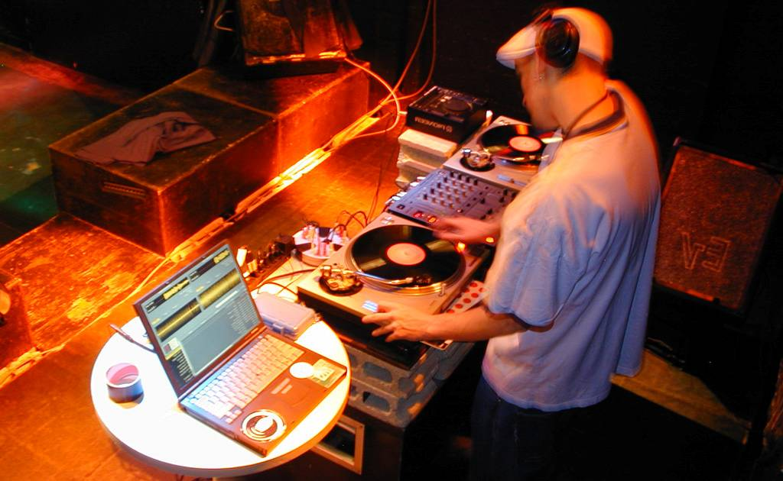
Notes:
Here is a flashback to my prior life as a musicion that offers a different vision of the role computing can play. This a shot I took on tour as a DJ in a club in Tokyo. The turntables and mixer are in essence the user interface for DJs. So what is the laptop doing in the picture? It’s clearly not the focus of attention. It is running Final Scratch, a software that allows a DJ to work with MP3 files through traditional turntables by using special records that contain a timecode, which is then analyzed to control playback of digital files.
Here computation moves out of its traditional gray box and starts to become more closely integrated with objects in the real world.

Slide 5
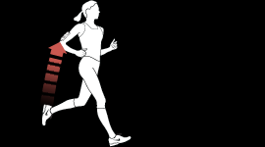
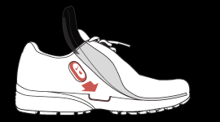
[Apple, Nike]
Notes:
Now, professional DJs are a niche audience so let’s look at two examples of more mainstream products that provide a new user experience by infusing everyday physical activity with computation. The Nike plus system syncs your workout data with
Your Ipod.

Slide 6
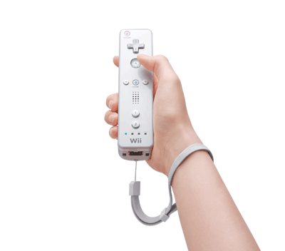
[Nintendo]
Notes:
And of course the Nintendo Wii has been wildly successful in reaching millions of casual gamers. Now, imagine you are a game designer. How do you explore such genre-extending ideas, and how do you nail the experience?

Slide 7
Experimentation
Matters!
Notes:
One of our group’s core beliefs is that you can’t just come up with good interaction designs by thinking hard about the problem. Of course applying your smarts is a prerequisite, but more than anything else <space> experimentation matters.
As David Kelley likes to say, “Enlightened trial and error outperforms the planning of flawless intellects.”

Slide 8

IDEO Camera
Notes:
Take this prototype of a digital camera developed at IDEO in the mid 1990s, at a time when such Cameras had not yet broken into the consumer space. IDEO was tasked to find a way to make sense of possible digital camera interactions – what were the fundamental modes of use? To explore, designers built this mockup of a camera back – it’s clearly not to scale, and it’s tethered by a thick umbilical to a desktop computer that drives the graphics and application logic. What matters though is that it has the right set of inputs and co-location of input and output which allows users to experience the artifact as if it was a camera.
Exploring such experience questions through prototypes is particularly important as computing moves off the desktop and into our pockets, homes, and environments, where interaction models and use cases are emerging.
If you trace the history of prototyping back through time, you find some really inspirational examples – let me share one with you.

Slide 9
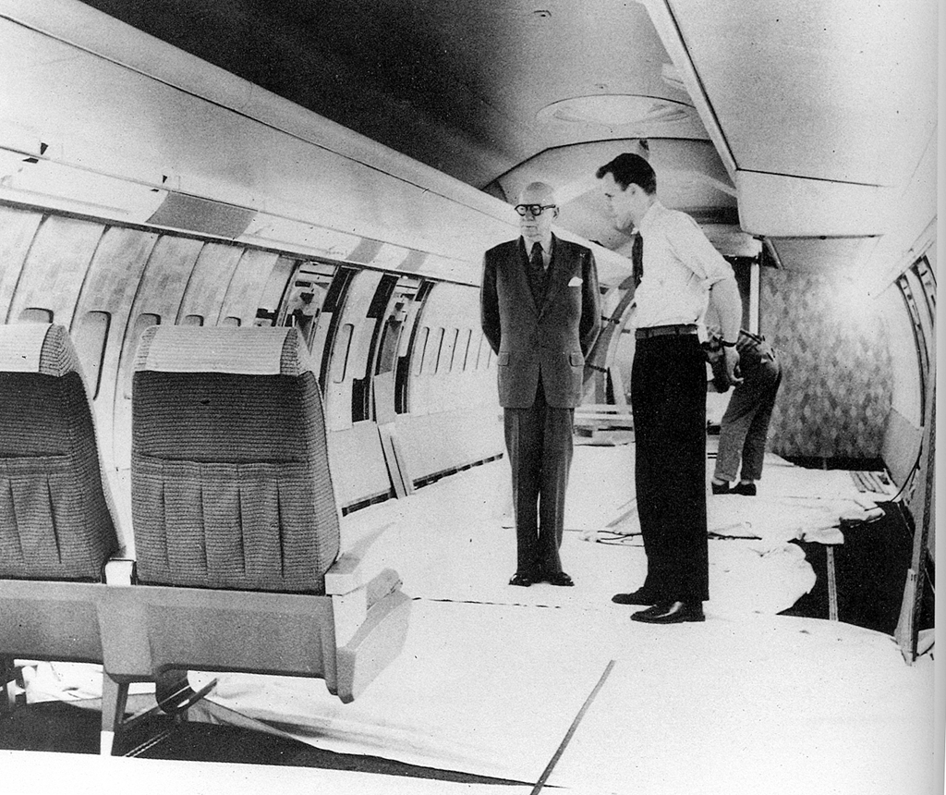
W.D. Teague
Notes:
How do you design an interior for a large passenger aircraft?
Build a full-scale mockup in a warehouse, and invite a couple dozen people to spend a day sitting in the mockup. This is a prototype for the interior design of a Boeing 707, the first commercially successful jet liner, from the late 1950s.
And the stern looking gentleman is Walter Dorwin Teague, one of the industrial design pioneers that introduced modern design process.

Slide 10
Pragmatic v. Epistemic Activity
START
GOAL
[Kirsh, Maglio 1994]
[Klemmer, Hartmann, Takayama 2006]
Notes:
A theoretic lens for understanding the role of prototyping is the distinction is between pragmatic and epistemic design activity.
Pragmatic actions are those related to directly accomplishing a task with a known goal.
Broadly speaking, planning tools have mostly been concerned with the pragmatic activity of getting things built.

Slide 11
Pragmatic v. Epistemic Activity
B
???
?
?
?
A
START
[Kirsh, Maglio 1994]
[Klemmer, Hartmann, Takayama 2006]
Notes:
But prototyping also serves an important epistemic function: design problems are ill-structured, meaning part of the designer’s job is to figure out what the space of solutions is in the first place . The goal itself is unclear.

Slide 12
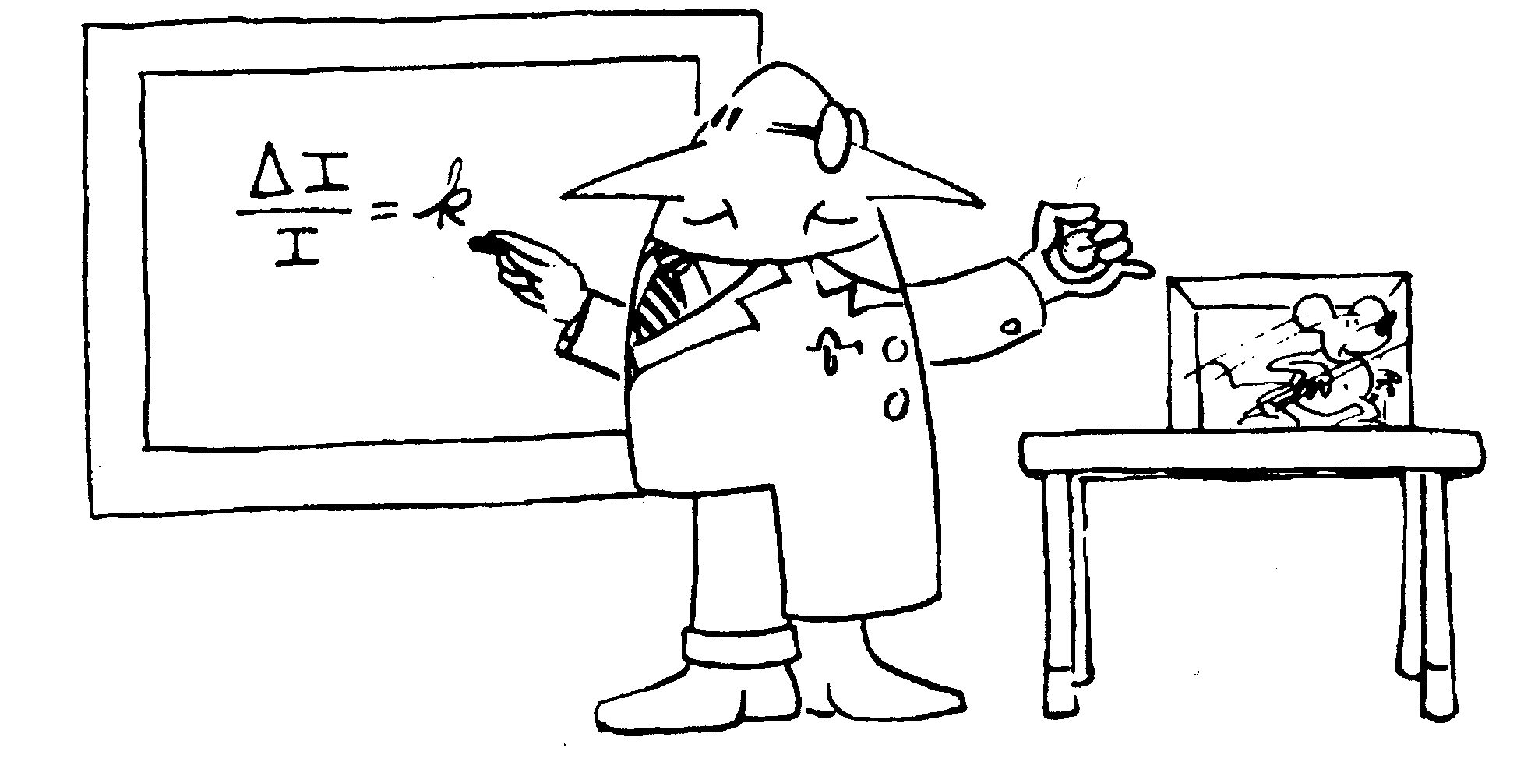
Notes:
Reflective, iterative design bears a lot of similarity to science. It’s not just a process of building it showing it to users and concluding that they liked it.
Prototypes embody design hypotheses and enable designers to test these hypotheses.
The goal in prototyping is not the artifact – it’s feedback and iteration: you build some prototypes, evaluate them, and use what you learned to drive the next design.

Slide 13
To Experiment Rapidly,
You Need the Right Tools
Notes:
To experiment Rapidly, you need the right set of tools. Really early on, this is where post-its an markers and glue sticks come in.

Slide 14
What comes after the
$1 prototype?
Notes:
But, what comes after your $1 prototype? What comes after the telling of a compelling scenario? If your product involves a tight interaction loop, how do you get to the point to really experience what the interactive behavior would feel like?

Slide 15
The Goal:
Enable everyone in your design team (not just the technology experts) to realize interaction design ideas, in order to gain insight faster.
Notes:
My research goal is move prototyping of novel interaction designs away from the exclusive domain of computer scientists and electrical engineer and give design generalists the right tools to create functional interaction design prototypes.

Slide 16
Three Ideas For Future Design Tools
Integrate Design, Test, and Analysis
Programming by Demonstration
Support Designing Multiple Alternatives
Notes:
Let me outline three ideas our research group has explored to move toward that vision

Slide 17

d.tools
[uist 2006]
Notes:
Our work on d.tools has explored how to more rapidly create and evaluate information appliances that incorporate rich physical interactions
The key contribution of d.tools, is the integration design, test, and analysis of information appliances in a single toolkit. Here’s a short video overview.

Slide 18
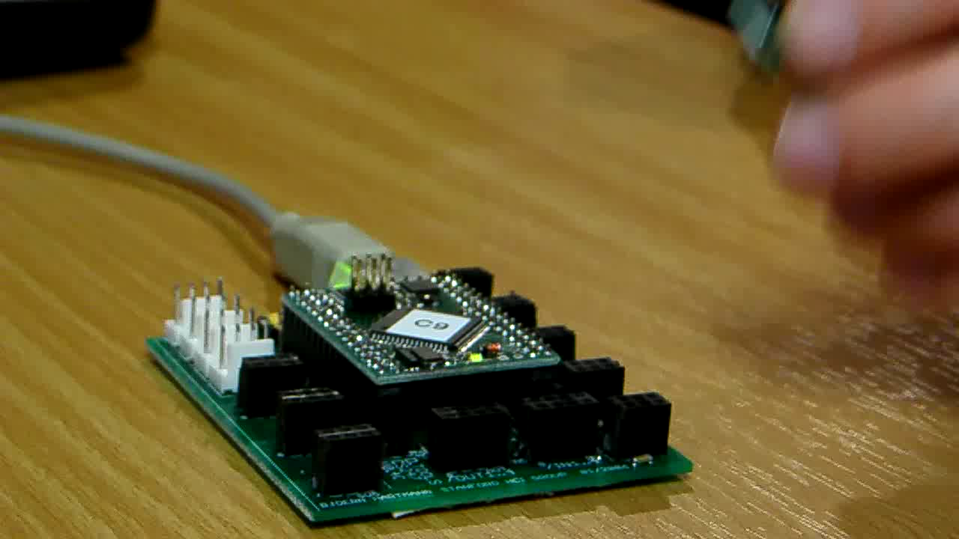
Notes:
As a designer plugs physical components such as sensors into the d.tools hardware interface, virtual counterparts appear in the d.tools authoring environment on the PC.
The DESIGNER then authors interactions by creating visual states, which encapsulate output, and by linking them through transitions, which get triggered by input events. The control flow interface is based on designers familiarity with storyboards.
d.Tools facilitates turning continuous sensor data into discrete events through an interactive demonstration and thresholding technique.
In d.tools, the interaction model is always live and can be tried out at any point.
To increase the complexity of prototypes, designers with programming knowledge can attach Java to visual states.
Here, Java code remote controls the Google Earth application. This is an example of how d.tools can be used to create mash-up prototypes.

Slide 19
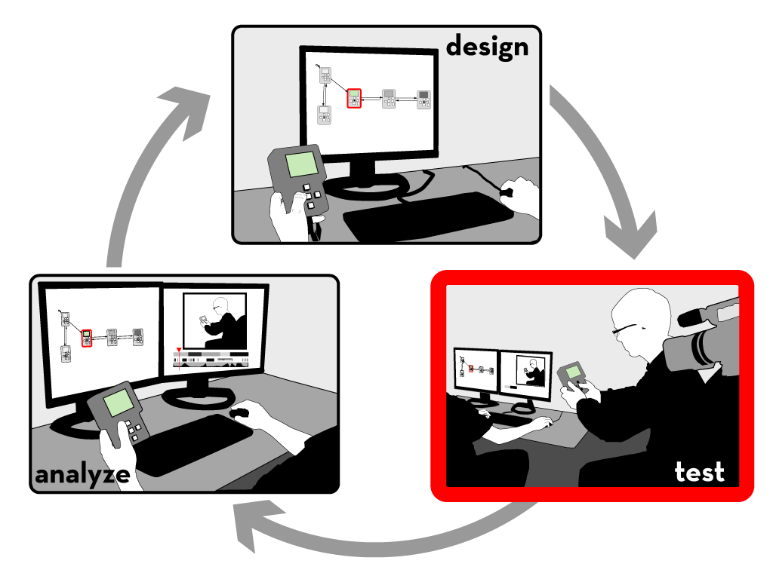
Notes:
Let’s move on to test mode

Slide 20

Notes:
A camera is pointed at the tester.
The live video from the camera is recorded and annotated in real-time with state transitions and input events.
In addition to events generated by the prototype itself, the experimenter can also add annotations with a video console.

Slide 21

Notes:
After a test session is completed, designers can leverage tight synchronization between the graphical interaction model, the recorded video, and the recorded event traces in analyze mode.

Slide 22

Notes:
In analyze mode, video playback is synchronized with a visualization that highlights active states.
In the other direction, designers can select states in the statechart to access corresponding video clips.
Designers can query for video sequences matching input by demonstrating that input on the prototype itself.
Multiple test sessions can be combined into a video spreadsheet, which can be used for rapid comparative evaluation.

Slide 23
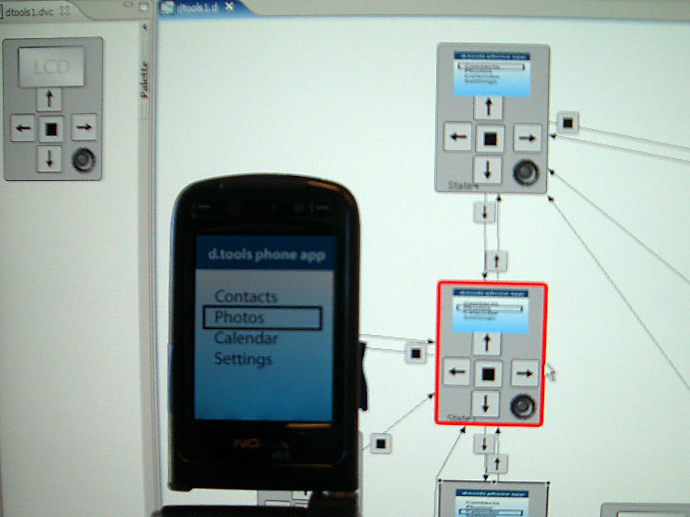
Notes:
More recently we have collaborated with Nokia design San Francisco to extend the d.tools authoring approach to mobile phone prototypes. The idea is that you run a client application on your smart phone which sends all input events from the a PC where you can edit the interaction model in realtime.

Slide 24

Notes:
In the tradition of eating your own dogfood, we hand-manufactured a dozen kits which we distributed student teams in a masters level HCI design course in 2006 and 2007.
This image shows a color mixing interface designed with d.tools in which users can “pour” color from tangible buckets onto an LCD screen and then draw with those mixed colors on a tabled; this project took part in the Microsoft Design Expo in Redmond in 2006.

Slide 25
Three Ideas For Future Design Tools
Integrate Design, Test, and Analysis
Programming by Demonstration
Support Designing Multiple Alternatives
Notes:
A second important principle that enables prototyping for physical interactions is programming by demonstration.

Slide 26
“Solving a problem simply means representing it so as to make the solution transparent”
—Herbert Simon, The Sciences of the Artificial
Notes:
As Herb Simon and Don Norman have pointed out, the representation of a problem is an important factor determining how we can manipulate that problem.

Slide 27

Representation Matters
Accelerometer X axis
Accelerometer Y axis
//detect accelerometer peaks
//read data sample
xVal[t++]=readA2DValue(xPin);
//look for changes in derivative
if(((xVal[t]-xVal[t-1]) >= 0
&& (xVal[t-1]-xVal[t-2]) < 0) ||
(((xVal[t]-xVal[t-1]) < 0
&& (xVal[t-1]-xVal[t-2]) >= 0)) {
//peak detected
//send message
oscSendMessageInt("/x/peak",1);
} else {
//no peak
}
Notes:
For tasks like sensor-based interactions, an individual's performance of the input they would like to recognize is a very different activity from symbolically specifying that input. The motivation of our work is to leverage the embodied performance to actually do the work of specifying the computation.

Slide 28
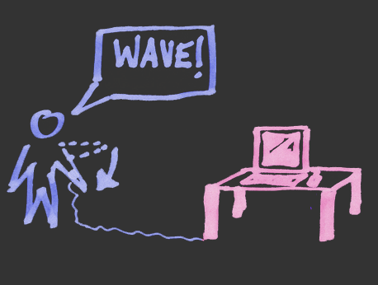
Idea: Programming by Demonstration
Notes:
We achieve this by applying programming by demonstration to the domain of sensor-based interaction design.

Slide 29
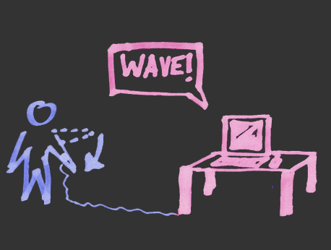
Idea: Programming by Demonstration
Notes:
29
Programming by demonstration (PBD) is the process of inferring general program logic from observation of examples of that logic.

Slide 30
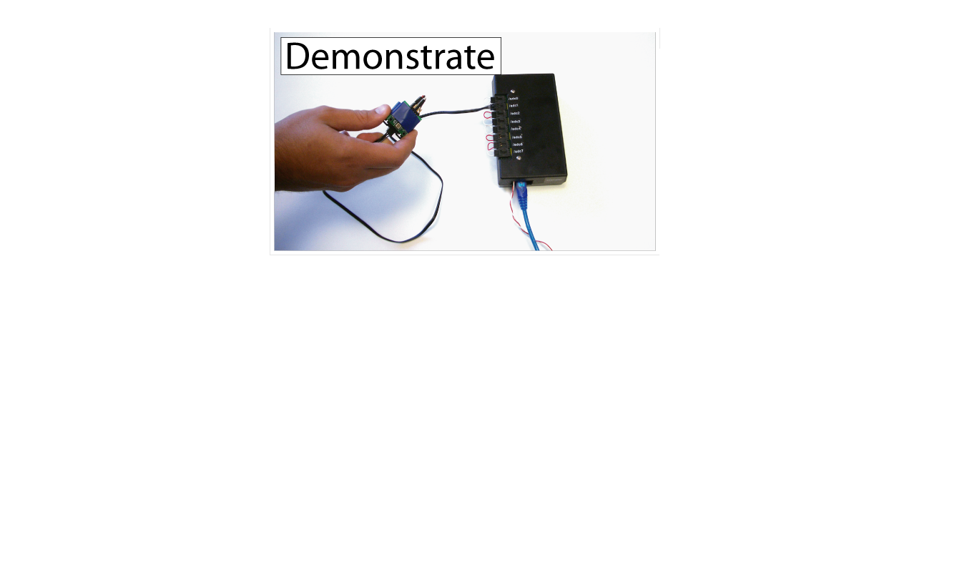
Exemplar
[chi 2007]
Notes:
We constructed another design tool, Exemplar, to investigate such an approach.
With Exemplar, an interaction designer first demonstrates a sensor-based interaction to the system (e.g., by shaking an accelerometer).

Slide 31
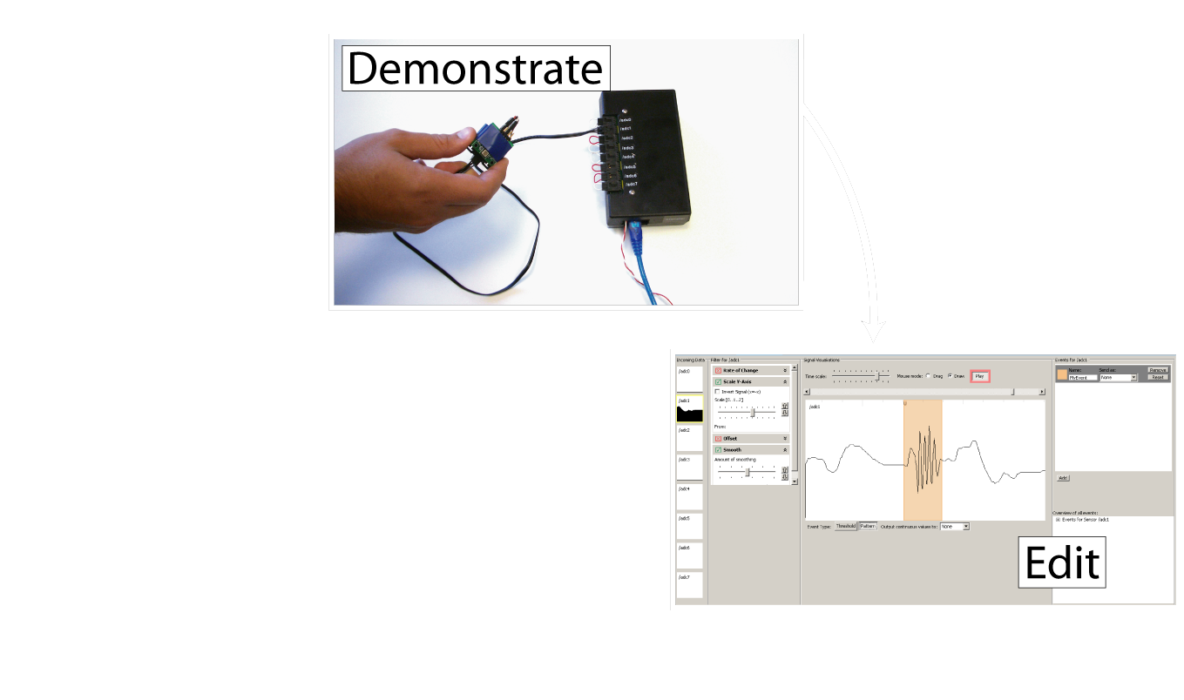
Exemplar
[chi 2007]
Notes:
The designer then edits a visual representation of the action by marking it up,

Slide 32
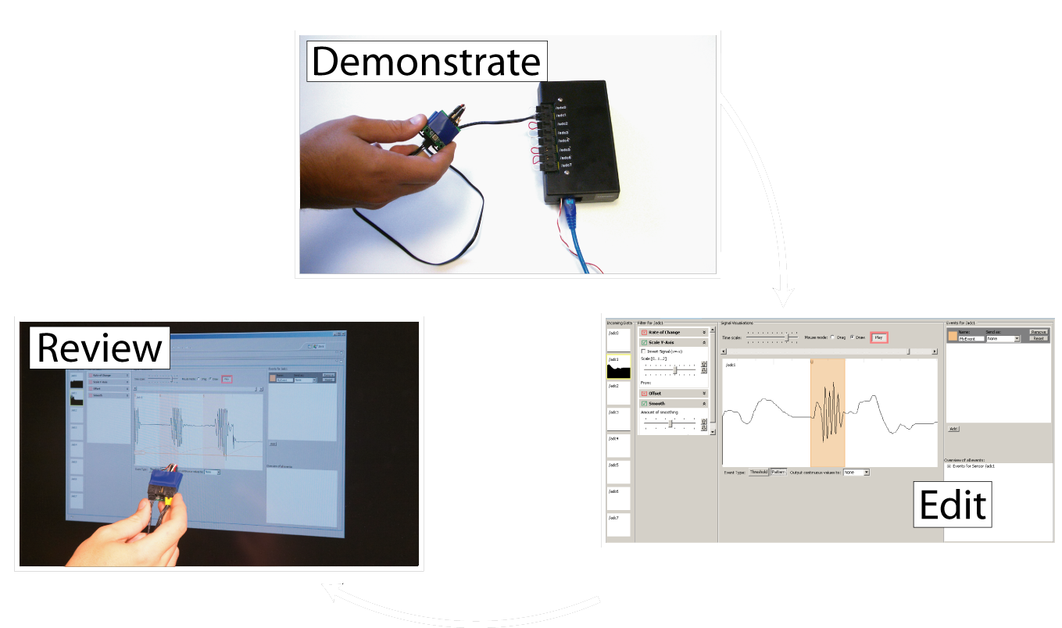
Exemplar
[chi 2007]
Notes:
and reviews (or tests) the result by performing the action again.

Slide 33
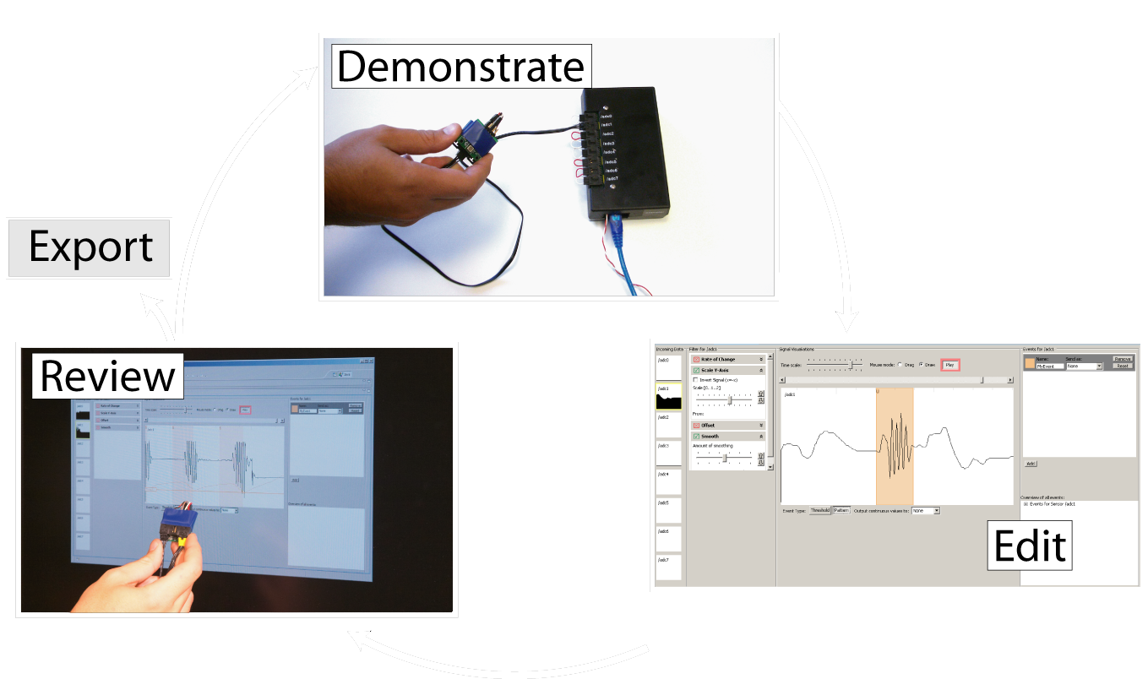
Exemplar
[chi 2007]
Notes:
Through iteration based on real-time feedback, the designer can refine the recognized action and link it with other prototyping applications.

Slide 34
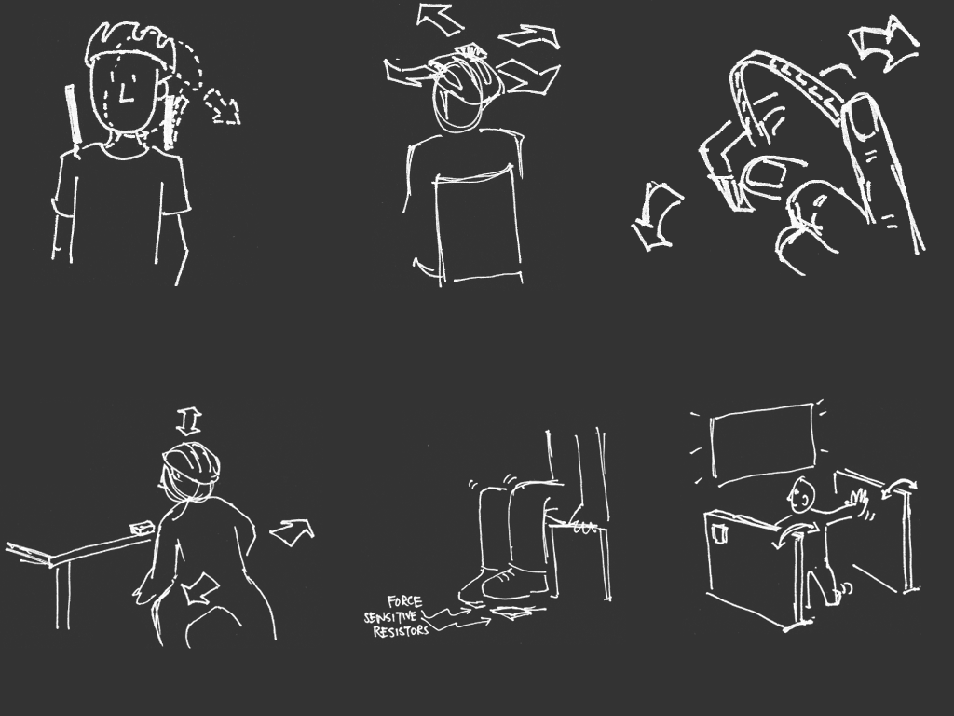
[sketches by Wendy Ju]
Notes:
Instead of going into any detail of the internals here, I’d rather share some of our user evaluation results of this tool with you. We gave students with little or no background in electronics a box of sensors and two existing mouse and keyboard-controlled games. Their taks was to develop novel engaging control schemes for these games. The rapid feedback cycle in Exemplar enabled participants to explore up to four different control schemes for a given game in less than 45 minutes. The takeaway point here is that even novices could rapidly and successfully create novel controls. Let me show you three of the creative solutions our participants came up with.

Slide 35

Notes:
One participant created a make shift booth - hitting walls and stomping on the floor navigated a spaceship.
Another participant taped an accelerometer on his bicycle helmet to detect him ducking down to fire rocket thrusters.
A third participant used the signal generated by the flicking of a bend sensor to trigger shooting of rubber bands.These results make us hopeful that we’re really starting to hit the kind of speed and fluidity needed to support creative design work.

Slide 36
Three Ideas For Future Design Tools
Integrate Design, Test, and Analysis
Programming by Demonstration
Support Designing Multiple Alternatives
Notes:
Now on to my last proposal: Design tools should explicitly support the creation and management of multiple alternative solutions.

Slide 37
“The best way to have a good idea is
to have lots of ideas.”
-Linus Pauling
Notes:
Linus Pauling may be the premier chemist of the twentieth century. He was awarded the Nobel Prize for his work on describing the nature of chemical bonds.
What is inspirations to me about this quote is the focus on trying out multiple alternative ideas, approaches, solution strategies. (rewrite)

Slide 38

[Buxton, Sketching User Experiences]
Notes:
John Chris Jones, Bill Buxton, and many other reflective designers see the very core of design as consisting of two activities: generating multiple possible solutions to a problem (divergence), followed by a selection of desirable solutions from that set (or convergence).

Slide 39

Prototypes for the
Microsoft mouse
From Moggridge,
Designing Interactions, Ch2
Notes:
Here are two specific ways in which divergence, or working with multiple alternatives, offers value in desing:
First, designers may build dozens of prototypes to get a more complete understanding of a design space.
For example, Paul Bradley built about eighty foam models for the original Microsoft mouse to quickly explore different directions.

Slide 40
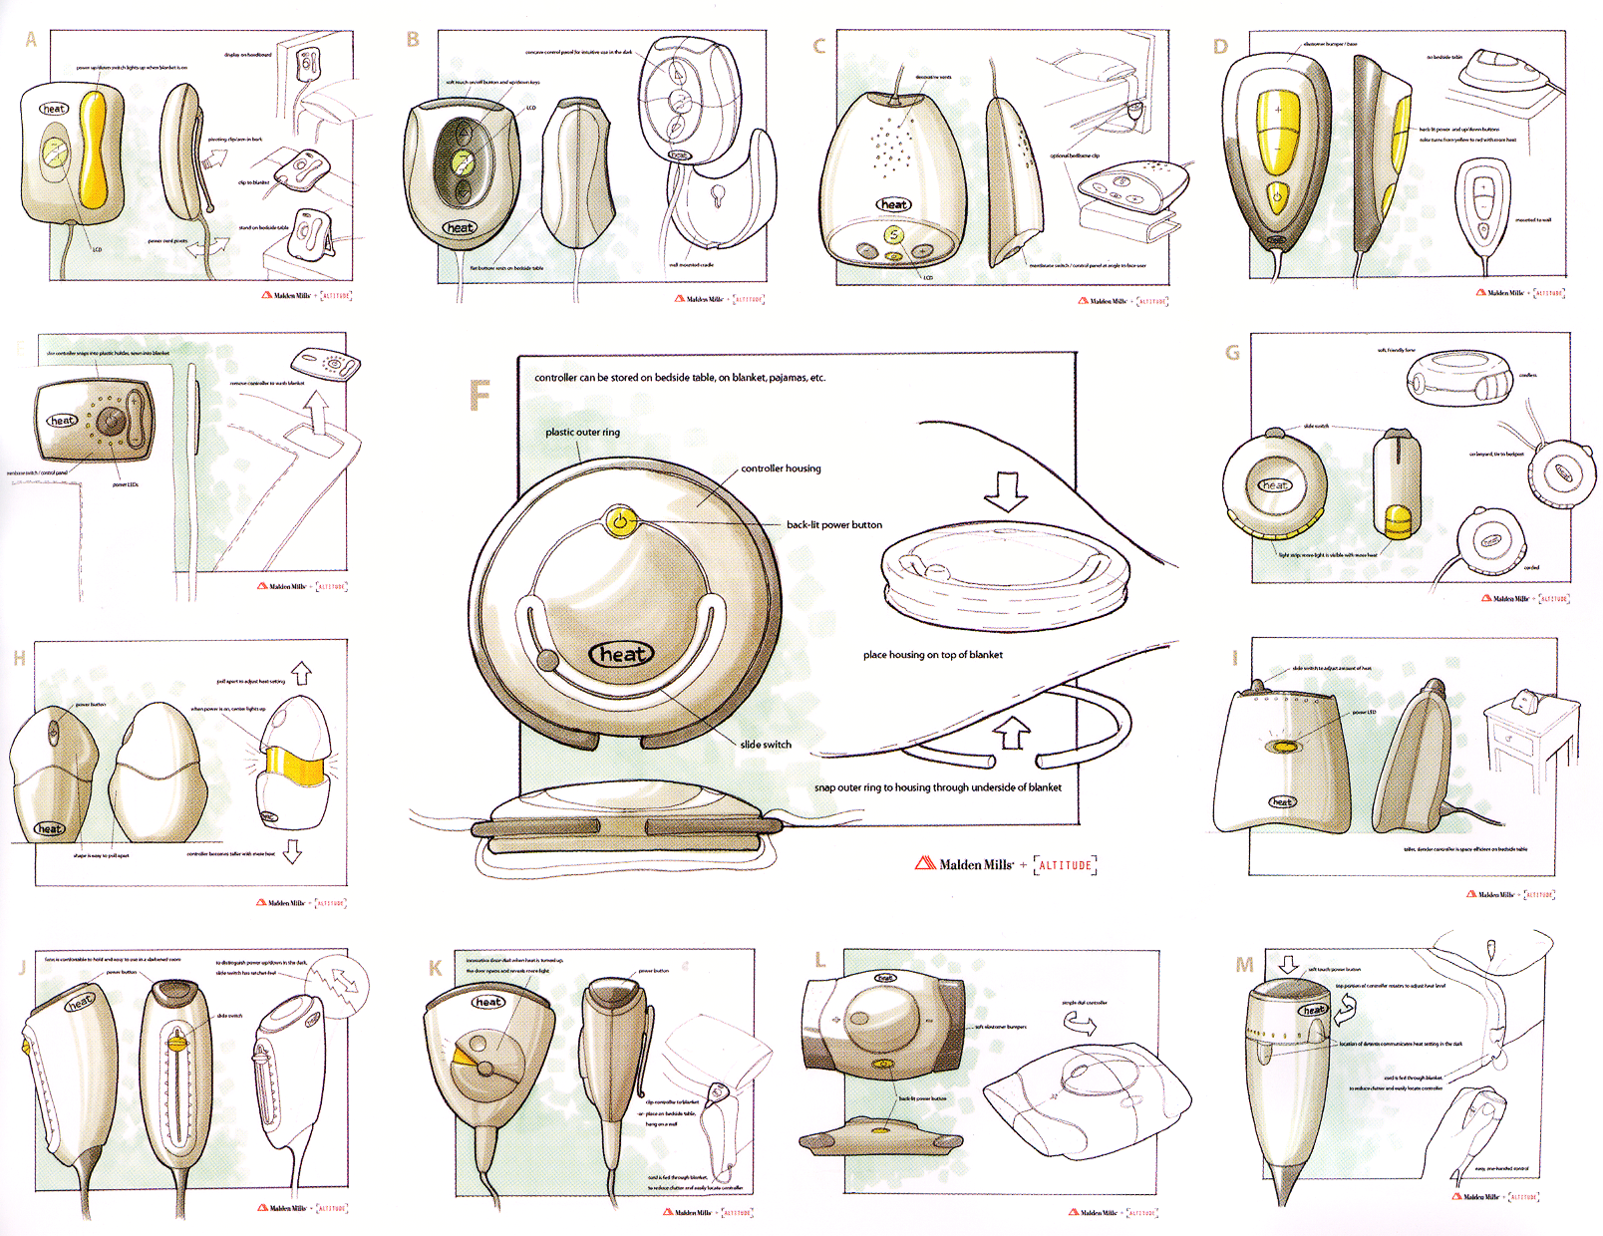
From Design Secrets: Products 2
Notes:
Second,discussing multiple prototypes allows project stakeholders to more effectively communicate their requirements.
Product design firm Altitude created these alternative renderings for a heating controller campus for the purpose of scaffolding discussions with their client, Malden Mills.

Slide 41

[Adobe Flash]
Notes:
Given the importance of alternatives, our authoring tools should support lightweight and rapid experimentation with alternative design options. However, such solutions do not yet exist for designing interactive behavior. A recent survey of designers at Carnegie Mellon found that they lack the tools to iterate on *behaviors* and to compare interaction designs side by side.
(Click) One of the central reasons it that design of interactive behavior, even for prototypes, often happens in textual code, which leaves the interaction designer with two representations to worry about: the code where behavior is authored, and the running program, where it is observed.

Slide 42
Juxtapose
Notes:
Our research insight is that in order to support experimentation with alternative behaviors, it’s necessary to build bridges between these representations.
Our current work on a system called Juxtapose demonstrates a novel environment for constructing multiple design alternatives through (selectively) parallel editing of behavior source code.

Slide 43
Juxtapose
Notes:
The idea is that alternatives can then be executed in parallel, allowing rapid comparison between them.

Slide 44
Juxtapose
Notes:
In addition, Arriving at a satisfying user experience often depends on adjusting
Many interrelated application parameters think of this as tweaking the experience dials. We’ve been working on mechanisms to automatically generate a control interface to interactively “tune”
parameters of the designed interaction at runtime. Here’s a short example

Slide 45
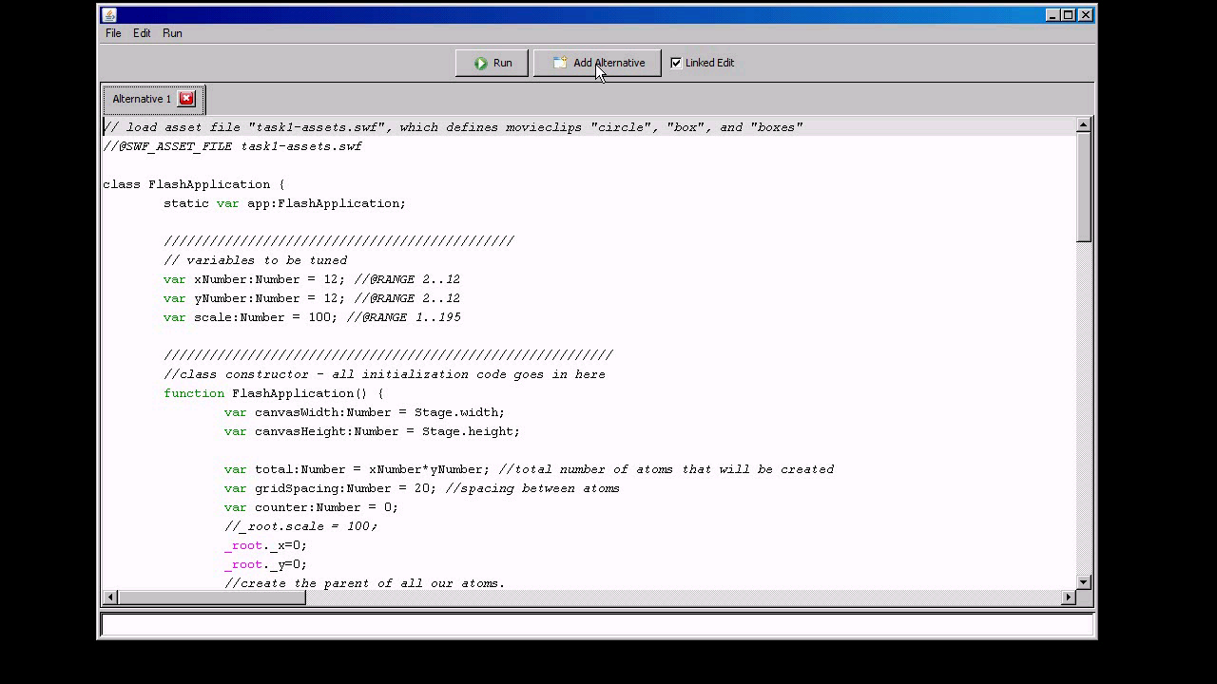
Notes:
In our tool, the code editor allows you to define multiple linked alternatives of interactions. These are then executed side by side. There is support for parallel input where input events are replicated across alternatives. A single alternative can also be brought into focus. Juxtapose automatically generates a control interface for parameters of the application. Designers can tune the behavior of their interactions while their application is running.
To adjust multiple parameters simultaneously, designers can use an actuated physical control board. The fast iterations enabled by Juxtapose are especially promising for mobile and physical computing applications. Alternatives here are executed on multiple handsets. A designer can thus rapidly switch between alternatives by putting one phone down and picking another one up.

Slide 46
Wait a minute! That looked a lot like programming, and very little like design…
Notes:
Some you probably thought something along these lines:<click>
What I’d like to emphasize though is that the real value of tools such as Juxtapose may be found in collaborative scenarios such as participatory design – we’re bascially introducing machinery that allows you to create alternative scenarios and high-level sliders for your prototype’s behavior ahead of time, in order to get more quality feedback by team members or outside testers. As Peter mentioned in his talk yesterday, one of the goals is to prototype new experiences in realtime with your customers. I believe this is a first step in this direction for interaction design.

Slide 47
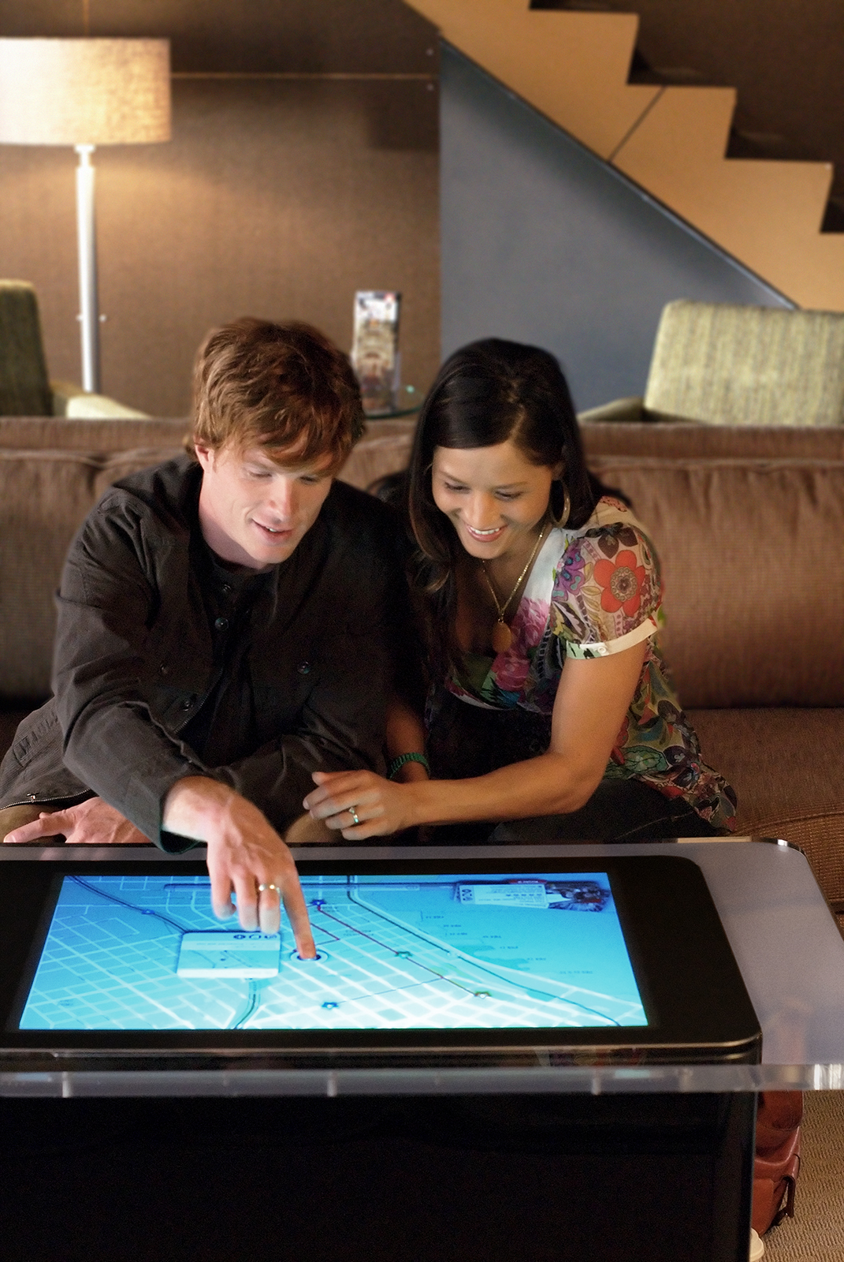
Microsoft
Surface
Notes:
One the topic of Collaboration - joint design activity is also one of the most exiting promises of new computing form factors such as the Microsoft Surface. I think there is tremendous opportunity in treating surface computing as a medium for design tools in the future, not just for entertainment, where its current focus lies. There will be a talk on Surface during the last half hour of the lunch break, which I encourage you to attend.

Slide 48
Three Ideas For Future Design Tools
Integrate Design, Test, and Analysis
Programming by Demonstration
Support Designing Multiple Alternatives
Notes:
So what’s the takeaway if you are not a design technologist? I believe that you can take the principles I outlined here and apply them to your domain. Your tools may look different from our tools, but I believe the principles of integrating design, test and analysis and working with multiple alternatives throughout your project, not just during ideation, can bring value to your practice. Programming by demonstration may be more specific to interaction design and require getting some engineering muscle on your team.

Slide 49
Experience Design @ Stanford
Notes:
Before I conclude, let me address one question that always comes up when I mention the words “design” and “Stanford” in the same sentence: So What about the d.school?

Slide 50

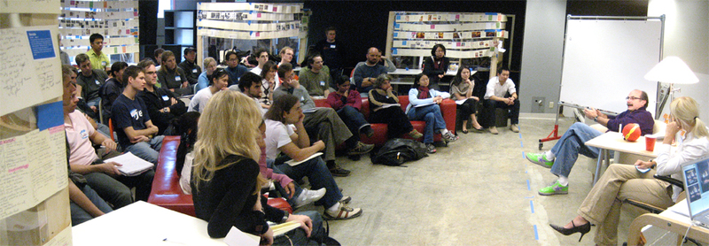
the d.school
Notes:
The d.school was Founded in 2004 by David Kelley & colleagues.
And has just moved to its third home in four years.
Not a dept. Pulls from Business, MS&E, CS, ME.
Goals are to create a culture of prototyping and build T-shaped people – with exposure to a broad set of perspectives and deep competency in one particular field.
Concerned with professional education at the masters level, not research.
Team taught
Multi-disciplinary
Real-world project based – client – the value of focus
Action-oriented: It’s ok to act and be wrong, it’s never ok to sit around and do nothing.

Slide 51
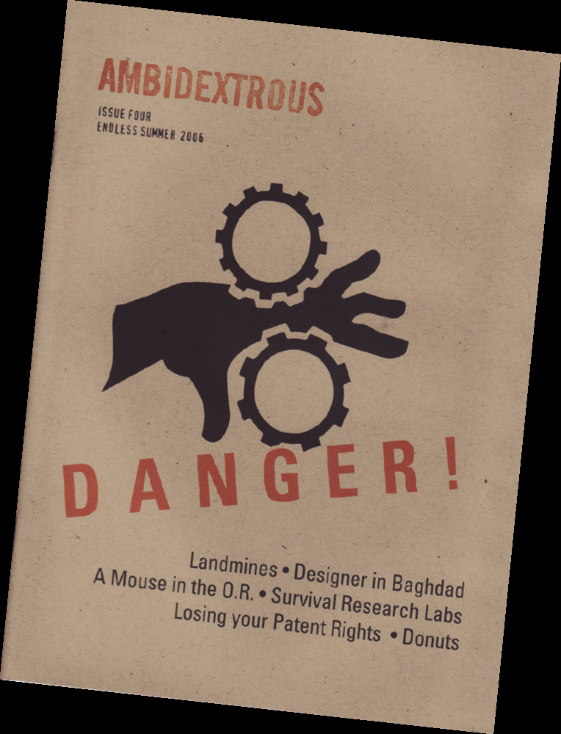
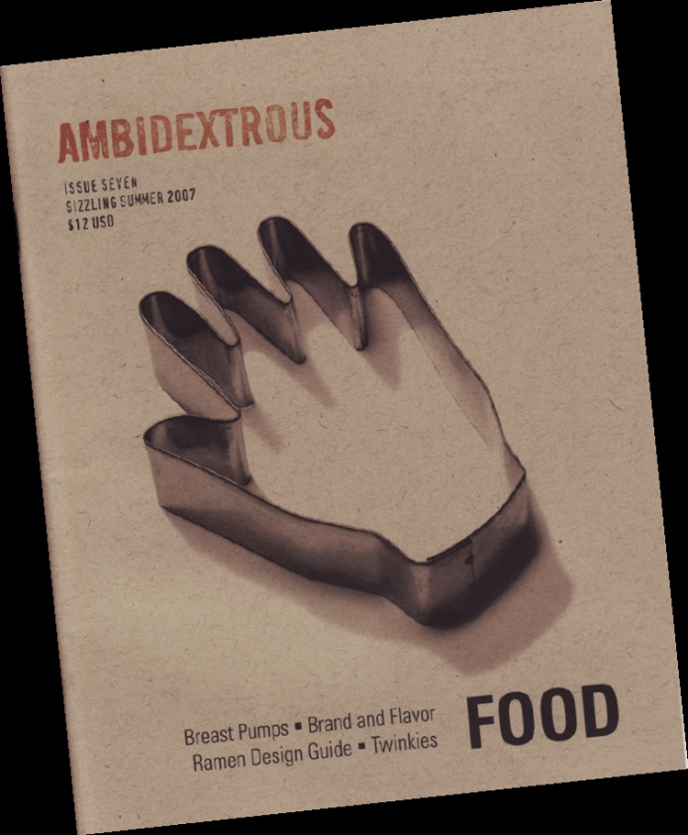
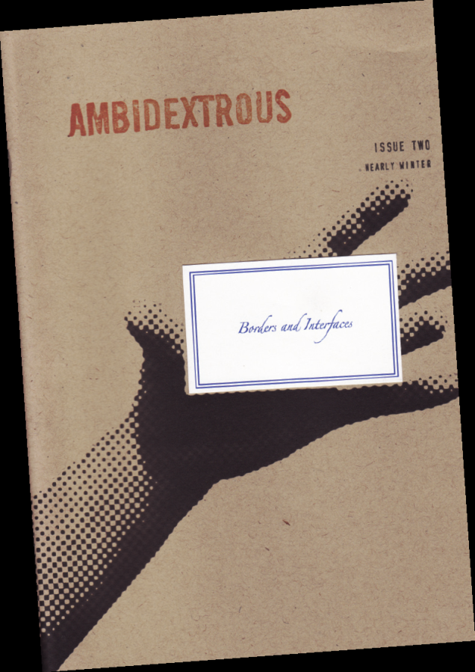
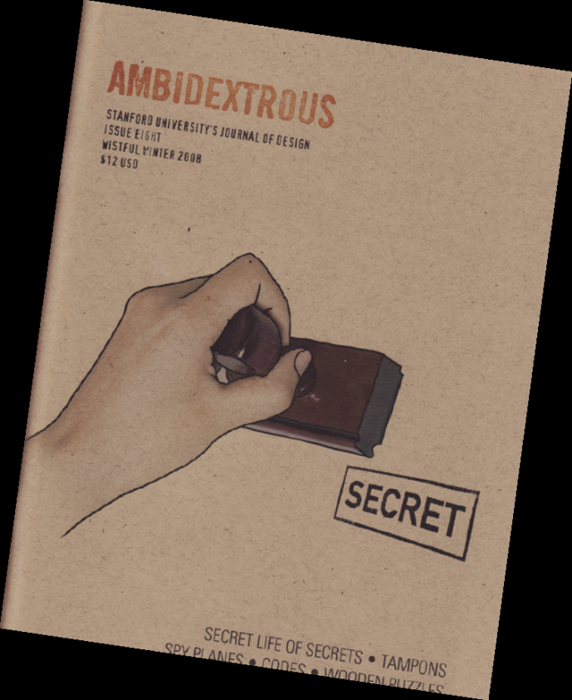
Quarterly journal of design practice
Student-run, but predominantly professional readership
Past contributors:
  Don Norman, Bill Moggridge, David Kelley, Genevieve Bell, Steve Portigal, Paul Dourish, Eli blevis, Ryan Freitas, Mike Kuniavsky, Nathan Shedroff, Bill Verplank, Larry Leifer, …
Notes:
If you want to stay connected with the larger design conversation going on at the d.school, take a look at Ambidextrous magazine, the dschool’s quarterly magazine of design that I co-edit. We have a table setup outside in the foyer.

Slide 52

Andrew Adams
Leith Abdulla
Michael Bernstein
Brandon Burr
Kevin Collins
Jennifer Gee
Wendy Ju
Dan Maynes-Aminzade
Manas Mittal
Avi Robinson-Mosher
Leila Takayama
Eino-Ville Talvala
Loren Yu
Leslie Wu
Notes:
And of course, the work that I shared today isn't mine alone. We have a truly fantastic group of graduate and undergraduate students and I'd like to thank all of my collaborators on the work I presented today, whose names are listed here.

Slide 53
http://hci.stanford.edu
http://dschool.stanford.edu
http://ambidextrousmag.org
Notes:
For more information on HCI research at Stanford or on Ambidextrous, please visit our web site. Thank you.

