Slide 1
Enlightened
Trial & Error
Interaction Design Prototyping Tools
Björn Hartmann
Stanford University HCI Group
& Microsoft Research

Slide 2

(cc) allcomm
Notes:
Since I usually speak on the academic conference circuit, I should starting with a bit of background. I am trained as a digital media designer and computer scientist.
As such, my focus is on the design of *digital* experiences. And more specifically, I am interested in creating the right kinds of *tools* for designing such experiences. I am also a researcher so some of the ideas I am talking about today are not ready for adoption in practice yet. I am conducting research in novel interactions and design tools both at Stanford and at Microsoft Research at the moment. However, I am *not* interested in designing for this interface… why not?

Slide 3

[O’Sullivan]
Notes:
This is a drawing by Dan O’Sullivan. It shows the mental model that my current PC has of me. My computer knows I have an eye – but only one – it does know that I have two ears. It knows I have a finger – but only one, maybe two – and it has no idea that I have a body. Given the richness our human experience in the physical world, it’s shocking that our experience in the digital world is so limited.

Slide 4
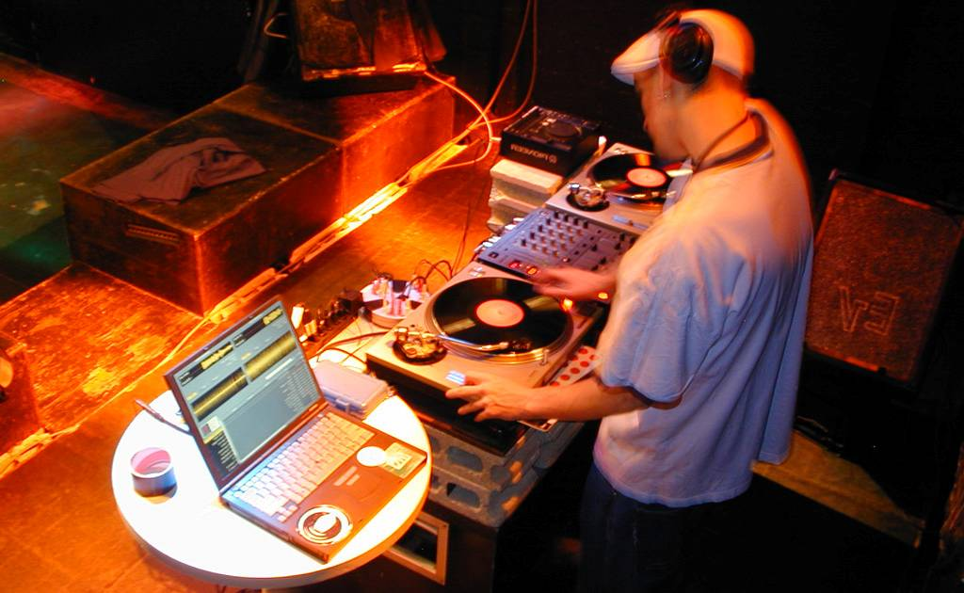
Notes:
Here is a flashback to my prior life as a musicion that offers a different vision of the role computing can play. This a shot I took on tour as a DJ in a club in Tokyo. The turntables and mixer are in essence the user interface for DJs. So what is the laptop doing in the picture? It’s clearly not the focus of attention. It is running Final Scratch, a software that allows a DJ to work with MP3 files through traditional turntables by using special records that contain a timecode, which is then analyzed to control playback of digital files.
Here computation moves out of its traditional gray box and starts to become more closely integrated with objects in the real world.

Slide 5

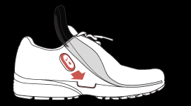
[Apple, Nike]
Notes:
Now, professional DJs are a niche audience so let’s look at two examples of more mainstream products that provide a new user experience by infusing everyday physical activity with computation. The Nike plus system syncs your workout data with
Your Ipod.

Slide 6
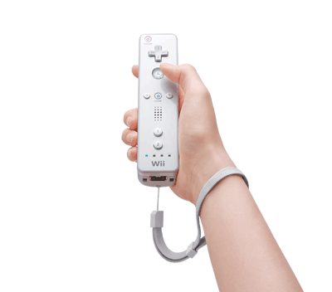
[Nintendo]
Notes:
And of course the Nintendo Wii has been wildly successful in reaching millions of casual gamers. Now, imagine you are a game designer. How do you explore such genre-extending ideas, and how do you nail the experience?

Slide 7
Experimentation
Matters!
Notes:
One of our group’s core beliefs is that you can’t just come up with good interaction designs by thinking hard about the problem. Of course applying your smarts is a prerequisite, but more than anything else <space> experimentation matters.
As David Kelley likes to say, “Enlightened trial and error outperforms the planning of flawless intellects.”

Slide 8

IDEO Camera
Notes:
Take this prototype of a digital camera developed at IDEO in the mid 1990s, at a time when such Cameras had not yet broken into the consumer space. IDEO was tasked to find a way to make sense of possible digital camera interactions – what were the fundamental modes of use? To explore, designers built this mockup of a camera back – it’s clearly not to scale, and it’s tethered by a thick umbilical to a desktop computer that drives the graphics and application logic. What matters though is that it has the right set of inputs and co-location of input and output which allows users to experience the artifact as if it was a camera.
Exploring such experience questions through prototypes is particularly important as computing moves off the desktop and into our pockets, homes, and environments, where interaction models and use cases are emerging.
If you trace the history of prototyping back through time, you find some really inspirational examples – let me share one with you.

Slide 9
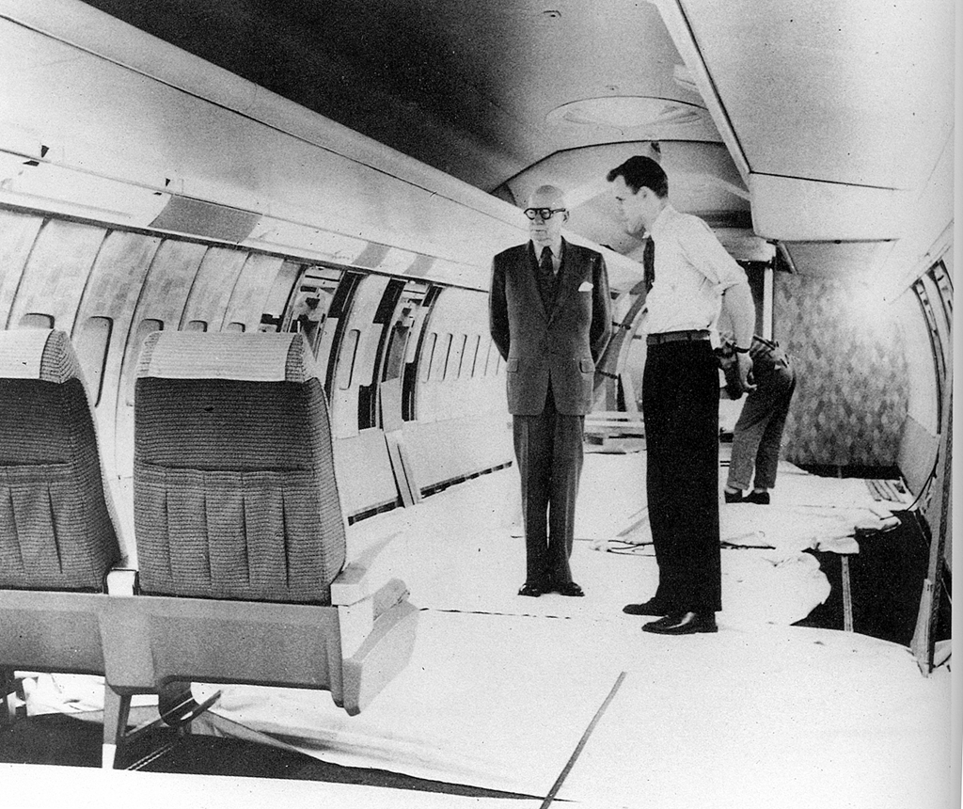
W.D. Teague
Notes:
How do you design an interior for a large passenger aircraft?
Build a full-scale mockup in a warehouse, and invite a couple dozen people to spend a day sitting in the mockup. This is a prototype for the interior design of a Boeing 707, the first commercially successful jet liner, from the late 1950s.
And the stern looking gentleman is Walter Dorwin Teague, one of the industrial design pioneers that introduced modern design process.

Slide 10
Pragmatic v. Epistemic Activity
START
GOAL
[Kirsh, Maglio 1994]
[Klemmer, Hartmann, Takayama 2006]
Notes:
A theoretic lens for understanding the role of prototyping is the distinction is between pragmatic and epistemic design activity.
Pragmatic actions are those related to directly accomplishing a task with a known goal.
Broadly speaking, planning tools have mostly been concerned with the pragmatic activity of getting things built.

Slide 11
Pragmatic v. Epistemic Activity
B
???
?
?
?
A
START
[Kirsh, Maglio 1994]
[Klemmer, Hartmann, Takayama 2006]
Notes:
But prototyping also serves an important epistemic function: design problems are ill-structured, meaning part of the designer’s job is to figure out what the space of solutions is in the first place . The goal itself is unclear.

Slide 12
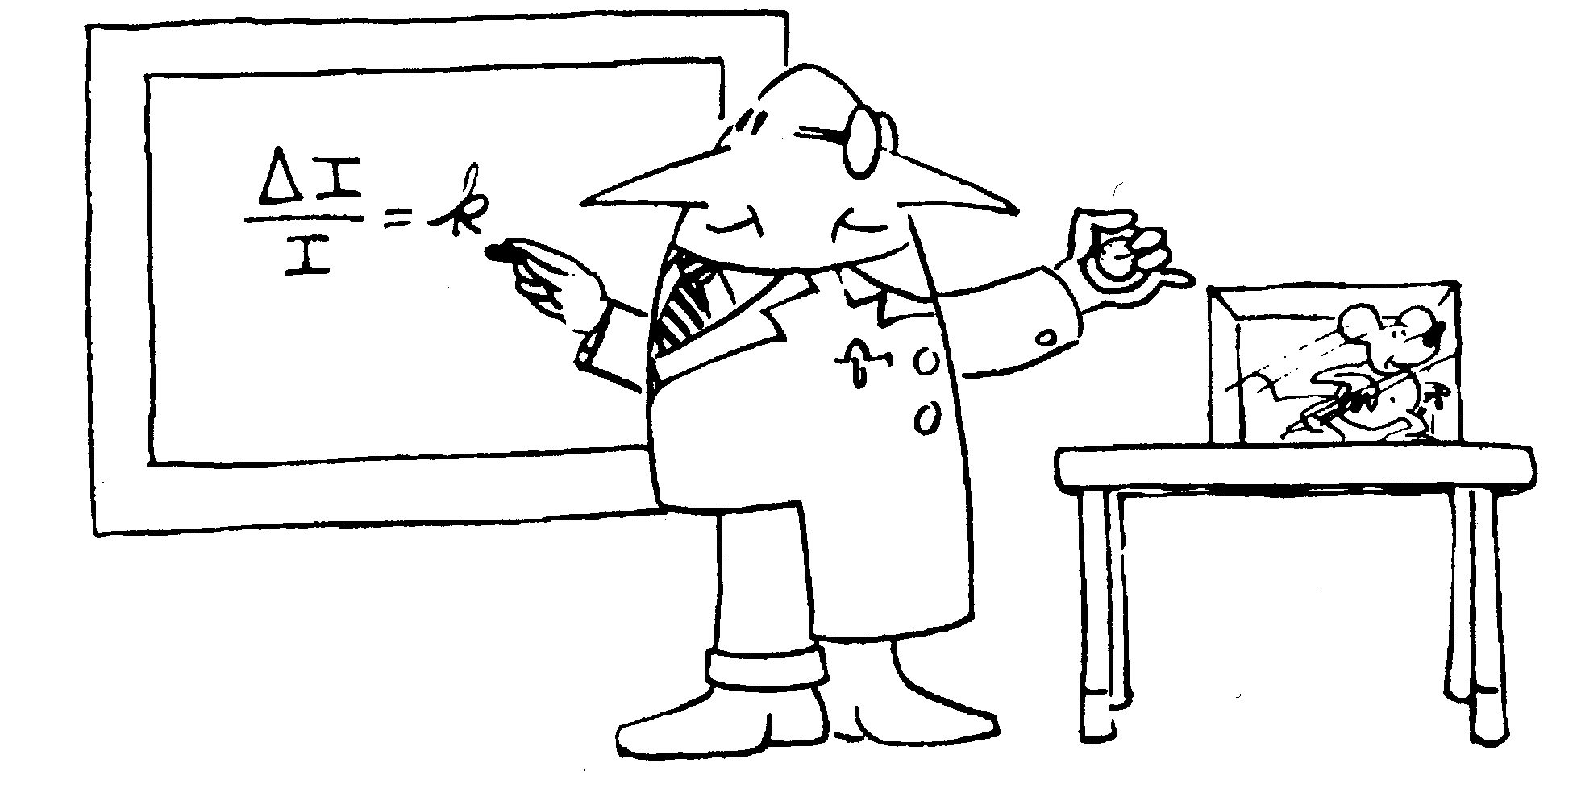
Notes:
Reflective, iterative design bears a lot of similarity to science. It’s not just a process of building it showing it to users and concluding that they liked it.
Prototypes embody design hypotheses and enable designers to test these hypotheses.
The goal in prototyping is not the artifact – it’s feedback and iteration: you build some prototypes, evaluate them, and use what you learned to drive the next design.

Slide 13
To Experiment Rapidly,
You Need the Right Tools
Notes:
To experiment Rapidly, you need the right set of tools. Really early on, this is where post-its an markers and glue sticks come in.

Slide 14
What comes after the
$1 prototype?
Notes:
But, what comes after your $1 prototype? What comes after the telling of a compelling scenario? If your product involves a tight interaction loop, how do you get to the point to really experience what the interactive behavior would feel like?

Slide 15
The Goal:
Enable everyone in your design team (not just the technology experts) to realize interaction design ideas, in order to gain insight faster.
Notes:
My research goal is move prototyping of novel interaction designs away from the exclusive domain of computer scientists and electrical engineer and give design generalists the right tools to create functional interaction design prototypes.

Slide 16
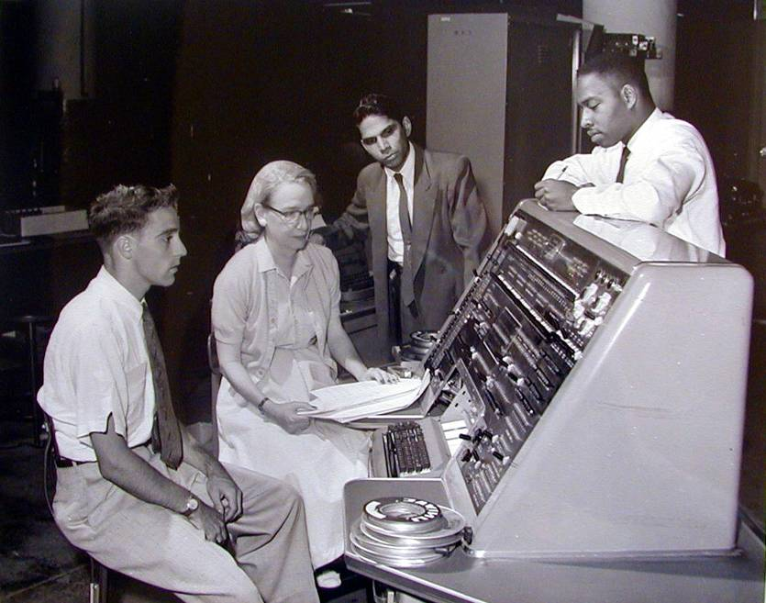
Design Tools
Notes:
Our research group's goal is to create the tools that will enable designers and end users to design interactive systems for the era of pervasive computing.
The idea of creating tools to empower users has a long and storied history in computer science, beginning with Grace Hopper’s invention in the early 1950s of the first compiler. What’s inspirational for me is that she conceptualized how improved tools could provide a much wider audience with access to computation.
As computation moves beyond the traditional desktop and software packages for individuals, there are two frontiers for design tools today : one is development with and for the web, the other is ubiquitous computing with new form factors.

Slide 17
Four Ideas For Future Design Tools
Integrate Design, Test, and Analysis
Leverage Programming by Demonstration
Support Designing Multiple Alternatives
Design by Modifying Examples
Notes:
Let me outline three ideas our research group has explored to move toward that vision

Slide 18

d.tools
[uist 2006]
Notes:
Our work on d.tools has explored how to more rapidly create and evaluate information appliances that incorporate rich physical interactions
The key contribution of d.tools, is the integration design, test, and analysis of information appliances in a single toolkit. Here’s a short video overview.

Slide 19
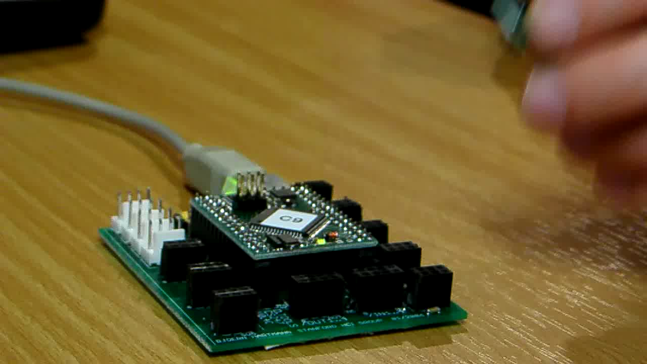
Notes:
As a designer plugs physical components such as sensors into the d.tools hardware interface, virtual counterparts appear in the d.tools authoring environment on the PC.
The DESIGNER then authors interactions by creating visual states, which encapsulate output, and by linking them through transitions, which get triggered by input events. The control flow interface is based on designers familiarity with storyboards.
d.Tools facilitates turning continuous sensor data into discrete events through an interactive demonstration and thresholding technique.
In d.tools, the interaction model is always live and can be tried out at any point.
To increase the complexity of prototypes, designers with programming knowledge can attach Java to visual states.
Here, Java code remote controls the Google Earth application. This is an example of how d.tools can be used to create mash-up prototypes.

Slide 20
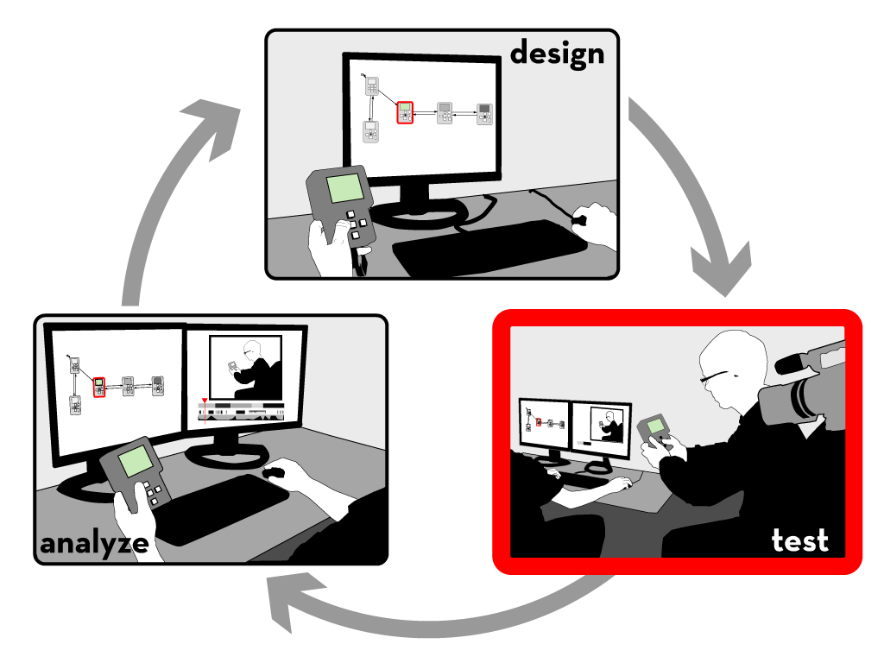
Notes:
Let’s move on to test mode

Slide 21

Notes:
A camera is pointed at the tester.
The live video from the camera is recorded and annotated in real-time with state transitions and input events.
In addition to events generated by the prototype itself, the experimenter can also add annotations with a video console.

Slide 22

Notes:
After a test session is completed, designers can leverage tight synchronization between the graphical interaction model, the recorded video, and the recorded event traces in analyze mode.

Slide 23

Notes:
In analyze mode, video playback is synchronized with a visualization that highlights active states.
In the other direction, designers can select states in the statechart to access corresponding video clips.
Designers can query for video sequences matching input by demonstrating that input on the prototype itself.
Multiple test sessions can be combined into a video spreadsheet, which can be used for rapid comparative evaluation.

Slide 24
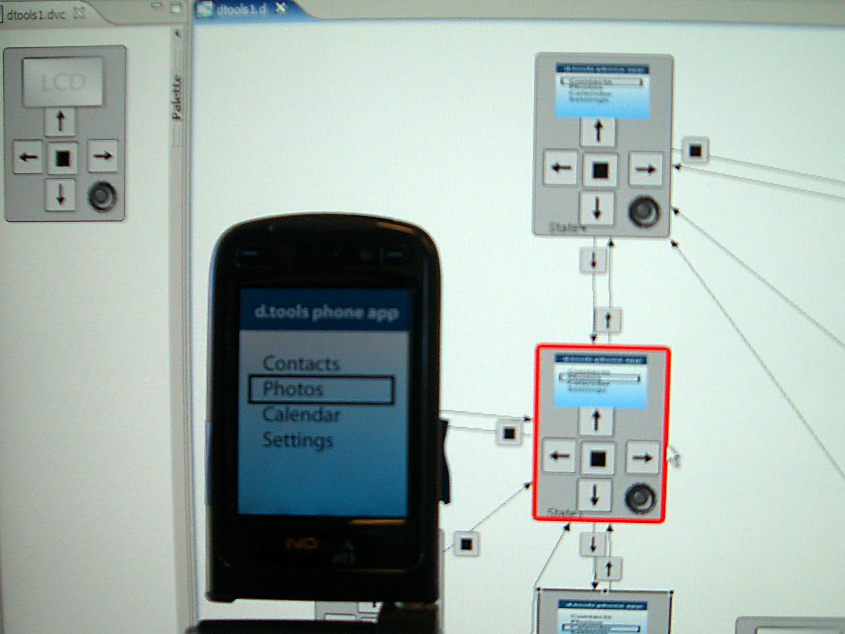
Notes:
More recently we have collaborated with Nokia design San Francisco to extend the d.tools authoring approach to mobile phone prototypes. The idea is that you run a client application on your smart phone which sends all input events from the a PC where you can edit the interaction model in realtime.

Slide 25

Notes:
In the tradition of eating your own dogfood, we hand-manufactured a dozen kits which we distributed student teams in a masters level HCI design course in 2006 and 2007.
This image shows a color mixing interface designed with d.tools in which users can “pour” color from tangible buckets onto an LCD screen and then draw with those mixed colors on a tabled; this project took part in the Microsoft Design Expo in Redmond in 2006.

Slide 26
Four Ideas For Future Design Tools
Integrate Design, Test, and Analysis
Leverage Programming by Demonstration
Support Designing Multiple Alternatives
Design by Modifying Examples
Notes:
Let me outline three ideas our research group has explored to move toward that vision

Slide 27
“Solving a problem simply means representing it so as to make the solution transparent”
—Herbert Simon, The Sciences of the Artificial
Notes:
As Herb Simon and Don Norman have pointed out, the representation of a problem is an important factor determining how we can manipulate that problem.

Slide 28

Representation Matters
Accelerometer X axis
Accelerometer Y axis
//detect accelerometer peaks
//read data sample
xVal[t++]=readA2DValue(xPin);
//look for changes in derivative
if(((xVal[t]-xVal[t-1]) >= 0
&& (xVal[t-1]-xVal[t-2]) < 0) ||
(((xVal[t]-xVal[t-1]) < 0
&& (xVal[t-1]-xVal[t-2]) >= 0)) {
//peak detected
//send message
oscSendMessageInt("/x/peak",1);
} else {
//no peak
}
Notes:
For tasks like sensor-based interactions, an individual's performance of the input they would like to recognize is a very different activity from symbolically specifying that input. The motivation of our work is to leverage the embodied performance to actually do the work of specifying the computation.

Slide 29
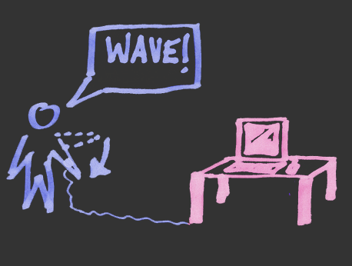
Idea: Programming by Demonstration
Notes:
We achieve this by applying programming by demonstration to the domain of sensor-based interaction design.

Slide 30
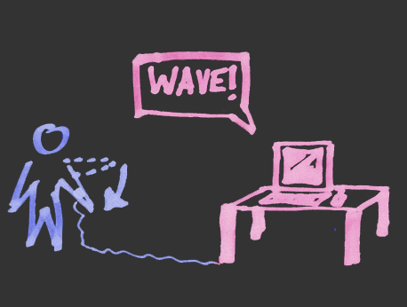
Idea: Programming by Demonstration
Notes:
30
Programming by demonstration (PBD) is the process of inferring general program logic from observation of examples of that logic.

Slide 31
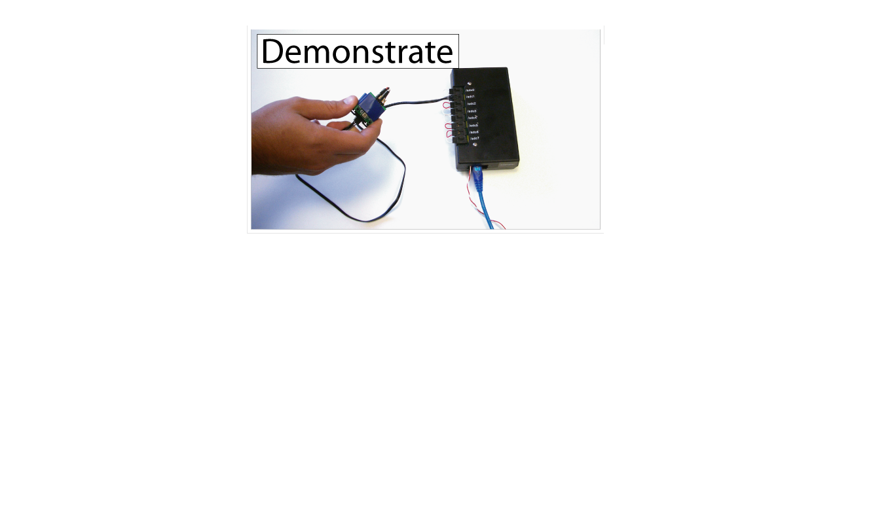
Exemplar
[chi 2007]
Notes:
We constructed another design tool, Exemplar, to investigate such an approach.
With Exemplar, an interaction designer first demonstrates a sensor-based interaction to the system (e.g., by shaking an accelerometer).

Slide 32
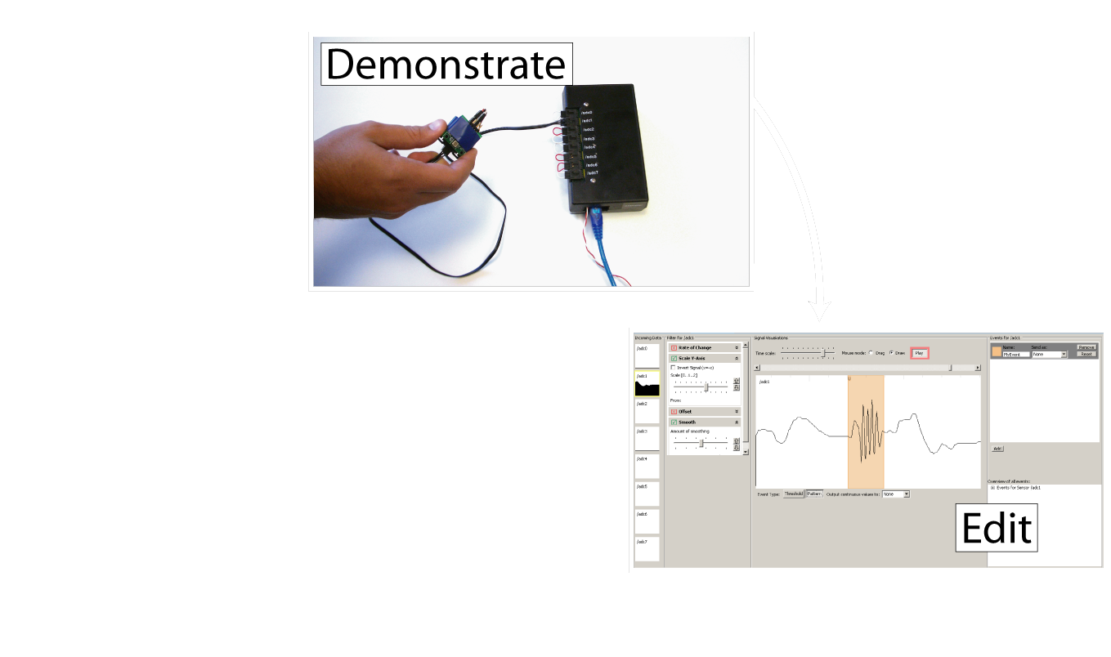
Exemplar
[chi 2007]
Notes:
The designer then edits a visual representation of the action by marking it up,

Slide 33
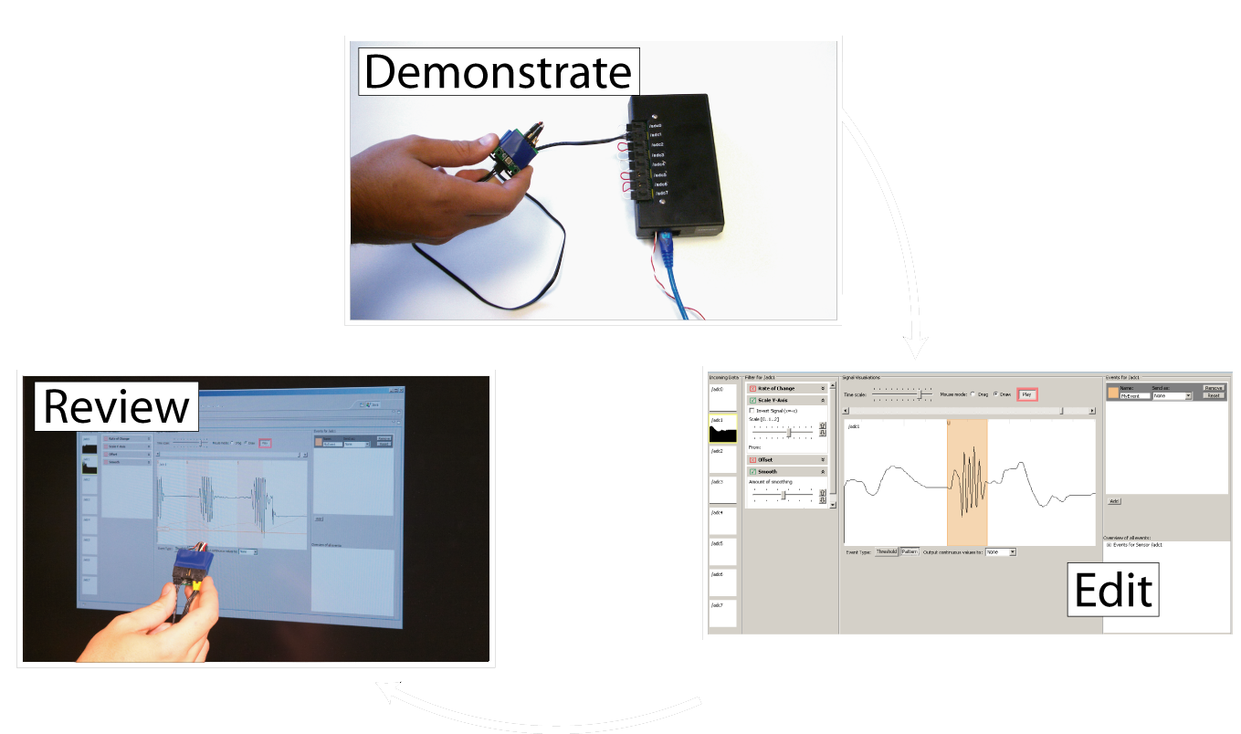
Exemplar
[chi 2007]
Notes:
and reviews (or tests) the result by performing the action again.

Slide 34
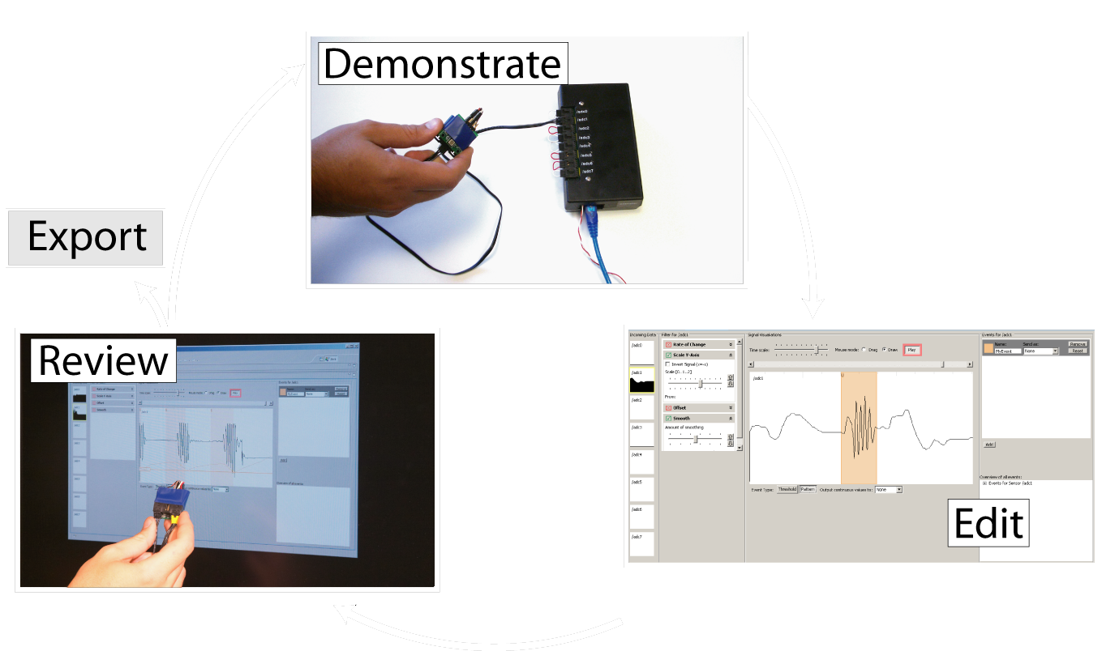
Exemplar
[chi 2007]
Notes:
Through iteration based on real-time feedback, the designer can refine the recognized action and link it with other prototyping applications.

Slide 35
Notes:
This scenario shows how Dan, an interaction designer, prototypes a bicycle helmet with blinkers that signal when the helmet is tilted. This example was inspired by Ted Selker’s smart helmet built at the media lab.
Our designer picks a accelerometer and connects it to a compatible hardware interface. Data from all inputs is shown simultaneously in Exemplar in small preview windows. Previews light up when sensor data changes rapidly to attract attention.
This overview allows him to discover pertinent signals.
Dan brings one accelerometer output into focus, then demonstrates examples of the action he wants to recognize.He reviews and marks up the sensor signal to define the regions that contains his action.
Here Exemplar generalizes from the examples by calculating thresholds of the highlighted region
In addition to drawing regions, Dan can also use a foot pedal to define examples while he performs them. Dan can immediately test his design to see if it works. Exemplar shows a visualization of sensor signal regions that match the demonstration. Exemplar will then generate events based on matching regions in two ways: first the software can send System Mouse and Keyboard events to remote control other applications
Or, Exemplar can send events to d.tools. Dan can refine the learned interaction model through direct manipulation. For example through filters that transform the incoming sensor data.
Exemplar offers two generalization techniques:
Thresholds, which compares a single data point to fixed limits.
And pattern matching, which enables recognition of actions characterized by a change over time, such as gestures.

Slide 36
Dynamic Time Warping
Demonstration Signal
Matching Input Signal
int DTWDistance(char s[1..n], char t[1..m], int d[1..n,1..m]) {
declare int DTW[0..n,0..m]
declare int i, j, cost
for i := 1 to m
DTW[0,i] := infinity
for i := 1 to n
DTW[i,0] := infinity
DTW[0,0] := 0
for i := 1 to n
for j := 1 to m
cost := d[s[i],t[j]]
DTW[i,j] := cost + minimum(DTW[ i-1, j ], // insertion
DTW[ i , j-1 ], // deletion
DTW[ i-1, j-1 ]) // match
return DTW[n,m]
}
[Sakoe, H. Chiba, S. ‘78]
Notes:
36
36
Let me highlight one technical feature here. For our pattern matching algorithm, we employ Dynamic Time Warping or DTW.
DTW was originally used in the area of speech recognition. This algorithm uses dynamic programming for a sequence comparison and outputs an error metric describing how much one signal has to be warped in time or space to match another. We then let the user interactively threshold against that error metric – thus both simple thresholding and pattern recognition have a unified control structure in the user interface.

Slide 37
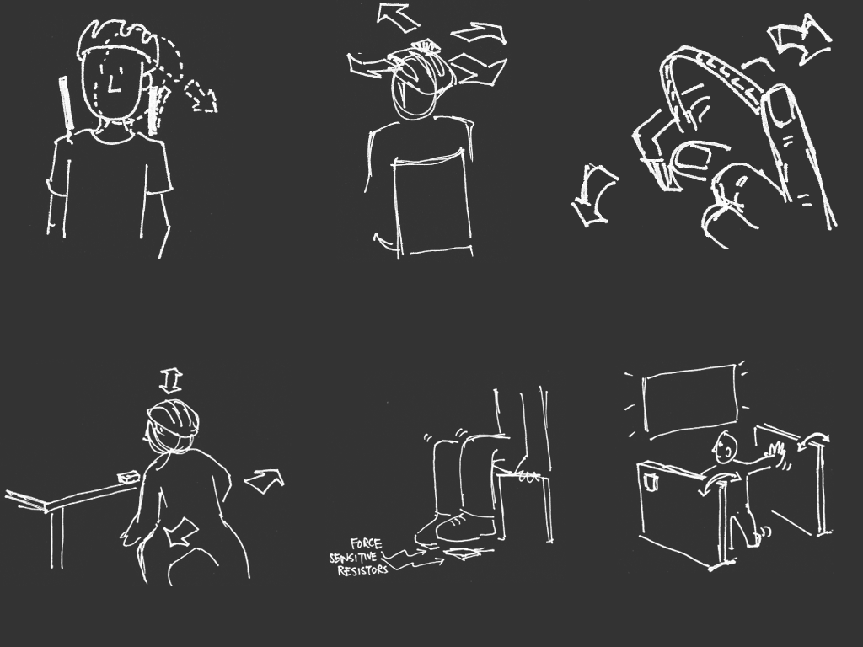
[sketches by Wendy Ju]
Notes:
Instead of going into any detail of the internals here, I’d rather share some of our user evaluation results of this tool with you. We gave students with little or no background in electronics a box of sensors and two existing mouse and keyboard-controlled games. Their taks was to develop novel engaging control schemes for these games. The rapid feedback cycle in Exemplar enabled participants to explore up to four different control schemes for a given game in less than 45 minutes. The takeaway point here is that even novices could rapidly and successfully create novel controls. Let me show you three of the creative solutions our participants came up with.

Slide 38

Notes:
One participant created a make shift booth - hitting walls and stomping on the floor navigated a spaceship.
Another participant taped an accelerometer on his bicycle helmet to detect him ducking down to fire rocket thrusters.
A third participant used the signal generated by the flicking of a bend sensor to trigger shooting of rubber bands.These results make us hopeful that we’re really starting to hit the kind of speed and fluidity needed to support creative design work.

Slide 39
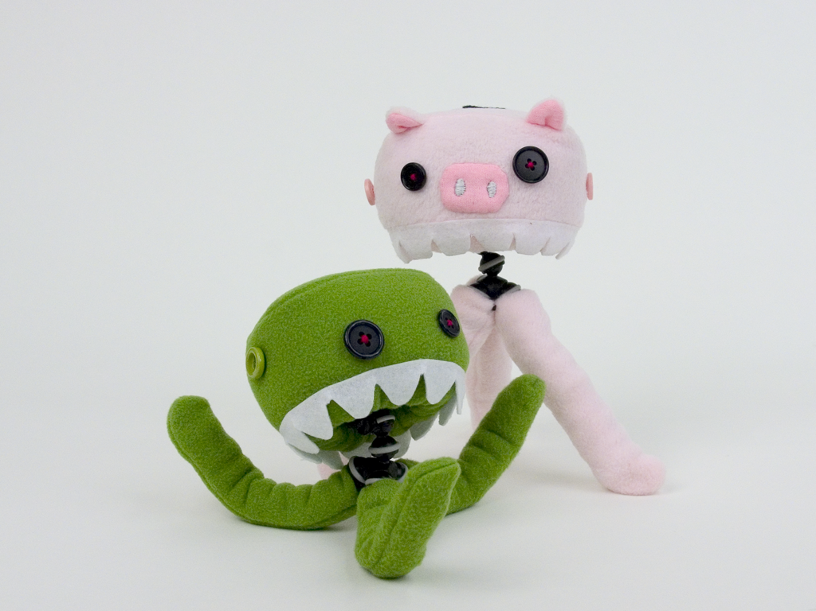
Be A Lead User
[Control Freaks by Haiyan Zhang]
Notes:
We also used Exemplar as the back end for a wireless gaming system on display on CHI2007.
This highlights another important aspect of our larger work process. Building the kinds of systems and applications that your design tools target is important – even if it’s not research itself. So over the past years, I have built a set of projects with collaborators that involve sensing and physical computing that were not done as research per se. Examples include

Slide 40
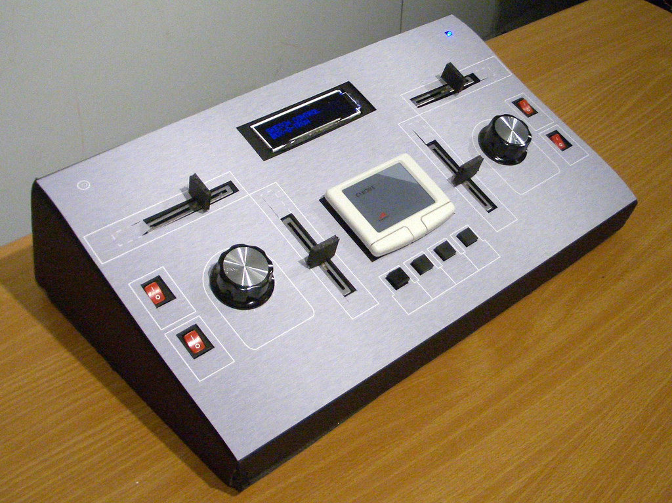
Be A Lead User
Notes:
Control interfaces for wizard-of-oz animation of 2d graphics.

Slide 41
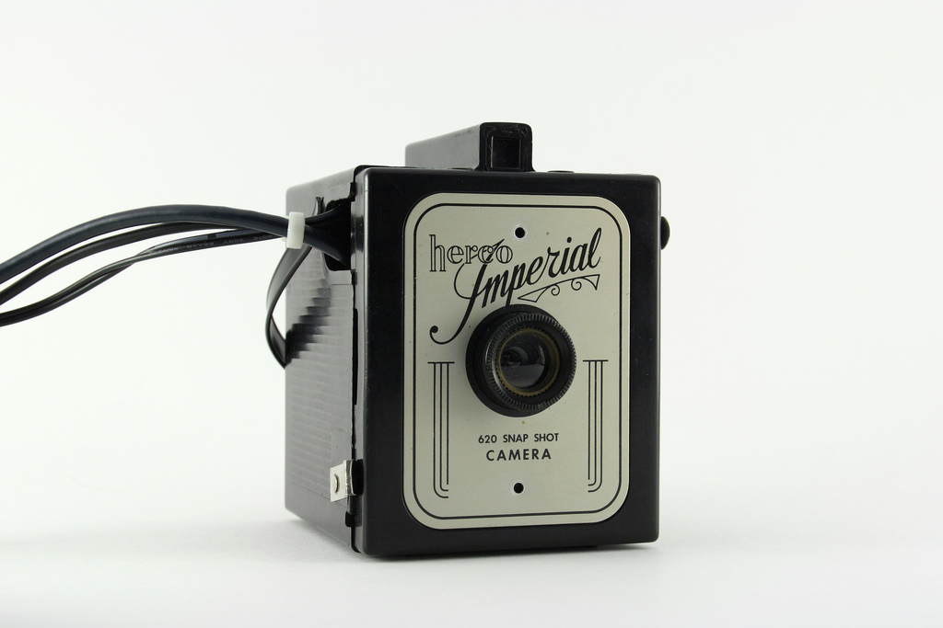
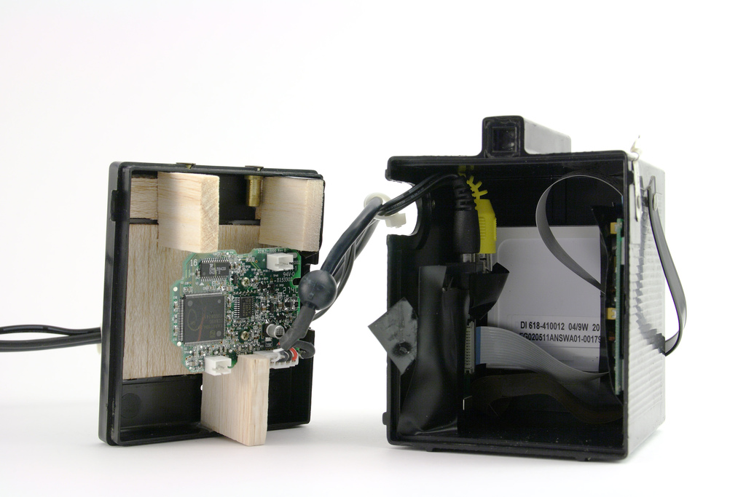
Be A Lead User
Notes:
The color field camera, which investigated connecting physical interfaces to web services

Slide 42
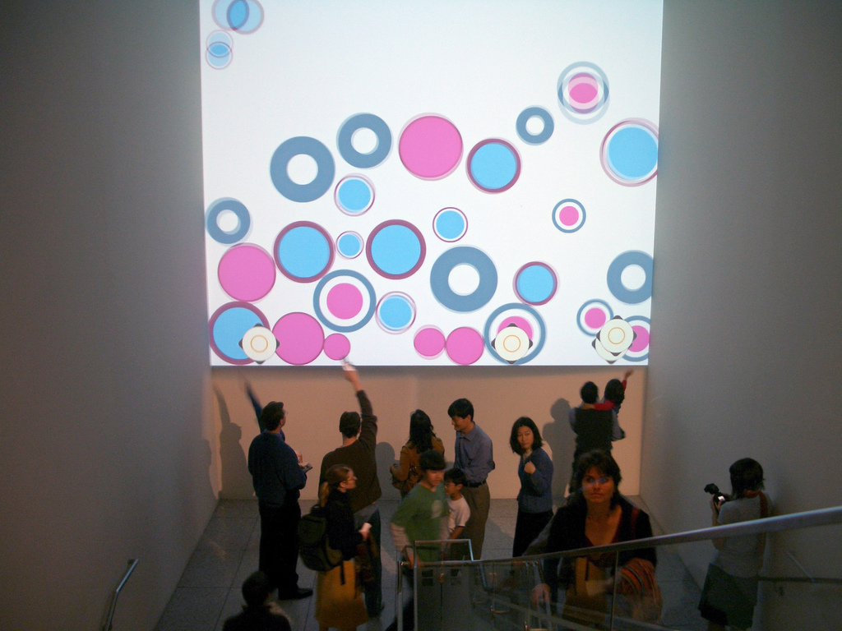
Be A Lead User
Notes:
And large scale interactive art installations at the SJMA

Slide 43
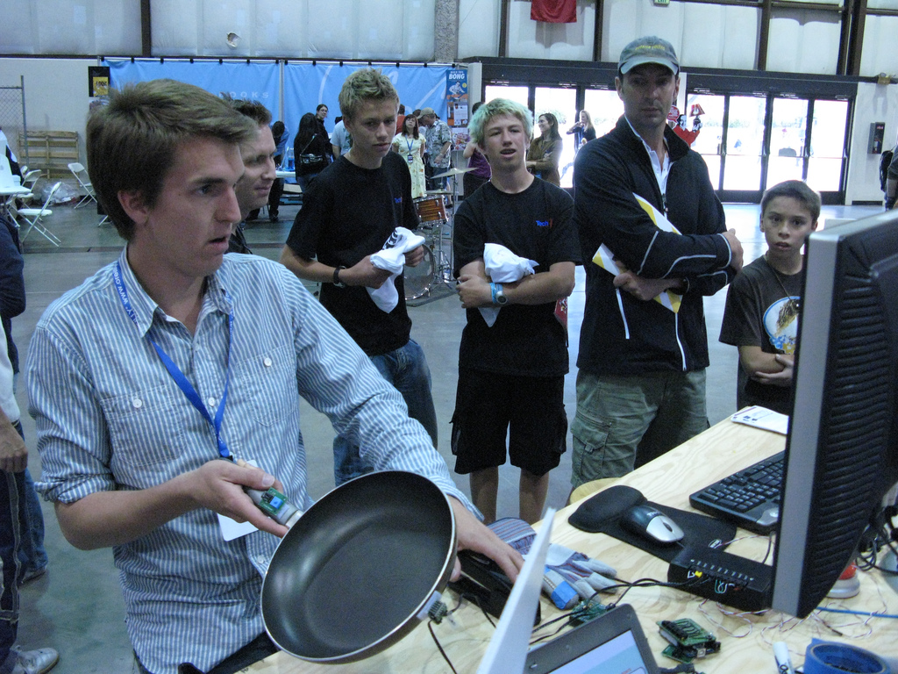
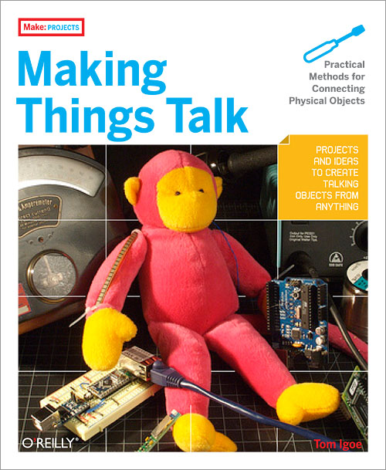
Share
Notes:
As with d.tools, we have made Exemplar available as open source software. Last year, we demonstrated exemplar at the Maker Faire, a Bay Area DIY event with 40,000 visitors. At our stand, hundreds of visitors built their own game controllers from household objects such as garden gloves, staplers and frying pans.<click> Exemplar has also been discussed in Tom Igoe’s recent book on physical computing.

Slide 44
Four Ideas For Future Design Tools
Integrate Design, Test, and Analysis
Leverage Programming by Demonstration
Support Designing Multiple Alternatives
Design by Modifying Examples
Notes:
Let me outline three ideas our research group has explored to move toward that vision

Slide 45
“The best way to have a good idea is
to have lots of ideas.”
-Linus Pauling
Notes:
Linus Pauling may be the premier chemist of the twentieth century. He was awarded the Nobel Prize for his work on describing the nature of chemical bonds.
What is inspirations to me about this quote is the focus on trying out multiple alternative ideas, approaches, solution strategies. (rewrite)

Slide 46

[Buxton, Sketching User Experiences]
Notes:
John Chris Jones, Bill Buxton, and many other reflective designers see the very core of design as consisting of two activities: generating multiple possible solutions to a problem (divergence), followed by a selection of desirable solutions from that set (or convergence).

Slide 47
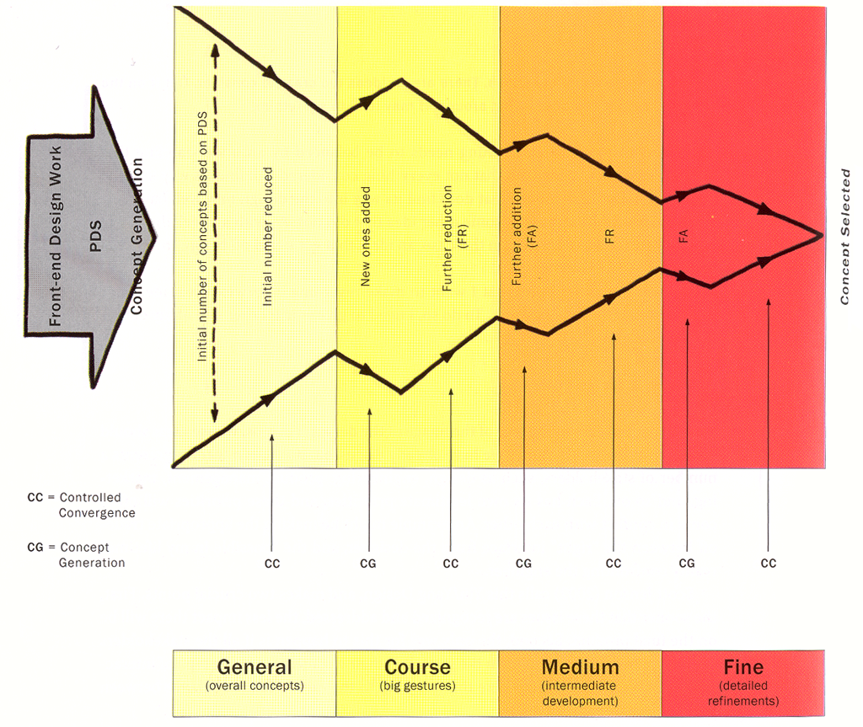
[Buxton, Sketching User Experiences]
Notes:
Alternating between Divergent and convergent steps happen at different granularities throughout a design process. While initially you may survey a range of very different concepts, the scope of experimentation narrows as a product becomes more well defined.

Slide 48

Prototypes for the
Microsoft mouse
From Moggridge,
Designing Interactions, Ch2
Notes:
Here are two specific ways in which divergence, or working with multiple alternatives, offers value in desing:
First, designers may build dozens of prototypes to get a more complete understanding of a design space.
For example, Paul Bradley built about eighty foam models for the original Microsoft mouse to quickly explore different directions.

Slide 49
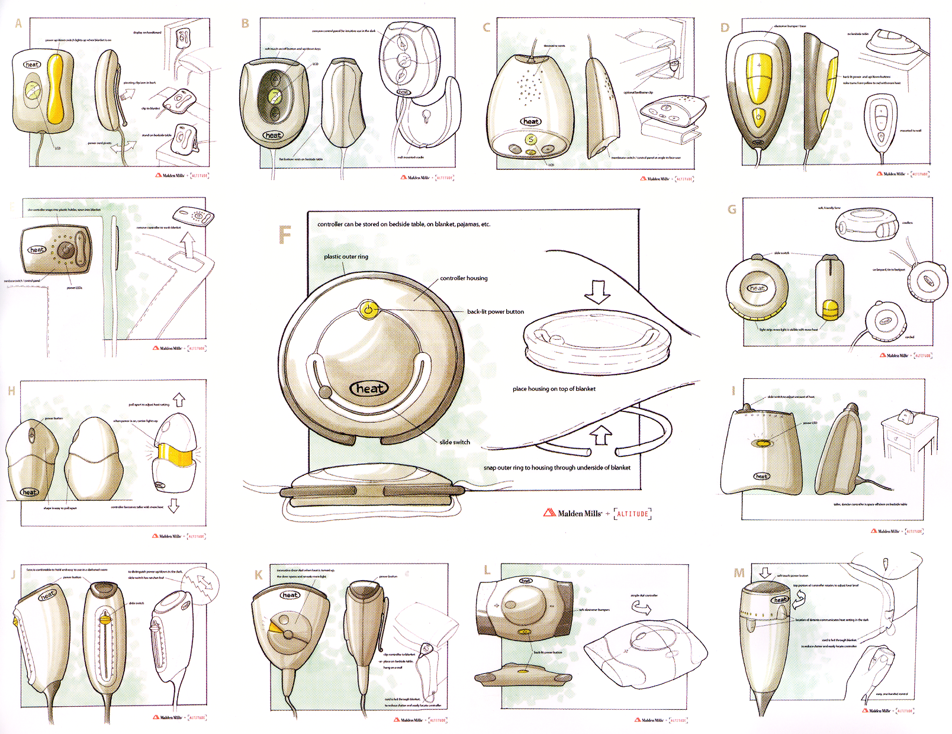
From Design Secrets: Products 2
Notes:
Second,discussing multiple prototypes allows project stakeholders to more effectively communicate their requirements.
Product design firm Altitude created these alternative renderings for a heating controller campus for the purpose of scaffolding discussions with their client, Malden Mills.

Slide 50

Tohidi et al, CHI 2006
Notes:
Third, comparing between multiple alternatives is important during user testing to keep participants honest:
Tohidi et al showed, that Participants will rate designs lower when multiple alternatives are seen, compared to when they see only one. And that Participants exposed to alternative designs will be less pressured to be positive.

Slide 51

[Adobe Flash]
Notes:
Given the importance of alternatives, our authoring tools should support lightweight and rapid experimentation with alternative design options. However, such solutions do not yet exist for designing interactive behavior. A recent survey of designers at Carnegie Mellon found that they lack the tools to iterate on *behaviors* and to compare interaction designs side by side.
(Click) One of the central reasons it that design of interactive behavior, even for prototypes, often happens in textual code, which leaves the interaction designer with two representations to worry about: the code where behavior is authored, and the running program, where it is observed.

Slide 52
Juxtapose
Notes:
Our research insight is that in order to support experimentation with alternative behaviors, it’s necessary to build bridges between these representations.
Our current work on a system called Juxtapose demonstrates a novel environment for constructing multiple design alternatives through (selectively) parallel editing of behavior source code.

Slide 53
Juxtapose
Notes:
The idea is that alternatives can then be executed in parallel, allowing rapid comparison between them.

Slide 54
Juxtapose
Notes:
In addition, Arriving at a satisfying user experience often depends on adjusting
Many interrelated application parameters think of this as tweaking the experience dials. We’ve been working on mechanisms to automatically generate a control interface to interactively “tune”
parameters of the designed interaction at runtime. Here’s a short example

Slide 55

Juxtapose
Notes:
For such parameter tuning, Juxtapose supports the use of a dedicated, spatially multiplexed hardware controller. As Fitzmaurice showed in 1995, such spatially multiplexed input devices outperform mouse and keyboard input for multivariate control tasks.
The controll board enables users to modify multiple parameters simultaneously; leaves the eyes free to focus on the application being tuned; and allows for tuning of interactions that require concurrent mouse and keyboard input.

Slide 56
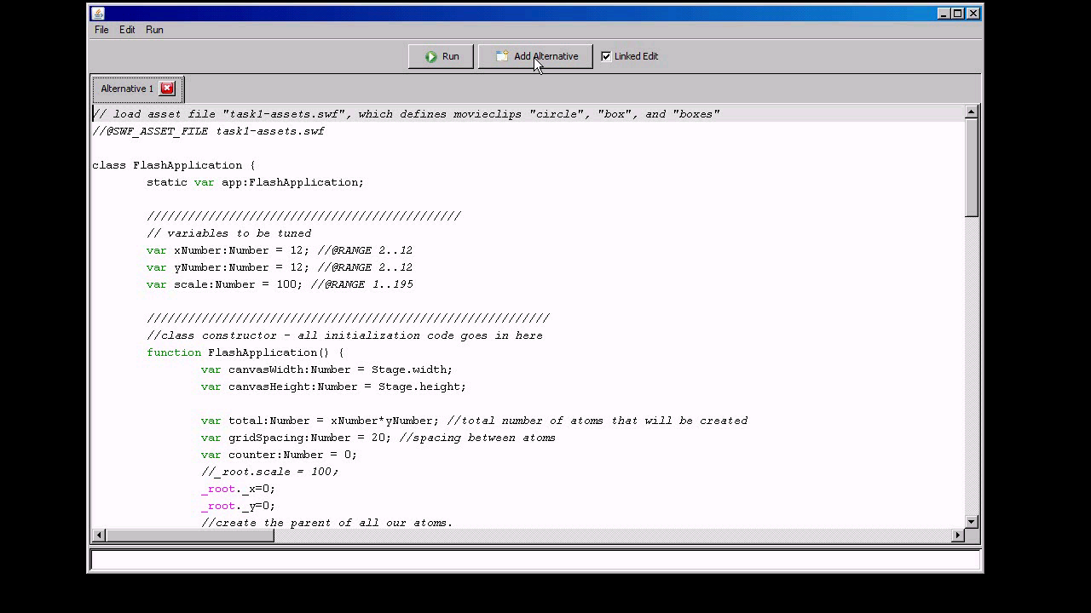
Notes:
In our tool, the code editor allows you to define multiple linked alternatives of interactions. These are then executed side by side. There is support for parallel input where input events are replicated across alternatives. A single alternative can also be brought into focus. Juxtapose automatically generates a control interface for parameters of the application. Designers can tune the behavior of their interactions while their application is running.
To adjust multiple parameters simultaneously, designers can use an actuated physical control board. The fast iterations enabled by Juxtapose are especially promising for mobile and physical computing applications. Alternatives here are executed on multiple handsets. A designer can thus rapidly switch between alternatives by putting one phone down and picking another one up.

Slide 57




Juxtapose Extensions
A
B
C
D
Juxtapose Editor +
Runtime on PC
Juxtapose Wrapper
User’s Application
on Phone
Control messages
Notes:
The benefits of Juxtapose are amplified for development off the desktop, where the cost of edit-compile-test cycles is much higher. In mobile development, coding happens on the PC -- because of the rich toolset available there -- while testing happens on device -- to get the user experience in context.
mobile phones are commodity hardware, and mobile developers already test on multiple handsets. We extended Juxtapose to leverage these device collections by executing different alternatives on different handsets. You write your alternatives on the PC, and the compiled applications are then distributed to a collection of handsets. A designer can thus rapidly switch between alternatives by putting one phone down and picking another one up. <click>
Our prototype works for FlashLite applications that target Nokia N93 phones. To allow remote control of application variables, we wrap the user’s application with an RPC interface behind the scenes.
57

Slide 58

Juxtapose Extensions
Bootloader
Juxtapose Editor +
Runtime on PC
Application Binaries
Juxtapose Wrapper
User’s Application
Control messages
Notes:
As we saw with d.tools, embedded microcontrollers are the tool of choice for working with sensors and actuators. d.tools treated the hardware as an I/O interface and kept all application logic on a PC. Such an approach is not always possible, for example, for wearable computing, and haptics, which requires very tight feedback loops. Microcontroller programming in those areas can be arduous. Even seasoned veterans often resort to debugging by blinking LEDs or printing statements to serial ports. We extended Juxtapose to support authoring for the popular Arduino microcontroller platform.<click>
building custom hardware, is expensive, so designer are likely to embed multiple different opportunities for interaction into the same prototype. Hence, Juxtapose for Arduino exports and runs only one code alternative on one attached board at a time. When the designer switches between alternatives, Juxtapose then transparently replaces the binary running on the microcontroller .

Slide 59
Wait a minute! That looked a lot like programming, and very little like design…
Notes:
Some you probably thought something along these lines:<click>
What I’d like to emphasize though is that the real value of tools such as Juxtapose may be found in collaborative scenarios such as participatory design – we’re bascially introducing machinery that allows you to create alternative scenarios and high-level sliders for your prototype’s behavior ahead of time, in order to get more quality feedback by team members or outside testers. one of the goals is to prototype new experiences in realtime with your customers. I believe this is a first step in this direction for interaction design.

Slide 60
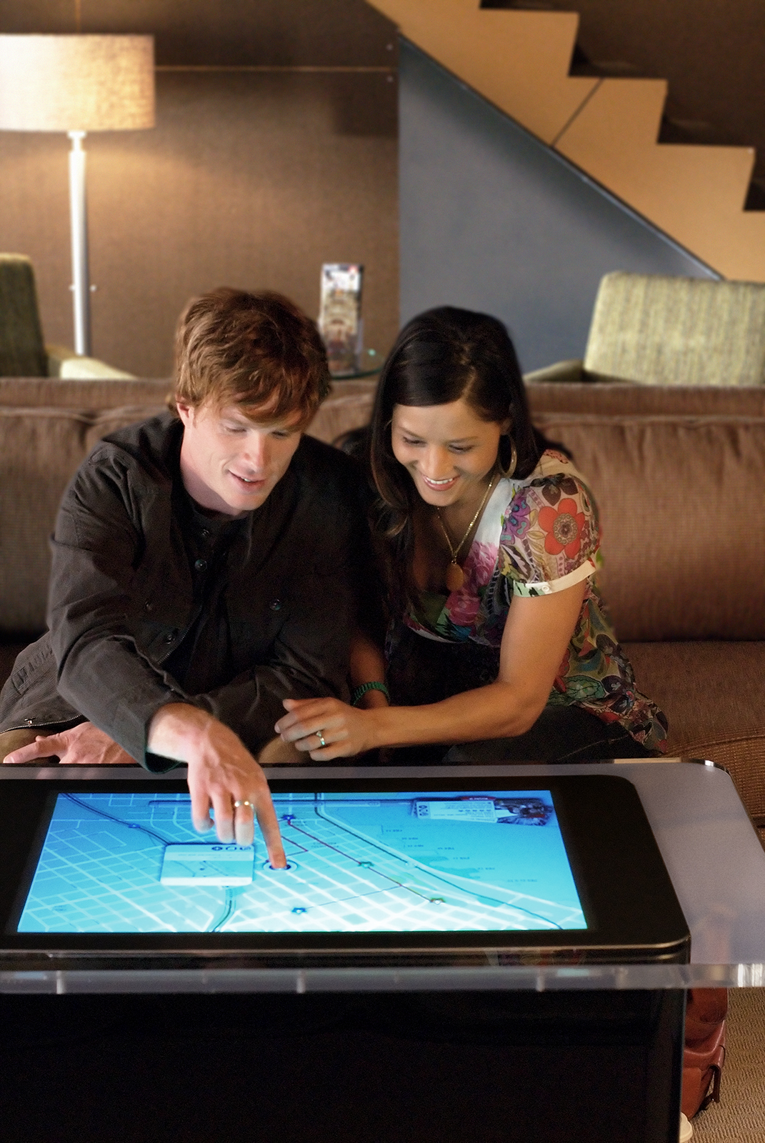
Microsoft
Surface
Notes:
One the topic of Collaboration - joint design activity is also one of the most exiting promises of new computing form factors such as the Microsoft Surface. I think there is opportunity in treating surface computing as a medium for design tools in the future, not just for entertainment, where its current focus lies.

Slide 61
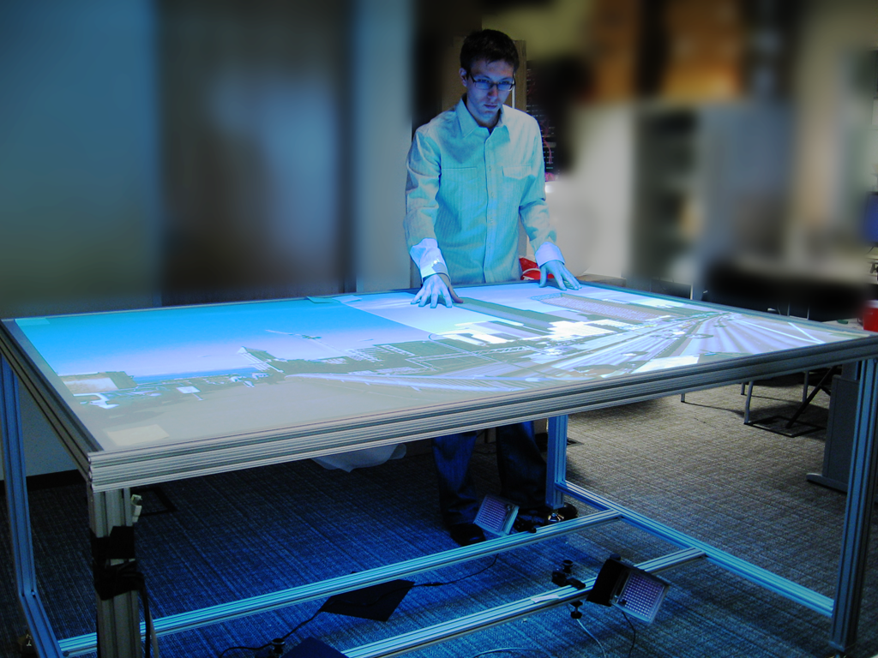

Slide 62
Four Ideas For Future Design Tools
Integrate Design, Test, and Analysis
Leverage Programming by Demonstration
Support Designing Multiple Alternatives
Design by Modifying Examples
Notes:
Let me outline three ideas our research group has explored to move toward that vision

Slide 63
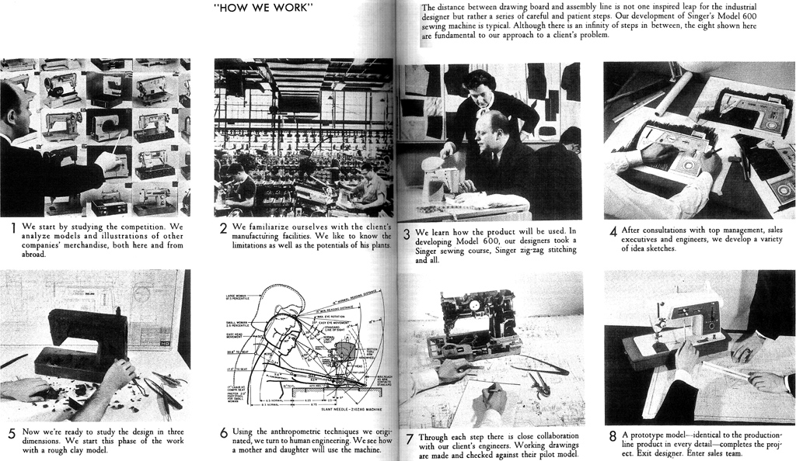
Design Process
Notes:
Henry Dreyfuss, one of Teague’s main competitors, captured the process by which industrial design creates new artifacts in a way that maximizes the utility and success in the 1950 book “Designing for People”. Dreyfuss’ process was based on observation and fieldwork, followed by development of many sketches and prototypes, which are tested, analyzed, and iteratively improved. While user-centered design as a whole still follows this process, I’d like to suggest that there are some important differences in how prototyping happens today.

Slide 64
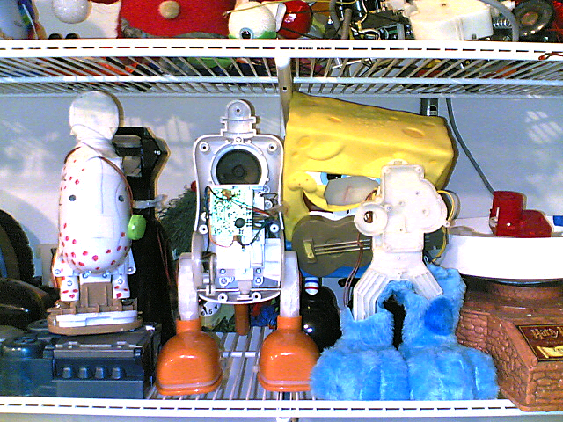
Design by Example Modification
Notes:
One of those differences is that, in our life in the Plentitude, as Rich Gold called it, we’re surrounded by an awful lot of existing stuff. And those artifacts are often used as jumping off points for new design. For example, in an interview study with professional toy designers that we conducted a while ago, all of our participnts reported that prototypes for new toys often start by cannibalizing the mechanisms and electronics of existing toys, and hot-gluing and hot-wiring them together. In fact, shopping for interesting mechanisms at Toys’R’Us is considered part of their job.

Slide 65
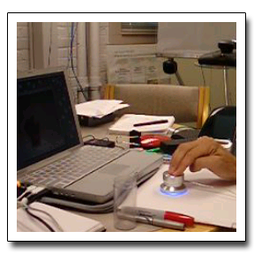
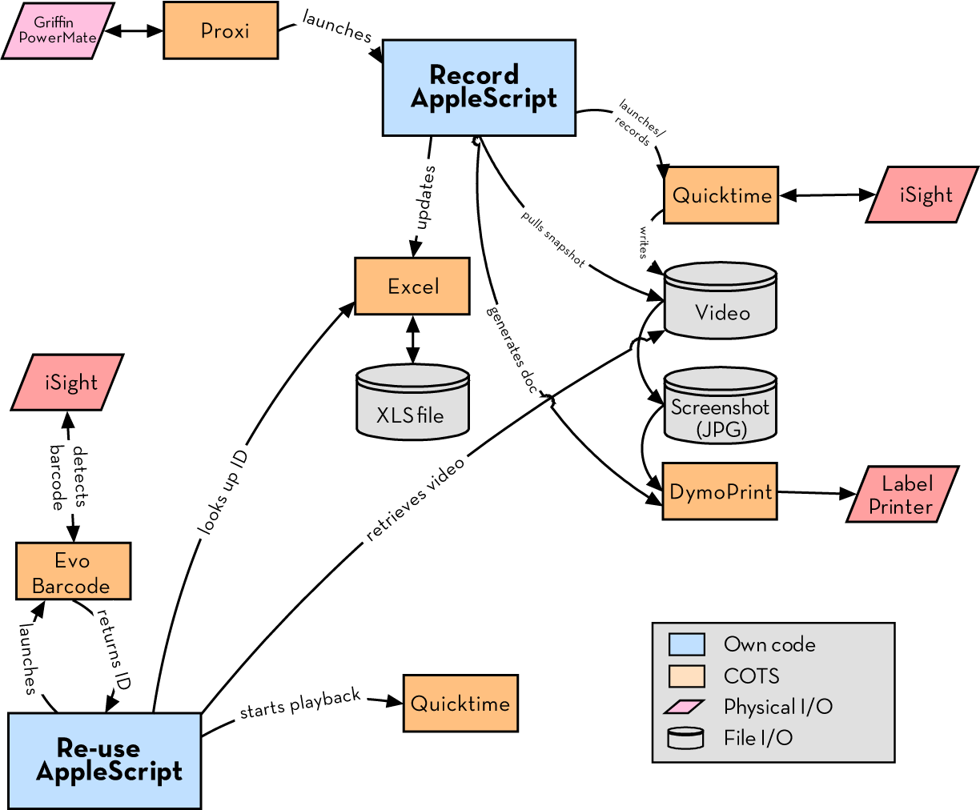
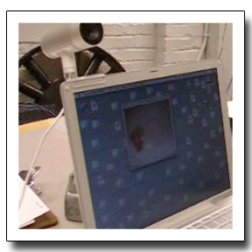
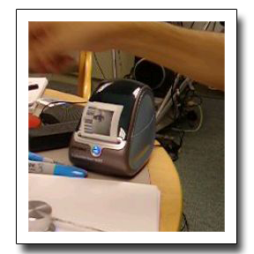
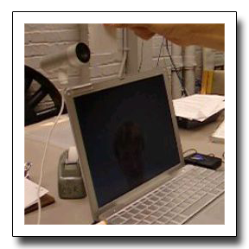
Button
initiates recording
Record
video message
Print barcode
Scan barcode
to retrieve message
Notes:
Sure enough, we find analogous practices in software. Prototypes may combine off-the-shelf software packages and copy-pasted code. Here’s an example of a document annotation prototype we saw in that same study. The purpose of the system is for design teams to annotate printed documents with video snippets using bar code stickers. This system used five different off the shelf apps, glued together with AppleScript found on the web and then modified. As the creator commented: “The main task (in his prototyping practice) was finding a match between his requirements and existing stuff.” (rewrite)

Slide 66
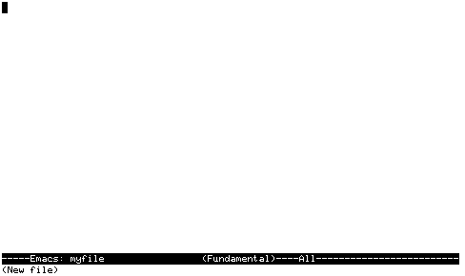
Notes:
If one looks at today’s design and development tools though , there seems to be an implicit belief that software is designed tabula rasa. That we start with a blank canvas and create a bunch of code.
How should design tools change if it’s much more common for software to be created by example modification? If designers and developers find something on the web, in example files, or in the source tree that provides an example that’s “kind of like” what the developer is interested in and then modify it?

Slide 67
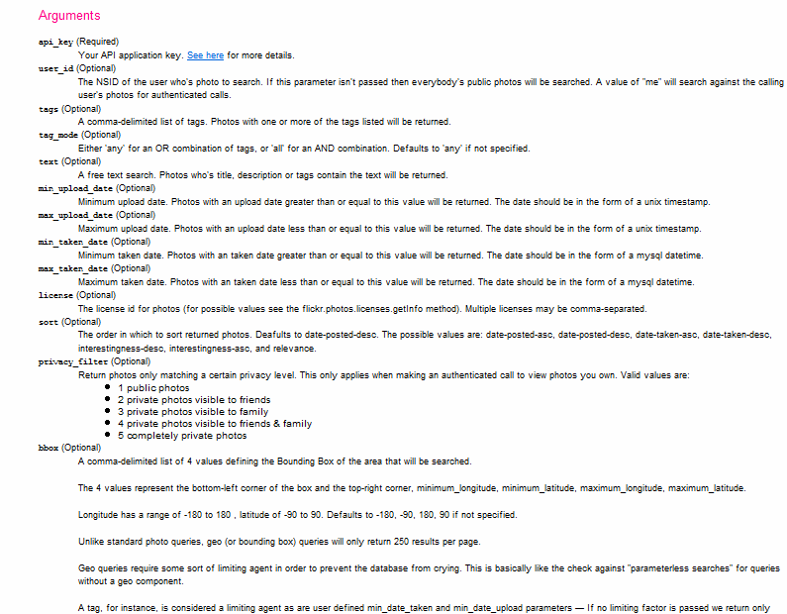
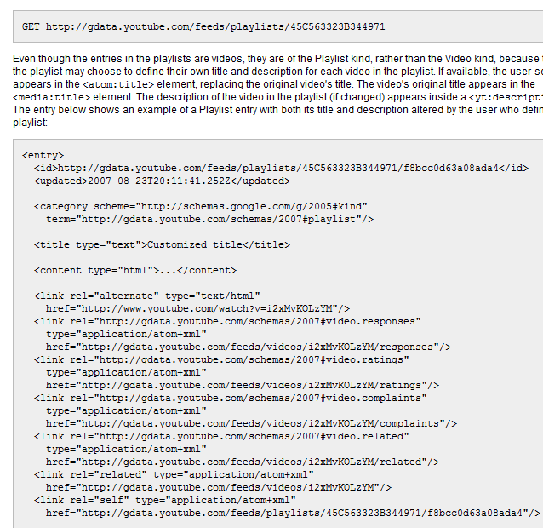
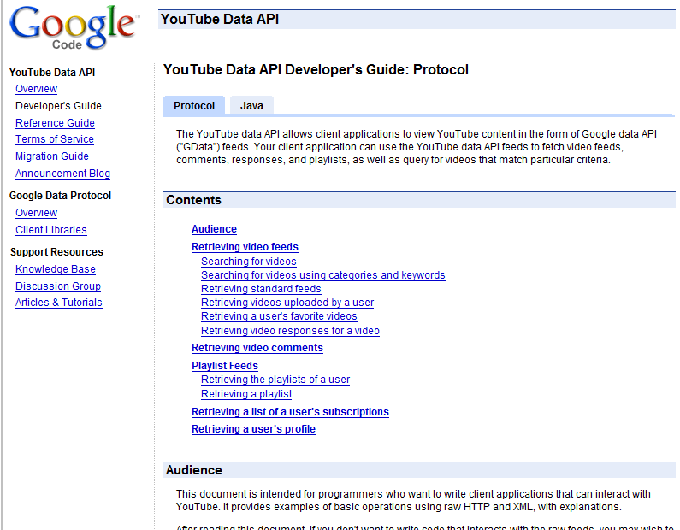
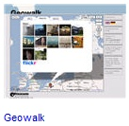
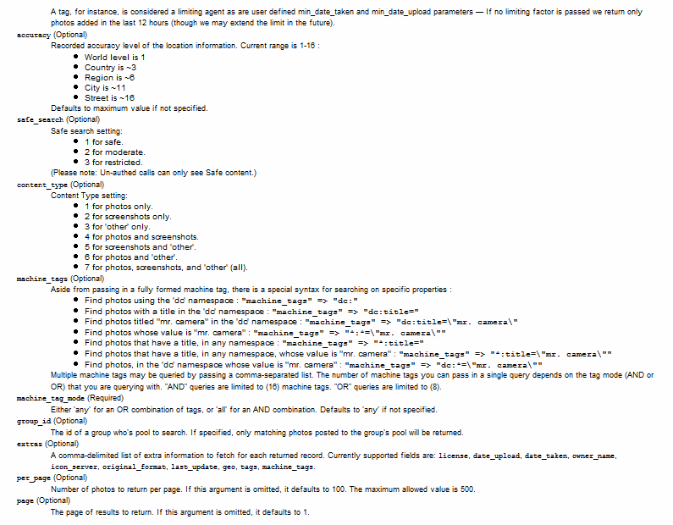
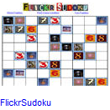
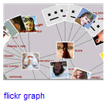
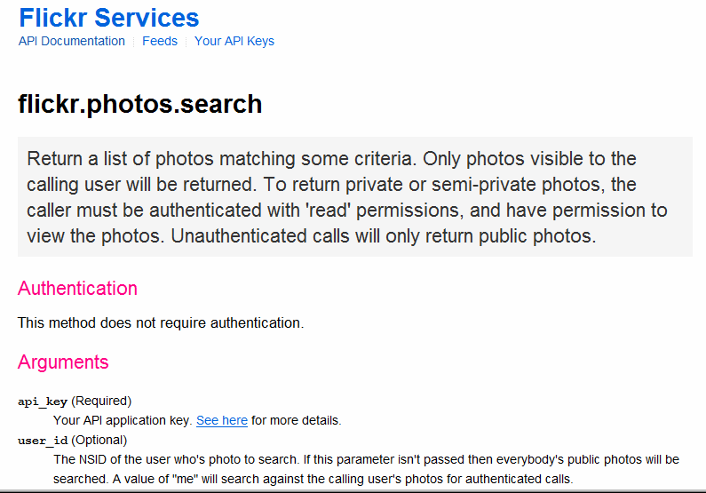
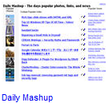
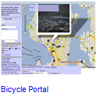
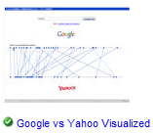
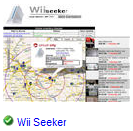
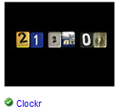
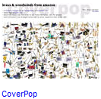



It’s easy to understand the sites,
but not their services.
[programmableweb.com]
Notes:
One strategy is to help people find good examples to work off.
“Programming by google search” is especially relevant in the growing area of working with web service APIs.
There are currently more than 500 public web-service APIs available, offered by most big internet companies: Yahoo, Google, Microsoft, Amazon, eBay, and AOL.
This issue of example modification is NOT unique to web application development, however web applications offer a distinct upportunity to address this modern development challenge.
<click>
One frustrating problem of programming the web today is that programming models and documentation conventions vary widely – there is no global type hierarchy to rely on, and there is no javadoc for web services.
<click>
So while it’s easy to understand the web sites, it is much harder to understand their services.

Slide 68


Web sites and their APIs are correlated…
≈
…let’s leverage that fact!
[flickr.com]
Notes:
To bridge this chasm, we note that web sites and their APIs are correlated.
For example, I can both look at the set of images taken on my last trip to Yosemite on the flickr website, AND I can retrieve the same set of images by calling an appropriate method in the flickr API.
The site and its API offer complementary views of the same underlying functionality.
In essence, the web site is the largest functional example of what can be accomplished with an API.
Our work on d.mix seeks to leverage the value that can be achieved by coordinating these representations.

Slide 69

Give me the code for this!
Notes:
d.mix models the correspondence between html pages and api calls to let users create program code by sampling content from a web page. (space)
It co-locates two different kinds of information on one page: examples of what functionality a web
site offers,

Slide 70
To retrieve this image, use:
flickr.photos.getInfo(
user_id = '73866493@N00', photo_id= ‘3208312’)
Notes:
together with information how one would obtain this information programmatically.
With d.mix. users can generate working code examples by selecting the information on the web site itself.
This selection technique allows users to remain in the domain of their task goal, in this case retrieving images.

Slide 71


d.mix active wiki
Source code generated by d.mix
is executed in the active wiki
Notes:
The source code generated through sampling with d.mix
Can then be copied to an active wiki, a server-side code environment, where it can be edited and safely executed. (click) The
active wiki provides a configuration-free environment for
rapid experimentation.

Slide 72

Scenario
Notes:
This scenario will clarify the main interaction techniques of d.mix:
A group of rock climbers would like to create a photo page for the group,

Slide 73

Notes:
Which should always show the latest iamges from the groups’ trips without requiring manual updates.

Slide 74

Notes:
Drew keeps his images on Flikckr where he aggregates them in an image set.
Jane begins by navigating to drew’s flickr page and clicks on the “sample this” button in her browser.
The page now shows dashed borders around items she can retrieve through the site’s API.
By right-clicking she can copy drew’s climbing image set into her sampling bin.
From the sampling bin, she sends selected items to the d.mix active wiki.
Because d.mix performed a deep copy of the images by generating web API calls,
Jane can edit parameters of those calls through a property sheet.
Here she sets that only the two most recent images for one of the image sets should be returned.
Jane can also change the source code that d.mix generated for her.
In the source view, she can add static HTML to the page or edit the web API calls made to retrieve images from flickr.

Slide 75

Notes:
When Jane is satisfied with the rendered view of her page, she can share the URL of the page she created with her group members.

Slide 76



d.mix users
Site owners or lead users define mappings between sites and services (once).
Lead Users
Web Developers
End Users
Notes:
There are several classes of users that work with d.mix.
First, lead users manually establish the correlation between sites and their services.
Alternatively, webmasters at sites such as Flickr, Yahoo, or Amazon.com could easily provide such mappings.

Slide 77
Web developers create d.mix applications
Lead Users
Web Developers
End Users
Notes:
After a small number of lead users author these mappings, many more web developers can create applications in d.mix and quickly prototype web-based mashups.

Slide 78
End-users run (and tailor) applications
in the d.mix wiki.
Lead Users
Web Developers
End Users
Notes:
Finally, end-users can run applications written in d.mix, by visiting them from any browser.
End-users can also tailor applications created in d.mix, by copy and pasting code from one d.mix wiki page to another.

Slide 79

d.mix Proxy Architecture
Rewritten page
with API annotations
Original Page
Proxy Server
Site-to-Service Map
(hosted on d.mix wiki)
Notes:
d.mix uses a programmable HTTP proxy that rewrites the original web site, adding API annotations. Each API annotation contains an associated snippet of code that generates a working web service call, in our case in the Ruby programming language.
The programmable proxy knows how to annotate web pages by using asite-to-service map. (space)

Slide 80
Authoring the Site-to-Service Map
…Without Help From the Site Owner
1 Map URL to Page Type
2 Identify visual elements in page to annotate (using XPath/CSS selectors)
3 Extract arguments for service calls from page source
Bind arguments to web service code snippet
Notes:
How does a 3rd party developer author a site-to-service map? (space)
First, a developer maps web page URLs to web “page types”. (space)
For any given “page type”, a developer defines a combination of XPath and CSS selectors that identify the visual elements to be annotated (space)
They then define selectors that infer web service arguments given the markup on a page. (space)
Finally, these arguments are bound to a web service code snippet
Note that it is easier for site owners to provide this mapping, as they do not need to infer these relationships programmatically through scraping. We hope that in the future, site owners will provide such site-to-service mappings for the larger web developer community.

Slide 81
Why Not Just Scrape?
Scraping at design-time rather than
at run-time minimizes brittleness
Web service calls can be parameterized
Scraping at run-time can lead to lock-out
Notes:
So why not rely solely on scraping, without trying to generate web service code?
(space) Web site content and markup change quickly. Thus, programs based on scraped content can be brittle.
web service APIs are more stable. Since applications are authored once, but executed many more times, scraping once at “application design time” is preferable to scraping at execution time.
(space)
Furthermore, web service calls can be meaningfully parameterized by changing the arguments used to call them. This is not possible with scraped content.
(space)
Finally, scraping may not scale. Many sites monitor their traffic and actively lock out clients that request a large number of pages in a short amount of time.

Slide 82

Notes:
Let me illustrate the process of creating a site-to-service map with a concrete example.
Here is a single photo page from flickr.com.

Slide 83

Page URL:
flickr.com/
photos/
<username>/
<photoid>/…
Regular Expression:
%r{flickr.com//?photos/
[^/]+/\d+/?&script}
Notes:
First, we note that photo pages have a consistent URL structure.
Thus, we can define a regular expression that detects similar photo pages,
And a set of expressions that furthermore classify pages into distinct page “types”.

Slide 84

Photo Title
Image URL
Tag Search
Notes:
Here are three items of interest: a photo’s title, the URL for an image, and a way to run a tag search (SPACE, SPACE)

Slide 85

Photo Title
(doc/"#title_div")
Image URL
(doc/"div.photoImgDiv")
Tag Search
(doc/"div.TagList")
Notes:
Each of these items can be accessed by searching the DOM, the document object model.
d.mix uses a combination of CSS and XPath selectors to identify elements, highlight them, and add a context-menu handler to each element.
For any given item on the page, there may be multiple matching web service calls that return that element. For example (SPACE), one can either sample “the first image in a photo set” or “this particular image”. d.mix generates multiple entries in the context menu to let the user guide the generalization process.

Slide 86
flickr.photos.getInfo(
photo_id = “298655528”).title
info = flickr.photos.getInfo(
photo_id = “298655528”)
URL = “http://farm”+ info.farm-id
+ “.static.flickr.com/”
+ info.server-id
+ “/” + info.attributes[”id”]
+ “_”
+ info.secret
+ “.jpg”
Extracted from page source:
Within <div> for all tags:
tag=div.at("a.Plain").inner_html
flickr.photos.search(
tags = “yosemite ...”)
Notes:
The site-to-service map then specifies how to connect each of these items to a source code snippet.
For example (SPACE) to perform a tag search, one needs to pass in the appropriate tag to a specific method. These arguments are also extracted using CSS and XPath selectors.

Slide 87
Putting it all together…
def self.annotate_photopage_tags(doc)
(doc/"div").reject{…}.each do |div|
tag = div.at("a.Plain").inner_html
src = generate_tag_search_source (...)
doc.at("body").inner_html +=
make_context_menu(div.at("a.Plain"),
["Images matching tag #{tag}"],[src])
end
Notes:
Continuing this example, here is an abbreviated form of the Ruby code that defines part of the site-to-service map for Flickr.com.
To summarize, it…

Slide 88
Putting it all together…
def self.annotate_photopage_tags(doc)
(doc/"div").reject{…}.each do |div|
tag = div.at("a.Plain").inner_html
src = generate_tag_search_source (...)
doc.at("body").inner_html +=
make_context_menu(div.at("a.Plain"),
["Images matching tag #{tag}"],[src])
end
Extract tag name
Notes:
…extracts tag names

Slide 89
Putting it all together…
def self.annotate_photopage_tags(doc)
(doc/"div").reject{…}.each do |div|
tag = div.at("a.Plain").inner_html
src = generate_tag_search_source (...)
doc.at("body").inner_html +=
make_context_menu(div.at("a.Plain"),
["Images matching tag #{tag}"],[src])
end
Instantiate Source Example
Notes:
…instantiates working examples for each different tag

Slide 90
Putting it all together…
def self.annotate_photopage_tags(doc)
(doc/"div").reject{…}.each do |div|
tag = div.at("a.Plain").inner_html
src = generate_tag_search_source (...)
doc.at("body").inner_html +=
make_context_menu(div.at("a.Plain"),
["Images matching tag #{tag}"],[src])
end
Add annotation to original page
Notes:
…and adds code examples as annotations on the original page

Slide 91
Dataflow Summary
d.mix design time
sends
code to
d.mix run time
adds
annotation
invokes
Web site
Web service
Notes:
After adding annotations, working code examples can be sent to the d.mix active wiki. (SPACE)
The active wiki enables quick testing and modification of generated code. (SPACE)
The code then queries the original web site programmatically.

Slide 92
Active Wiki
Wiki editor provides syntax-highlighting for Ruby script
Sandboxed execution runs
script with limited capabilities
Libraries facilitate invoking
web services and
manipulating results
Notes:
After code is copied or appended to wiki pages, programs can be modified directly in the active wiki
(SPACE)
Programs are then run in a sandboxed execution model. For example, a program may make a web service call, but it does not have read/write access to the wiki server’s file system.
(SPACE)
The active wiki also provides libraries that faciliate calling web services and transforming the results.

Slide 93

Beyond the Desktop Browser
Notes:
A proxy that can be programmed with code hosted on wiki pages is a flexible, general tool for prototyping web applications. For example, we have used the d.mix architecture to create an application that reformats web content to better fit mobile devices. It extracts only essential information — here, movie names and show times — from
a cluttered web page. This application took half an hour to build using the d.mix system.

Slide 94

Integrate Design, Test, and Analysis
Leverage Programming by Demonstration
Support Alternative Design Choices
Enable Programming by Example Modification
Notes:
Web-based, Mobile and Ubiquitous computing is likely to be dominated by a much wider variety of applications and usage contexts than traditional desktop software. To enable design and development in these areas, we need design tools that lower the threshold and democratize application creation. Doing this successfully requires attention to how computation is represented. I’ve shared four projects with you today that embody the strategies we believe will get us there.
* d.tools showed how State structure can be authored and presented as storyboards and how those storyboards in turn can facilitate analysis of user test data.
* Sensor input -- and other actions that are difficult to specify symbolically -- can be handled through demonstration, as we experienced with Exemplar.
* Design is about choice between alternatives and tools should better support the enumeration and manipulation of alternatives. Juxtapose is a first step towards working with alternatives and options for interactive behavior.
* Finally, Finding an effective example is often easier than writing thing from scratch -- we can leverage this as a paradigm for software creation!

Slide 95
Experience Design @ Stanford
Notes:
Before I conclude, let me address one question that always comes up when I mention the words “design” and “Stanford” in the same sentence: So What about the d.school?

Slide 96


the d.school
Notes:
The d.school was Founded in 2004 by David Kelley & colleagues.
And has just moved to its third home in four years.
Not a dept. Pulls from Business, MS&E, CS, ME.
Goals are to create a culture of prototyping and build T-shaped people – with exposure to a broad set of perspectives and deep competency in one particular field.
Concerned with professional education at the masters level, not research.
Team taught
Multi-disciplinary
Real-world project based – client – the value of focus
Action-oriented: It’s ok to act and be wrong, it’s never ok to sit around and do nothing.

Slide 97




Quarterly journal of design practice
Student-run, but predominantly professional readership
Past contributors:
  Don Norman, Bill Moggridge, David Kelley, Genevieve Bell, Steve Portigal, Paul Dourish, Eli blevis, Ryan Freitas, Mike Kuniavsky, Nathan Shedroff, Bill Verplank, Larry Leifer, …
Notes:
If you want to stay connected with the larger design conversation going on at the d.school, take a look at Ambidextrous magazine, the dschool’s quarterly magazine of design that I co-edit. We have a table setup outside in the foyer.

Slide 98

Andrew Adams
Leith Abdulla
Michael Bernstein
Brandon Burr
Kevin Collins
Jennifer Gee
Wendy Ju
Dan Maynes-Aminzade
Manas Mittal
Avi Robinson-Mosher
Leila Takayama
Eino-Ville Talvala
Loren Yu
Leslie Wu
Notes:
And of course, the work that I shared today isn't mine alone. We have a truly fantastic group of graduate and undergraduate students and I'd like to thank all of my collaborators on the work I presented today, whose names are listed here.

Slide 99
http://hci.stanford.edu
http://dschool.stanford.edu
http://ambidextrousmag.org
Notes:
For more information on HCI research at Stanford or on Ambidextrous, please visit our web site. Thank you.

