Slide 1
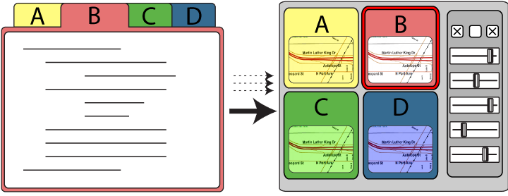
Design as Exploration
Creating Interface Alternatives through
Parallel Authoring and Runtime Tuning
Björn Hartmann
Loren Yu, Abel Allison, Yeonsoo Yang
Scott R. Klemmer
Notes:
In this talk I will propose new ways in which tools can support designers in creating user interface alternatives.

Slide 2
Exploration of alternatives
is central to design.
Notes:
Exploration of alternatives is central to many areas of design because it offers important benefits.
* 3 Reasons

Slide 3

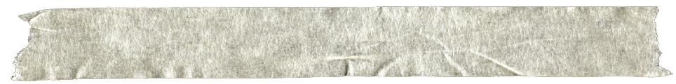
MAP THE
DESIGN SPACE
Prototypes for the
Microsoft mouse
From Moggridge,
Designing Interactions, Ch2
Notes:
Designers often build dozens of prototypes to get a more complete understanding of a design space.
*Paul Bradley, 80 models, explore different possible shapes

Slide 4
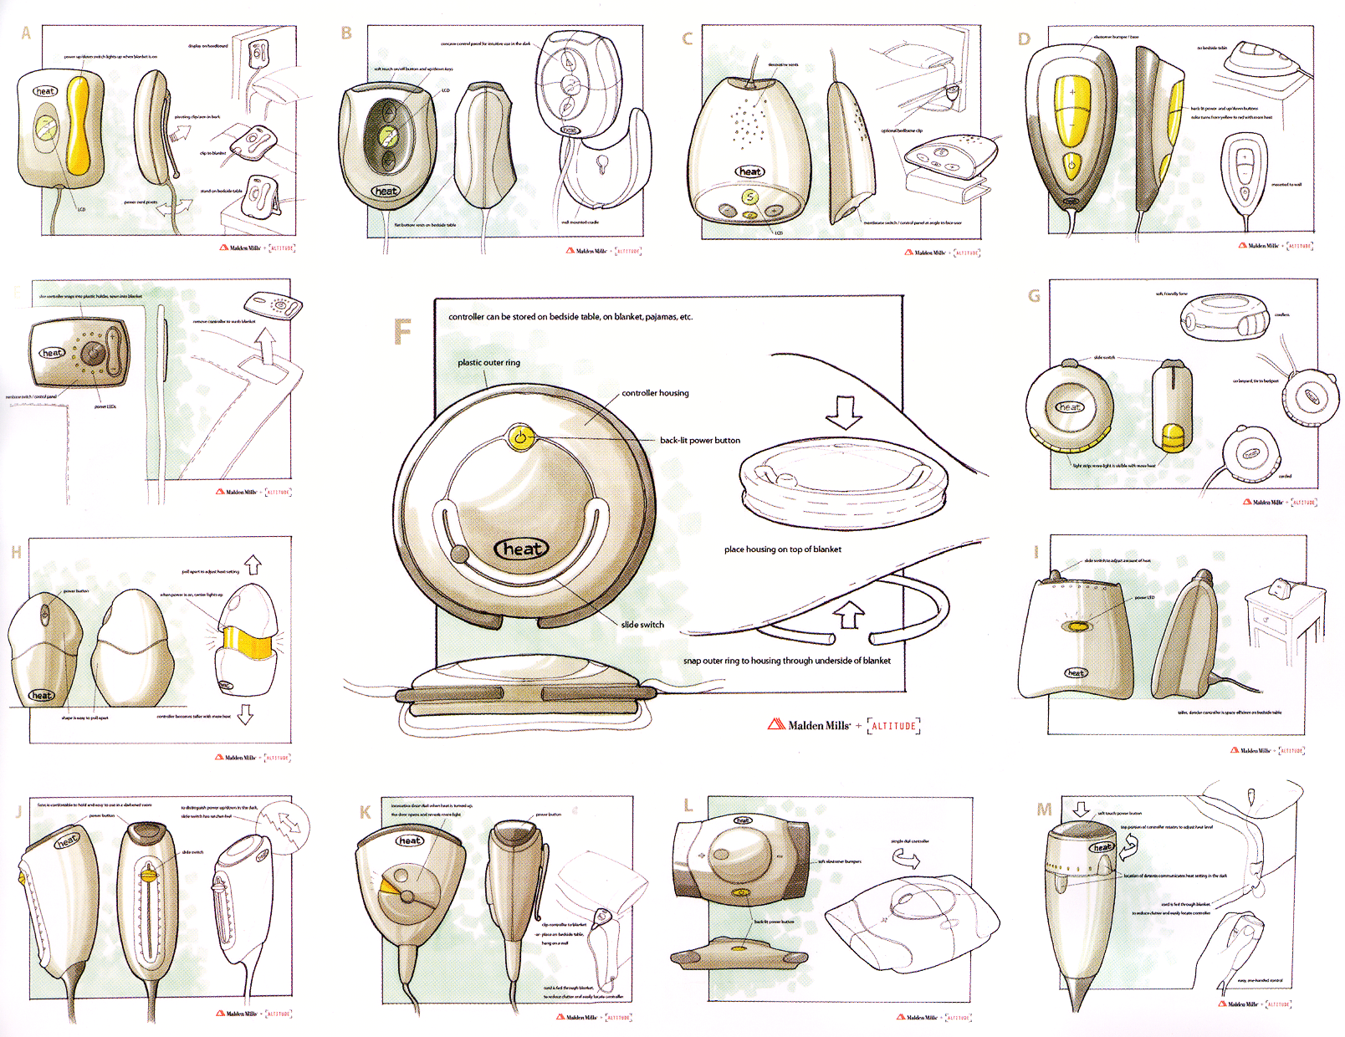
CommunicatE
From Design Secrets: Products 2
Notes:
Second, Discussing multiple prototypes allows project stakeholders to more effectively communicate their requirements.
* Altitude, heating controller, Malden mills.

Slide 5

TEST
Tohidi et al, CHI 2006
Notes:
Third, Maryam Tohidi demonstrated: showing multiple alternatives is important during testing of user interfaces to keep participants honest
* less pressure to conflate opinion and being nice.

Slide 6
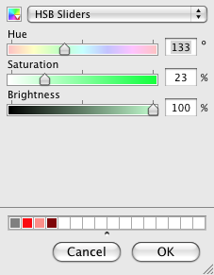
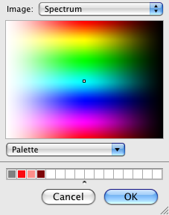
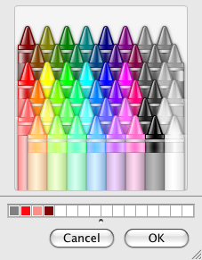
How can tools support the creation of user interface alternatives?
Color picker #1
Color picker #2
Color picker #3
Notes:
Central Research Questions:
If we take exploration as a core activity of design, how can *interaction* design tools support creation and management of user interface alternatives?
Prior research: static graphics; no tools yet for alternatives interactive behavior

Slide 7
“[D]esigners frequently wanted to have multiple designs side-by-side [...]
However […] there is no built-in way in today’s implementation tools to have two versions of a behavior operating side-by-side.”
Myers et al., VL/HCC 2008
Notes:
“there is no built-in way in today’s implementation tools to have two versions of a behavior operating side-by-side”.

Slide 8

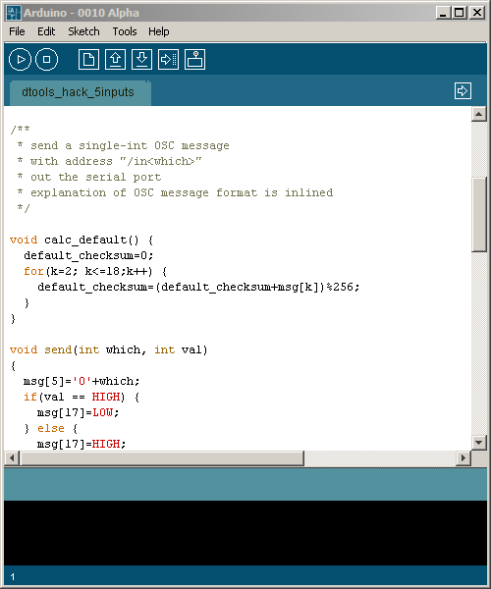
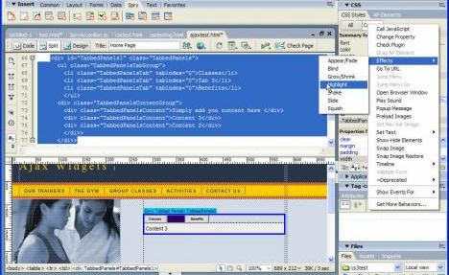
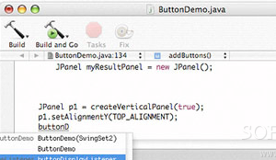
Interaction Designers Write Code
Adobe Flash
Arduino / Processing
Adobe Dreamweaver
Xcode (iPhone)
Notes:
Why? One of the central reasons it that design of interactive behavior, even for prototypes, often happens in textual code. Interaction designers today frequently write a few dozen lines of script to express logic.

Slide 9
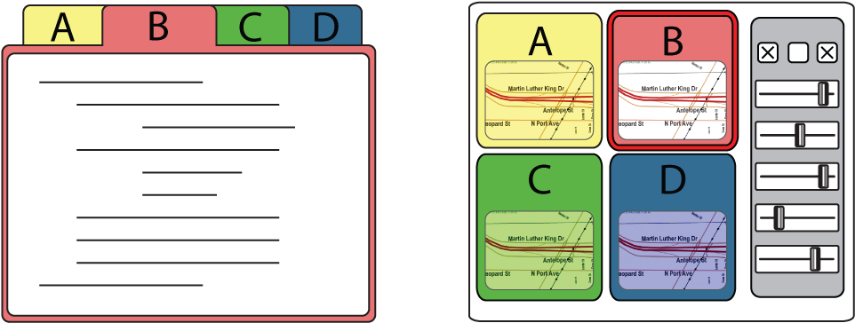
Programming requires working with two representations.
…
…
…
…
…
Editor: author behavior
Runtime: observe behavior
Notes:
Programming interactions leave the interaction designer with two representations to worry about: the code where behavior is authored, and the running program, where it is observed.

Slide 10
Outline
Requirements for Alternatives of Programmed Interactions
Juxtapose for Desktop Interactions:
System & Evaluation
Alternatives off the Desktop
Related & Future Work
Notes:
In the remainder of this talk I will first discuss three requirements for alternatives of programmed interactions.
I will then describe how we address these requirements in Juxtapose, a tool for exploring alternatives for Flash interactions written in Actionscript.
To demonstrate that the ideas embodied in Juxtapose can transcend WIMP interactions, I will present implementations for mobile and embedded applications before concluding the talk with a look at related and future work.

Slide 11

3 Requirements for Programmed Interactions
(based on 3 interviews & code inspection)
Manage parameter variations
Manage code alternatives
Access variations & alternatives at runtime
Notes:
What are the most important ways in which designers explore alternatives of programmed interactions today?
Three interviews, code review -> three requirements.
Creating satifsying user experience: "tweaking the dials”; code stays same, params vary. Tools should explicitly support this parameter tuning.

Slide 12
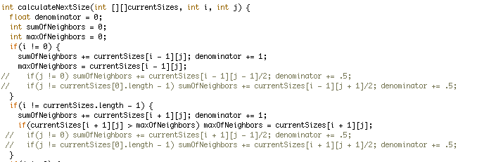
3 Requirements for Programmed Interactions
Manage parameter variations
Manage code alternatives
Access variations & alternatives at runtime
Processing code brought in by an interviewee
Notes:
To compare different behaviors, changes to logic are required as well.
Example from inquiry: two behaviors in same function body; comment/uncomment in runs.
Tools should support creation and management of different code alternatives.

Slide 13
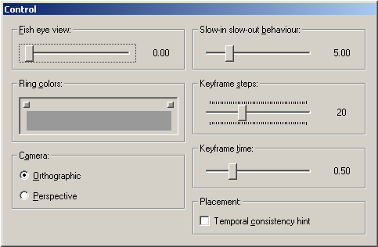
3 Requirements for Programmed Interactions
Manage parameter variations
Manage code alternatives
Access variations & alternatives at runtime
Notes:
Third, management of code and data alternatives has to work across editing and execution environments
expert do some this by writing control slider code –not part of the final application, but tools for exploration.
Tools construct such control interfaces automatically to open exploration to a wider audience.
To investigate how these requirements might be fulfilled, we constructed Juxtapose, a tool for working with multiple design alternatives in parallel.

Slide 14
Juxtapose: Source alternatives…
Notes:
Jxutapose manages alternatives at the source level

Slide 15
Juxtapose: Source alternatives…
Notes:
in an augmented editor

Slide 16
… are executed in parallel,
Notes:
These source alternatives can then be executed in parallel, which enables rapid comparison between them.

Slide 17
and tuned through an generated UI.
Notes:
Juxtapose combines parallel execution with automatic generation of control interfaces to interactively “tune” parameters of the designed interaction at runtime.

Slide 18
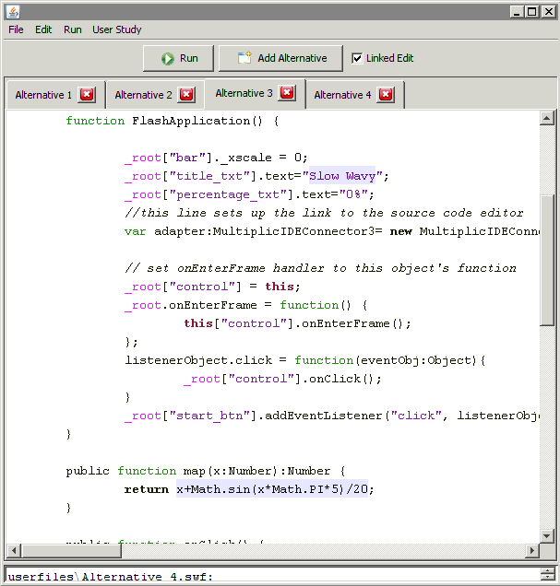
Parallel Editing
Juxtapose editor for
ActionScript 2.
Generates Flash files.
Notes:
To make working with multiple code alternatives feasible, an authoring environment must
Offer techniques for manipulating content across alternatives
make differences visually apparent

Slide 19

Parallel Editing
Notes:
In the Juxtapose editor, alternatives are accessible through document tabs;

Slide 20
Parallel Editing
Linked Editing: Toomim 2004
Notes:
Edits can be either local to one alternative or global to all alternatives by toggling a linked edit mode.
Linked editing - Mike Toomim 2004. Find code duplicates within a project extended to define project alternatives.

Slide 21

Parallel Editing
Linked Editing: Toomim 2004
Notes:
Source differences, text entered in “unlinked edit”, are highlighted with a shaded background
Shared text: white background

Slide 22
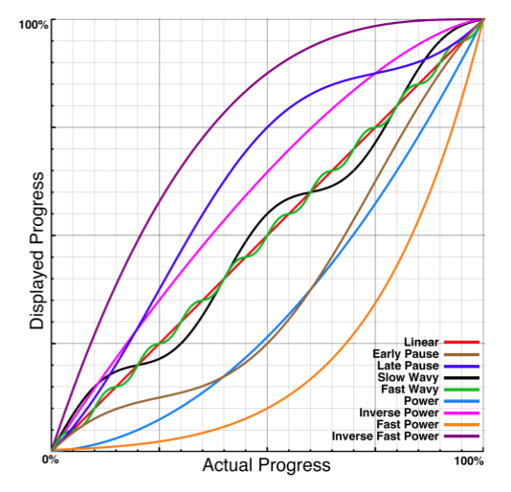
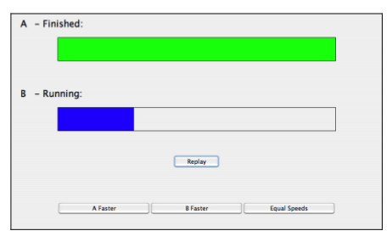
Example: Rethinking the Progress Bar
Harrison et al., UIST 2007
Progress bar test application
Progress profiles
Notes:
How would a designer use parallel editing for exploration?
Simple example 2007: “rethinking the progress bar” showed how different progress curves can affect the *perception* of completion speed. To test different progress curves, a function that maps actual progress to displayed progress was varied.
In clip designer starts with code for showing a normal, linear progress bar<click>

Slide 23
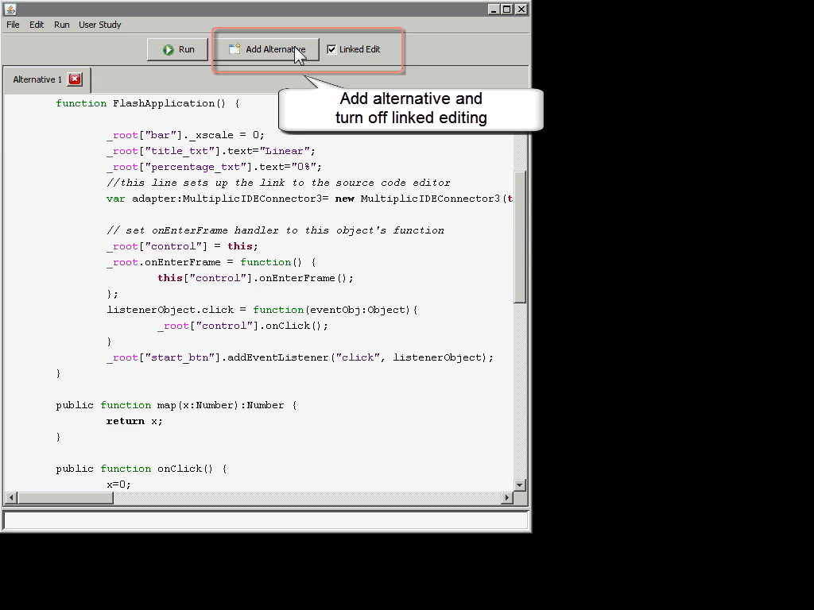
Notes:
To explore different mapping functions, our designer creates source alternatives in new tabs. In each alternative, she changes the mapping function and an identifying name through unlinked editing. The changes here are rapid as only two lines of code differ between our alternatives.
* When run, all alternatives are executed side-by-side.
investigate different progress bar behaviors
bring one alternative into full view for detailed inspection.
In addition to sequential interaction, designers may want to view behavior in parallel.

Slide 24
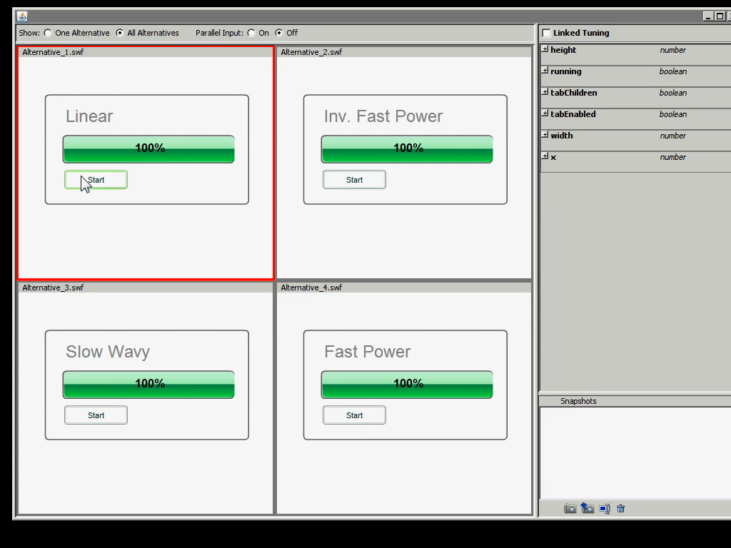
Parallel Input: Event Echoing
Notes:
Juxtapose supports parallel input through event echoing. Mouse events can be intercepted in the active alternative and injected into all other alternatives, which then show a ghost cursor.

Slide 25
Implementing Parallel Editing:
The Cursor Correspondence Problem
Doc. A
Doc. B
Doc. C
Straightforward solution:
Longest common subsequence algorithm
diff(A,B,…,N)
Run during idle times
Notes:
To implement - solve the cursor correspondence problem for linked editing:
Pos N doc a. The original linked editing research proposed tracking correspondences with a longest-common subsequence algorithm. Juxtapose uses this algorithm during idle times but also offers an incremental structure tracking algorithm while users are typing to guarantee interactive response rates.

Slide 26
Limits of Parallel Editing & Execution
Level of granularity for editing:
Extension to multi-file projects is not trivial.
Can the user make sense of behaviors running in parallel?
Notes:
One question for parallel editing is which level of granularity alternatives should be defined on. We chose the file level: many prototypes are authored in single files.
Larger level, across files in a project, may require significantly different editing techniques.
Another question is to what extent one can actually make sense of two or more behaviors executing in parallel. Since this is highly application dependent, the best strategy may be to offer the flexibility to choose between sequential and parallel input.

Slide 27
Limits of Event Echoing
Delete this file?
Delete this file?
Yes
No
Yes
No
Ok
Notes:
Event : low level of mouse move and click events -- useful when both application logic and visual layout are similar across alternatives.
Layout not similar, or applications are in different states: event echoing can have unintended consequences. Open question: can more general parallel.i. be offered without requiring the designer to explicitly model corresponding abstract events?

Slide 28
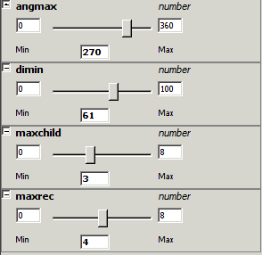
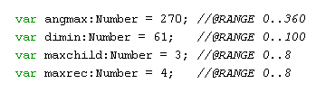
Parameter Tuning
Notes:
To explore parameter spaces, Juxtapose automatically generates control interfaces from variable definitions in the user’s program. When the control widgets are manipulated, the variable value is then updated in the running program.

Slide 29
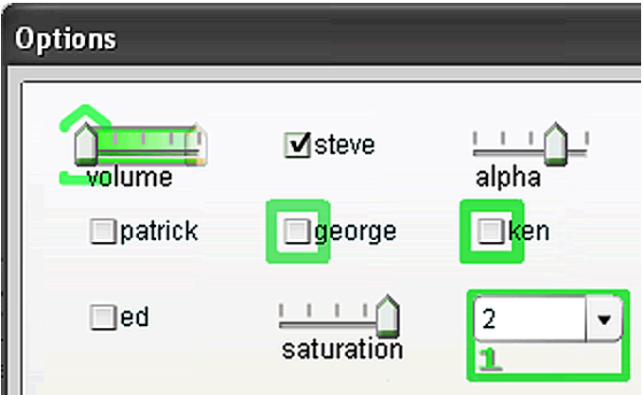
Example: Tuning Phosphor
Baudisch, UIST 2006
Notes:
To see tuning in action, consider Patrick Baudisch’s phosphor paper from UIST 2006: Phosphor shows afterglows when UI widgets are changed to make such transitions visually salient in
Params of concern: timing characteristics and and coloring of afterglow.

Slide 30
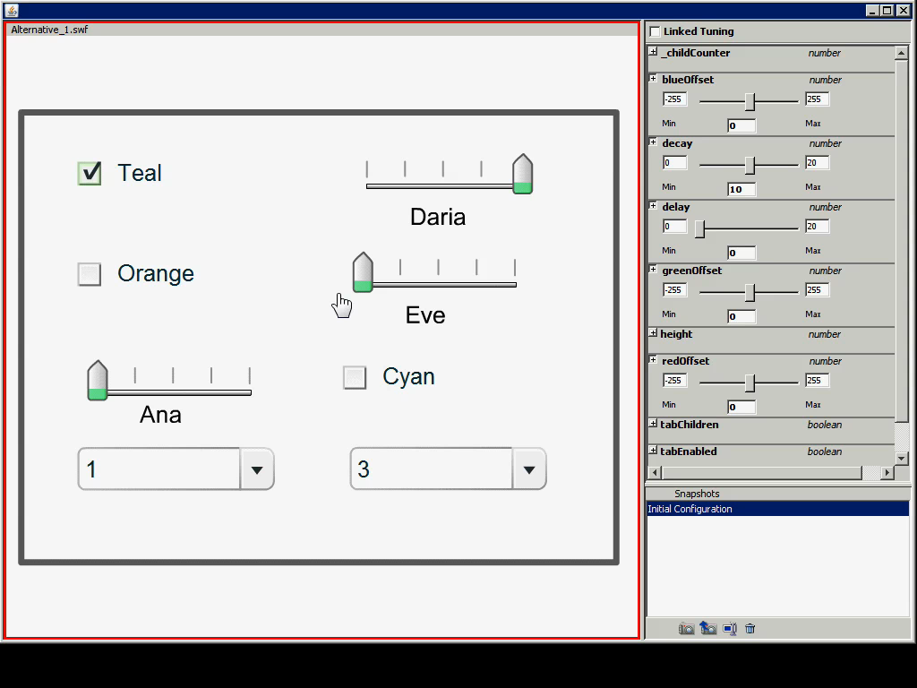
Example: Tuning Phosphor
Baudisch, UIST 2006
Notes:
We reimplemented some of Phosphor’s techniques in Actionscript - running Phosphor within Juxtapose enables designers to directly manipulate variables that govern fade duration and fade delay at runtime.
Once a designer finds a suitable set of tuned parameters, that set can be saved in a snapshot for later recall.

Slide 31
Generating Tuning Interfaces
Send variable info
Juxtapose User Library
A
Inspect
User’s Application:
//…
Number A = 10;
Boolean B = true;
X
B
Juxtapose Process
User Process
Notes:
Runtime variable tuning requires bi-directional data exchange between the user’s application and the tuning interface. For inter–process communication, a Juxtapose library module is added to the user’s code. On startup, the library collects global variable names, types, and values using reflection. The library then sends this information through a remote procedure call to the Juxtapose runtime UI.
Using this information, Juxtapose builds a control UI.

Slide 32
Generating Tuning Interfaces
Send tuning message
Juxtapose User Library
A
Update
User’s Application:
//…
Number A = 10;
Boolean B = true;
X
B
Juxtapose Process
User Process
Notes:
When the widgets of the tuning interface are modified, value update messages are sent to the running application through nother remote procedure call The Juxtapose user library then updates the variable value in the running application.

Slide 33
What parameter ranges should be chosen?
0.0-1.0?
0-100?
0-255?
Number.minValue – Number.maxValue?
Any nontrivial
program property
is undecidable.
Notes:
The generated numerical control widgets have a particular range – how should that range be chosen?
From 0 to 1? To 100? Well, we cannot actually know ahead of time.

Slide 34
Take a guess, then give control to the user.
At authoring time: source annotations
Notes:
While Juxtapose can take a guess, the solution is to give control over parameter ranges to the user.
This can be done at authoring time, using annotations, which are parsed with a preprocessor. The variable set sent by the user application at runtime is then matched against the parsed ranges to initialize control sliders.

Slide 35
Limits of Tuning
Which variables matter?
Juxtapose extracts only globals
Notes:
Ideally users should benefit from tuning and alternatives without having to change source.
In practice, may have to write additional code solely concerned with making app tunable. Two issues:
First, we have to decide which variables matter. Showing all program variables to the user is not a good idea since many irrelevant variables would be shown; in addition, variables will go in and out of scope. Current sol: extract global variables. Program analysis techniques may improve upon this set.

Slide 36
Limits of Tuning
Which variables matter?
Juxtapose extracts only globals
Are variables read again?
Juxtapose uses callbacks
01 var tunable = 5; //@RANGE 0..100
03 var callback= function(varName,oldVal,newVal){
04 redraw();
05 return newVal;
06 }
07 this.watch(′tunable′,callback);
Notes:
For tuning to be effective: var must be read again in program after its value was changed.
The only way to guarantee that a variable change is acted on, is to notify the program explicitly and have the programmer write code to respond to that change.
Juxtapose uses callback functions native to Actionscript to notify user applications.

Slide 37
Understanding User Strategies &
Measuring Benefits
Questions:
  How does Juxtapose fit into interaction prototyping practice?
  Can we quantify the benefits?
Method:
  Lab evaluation, N=18, students
  75-90 minute sessions with design tasks & survey
Notes:
Eval guided by 2 questions:
Qualitative: how does Juxtapose fit into interaction prototyping practice?
Can we make quantitative claims about its benefits?
summary usability evaluation in our lab with 18 participants.
All participants had at least a working knowledge of procedural programming.
37

Slide 38
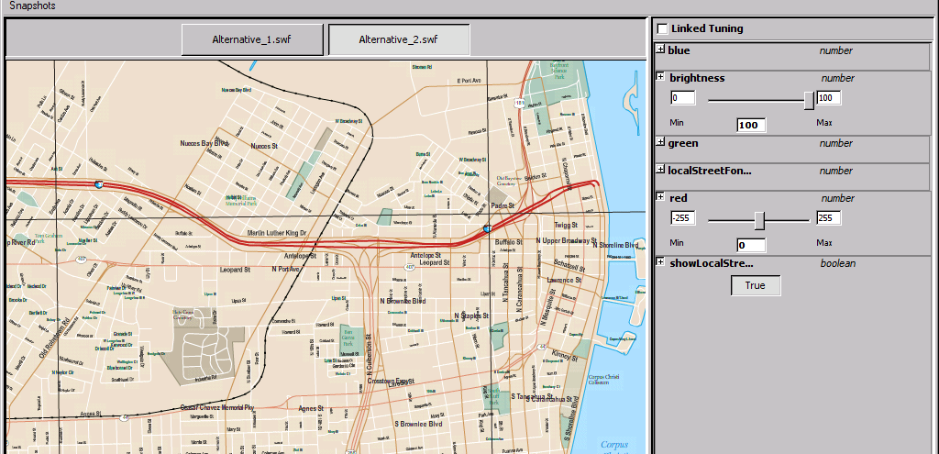
Mapping Task
Given ActionScript code that loads a multilayered map, develop navigation options for a handheld GPS prototype for pedestrians and bicyclists.
Notes:
To gather qualitative data, we assigned an open-ended task where we provided a
working ActionScript program that loaded a map containing 28 layers of information. Participants
were given 30 minutes to create two navigation alternatives for a future GPS unit – one suitable for pedestrians, and one for bicyclists.
38

Slide 39
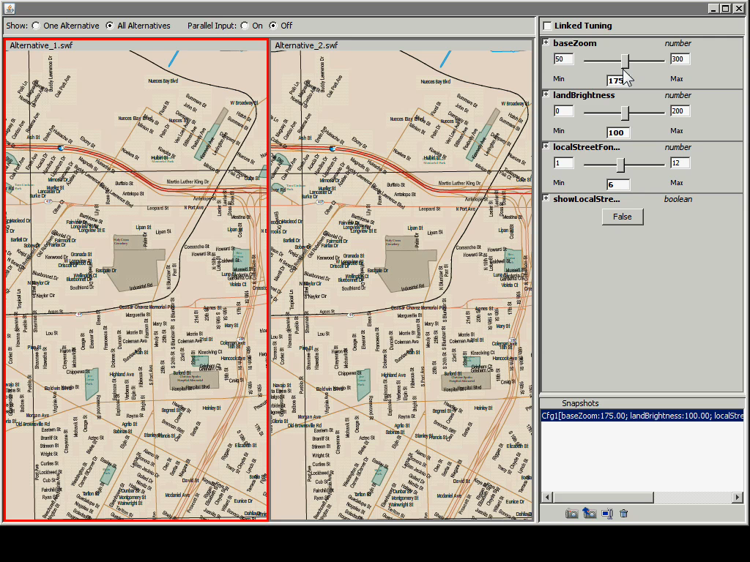
Alternatives for Map
Navigation & Rendering
Notes:
Here’s an example of how tuning could be used to change map rendering.

Slide 40
Participants’ Strategies
Linked vs. unlinked editing with multiple alternatives applied by all participants.
Alternatives used both for different scenarios, as well as “scratch space”
Snapshots important to save state
Notes:
On a high level, This task demonstrated that linked editing with tabbed alternatives is accessible to interaction designers.
some participants mapped alternatives directly the two sub tasks (navigation for pedestrians and bikers), others used alternatives as a lightweight scratch space– they would create a new alternative, experiment in it, and then either discard the original (if experimentation was successful), or the newer alternative (if it wasn’t).
Parameter snapshots turned out to be very important to save state since tuning at runtime is not written back into source code. Without snapshots, these changes would be lost.
40

Slide 41
Suggested improvements
Automate code restructuring for callbacks
Introduce direct manipulation for parameters in user’s application
(when possible)
Notes:
Now for the tradeoffs involved in runtime tuning -, making variables tunable often required use of callback functions in this talk. While users will always have to reason about parameter changes, the mechanics of authoring callbacks could be addressed through code generation wizards.
Many participants also adjusted size and position of graphic objects through tuning. Because objects are selectable, direct manipulation of position,rotation,scale, as opposed to sider-based variable tuning, would be preferable.
41

Slide 42





Tree Matching Task
Search in 4D parameter space. Given recursive drawing code for this:
Produce these:
Notes:
To gather quantitative data, we created a close-ended task that asked participants to adjust four dimensions of an algorithmic tree drawing routine to match four specific tree shapes.
This task is clearly far removed from design practice, but its concrete goal allows for better measurement of performance.
42

Slide 43
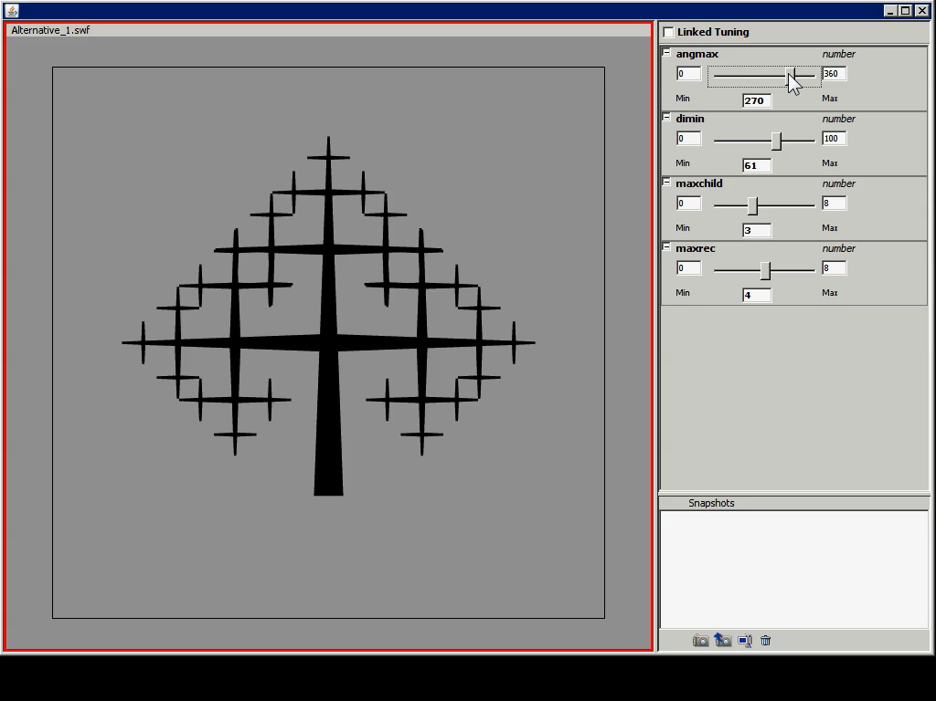
Notes:
For two trees, this task was accomplished using the Juxtapose tuning interface. For the other two, participants were given the same editor without the possibility of creating alternatives or tuning, making changes in code.

Slide 44
Notes:
Of course, if you give people sliders to change parameters, they’ll test many more parameter combinations than they ever could through editing code and recompiling.
Direct manipulation is good, but we knew that.
More interesting: where does it provide benefits?

Slide 45
not
significant
not
significant
p<0.01
p~0.01
Notes:
Dig deeper, and look at task completion times for different trees. only two trees showed significant time differences.
Observation: interaction of multiple parameter dimensions, harder time reasoning about parameter settings– matching tu rned into a multi-dimensional trial and error exercise. It’s precisely this trial-and-error phase is when reasoning about the problem could not produce a satisf. Sol. where tuning was most beneficial.

Slide 46
Outline
Requirements for Alternatives of Programmed Interactions
Juxtapose for Desktop Interactions:
System & Evaluation
Alternatives off the Desktop
Related & Future Work
Notes:
To demonstrate that general principles of working with alternatives carry over into other domains, we ported the juxtapose runtime environments to mobile phones and microcontrollers.

Slide 47
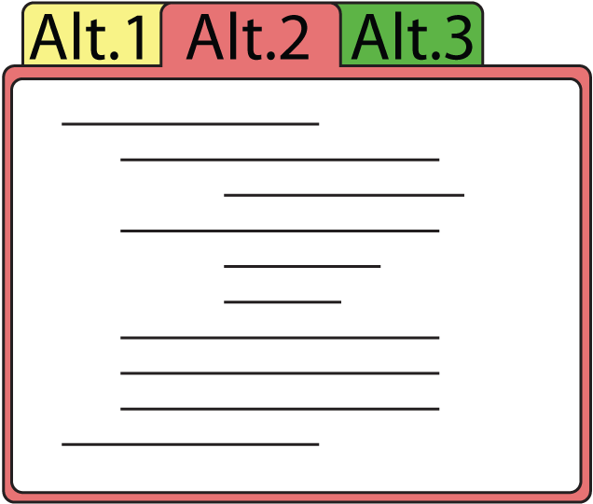


Juxtapose Mobile
Alternative
1
Alternative
2
Alternative
3
Notes:
Mobile phones are commodity hardware, and mobile developers already test on multiple handsets. We extended Juxtapose to leverage these device collections by executing different alternatives on different handsets. You write your alternatives on the PC, and the compiled applications are then distributed to a collection of handsets.
47

Slide 48
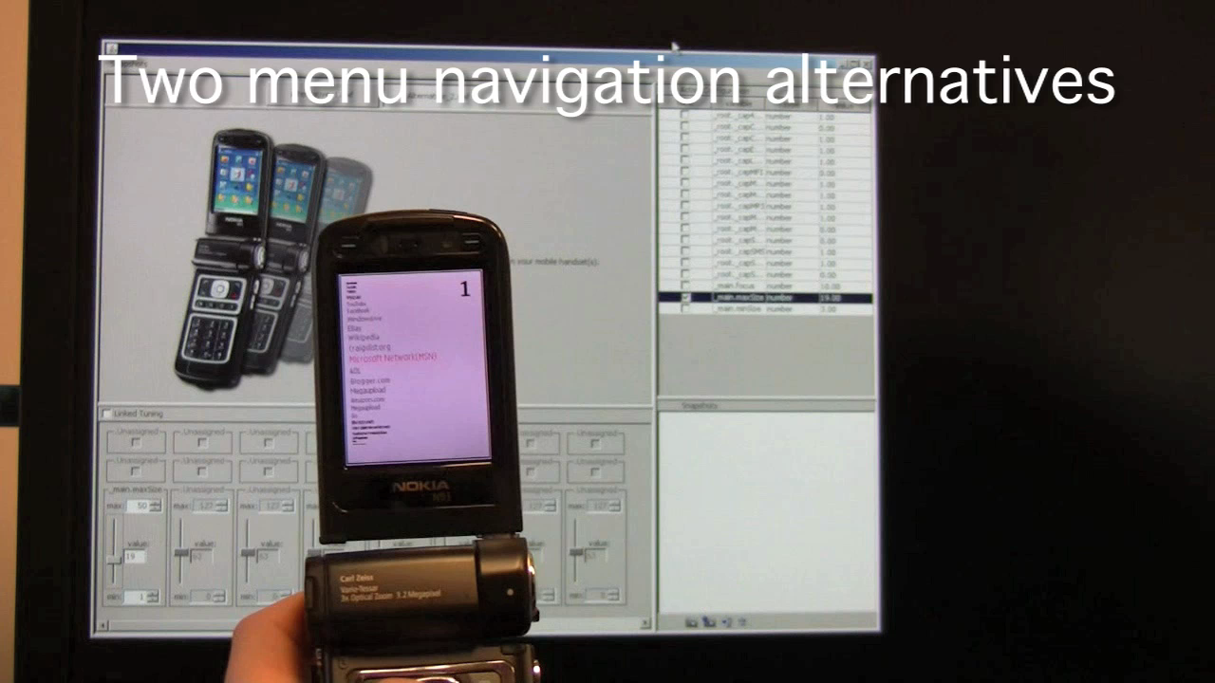
Notes:
A designer can thus rapidly switch between alternatives by putting one phone down and picking another one up. <click>
Tuning now allows designers to use their PC to change the behavior of a program that’s executing on the handset.

Slide 49
Juxtapose Mobile
Juxtapose Wrapper
User’s Flash
Application
Alt. 1
Alt. 2
var1
var2
TCP/IP
Juxtapose
Runtime on PC
Juxtapose Wrapper
User’s Flash
Application
Notes:
Our Juxtapose mobile prototype generates binaries which run on the Flash Lite player on Nokia smart phones. Under the hood things are quite similar to desktop, except that interprocess communication now has to be replaced with socket communication across a network.
49

Slide 50

Juxtapose for Microcontrollers
Arduino:
8bit Atmel AVR RISC chip
programmed in C with gcc
Notes:
Embedded microcontrollers are the tool of choice for working with sensors and actuators. <click>We extended Juxtapose to support authoring for the 8-bit Arduino microcontroller platform. Building custom hardware is resource intensive, so unlike for mobile phones, designer are less likely to build multiple physical prototypes. Instead, in current practice, one can often different software versions of code shoehorned into the microcontroller firmware, turned on and off by either software or hardware switches.

Slide 51
How might one implement variable tuning
in a language without reflection?
Notes:
Now languages that can run on an 8bit microcontroler with 16k of memory don't usually allow language reflection.
So, … how might one implement variable tuning in a language without reflection?

Slide 52
Parse code and build symbol table
int dly = 25;
boolean blink=false;
void setup() {...}
//…
Var. Name | Type | Pointer
“dly” | int | &dly
“blink” | boolean | &blink
Notes:
To enable runtime tuning, we added a preprocessing step to compilation
Juxtapose parses the user's source code; extracts global variable definitions; builds a symbol table with pointers to those variable,

Slide 53
Emit table into code & compile
Auto-generated
table
void initVarTable(void) {
varTable[1].varName = PSTR("dly");
varTable[1].varType = VAR_TYPE_INT;
varTable[1].varPtr = &dly;
varTable[2].varName = PSTR("blink");
varTable[2].varType = VAR_TYPE_BOOLEAN;
varTable[2].varPtr = &blink;
}
// plus a bunch of communication code...
Notes:
, and emits that table back into the source code (along with communication routines) before compilation.

Slide 54
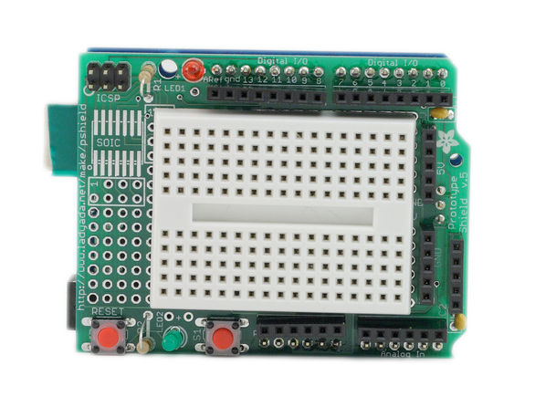
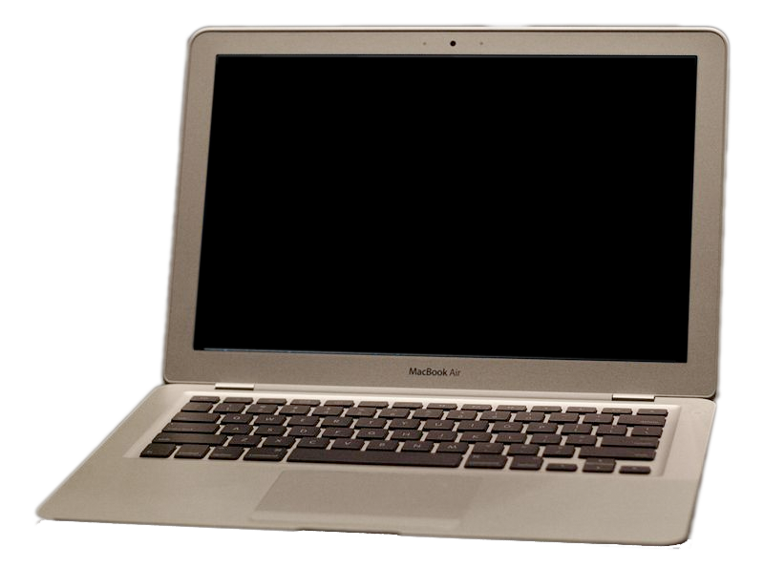
At Runtime
Serial message:
tune “dly” value 100
dly
blink
*(varTable[“dly”].varPtr)
= 100;
X
Notes:
At runtime, the user library can then look up the variable name in that symbol table
And adjust values through dereferencing the pointer in the table

Slide 55
So What’s Different?
Target Platform | How are alternatives executed? Why? | How do users interact with alternatives?
 | In parallel | Sequentially or in parallel
 | In parallel, because commodity hardware is (relatively) cheap | Sequentially (parallelism is possible, but less appealing)
 | Sequentially, because custom hardware is expensive to build | Sequentially
Notes:
So, what’s different across these domains?
It’s not so much about technical barriers – we have shown that there are implementations for both alternatives and tuning that make diffs in software architectures relatively transparent to users.
However, different intrinsic modes of interaction and costs of making changes in hardware affect how alternatives can be executed, and how users interact with them.

Slide 56
What’s Important?
A structured approach to alternatives
eliminates cruft and enables more exploration.
Notes:
lots of detail – step back to the important ideas. Fundamentally, this talk proposes that a structured approach to supporting alternatives in design tools offers two benefits: First, it eliminates the cruft of current practice for managing alternatives. Second, it enables a larger group of users to explore more variations and alternatives in their designs.

Slide 57
What’s Important?
A structured approach to alternatives
eliminates cruft and enables more exploration.
Tool support requires connecting authoring and
execution environments.
3 Techniques:
  Linked editing to manage code alternatives
  Execute set of programs side-by-side
  Auto-generate tuning interface
Notes:
For programmed interactions, supporting alternatives requires spanning both authoring and runtime environments. Juxtapose shows how this integration can be realized with three techniques: using linked editing to effectively manage alternatives at the source level, execution of sets of programs for comparison at runtime, and auto-generation of tuning interfaces through reflection and source parsing.

Slide 58
Related Work
Augmented Development Tools
Alternatives in Other Domains
Partials, Terry, PhD Thesis 05
Amulet Inspector, Myers, IEEE ToSE 97
JPie, Goldman,Sci. of Comp. Prog. 98
ChucK, Wang, NIME 04
Adobe Image Foundation Tookit, 08
Design Galleries, Marks, SIGGRAPH 97
Spreadsheets for Images,
Levoy, SIGGRAPH 94
Spreadsheets for Visualization,
Chi, IEEE CGA 98
Parameter Spectrums & Parallel Pies,
Terry, UIST 02 & CHI 04
Subjunctive Interfaces, Lunzer, TOCHI 08
TEAM STORM, Hailpern, CHI 07
(only first authors listed)
Notes:
Inspiration:; augmented programming environments for user interfaces.; design tools for working with alternatives. Pick three examples.

Slide 59

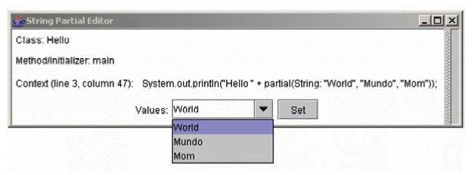
Related Work
Augmented Development Tools
Partials, Terry, PhD Thesis 05
Amulet Inspector, Myers, IEEE ToSE 97
JPie, Goldman,Sci. of Comp. Prog. 98
ChucK, Wang, NIME 04
Adobe Image Foundation Tookit, 08
Language-level support
Notes:
Aligned: to Juxtapose are Partials, proposed in the Appendix of Terry’s PhD Thesis.
Partials are an extension to Java syntax that delays assignment of values to variables until runtime. Partial variables list a set of possible values in source code; at runtime, the developer can choose between these values through a generated interface. Partials: augment syntax source language. Juxtapose :augmenting authoring environment

Slide 60
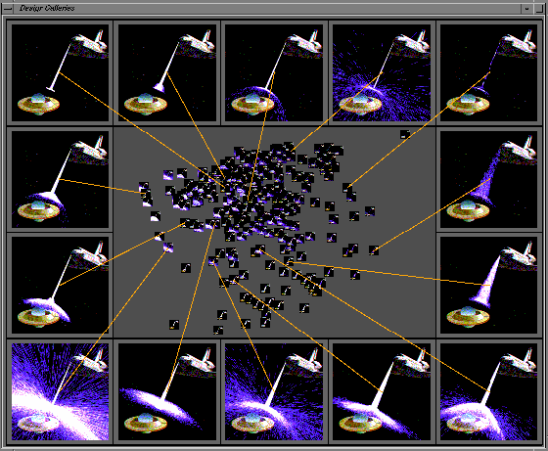
Related Work
Alternatives in Other Domains
Design Galleries, Marks, SIGGRAPH 97
Spreadsheets for Images,
Levoy, SIGGRAPH 94
Spreadsheets for Visualization,
Chi, IEEE CGA 98
Parameter Spectrums & Parallel Pies,
Terry, UIST 02 & CHI 04
Subjunctive Interfaces, Lunzer, TOCHI 08
TEAM STORM, Hailpern, CHI 07
Alternatives are
generated automatically from
formal specification
Notes:
Fully automatic generation of alternatives was proposed in Design Galleries, a browsing interface for exploring parameter spaces of rendered images. Design Galleries are for static images, not dynamic artifacts. In fact, Design Galleries assume that image generation is time-intensive and should be performed offline.Juxtapose makes the assumption that the results of parameter changes can be observed immediately.

Slide 61
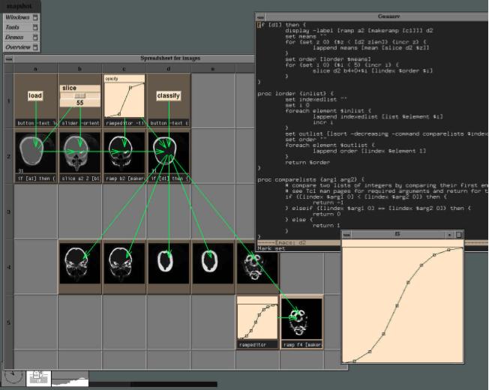
Related Work
Alternatives in Other Domains
Design Galleries, Marks, SIGGRAPH 97
Spreadsheets for Images,
Levoy, SIGGRAPH 94
Spreadsheets for Visualization,
Chi, IEEE CGA 98
Parameter Spectrums & Parallel Pies,
Terry, UIST 02 & CHI 04
Subjunctive Interfaces, Lunzer, TOCHI 08
TEAM STORM, Hailpern, CHI 07
Exploit spatial syntax
Notes:
Spreadsheets also inherently support parallel exploration, for example in Marc Levoy’s spreadsheets for image manipulation. Spreadhseets offer more complex ways of defining alternatives than Juxtapose’s local-or-global editing. Investigating how a such an approach could extend to interaction design is an interesting avenue for future work.

Slide 62
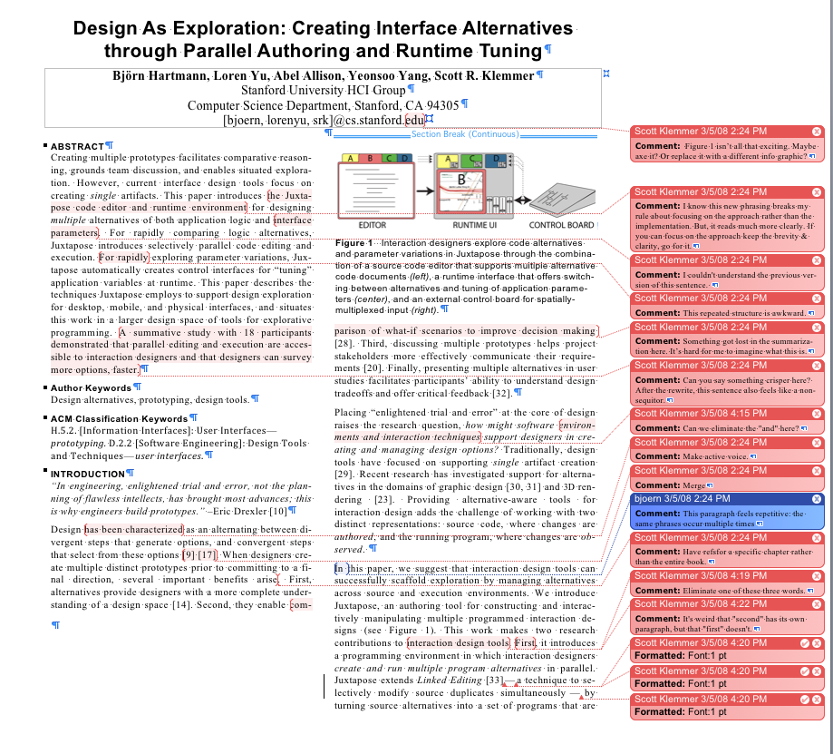
Current Work:
Revisions for Interaction Design
Revisions & comments
for text in Microsoft Word
Revisions & comments for interactions
in d.tools
Notes:
Our research into synchronous, parallel presentation of alternatives also led us to think about ways to record changes to interaction designs over time. In word processing, change tracking and revision management enable teams to collaborate on documents. We are currently investigating how revision principles might apply to interaction design. In particular, alternatives appear to be a useful additional building block for the revision of interaction designs.

Slide 63
http://hci.stanford.edu
Björn Hartmann
Loren Yu, Abel Allison, Yeonsoo Yang
Scott R. Klemmer
Supported by:
NSF grant IIS- 0745320
Equipment from Intel & Nokia
SAP Stanford Graduate Fellowship
Notes:
For more information about Juxtapose, I invite you to visit our website. Thank you.

Slide 64
Take a guess, then give control to the user.
At runtime: editable min/max values
Notes:
At runtime, users can also change these limits using editable slider ranges.

Slide 65
Implementing Parallel Editing:
Incremental Structure Tracking
INSERT
DELETE
Doc. A
Doc. B
Doc. A
Doc. B
User
inserts
text
Doc. A
Doc. B
Empty
block
created
User
deletes
text
Doc. A
Doc. B
Blocks
sub-
divided
Notes:
To guarantee interactive response during text editing, Juxtapose also uses an incremental algorithm while users are typing that tracks structural correspondence of text regions in different documents. Insertions and deletions split these regions across all alternatives. During idle times, these regions are re-synchronized with the diff algorithm.

Slide 66
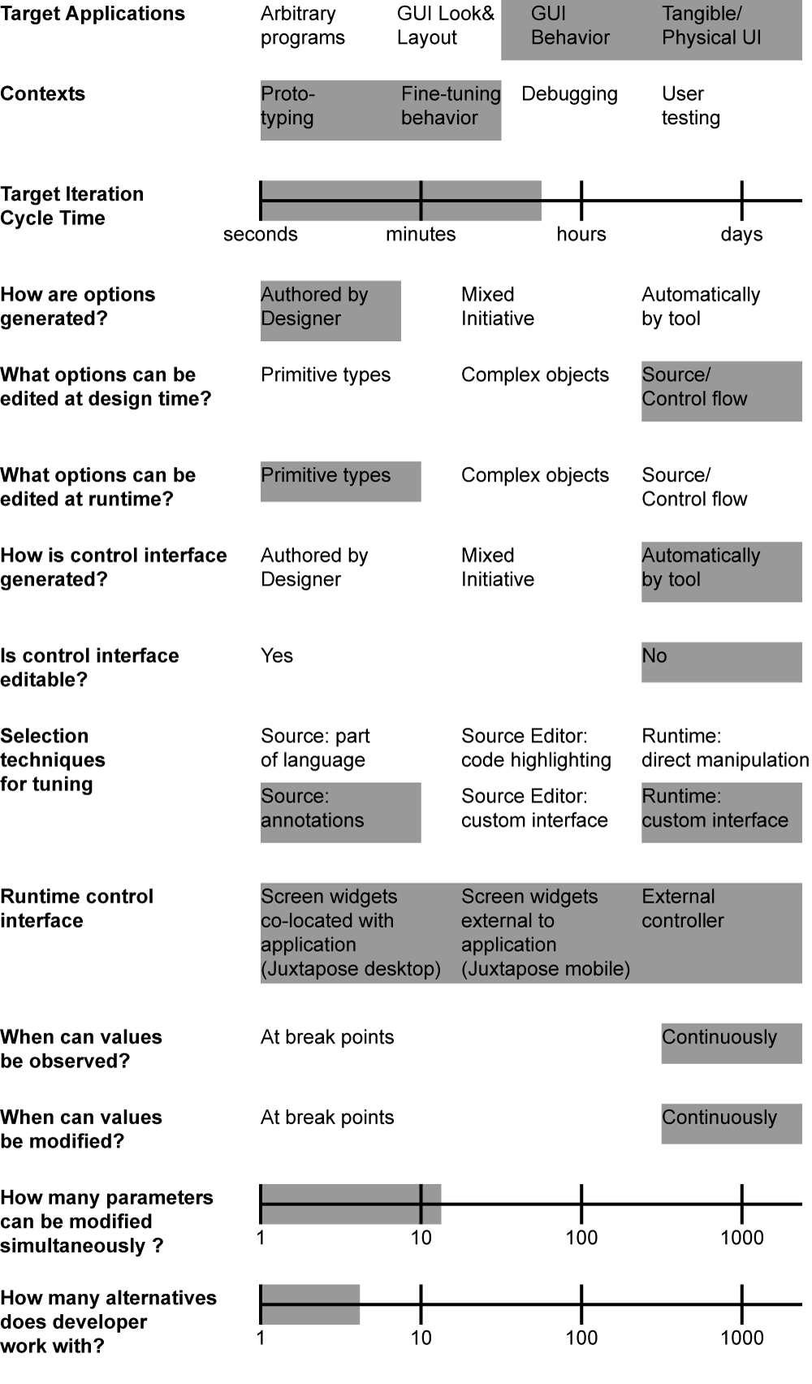
Future Work
Graphics
+ Code?
Notes:
One area of fruitful future work is to find a way to combine our techniques for code alternatives with techniques for graphical alternatives. Interaction design is about both look and feel – appearance and behavior. Juxtapose focused on alternatives for behavior; it is worth investigating how these techniques can be combined with ways to explore appearance, e.g, Parallel Pies proposed by Michael Terry. The crux here will be simplification – the naïve cross-product of interaction techniques is unlikely to work.

Slide 68

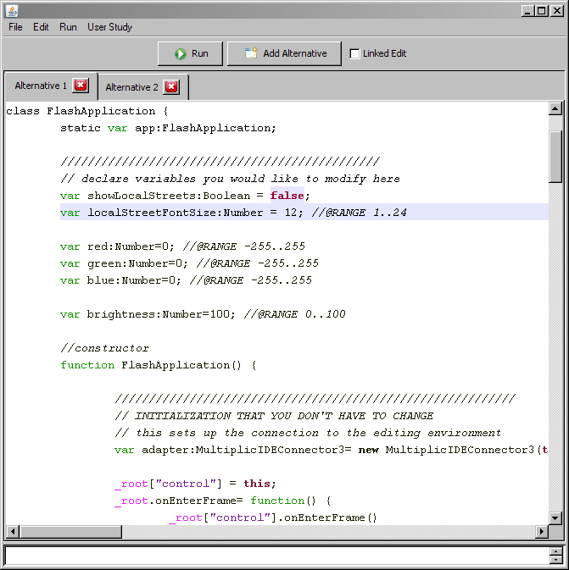
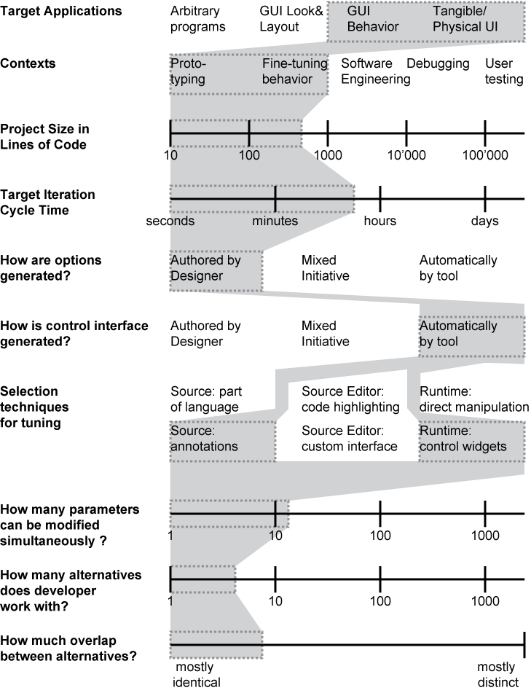
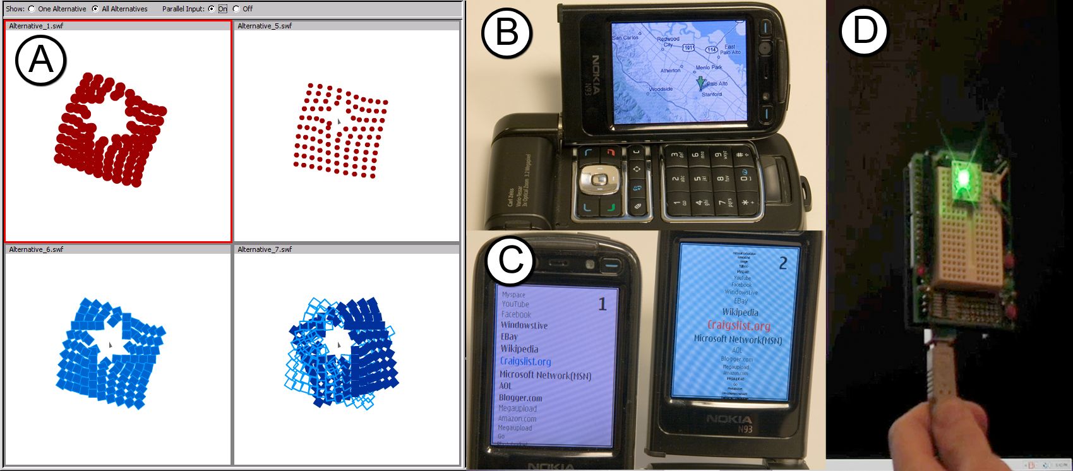
FRAME
DEMONSTRATE
UNDERSTAND
Notes:
Given this framing work, we constructed Juxtapose,

Slide 69
FRAME
DEMONSTRATE
UNDERSTAND
Notes:
This talk will address this question in three parts.
First, I will frame exploration in design using examples from design research and practice; from this basis, I will develop requirements specific for the domain of interaction design.
Second, I will demonstrate how these requirements can be operationalized through Juxtapose, a code editor and runtime environment for interactions written in ActionScript.
Third, I will put Jutxapose into a larger context to understand its tradeoffs through results from a usability study and discussion of related work within a larger design space of tools. [frame; demonstrate; understand]

Slide 70
FRAME
DEMONSTRATE
UNDERSTAND

Slide 71
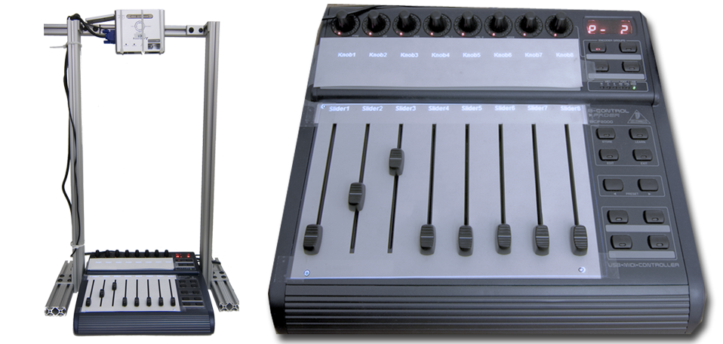
Tangible Control
Notes:
Juxtapose supports use of an external controller for variable tuning for three reasons. The controller enables users to modify multiple parameters simultaneously, leaves the eyes free to focus on the application being tuned, and allows for tuning of interactions that require mouse and keyboard input, e.g., adjusting the rate at which mouse wheel movement magnifies a document. To facilitate locating a particular variable’s control, the mixer was augmented with a small top-mounted projector which displays parameter names. There are two ways to ensure that the controller stays in sync with variable values recalled through snapshots: either use only relative inputs, or use absolute inputs that can be actuated. We chose motorized faders as absolute controls have the advantage that their position provides proprioceptive feedback.

Slide 72
Switching alternatives
Bootloader
Load
Alternative2.hex
Alternative 2
Notes:
Because of space constraints, only one alternative can fit into the microcontroller’s memory. When the designer switches between alternatives, Juxtapose transparently replaces the entire binary running on the microcontroller through a bootloader.

Slide 73
p<0.001 (paired two-tailed Student’s t)
Notes:
Rather obviously, participants completed the matching task faster with Juxtapose than without.
What’s more important is – why?

Slide 74
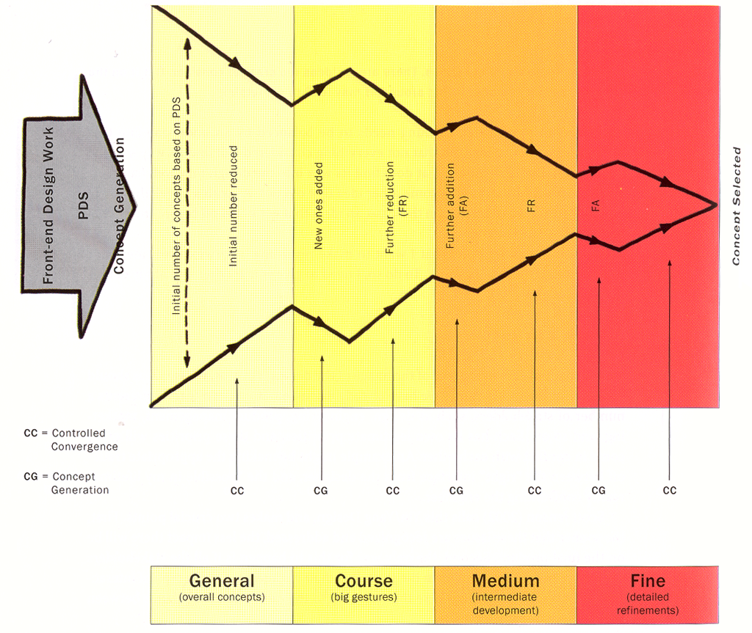
Buxton, Sketching User Experiences
Notes:
Alternating between Divergent and convergent steps happen at different granularities throughout a design process. While initially you may survey a range of very different concepts, the scope of experimentation narrows as a product becomes better defined.

Slide 75
How can interaction design tools
support creation and management
of user interface alternatives?
Notes:
The central research question of this talk is the following:
If we take exploration as a core activity of design, how can *interaction* design tools support creation and management of user interface alternatives? [opening]
Such tools don’t yet exist for designing interactive behavior (click)

Slide 76
Juxtapose Mobile
Juxtapose Wrapper
Open socket,
send variable info
User’s Flash
Application
Alt. 1
Alt. 2
var1
var2
TCP/IP
Juxtapose
Runtime on PC
Juxtapose Wrapper
User’s Flash
Application
Open socket,
Send variable info
Notes:
Our Juxtapose mobile prototype generates binaries which run on the Flash Lite 2.0 player on Nokia N93 smart phones.
Under the hood things are quite similar to desktop, except that interprocess communication now has to be replaced with socket communication across a network.
76

Slide 77
Juxtapose Mobile
Juxtapose Wrapper
Tuning messages
For Alternative 1
User’s Flash
Application
Alt. 1
Alt. 2
var1
var2
TCP/IP
Juxtapose
Runtime on PC
Juxtapose Wrapper
User’s Flash
Application
Tuning messages
For Alternative 2
Notes:
77

Slide 78
Adding Tuning to the Arduino IDE
Notes:
We are currently working with the administrators of the Arduino project to include variable tuning into a future release of the Arduino environment, which by estimates has 20-40,000 users currently.

Slide 79
Tuning without Reflection
Parse source to extract global variable declarations
Emit variable table + wrapper code into source
Compile modified source

Slide 80
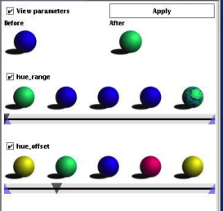
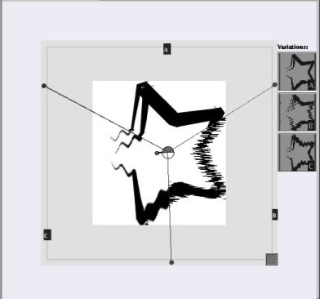
Related Work
Design Galleries, Marks, SIGGRPAH 97
Parameter Spectrums & Parallel Pies,
Terry, UIST 02 & CHI 04
Subjunctive Interfaces, Lunzer, TOCHI 08
Spreadsheets for Images,
Levoy, SIGGRAPH 94
Spreadsheets for Visualization,
Chi, IEEE CGA 98
TEAM STORM, Hailpern, CHI 07
Partials, Terry, PhD Thesis 05
Amulet Inspector, Myers, IEEE ToSE 97
Jpie, Goldman,Sci. of Comp. Prog. 98
ChucK, Wang, NIME 04
Adobe Image Foundation Tookit, 08
(only first authors listed)
Mixed initiative
Notes:
Michael Terry introduced the concept of set-based image manipulation. Parameter spectrums preview multiple parameter settings, and Parallel Pies embed these filters into a single canvas. The contributions of our work are largely complementary but it would be worthwhile to investigate the mixed initiative approach of parameter spectrums, where some values are auto-generated.

Slide 81

Generate Options, Select. Repeat.
Redrawn from
Buxton, Sketching User Experiences
Notes:
This diagram by Bill Buxton gives voice to a widely held view that the very core of design consists of two interleaved activities: generating multiple possible solutions to a problem (divergence), followed by a selection of desirable solutions from that set (or convergence).

Slide 82
Limits of Parallel Editing
Cognitive challenge:
Changes to alternatives are
not visible during editing
Level of granularity for editing:
Extension to multi-file projects not trivial
Notes:
One of the challenges of parallel editing: User looks at one alternative, but changes made to many other alternatives behind the scenes.
* bounds the complexity of parallel editing operations.
editing subsets of alternatives for editing is technically feasible, experience suggests too burensome on the user of remembering state of different documents.
Another question is which level of granularity alternatives should be defined on. We chose the file level: prototypes are authored in single files.
Larger level, across files in a project, may require significantly different editing techniques.

Slide 83
Beyond the Desktop
MOBILE PHONES
MICRO
CONTROLLERS
Notes:
To investigate how general principles of working with alternatives and parameter tuning carry over into other domains, we also wrote runtime environments for mobile phones and microcontrollers. In Both cases, the source code editors is the same, but the runtime environments differ.

