Slide 1
Understanding & Modeling
Input Devices
Björn Hartmann
bjoern@cs.stanford.edu
Notes:
* Diss research: new prototyping tools that foster iteration and exploration during the design of novel user interfaces

Slide 2
Questions for today
How do common input devices work?
How can we think about the larger space of all possible input devices?
Can we predict human input performance?
Next class: What about uncommon input devices (music controllers, multitouch, …)?
Notes:
Why do we care? Need both Practical and Theoretical understanding
(What do I need to know to build my own?)

Slide 3
Today’s lecture in graph form
Level of
abstraction
abstract
models
Functional Dissection of Mouse & Keyboard
Design Space of Input Devices
Modeling Human Performance
concrete
details
time

Slide 4
I spilled coffee on my keyboard.
Now 25% of the keys don’t work anymore.
But some of the defective keys are nowhere near the spill.
What’s going on?

Slide 5
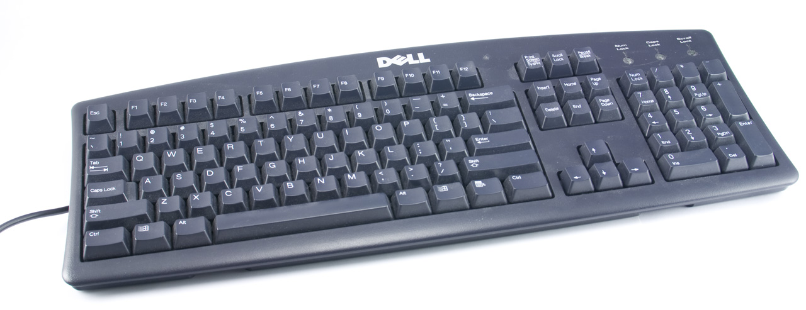

Slide 6
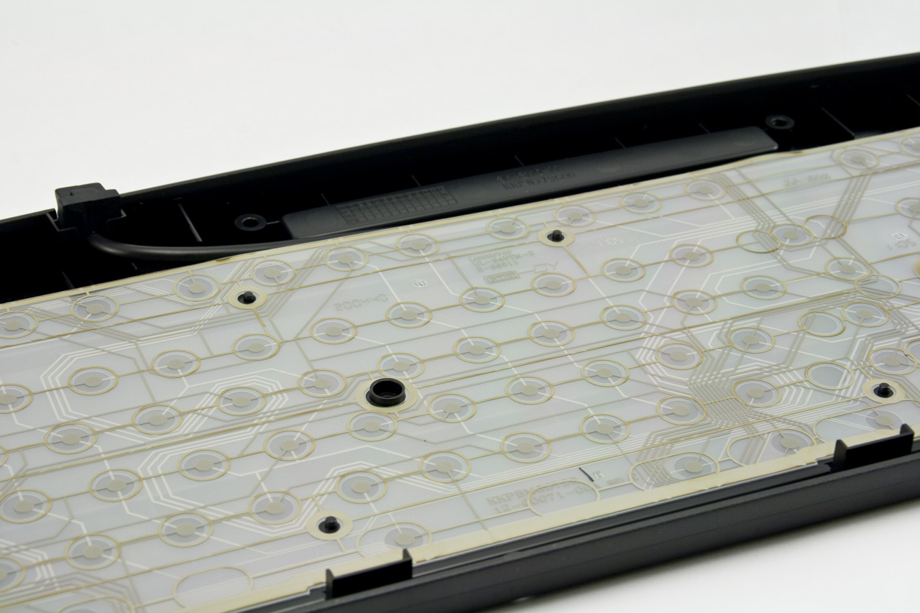

Slide 7
Key cap
Top conductive layer
Separating layer
(with hole)
Bottom conductive
layer

Slide 8
Key cap
Top conductive layer
Separating layer
(with hole)
Bottom conductive
layer

Slide 9
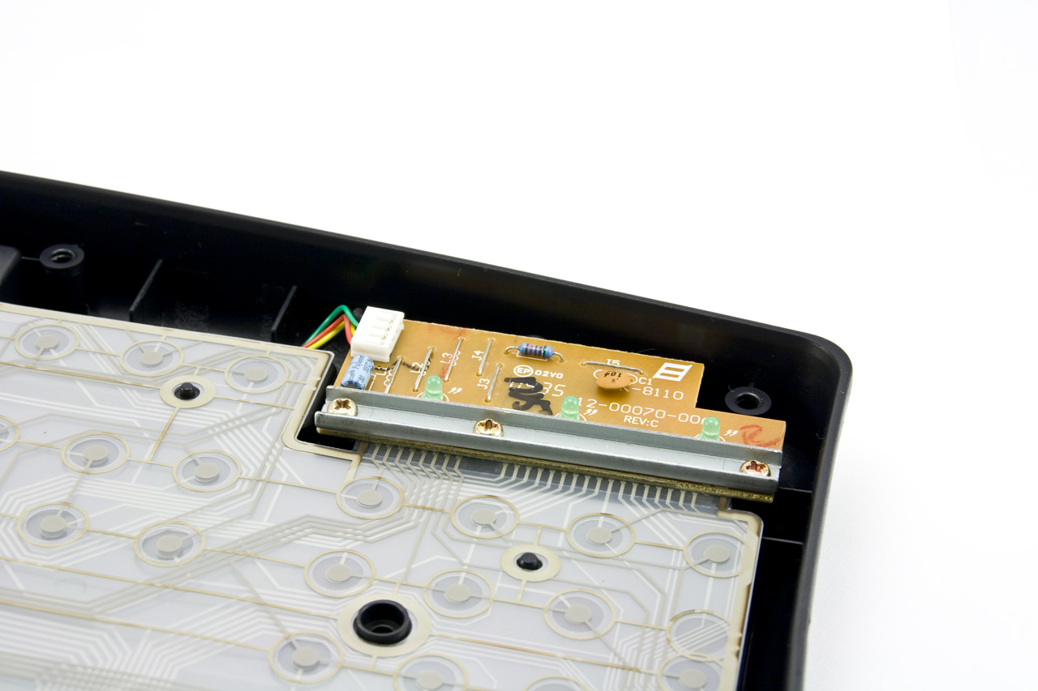

Slide 10
Row/Column Scanning
9 lines
20 keys
C1
C2
C3
C4
C5
R1
Q
W
E
R
T
R2
A
S
D
F
G
R3
Z
X
C
V
B
R4
Notes:
http://www.dribin.org/dave/keyboard/one_html/

Slide 11
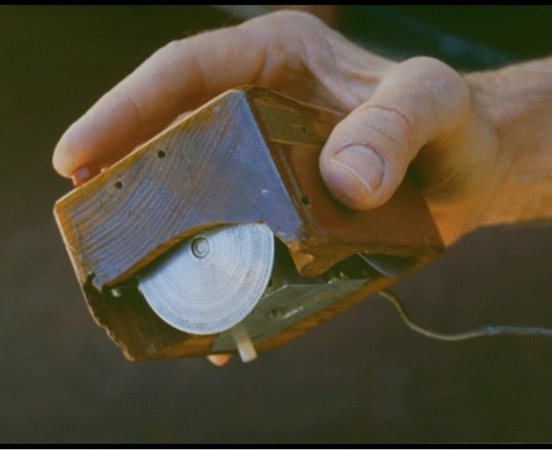
Mouse. Engelbart and English ~1964
Source: Card, Stu. Lecture on Human Information Interaction. Stanford, 2007.
Notes:
Doug Engelbart SRI 19??

Slide 12
A Layered Framework
From: Hartmann, Follmer, Klemmer: Input Devices are like Onions
Notes:
The main insight this framework provides is that a series of changes of representation take place between a user’s action and the final set of events delivered to an application. Concretely, the action a user performs with a device is often not directly what is sensed by the device.
User Action
User action is the embodied performance of the user controlling an application. It is the action that the designer intends the device to sense.
Mechanical Intermediaries / Physical Properties
This level represents the physical manifestation of the input device, both the tactile features exposed to the user and the mechanical system that may couple sensors to user action.
Sensing
The sensor is responsible for transducing a physical quantity into an electrical one, which may be analog or digital.
Signal Coding
This stage is responsible for changing the raw sensor data into a format that better represents the phenomenon intended to be measured. Coding can include signal conditioning and filtering, but also changes in representation such as mapping varying voltages to absolute sensed distances for an ultrasonic ranger; mapping gyroscope and accelerometer data into an estimate of device orientation; or counting rotary encoder pulses to extract relative rotation direction and magnitude.
Transformation
What is sensed is not the user’s action: In the Bop It! toy, different physical actions are all sensed with simple momentary switches and complex mechanical intermediaries.
Transformation is the term we use to define software mappings that align input device data with requirements of the applications or platform that use the device. Typical transformations include: transfer functions (e.g., mouse acceleration), finite state machines (e.g., key repeat for keyboards),
Device Abstraction
This layer represents how the input device appears to an application (essentially the device’s API). The abstraction could be a standard protocol like mouse or keyboard, USB HID, OpenSoundCountrol (OSC)

Slide 13
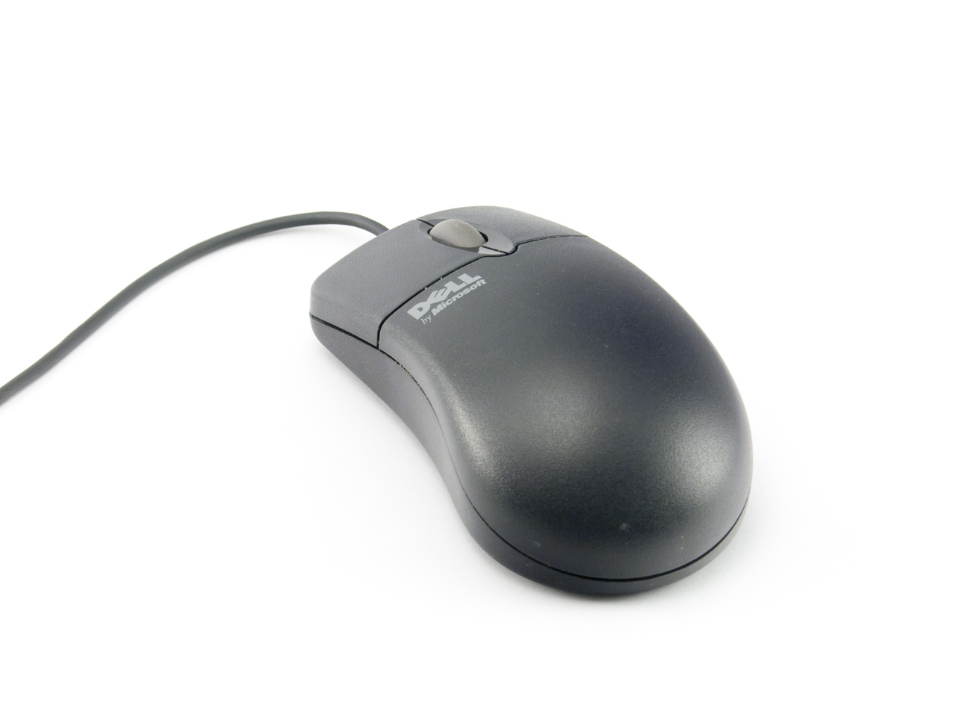

Slide 14
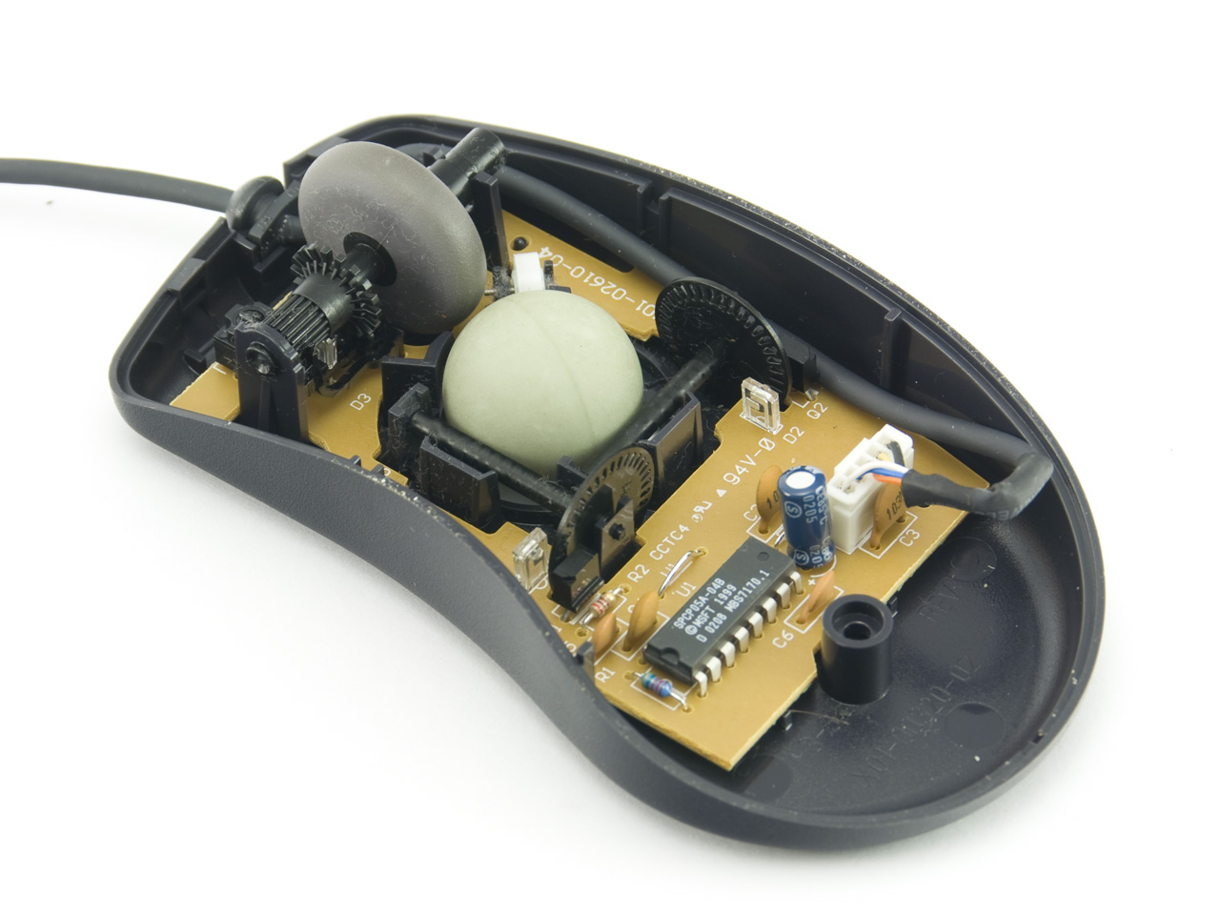

Slide 15
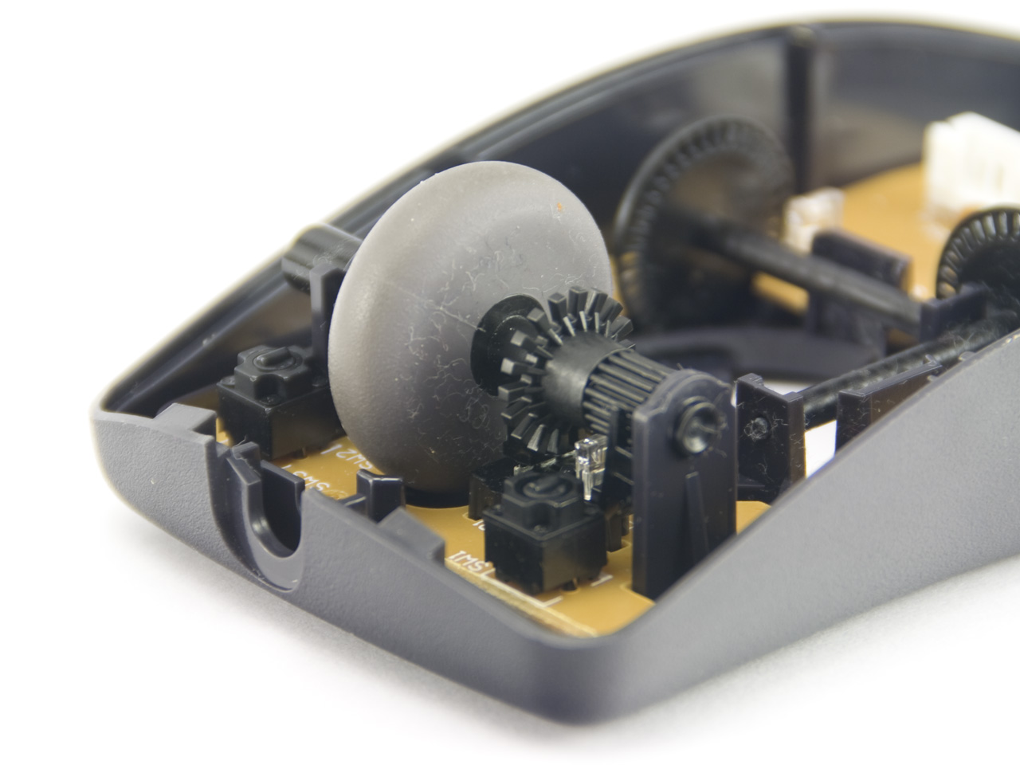
Right button
Encoder wheel for scrolling
Left button

Slide 16
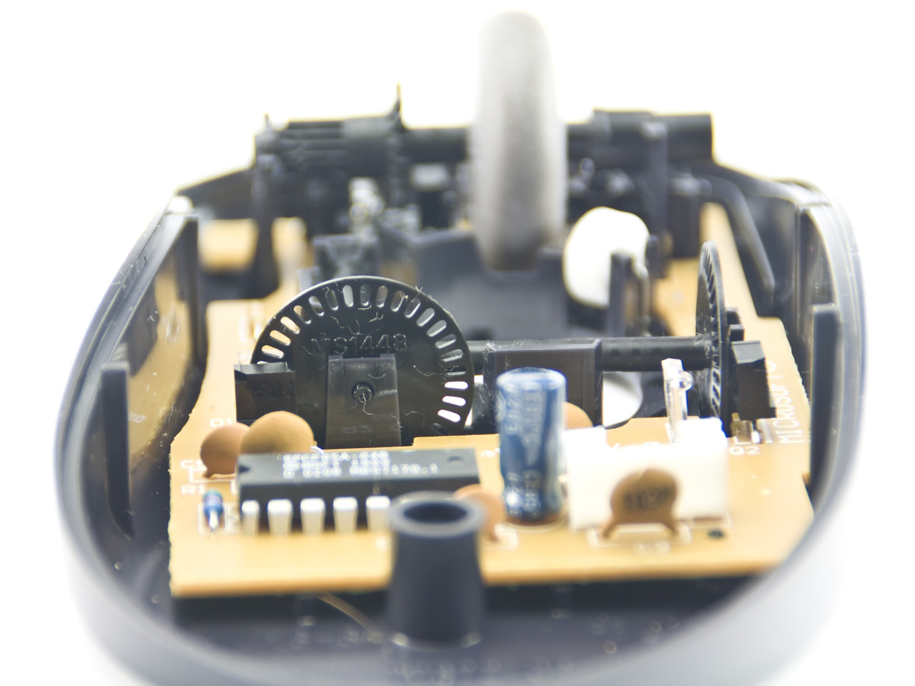
slotted wheel
(between emitter & detector)
IR emitter
IR detector

Slide 17
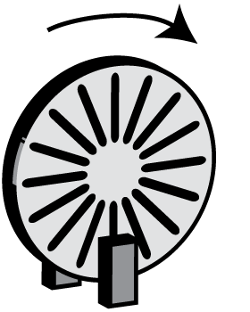
Sensing: Rotary Encoder
High
Notes:
How do we get direction?

Slide 18
Sensing: Fwd Rotation
Low
Notes:
How do we get direction?

Slide 19
Sensing: Backwd Rotation
Oops!
Low
Notes:
How do we get direction?

Slide 20
Solution: Use two out-of-phase detectors
High
High
Notes:
How do we get direction?

Slide 21
Sensing: Rotary Encoder
Low
High
Notes:
How do we get direction?

Slide 22
Sensing: Rotary Encoder
Coding:
HH-> LH: dx = 1
HH-> HL: dx = -1
High
Low
Notes:
How do we get direction?

Slide 23
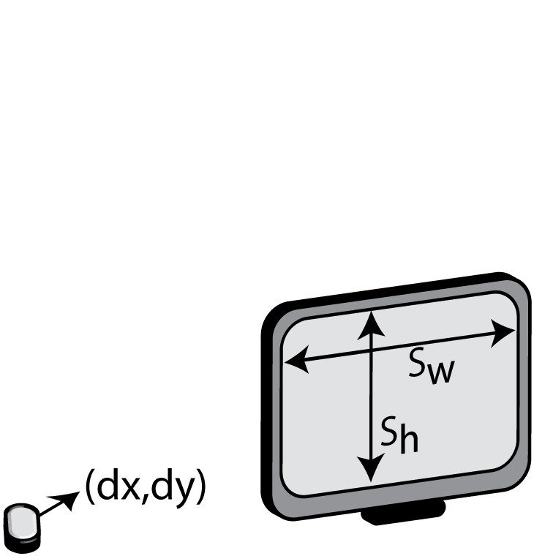
Transformation
cx_{t} = max(0, min( sw, cx_{t-1}+dx*cd ))
cy_{t} = …
cx_{t}: cursor x position in screen coordinates at time t
dx: mouse x movement delta in mouse coordinates
sw: screen width
cd: control-display ratio

Slide 24
Device Abstraction
Click, DoubleClick, MouseUp, MouseDown, MouseMove …

Slide 25
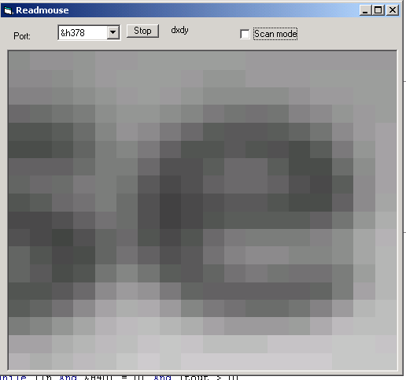
What about optical mice?
Source: http://spritesmods.com/?art=mouseeye
Notes:
Optical flow

Slide 26
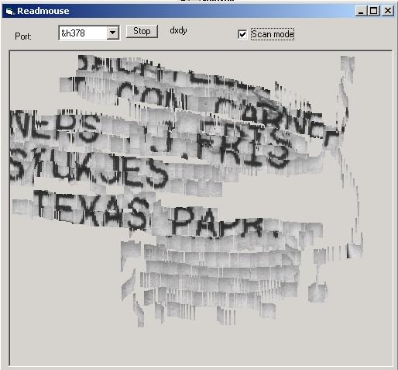
bbbbbbbbbb
Source: http://spritesmods.com/?art=mouseeye

Slide 27
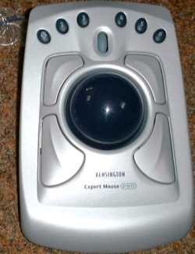

Trackball, Trackpad
Notes:
Turn a ball mouse upside down and move the ball with your fingers – you end up with a track ball: indirect, relative rotation in 2D,
And on laptops you have a trackpad, which gives you 2D of relative position, along with some force sensitivity – you can often click on the pad itself by tapping quickly

Slide 28
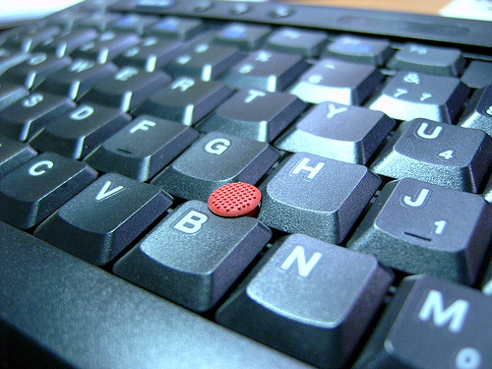
Trackpoint
Indirect, force sensing, velocity control
Nonlinear transfer function
Velocity
Force
(cc) Image by flickr user tsaiid
Notes:
Look at standard office task of speradhseet entry:
Three major factors contribute to the performance: switching from typing to pointing, the pointing action, and switching from pointing to typing. Compared to a mouse, the in-keyboard isometric joystick substantially reduces switching times, but with some penalty in pointing: force based control where you control the velocity of the cursor is slower than relative position based control in a mouse.
However, once again looking at human physiology, you can improve the situation by finding a good mapping function of how force gets translated to velocity.
People at IBM did this and they reported User tests show a 7.8 +/- 3.5% performance improvement over a standard non-dynamic joystick, which may not sound like much, with tests showing early versions of TrackPoint II to be only 20% slower than a mouse for pure pointing tasks [6].

Slide 29
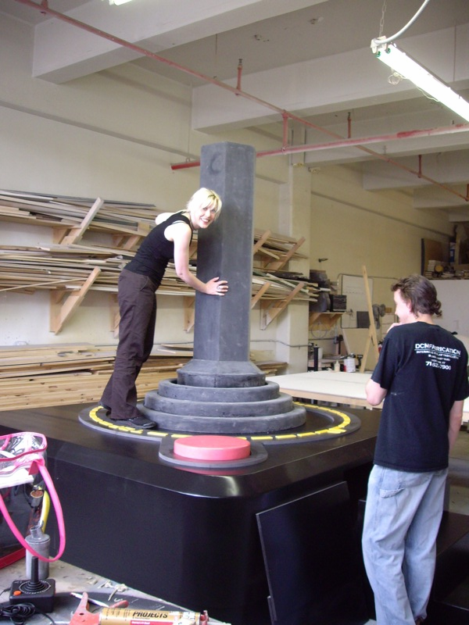
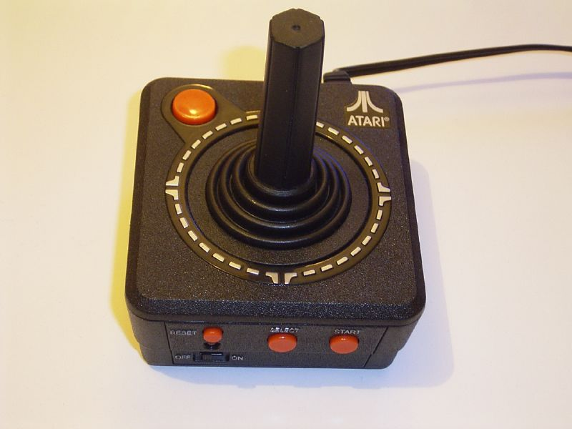
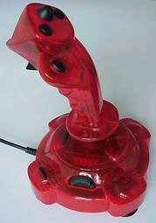
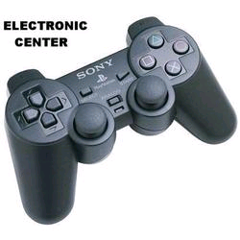
Joysticks
Notes:
(cc) Flickr user duncan, seanaes

Slide 30
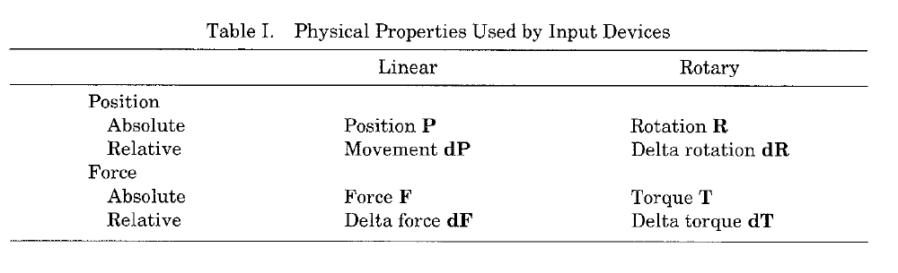
A design space of input devices…
Card, S. K., Mackinlay, J. D., and Robertson, G. G. 1991.
A morphological analysis of the design space of input devices.
ACM TOIS 9, 2 (Apr. 1991), 99-122.
Notes:
What is Sensed
Motion (e.g., mouse)
Position (e.g., trackpad)
Force (e.g., trackpoint)
What it Controls
Position of cursor
Absolute mapping from device to screen
Relative mapping
Velocity of cursor

Slide 32
Implicit Assumptions: Desktop-centric computing
Notes:
For each of these dimensions our physiology determines maximum performance; the fitts law factors;
You can then use the combination of knowledge about the type of input device and human performance characteristics to theretically analyze which devices are likely to outperform which others…

Slide 33
Which device is fastest?
For what task? Pointing.
Combination of two factors:
  Bandwidth of human muscle group (upper limit)
  Bandwidth of device itself

Slide 34
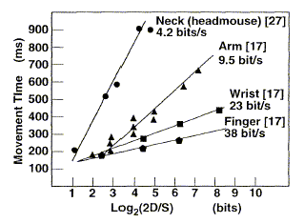
Bandwidth of Human Muscle Groups
Source: Card, Stu. Lecture on Human Information Interaction. Stanford, 2007.
Notes:
Log(2d/s)
D = distance to move

Slide 35
Fitts’ Law
Time T_{pos} to move the hand to target size S which is distance D away is given by:
  T_{pos} = a + b log₂ (2D/S)
Time to move the hand depends only on the relative precision required
Source: Landay, James. “Human Abilities”. CS160 UC Berkeley.

Slide 36
Mouse vs. Headmouse
Source: Card, Stu. Lecture on Human Information Interaction. Stanford, 2007.

Slide 37
Headmouse: No chance to win
Source: Card, Stu. Lecture on Human Information Interaction. Stanford, 2007.
Notes:
Why these results?
Time to position mouse proportional to Fitts’ Index of Difficulty I_{D}.
[i.e. how well can the muscles direct the input device]
Therefore speed limit is in the eye-hand system, not the mouse.
Therefore, mouse is a near optimal device.

Slide 38
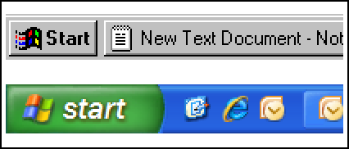
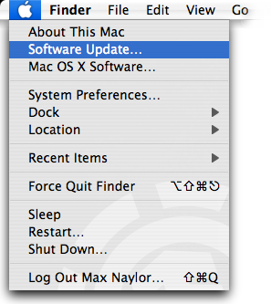
Fitts’ Law in Windows & Mac OS
Windows 95: Missed by a pixel
Windows XP: Good to the last drop
The Apple menu in Mac OS X v10.4 Tiger.
Source: Jensen Harris, An Office User Interface Blog : Giving You Fitts. Microsoft, 2007; Apple

Slide 39
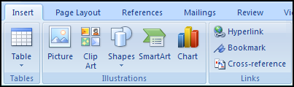
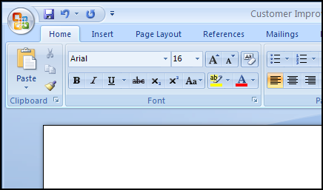
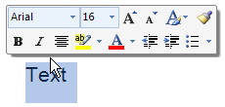
Fitts’ Law in Microsoft Office 2007
Larger, labeled controls can be clicked more quickly
Magic Corner: Office Button in the upper-left corner
Mini Toolbar: Close to the cursor
Source: Jensen Harris, An Office User Interface Blog : Giving You Fitts. Microsoft, 2007.

Slide 40
http://bjoern.org

