Slide 1
Enlightened Trial and Error
Interaction Prototyping Tools that
Foster Iteration and Exploration
Björn Hartmann
bjoern@cs.stanford.edu
Notes:
* Diss research: new prototyping tools for the design of novel user interfaces

Slide 2

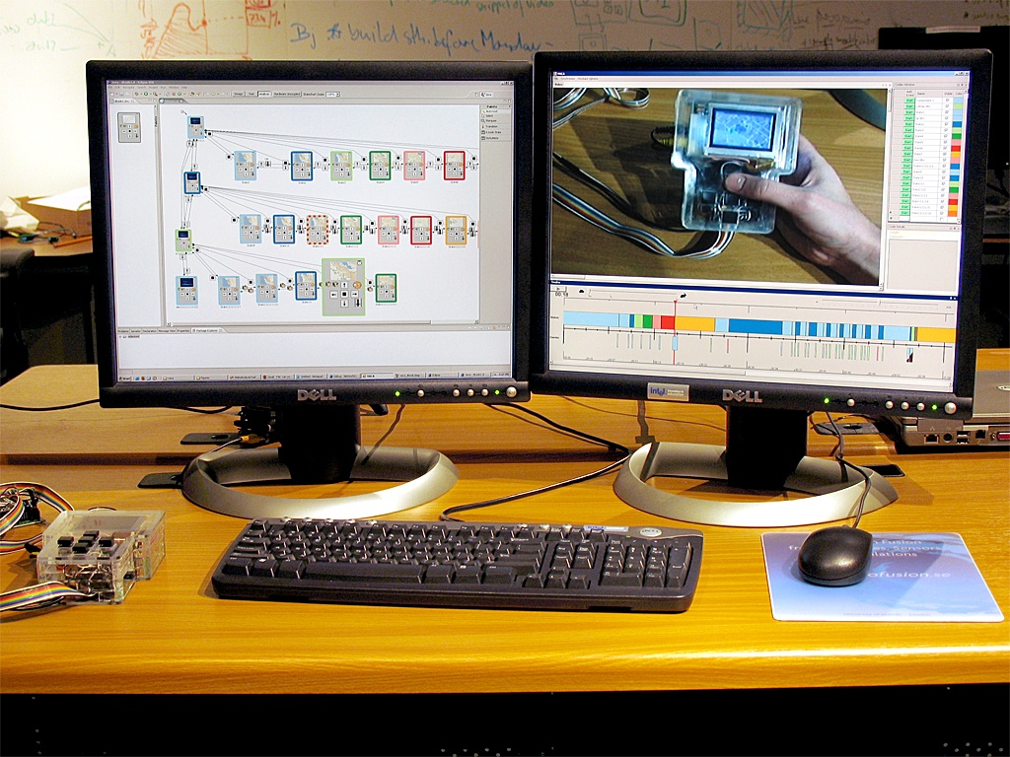
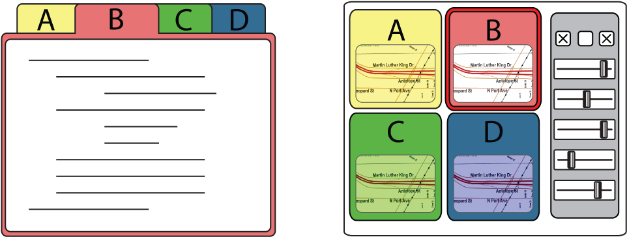
Prototyping Tools
1
2
3
Enable
Rapid Authoring
Off the Desktop
Aid Iteration
by Managing
Feedback
Aid Exploration
of Multiple
Alternatives
Notes:
Specifically, I will introduce systems that address three concerns:
First, how enable a larger group of design practitioners to rapidly create… visual and demonstration-based authoring
Second, how to support iteration

Slide 3
Prototyping is the central activity that structures the design process.
Lawson, How Designers Think, Architectural Press
Cross, Designerly Ways of Knowing, Springer
Schrage, Serious Play, HBS Press
Moggridge, Designing Interactions, MIT Press
Buxton, Sketching User Experiences, Morgan Kaufmann
Notes:
Prototypes are central to good design, in any domain.
Prototyping is the pivotal activity that structures innovation, collaboration, and creativity in design, whether you are designing furniture, medical devices, or user interfaces.
Prototypes embody design hypotheses and enable designers to test these hypotheses.

Slide 4
Prototypes enable exploration and iteration around concrete artifacts.
Lawson, How Designers Think, Architectural Press
Cross, Designerly Ways of Knowing, Springer
Schrage, Serious Play, HBS Press
Moggridge, Designing Interactions, MIT Press
Buxton, Sketching User Experiences, Morgan Kaufmann
Notes:
The goal in prototyping is not the artifact – it’s learning: you build some prototypes, evaluate them, and use what you learned to drive the next design.

Slide 5

Exploration:
Generate Parallel Alternatives
Redrawn from
Buxton, Sketching User Experiences
Notes:
Any sufficiently complex problem has a space of possible solutions. To map that space, designers frequently generate multiple solutions to a problem simultaneously, to then select of desirable features from that set

Slide 6

Prototypes for the
Microsoft mouse
From Moggridge,
Designing Interactions, Ch2
Notes:
*Paul Bradley, 80 models, explore different possible shapes
Pliable materials enable rapid creation

Slide 7
Iteration: Incorporate Insight
ANALYZE
EVALUATE
PROTOTYPE
Dreyfuss, Designing for People, 1955;
Lawson, How Designers Think, 1997;
Cross, Designerly Ways of Knowing, 2005
Notes:
Iterative design acknowledges that fit between problem and solution can only be achieved through repeated testing and improvement.

Slide 8
Notes:
ongoing public re-design of drupal.org, a popular open-source content management system.
Designer Mark Bouchard’s iteratiopublishes proto online
User community gives feedback, which drives next week’s work.

Slide 9
Neither exploration nor iteration are supported in today’s user interface design tools.
Notes:
Even though exploration and iteration are core activities in design,
In the realm of user interfaces, neither are supported by today’s design tools.
Focus is on “getting a single, complete product built” – and that part is important.
But not entire story – example of shortcomings of current tools:

Slide 10
“[D]esigners frequently wanted to have multiple designs side-by-side [...]
However […] there is no built-in way in today’s implementation tools to have two versions of a behavior operating side-by-side.”
Myers et al., VL/HCC 2008
Notes:
Interview of 259 designers.
“there is no built-in way in today’s implementation tools to have two versions of a behavior operating side-by-side”.

Slide 11
Why should we care?
Designers tend to hang on to initial solution (Cross, Designerly Ways of Knowing)
Decisions made with insufficient knowledge
Gained knowledge is lost or not acted on
Resources wasted in working around tools
Problems uncovered too late
Poor solutions, failed products
Notes:
After all, products do make it to market, new websites are published

Slide 12
1
2
3
Enable
Rapid Authoring
Off the Desktop
Aid Iteration
by Managing
Feedback
Aid Exploration
of Multiple
Alternatives

Slide 13
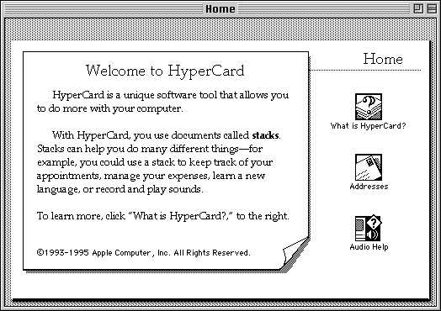
Related Work:
Rapid Authoring of GUIs
Also:
SILK, Landay, 1996
DEMAIS, Bailey, 2001
DENIM, Lin, 2000
Hypercard, Atkinson 1985
Notes:
Myst
Assume desktop centric development – i.e, you know what I/O is available

Slide 14
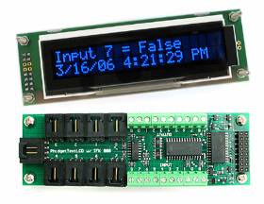
Related Work:
Rapid Authoring of GUIs
Also:
iStuff, Ballagas, 2003
Calder, Lee, 2004
DART, McIntyre, 2004
Phidgets, Greenberg, 2001
Notes:
Enabled Programmers
Not offered: low threshold visual authoring and direct manipulation

Slide 15
d.tools
Visual, storyboard-based authoring
Unites design of I/O affordances and application behavior
Exposes hardware & software extension points
d.tools
Notes:
* leverages the storyboard paradigm familiar to
First to unite both the design of what a physical device can sense and output, and its dynamic behavior
d.tools offers an extensible
* examples to make clear what level of fidelity d.tools targets.

Slide 16
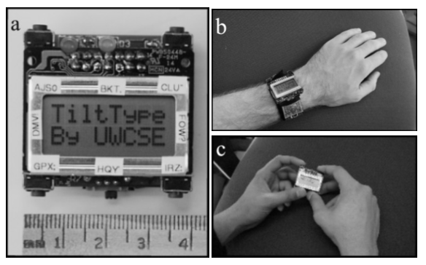
Example: Mobile Text Entry
If |Buttons| < |Letters|:
Select alphabet subset
Select letter from subset
Available Controls:
1. X/Y Tilt data
2. Discrete corner buttons
TiltType, Partridge et al., UIST 2002
Notes:
Take mobile text entry problem
In absence of a touchscreen, If buttons < letters, we’ll need
UW researchers proposed a new entry method using a combination of buttons and tilt information. How well would such an input technique work?
This is the kind of question that a d.tools prototype can answer.

Slide 17
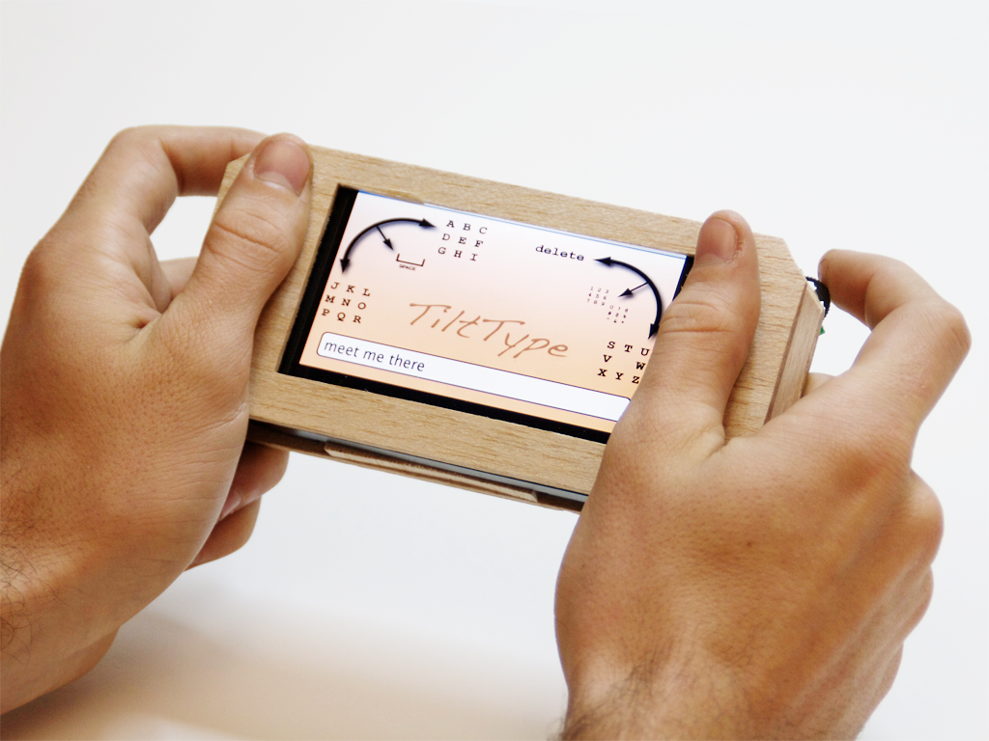
Example: Tilt-based text entry
3-way navigation
switches
2 axis accelerometer
Notes:
Slightly larger than wristwatch, but with same input.
About one afternoon of work

Slide 18
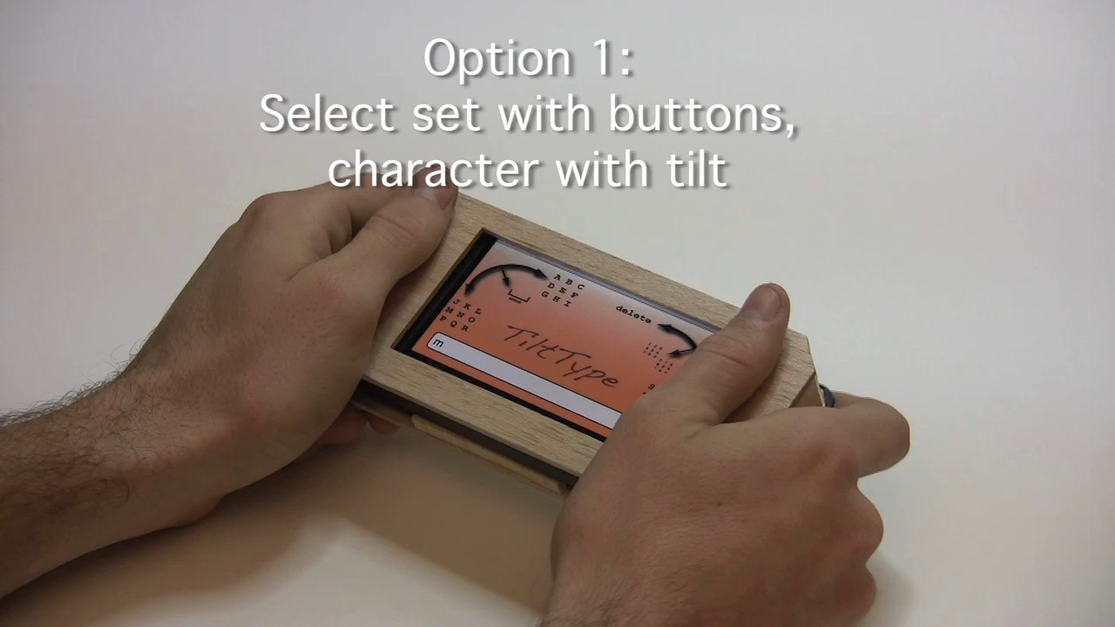
Notes:
We were able to prototype the UW technique of using buttons, followed by tilt to type letters.
More importantly, d.tools was rapid enough so we could ask what happened if you reversed the control structure:
First tilt, then use buttons to disambiguate. Because tilting is more error prone, this second technique, actually outperformed the method that was published.
So having a rapid enough tool supported serendipitous discovery of a better solution.

Slide 19
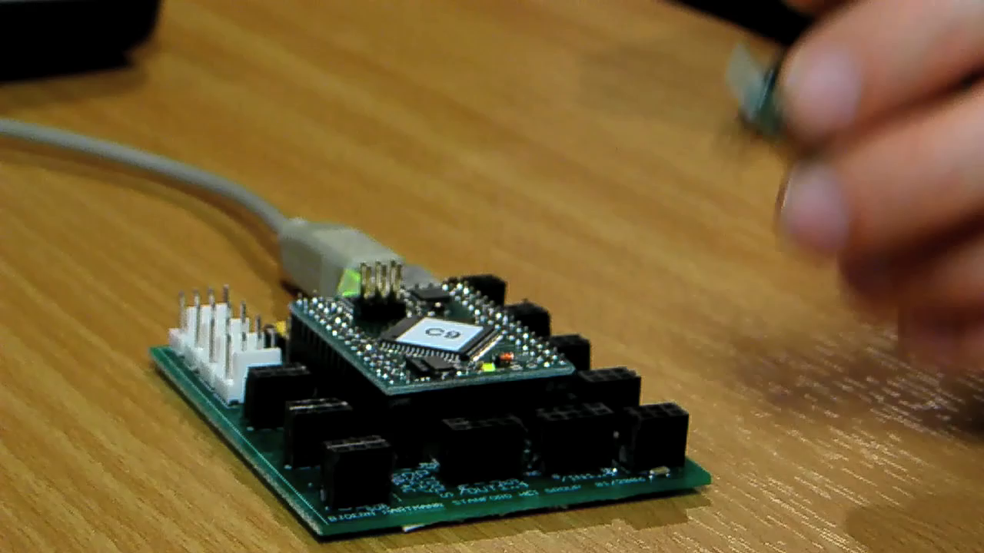
Authoring with d.tools
Notes:
As a designer plugs physical components such as sensors into the d.tools hardware interface, virtual counterparts appear in the d.tools authoring environment on the PC.
The DESIGNER then authors interactions by creating visual states, which encapsulate output, and by linking them through transitions, which get triggered by input events.
In d.tools, the interaction model is always live and can be tried out at any point.
Simulation
To increase the complexity of prototypes, designers with programming knowledge can attach code to visual states.

Slide 20
Design Environment
Notes:
The D.Tools software has two complementary visual editors. The first is the Device Designer on the left. This is where the blueprint of the device is being laid out – what inputs and outputs exist. Having such a representation reduces the cognitive friction involved in switching between working with hardware and software.

Slide 21
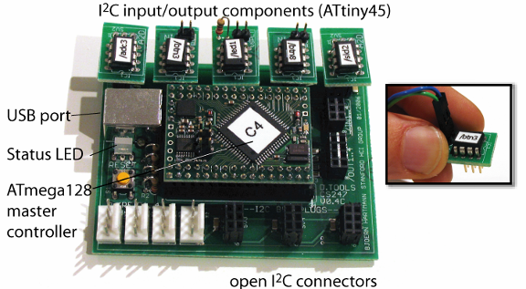
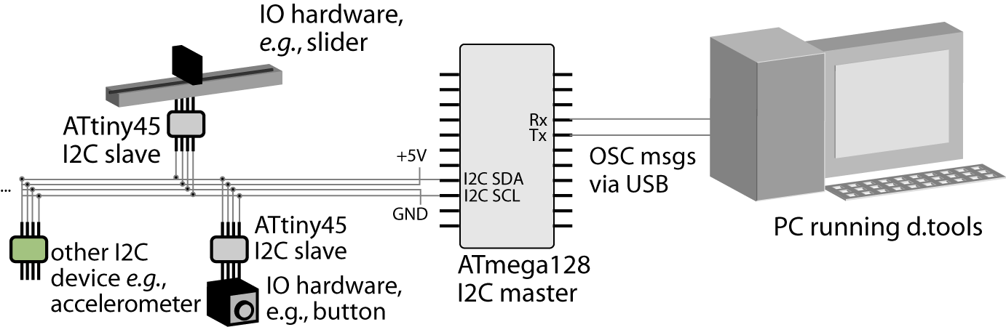
Smart Hardware
Notes:
This interaction is achieved by making individual components smart – each component is equipeed with a tiny microcontroller that sends ist type and a unique ID on a shared bus when plugged in.
The d.tools hardware we designed emphasizes use of established and open communication standards – this offers extension points to knowledgeable users that want to augment the library of supported devices.

Slide 22
Design Environment
Notes:
Designers define their prototype’s behavior by creating
interaction graphs in the storyboard editor on the right where events trigger transitions from one state to another.

Slide 23
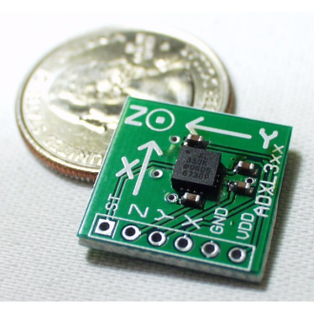
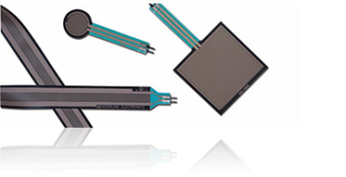
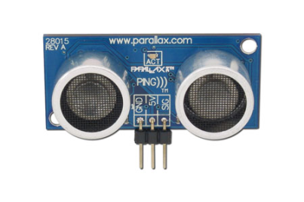
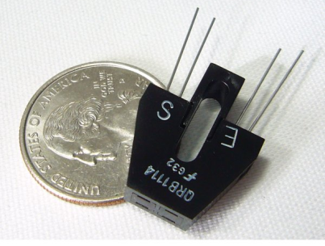
How can we help designers map continuous sensor data to application events?
Force Sensitive
Resistors
Accelerometers
IR/Ultrasonic
Rangers
Phototransistors

Slide 24

Representation Matters
Accelerometer X axis
Accelerometer Y axis
//detect accelerometer peaks
//read data sample
xVal[t++]=readA2DValue(xPin);
//look for changes in derivative
if(((xVal[t]-xVal[t-1]) >= 0
&& (xVal[t-1]-xVal[t-2]) < 0) ||
(((xVal[t]-xVal[t-1]) < 0
&& (xVal[t-1]-xVal[t-2]) >= 0)) {
//peak detected
//send message
oscSendMessageInt("/x/peak",1);
} else {
//no peak
}
Notes:
While a designer will definitely know how to perform the input they would like to recognize,
symbolically specifying how that input should be recognized is a very different problem.
So the question is: can we use the performance itself to actually do the work of specifying the computation?

Slide 25
Isn’t all machine learning example-based ?
Yes, algorithms enable demonstration-based authoring, but are only the backend.
What are appropriate interaction techniques that make real-time demonstration and testing feasible for designers?
Insight: Combine recognition and direct manipulation to leverage the designer’s knowledge
Notes:
Examples pre-exist (labeled data);

Slide 26
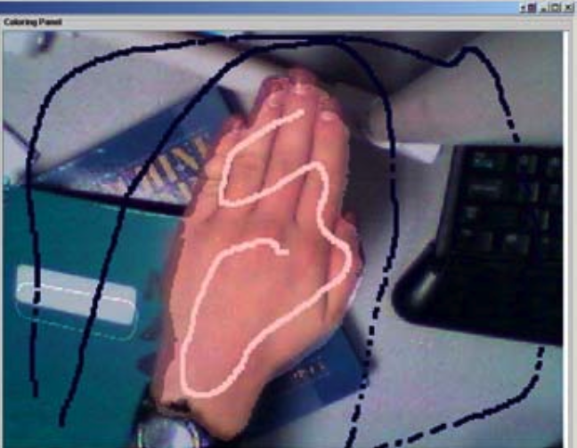
Related Work: Interfaces for
Programming by Demonstration
Also:
Flexigesture, Merrill, CHI 2005
a CAPella, Dey, CHI 2004
Monet, Li, UIST 2005
Crayons, Fails, CHI 2003
Notes:
Prior work includes Crayons, which let users draw on camera images to train computer vision classifiers and
FlexiGesture is an electronic instrument that can learn gestures to trigger sample playback. Users can program which movements should trigger which samples by demonstration.
Exemplar generalizes FlexiGesture’s approach into a design tool for variable input/output configurations.

Slide 27
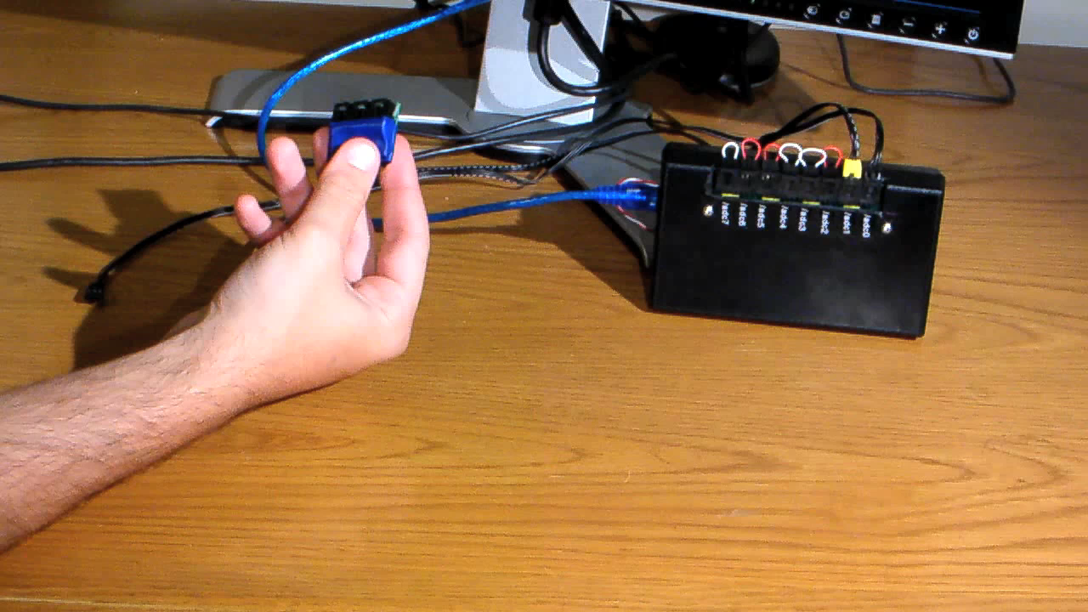
Authoring by Demonstration
[chi 2007]
Notes:
With Exemplar, an interaction designer first demonstrates a sensor-based interaction to the system (e.g., by shaking an accelerometer).

Slide 28
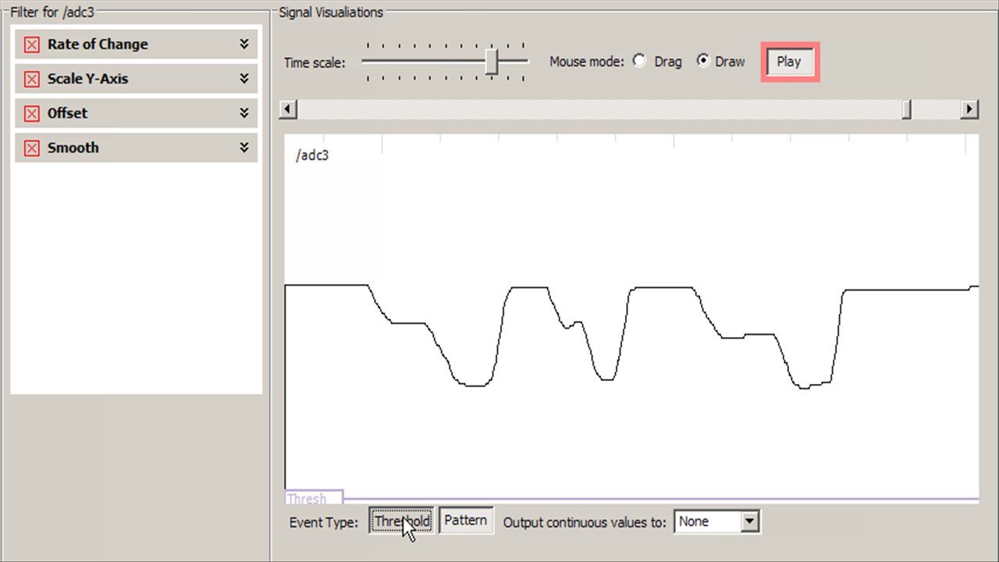
Generalization: Thresholds
Notes:
Thresholding is readily understood by non-experts since it has a straight forward visual interpretation

Slide 29
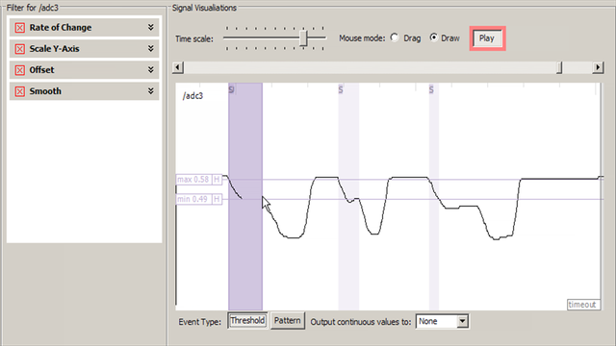
Generalization: Thresholds
Notes:
Thresholding is readily understood by non-experts since it has a straight forward visual interpretation
In real life simple thresholds not enough – noise and oscillation.

Slide 30
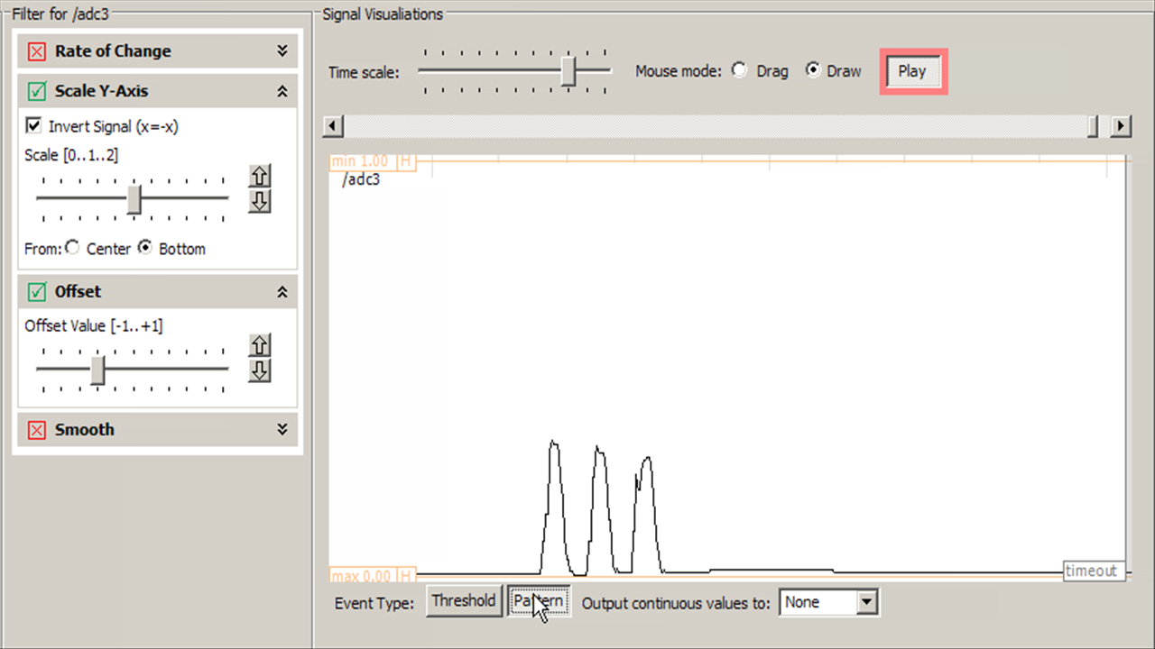
Generalization: Patterns
Notes:
To detect gestures, i.e., signals that vary over time, exemplar uses the same control paradigm – marking sensor data and interactively adjusting thresholds
However, instead of thresholding

Slide 31
Dynamic Time Warping
Demonstration Signal
Matching Input Signal
int DTWDistance(char s[1..n], char t[1..m], int d[1..n,1..m]) {
declare int DTW[0..n,0..m]
declare int i, j, cost
for i := 1 to m
DTW[0,i] := infinity
for i := 1 to n
DTW[i,0] := infinity
DTW[0,0] := 0
for i := 1 to n
for j := 1 to m
cost := d[s[i],t[j]]
DTW[i,j] := cost + minimum(DTW[ i-1, j ], // insertion
DTW[ i , j-1 ], // deletion
DTW[ i-1, j-1 ]) // match
return DTW[n,m]
}
Quadratic in time & space
But: n is small @100Hz sampling
[Sakoe, H. Chiba, S. ‘78]
Notes:
31
31
Let me highlight one technical feature here. For our pattern matching algorithm, we employ Dynamic Time Warping or DTW.
DTW was originally used in the area of speech recognition. This algorithm uses dynamic programming for a sequence comparison and outputs an error metric describing how much one signal has to be warped in time or space to match another. We then let the user interactively threshold against that error metric – thus both simple thresholding and pattern recognition have a unified control structure in the user interface.

Slide 32
How should we evaluate design tool research?

Slide 33
Triangulation of evaluation methods
What?
Why?
Cognitive Dimensions of Notation (CDN) Inspection
First-Use Laboratory Studies
Class & Industry Deployment
Used by authors as design tools for public exhibitions
Analysis of d.tools as a
visual notation
Threshold and usability
Real-world stress test
Complexity ceiling for knowledgeable users
Notes:
33
To evaluate Exemplar, we followed a mixed methods approach.
First, to understand the design tradeoffs of Exemplar as a visual authoring environment, we carried out an expert inspection according to the Cognitive Dimensions of Notation framework of Green and Blackwell.
Second, to determine threshold and utility for novices, we conducted a first-use study in our lab with twelve participants.
Afterwards, we also deployed Exemplar to our HCI design studio class, and used Exemplar ourselves as an authoring tool to produce a CHI Interactivity installation.

Slide 34
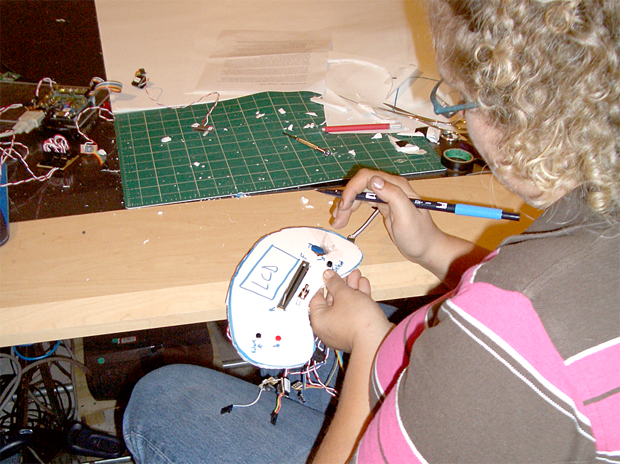
Laboratory Studies
Notes:
To understand how accessible our approach was, we recruited two sets of participants to our lab.
Participants were given two close ended and one exploratory design tasks – to build an MP3 player prototype, and to create new sensor-based controls for existing games.

Slide 35

Notes:
One participant created a make shift booth - hitting walls and stomping on the floor navigated a spaceship.
Another participant modified the bicycle helmet example so that the accelerometer on his helmet would detect him ducking down to fire rocket thrusters.
A third participant used the signal generated by the flicking of a bend sensor to trigger shooting of rubber bands.

Slide 36
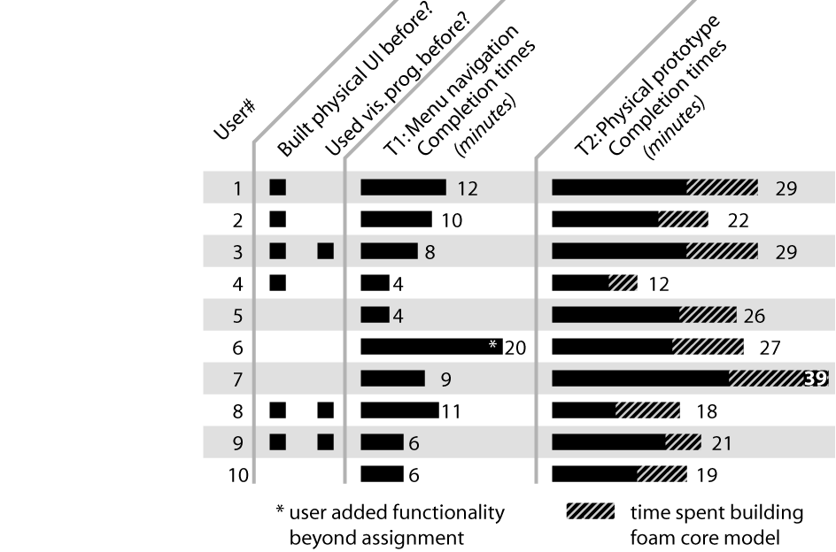
Laboratory Studies
Notes:
This study showed that the combination of plug and play hardware with visual statechart authoring lowered the threshold sufficiently
so that even novices could get up and running quickly- you can see some task completion times above.
Approaching parity between design of behavior and design of physical - as flexible as foamcore.
The takeaway point here is that even novices could rapidly and successfully create novel controls.

Slide 37

Class Deployment
(Hardware manufactured for us by Leapfrog)
Notes:
In addition to traditional evaluation methods such as lab studies, we also deployed d.tools to students. We hand-manufactured a dozen kits which we distributed student teams in a masters level HCI design course in 2006.
This image shows a color mixing interface designed with d.tools in which users can “pour” color from tangible buckets onto an LCD screen and then draw with those mixed colors on a tabled; this project took part in the Microsoft Design Expo in Redmond in 2006.
In 2007 we partnered with leapfrog, the educational toy company – we trained designers to use d.tools, in return, the company improved our hardware design and manufactured kits for students.

Slide 38
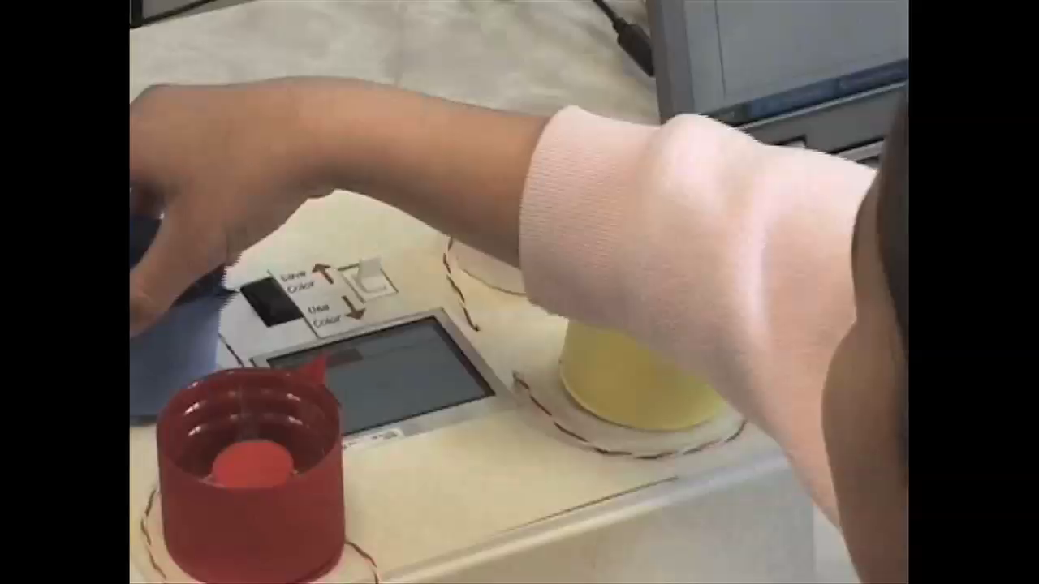

Slide 39
What’s Important?
d.Tools successfully enabled non-programmers to prototype novel, sensor-based user interfaces.
Techniques:
  Virtual modeling of physical device and plug&play hardware enable visual, storyboard-based authoring.
  Programming by demonstration for sensor events raises complexity of possible interactions.
Design tool research requires triangulation of evaluation methods

Slide 40
1
2
3
Enable
Rapid Authoring
Off the Desktop
Aid Iteration
by Managing
Feedback
Aid Exploration
of Multiple
Alternatives

Slide 41
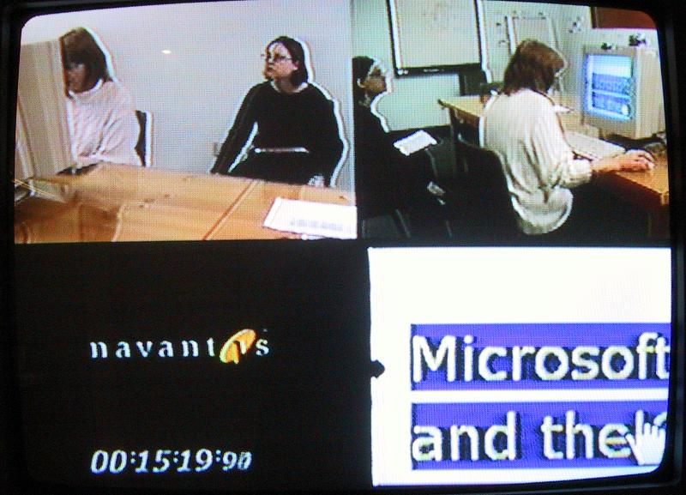
Notes:
Second result of out inquiry was that
User tests, even of prototypes are frequently video recorded.
However, that video material is rarely used because search is so expensive.
Flicr cc brycej

Slide 42
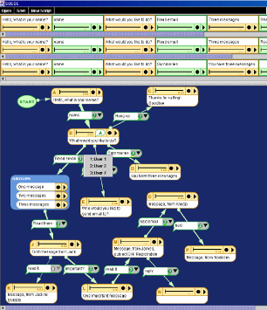
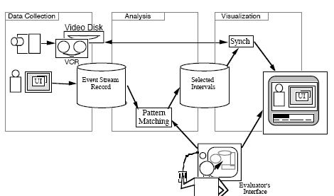
Related Work:
Capturing & Managing Feedback
I-Observe, Badre, 1995
SUEDE, Klemmer, 2000
Notes:
A smaller body of work has investigated how to capture user test data or present feedback and changes to documents.
I-Observe and EVA are two early examples of providing improved video access through event traces – however, these systems did not directly integrate with an authoring environment as dtools does.

Slide 43
Notes:
Insight in d.tools is to integrate design, test, and analysis into a single tool, so that we can leverage the correlation of the design model and collected test data. <click> In test mode, d.tools records a video of the user’s interaction with a physical prototype designed with d.tools, and logs interaction events to structure this video recording.

Slide 44

Notes:
A camera is pointed at the tester.
The live video from the camera is recorded and annotated in real-time with state transitions and input events.
In addition to events generated by the prototype itself, the experimenter can also add annotations with a video console.

Slide 45

Notes:
After a test session is completed, designers can leverage tight synchronization between the graphical interaction model, the recorded video, and the recorded event traces in analyze mode.

Slide 46
Notes:
In analize mode, d.tools can use a dual monitor setup shows the design environment on the left, and recorded and tagged video of a test session with a d.tools prototype on the right

Slide 47
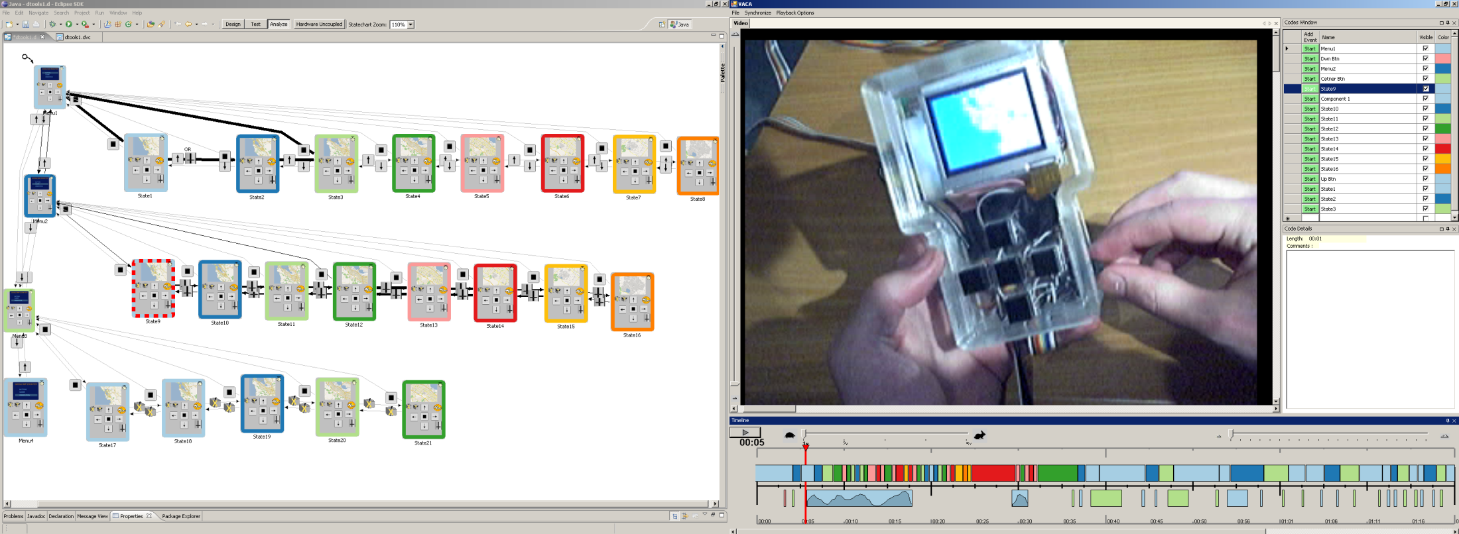
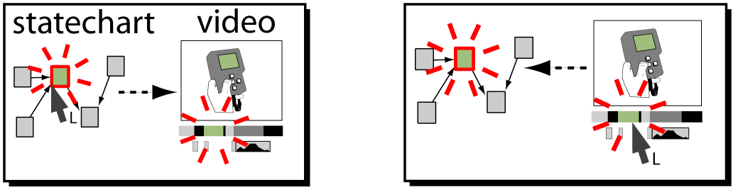
Analyze
Notes:
First, designers can access the statechart through the video.
By moving the playhead through the recorded video – the state underneatch the playhead is highlighted in the statechart.

Slide 48


Slide 49
Analyze
Notes:
Second, designers can access the video through the statechart. Clicking on a state filters out all video segments from other states and only shows matching segments in the video annotation timeline

Slide 50
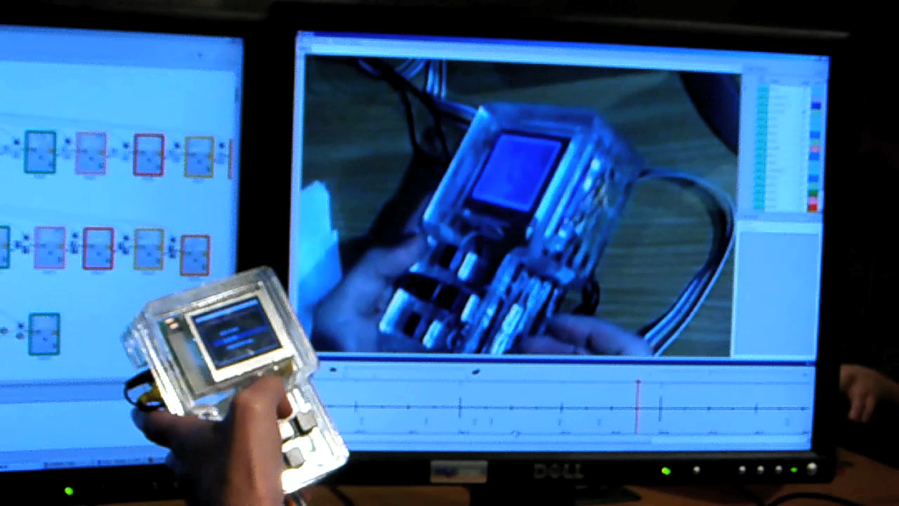
Analyze
Notes:
Third, designers can query by demonstration through the physical prototype itself.
Example: The query „show me all video segments where the tester moved the volume slider“ is executed by simply moving the slider on the prototype itself.

Slide 51
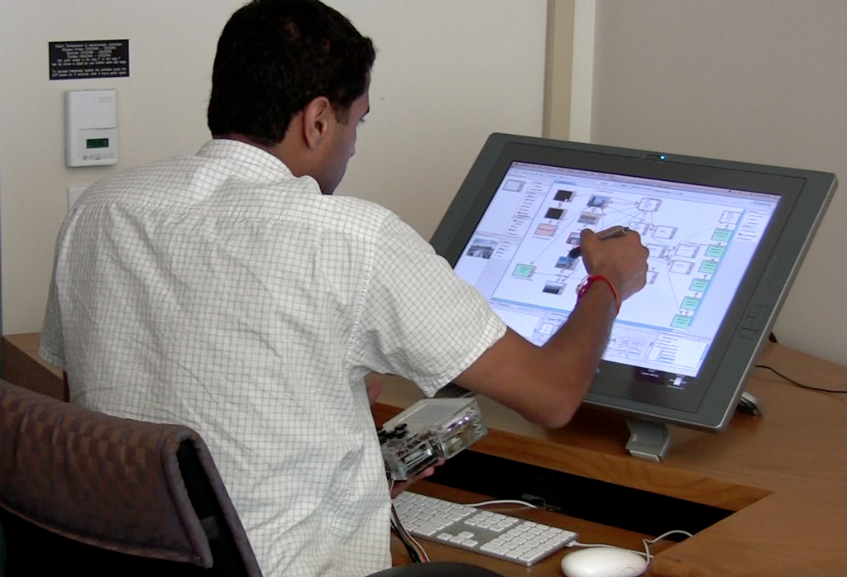
How might we revise interaction designs?
Notes:
Analyzing user data then suggests changes .
Design is a team sport, rarely done alone
In other creative domains, we

Slide 52
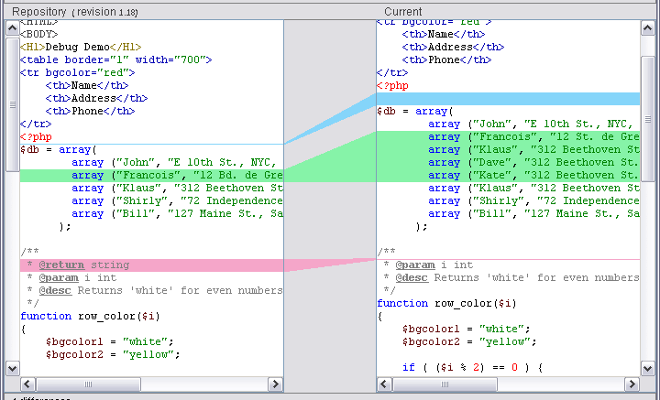
Tools for revising interaction designs
Movie production
Programming
Notes:
If we look at creation tools today, we see textual and sketched commenting in a wide variety of applications like word processors, in the reviews of dailies at 3d animation studios like pixar, or in image editing in photoshop. Commenting allows team members who may not be expert in using the tool for production to express revisions.

Slide 53
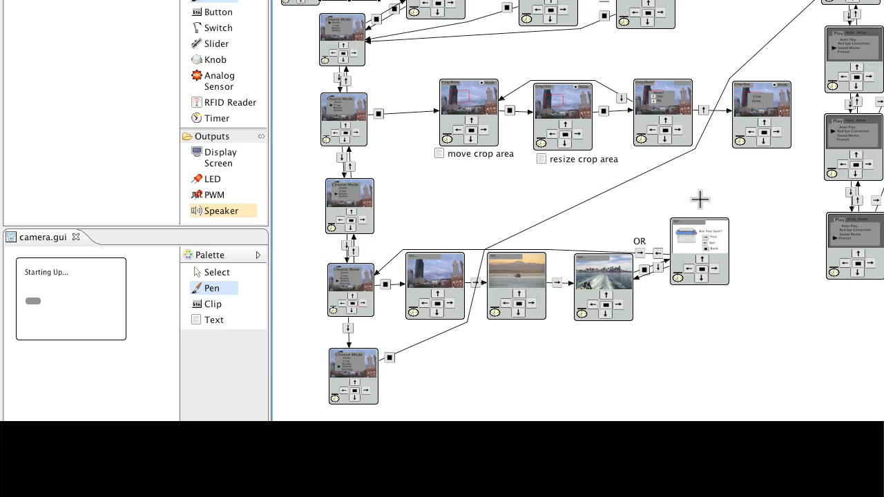
Notes:
This is work in progress and I’m happy to talk about it later

Slide 54
What’s Important?
Integrating analysis of test data into a design tool can radically shorten the time to work with test videos.
Integration is enabled by a high-level visual representation of the software model.
Design is a team sport – new revision tools are needed to record insight gained during analysis.
Notes:
Can’t tie videos to lines of c++ code.

Slide 55
1
2
3
Enable
Rapid Authoring
Off the Desktop
Aid Iteration
by Managing
Feedback
Aid Exploration
of Multiple
Alternatives

Slide 56
How can tools support the creation of multiple user interface alternatives?
Notes:
Central Research Questions:
If we take exploration as a core activity of design, how can *interaction* design tools support creation and management of user interface alternatives?
Prior research: static graphics; no tools yet for alternatives interactive behavior

Slide 57
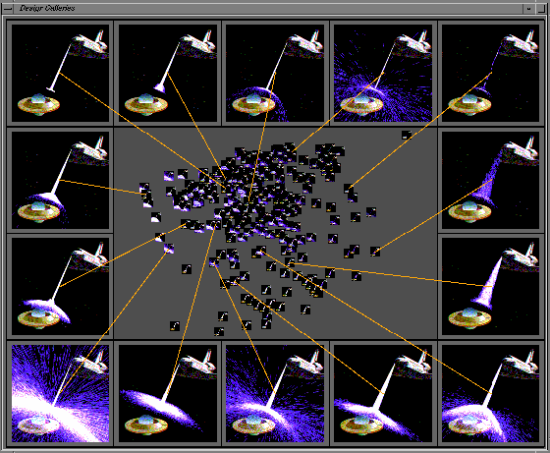
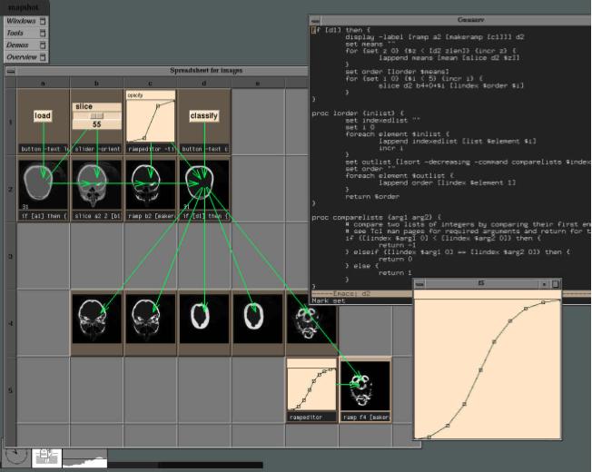
Related Work:
Working with Alternatives
Design Galleries, Marks, 1997
Levoy, Spreadsheets for Images, 1994
Subjunctive Interfaces, Lunzer, TOCHI 08
Spreadsheets for Visualization, Chi, IEEE CGA 98
Parameter Spectrums & Parallel Pies, Terry, UIST 02 & CHI 04
Partials, Terry, Phd 2005
Notes:
Other domains, specifically 3d rendering and image processing, have realized the importance of exploration and built tools.
For example, Design Galleries addresses the problem of finding good parameter combinations for complex 3d renderings by automatically generating a whole space of parameter settings and showing abrowsing interface for exploring parameter space.
Spreadsheets also inherently support parallel exploration, and example in Marc Levoy’s spreadsheets for image manipulation. Do these approaches translate to interaction design?

Slide 58

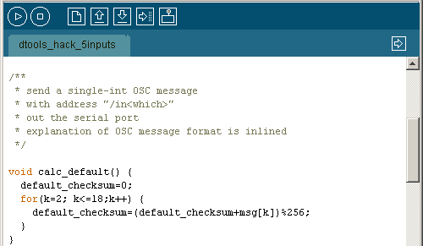
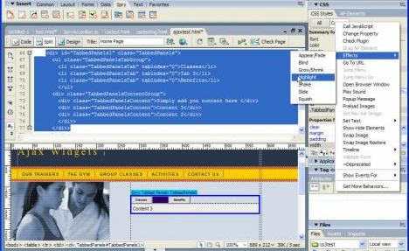
Interaction Designers Write Code
Adobe Flash
Arduino / Processing
Adobe Dreamweaver
Notes:
Why? One of the central reasons it that design of interactive behavior, even for prototypes, often happens in textual code. Interaction designers today frequently write a few dozen lines of script to express logic.

Slide 59

3 Requirements for Programmed Interactions
(based on 3 interviews & code inspection)
Manage parameter variations
Manage code alternatives
Access variations & alternatives at runtime
Notes:
What are the most important ways in which designers explore alternatives of programmed interactions today?
Three interviews, code review -> three requirements.
Creating satifsying user experience: "tweaking the dials”; code stays same, params vary. Tools should explicitly support this parameter tuning.

Slide 60
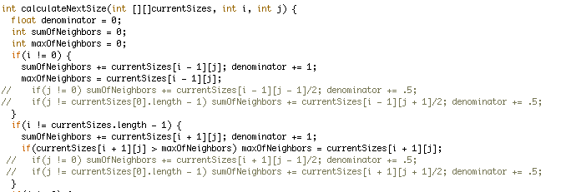
3 Requirements for Programmed Interactions
Manage parameter variations
Manage code alternatives
Access variations & alternatives at runtime
Processing code brought in by an interviewee
Notes:
To compare different behaviors, changes to logic are required as well.
Example from inquiry: two behaviors in same function body; comment/uncomment in runs.
Tools should support creation and management of different code alternatives.

Slide 61
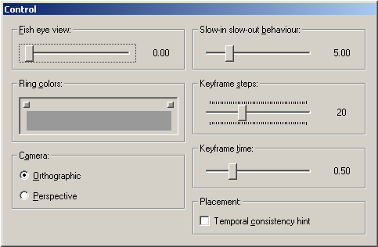
3 Requirements for Programmed Interactions
Manage parameter variations
Manage code alternatives
Access variations & alternatives at runtime
Notes:
Third, management of code and data alternatives has to work across editing and execution environments
expert do some this by writing control slider code –not part of the final application, but tools for exploration.
Tools construct such control interfaces automatically to open exploration to a wider audience.
To investigate how these requirements might be fulfilled, we constructed Juxtapose, a tool for working with multiple design alternatives in parallel.

Slide 62
Juxtapose: Source alternatives…
Notes:
Jxutapose manages alternatives at the source level

Slide 63
Juxtapose: Source alternatives…
Notes:
in an augmented editor

Slide 64
… are executed in parallel,
Notes:
These source alternatives can then be executed in parallel, which enables rapid comparison between them.

Slide 65
and tuned through an generated UI.
Notes:
Juxtapose combines parallel execution with automatic generation of control interfaces to interactively “tune” parameters of the designed interaction at runtime.

Slide 66
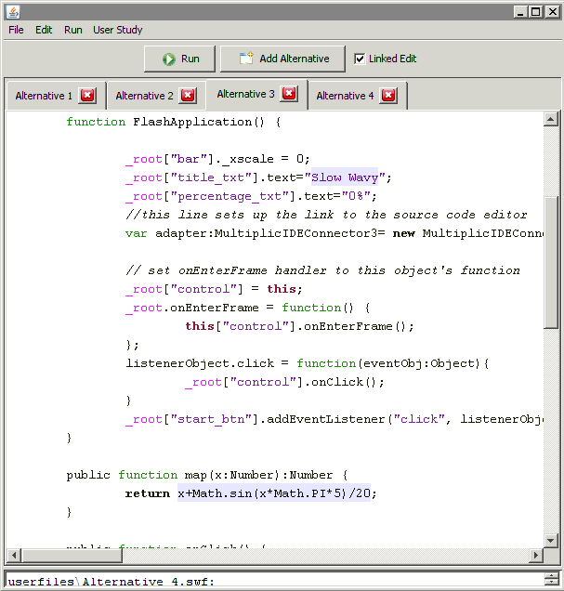
Parallel Editing
Juxtapose editor for
ActionScript 2.
Generates Flash files.
Notes:
To make working with multiple code alternatives feasible, an authoring environment must
Offer techniques for manipulating content across alternatives
make differences visually apparent
We extend linked editing a technique to track source duplicates.

Slide 67

Parallel Editing
Notes:
In the Juxtapose editor, alternatives are accessible through document tabs;

Slide 68
Parallel Editing
Linked Editing: Toomim 2004
Notes:
Edits can be either local to one alternative or global to all alternatives by toggling a linked edit mode.
Linked editing - Mike Toomim 2004. Find code duplicates within a project extended to define project alternatives.

Slide 69

Parallel Editing
Linked Editing: Toomim 2004
Notes:
Source differences, text entered in “unlinked edit”, are highlighted with a shaded background
Shared text: white background

Slide 70
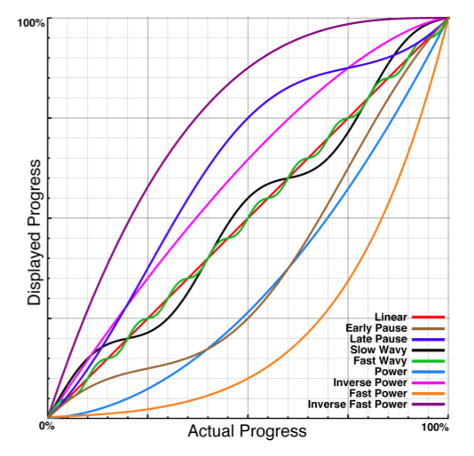
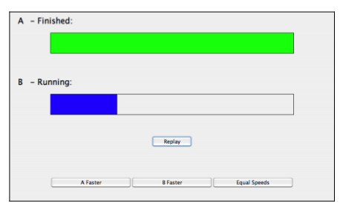
Example: Rethinking the Progress Bar
Harrison et al., UIST 2007
Progress bar test application
Progress profiles
Notes:
How would a designer use parallel editing for exploration?
Simple example 2007: “rethinking the progress bar” showed how different progress curves can affect the *perception* of completion speed. To test different progress curves, a function that maps actual progress to displayed progress was varied.
In clip designer starts with code for showing a normal, linear progress bar<click>

Slide 71
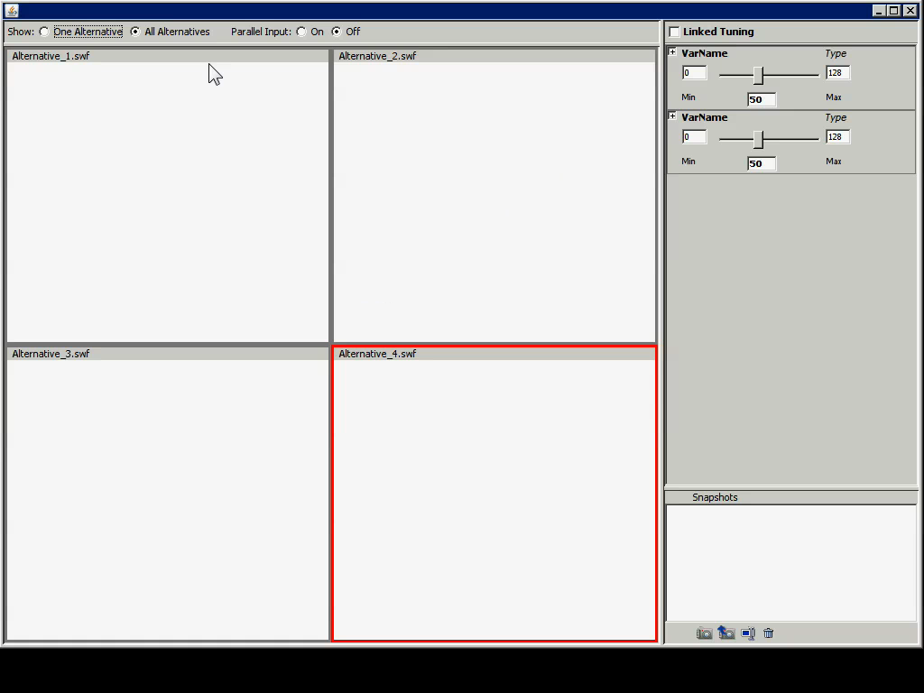
Notes:
To explore different mapping functions, our designer creates source alternatives in new tabs. In each alternative, she changes the mapping function and an identifying name through unlinked editing. The changes here are rapid as only two lines of code differ between our alternatives.
* When run, all alternatives are executed side-by-side.
investigate different progress bar behaviors
bring one alternative into full view for detailed inspection.
In addition to sequential interaction, designers may want to view behavior in parallel.

Slide 72
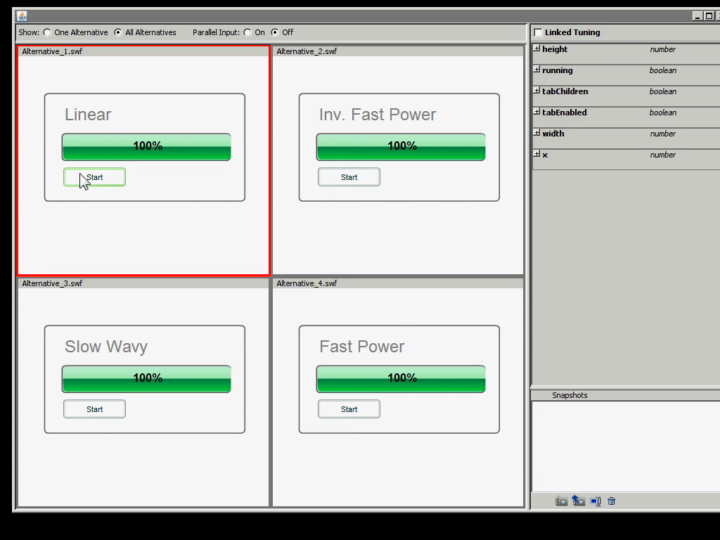
Parallel Input: Event Echoing
Notes:
Juxtapose supports parallel input through event echoing. Mouse events can be intercepted in the active alternative and injected into all other alternatives, which then show a ghost cursor.

Slide 73
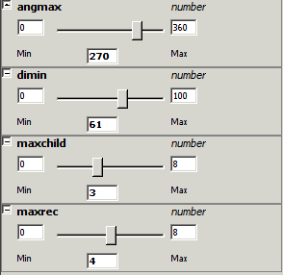
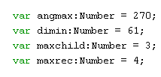
Parameter Tuning
Notes:
To explore parameter spaces, Juxtapose automatically generates control interfaces from variable definitions in the user’s program. When the control widgets are manipulated, the variable value is then updated in the running program.

Slide 74
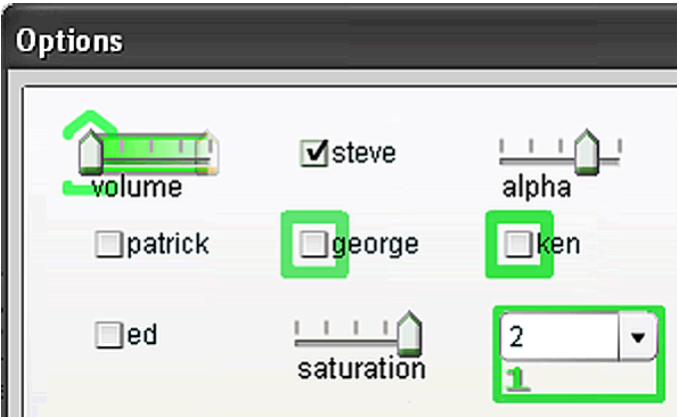
Example: Tuning Phosphor
Baudisch, UIST 2006
Notes:
To support “parameter tuning” Juxtapose automatically generates control interfaces for global application variables at runtime
To see tuning in action, consider Patrick Baudisch’s phosphor paper from UIST 2006: Phosphor shows afterglows when UI widgets are changed to make such transitions visually salient in
Params of concern: timing characteristics and and coloring of afterglow.

Slide 75
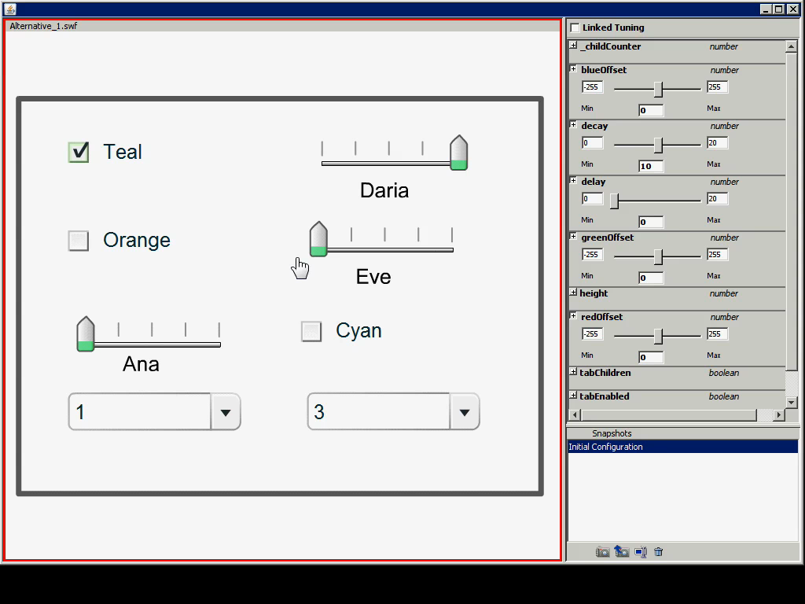
Example: Tuning Phosphor
Baudisch, UIST 2006
Notes:
We reimplemented some of Phosphor’s techniques in Actionscript - running Phosphor within Juxtapose enables designers to directly manipulate variables that govern fade duration and fade delay at runtime.
Once a designer finds a suitable set of tuned parameters, that set can be saved in a snapshot for later recall.

Slide 76
Generating Tuning Interfaces
Send variable info
Juxtapose User Library
A
Inspect
User’s Application:
//…
Number A = 10;
Boolean B = true;
X
B
Juxtapose Process
User Process
Notes:
Runtime variable tuning requires bi-directional data exchange between the user’s application and the tuning interface. For inter–process communication, a Juxtapose library module is added to the user’s code. On startup, the library collects global variable names, types, and values using reflection. The library then sends this information through a remote procedure call to the Juxtapose runtime UI.
Using this information, Juxtapose builds a control UI.

Slide 77
Generating Tuning Interfaces
Send tuning message
Juxtapose User Library
A
Update
User’s Application:
//…
Number A = 10;
Boolean B = true;
X
B
Juxtapose Process
User Process
Notes:
When the widgets of the tuning interface are modified, value update messages are sent to the running application through nother remote procedure call The Juxtapose user library then updates the variable value in the running application.

Slide 78





When is tuning most useful?
Search in 4D parameter space. Given recursive drawing code for this:
Produce these:
Notes:
To gather quantitative data, we created a close-ended task that asked participants to adjust four dimensions of an algorithmic tree drawing routine to match four specific tree shapes.
This task is clearly far removed from design practice, but its concrete goal allows for better measurement of performance.
78

Slide 79
Notes:
Of course, if you give people sliders to change parameters, they’ll test many more parameter combinations than they ever could through editing code and recompiling.
Direct manipulation is good, but we knew that.
More interesting: where does it provide benefits?

Slide 80
not
significant
not
significant
p<0.01
p~0.01
Notes:
Dig deeper, and look at task completion times for different trees. only two trees showed significant time differences.
Observation: interaction of multiple parameter dimensions, harder time reasoning about parameter settings– matching tu rned into a multi-dimensional trial and error exercise. It’s precisely this trial-and-error phase is when reasoning about the problem could not produce a satisf. Sol. where tuning was most beneficial.

Slide 81
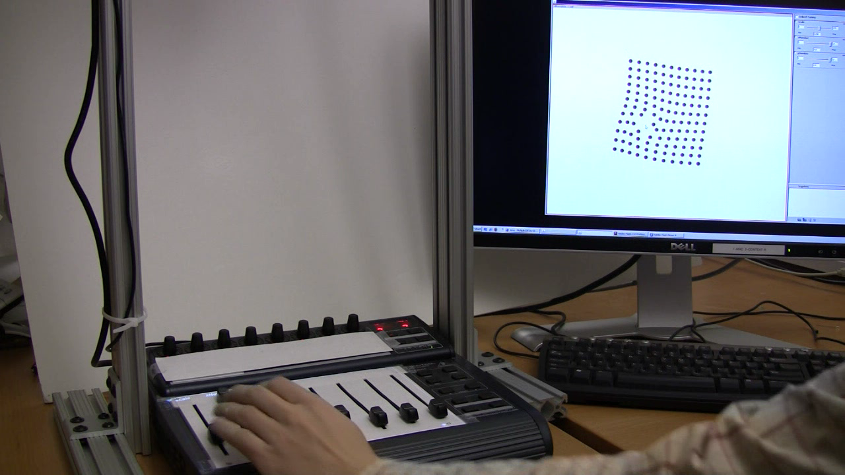
Tangible Control
Notes:
Juxtapose supports use of an external controller for variable tuning for three reasons. The controller enables users to modify multiple parameters simultaneously, leaves the eyes free to focus on the application being tuned, and allows for tuning of interactions that require mouse and keyboard input, e.g., adjusting the rate at which mouse wheel movement magnifies a document. To facilitate locating a particular variable’s control, the mixer was augmented with a small top-mounted projector which displays parameter names. There are two ways to ensure that the controller stays in sync with variable values recalled through snapshots: either use only relative inputs, or use absolute inputs that can be actuated. We chose motorized faders as absolute controls have the advantage that their position provides proprioceptive feedback.

Slide 82
Do these principles hold beyond desktop GUI applications?

Slide 83
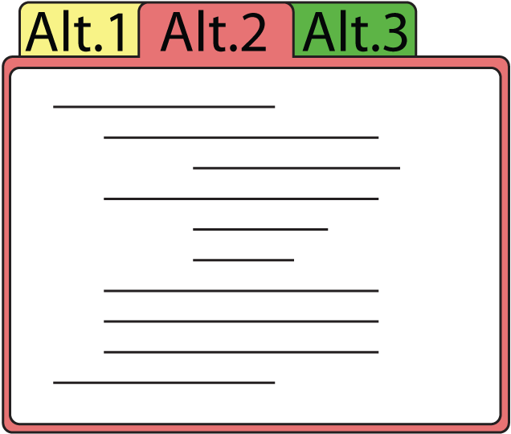


Juxtapose Mobile
Alternative
1
Alternative
2
Alternative
3
Notes:
Mobile phones are commodity hardware, and mobile developers already test on multiple handsets. We extended Juxtapose to leverage these device collections by executing different alternatives on different handsets. You write your alternatives on the PC, and the compiled applications are then distributed to a collection of handsets.
83

Slide 84
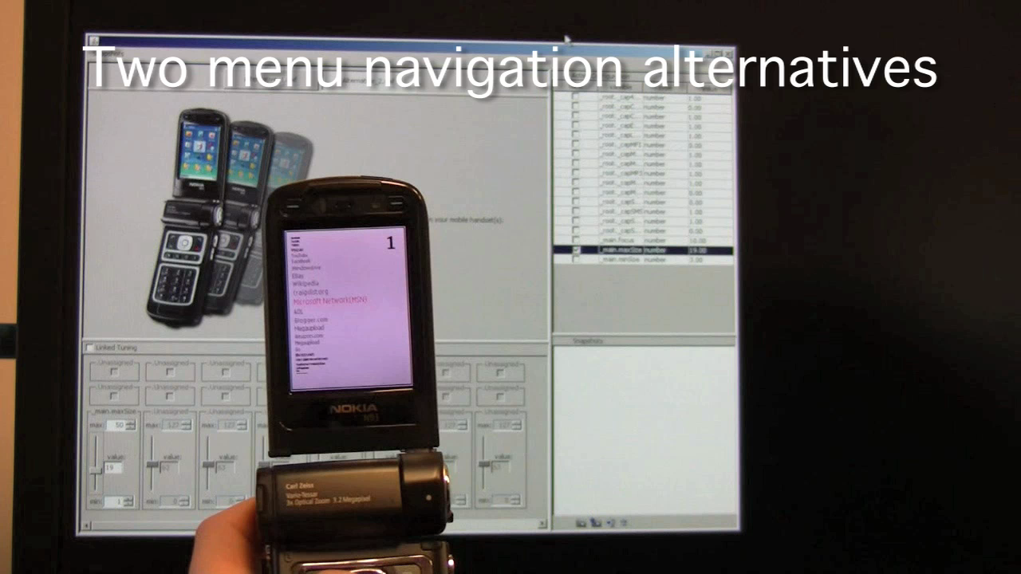
Notes:
A designer can thus rapidly switch between alternatives by putting one phone down and picking another one up. <click>
Tuning now allows designers to use their PC to change the behavior of a program that’s executing on the handset.

Slide 85

Juxtapose for Microcontrollers
Arduino:
8bit Atmel AVR RISC chip
programmed in C with gcc
Notes:
Embedded microcontrollers are the tool of choice for working with sensors and actuators. <click>We extended Juxtapose to support authoring for the 8-bit Arduino microcontroller platform. Building custom hardware is resource intensive, so unlike for mobile phones, designer are less likely to build multiple physical prototypes. Instead, in current practice, one can often different software versions of code shoehorned into the microcontroller firmware, turned on and off by either software or hardware switches.

Slide 86
How might one implement variable tuning
in a language without reflection?
Notes:
Now languages that can run on an 8bit microcontroler with 16k of memory don't usually allow language reflection.
So, … how might one implement variable tuning in a language without reflection?

Slide 87
Parse code and build symbol table
int dly = 25;
boolean blink=false;
void setup() {...}
//…
Var. Name | Type | Pointer
“dly” | int | &dly
“blink” | boolean | &blink
Notes:
To enable runtime tuning, we added a preprocessing step to compilation
Juxtapose parses the user's source code; extracts global variable definitions; builds a symbol table with pointers to those variable,

Slide 88
Emit table into code & compile
Auto-generated
table
void initVarTable(void) {
varTable[1].varName = PSTR("dly");
varTable[1].varType = VAR_TYPE_INT;
varTable[1].varPtr = &dly;
varTable[2].varName = PSTR("blink");
varTable[2].varType = VAR_TYPE_BOOLEAN;
varTable[2].varPtr = &blink;
}
// plus a bunch of communication code...
Notes:
, and emits that table back into the source code (along with communication routines) before compilation.

Slide 89
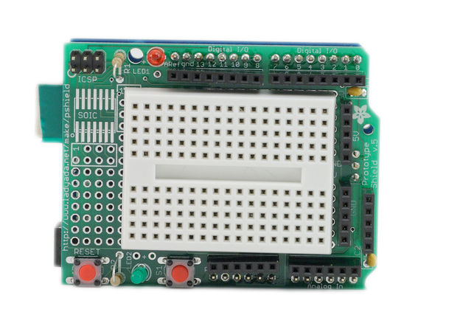

At Runtime
Serial message:
tune “dly” value 100
dly
blink
*(varTable[“dly”].varPtr)
= 100;
X
Notes:
At runtime, the user library can then look up the variable name in that symbol table
And adjust values through dereferencing the pointer in the table

Slide 90
What’s Important?
A structured approach to alternatives
eliminates cruft and enables more exploration.
Tool support requires connecting authoring and
execution environments.
3 Techniques:
  Linked editing to manage code alternatives
  Execute set of programs side-by-side
  Auto-generate tuning interface
Notes:
For programmed interactions, supporting alternatives requires spanning both authoring and runtime environments. Juxtapose shows how this integration can be realized with three techniques: using linked editing to effectively manage alternatives at the source level, execution of sets of programs for comparison at runtime, and auto-generation of tuning interfaces through reflection and source parsing.

Slide 91
Summary &
Future Agenda
Notes:
After individual exploration, designers seek to get feedback on prototypes from others. Design team members and other project stakeholders are a natural first constituency for feedback. How might we enable a broad range of design stakeholders to rapidly revise user interfaces?

Slide 92
Prototyping Tools
1
2
3
Enable
Rapid Authoring
Off the Desktop
Aid Iteration
by Managing
Feedback
Aid Exploration
of Multiple
Alternatives

Slide 93



Community Impact

Slide 94
Research Agenda
How can programming languages & IDEs be co-designed to facilitate prototyping?
How might authoring environments support the process of design by example modification?
What will the interaction design studio of the future look like?

Slide 95


Slide 96


Slide 97


Slide 98


Slide 99


Slide 100

Leith Abdulla
Abel Allison
Marcello Bastea-Forte
Hrvoje Benko
Michael Bernstein
Brandon Burr
Timothy Cardenas
Kevin Collins
Scott Doorley
Sean Follmer
Jennifer Gee
Scott R. Klemmer
Nirav Mehta
Manas Mittal
Merrie Morris
Avi Robinson-Mosher
Anthony Ricciardi
Andrew Wilson
Leslie Wu
Yeonsoo Yang
Loren Yu
Frog Design
IDEO
LeapFrog
Nokia
San Jose Tech Museum
San Jose Museum of Art
Notes:
And of course, the work that I shared today isn't mine alone. We have a truly fantastic group of graduate and undergraduate students and I'd like to thank all of my collaborators on the work I presented today, whose names are listed here.

Slide 101
Hartmann, Björn, Loren Yu, Abel Allison, Yeonsoo Yang, and Scott R. Klemmer. Design as Exploration: Creating Interface Alternatives through Parallel Authoring and Runtime Tuning. In Proceedings of uist 2008: ACM Symposium on User Interface Software and Technology. Monterey, CA, 2008. (best student paper award)
Hartmann, Björn, Leslie Wu, Kevin Collins and Scott R. Klemmer. Programming by a Sample: Rapidly Creating Web Applications with d.mix. In Proceedings of uist 2007: ACM Symposium on User Interface Software and Technology. Newport, Rhode Island, USA, 2007.
Hartmann, Björn, Leith Abdulla, Manas Mittal and Scott R. Klemmer. Authoring Sensor Based Interactions Through Direct Manipulation and Pattern Matching. In Proceedings of chi 2007: ACM Conference on Human Factors in Computing Systems. San Jose, CA, 2007. (best paper award)
Hartmann, Björn, Scott R. Klemmer, Michael Bernstein, Leith Abdulla, Brandon Burr, Avi Robinson-Mosher, and Jennifer Gee. Reflective physical prototyping through integrated design, test, and analysis. In Proceedings of uist 2006: ACM Symposium on User Interface Software and Technology. Montreux, Switzerland, 2006. (best paper award)
Klemmer, Scott R., Björn Hartmann, and Leila Takayama. How Bodies Matter: Five Themes for Interaction Design. In Proceedings of dis 2006: ACM Conference on the Design of Interactive Systems. State College, PA, 2006.
Funding Acknowledgments:
Stanford MediaX/DNP Grant; NSF grant IIS-0534662
Stanford School of Engineerring & SAP Graduate Fellowships
Equipment donations from Intel & Nokia
http://bjoern.org
Notes:
For more information about Juxtapose, I invite you to visit our website. Thank you.

Slide 102
So What’s Different?
Target Platform | How are alternatives executed? Why? | How do users interact with alternatives?
 | In parallel | Sequentially or in parallel
 | In parallel, because commodity hardware is (relatively) cheap | Sequentially
 | Sequentially, because custom hardware is expensive to build | Sequentially
Notes:
So, what’s different across these domains?
It’s not so much about technical barriers – we have shown that there are implementations for both alternatives and tuning that make diffs in software architectures relatively transparent to users.
However, different intrinsic modes of interaction and costs of making changes in hardware affect how alternatives can be executed, and how users interact with them.

Slide 103
Juxtapose Mobile
Juxtapose Wrapper
User’s Flash
Application
Alt. 1
Alt. 2
var1
var2
TCP/IP
Juxtapose
Runtime on PC
Juxtapose Wrapper
User’s Flash
Application
Notes:
Our Juxtapose mobile prototype generates binaries which run on the Flash Lite player on Nokia smart phones. Under the hood things are quite similar to desktop, except that interprocess communication now has to be replaced with socket communication across a network.
103

