Slide 1
Enlightened Trial and Error
Gaining Design Insight Through
Interaction Prototyping Tools
Björn Hartmann
bjoern@cs.stanford.edu
Notes:
* Diss research: new prototyping tools for the design of physically embodied user interfaces

Slide 2

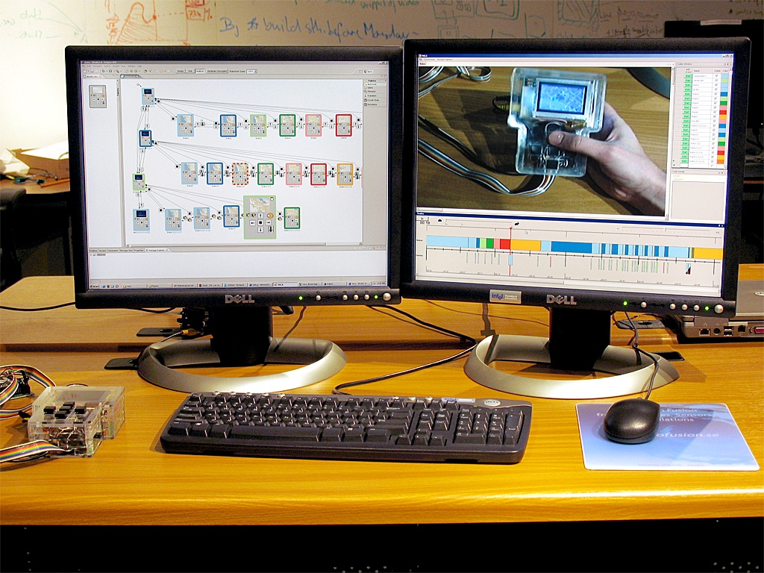
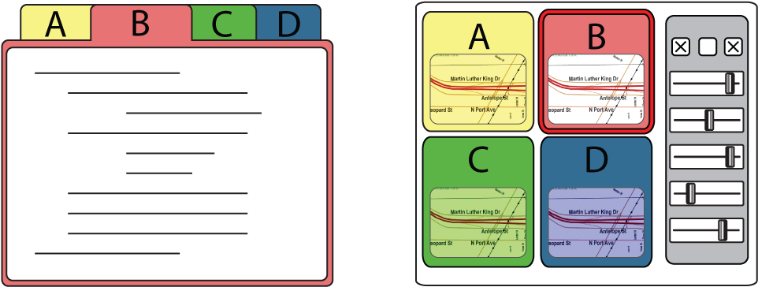
Prototyping Tools for
Ubiquitous Computing
1
2
3
Enable
Rapid Authoring
Off the Desktop
Aid Iteration
by Managing
Feedback
Aid Exploration
of Multiple
Alternatives
Notes:
In my talk, I will introduce systems that address three important concerns for prototyping new user interfaces: First, how enable a larger group of designers to rapidly create functional ubiquitous computing prototypes.
Second, I’ll demonstrate how to support iteration in the design process by integrating feedback from users and design team members into the design environment.
Third, I’ll introduce ways to enable simultaneous exploration of multiple design alternatives in parallel.
Why focus on prototypes?

Slide 3
Prototypes enable exploration and iteration around concrete artifacts.
Lawson, How Designers Think, Architectural Press
Cross, Designerly Ways of Knowing, Springer
Schrage, Serious Play, HBS Press
Moggridge, Designing Interactions, MIT Press
Buxton, Sketching User Experiences, Morgan Kaufmann
Notes:
Prototypes are central to good design, in any domain.
Prototyping is the pivotal activity that structures innovation, collaboration, and creativity in design, whether you are designing furniture, medical devices, or user interfaces.
The goal in prototyping is not the object per se–
Prototypes are cognitive artifacts for reasoning about a design problem .
They enable…
you build some prototypes, evaluate them, and use what you learned to drive the next design.

Slide 4

Exploration:
Generate Parallel Alternatives
Redrawn from
Buxton, Sketching User Experiences
Notes:
Any sufficiently complex problem has a space of possible solutions. To map that space, designers frequently generate multiple solutions to a problem simultaneously (in a process of elaboration or divergence), to then select of desirable features from that set (convergence). This happens at multiple scales throughout any given project schedule.

Slide 5
Iteration: Incorporate Insight
ANALYZE
EVALUATE
PROTOTYPE
Dreyfuss, Designing for People, 1955;
Lawson, How Designers Think, 1997;
Cross, Designerly Ways of Knowing, 2005
Notes:
Iterative design acknowledges that fit between problem and solution can only be achieved through repeated testing and improvement.

Slide 6

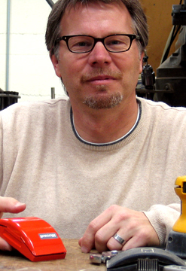
Prototypes for the
Microsoft mouse
From Moggridge,
Designing Interactions, Ch2
Notes:
An example of exploration:
*Paul Bradley, 80 models, explore different possible shapes
Pliable materials enable rapid creation

Slide 7
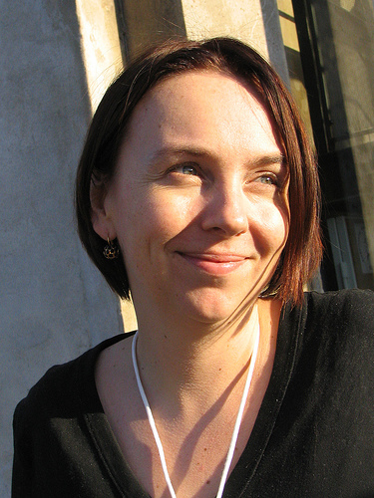
Notes:
Designer Leisa Reichelt led the public redesign of drupal.org at bouchard design
publishes proto online
User community gives feedback, which drives next week’s work.

Slide 8
Neither exploration nor iteration are supported in today’s user interface design tools.
Notes:
Even though parallel exploration and sequential iteration are core activities in design,
In the realm of user interfaces, neither are particularly well supported by today’s design tools.

Slide 9
Prototyping != Development
Success criteria for
interaction prototypes
(Some) success criteria for
interactive products
Rapid to construct
Conveys user experience
Uncovers design space
Elicits the right feedback
Robust
Complete
Polished
Notes:
Focus is on “getting a single, complete, polished product built” – important but wrong set of tradeoffs early in the design process
Where learning about the structure of the design space and eliciting feedback are the primary goals.

Slide 10
1
2
3
Enable
Rapid Authoring
Off the Desktop
Aid Iteration
by Managing
Feedback
Aid Exploration
of Multiple
Alternatives
Notes:
Base level: rapid authoring

Slide 11
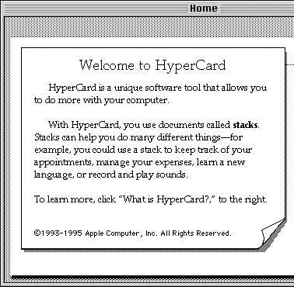
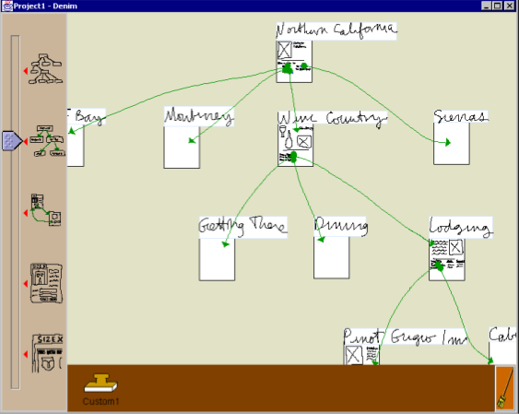
Related Work: Prototyping Tools exist…
Atkinson, Hypercard, 1985
Denim. Lin et al. CHI 2000
Also:
SILK, Landay, 1996
DEMAIS, Bailey, 2001
Notes:
Of course in research, there is an existing lineage in focusing specifically on rapid authoring, going back to Arkinson’s Hypercard on the Apple Macintosh.
Work such as Denim for prototyping the information architecture of web sites were an important inspiration for my own research.
What these tools have left unaddressed though is what happens when the user interface moves beyond software alone into the realm of ubiquitous computing hardware.

Slide 12
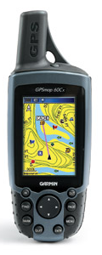
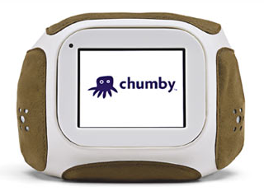
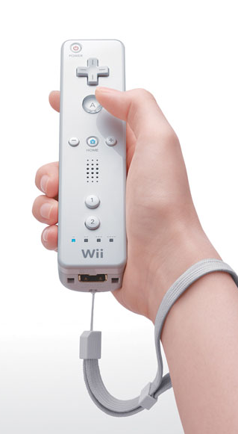
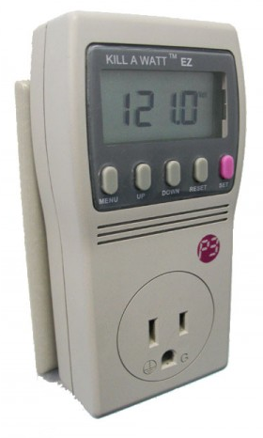
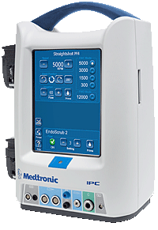
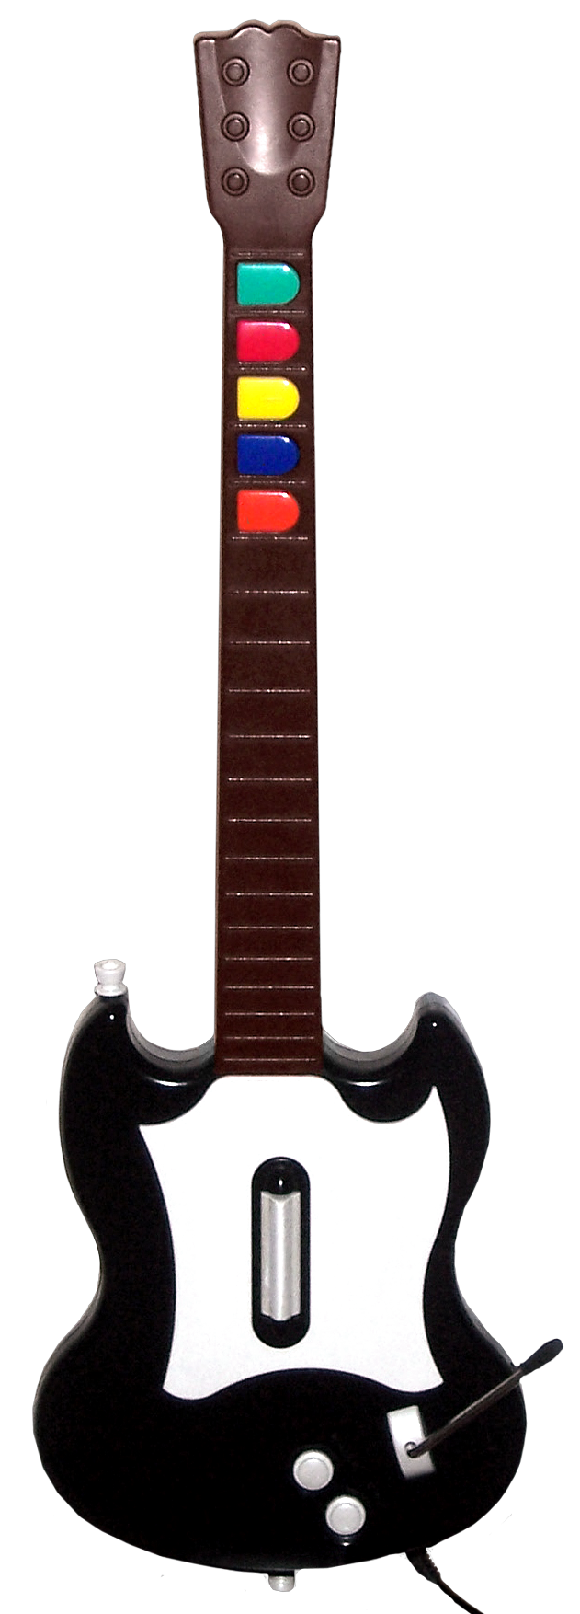
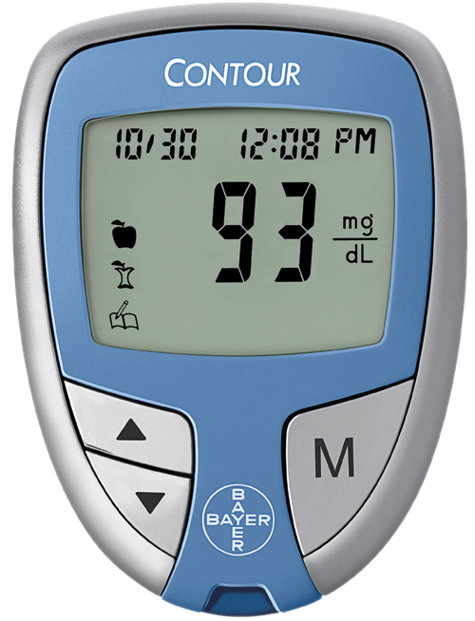
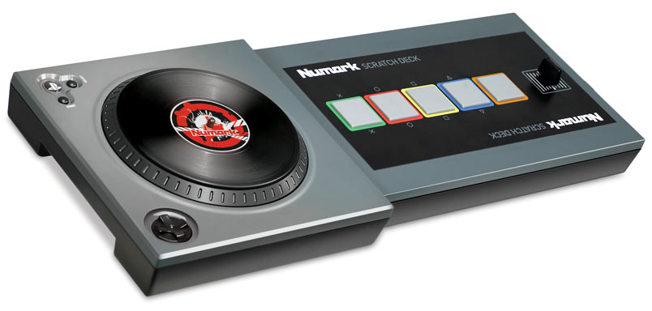
…but not for physical interfaces.
© Chumby Industries
© Medtronic
© Garmin
© Bayer
© Numark
© Nintendo
Notes:
As computation moves beyond desktop PCs and pervades . All of these devices have user interfaces as well – so how might we prototype them?

Slide 13
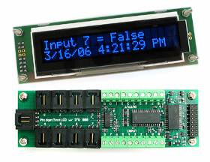
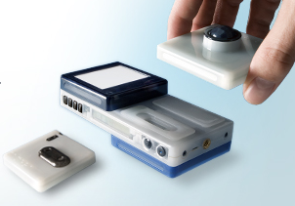
Related Work:
Toolkits for Physical Computing
Phidgets, Greenberg, 2001
Bug Labs, 2009
Also:
iStuff, Ballagas, 2003
Calder, Lee, 2004
DART, McIntyre, 2004
Notes:
There is also existing work in hardware toolkits that abstract sensing and actuation into software.
Projects such as Phidgets and the Bug enable Programmers to extend their knowledge of event-based programming into the physical world.
However, these toolkits primarily target accomplished developers.
As our fieldwork revealed, this restriction limits their success with interaction designers.

Slide 14
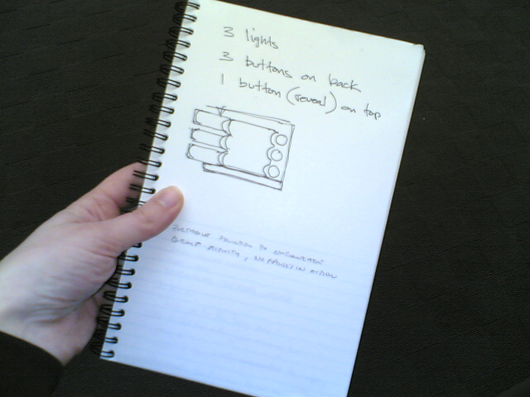
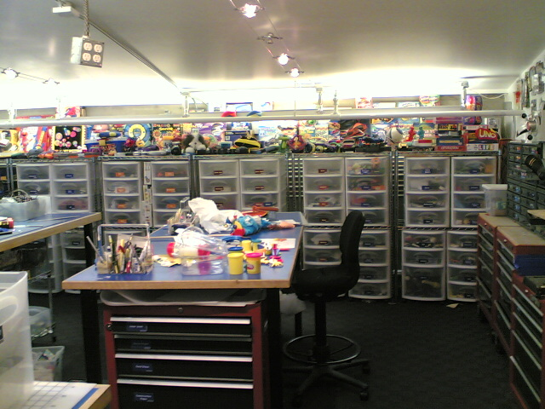
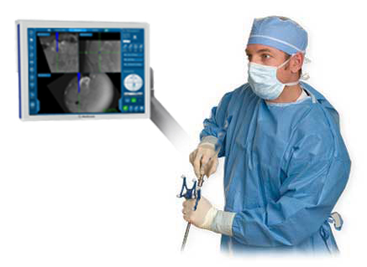
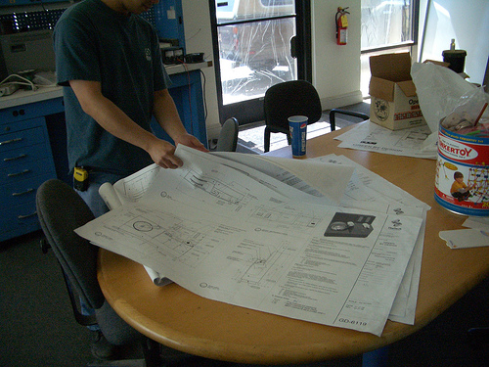
Fieldwork (11 designers, 3 companies)
Comprehensive prototypes are
only built for presentation,
not for design thinking.
Notes:
During my fieldwork,
I interviewed 11 designers and observed at 3 bay area design firms. To get a first-hand view of design team practive, I served as a technical consultant for one of the design companies in the design of a surgical device.
(I cannot show you actual images so here’s a standin)
Professional design companies do have access to resources and expertise to build anything
Nonuniformly distrib = 1 ee or cs person on staff
This means functional ubiquitous computing prototypes that require coding are generally expensive one-offs used only for presentation. Today’s prototyping tools are not flexible enough to create functional prototypes as tools for design thinking itself.

Slide 15
d.tools – Design Principles
Leverage familiarity with storyboards: use states¹ as level of abstraction
Tightly integrate of physical and digital design realms
Visualize hardware configuration & events in software, in real-time
d.tools
1: Harel,D. Statecharts: A visual formalism for complex systems.
Science of computer programming (1987)
Notes:
As we set out to address the identified opportunities, we devised the following design principles:
First, since we learned about the reticence of designers to start in code, leverage their existing practice of creating storyboards – this suggests a control flow paradigm where states or ui screens are the level of abstraction
Bridge the gap between physical and digital realms through tight integration between hardware and software
To do that, the final principle is to visualize as much information as possible both about hardware configuration, and about any hardware events that may occur both while you’re building and while you ‘re testing a protoytpe, In realtime
Let’s look an example of what you would build with d.tools.

Slide 16
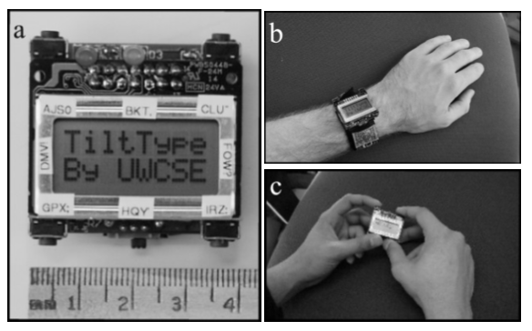
Example: Mobile Text Entry
If |Buttons| < |Letters|:
Select alphabet subset
Select letter from subset
Available Controls:
1. X/Y Tilt data
2. Discrete corner buttons
TiltType, Partridge et al., UIST 2002
Notes:
Take mobile text entry problem
In absence of a touchscreen, If buttons < letters, we’ll need
UW researchers proposed a new entry method using a combination of buttons and tilt information. How well would such an input technique work?
This is the kind of question that a d.tools prototype can answer.

Slide 17
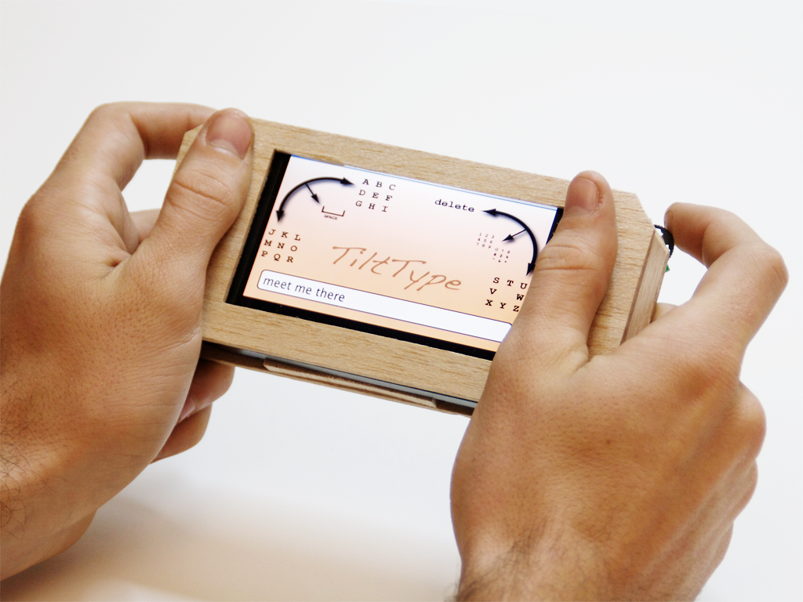
Example: Tilt-based text entry
3-way navigation
switches
2 axis accelerometer
Notes:
Slightly larger than wristwatch, but with same input.
About one afternoon of work

Slide 18
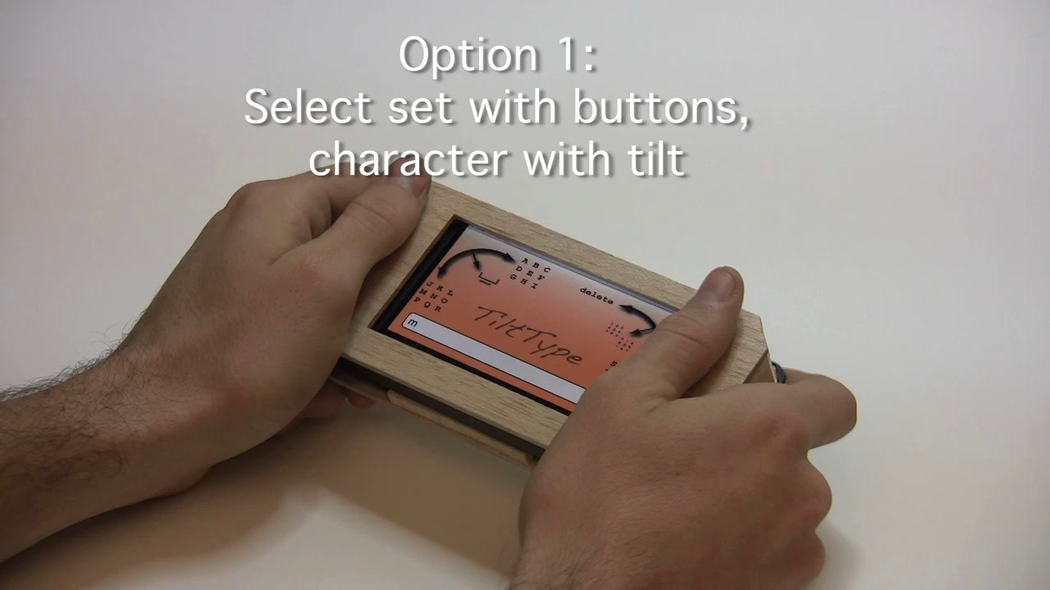
Notes:
We were able to prototype the UW technique of using buttons, followed by tilt to type letters.
More importantly, d.tools was rapid enough so we could ask what happened if you reversed the control structure:
First tilt, then use buttons to disambiguate. Because tilting is more error prone, this second technique, actually outperformed the method that was published.
So having a rapid enough tool supported serendipitous discovery of a better solution.

Slide 19
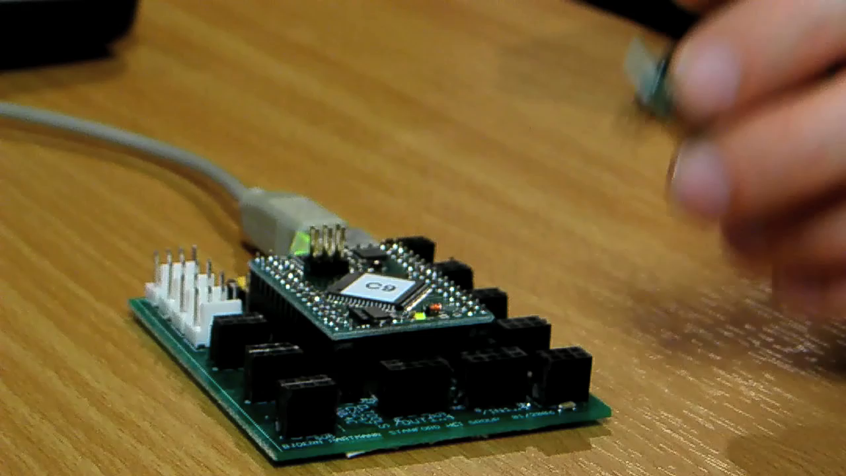
Authoring with d.tools
Notes:
As a designer plugs physical components such as sensors into the d.tools hardware interface, virtual counterparts appear in the d.tools authoring environment on the PC.
The DESIGNER then authors interactions by creating visual states, which encapsulate output, and by linking them through transitions, which get triggered by input events.
In d.tools, the interaction model is always live and can be tried out at any point.
Simulation
To increase the complexity of prototypes, designers with programming knowledge can attach code to visual states.

Slide 20
Design Environment
GUI Editor
Notes:
The D.Tools software has three complementary visual editors.
Lower-left is GUIeditor – arrange graphics for a state

Slide 21
Design Environment
Device
Designer
Notes:
Top left is device designer
This is where the blueprint of the device is being laid out – what inputs and outputs exist. Having such a representation reduces the cognitive friction involved in switching between working with hardware and software.

Slide 22
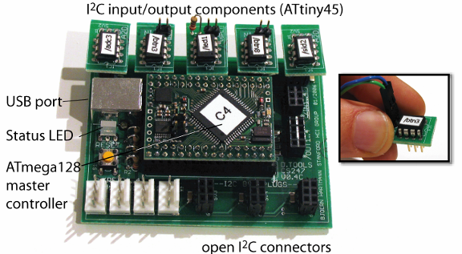
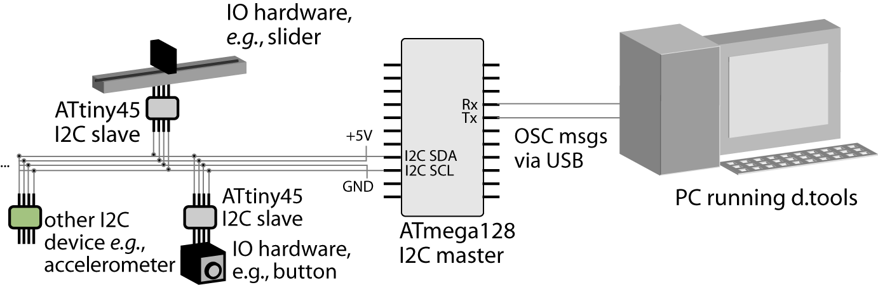
Smart Hardware
Notes:
This interaction is achieved by making individual components smart – each component is equipeed with a tiny microcontroller that sends ist type and a unique ID on a shared bus when plugged in.
The d.tools hardware we designed emphasizes use of established and open communication standards – this offers extension points to knowledgeable users that want to augment the library of supported devices.

Slide 23
Design Environment
Storyboard Editor
Notes:
Designers define their prototype’s behavior by creating
interaction graphs in the storyboard editor on the right where events trigger transitions from one state to another.

Slide 24
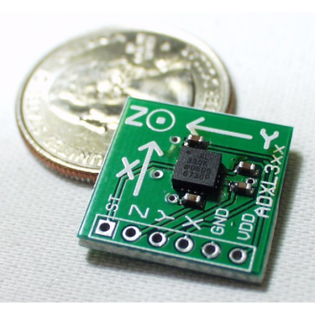
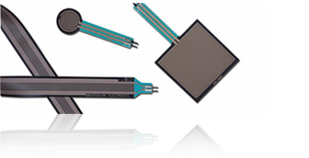
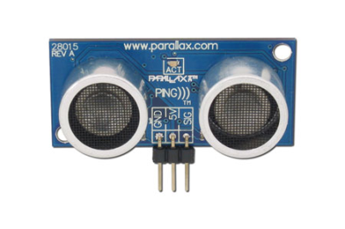
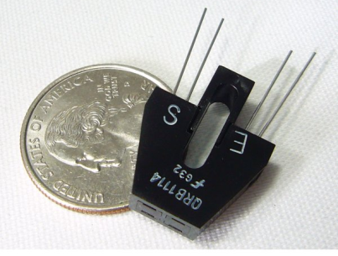
How can we help designers map continuous sensor data to application events?
Force Sensitive
Resistors
Accelerometers
IR/Ultrasonic
Rangers
Phototransistors

Slide 25

Representation Matters
Accelerometer X axis
//detect accelerometer peaks
//read data sample
xVal[t++]=readA2DValue(xPin);
//look for changes in derivative
if(((xVal[t]-xVal[t-1]) >= 0
&& (xVal[t-1]-xVal[t-2]) < 0) ||
(((xVal[t]-xVal[t-1]) < 0
&& (xVal[t-1]-xVal[t-2]) >= 0)) {
//peak detected
//send message
oscSendMessageInt("/x/peak",1);
} else {
//no peak
}
Accelerometer Y axis
Notes:
While a designer will definitely know how to perform the input they would like to recognize,
symbolically specifying how that input should be recognized is a very different problem.
So the question is: can we use the performance itself to actually do the work of specifying the computation?

Slide 26
Bridging HCI and Machine Learning
ML algorithms enable demonstration-based authoring.
HCI: What are appropriate interaction techniques that make real-time demonstration and testing feasible for designers?
Insight: Combine recognition and direct manipulation to leverage the designer’s knowledge
Notes:
Examples pre-exist (labeled data);

Slide 27
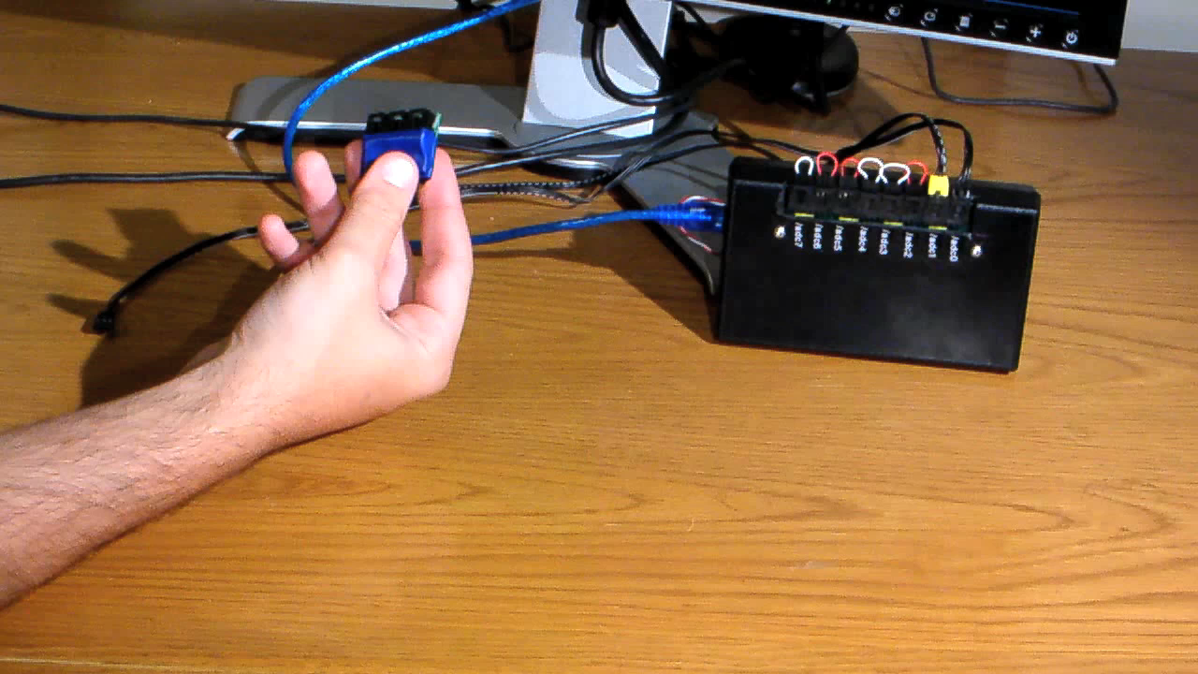
Authoring by Demonstration
[chi 2007]
Notes:
With Exemplar, an interaction designer first demonstrates a sensor-based interaction to the system (e.g., by shaking an accelerometer).

Slide 28
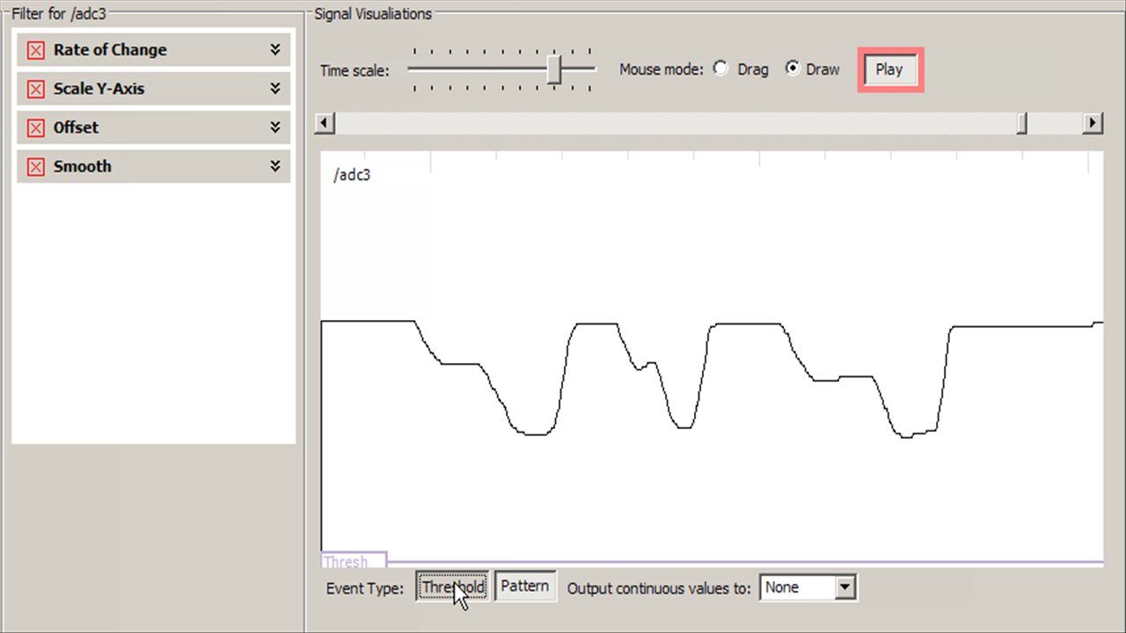
Generalization: Thresholds
Notes:
Thresholding is simple and powerful. since it has a straight forward visual interpretation

Slide 29
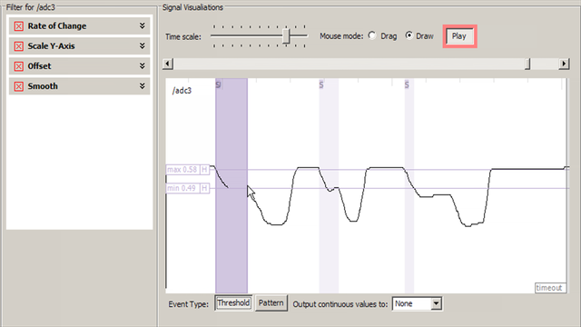
Generalization: Thresholds
Notes:
Thresholding is readily understood by non-experts since it has a straight forward visual interpretation
In real life simple thresholds not enough – noise and oscillation.

Slide 30
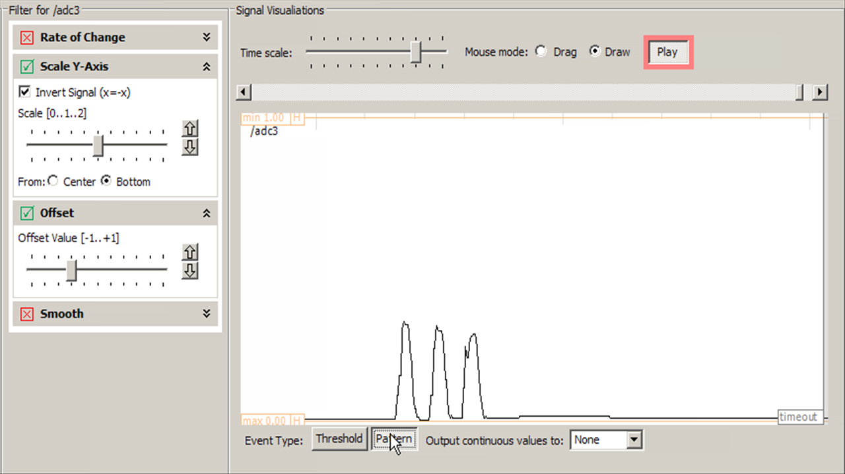
Generalization: Patterns
Notes:
To detect gestures, i.e., signals that vary over time, exemplar uses the same control paradigm – marking sensor data and interactively adjusting thresholds
However, instead of thresholding

Slide 31
Dynamic Time Warping (DTW)
Demonstration Signal
Matching Input Signal
int DTWDistance(char s[1..n], char t[1..m], int d[1..n,1..m]) {
declare int DTW[0..n,0..m]
declare int i, j, cost
for i := 1 to m
DTW[0,i] := infinity
for i := 1 to n
DTW[i,0] := infinity
DTW[0,0] := 0
for i := 1 to n
for j := 1 to m
cost := d[s[i],t[j]]
DTW[i,j] := cost + minimum(DTW[ i-1, j ], // insertion
DTW[ i , j-1 ], // deletion
DTW[ i-1, j-1 ]) // match
return DTW[n,m]
}
Quadratic in time & space
But: n is small @100Hz sampling
[Sakoe, Chiba, ‘78]
Notes:
31
31
Let me highlight one technical feature here. For our pattern matching algorithm, we employ Dynamic Time Warping or DTW.
used in the area of speech recognition.
uses dynamic programming for a sequence comparison ( think of it as the continuous generalization of the edit distance algorithm) and outputs an error metric describing how much one signal has to be warped in time or space to match another.
We then let the user interactively threshold against that error metric – thus both simple thresholding and pattern recognition have a unified control structure in the user interface.

Slide 32
How well does this work?
Notes:
Tools are hard b/c it’s one level removed

Slide 33
Triangulation of evaluation methods
What?
Why?
Usability Inspection
First-Use Laboratory Studies
Class & Industry Deployment
Used by authors as design tools for public exhibitions
Analysis of d.tools as a
visual notation
Threshold and usability
Real-world stress test
Complexity ceiling for knowledgeable users
Notes:
33
Interest of time – only mention two
Two limitations: conflate learning curve with utility.; how representative is task?

Slide 34
Laboratory Studies
Study 1
Study 2
Tool: d.tools
Task: Build functional MP3 player prototype
Time: 45 minutes
N=10
Tool: Exemplar
Task: Create sensor-based controls for a provided game
Time: 30 minutes
N=12
Participants: graduate students in design programs + alumni
Notes:
To evaluate d.tools and Exemplar, we performed two lab evaluation
The first one, on authoring in d.tools alone, asked participants to build a functional mp3 player prototype aimed at pre-teens
()
In a second study, we provided existing keyboard and mouse-controlled games, and a box of sensors to participants and asked them to devise new control strategies for those games.
(Click)
Participants in both cases were predominantly hci and design grad students and alumni from stanford
Want to show you some clips from that second study

Slide 35

Notes:
One participant created a make shift booth - hitting walls and stomping on the floor navigated a spaceship.
Another participant used a bicycle helmet so that the accelerometer on his helmet would detect him ducking down to fire rocket thrusters.
A third participant used the signal generated by the flicking of a bend sensor to trigger shooting of rubber bands.

Slide 36
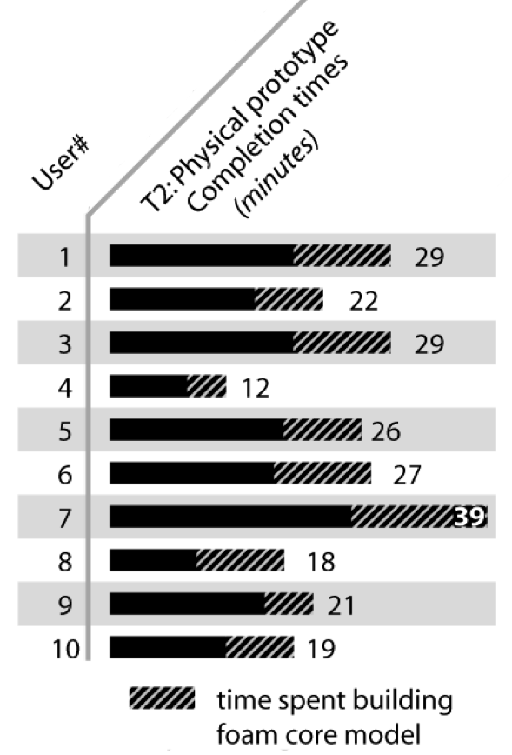
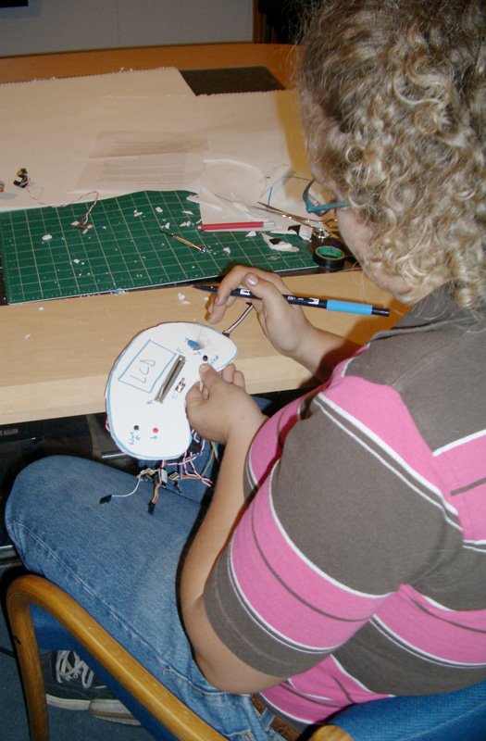
D.tools evaluation video analysis
Task: Build a functional
MP3 player prototype
Notes:
What else can we tell?
Some data from the first study: how long did it take people to build basic playback and navigation functionality?
Task completion times are not directly comparable – what does it mean to be done?
Approaching parity between design of behavior and design of physical - as flexible as foamcore.
The takeaway point here is that even novices could rapidly and successfully create functional prototypes

Slide 37
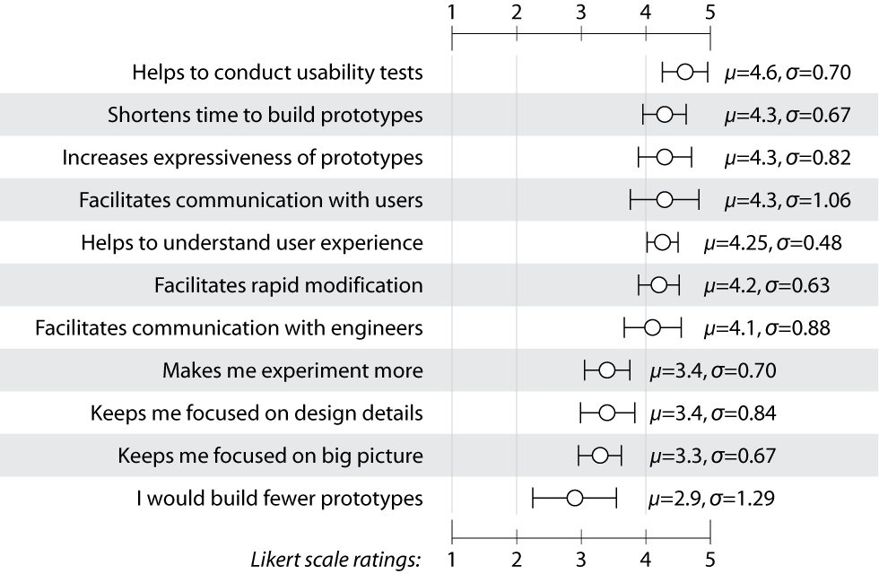
D.tools post-test survey (n=10)
Notes:
That result was also reflected in our survey responses
d.Tools earned the highest ratings for enabling rapid construction and testing of functional prototypes. It was less clear to what extent d.tools helped exploration of multiple options or whether it helped designers focus on larger design goals or smaller interaction details.
There’s always a danger in of course of a tendency to please investigators in self-reports, so I’d argue we should look at the high and low end of survey responses to get a sense of relative strengths and weaknesses.

Slide 38

Class Deployment
(In collaboration with Leapfrog)
Notes:
, we also deployed d.tools to students. in a masters level HCI design course.
Made possible by partnership with leapfrog, the educational toy company – we trained designers to use d.tools, in return, the company improved our hardware design and manufactured kits for students.
This image shows a color mixing interface designed with d.tools in which users can “pour” color from tangible buckets onto an LCD screen and then draw with those mixed colors on a tabled; this project took part in the Microsoft Design Expo in Redmond in 2006.
Insufficient support for dynamic graphics – those aspects that are well handled in GUI prototoyping tools – had not gotten enough attention. As a result, we added the Graphic user interface editor you saw earlier.

Slide 39
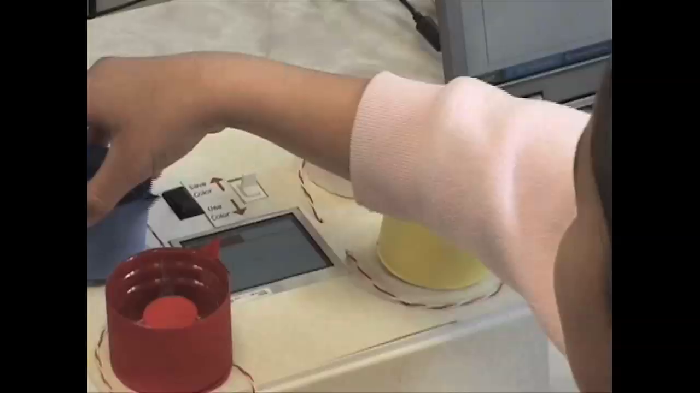
Notes:
Example of a shortcoming of d.tools was insuffcient support for dynamic graphics so that these students had to combine d.tools with Adobe Flash./

Slide 40
Impact
d.tools / Exemplar used for prototyping at:
  Leapfrog
  Nokia SF
  IDEO
  Frog design
3471 d.tools downloads as of 5/27/09
Notes:
Just a quick note on impact, I’ll come back to this later,

Slide 41
What’s Important?
d.tools successfully enabled non-programmers to prototype novel, sensor-based user interfaces.
Techniques:
  Plug&play hardware and visual, storyboard-based environment offer low threshold to authoring.
  Programming by demonstration for sensor events raises complexity of possible interactions.

Slide 42
1
2
3
Enable
Rapid Authoring
Off the Desktop
Aid Iteration
by Managing
Feedback
Aid Exploration
of Multiple
Alternatives

Slide 43
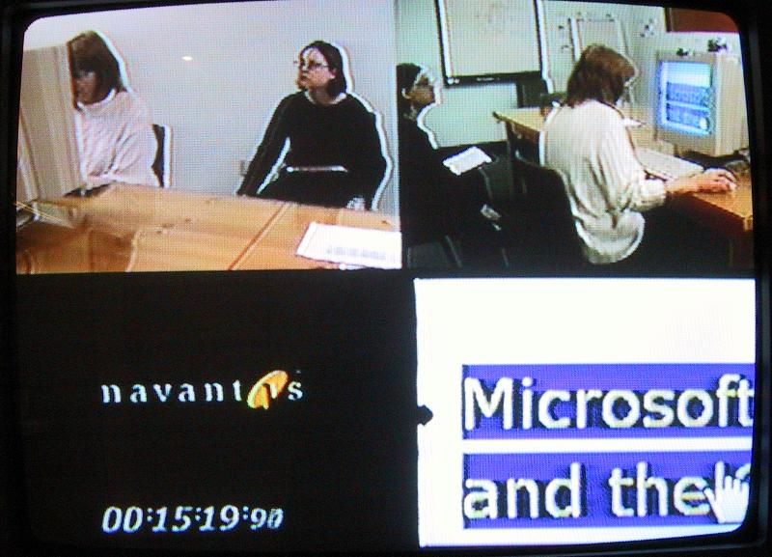
Flickr Image (cc) brycej
Notes:
Second result of out inquiry was that
User tests, even of prototypes are frequently video recorded.
However, that video material is rarely used because search is so expensive.
Flicr cc brycej

Slide 44
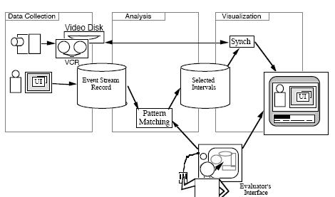
Related Work:
Capturing & Managing Feedback
I-Observe, Badre, 1995
EVA, Mackay, 1992
Notes:
A smaller body of work has investigated how to capture user test data or present feedback and changes to documents.
I-Observe and EVA are two early examples of providing improved video access through event traces – however, these systems did not directly integrate with an authoring environment as dtools does.

Slide 45
Notes:
Insight in d.tools is to integrate design, test, and analysis into a single tool, so that we can leverage the correlation of the design model and collected test data. <click> In test mode, d.tools records a video of the user’s interaction with a physical prototype designed with d.tools, and logs interaction events to structure this video recording.

Slide 46

Notes:
A camera is pointed at the tester.
The live video from the camera is recorded and annotated in real-time with state transitions and input events.
In addition to events generated by the prototype itself, the experimenter can also add annotations with a video console.

Slide 47

Notes:
After a test session is completed, designers can leverage tight synchronization between the graphical interaction model, the recorded video, and the recorded event traces in analyze mode.

Slide 48
Notes:
In analize mode, d.tools can use a dual monitor setup shows the design environment on the left, and recorded and tagged video of a test session with a d.tools prototype on the right

Slide 49
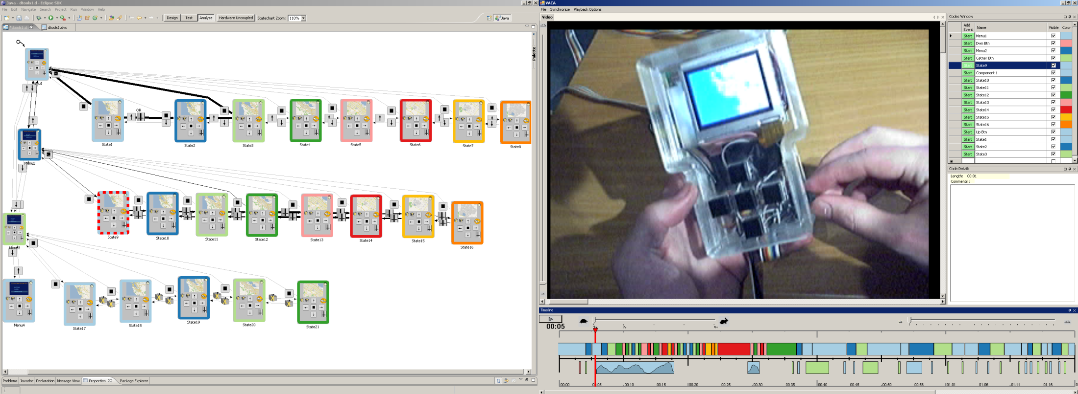
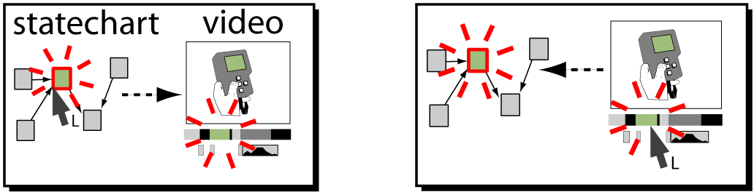
Review
Notes:
First, designers can access the statechart through the video.
By moving the playhead through the recorded video – the state underneatch the playhead is highlighted in the statechart.

Slide 50


Slide 51
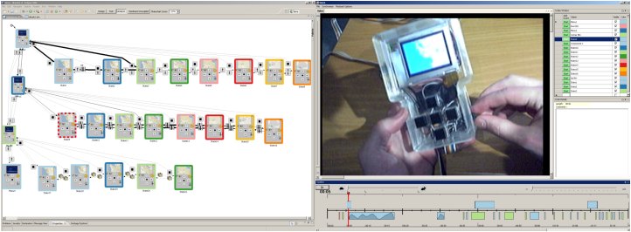
Notes:
Second, designers can access the video through the statechart. Clicking on a state filters out all video segments from other states and only shows matching segments in the video annotation timeline

Slide 52
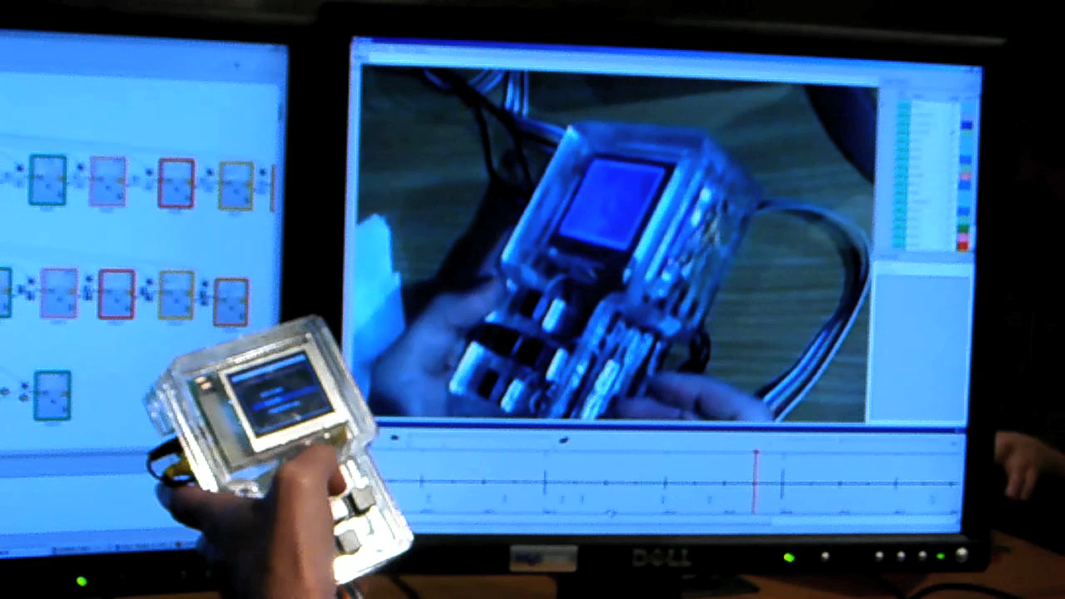
Notes:
Third, designers can query by demonstration through the physical prototype itself.
Example: The query „show me all video segments where the tester moved the volume slider“ is executed by simply moving the slider on the prototype itself.

Slide 53
How might tools help designers make & communicate interaction design revisions?
Notes:
Built prototype; tested it; Analyzing user data then suggests revisions in make in the next iteration.
which brings up the question ….
Appearance + brhavior
In other creative domains, we

Slide 54
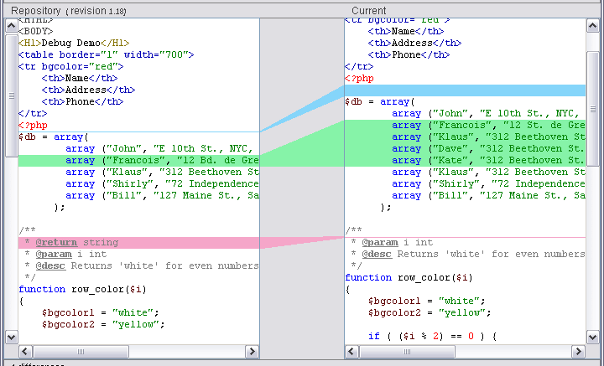
(Pixar Image from Buxton, Sketching User Experiences)
Movie production
Programming
Notes:
Pixar: sketch what should change
Pgm: visualize what did change
Takeaway lessions is that we want to support sketching or stylus based input when we’re concerned with graphics and appearance,
And that there is a balance to be struck between suggesting what should be changed, and capturing what *was* changed.

Slide 55
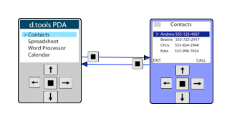
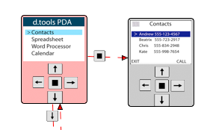
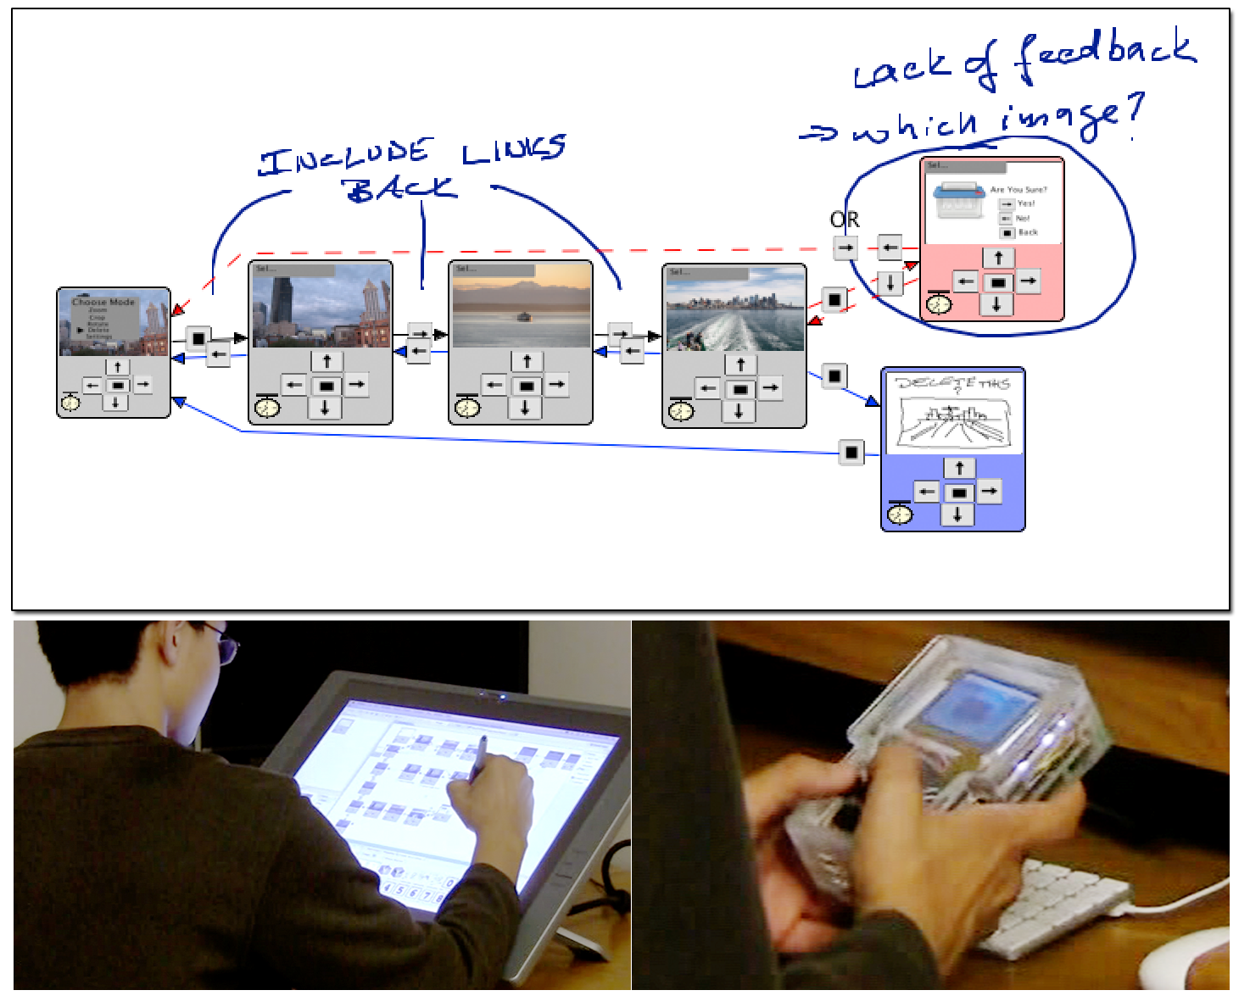
Additions
Deletions
Sketched
Graphics
Freeform Comments
Notes:
we then augmented d.tools with SUCH SKETCHING AND change tracking functions, which we titled d.note.
Much like change tracking in word processors, d.note visually distinguishes additions and deletions made to diagrams; additionally it supports sketching of graphical output and freeform commenting.

Slide 56
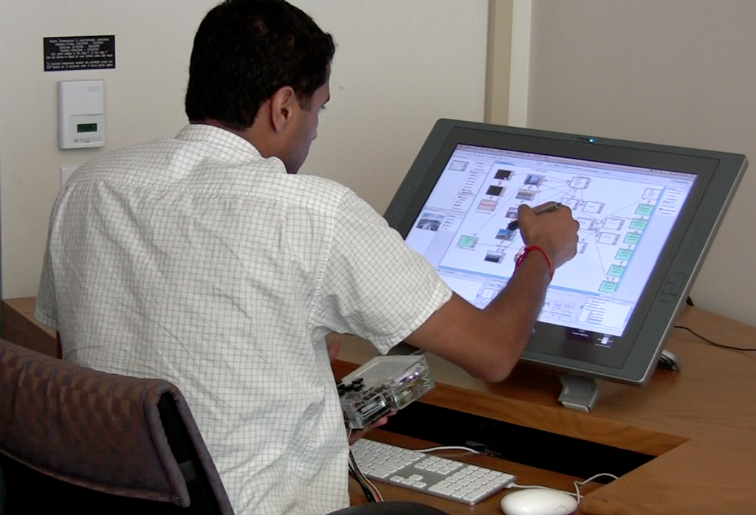
Notes:
Just to stress: to enable sketching, this interface is now entirely pen driven.

Slide 57
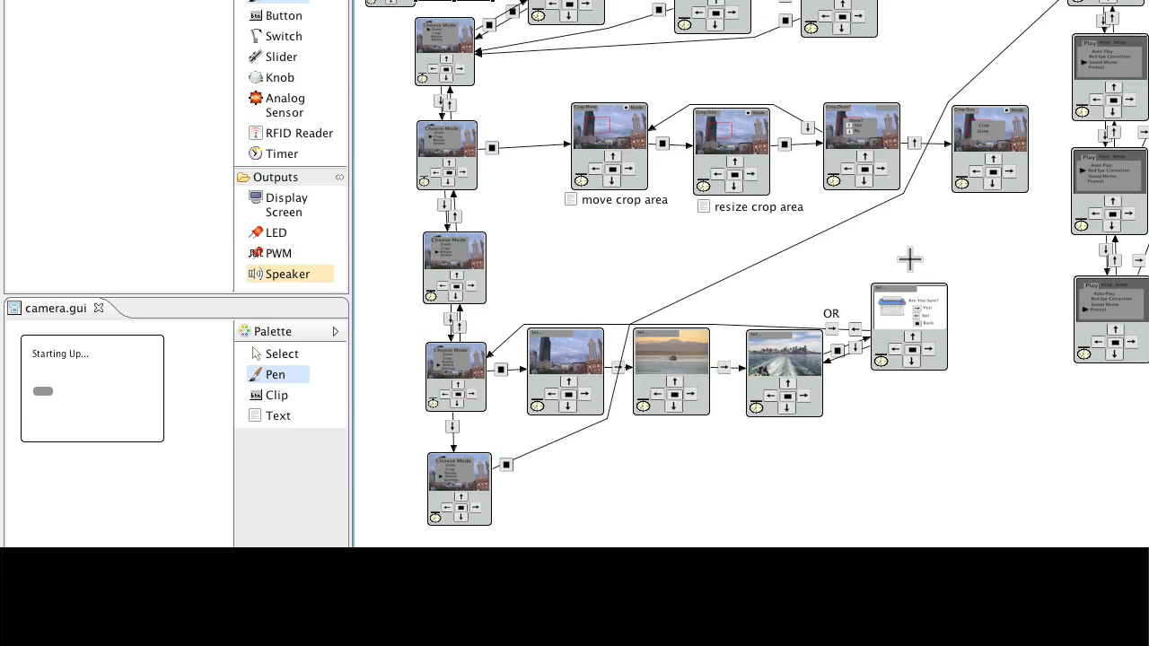
Notes:
during revision with d.note
users can sketch freeform comments
mark states and transitions for deletion
create new states and transition, and sketch screen graphics which are instantly shown on connected hardware

Slide 58
Comparing static & dynamic revision
12 participants
2 prototypes
(camera, photo viewer)
12 annotated images
of d.tools diagrams
12 d.tools diagrams
revised with d.note
8 new participants
List of clear revisions
List of revisions
requiring clarification
Notes:
What are the benefits of such an interactive tool compared to the common practice today of sketching & writing comments on screenshots and printed out diagrams (we found out through a small online survey with professionals with 10 answers)?
We ran a two-stage comparative study. In the first stage we gave people working prototypes and their d.tools diagrams and asked them to suggest changes for the next iteration *by sketching on a static image or by using d.note.
In the second stage, a different set of participants then interpreted the diagrams. For each diagram, they created two lists: one of revisions they understood and could carry out; and one of revisions that needed clarification.

Slide 59
D.note evaluation
Making revisions
Interpreting revisions
Reported benefits: can make and test concrete changes
Led to more careful suggestions
(Deletions only prevalent with d.note)
Fewer clarifications required for d.note diagrams
(mean: 1.6 vs. 2.9 requests, p < 0.05)
Notes:
The results in brief:
Participants in first part reported that the primary gain was the ability make and test concrete changes
This ability to test led to more careful change suggestions – we analyzed the diagrams and in the d.note conditions people deleted states and transitions that were no longer needed after making a change – in the static condition, people sketched new additions but left the old, now incorrect design largely in place instead of crossing it out
Does this matter when others later interpret revised and annotated diagrams?
It turns out it does – fewer clarifications were requested for d.note diagrams by the second set of participants
Implementation of changes more clear with d.note
Motivation for changes less clear

Slide 60
What’s Important?
Integrating analysis of test data into a design tool can radically shorten the time to work with test videos.
Integration is enabled by a high-level visual representation of the software model.
Interactive revision tools enable earlier testing of proposed changes, and those changes require fewer clarifications.
Notes:
Can’t tie videos to lines of c++ code.

Slide 61
1
2
3
Enable
Rapid Authoring
Off the Desktop
Aid Iteration
by Managing
Feedback
Aid Exploration
of Multiple
Alternatives

Slide 62
How can tools support the creation of multiple user interface alternatives?
Myers et al., VL/HCC 2008:
Comparing working UI alternatives “very important” or “crucial”
for 43% of surveyed interaction designers (N=210)
Notes:
Central Research Questions:
If we take exploration as a core activity of design, how can *interaction* design tools support creation and management of user interface alternatives?
Prior research: static graphics; no tools yet for alternatives interactive behavior

Slide 63


Related Work:
Working with Alternatives
Design Galleries, Marks, 1997
Levoy, Spreadsheets for Images, 1994
Subjunctive Interfaces, Lunzer, TOCHI 08
Spreadsheets for Visualization, Chi, IEEE CGA 98
Parameter Spectrums & Parallel Pies, Terry, UIST 02 & CHI 04
Partials, Terry, Phd 2005
Notes:
Other domains, specifically 3d rendering and image processing, have realized the importance of exploration and built tools.
For example, Design Galleries addresses the problem of finding good parameter combinations for complex 3d renderings by automatically generating a whole space of parameter settings and showing abrowsing interface for exploring parameter space.
Spreadsheets also inherently support parallel exploration, and example in Marc Levoy’s spreadsheets for image manipulation. Do these approaches translate to interaction design?

Slide 64



Interaction Designers Write Code
Flash
Arduino / Processing
Dreamweaver
Notes:
Why? One of the central reasons it that design of interactive behavior, even for prototypes, often happens in textual code. Interaction designers today frequently write a few dozen lines of script to express logic.
Exploratory coding != coding to spec!

Slide 65

3 Requirements for Programmed Interactions
Manage parameter variations
Manage code alternatives
Access variations & alternatives at runtime
Notes:
What are the most important ways in which designers explore alternatives of programmed interactions today?
Three interviews, code review -> three requirements.
Creating satifsying user experience: "tweaking the dials”; code stays same, params vary. Tools should explicitly support this parameter tuning.

Slide 66

3 Requirements for Programmed Interactions
Manage parameter variations
Manage code alternatives
Access variations & alternatives at runtime
Processing code brought in by an interviewee
Notes:
To compare different behaviors, changes to logic are required as well.
Example from inquiry: two behaviors in same function body; comment/uncomment in runs.
Tools should support creation and management of different code alternatives.

Slide 67

3 Requirements for Programmed Interactions
Manage parameter variations
Manage code alternatives
Access variations & alternatives at runtime
Notes:
Third, management of code and data alternatives has to work across editing and execution environments
expert do some this by writing control slider code –not part of the final application, but tools for exploration.
Tools construct such control interfaces automatically to open exploration to a wider audience.
To investigate how these requirements might be fulfilled, we constructed Juxtapose, a tool for working with multiple design alternatives in parallel.

Slide 68
Juxtapose: Source alternatives…
Notes:
Jxutapose manages alternatives at the source level

Slide 69
Juxtapose: Source alternatives…
Notes:
in an augmented editor

Slide 70
… are executed in parallel,
Notes:
These source alternatives can then be executed in parallel, which enables rapid comparison between them.

Slide 71
and tuned through an generated UI.
Notes:
Juxtapose combines parallel execution with automatic generation of control interfaces to interactively “tune” parameters of the designed interaction at runtime.

Slide 72

Parallel Editing
Juxtapose editor for
ActionScript 2.
Generates Flash files.
Notes:
To make working with multiple code alternatives feasible, an authoring environment must
Offer techniques for manipulating content across alternatives
make differences visually apparent
We extend linked editing a technique to track source duplicates.

Slide 73

Parallel Editing
Notes:
In the Juxtapose editor, alternatives are accessible through document tabs;

Slide 74
Parallel Editing
Notes:
Edits can be either local to one alternative or global to all alternatives by toggling a linked edit mode.
Linked editing - Mike Toomim 2004. Find code duplicates within a project extended to define project alternatives.

Slide 75

Parallel Editing
Implementation:
Longest common subsequence algorithm
diff(A,B,…,N) [Toomim, VL/HCC 2004]
Notes:
Source differences, text entered in “unlinked edit”, are highlighted with a shaded background
Shared text: white background

Slide 76


Example: Rethinking the Progress Bar
Harrison et al., UIST 2007
Progress bar test application
Progress profiles
Notes:
How would a designer use parallel editing for exploration?
Chris Harrison showed how different progress curves can affect the *perception* of completion speed. To test different progress curves, a function that maps actual progress to displayed progress was varied.
In clip designer starts with code for showing a normal, linear progress bar<click>
“Fast power” function, which start slow and rapidly accelerates was preferred (orange line)
f(x) = (x+(1-x)/2)8

Slide 77

Notes:
To explore different mapping functions, our designer creates source alternatives in new tabs. In each alternative, she changes the mapping function and an identifying name through unlinked editing. The changes here are rapid as only two lines of code differ between our alternatives.
* When run, all alternatives are executed side-by-side.
investigate different progress bar behaviors
bring one alternative into full view for detailed inspection.
In addition to sequential interaction, designers may want to view behavior in parallel.

Slide 78

Parallel Input: Event Echoing
Notes:
Juxtapose supports parallel input through event echoing. Mouse events can be intercepted in the active alternative and injected into all other alternatives, which then show a ghost cursor.

Slide 79


Parameter Tuning
Notes:
To explore parameter spaces, Juxtapose automatically generates control interfaces from variable definitions in the user’s program. When the control widgets are manipulated, the variable value is then updated in the running program.

Slide 80

Example: Tuning Phosphor
Baudisch, UIST 2006
Notes:
To support “parameter tuning” Juxtapose automatically generates control interfaces for global application variables at runtime
To see tuning in action, consider Patrick Baudisch’s phosphor paper from UIST 2006: Phosphor shows afterglows when UI widgets are changed to make such transitions visually salient in
Params of concern: timing characteristics and and coloring of afterglow.

Slide 81

Example: Tuning Phosphor
Notes:
We reimplemented some of Phosphor’s techniques in Actionscript - running Phosphor within Juxtapose enables designers to directly manipulate variables that govern fade duration and fade delay at runtime.
Once a designer finds a suitable set of tuned parameters, that set can be saved in a snapshot for later recall.

Slide 82
Generating Tuning Interfaces
Send variable info
Juxtapose User Library
A
Inspect
User’s Application:
//…
Number A = 10;
Boolean B = true;
X
B
Juxtapose Process
User Process
Notes:
For inter–process communication, a Juxtapose library module is added to the user’s code. On startup, the library collects global variable names, types, and values using reflection. The library then sends this information through a remote procedure call to the Juxtapose runtime UI.
Using this information, Juxtapose builds a control UI.

Slide 83
Generating Tuning Interfaces
Send tuning message
Juxtapose User Library
A
Update
User’s Application:
//…
Number A = 10;
Boolean B = true;
X
B
Juxtapose Process
User Process
Notes:
When the widgets of the tuning interface are modified, value update messages are sent to the running application through nother remote procedure call The Juxtapose user library then updates the variable value in the running application.

Slide 84





When is tuning most useful?
Search in 4D parameter space. Given recursive drawing code for this:
Produce these:
N=18; undergraduate + graduate HCI students
Notes:
To gather quantitative data, we created a close-ended task that asked participants to adjust four dimensions of an algorithmic tree drawing routine to match four specific tree shapes.
This task is clearly far removed from design practice, but its concrete goal allows for better measurement of performance.
84

Slide 85


Slide 86
Notes:
Of course, if you give people sliders to change parameters, they’ll test many more parameter combinations than they ever could through editing code and recompiling.
Direct manipulation is good, but we knew that.
More interesting: where does it provide benefits?

Slide 87
not
significant
not
significant
p<0.01
p~0.01
Notes:
Dig deeper, and look at task completion times for different trees. only two trees showed significant time differences.
Observation: interaction of multiple parameter dimensions, harder time reasoning about parameter settings– matching tu rned into a multi-dimensional trial and error exercise. It’s precisely this trial-and-error phase is when reasoning about the problem could not produce a satisf. Sol. where tuning was most beneficial.

Slide 88

Tangible Control
Notes:
Juxtapose supports use of an external controller for variable tuning for three reasons. The controller enables users to modify multiple parameters simultaneously, leaves the eyes free to focus on the application being tuned, and allows for tuning of interactions that require mouse and keyboard input, e.g., adjusting the rate at which mouse wheel movement magnifies a document. To facilitate locating a particular variable’s control, the mixer was augmented with a small top-mounted projector which displays parameter names. There are two ways to ensure that the controller stays in sync with variable values recalled through snapshots: either use only relative inputs, or use absolute inputs that can be actuated. We chose motorized faders as absolute controls have the advantage that their position provides proprioceptive feedback.

Slide 89
How can we extend these benefits to pervasive computing?

Slide 90



Juxtapose Mobile
Alternative
1
Alternative
2
Alternative
3
Notes:
Mobile phones are commodity hardware, and mobile developers already test on multiple handsets. We extended Juxtapose to leverage these device collections by executing different alternatives on different handsets. You write your alternatives on the PC, and the compiled applications are then distributed to a collection of handsets.
90

Slide 91

Notes:
A designer can thus rapidly switch between alternatives by putting one phone down and picking another one up. <click>
Tuning now allows designers to use their PC to change the behavior of a program that’s executing on the handset.

Slide 92

Juxtapose for Microcontrollers
Arduino:
8bit Atmel AVR RISC chip
programmed in C with gcc
Notes:
Embedded microcontrollers are the tool of choice for working with sensors and actuators. <click>We extended Juxtapose to support authoring for the 8-bit Arduino microcontroller platform. Building custom hardware is resource intensive, so unlike for mobile phones, designer are less likely to build multiple physical prototypes. Instead, in current practice, one can often different software versions of code shoehorned into the microcontroller firmware, turned on and off by either software or hardware switches.

Slide 93
How can we implement variable tuning
in a static language without reflection?
Notes:
Now languages that can run on an 8bit microcontroler with 16k of memory don't usually allow language reflection.
So, … how might one implement variable tuning in a language without reflection?

Slide 94
Parse code and build symbol table
int dly = 25;
boolean blink=false;
void setup() {...}
//…
Var. Name | Type | Pointer
“dly” | int | &dly
“blink” | boolean | &blink
Notes:
To enable runtime tuning, we added a preprocessing step to compilation
Juxtapose parses the user's source code; extracts global variable definitions; builds a symbol table with pointers to those variable,

Slide 95
Emit table into code & compile
Auto-generated
table
void initVarTable(void) {
varTable[1].varName = PSTR("dly");
varTable[1].varType = VAR_TYPE_INT;
varTable[1].varPtr = &dly;
varTable[2].varName = PSTR("blink");
varTable[2].varType = VAR_TYPE_BOOLEAN;
varTable[2].varPtr = &blink;
}
// plus a bunch of communication code...
Notes:
, and emits that table back into the source code (along with communication routines) before compilation.

Slide 96

Impact
Plans to integrate variable tuning into Arduino IDE

Slide 97

Adding alternatives to d.tools
Notes:
We’ve also thought about ways to add support for alternatives back into the visual d.tools language.
and introduced the notion of state alternatives.

Slide 98

Notes:
An alternative starts out as a copy of the original state with the same incoming transitions.
Inside the alternative, one can then redefine output and outgoing transitions for any state. Which alternative is active can be switched at runtime through radio-buttons

Slide 99
What’s Important?
A structured approach to alternatives
eliminates cruft and enables more exploration.
Tool support requires connecting authoring and
execution environments.
3 Techniques:
  Linked editing to manage code alternatives
  Execute set of programs side-by-side
  Auto-generate tuning interface
Notes:
For programmed interactions, supporting alternatives requires spanning both authoring and runtime environments. Juxtapose shows how this integration can be realized with three techniques: using linked editing to effectively manage alternatives at the source level, execution of sets of programs for comparison at runtime, and auto-generation of tuning interfaces through reflection and source parsing.

Slide 100
Summary
Notes:
Let me conclude by summarizing the contributions of this work

Slide 101
Contributions
Interaction techniques for prototyping physical user interfaces:
Tight coupling between physical & digital realm through plug-and-play hardware, software models of hardware configuration
Storyboard-based visual authoring with extensibility through scripting
Demonstration-based definition of interaction events from raw sensor data
1
Enable
Rapid Authoring
Off the Desktop
Notes:
The first research question was how to enable a larger group of designers to rapidly create functional ubiquitous computing prototypes
My dissertation contributes a set of interaction techniques to achieve that goal:
================
3) A method of programming by demonstration for sensor- based interactions that emphasizes designer control of the generalization criteria for collected examples.

Slide 102
Contributions
Integration of design, test, analysis and revision stages:
Time code correlation between video and state model enables rapid review of usability videos
Interactive revision tools for d.tools control flow diagrams enable testing of proposed changes and require fewer clarifications.
2
Aid Iteration
by Managing
Feedback
Notes:
The second question was how one might aid iteration during prototyping.
My dissertation introduced methods for integrating design, testm analysis and revision stages into a common design environment. Specifically:
It demonstrated how time code correlation between video and a graphical state model can aid rapid review of usability videos and provide context for those videos
2) I showed that interactive revision tools for interaction design diagrams enables testing of proposed changes while creating a record of those changes; and that such diagram require fewer requests for clarifications by others.

Slide 103
Contributions
Techniques for authoring and running multiple UI alternatives in parallel:
Selectively parallel source editing though and execution
Automatic generation of tuning interface from source analysis & runtime reflection
3
Aid Exploration
of Multiple
Alternatives
Notes:
Third, l introduced ways to enable simultaneous exploration of multiple user interface alternatives in parallel. In particular, Juxtapose demonstrated how to achieve such exploration of code alternatives through linked source editing and parallel execution; and exploration of parameter spaces thorugh automatic generation of tuning interfaces.

Slide 104



Impact
Notes:
A final word on impact=-
It’s been fun to see this work taken up by others.
Like this german group that took d.tools, extended it without our knowledge, and pubished a follow-on paper. Also, this work has made it into trade books like X and Y.”

Slide 105

Co-Authors
Leith Abdulla
Abel Allison
Marcello Bastea-Forte
Hrvoje Benko
Michael Bernstein
Brandon Burr
Anthony Cassanego
Timothy Cardenas
Jennifer Carlile
Jesse Cirimele
Merrie Morris
Avi Robinson-Mosher
Anthony Ricciardi
Leila Takayama
Parul Vora
Andy Wilson
Leslie Wu
Yeonsoo Yang
Loren Yu
Haiyan Zhang
Kevin Collins
Scott Doorley
Sean Follmer
Jennifer Gee
Sohyeong Kim
Scott R. Klemmer
Nirav Mehta
Manas Mittal
Co-Conspirators
David Akers
Joel Brandt
Wendy Ju
Dan Maynes-Aminzade
Heidy Maldonado
Ron Yeh
Companies
Frog Design
IDEO
LeapFrog
Nokia
San Jose Tech Museum
San Jose Museum of Art
Notes:
And of course, the work that I shared today isn't mine alone. I’ve been fortunate to work with a truly fantastic group undergraduate, graduate and industry researchers and I'd like to thank all of my collaborators on the work I presented today, whose names are listed here, as well as my co-conspirators at stanford

Slide 106
http://bjoern.org
Funding Acknowledgments:
Stanford MediaX/DNP Grant; NSF grant IIS-0534662
Stanford School of Engineerring & SAP Graduate Fellowships
Equipment donations from Intel & Nokia
Notes:
What’s next? One thing is clear: I will start as an assistant professor somewhere later on this year. It’s not yet clear where that place will be, but you can keep track of my whereabouts, and find out about other projects I did not talk about today, on my website.
Thank you.

