Slide 1
You Are Not Alone:
How Authoring Tools Can Leverage Activity Traces to Help Users, Developers & Researchers
Bjoern Hartmann
Stanford HCI Lunch
8/19/2009
Notes:
Authoring tool: A software application that targets creation or editing of media. Word processorts, programming IDEs, graphics editors, video editors, etc.
Activity trace: a log of the authoring process (i.e., actions over time)

Slide 2
The Idea (Not New)
Record what users are doing while using an authoring tool.
(At what level of detail? Privacy? Confidentiality?)
Extract relevant patterns from these traces. (What patterns? Automatically or with user involvement?)
Aggregate data from many users.
(How? What is the right group boundary?)
Present useful data back to either the users, or the developers. (What is useful? In what format? Feedback loop or canned answers?)

Slide 3
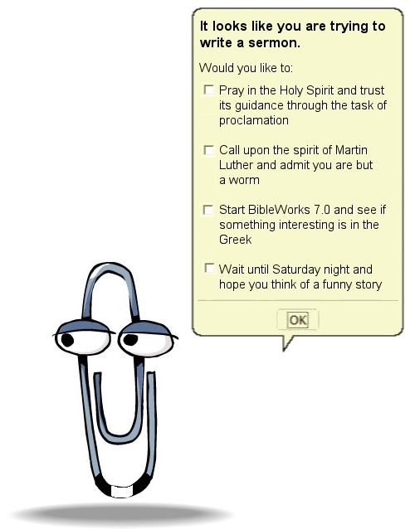
Notes:
No feedback systems

Slide 4

Notes:
Collaborative Filtering

Slide 5
Domain:
Authoring tools
Algorithms:
Recommender systems,
Data mining, PL
Social Perspective:
Crowd sourcing,
User communities

Slide 6
Potential benefits
For users:
  Gain expertise through tutorials (Grabler SIGGRAPH09) & tool suggestions (Matejka UIST09)
  Understand expert practices (2draw.net)
  Improved documentation (Stylos VLHCC09)
  Help with debugging
  (Kim, SIGSOFT06; Livshits SIGSOFT05)
For tool developers & researchers:
  Understand user practices (Terry CHI08)
  Understand program behavior in the wild
  (Liblit PLDI05)
  Understand usability problems in the wild (Hilbert 2000)

Slide 7
Instrumenting image manipulation applications

Slide 8
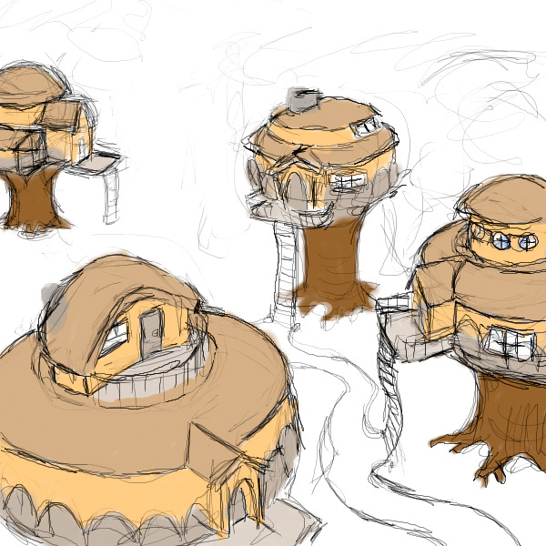
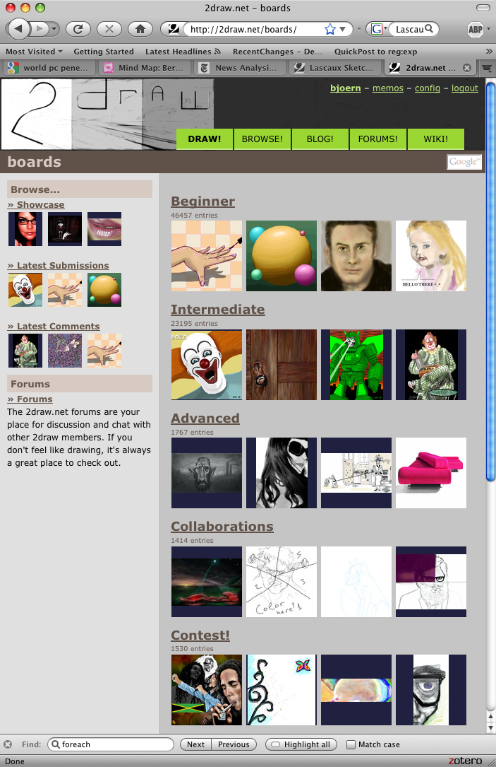
Example: 2draw.net
Notes:
2draw.net , developed by one of my former collaborators, offers online drawing application for creating and sharing digital illustrations.
One of the key features of this web application is that it records the process of the illustration over time and makes this process visible to others.
Watching a drawing evolve over time offers key insights to learners of how professionals work. such as the use of underdrawings, working in rough flat colors before shading, etc.

Slide 9
Examining 2draw
Record: canvas state over time
Extract: snapshots of drawing
Aggregate: no aggregation across users
Present: browse timeline of snapshots
Benefit: understand technique behind drawings

Slide 10
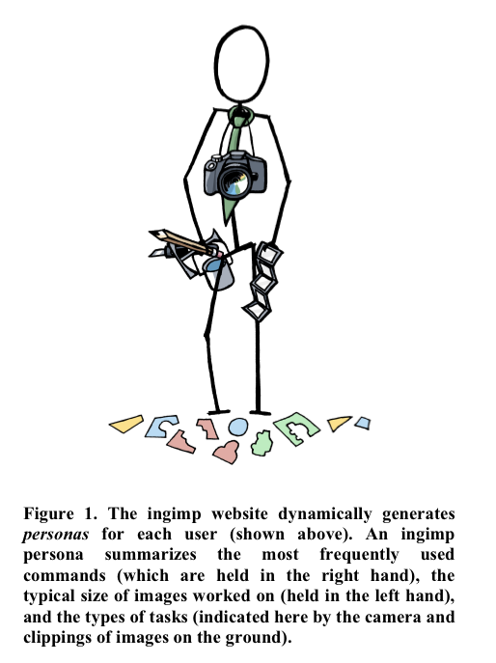
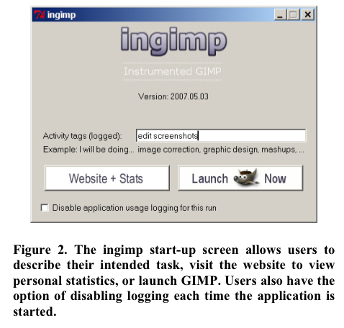
Terry et al., InGimp (CHI 2008)
http://www.ingimp.org/statsjam/index.php/Main_Page

Slide 11
Examining InGimp
Record: application state / command use
Extract:
Aggregate: send usage sessions to remote db
Present: usage statistics
Benefit: understand aggregate user profiles

Slide 12
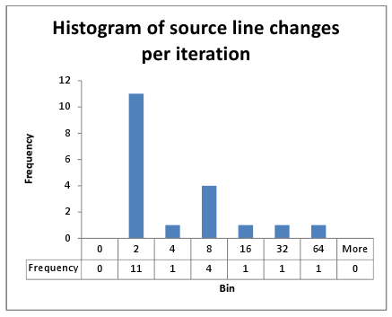
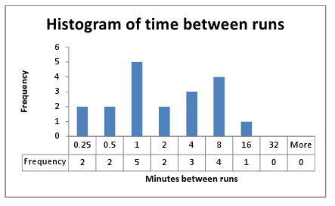
Own Experiment: Instrumenting Processing
Use Distributed Version Control System to record a new revision every time the user compiles/runs program

Slide 13
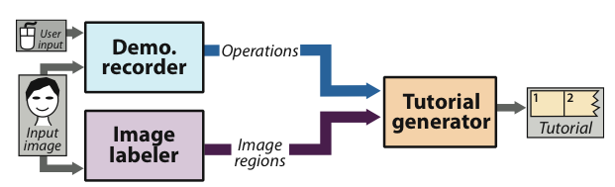
Grabler et al., Photo Manipulation Tutorials (SIGGRAPH 09)
Notes:
We present a demonstration-based system for automatically generating succinct step-by-step visual tutorials of photo manipulations. An author first demonstrates the manipulation using an instrumented version of GIMP that records all changes in interface and application state. From the example recording, our system automatically generates tutorials that illustrate the manipulation using images, text, and annotations. It leverages automated image labeling (recognition of facial features and outdoor scene structures in our implementation) to generate more precise text descriptions of many of the steps in the tutorials. A user study comparing our automatically generated tutorials to hand-designed tutorials and screen-capture video recordings finds that users are 20–44% faster and make 60–95% fewer errors using our tutorials. While our system focuses on tutorial generation, we also present some initial work on generating content-dependent macros that use image recognition to automatically transfer selection operations from the example image used in the demonstration to new target images. While our macros are limited to transferring selection operations we demonstrate automatic transfer of several common retouching techniques including eye recoloring, whitening teeth and sunset enhancement.

Slide 14
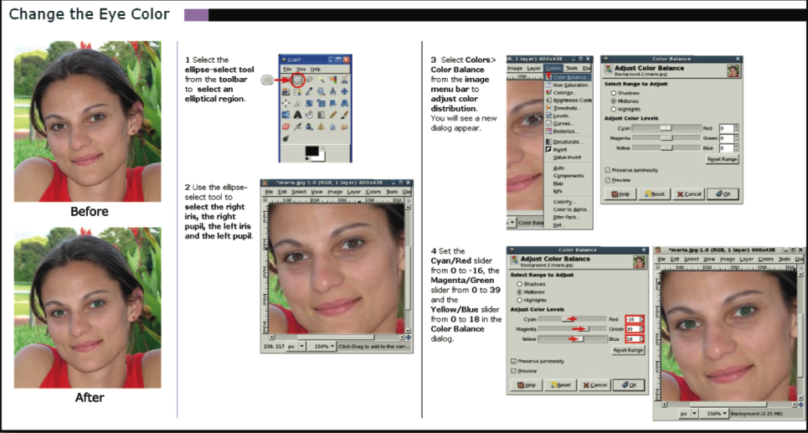

Slide 15
Examining PMT
Record: application state / command use / screenshots
Extract: high-level commands
Aggregate: ---
Present: graphical, annotated tutorial
Benefit: higher quality, lower cost tutorials

Slide 16
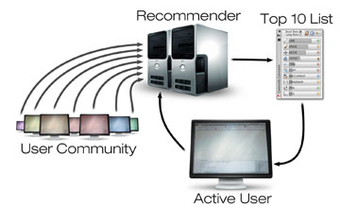

CommunityCommands (Matjeka, UIST09)
Notes:
We explore the use of modern recommender system technology to address the problem of learning software applications. Before describing our new command recommender system, we first define relevant design considerations. We then discuss a 3 month user study we conducted with professional users to evaluate our algorithms which generated customized recommendations for each user. Analysis shows that our item-based collaborative filtering algorithm generates 2.1 times as many good suggestions as existing techniques. In addition we present a prototype user inter-face to ambiently present command recommendations to users, which has received promising initial user feedback.

Slide 17
Improved documentation

Slide 18
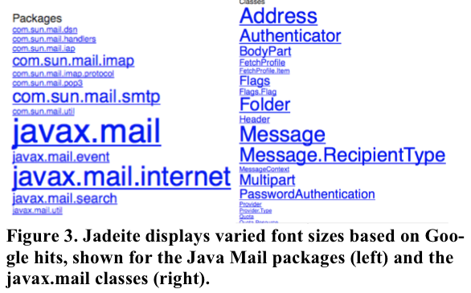
Stylos, Jadeite (VL/HCC 2009)
Notes:
Jadeite is a new Javadoc-like API documentation
system that takes advantage of multiple users’ aggre-
gate experience to reduce difficulties that program-
mers have learning new APIs. Previous studies have
shown that programmers often guessed that certain
classes or methods should exist, and looked for these in
the API. Jadeite’s “placeholders” let users add new
“pretend” classes or methods that are displayed in the
actual API documentation, and can be annotated with
the appropriate APIs to use instead. Since studies
showed that programmers had difficulty finding the
right classes from long lists in documentation, Jadeite
takes advantage of usage statistics to display com-
monly used classes more prominently. Programmers
had difficulty discovering how to instantiate objects, so
Jadeite uses a large corpus of sample code to auto-
matically the most common ways to construct an in-
stance of any given class. An evaluation showed that
programmers were about three times faster at perform-
ing common tasks with Jadeite than with standard
Javadoc.
Figure 1. Novel features of the Jadeite documentation system.
Font sizes are varied based on usage data (a); common meth-
ods of class construction (c) are automatically determined; and
users can add new placeholder classes or methods (b) to stand in for expected part of an api

Slide 19
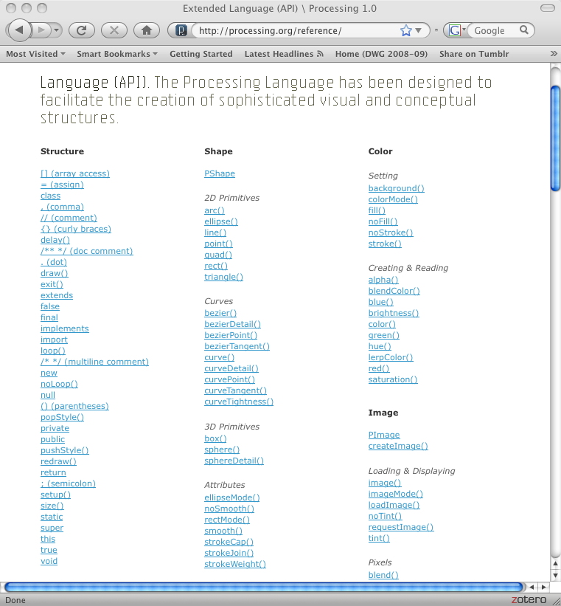

Slide 20
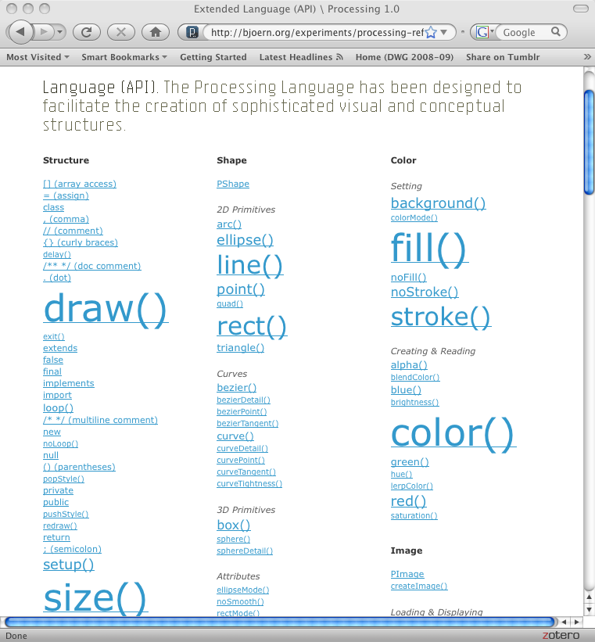
Notes:
Will use tonight and report back

Slide 21
Documentation Algorithm
For each file in source code corpus of Processing projects (existing documentation, forum posts, web search), calculate # of function calls for all known API functions (use hash table fn_name->count)
Rescale font size on documentation page by relative frequency of occurrence in corpus
Notes:
People who bought X also bought Y:
Given that I’m looking at function colorModel(), what else should I look at? (Intuition: use nearby functions in source code)

Slide 22
debugging

Slide 23
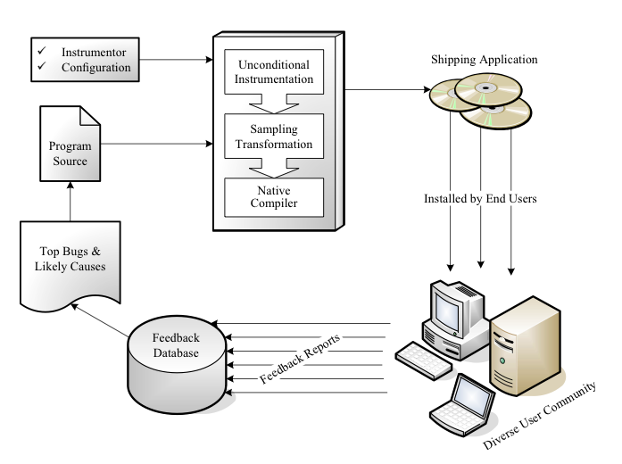
Cooperative Bug Isolation (Liblit, UCB)
Notes:
Ben Liblit’s PHD here at berkeley proposed a way to support debugging based on feedback from actual users. Cooperative Bug Isolation (CBI) leverages the key strength of user communities: their overwhelming numbers.
His system instrumented program binaries so that they’d record certain aspects of program behavior during regular use and report feedback back to the authors.
My question is: what if we follow a similar approach, but instead have an authoring environment be the instrumented application.
Here’s an example from an authoring env for graphic design and illustration:
===
We propose a low-overhead instrumentation strategy for gathering information from the executions experienced by large numbers of software end users. Our approach limits overhead using sparse random sampling rather than complete data collection, while simultaneously ensuring that the observed data is an unbiased, representative subset of the complete program behavior across all runs. We discuss a number of specific instrumentation schemes that may be coupled with the general sampling transformation to produce feedback data that we have found to be useful for isolating the causes of a wide variety of bugs.

Slide 24
Examining CBI
Record: sparse sampling of application state
Extract: ---
Aggregate: establish correspondence between different reports
Present: priority list of runtime bugs to developer
Benefit: understand real defects in released software

Slide 25
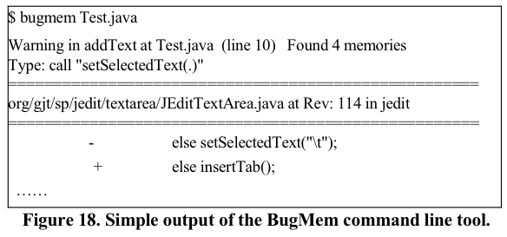
BugMem (Kim, UCSC)
Notes:
Memories of Bug Fixes using Java (20K lines of code) and MySQL. Memories of Bug Fixes is a project that data-mines software change repositories, and utilizes the previous bug fixes in the repositories to predict bugs in new changes.

Slide 26
Examining BugMem
Record: --- (use existing source code repository)
Extract: bug signature and fixes
Aggregate: ?
Present: list of bugs in repository that match fixes in same repository
Benefit: find bugs in existing code that your team has fixed in the past

Slide 27
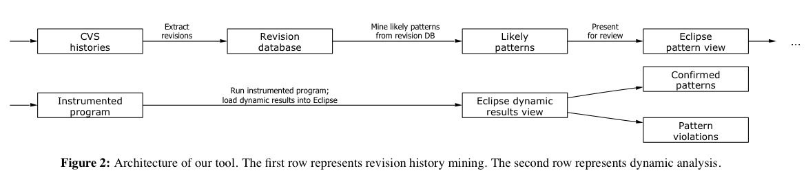
DynaMine (Livshits @ Stanford)
Notes:
DynaMine: a Framework for Finding Common Bugs by Mining Software Revision Histories.
A great deal of attention has lately been given to addressing software bugs such as errors in operating system drivers or security bugs. However, there are many other lesser known errors specific to individual applications or APIs and these violations of applicationspecific coding rules are responsible for a multitude of errors. In this paper we propose DynaMine, a tool that analyzes source code check-ins to find highly correlated method calls as well as common bug fixes in order to automatically discover application-specific coding patterns. Potential patterns discovered through mining are passed to a dynamic analysis tool for validation; finally, the results of dynamic analysis are presented to the user.
The combination of revision history mining and dynamic analysis techniques leveraged in DynaMine proves effective for both discovering new application-specific patterns and for finding errors when applied to very large applications with many man-years of development and debugging effort behind them. We have analyzed Eclipse and jEdit, two widely-used, mature, highly extensible applications consisting of more than 3,600,000 lines of code combined. By mining revision histories, we have discovered 56 previously unknown, highly application-specific patterns. Out of these, 21 were dynamically confirmed as very likely valid patterns and a total of 263 pattern violations were found.

Slide 28

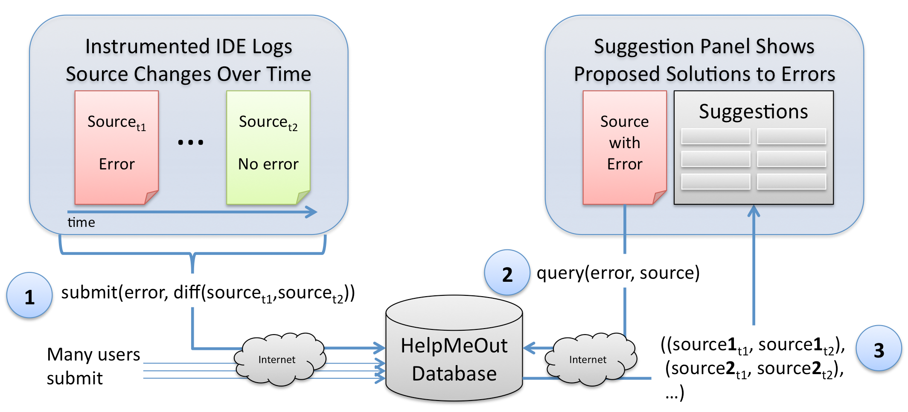
‘;l’;l

Slide 29
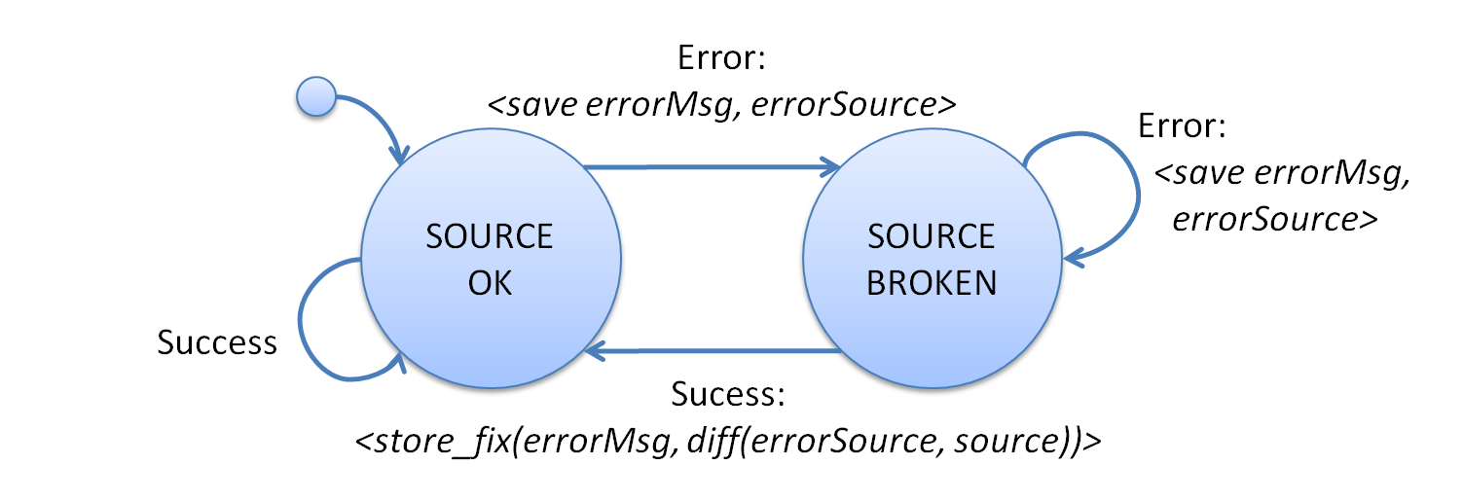

Slide 30
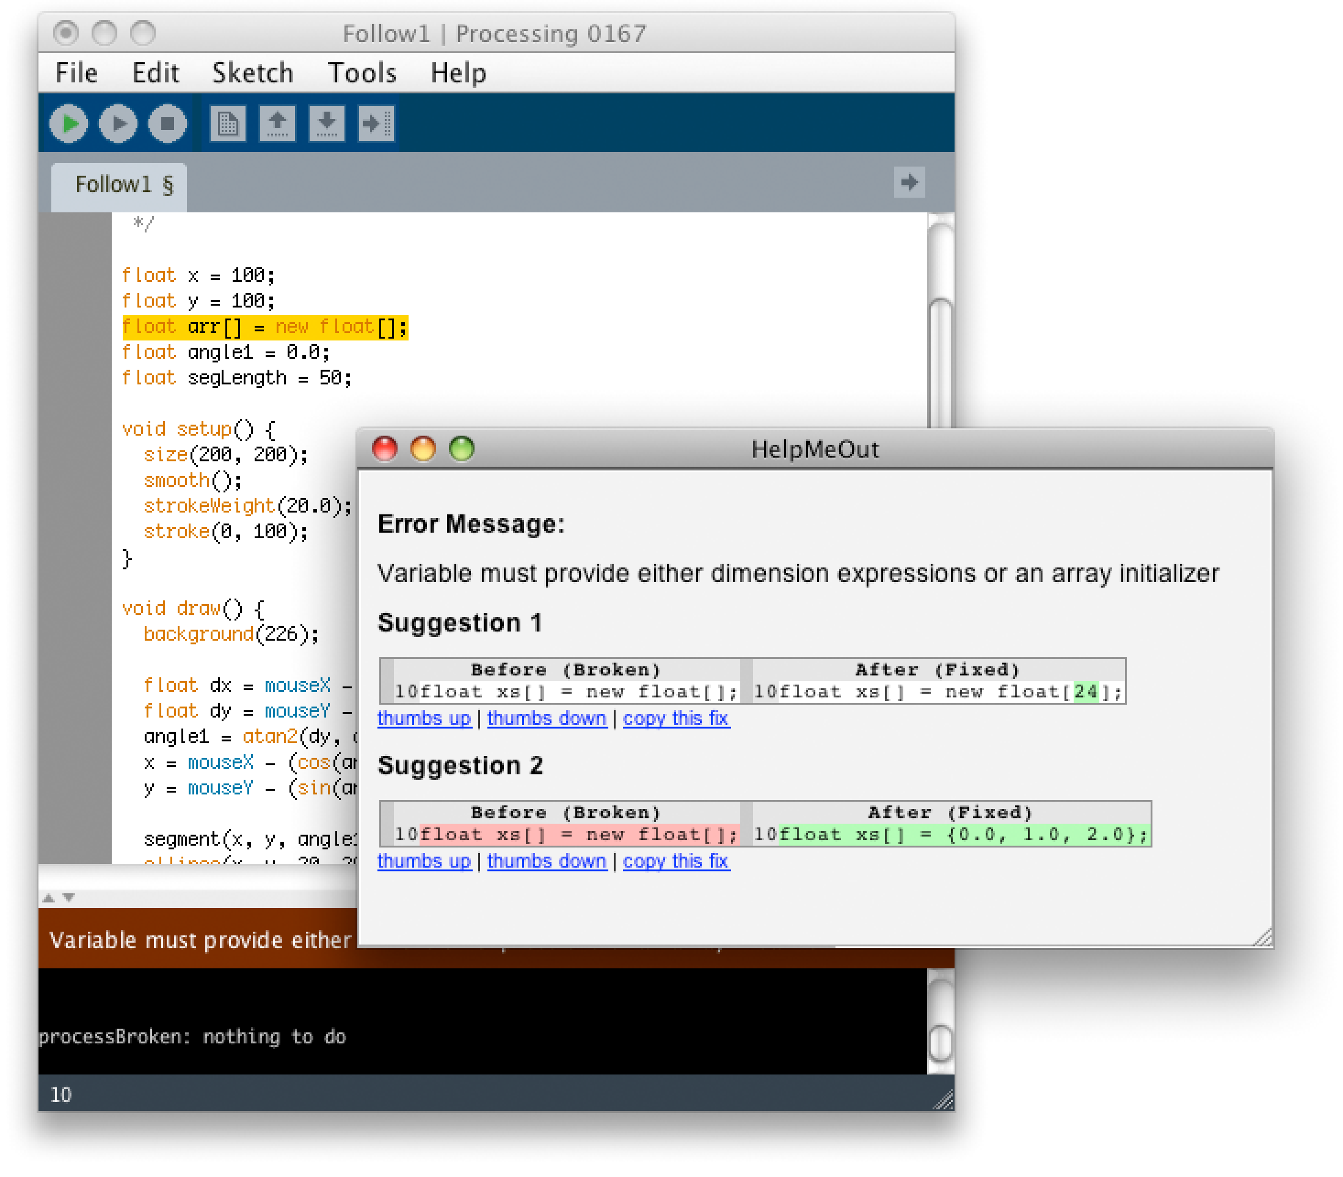

Slide 31
Examining HelpMeOut
Record: source code at every compilation step
Extract: error messages and code diffs
Aggregate: collect fixes from many users in db; explanations from experts
Present: list of fixes in db that match user’s error and code context; explanations when available
Benefit: find fixes that others have used to correct similar problems in the past

Slide 32
A Design Space for Finding Answers to Questions from Online Data
How many answers
are needed?
1
10
100
How many answers
are shown / available?
1
10
100
What reporting
format?
Individual answers
Aggregate data
When are answers
available?
Immediately
(Already published)
Near
real-time
With
Latency
Who publishes
answers?
Authority
Expert
Peer
Anyone?
Can questioner
seek clarification/detail?
Yes
No
How was answer authored?
Explicitly
Implicitly
Notes:
Most of our questions are asked and answered through some form of CMC these days. How should we think about the space of what q's can be asked and how q's can be answered in a useful way?Find some relevant structuring questions, then review existing ways of asking questions and finding answers online - where do they map into that space? Where is more opportunity?
When was the information published? pre-published, published in return to questions: with latency (stack overflow, fora) , real-time (aardvark, chat) (sync/async)
Who published the information? authoritative source (product documentation), expert, peer
One author or many authors; individual or aggregate opinion?
Is the source identifiable? Yes, partially, no not at all
Is informaiton explicitly published as a problem solution;
was it "authored"? Explicit (fora, tutorial) Implicit (side-product e.g. open source code bases, usage logs)
How many answers are required? (one, ... many)
How many answers are readily available? (one, ... many)
How realistic is it to ask for clarification/more detail/...?
Things to map in this space:Aardvark, IM, mechanical turk, stack overflow, wikipedia, asking q's on twitter,fb, google code search, product documentation, blueprint

Slide 33
HelpMeOut
How many answers
are needed?
1
10
100
How many answers
are shown / available?
1
10
100
What reporting
format?
Individual answers
Aggregate data
When are answers
available?
Immediately
(Already published)
Near
real-time
With
Latency
Who publishes
answers?
Authority
Expert
Peer
Anyone?
Can questioner
seek clarification/detail?
Yes
No
How was answer authored?
Explicitly
Implicitly
Notes:
Most of our questions are asked and answered through some form of CMC these days. How should we think about the space of what q's can be asked and how q's can be answered in a useful way?Find some relevant structuring questions, then review existing ways of asking questions and finding answers online - where do they map into that space? Where is more opportunity?
When was the information published? pre-published, published in return to questions: with latency (stack overflow, fora) , real-time (aardvark, chat) (sync/async)
Who published the information? authoritative source (product documentation), expert, peer
One author or many authors; individual or aggregate opinion?
Is the source identifiable? Yes, partially, no not at all
Is informaiton explicitly published as a problem solution;
was it "authored"? Explicit (fora, tutorial) Implicit (side-product e.g. open source code bases, usage logs)
How many answers are required? (one, ... many)
How many answers are readily available? (one, ... many)
How realistic is it to ask for clarification/more detail/...?
Things to map in this space:Aardvark, IM, mechanical turk, stack overflow, wikipedia, asking q's on twitter,fb, google code search, product documentation, blueprint

Slide 34
Stack Overflow
How many answers
are needed?
1
10
100
How many answers
are shown / available?
1
10
100
What reporting
format?
Individual answers
Aggregate data
When are answers
available?
Immediately
(Already published)
Near
real-time
With
Latency
Who publishes
answers?
Authority
Expert
Peer
Anyone?
Can questioner
seek clarification/detail?
Yes
No
How was answer authored?
Explicitly
Implicitly
Notes:
Most of our questions are asked and answered through some form of CMC these days. How should we think about the space of what q's can be asked and how q's can be answered in a useful way?Find some relevant structuring questions, then review existing ways of asking questions and finding answers online - where do they map into that space? Where is more opportunity?
When was the information published? pre-published, published in return to questions: with latency (stack overflow, fora) , real-time (aardvark, chat) (sync/async)
Who published the information? authoritative source (product documentation), expert, peer
One author or many authors; individual or aggregate opinion?
Is the source identifiable? Yes, partially, no not at all
Is informaiton explicitly published as a problem solution;
was it "authored"? Explicit (fora, tutorial) Implicit (side-product e.g. open source code bases, usage logs)
How many answers are required? (one, ... many)
How many answers are readily available? (one, ... many)
How realistic is it to ask for clarification/more detail/...?
Things to map in this space:Aardvark, IM, mechanical turk, stack overflow, wikipedia, asking q's on twitter,fb, google code search, product documentation, blueprint

Slide 35
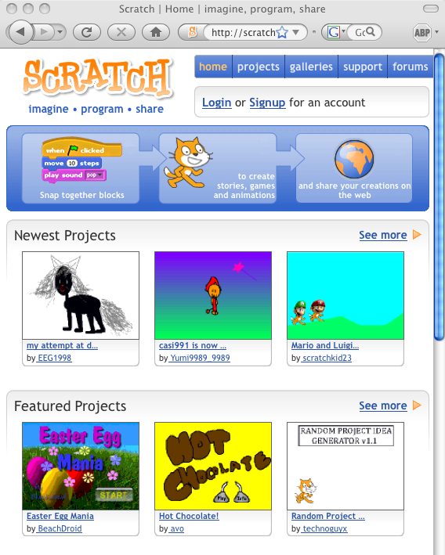
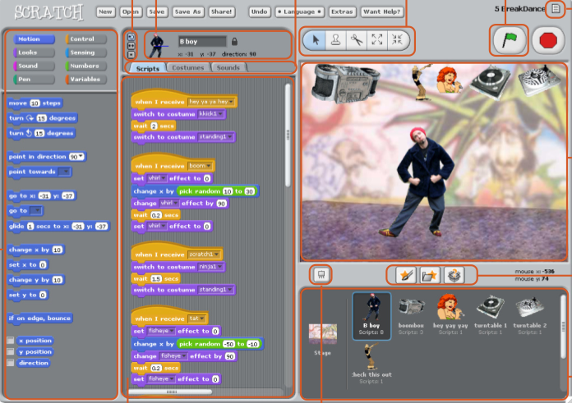
Non-Example: Scratch (MIT)
Scratch authoring environment with “Share” button
Scratch web site lists shared projects
Notes:
Resnick: 30% of projects on Scratch website are based on other projects; up to 29 different remixes of pre-existing
Shared is end result, not process itself.

Slide 36
