Slide 1
Painted Aperture for Portraits
Edward Luong
Advisor: Jongmin Baek

Slide 2
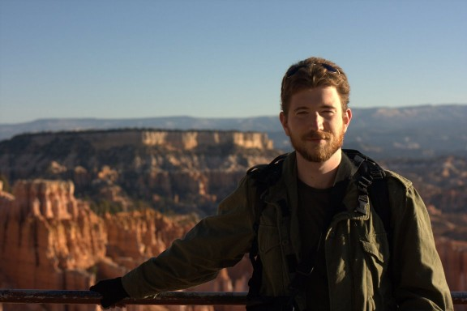
Motivation

Slide 3
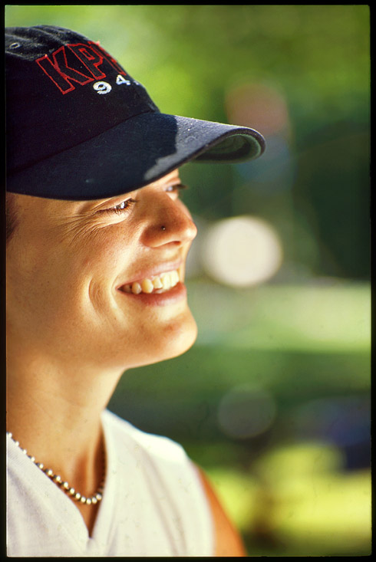
Motivation
Shallow depth of field is useful to direct attention to foreground
Controlled primarily by the size of the aperture. A larger aperture leads to a shallower depth of field.
http://silverbased.org/shallowest-dof/
Notes:
Details or other people in the background may distract from the focus of the shot

Slide 4
Motivation
Cameras on mobile devices are small and have limited capabilities (lens, sensor size, field of view)
N900 has an actual lens and the ability to control depth of field to some degree.
However:
Most camera phones are not as powerful as the N900
Controlling DOF may be hard to use for an amateur
Ranges where it can be utilized may be restrictive

Slide 5
Why not “fake” it?
We are.
Merging multiple images has other benefits
Reducing noise
May be hard to matte a plane to keep in focus
Would still need a depth mask to apply blur (sure, can fake with gradient.. OK)
Approaches are not mutually exclusive. One could imagine a hybrid strategy.
Notes:
May help with lowlight photography

Slide 6
Idea: Painted Aperture
Capture multiple (sharp, infocus) images of the subject from shifted points of view, and combine them into a single image.
User can move camera in circular motion while the camera streams in frames
Reconstruct image that would have been captured by a camera with a larger aperture by aligning images and blending.

Slide 7
Previous Work
Synthetic Aperture Focusing using a Shear-Warp Factorization of the Viewing Transform [Vaish 2005]
Using Plane + Parallax to Calibrate Dense Camera Arrays [Vaish 2004]
Lightfield Fax project by Abe Davis

Slide 8
Capturing
Take a single high-res “detail” image and numerous low-res “blur” images.
Trying to reconstruct an image for a synthetic aperture from point samples. Also can be seen as sampling the light field.
Sampling is important! Goals:
Minimize motion blur
Sample “aperture” well (uniformly)
Implemented two modes: Spots and Stream

Slide 9
Capture: Spots
Notes:
This approach attempts to minimize motion blur and sparsely (but uniformly) sample. To reduce motion blur, user should know when photos are taken to minimize motion during the shot
Wacky interface based on anchoring finger/pen on the touchscreen
Can control sampling density
Unfortunately, this is slow (on the user side)

Slide 10
Capture: Video
Can achieve much higher sampling density if we stream frames from the sensor.
This is fast and much easier to use, but:
Motion blur: can combat this by only grabbing frames when non-blurred (using sharpness mask).
Non-uniform sampling: UI can guide the user into regions that are not sufficiently sampled
These problems can also (hopefully) be solved during reconstruction

Slide 11
Registration
Notes:
Rest of the pipeline occurs offline.
Registration uses SIFT to find feature points. All of this is performed at the “blur” resolution.

Slide 12
Registration
Notes:
User selects a region to indicate features in the plane in focus

Slide 13
Registration
Notes:
RANSAC used to estimate camera position. Also makes it slightly more robust to user feature selection.

Slide 14
Registration

Slide 15
Reconstruction
Ideally, we would reconstruct the signal and resample the synthetic aperture. This can help with problems with non-uniform sampling
Simpler approach is just to align on the foreground features and blend (average) all the images.
Parallax causes background objects to shift more, creating effect of defocus blur.
Combine “detail” image with up-sampled version of the combined “blur” image. [Not implemented]
Notes:
Look at matricies or optical flow to determine how much each region moved. For stable regions, sample from “detail”. For others, sample from “blur”
Binary matte would work fine

Slide 16
Blend

Slide 17
Blend

Slide 18
Limitations
Only works on certain scenes, and to varying degrees of success
Alignment depends on features that can be found robustly. May be difficult to guarantee in some scenes
Foreground alignment assumes foreground is approximately planar to avoid parallax. Either the subject is indeed planar, or the camera is far.
Defocus is dependent on background parallax. This means the background should be far relative to the foreground.
Capture is slow. May suffer from motion in scene
Notes:
Use books because they are planar
For a portrait, motion of the person may be OK if we can use the detail for the foreground and features are mostly on the silhouette or stationary

Slide 19
Lack of SIFT Features

Slide 20
Lack of SIFT Features
Notes:
Finding SIFT features

Slide 21
Lack of SIFT Features

Slide 22
Lack of SIFT Features
Notes:
Probably better if had selected chair but this is illustrative of the scene sensitivity

Slide 23
Lack of SIFT Features

Slide 24
Limitations
Synthesized image has poor quality:
Ghosting if not densely sampled or not reconstructed properly.
Alignment on foreground blurs out sharp features that we want to preserve.

Slide 25
Ghosting (1+6 images)

Slide 26
Ghosting (1+6 images)

Slide 27
Ghosting (1+16 images)

Slide 28
Ghosting (1+16 images)

Slide 29
Weird Ghosting

Slide 30
Weird Ghosting

Slide 31
Weird Ghosting
Notes:
Very sensitive to features and

Slide 32
Limitations
Performance:
Slowest step is SIFT. Homography is performed on a sparse set of of samples and is quite fast.
Being able to do real-time feature detection would be really useful for many different applications

Slide 33
Results

Slide 34
Results
Notes:
Simple idea can actually go quite a way… We can focus on different depth planes

Slide 35
Results (bg)

Slide 36
Results (bg)

Slide 37
Results (bg)

Slide 38
Results (bg)

Slide 39
Results (fg + bg)
Notes:
Here, selected forground and background

Slide 40
Results (fg + bg)

Slide 41
Results (fg + bg)
Aligned on fg
Aligned on bg

Slide 42
Extensions
Finish implementation that uses the “detail” image and upsamples the “blur” images
Pick which aperture samples to use. This can be used to control the amount of defocus blur. (Andrew Adams light field viewer)
If we could draw the aperture samples that we use, we could also synthetically shape the bokeh

