Slide 1
New Techniques in Computational photography
Marc Levoy
Computer Science Department
Stanford University
Notes:
40 minutes at a fast pace
34:15 total + 30% = ~45 minutes

Slide 2
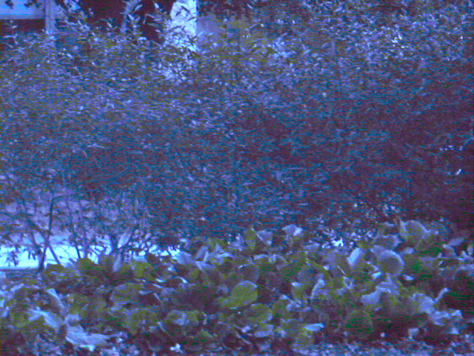
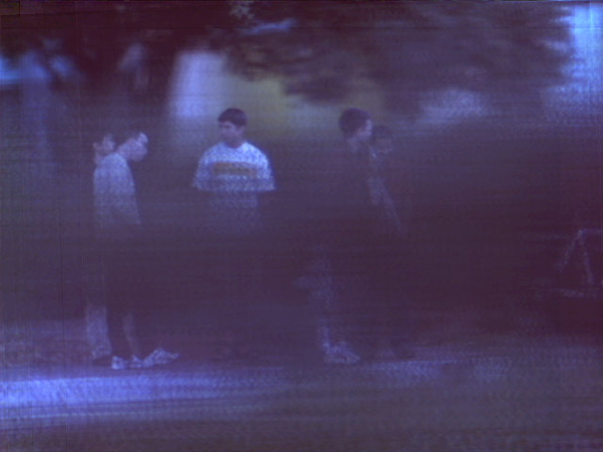

Slide 3
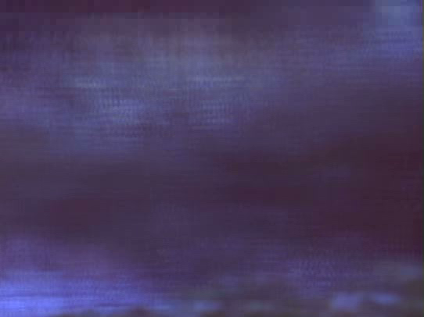

Slide 4
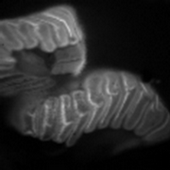

Slide 5
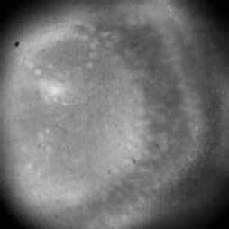
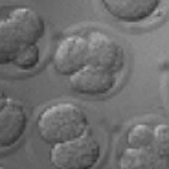
Other examples
fern spore
(60x, autofluorescence)
mouse oocyte
(40x, DIC)
zebrafish optic tectum
(calcium imaging of neural activity)

Slide 6
Axial resolution (a.k.a. depth of field)
wave term + geometrical optics term
ordinary microscope (16x/0.4NA (dry), e = 0)
with microlens array (e = 125μ)
stopped down to one pixel per microlens
(wave optics dominates)
(geometrical optics dominates)
→ number of slices
in focal stack = 12

