Slide 1
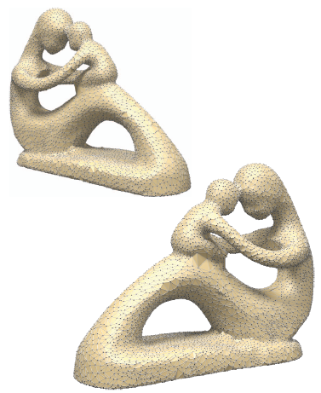
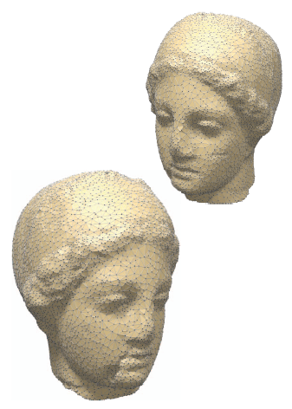
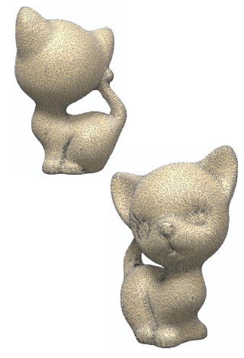
Visibility of noisy point cloud data
Ravish Mehra^{1,2} Pushkar Tripathi^{1,3} Alla Sheffer⁴ Niloy Mitra^{1,5}
¹IIT Delhi ²UNC Chapel Hill ³GaTech ⁴UBC ⁵KAUST
Notes:
Hello everyone,
My name is Ravish Mehra and I am graduate student at University of north carolina at Chapel Hill. Today I am going to talk about “Visibility of noisy point cloud data”.
I started this project here at IIT and it was recently jointly accepted by Shape modeling international conference and Elsevier – Computers & graphics journal.

Slide 2
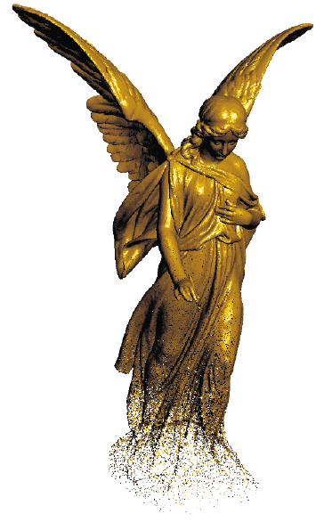
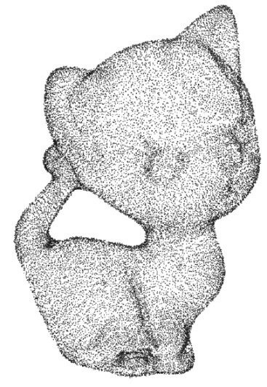
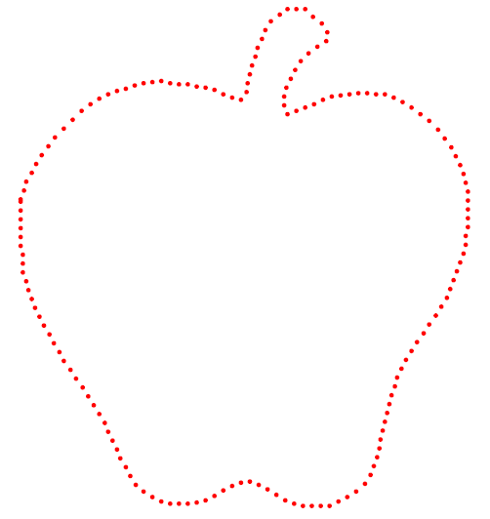
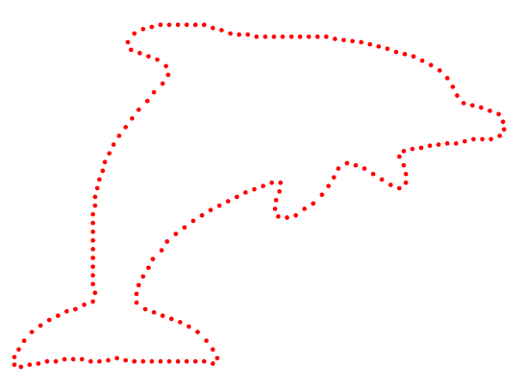
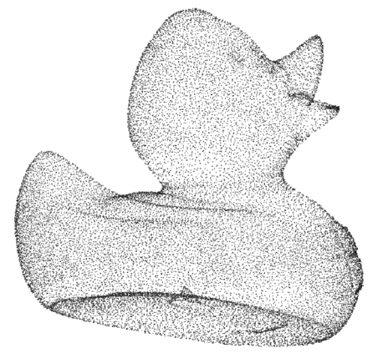
Motivation
Point Cloud Data (PCD) - set of points
2D : sampled on boundary of curve
3D : sampled on object’s surface
natural output of 3D scanners
simplistic object representation
easier PCD data structures
generalized to higher dimensions
Recent research
[Levoy 00], Pauly[01], Zwicker[02], Alexa[03,04]
effective and powerful shape representation
model editing, shape manipulation
Alexa at al.[01]
Notes:
In simple terms, point cloud data is a set of points. In case of 2D, points are sampled from the boundary of a curve. In case of 3D, PCD are points sampled on the surface of the object. PCD usually contain only positions but in some cases, can store additional information like normal and color etc
They form the natural output of 3D scanning systems, like the one we saw yesterday during the demo session. //employed for surface reconstruction of a 3D object.
As an alternative to meshes, they are simple and flexible object representation.
PCD data structures are easier to handle.
Recent research has shown that even with this minimum information of only positions, that PCD is a powerful shape representation that can be used for complicated tasks like model editing and shape manipulation.

Slide 3
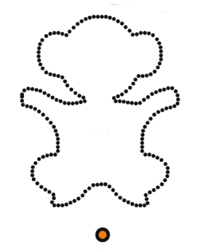
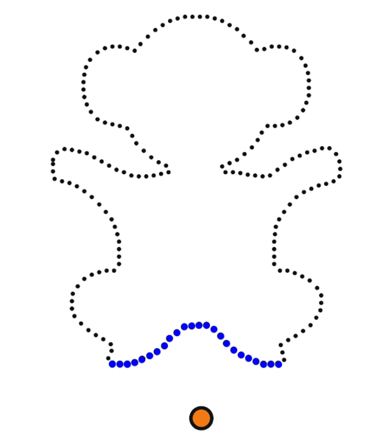
Problem Statement
Visibility of PCD
given point set P and viewpoint C, determine set of all visible points from C
points corresponds to a underlying curve(2D) or surface (3D)
visibility defined w.r.t underlying curve/surface
P
P
Visible points
C
C
Notes:
Problem that we are trying to solve is give a set of points (with or without noise) and a viewpoint or camera location, we have to extract the visibility information for the viewpoint.
The visibility problem is well defined for points corresponding to an underlying curve or surface. In this case, visibility is defined wrt the underlying curve/surface i.e. points lying on the visible parts of the underlying surface or curves are defined as visible points.
//Visibility of point set is ambiguous if we consider points occluding other points. The problem is ill posed as the likelihood of point being exactly occluded by other points is negligible.

Slide 4
Prior Work
Object visibility - determining visible faces
widely studied in computer graphics - Appel[1968], Sutherland[1974]
hardware solutions exist – z-buffer test - Catmull[1974], Wolfgang[1974]
Point visibility – determining visible points
surface reconstruction
Hoppe[92], Amenta[00], Dey[04], Mederos[05], Kazhdan[06]
Moving least square(MLS) : Leving[1998], Amenta[04], Dey[05], Huang[09]
object visibility
hidden surface test , z-buffer test
visible points = points on the visible surface
surface
reconstruction
object
visibility
Points on
visible surface
Notes:
Problem of correctly and efficiently identifying visible parts of an object has received significant attention since early days of computer graphics.
Given importance of this problem, hardware solutions like z-buffer test have been proposed and widely deployed in today’s generation graphics hardware.
For point set, typical method of extracting visibility is
1) Reconstructing the underlying surface
Over the years, many techniques have been proposed to perform surface reconstruction. Surface reconstruction is a difficult problem, both theoretically as well as practically, and often requires additional information like normals and assumptions on sampling condition and noise.
2) Determining visible parts of the surface
3) Mark points as visible if they lie on visible surface parts

Slide 5
Hidden Point Removal (HPR)
HPR operator – Katz et al.[07]
simple and elegant algorithm for point set visibility
without explicit surface reconstruction
two steps : inversion and convex hull
extremely fast : asymptotic complexity
works for dense as well as sparse PCDs
O(n logn)
Katz S, Tal A, Basri R. Direct visibility of point sets. In: SIGGRAPH ’07: ACM
SIGGRAPH 2007 papers. ACM, New York, NY, USA, 2007. p. 24.
Notes:
Katz and colleagues, in SIGGRAPH 2007, proposed a simple and elegant operator to extract the visibility information of the point cloud without performing surface reconstruction. Its called Hidden Point Removal or in short HPR operator.
It consists of a two step process of inversion and convex hull.
This operator is extremely fast and has asymptotic complexity of O(n log n) where n is number of points and works on dense as well as sparse point clouds.

Slide 6
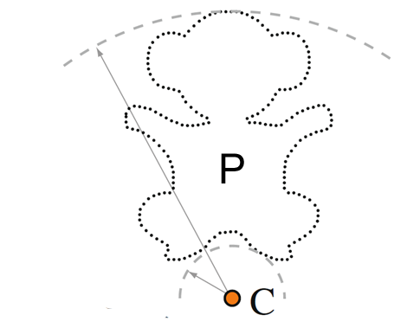
Input points
Given point cloud P and viewpoint C (coordinate system
with C as origin)
Notes:
We illustrate the HPR operator via a 2D example
We take a 2D point set and a viewpoint C. We have to determine the set of visible points from the viewpoint C. First of all, we associate a coordinate system with viewpoint C as origin.
//An additional viewpoint, opposite to the current viewpoint on the line connecting the original viewpoint to the object's center of mass, is set. Then, R is determined by maximizing the number of disjoint points that are considered visible by both viewpoints.
For more details, please refer to the original paper

Slide 7
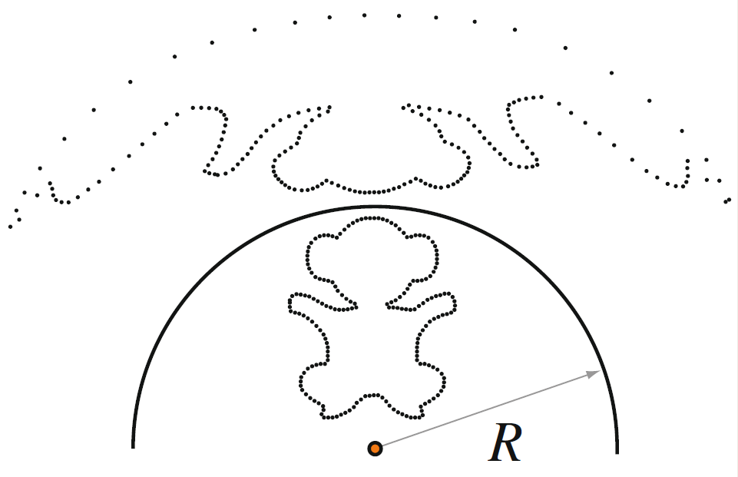
Step 1 : Inversion
Inversion : For each point p_{i} P, inversion function f(p_{i})
a) Spherical where R is radius of inversion
b) Exponential where γ > 1 and |p_{i}| is norm and |p_{i}| < 1
Notes:
In the first step, the point cloud is inverted by a suitable inversion function. Typically, spherical/exponential functions are used.
In the spherical inversion, the inversion parameter is Radius of inversion R.
In case of exponential function, gamma is the inversion parameter.

Slide 8
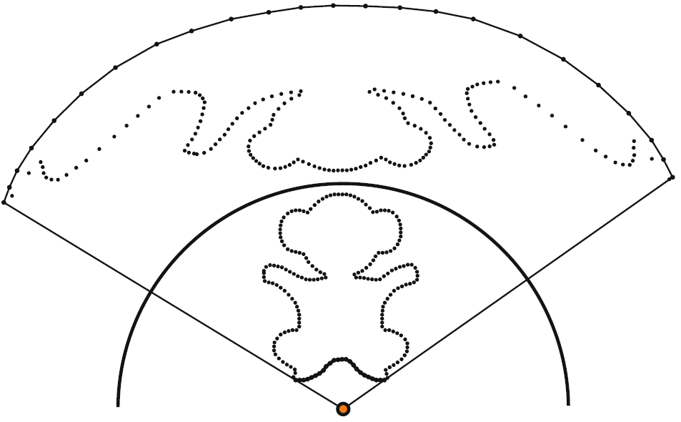
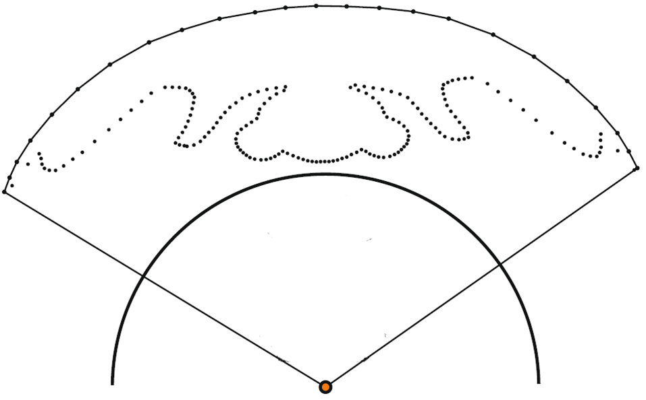
Step 2 : Convex Hull
Convex Hull : Take convex hull of f(P) U C
Visible points : p_{i} marked visible if f(p_{i}) lies on convex hull
Notes:
The second step performs a convex hull construction on the inverted point cloud and the viewpoint.
Points p_{i} whose corresponding inverted points f(p_{i}) lie on the convex hull, are marked visible.

Slide 9
Visible points
Visible points
Visible points : p_{i} marked visible if f(p_{i}) lies on convex hull

Slide 10
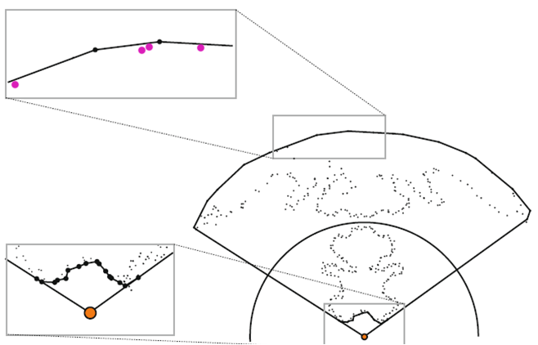
HPR Limitations - I
Susceptibility to noise
noise in PCD
visible points get displaced from convex hull
noise increases -> false negatives increase
→ large perturbations in convex hull
declared hidden
→ false negatives
False negatives
Visible points
Notes:
HPR operator has several limitations, the most important of which, is its susceptibility towards noise.
Noise in PCD is quite common and can come from various stages of the scanning process.
The effect of noise on HPR operator is quite drastic. Noise in the PCD displaces the points causing large structural perturbations in the convex hull.
Certain points that earlier lied on the convex hull get displaced, resulting in HPR operator declaring them as hidden. Such visible points that are wrongly declared hidden by the HPR are called false negatives.
As noise amount increases, false negatives also increase.
//In case of noise, the optimum radius used by the HPR, may converge at a higher value also resulting in hidden points being declared visible. These are called false positives.

Slide 11
HPR Limitations - II
High curvature concave regions
convex , oblique planar : correctly resolved
concave : curvature threshold κ_{max} exists
only regions with curvature κ < κ_{max} correctly resolved
increasing R increases κ_{max}
, but results in false positives
Hidden points
Visible points
HPR
HPR large R
Notes:
Another important drawback of HPR is its inability to resolve concave regions of high curvature. According to the original paper, HPR correctly resolves convex and oblique planar regions.
For concave regions, a curvature threshold exists
For concave regions whose curvature is less than Kmax are correctly resolved.
But for concave regions with curvature > Kmax, HPR operator cannot extract the visibility. In this case, several visible points are declared hidden.
One could potentially increase the curvature threshold Kmax by increasing radius of inversion R. But increasing R, also results in several hidden points being wrongly declared as visible called false positives.
Therefore one cannot hope to increase curvature threshold without introducing false positives.

Slide 12
Robust HPR operator
Notes:
We overcome both these limitations of the original HPR operator proposed by Katz et al and introduce a robust visibility operator that handles both noisy point cloud as well as high curvature concave regions.

Slide 13
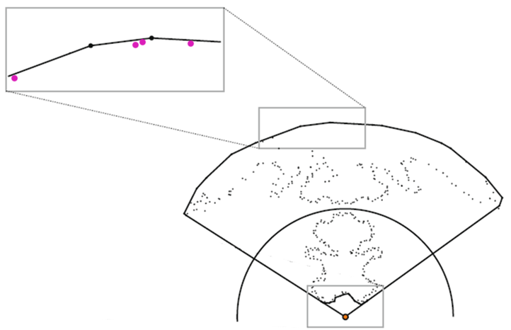
Noise robustness
Observation
noisy inverted points stay close to convex hull
Robust HPR
quantify effect of noise on inversion of points
maximum deviation of inverted points from convex hull
relax visibility condition
→ include points near convex hull
Notes:
One important observation to make in case of noisy point clouds is that, they don’t get displaced very far from the convex hull. In such cases the corresponding inverted points stay close to the new convex hull instead of being exactly on it.
We theoretically quantify this observation by analyzing the effect of noise on the inversion.
Based on this, we bound the maximum deviation possible of the inverted point from the new convex hull.
Once this maximum deviation is known, we can relax the visibility criteria from being exactly on the convex hull to being near the convex hull.

Slide 14
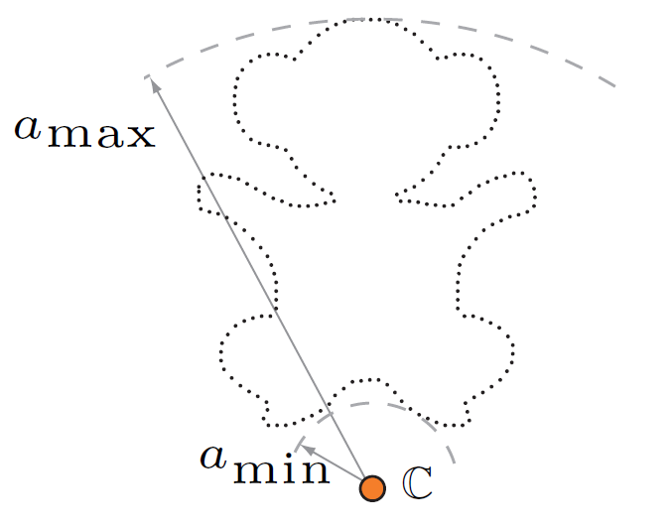
Robust Visibility
Symbols
C : viewpoint
P := {p_{i}} : original noise free point set
P^{σ} := {p_{i} + σ n_{i}} : noisy point set
a : maximum noise amount
σ : uniform random variable over range [0, a]
n_{i} : unit vector in random direction
R : radius of inversion
a_{min} : distance from C to closest point in P
a_{max} : distance from C to farthest point in P
D = |a_{max} – a_{min}| : diameter of PCD
Noise model : in case of noise, every point
is perturbed to a position chosen uniformly at random
from a ball of radius a centered at it, as Mitra et al.[04], Pauly et al.[04]
p_{i}+ σ n_{i}
p_{i}
Notes:
For discussing these theoretical results, we will first introduce the various symbols and the noise model used.
INTRODUCE SYMBOLS
INTRODUCE NOISE MODEL
Here we discuss the results of only spherical inversion, while the corresponding results for the exponential inversion case can be found in the Appendix of the paper.

Slide 15
Theorem 1 : Maximum noise in the inverted domain under spherical inversion function is
inverted noisy points will be perturbed at max
worst case : some visible points might
move out by = convex hull displacement
move in by
maximum separation from points to convex hull = 2
points closer than 2
Projection and visibility condition :
where α is projection parameter and D = |a_{max} – a_{min}| = diameter of PCD
→ mark visible
→ project
Notes:
Given the input noise sigma, this first theorem quantifies the corresponding maximum noise in the inverted domain.
We have to be careful here because we don’t want the points on the opposite side of the point cloud to get projected. Thus, …

Slide 16
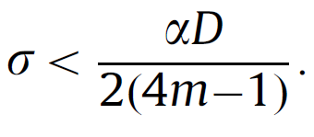
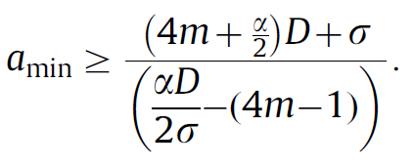
On further simplification, we get
Lemma 1 : Projection can be applied if
This gives an upper bound on noise
Theorem 2 : Minimum distance between a viewpoint and the PCD is
region of space - visibility cannot be estimated : defines a guard zone
for , guard zone spans entire space
Noisy Point Cloud
Guard Zone

Slide 17
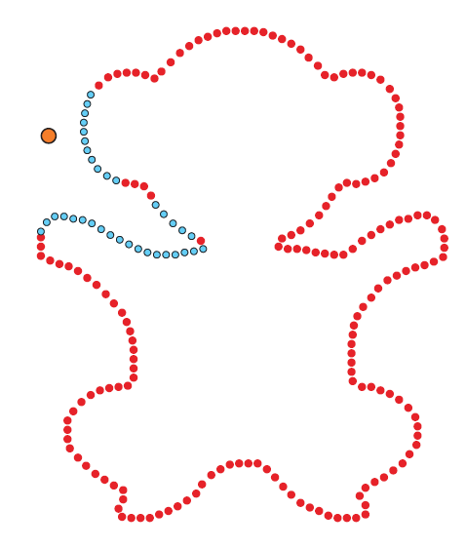
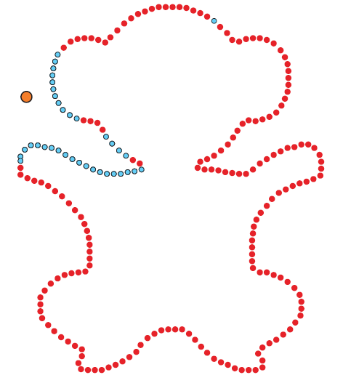
Concavity robustness
Observation – consistent visibility
convex, oblique planar regions : correctly visible
high curvature concave regions : high R
Robust HPR
softer notion of visibility : weighted visibility
visible points → persistently visible over range of R
Keeping viewpoint fixed, vary R in range [a_{max},R_{max}]
Each point assigned weight
weight(P) = # of times P is tagged visible
False positives not persistently visible →low weights
Filter out points with low weights
Hidden points
Visible points
Hidden points
Visible points
Robust HPR
Ground truth
HPR
HPR large R
Notes:
For dealing with concave regions with high curvature, we come back to the observation that visibility of convex, oblique planar regions are correctly estimated by the HPR operator.
For concave regions with high curvature, higher values of R are needed. But that might results in false positives in the PCD.
For dealing with PCD with such regions, we introduce a softer notion of visibility i.e. a weighted visibility. We perform multiple visibility test for the same viewpoint but with varying R in the range [amax, Rmax]. The idea is that visible points should be persistently visible for a range of values of R. Each point is then assigned a weight equal to the number of times the point is declared visible. This weight is then normalized. Thus instead of using a 0/1 binary visibility of hidden or visible we assign a normalized visibility weight to each point cloud.
False positives are not persistently visible and get removed by filtering points with low visibility weights.

Slide 18
RESULTS
Notes:
We now discuss some of the visibility results of the robust HPR operator and compare it with the original operator.

Slide 19
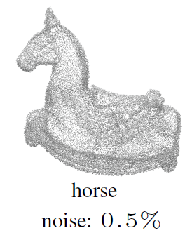
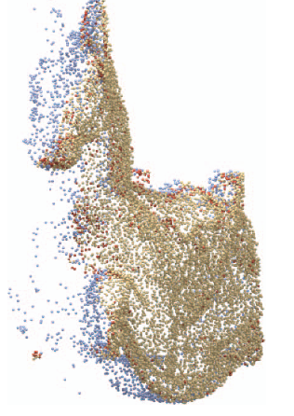
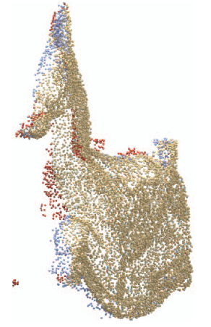
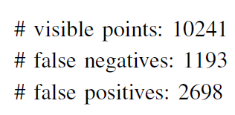
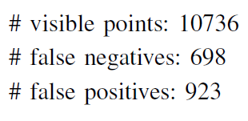
HPR Visible point
HPR False positive
HPR False negative
Original HPR
Robust HPR

Slide 20
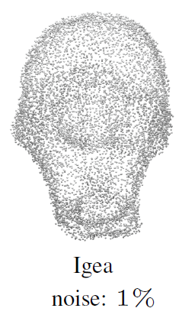
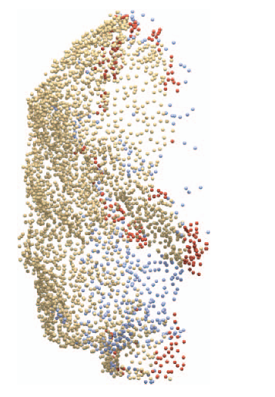
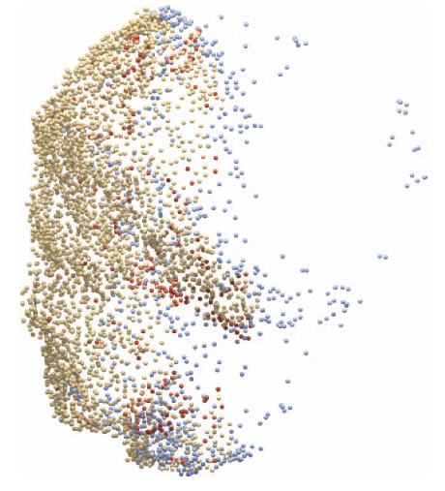
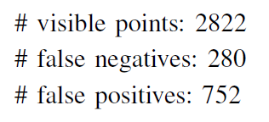
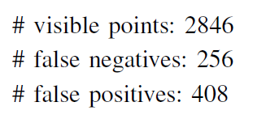
HPR Visible point
HPR False positive
HPR False negative
Original HPR
Robust HPR

Slide 21
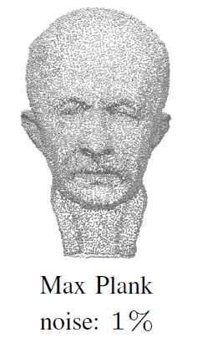
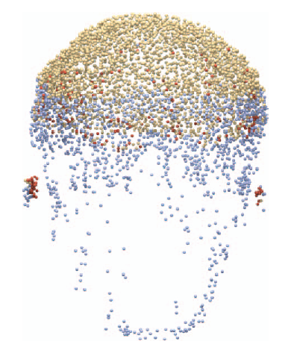
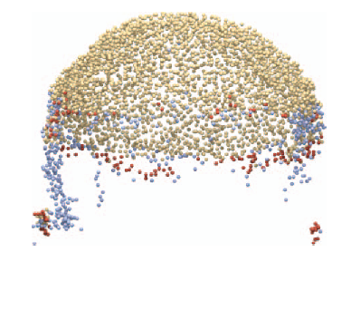
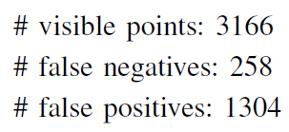
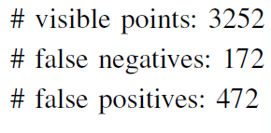
HPR Visible point
HPR False positive
HPR False negative
Original HPR
Robust HPR

Slide 22
Timings
Robust visibility operator timings for the test scenarios shown
on a 2.8 GHz Intel Xeon desktop with 3 GB RAM
Notes:
Spend more time

Slide 23
Applications
Notes:
We now come to the applications of robust HPR operator.

Slide 24
Visibility based reconstruction
From a viewpoint
set of visible points – robust visibility
local connectivity = convex hull connectivity → partial reconstruction
Place multiple viewpoints : outside guard zone
locally consistent partial reconstructions
globally coupling → graph theoretic framework → full reconstruction
* for more details, please refer to the paper
Notes:
One of the main applications of a visibility operator is in visibility based reconstruction. For 2D points, its curve reconstruction and for 3D points its surface reconstruction.
When we apply a visibility operator for a viewpoint, we get a set of visible points as well as the local connectivity between those points. Local connectivity is same as the convex hull connectivity. There we get a partial reconstruction for a single viewpoint.
For performing a full reconstruction, we place multiple viewpoints around the point cloud outside its guard zone and gather partial reconstructions from each of these points. We then globally couple them using a graph theoretic framework and get a full reconstruction.
More details are in the paper.

Slide 25
Curve reconstruction
noise-free
medium-noise
high-noise

Slide 26
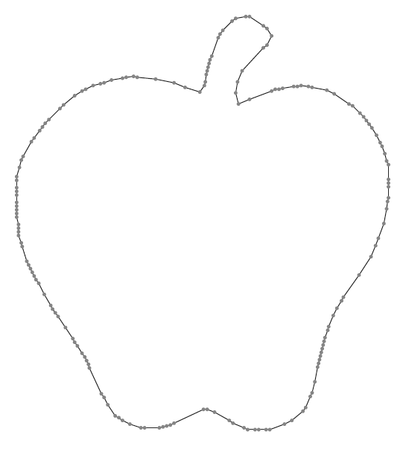
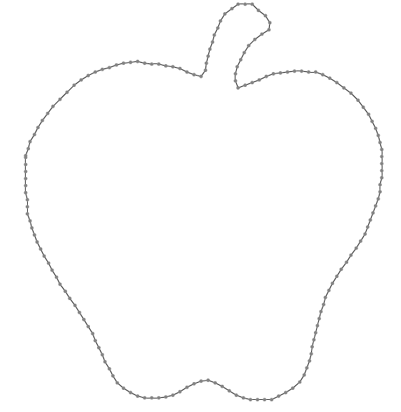
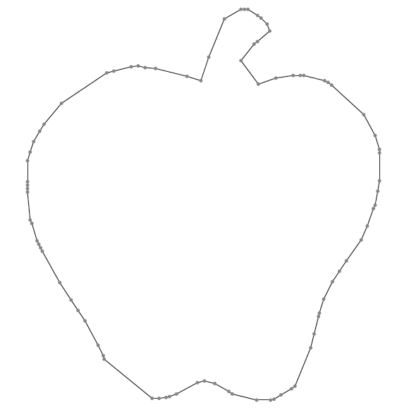
medium-noise sampling
high-noise sampling
noise-free
75%-missing sampling
noise-free
50%-missing sampling
noise-free sampling

Slide 27
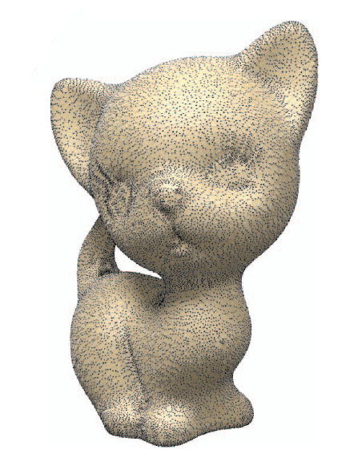
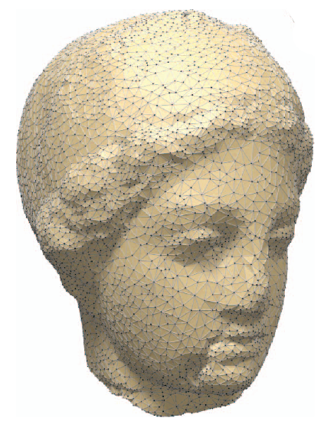
Surface reconstruction
Notes:
NOISELESS

Slide 28
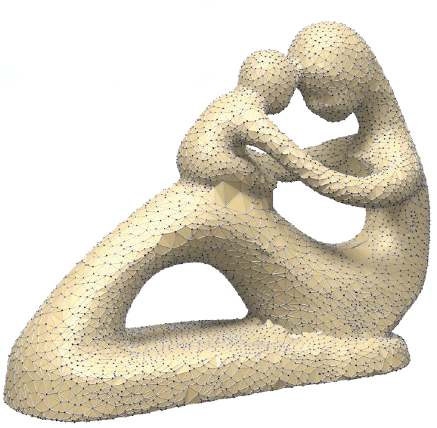
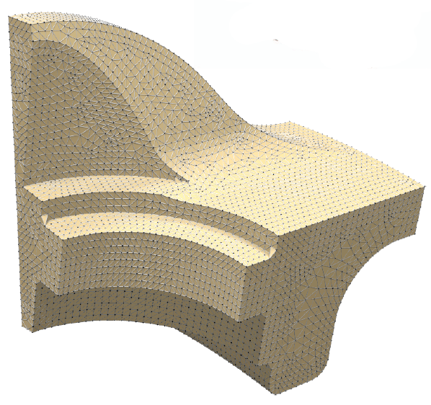
Surface reconstruction
Notes:
NOISELESS

Slide 29
Noise Smoothing
Place multiple viewpoints – outside guard zone
each viewpoint → local connectivity
build global weighted connectivity
edge weight = # times edge appears in local connectivities
apply HC Laplacian smoothing : Volmer et al.[1999]
Repeat above step - typically 4-5 iterations
Notes:
For performing noise smoothing, we again place multiple viewpoints around the point cloud, outiside its guard zone. From each point, we get a set of visible points with local connectivity. Build a global weighted connnectivity, where each edge is assigned a weight = # times edge appears in diff. local connectivities.
Using this edge weights and connectivity information, we apply HC laplacian smoothing to smooth the PCD. This step is repeated for 4-5 iterations.

Slide 30
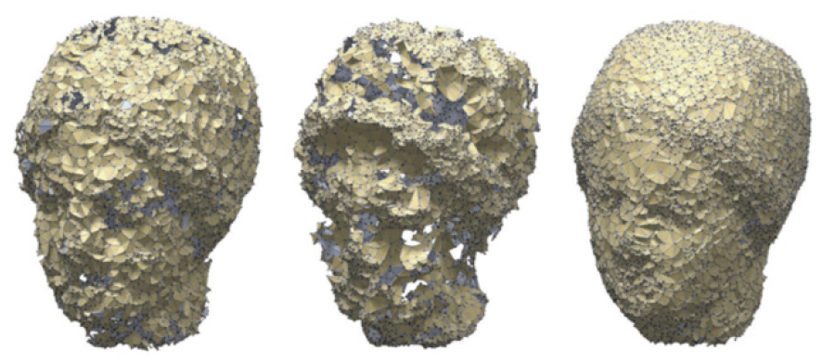
Noise Smoothing
Noisy PCD
Original HPR
smoothing
Robust HPR
smoothing

Slide 31
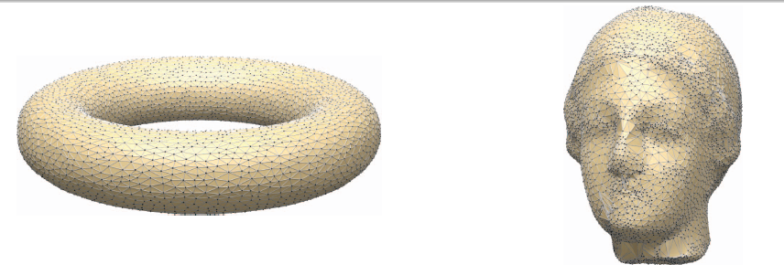
Smoothing + Reconstruction
Noisy
Smooth

Slide 32
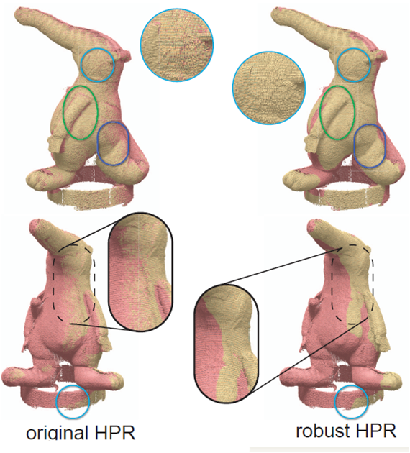
Visibility
Raw Scan :
Coati model
Hidden points
Visible points
Notes:
Typical behavior of original HPR and robust HPR on raw scanned data from
a given viewpoint (not shown), with the hidden points in pink and visible points in
yellow. Notice that the boundary between visible and hidden regions is sharp with
robust HPR, indicating few misclassifications. We highlight some regions where original HPR clearly produces a large number of misclassifications.

Slide 33
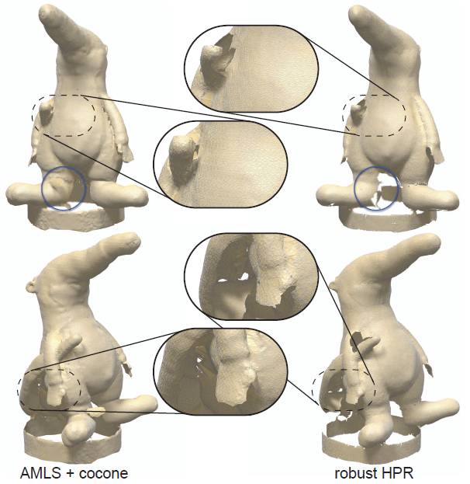
Reconstruction
Raw Scan :
Coati model
Dey et al.[01,05]
Notes:
Reconstruction outputs on raw scanned data for the coati model using a
combination of AMLS [18] and cocone [12] (left), and robust HPR based smoothing
(Section 4.4) with reconstruction (Algorithm 2). While AMLS-cocone generate
large triangles in poorly sampled regions our approach provides a more natural
result leaving such regions empty. Similarly, by construction, our method avoids
self intersections present in AMLS-cocone based reconstruction

Slide 34
Conclusion
Better understanding of behavior of PCD under noise
Theoretical bounds leading to practical visibility algorithm
Testing on synthetic/real data sets
Applications : reconstruction and smoothing

Slide 35
Acknowledgements
Tamal Dey
Mitra and colleagues
Yongliang Yang
AIM@SHAPE
Anonymous reviewers
and
THANK YOU

Slide 36
Comparison
noise-free
medium-noise
high-noise

Slide 37
Comparison
noise-free
medium-noise
high-noise

Slide 38
Comparison
noise-free
medium-noise
high-noise

