Slide 1
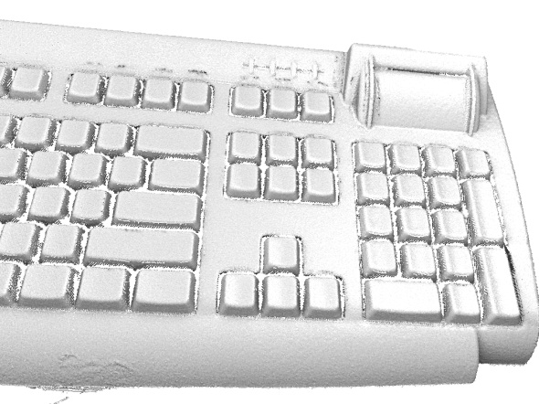
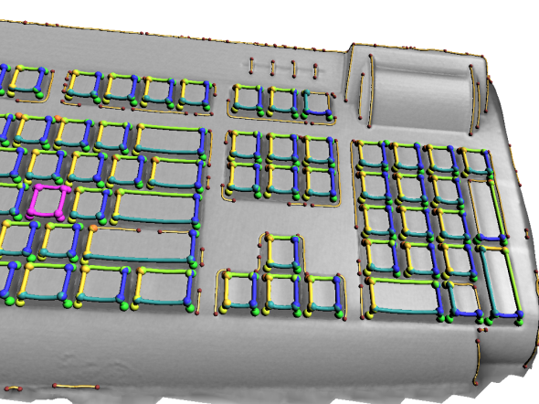
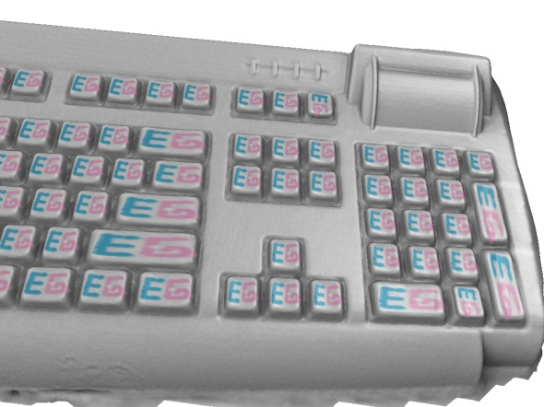





Shape Analysis with
Subspace Symmetries
Alexander Berner¹ Michael Wand^{1,2} Niloy Mitra^{3,4}
Daniel Mewes¹ Hans-Peter Seidel¹
¹MPI Informatik ²Saarland University ³KAUST ⁴IIT Delhi

Slide 2
Overview
_Introduction_
Related Work
Subspace Symmetries
Detection Algorithm
Results
Conclusions

Slide 3
Overview
Introduction
Related Work
Subspace Symmetries
Detection Algorithm
Results
Conclusions

Slide 4
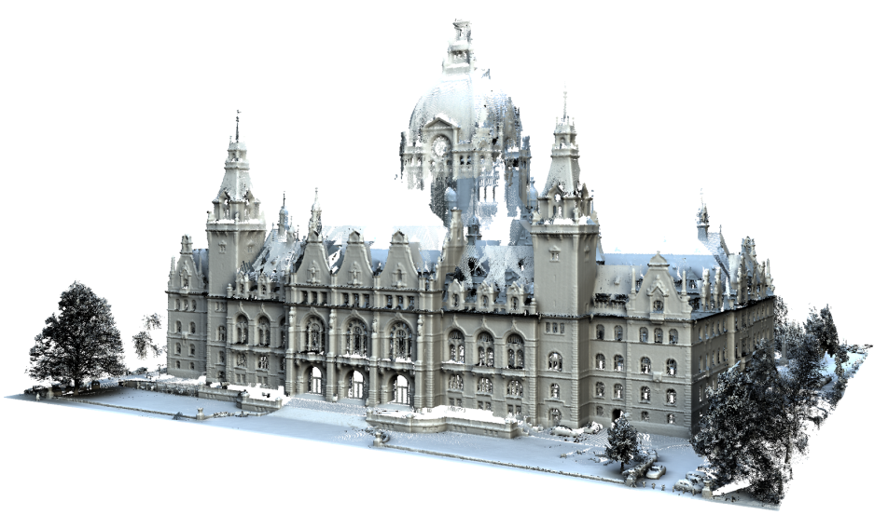
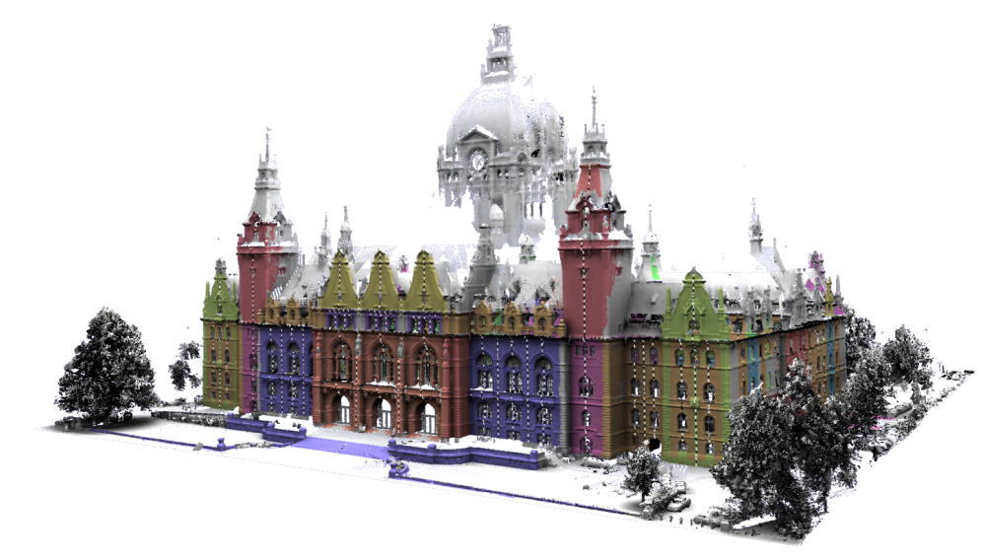
Partial Symmetries
Partial Symmetry Detection
  Find similar parts
  Decomposition into building blocks
  Fundamental tool in shape understanding

Slide 5
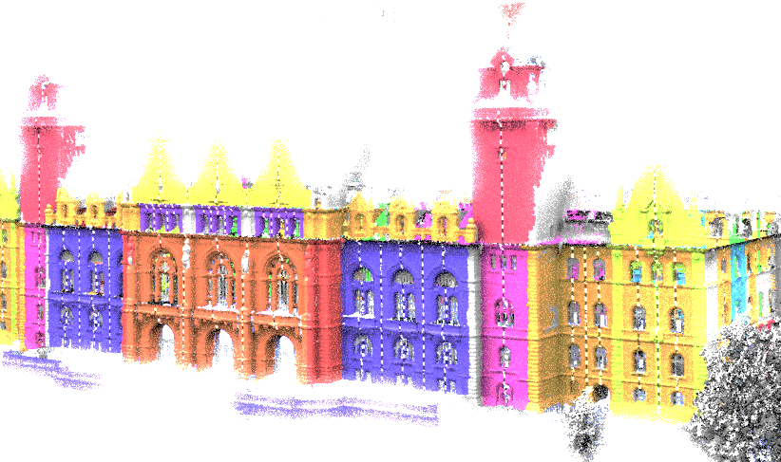
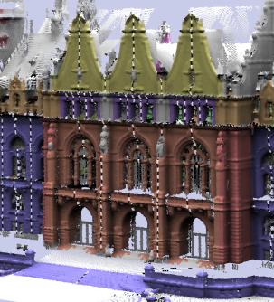
Partial Symmetries
Partial Symmetry Detection
Repetetive Parts

Slide 6
Partial Symmetries
P
f₁
f₂
f₃
f₄
f₅
S
Partial Symmetry Detection
  Repetitive part (sufficiently large),
  Transformations f_{i} ∈ G,
  Group of transformations G
P
P ⊆ S
f_{i}(P ) ⊆ S

Slide 7
Restriction
f₁
P
f₃
G
f₄
f₂
Restriction
  Fixed group of transformations
    Rigid motions, reflections, scaling, affine maps
    Intrinsic isometries
  Need to define a priori what constitutes similarity

Slide 8
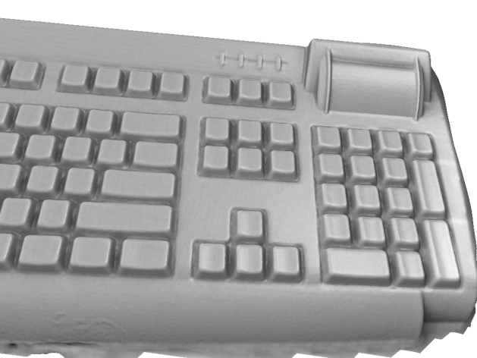
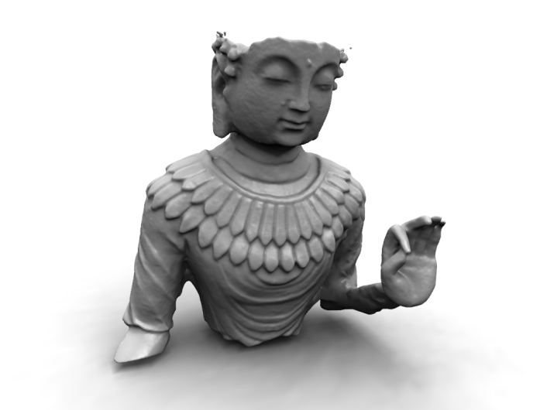
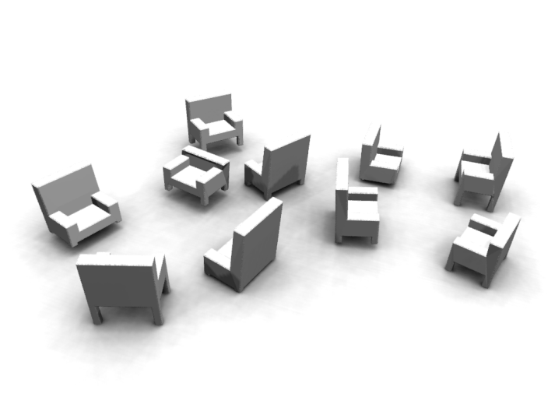
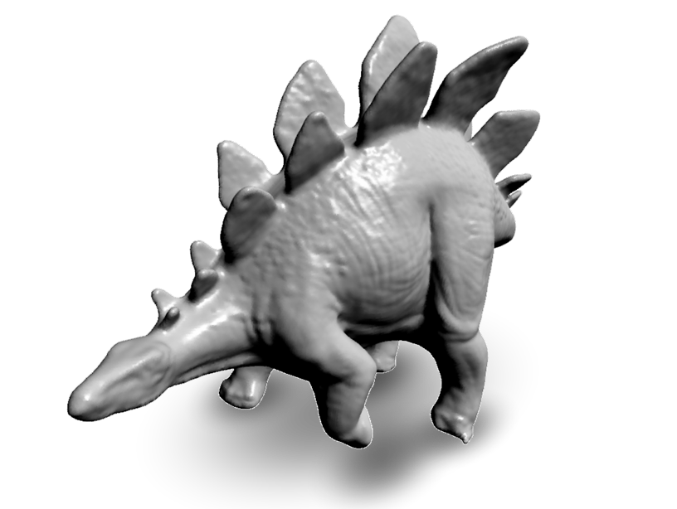
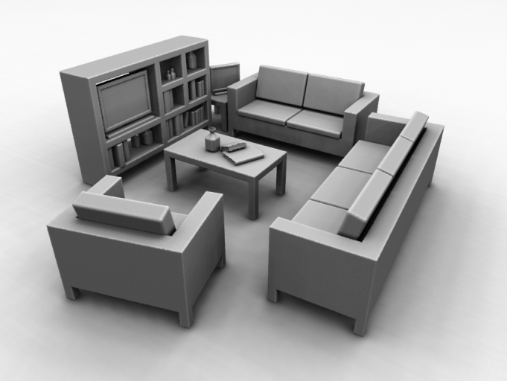
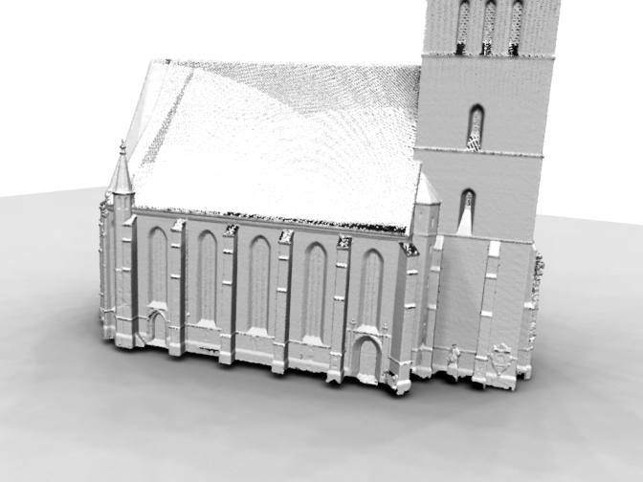
More General Symmetries

Slide 9
Overview
Introduction
Related Work
Subspace Symmetries
Detection Algorithm
Results
Conclusions

Slide 10
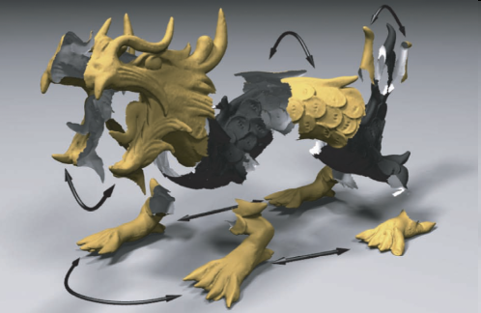
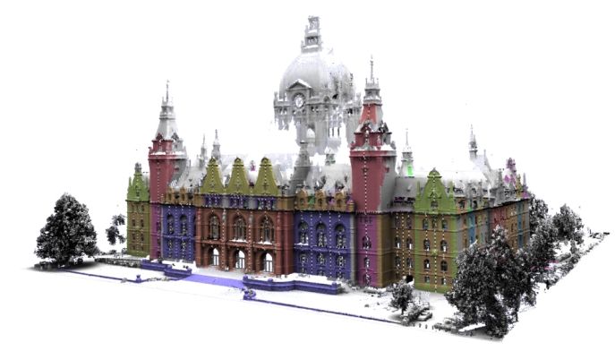
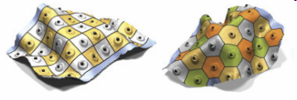
Symmetry Detection
Fixed Transformation groups
  Reflections
    [Podolak et al. 2006], [Loy et al. 2006]
  Euclidean Transformations
    [Bokeloh et al. 2009]
  Similarity transforms
    [Mitra et al. 2006], [Pauly et al. 2008]
  Intrinsic isometries
    [Ovsjanikov et al. 2008],
    [Lasowski et al. 2009], [Xu et al. 2009]
    [Mitra et al. 2010], [Kim et al. 2010]

Slide 11
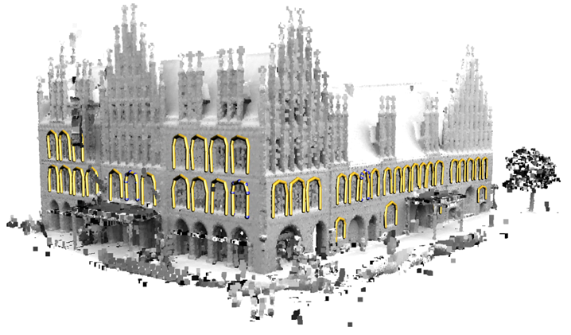
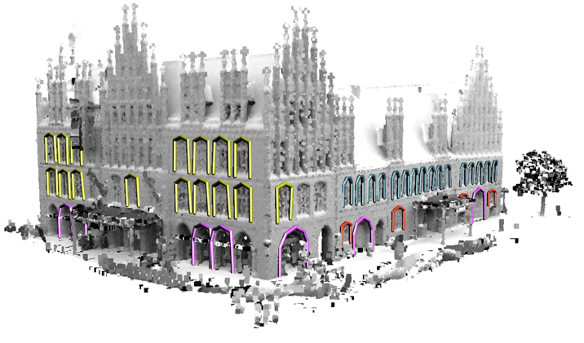
Global Matching of General Shapes
Global Pairwise Matching
  Topological Methods
    [Hilga et al. 2001]
  Combinatorial Search
    [Zhang et al. 2008], [Au et al. 2010]
Learning
  [Kalogerakis et al. 2010],
  [van Kaik et al. 2011], [Sunkel et al. 2011]

Slide 12
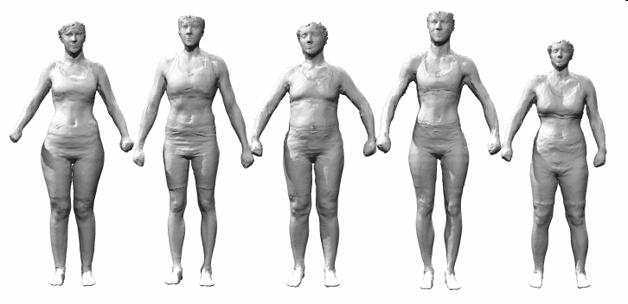
Global Matching of General Shapes
Building subspace models
  Local matching, user guided
    [Blanz et al. 1999], [Allen et al. 2003],
    [Hasler et al. 2009]

Slide 13
Overview
Introduction
Related Work
Subspace Symmetries
Detection Algorithm
Results
Conclusions

Slide 14
Subspace Symmetries
f₁
P
f₃
G
f₄
f₂
No transformation groups
  (Almost) arbitrary mappings
  How to avoid spurious matches?
Key idea
  Matching functions must form low dimensional subspace

Slide 15
Subspace Symmetries
Shapes
Subspace (1D)

Slide 16
Objective
Find
  Part
  Functions f₁, ..., f_{n}:
Such that:
P
⊆ S
P
→ S
Rigid Motion
(Param)
Shape Coordinates
(Param)
d <
< n
Mean
(Model)
Basis function
(Model)

Slide 17
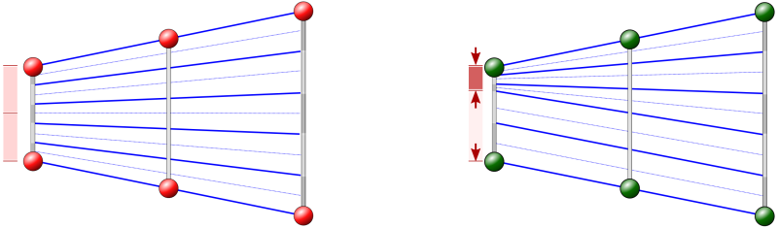
Remarks
Uniqueness:
  Many aquivalent subspace models might fit the same data
  Symmetry breaking: minimize bending
Gaussian Model:
  We can learn covariance from data
  Additional constraint
Example Shapes
P

Slide 18
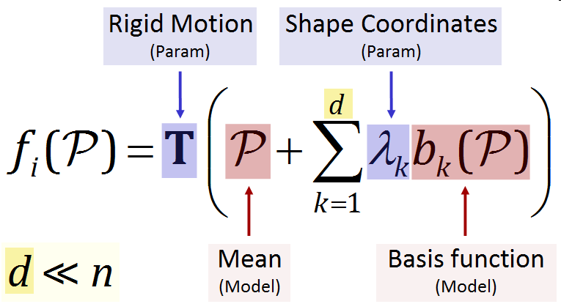
Challenge
Input
  Shape
Unknowns
  Part
  Functions f₁, ..., f_{n}
Can be computed
  Rigid transformations T₁, ..., T_{n}
  Basis functions b₁, ..., b_{n}
  Shape coordinates λ₁, ..., λ_{n}
S ⊆ R³
P µ S

Slide 19
Challenge
Unknowns
  Part
  Functions f₁, ..., f_{n}
Problems
  Need correspondences
  High dimensional objects
  Very large search space
P ⊆ S
?

Slide 20
Overview
Introduction
Related Work
Subspace Symmetries
Detection Algorithm
Results
Conclusions

Slide 21
Three Steps to Reduce Complexity
1. Feature matching
  Sparse, discrete matching
2. Graph matching
  Matching heuristic
3. Optionally: User training
  Learn graphs from user input

Slide 22
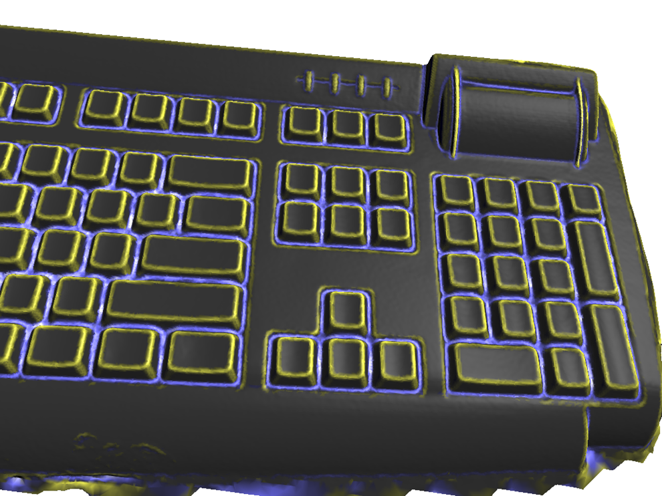
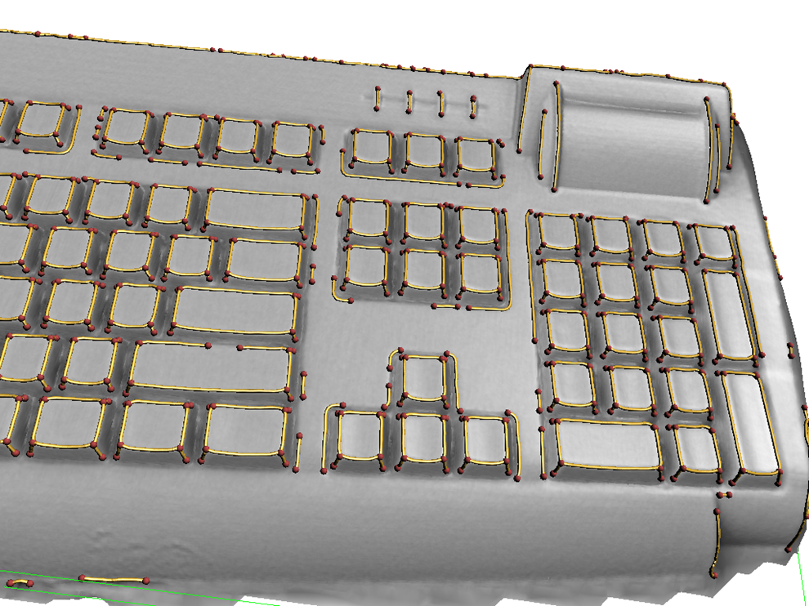
Feature Extraction
Features: surface curves & crossings
  Assumption: Features invariant under symmetry
  See paper technical details

Slide 23
Feature Matching
Brute-foce feature matching
  d-dimensional subspace, n feature points
  (3 + d) ⋅ d unknowns
  Brute force algorithm: double exponential in d
Need more efficient strategy

Slide 24
Heuristic Bootstrapping
Stronger Assumption
  Corresponding parts have similar feature graphs
Similar Graphs
  Same topology (small defects possible)
  Very coarse similarity in geometry
    Angles, up to some noise
    Roughly: Intrinsic length up to small factor
    Ridges / valleys
Bootstrapping
  Find a few instances first, build PCA model
  Partial matching finds more

Slide 25
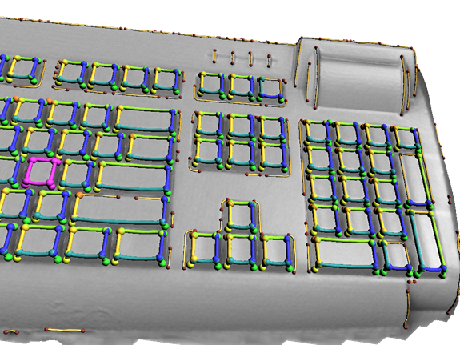
Graph Matching

Slide 26
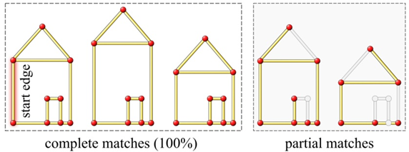
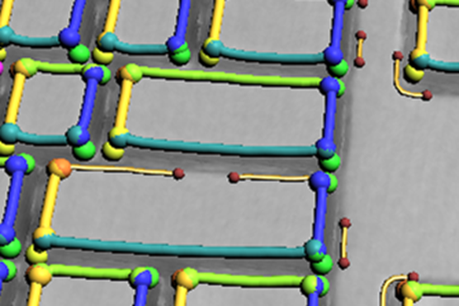
Complete & Partial Matches

Slide 27
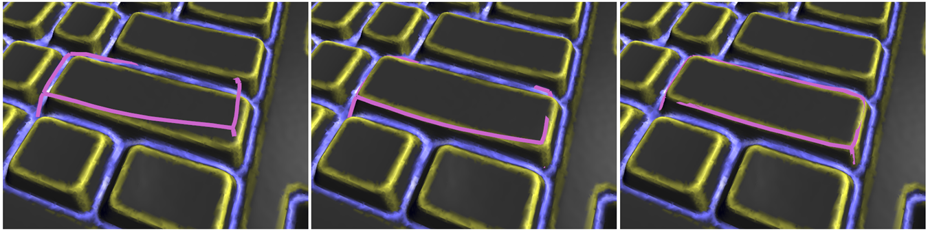
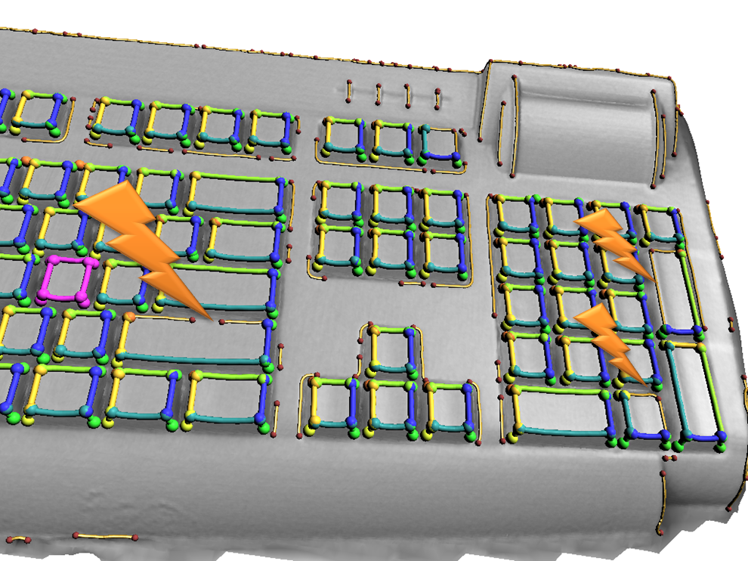

Refinement
Use discovered subspace model

Slide 28
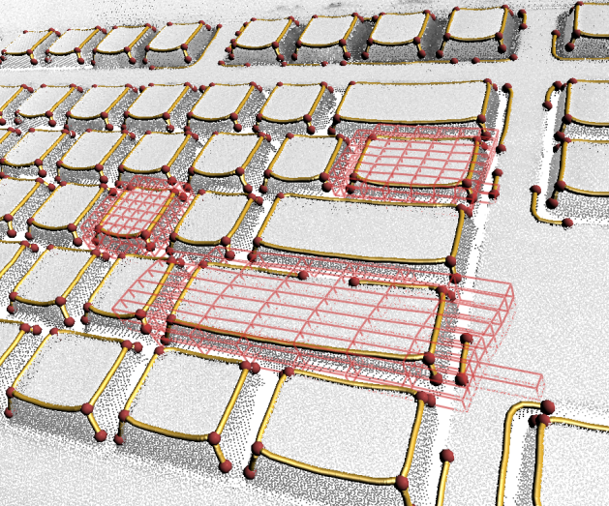
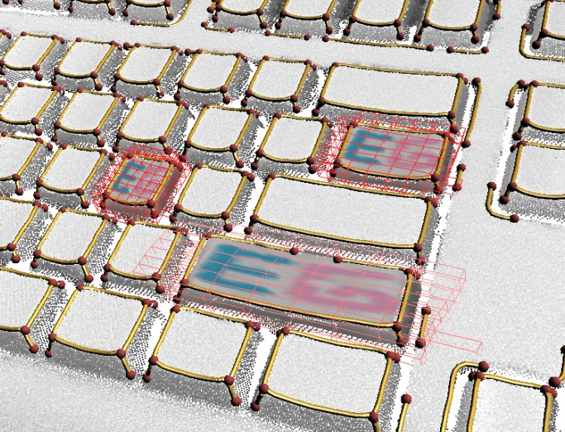
Dense Correspondences
Deformable ICP
  Fit bending minimizing dense correspondence field
  Thin-plate-splines

Slide 29

Result

Slide 30
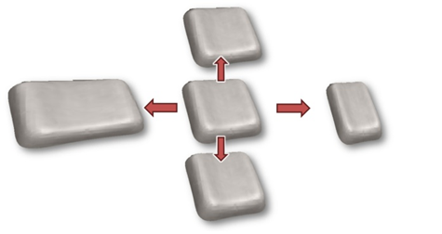
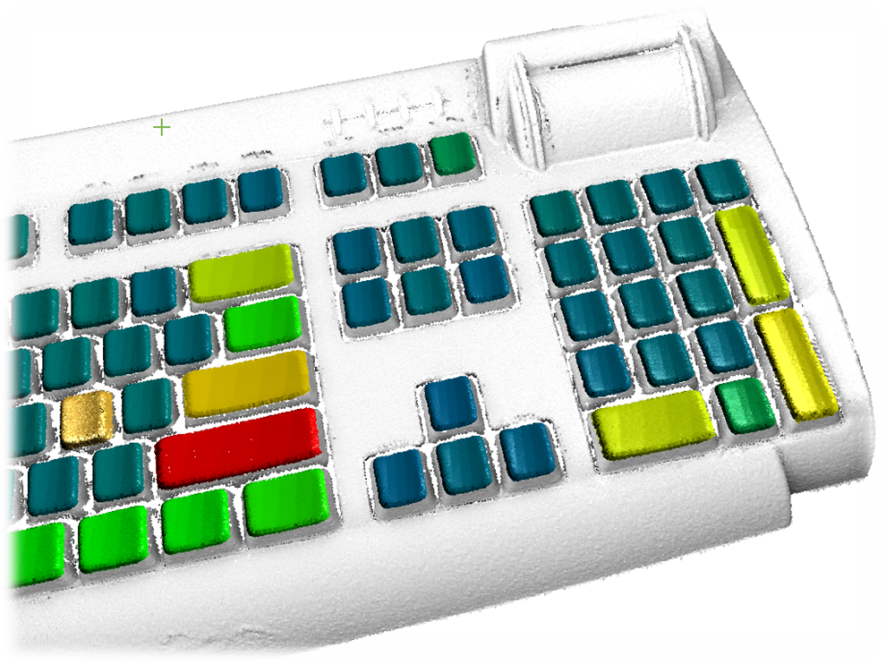
Result
initial match
principal eigenvalue

Slide 31
Extension: Manual Training
Training
  Click on corresponding feature points
  Mark relevant lines (one instance)
  Then: Learn PCA model of relevant graph parts
Usage
  Noisy, cluttered feature graphs
  Focus on „interesting“ subset
  Instance retrieval is still automatic

Slide 32
Overview
Introduction
Related Work
Subspace Symmetries
Detection Algorithm
Results
Conclusions

Slide 33
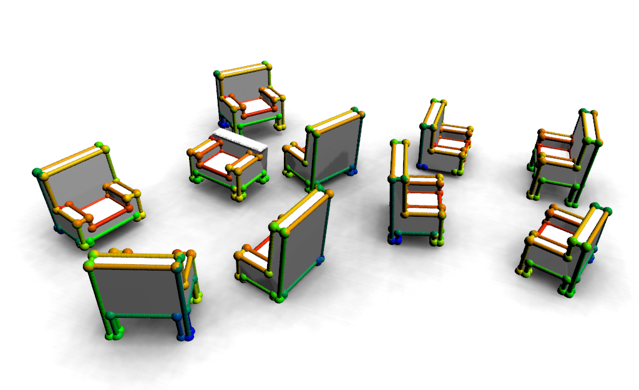
Chairs (synthetic)

Slide 34
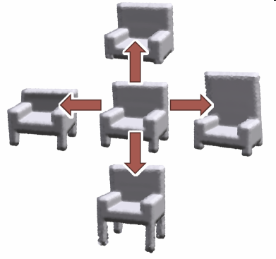
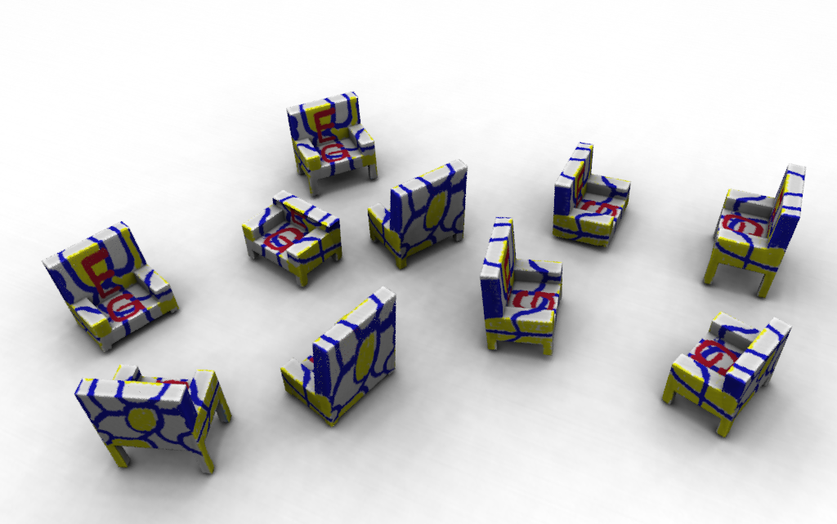
Chairs (synthetic)

Slide 35

Living Room (synthetic)

Slide 36
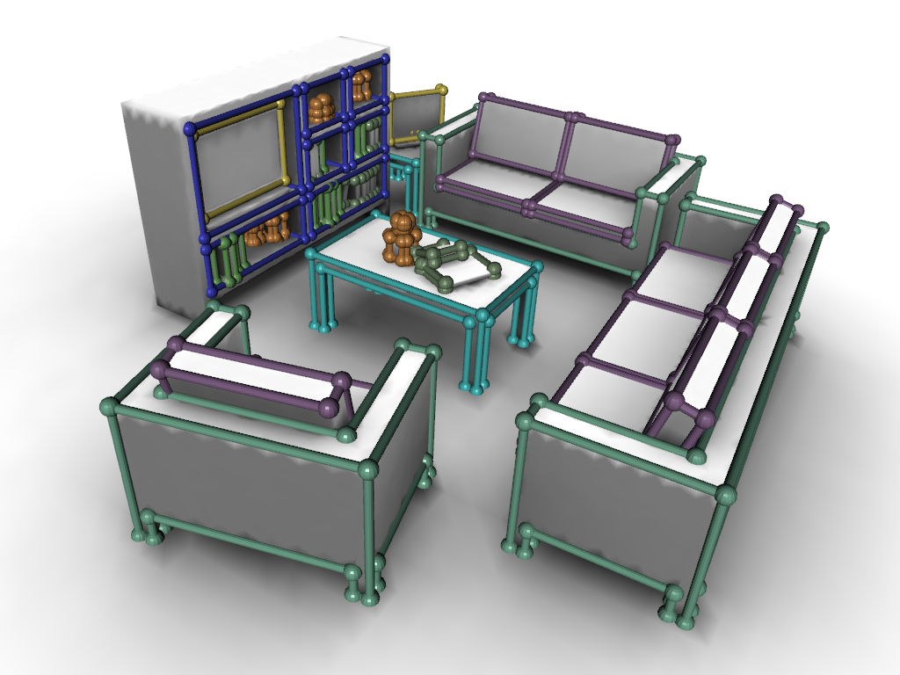
Living Room (synthetic)

Slide 37
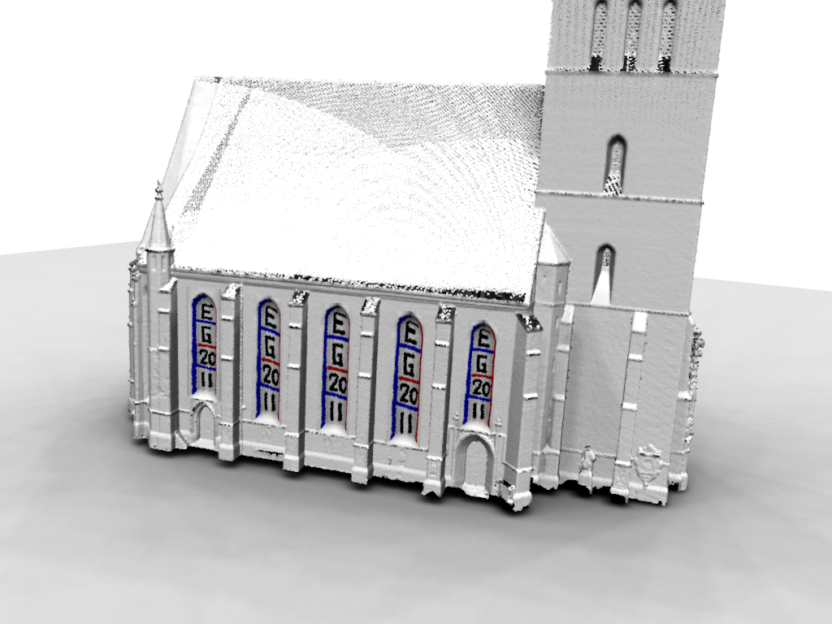
Church (3D Scan)

Slide 38
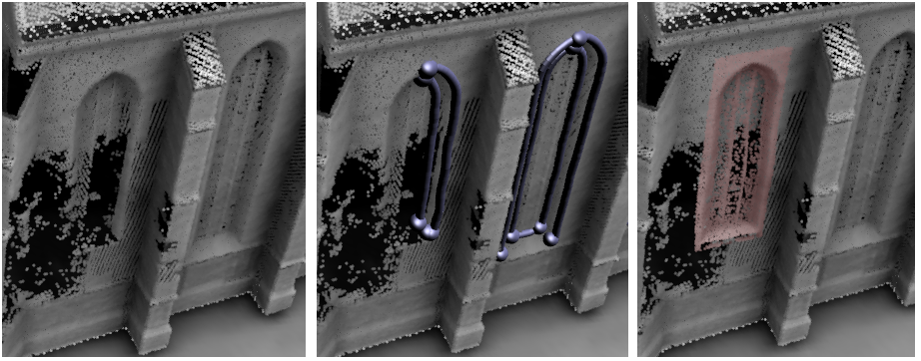
Application: Non-Rigid Hole Filling

Slide 39
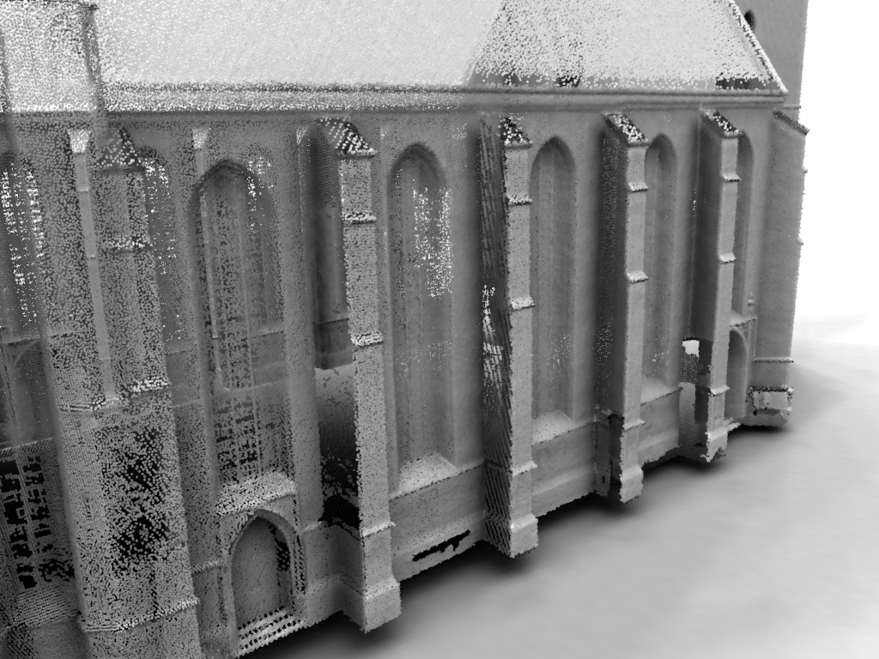
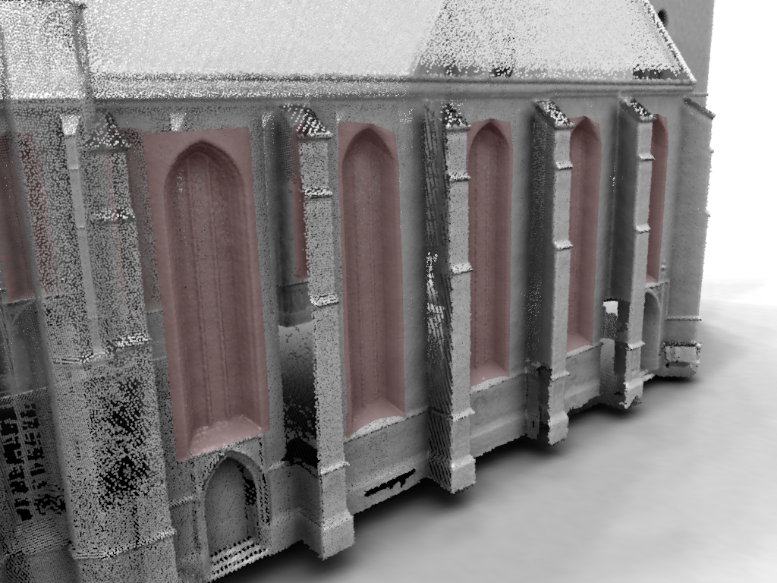
Application: Super Resolution

Slide 40
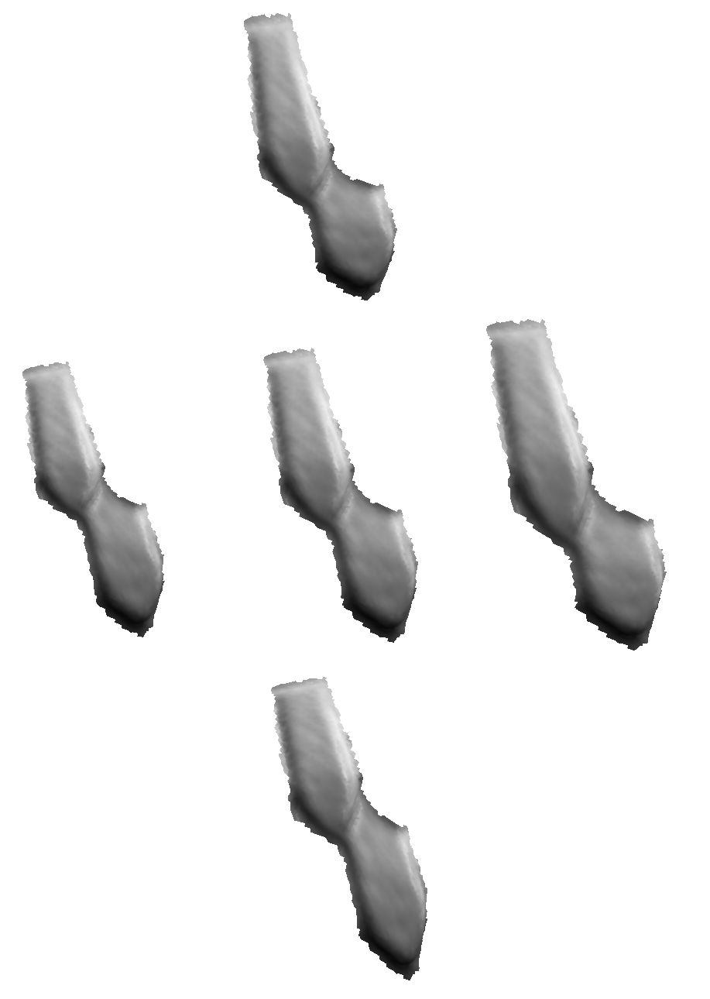
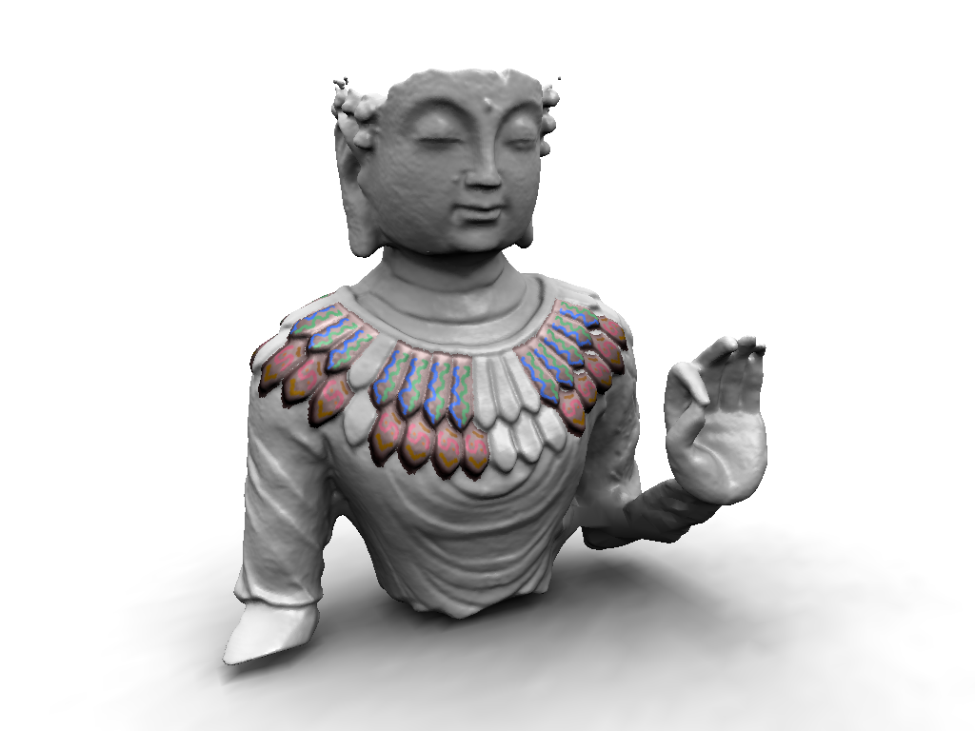
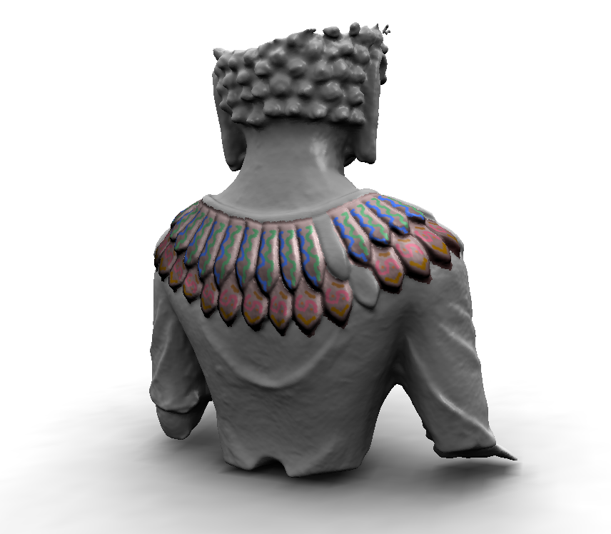
Statue (3D Scan)

Slide 41
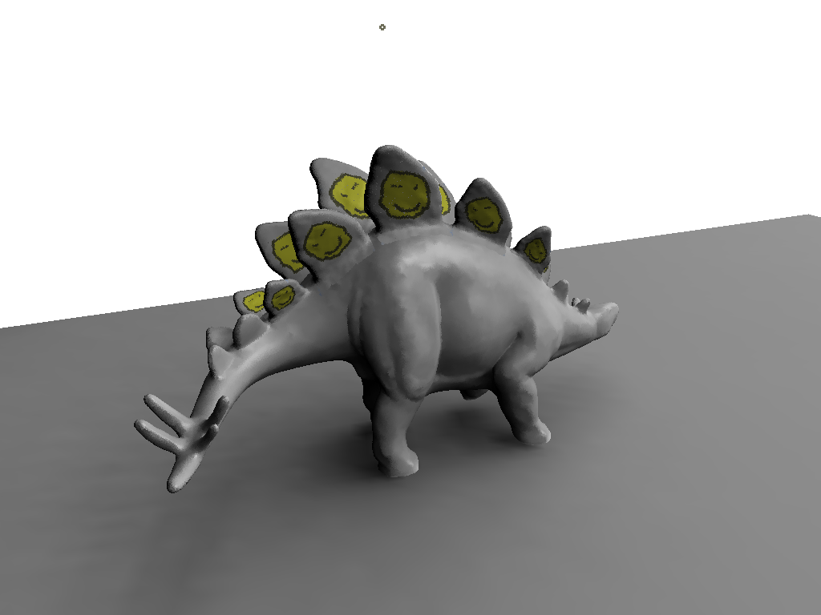
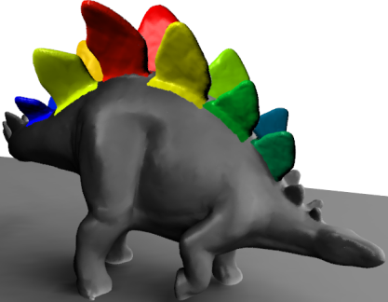
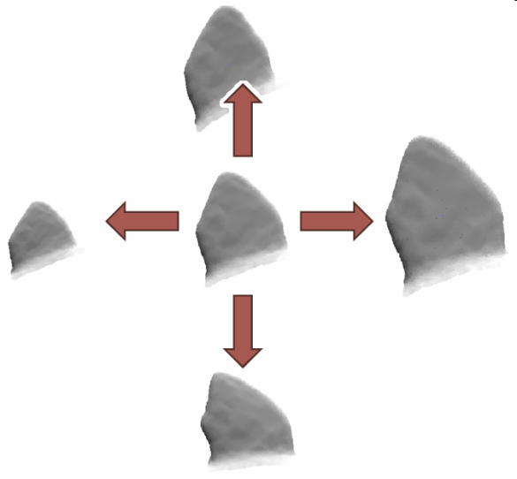
Dino (3D Scan, Manual Training)

Slide 42
Overview
Introduction
Related Work
Subspace Symmetries
Detection Algorithm
Results
Conclusions

Slide 43
Conclusions
General notion of symmetry
  Important problem
  Proposal: subspace model
Heuristic graph matching algorithm
  Can get good results on clean input
    Meshes and range data
    Parameter dependent
  Training improves performance on ambiguous data
Future challange
  Efficient direct solution

Slide 45
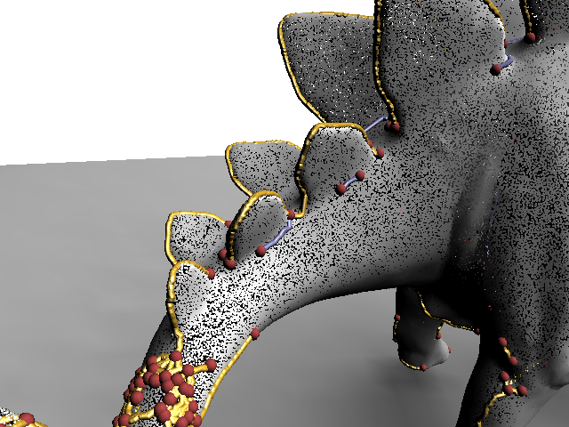
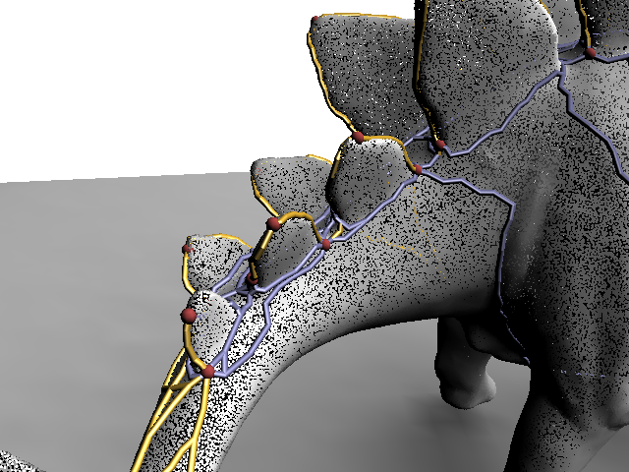
Unsupervised Feature Graphs
Unsupervised
Supervised

Slide 46
Partial Symmetries
Partial Symmetry Detection

Slide 47

Statue

Slide 48
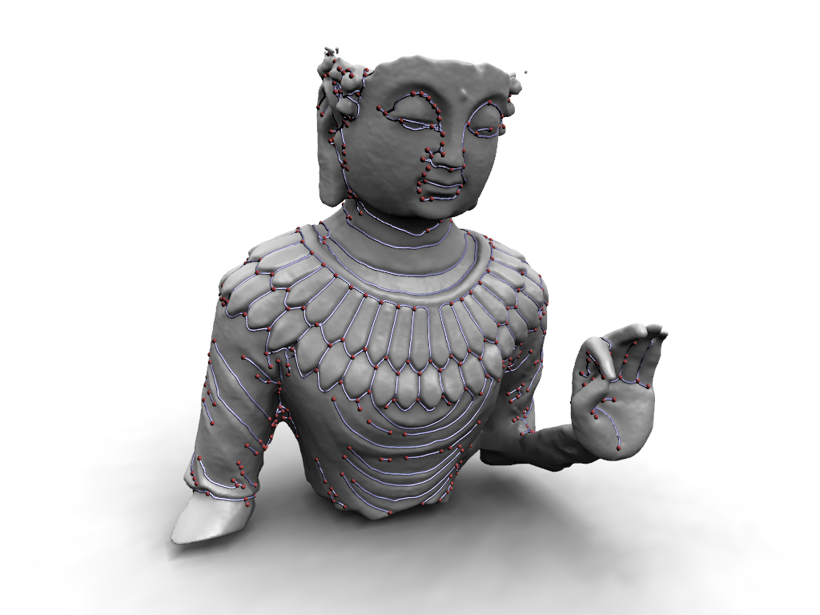
Statue

Slide 49
Feature Matching
Discovery
  (2 + d) feature points fix a subspace
  at least d instances needed to capture variability
  O(n^{(d 2)}) – double exponential in d
Finding instances
  O(n^{(d + 2)}) – exponential in d
Too costly
  Taking line proporties into account did not help in practice

Slide 50

Keyboard (3D Scan)

Slide 51

Keyboard (3D Scan)

Slide 52

Keyboard (3D Scan)

Slide 53
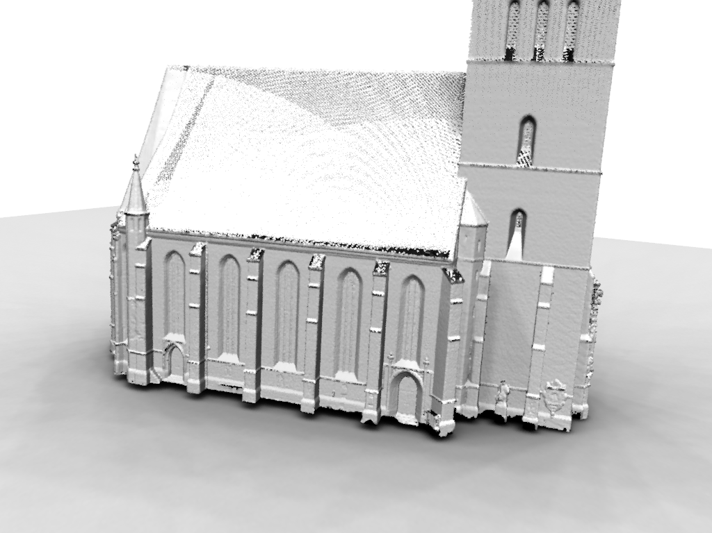
Church (3D Scan)

Slide 54

Church (3D Scan)

Slide 55

Church (3D Scan)

Slide 56

Dino (3D Scan, Manual Training)

Slide 57

Dino (3D Scan, Manual Training)

Slide 58

Dino (3D Scan, Manual Training)

Slide 59

Dino (3D Scan, Manual Training)

Slide 60


Statue (3D Scan)

Slide 61

Living Room (synthetic)

Slide 62




Many Applications
Output
Input
Applications
  Super resolution
  Shape completion
  Inverse procedural modeling

Slide 63


More General Symmetries

Slide 64
Application: Non-Rigid Hole Filling

Slide 65
Application: Super Resolution

Slide 66
Refinement

Slide 67

Refinement

Slide 68


Dense Correspondences
Deformable ICP
  Fit bending minimizing dense correspondence field
  Thin-plate-splines

