Slide 1
General Game Learning
Matthew Fisher

Slide 2
What is general game learning?
Learning to play games you have never seen
  Reading or listening to the rules
  Asking questions about the rules
  Learning the rules by playing (ex. Tetris)
  Figuring out the objective
  Being reprimanded for making illegal moves
  Learning from mistakes
  Deciding on good strategies
    The focus of 99% of game AI research

Slide 3
Goal of this talk
Convince you that general game learning is:
  Important
  Interesting
  Possible

Slide 4
Why is GGL specifically interesting?
Task Automation
  Automating real tasks is a big AI goal (folding clothes, driving cars, SQL-injection attacks)
    manually code specialized controllers for each task
    have controllers that can learn a task from examples
  Real tasks are hard to setup and evaluate
  Digital games are plentiful, complex, accessible to a computer, and easily evaluated
  To a computer there is no difference between the real world and a good simulation

Slide 5
Games
Why are games a great task?
  Games have a clear goal that can be quantified
  Games are challenging to understand
    Games require complex reasoning
    Games require often incomplete rule-learning
  Digital games are fully accessible to computers
  Games are one way humans and computers interact
  Games are fun and popular
    Deep Blue, Watson
  The dataset of available games is huge and untapped

Slide 6
We will use digital games to study…
  Unsupervised object segmentation and categorization
  Rule learning
  Knowledge transfer between categories
    Between Mario & Luigi
  Goal inference
  Game state value estimation
  Action planning
  Knowledge transfer between games
    Between Super Mario 1 and Super Mario 3
    Between Shogi and Chess

Slide 7
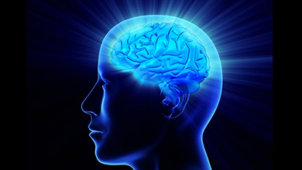
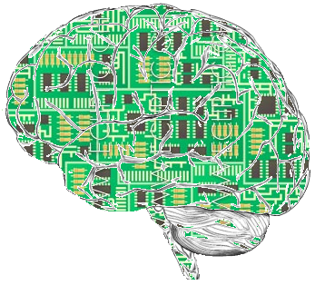
Artificial intelligence
Notes:
Going to frame problem in the context of AI to demonstrate how the concept fits into the field at large. My argument is going to be that GGL is absolutely central to AI and yet relatively unexplored.

Slide 8


Goal is to solve problems

Slide 9
Problem Space (Humans)
Natural Language Understanding
Speech Recognition
Motion Planning
Vision, Object Recognition, Categorization
Adversary Prediction
Rule Learning
Strategic Planning
Competition
Notes:
“AI completeness” argument

Slide 10

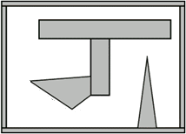
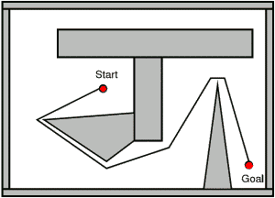
Solution Space (Humans)
Raw Sensor Input
Implement Solution
Internal Representation
Solve Internal Representation
Notes:
Often subconscious

Slide 11
(Some) Tasks in General Learning
  Define meaningful internal representation
    Categorize, classify, and learn from raw data
  Process raw signal
  Map raw signal onto internal representation
  Solve problem using the internal representation
  Map solution to an action and execute it

Slide 12
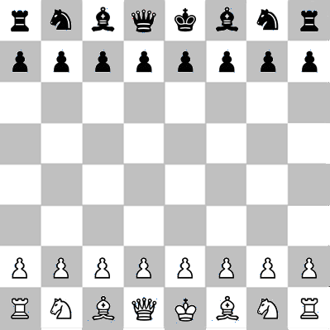
Representation is everything
Trying to learn rules without a good representation is impossible
  Imagine trying to learn the rules of Chess at the level of pixels or 2x2 blocks
  We can guess that one representation is better than another if it is easier to learn rules about how the environment behaves using the representation

Slide 13
Real-world
General Game Learning

Slide 14
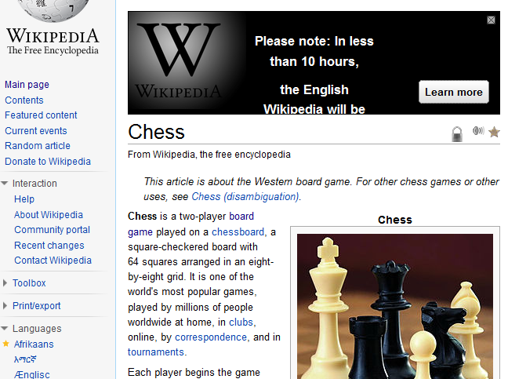
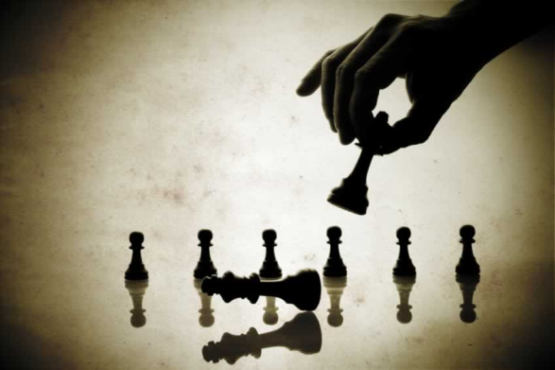
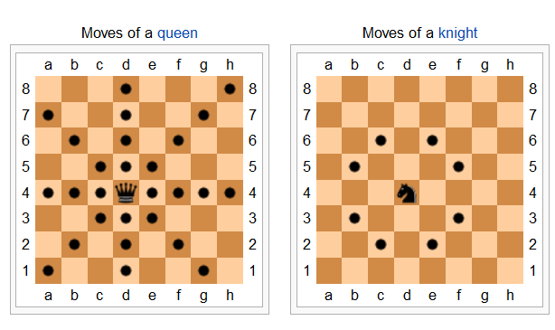
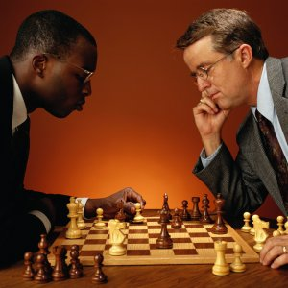
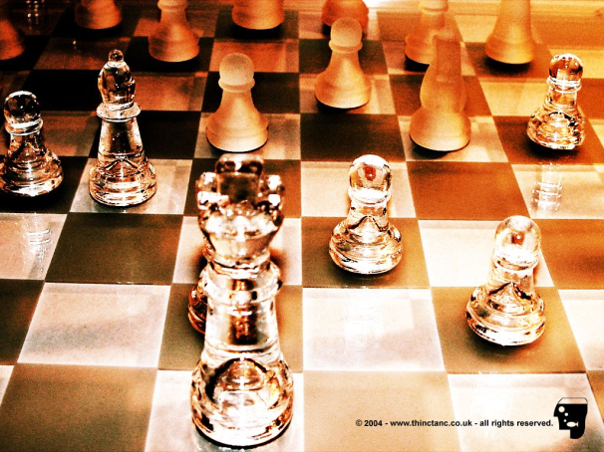

Human Game Learning Process
Rule Learning
Strategic Planning
Natural Language Understanding
Object Categorization and Recognition (Vision)
Learning from Mistakes
Conversation

Slide 15
Real-world Game Learning
Research is bottlenecked by
  3D object segmentation and categorization
  3D environment reconstruction
  Natural language processing
Human game learning in the physical world still provides us with useful insights
  Constructing a good representation for rule learning and action planning is rarely challenging to humans
Notes:
The problems (and challenges) are still fundamentally similar

Slide 16
Existing Game Research

Slide 17
Game AI Research
An AI that plays Chess well is only the summit of Mount Everest
  It assumes that you already have a perfect game representation and understanding of the rules that define this representation
General Game Playing (Michael Genesereth) generalizes learning strategy across games but ignores learning the game representation

Slide 18
Forcing General Game Learning
A few people have tried general game learning
  Dramatically reduce space of games under consideration (ex. RPS, TTT variants)
  Manually teach system all relevant categories and train classifiers for them
    the largest number of categories that has been successfully used is 3
  Focus is on robots interacting with humans, not so much on game learning

Slide 19
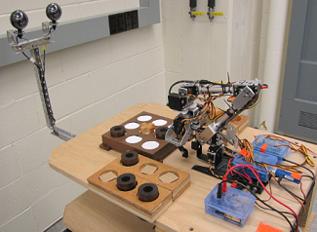
State of the art (2011)
  People have taught robots to observe two entities playing tic-tac-toe or rock-papers-scissors in contrived settings and then attempt to play these games

Slide 20
Digital-world
General Game Learning

Slide 21
What games
Many different types of games
  Real-time (Mario) vs. turn-based (Reversi)
  Discrete (Tetris) vs. continuous (Space Invaders)
  Complete information (FreeCell) vs. incomplete information (Poker)
  Single player (Zelda) vs. competitive (Chess)
For now, focus is on 2D, sprite-based games

Slide 22
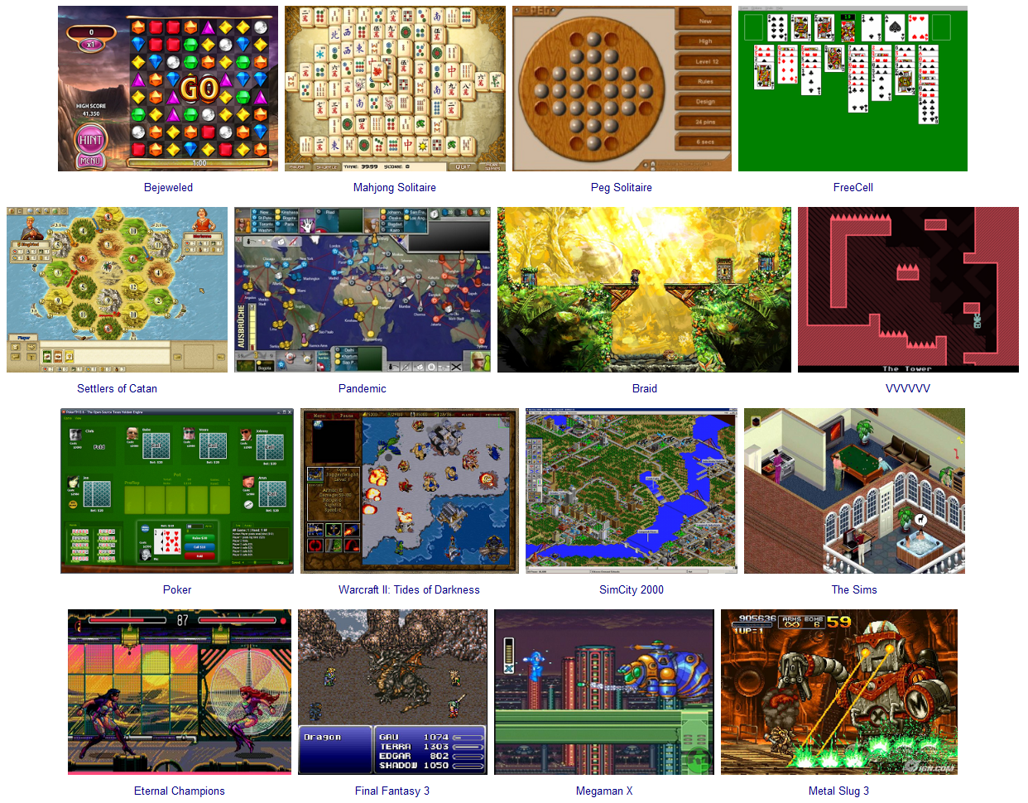

Slide 23
(One Possible) General Game Learning Pipeline

Slide 24
Inputs
AI gets a video feed of the game
AI can take actions as if it were a human (ex. with the keyboard, mouse, or game controller)
AI may have access to: (semi-supervised)
  Human playthroughs of the game
  Partial annotations of playthroughs denoting specific objectives (ex. “reach the final boss”, “don’t die”)

Slide 25
Pipeline Strategy
Construct many possible representations
  Each segmentation of the input video feed leads to different symbolic representations
  Attempt to learn rules on each symbolic representation independently
  The representation which leads to the simplest rules and best predicts future states of the game is the best representation

Slide 26
Game Learning Pipeline
  Map video feed of the game onto a candidate symbolic representation
  Decide what kind of actions are possible
  Learn a model for how symbolic representation evolves as a function of the action taken
  Determine the goal of the game
  Plan actions that accomplish the goal
Specializing for a given game is “easy” – our focus is on generalizing learning across games

Slide 27
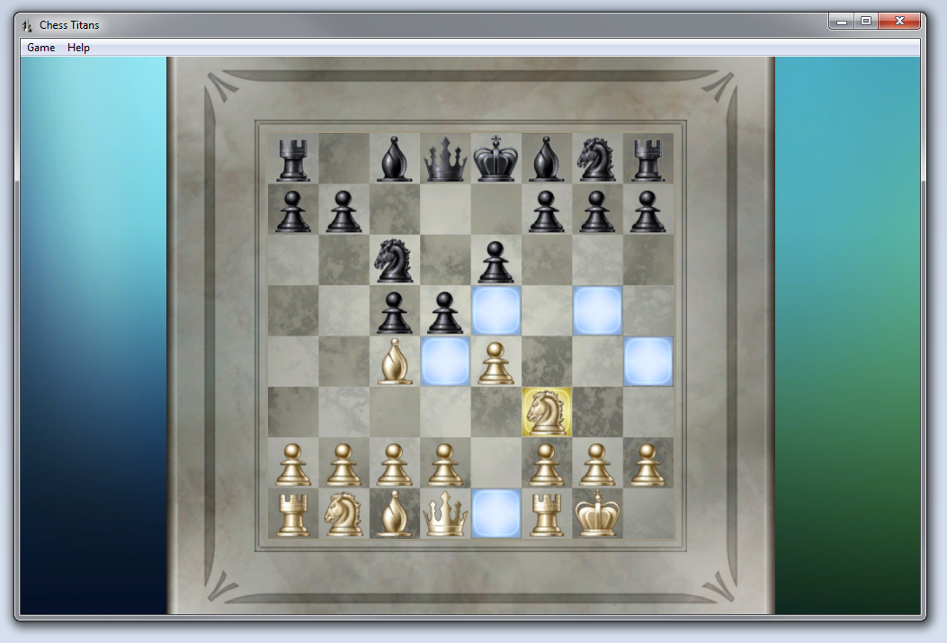
Pipeline Example: Chess Titans

Slide 28
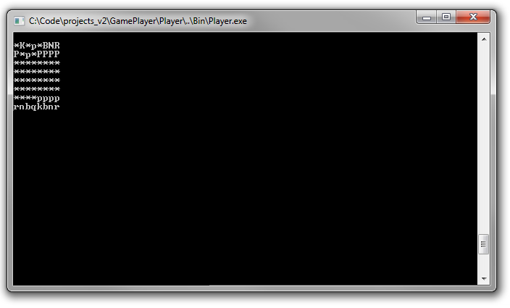
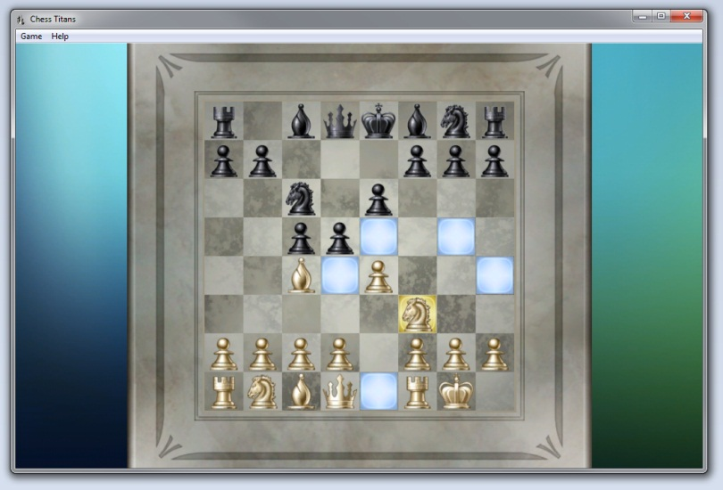
  1. Map to symbolic representation
Observable State
+
Hidden Variables
WhitePlayer has control
The black rooks and black king have not moved
No En passant is possible
…

Slide 29
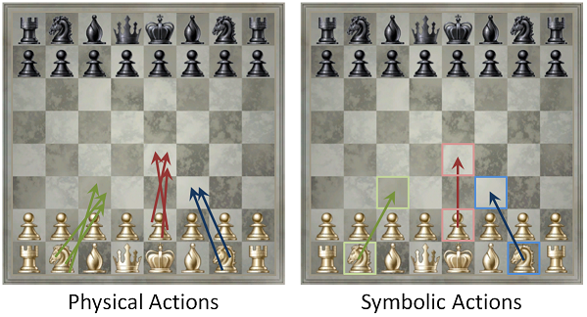
2. What actions are possible

Slide 30
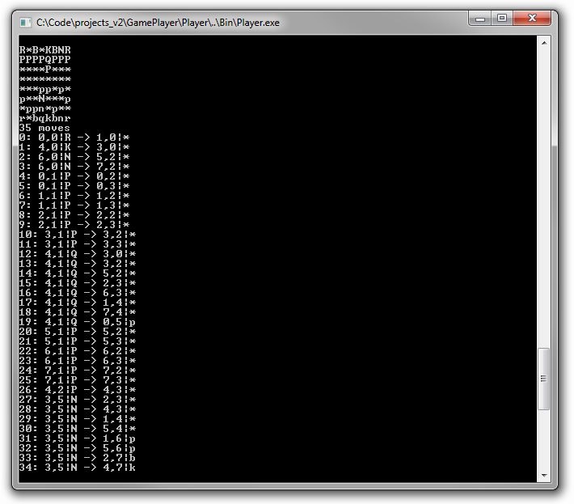
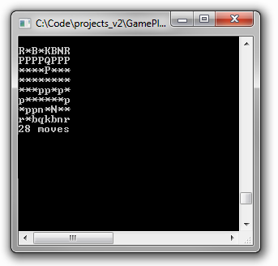
3. What rules govern the game
How does the game state evolve in response to actions and time?

Slide 31
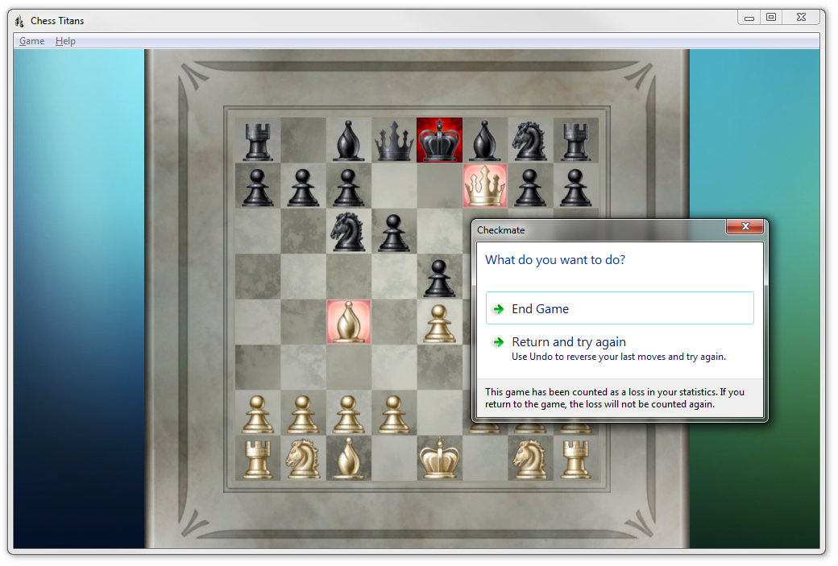
4. Determine the goal

Slide 32
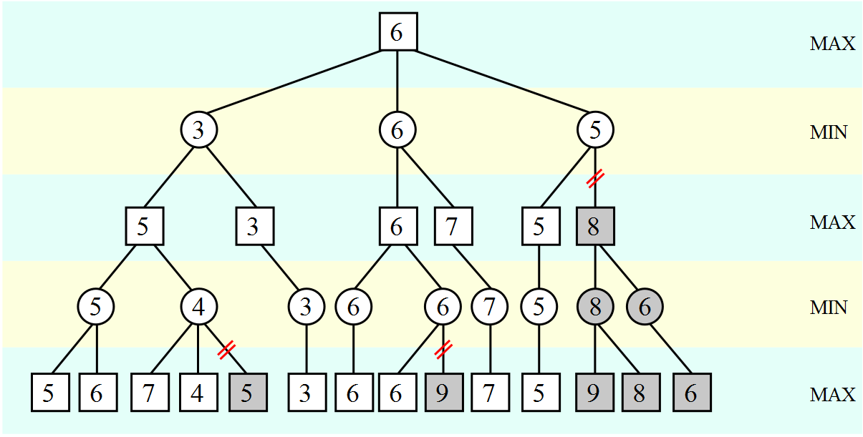
5. Execute actions leading to goal
Game State Value Estimator
+

Slide 33
Imperfect game models
Learning at each stage in this pipeline is going to be hard, but it doesn’t need to be perfect
  You can play a fine game of Chess if you don’t know the en passant or castling rules
  The rules that occur often are typically the ones that are most important

Slide 34
Pipeline Stages

Slide 35
Stage 1: Extract Symbolic Representation

Slide 36
Extract Symbolic Representation
Co-segmentation
  Assume the set of input images contain many instances of similar objects
  Simultaneously segment the images and extract a set of commonly-occurring templates
Template matching
  Use template matching to isolate the instances and extract a set of representations

Slide 37
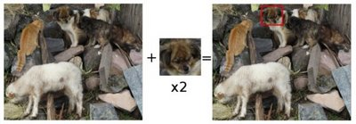
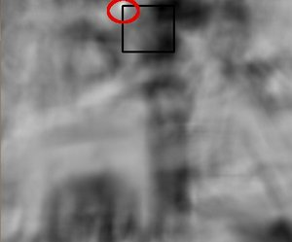
Template Matching

Slide 38
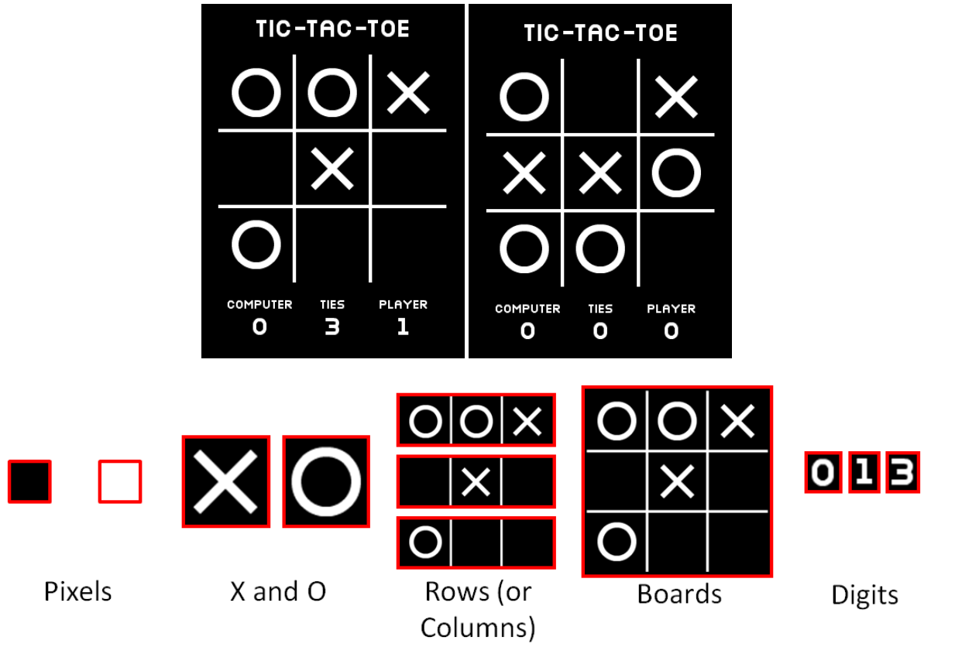

Slide 39
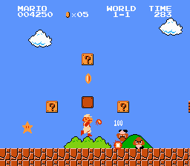
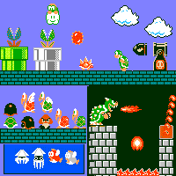
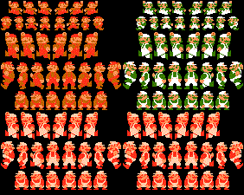
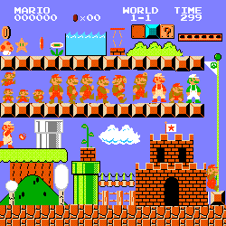

Slide 40
Human Knowledge
The AI cannot be expected to re-derive the meaning of human language and numerals
  Search for dominant patterns among the symbol sets (grids, graphs, text)
  When certain patterns are detected (ex. a string of glyphs) use character recognition to replace them with a related symbolic form (ex. “Score” or “9000”)
  One goal of GGL is to discover what patterns are necessary and which can be learned

Slide 41
Stage 2: Determine Valid Actions

Slide 42

Discrete input

Slide 43
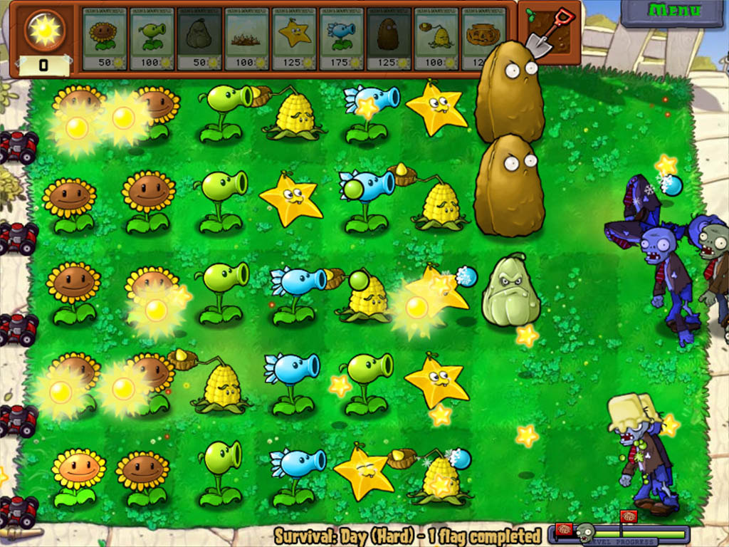
Near-continuous input

Slide 44
Use symbolic representation

Slide 45
Use symbolic representation

Slide 46
Stage 3: Learn a Game Model

Slide 47
Game Model
A game model encodes all the relevant rules of the game
  Defines which actions are legal (Chess, Reversi)
  Takes the current state and a user action and returns the next state
  Need to learn from observations and experiments
  Markov decision process
Games are complicated but the behaviors of subcomponents is often simple

Slide 48
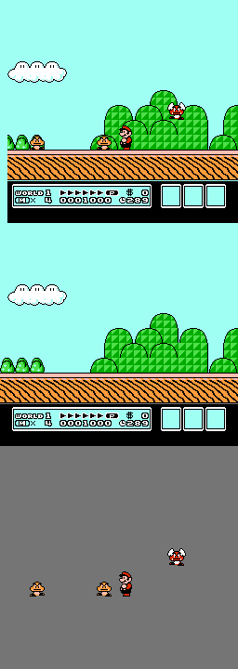
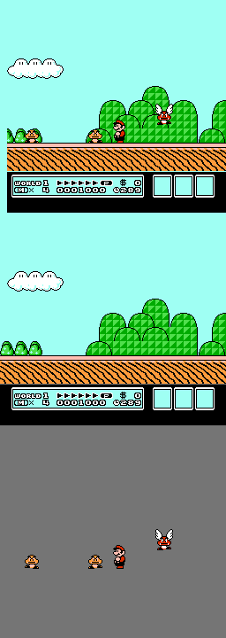
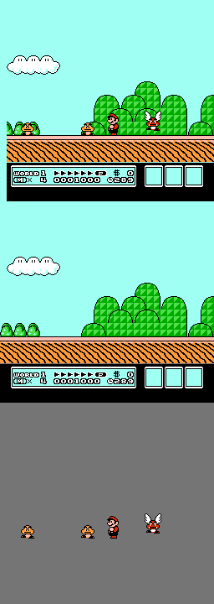

Simple Entity Behavior
t
t+200ms
t+400ms
Composite
Whole Frame
Background Estimation
Sprite Extraction

Slide 49
Natural Language Rules
Chess
  A player can move a rook or queen along any horizontal or vertical straight line so long as the intervening pieces are all empty
  Players can only move pieces of their color
  It is legal for white player to move a white pawn forward two squares if it is in its home row and the two squares in front of the pawn are empty

Slide 50
Natural Language Rules
Super Mario Bros.
  Pressing right moves Mario to the right
  If Mario falls into a pit or fire he will die
  Goombas move slowly in one direction and can fall off ledges
  If Goombas hit an obstacle they will flip directions
  Jumping on Goombas kills them but colliding with them from the side will hurt Mario
  When Mario reaches a flag at the end of a stage he advances to the next stage in that world

Slide 51
Models encode rules
Need to specify a language that can encode game rules
  Complex enough to model important game behavior
  Simple enough to be learned from observations
Genre-specific vocabulary
  Piece, grid, board location, move
  Collision, velocity, parabola, atlas/map, portal

Slide 52
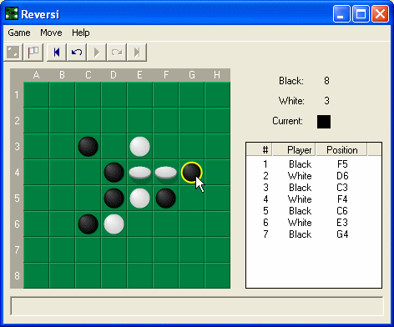
Reversi

Slide 53
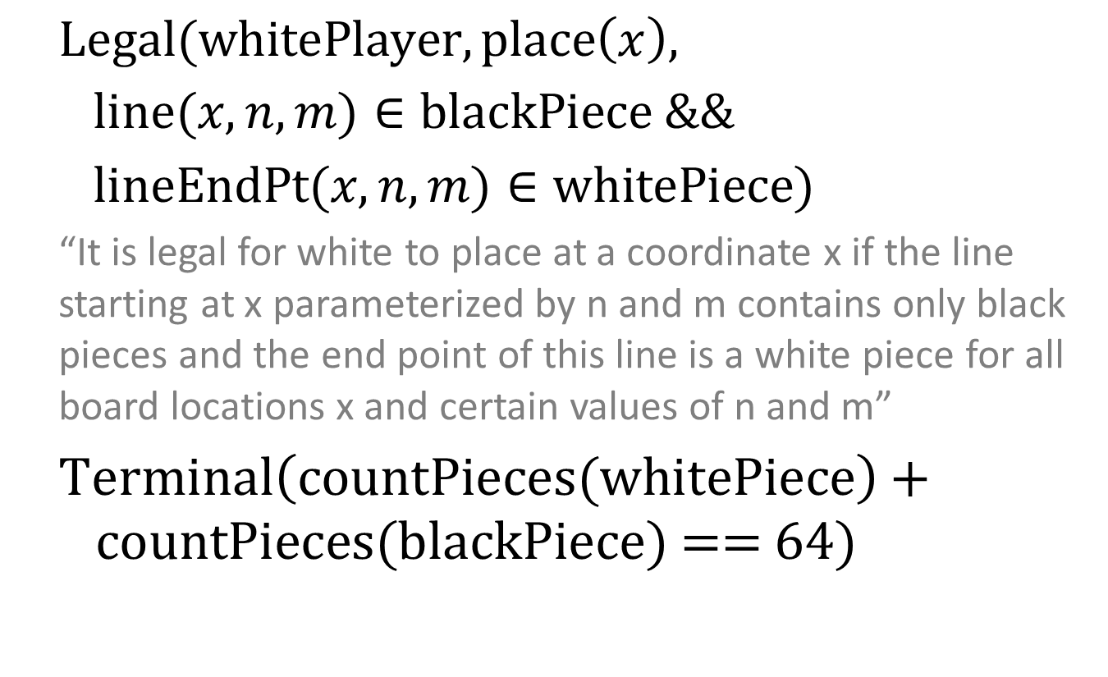
Game Model Languages
$\text{Legal}(\text{whitePlayer},\text{place}\left(x\right),$
$\text{line}(x,n,m)∈\text{blackPiece} \&\&$
$\text{lineEndPt}(x,n,m)∈\text{whitePiece}\text{)}$
“It is legal for white to place at a coordinate x if the line starting at x parameterized by n and m contains only black pieces and the end point of this line is a white piece for all board locations x and certain values of n and m”
$\text{Terminal}\left(\text{countPieces}\text{(}\text{whitePiece}\right)+ \text{countPieces}\text{(}\text{black}\text{Piece}\text{) == 64)}$

Slide 54
Learning Rules and Representation
Rules that apply generally are more likely than a bunch of special cases
  Information gain criteria
  Occam's razor
Categories are important
  Two entities probably belong to the same category if most of the rules that apply to entity A apply to entity B

Slide 55
Learning Rules and Representation
A representation is good if it is easy to build rules that describe it
  We can use this to decide between many possible candidate representations

Slide 56
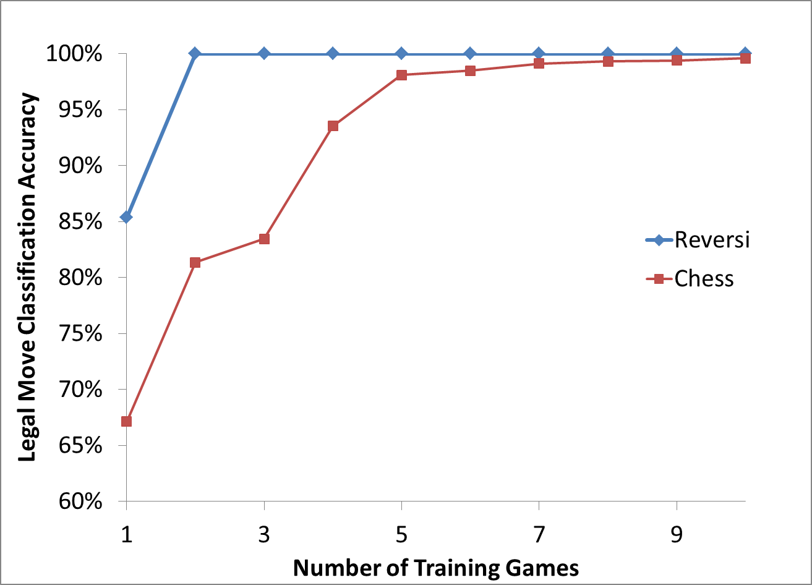

Slide 57
Stage 4: Determine the Goal

Slide 58
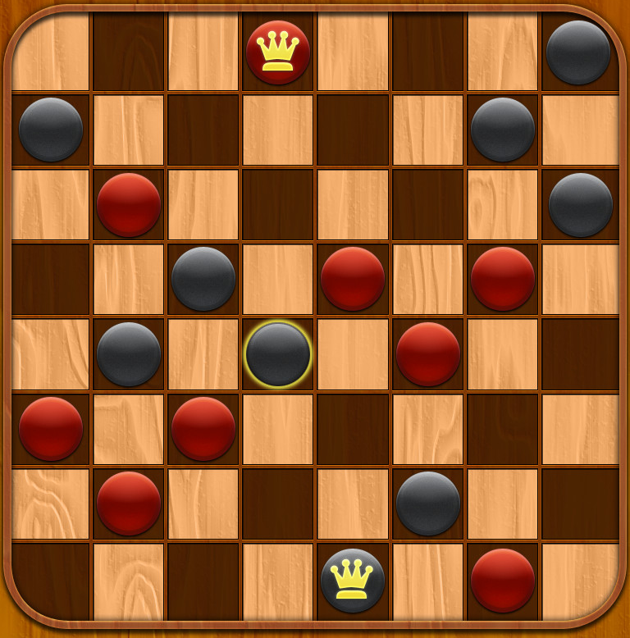
Giveaway Checkers

Slide 59
Giveaway Checkers
How can we tell if we are playing regular Checkers or Giveaway Checkers?
  If we have observations of humans playing the game, what value are they placing on their pieces?
  If we have an AI (or human) opponent, are they trying to capture our pieces or not?

Slide 60
State Value Inference
True Goal of Chess
  Construct a situation in which your opponent is unable to prevent you from capturing their king
Inferred Value Function
  Capture enemy pieces, keep your own pieces from being captured
  King=20, Queen=10, Rook=6, Bishop=4, Knight=3, Pawn=1
  We can play the game just fine using this value function, in fact, it is ultimately more useful

Slide 61
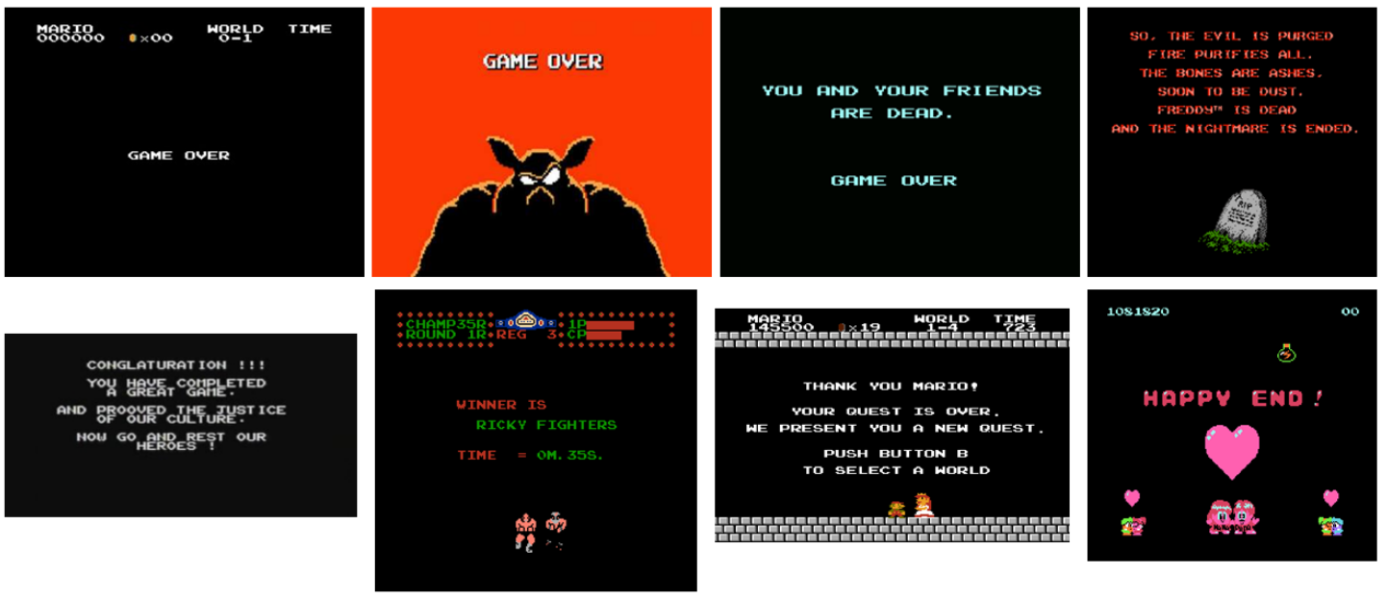
State Value Inference
THANK YOU
CONGLATURATION !!!
WINNER IS
HAPPY END!
GAME OVER
DEAD
DIED

Slide 62
General Values
Novelty
  Seeing the death screen 10,000 times is not as interesting as exploring the world. If you explore a game and manage to see the ending, you’ve won.
Canonical directions
  In many platformer games “proceed to the right, and don't die” is a good approximation of the goal
Number of actions
  Maximizing the number of actions available is a good idea in many piece-type games

Slide 63
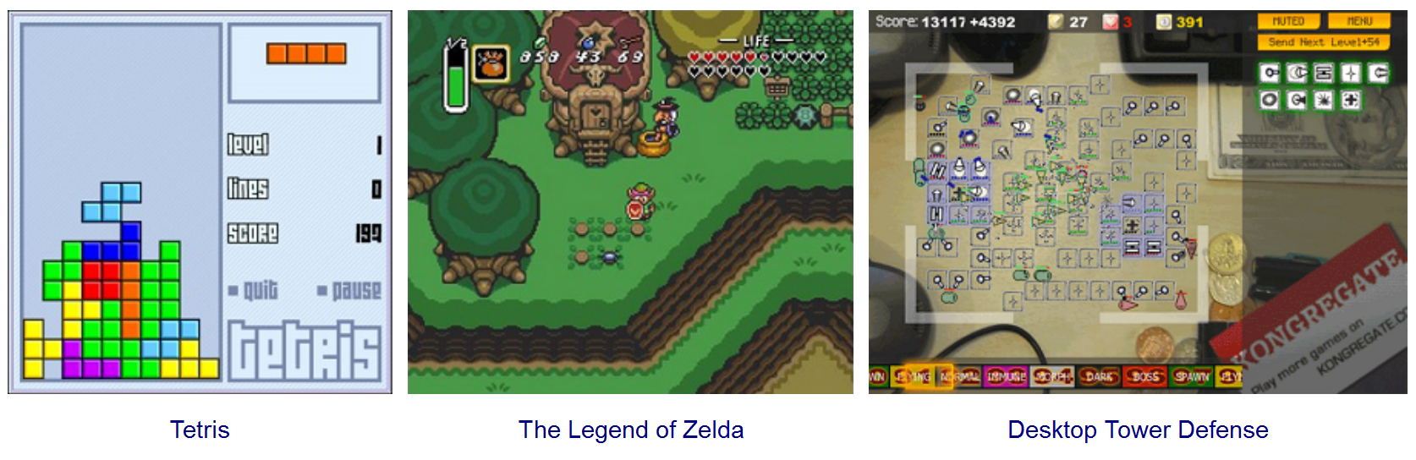
State Value Inference
Level, lines, score, life
  See what humans appear to be optimizing
  Try to optimize each possible number on many different passes, see which results in the best behavior (ex. exploration criteria)

Slide 64
Prior work
Value function inference for specific games is often used to derive information from experts
  Value function for Chess was parameterized with approximately 8,000 parameters
  Parameter values were learned by analyzing thousands of grandmaster Chess games
Goal is to use this idea on learned game models and construct “general parameterizations” of the value function

Slide 65
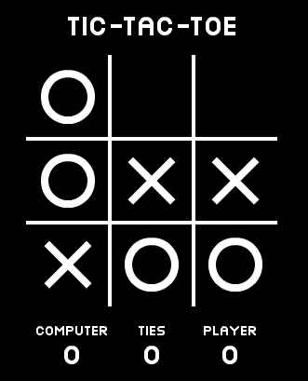
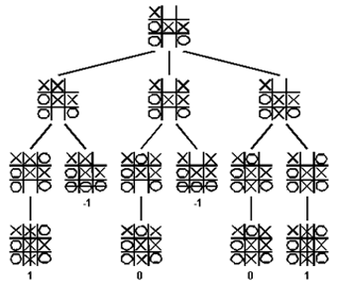
Stage 1 – 4 Summary
Symbolic Game State
Symbolic Game State
List of Actions and Resulting Game States
Pixels
Complete Game Description
Goal Evaluator

Slide 66
Stage 5: Plan Actions

Slide 67
Execute actions leading to goal
Different games are solved in different ways
  Minimax tree search (Chess, Chinese Checkers)
    Requires value function:
      Use one modeled from examples in Stage 4
      Use one derived from General Game Playing
  Motion planning (Mario, Tetris)
    Try many different state value functions
    Reinforcement learning techniques
      Markov decision process formulation

Slide 68
Execute actions leading to goal
This is what General Game Playing is for
  Active area of research
  CS227B, Michael Genesereth
  Not designed for incomplete game models
Uses Game Description Language
  Mapping from a symbolic representation of the game state to a list of actions and the resulting states
  Many general game players have been developed
    Bandit-based Monte Carlo
  Can easily convert game model to GGP

Slide 69
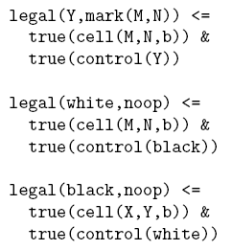
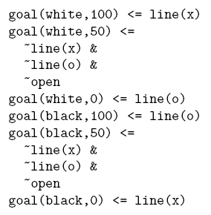
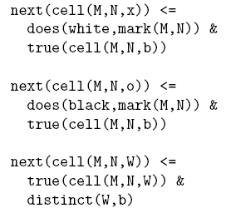
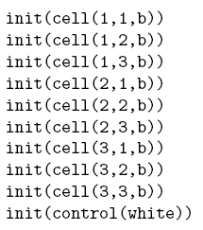

Execute actions leading to goal

Slide 70
Typical general game player
“Game state value estimator” trained from many game simulations
+

Slide 71
5. Execute actions leading to goal
General Game Playing is not going to help much for Mario or Zelda
Can use basic search and control algorithms
  Relies on a reasonably good model of the state space transitions for the game
Try and try again
  Millions of deaths are fine as long as it eventually learns; once it does we can look at how to make it learn faster or better

Slide 72
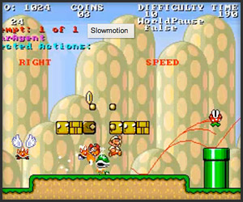
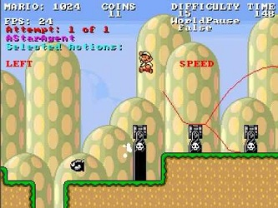
Mario AI Competition

Slide 73
Conclusions

Slide 74
Results: Deliverables are easy
Viable game learners answer a lot of questions
  Can we determine what components are meaningful?
  What games are hard to learn?
  How many games do you need to learn rules?
  Can we construct a useful set of rules that generalize across many games?
  How well can we play even if we only know some of the rules?
  Can we compute a useful reward function from watching human players?

Slide 75
We will use digital games to study…
  Unsupervised object segmentation and categorization
  Rule learning
  Knowledge transfer between categories
    Between Mario & Luigi
  Goal inference
  Game state value estimation
  Action planning
  Knowledge transfer between games
    Between Super Mario 1 and Super Mario 3
    Between Shogi and Chess

Slide 76
First steps: NES games
t
t+100ms
t+200ms
Composite
Whole Frame
Background Estimation
Sprite Extraction

Slide 77


Lots and lots of 2D games (>100,000)

Slide 78
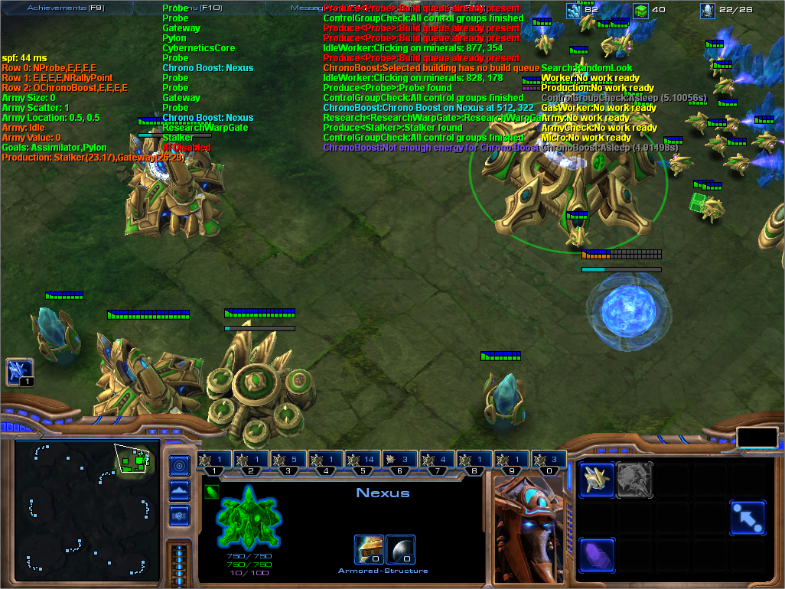
2D vs. 3D games

Slide 79
Games provide validation
  Automatic segmentation and categorization in real-world computer vision is frustrating
    Typical validation is through semi-supervised learning and relies upon the fact that humans know the rules
  Automatic segmentation and categorization in games is doable
    A segmentation and categorization is good if it results in simple rules – fully unsupervised validation

Slide 80
  Learning a game representation
  Observe an environment
  Segment it into meaningful entities
  Categorize the entities
  Learn rules about the categories and their relationships
  Use these rules to predict how categories will behave in response to the passage of time or various actions
Each game is its own universe with its own rules – the real world is just another, more persistent game
  But some rules transfer: objects without something supporting them from below often fall down in both Super Mario Brothers and the real world

Slide 81
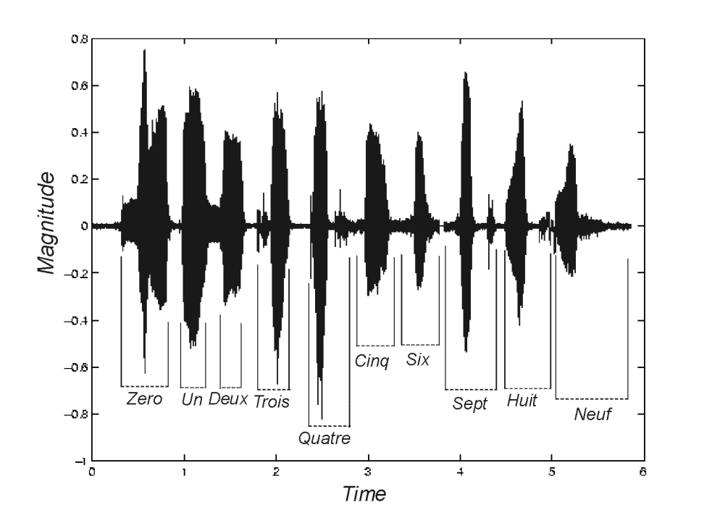
Human DSL’s
We aren’t as general as we like to think we are
  Sticking an audio signal through the visual cortex takes us a long time to learn
  We want AI to to be able to generalize learning, but some specialization is expected

