Slide 1


Example-based Synthesis of 3D Object Arrangements
Matthew Fisher Daniel Ritchie Manolis Savva
Thomas Funkhouser Pat Hanrahan

Slide 2
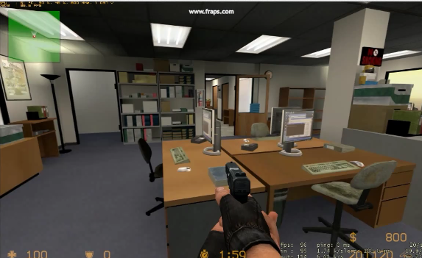
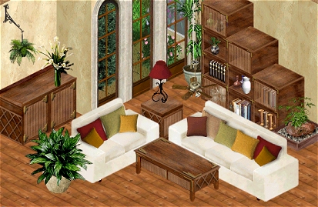
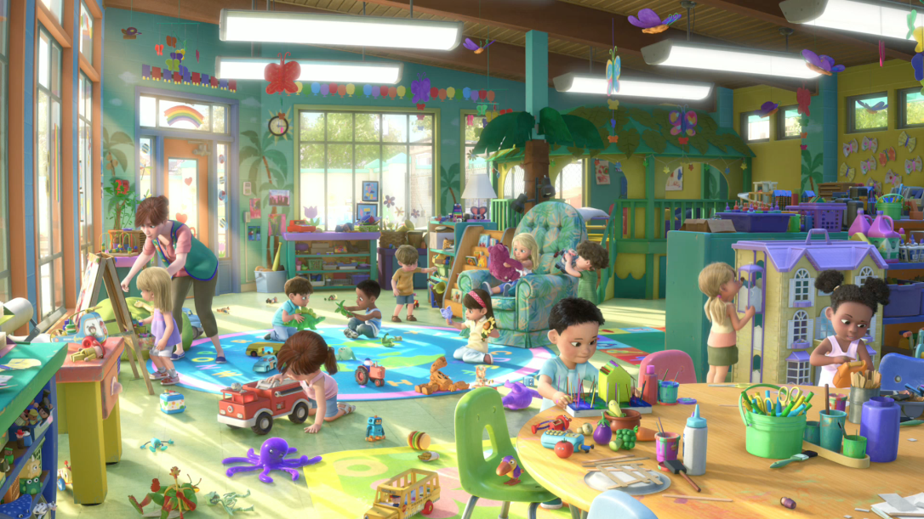
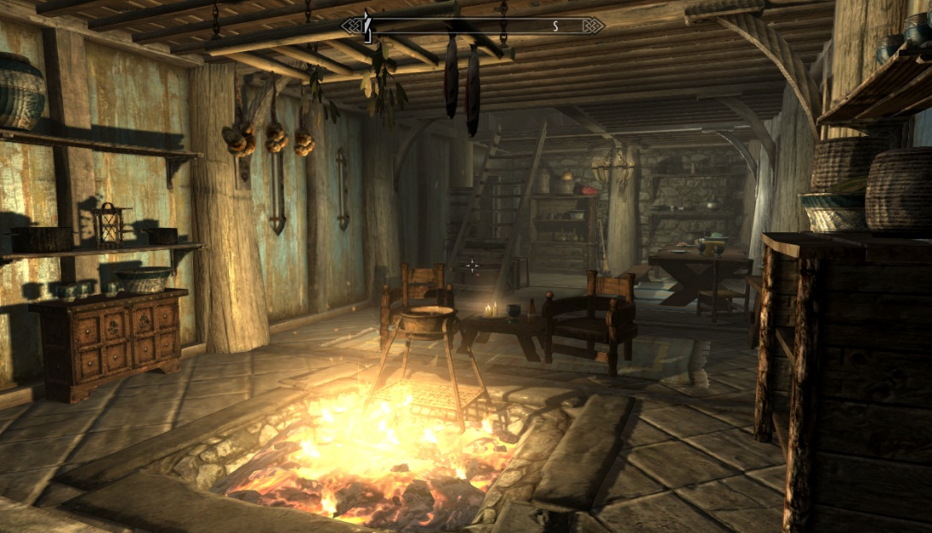
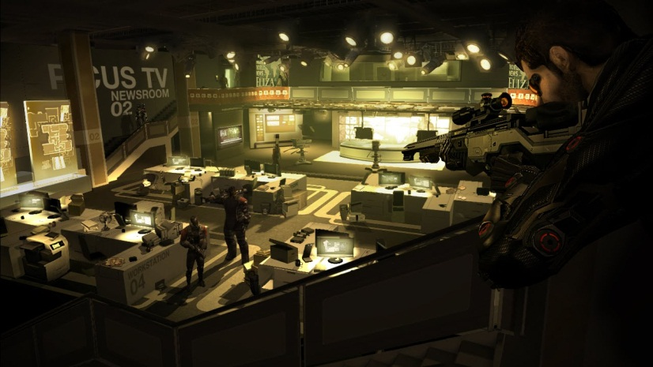
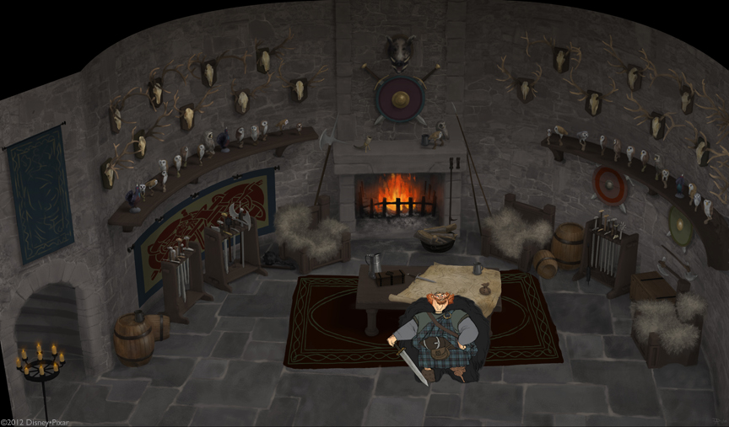
Notes:
The main motivation for this project comes from the increasing demand for detailed 3D environments. We see such environments in large scale virtual worlds, in games and in special effects shots for movies. In order to create such 3D content many skilled artists have to expend considerable amounts of time and effort. This an important problem for which any improvement can have substantial impact. For example, imagine that as a level designer for a game you had to design a medieval room like the one you see on the bottom right. It’s not uncommon for such set dressing tasks to take hours. Imagine that you have to do this for hundreds of similar and yet plausibly different rooms. That’s not fun!

Slide 3








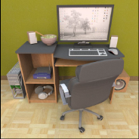
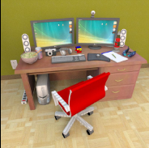
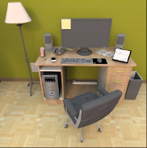
Example-based Synthesis
Example Scenes
Synthesis Engine
Synthesized Scenes
Notes:
A promising solution to this content-creation bottleneck is example-based synthesis: algorithms that can generate new environments similar to a set of input examples.
A user provides the system with examples illustrating the desired type of scene (such as the computer desks here). The system then uses this input in order to create a large set of synthesized results.
The user can then select the results that she likes best from a ranked list.

Slide 4
Example-based Synthesis
Plausibility
Variety
Minimal Input
Example Scenes
Synthesis Engine
Synthesized Scenes
Notes:
Now, to support a tool like this there are several criteria that the algorithm should meet. First: the content it generates should be plausible. Second, the output should exhibit variety. And third, it should require as few input examples as possible from the users since creating such examples is time consuming. However, as we will see, these goals are challenging because they stand in conflict to one another.

Slide 5
Scene Variety
Notes:
So how might we create a system that synthesizes a variety of scenes? To answer this question, it’s important to consider the ways in which scenes can vary. For example, here you see one way in which we could make new scenes, by slightly perturbing the arrangement of the objects in one input scene. Obviously, since we’re using the same objects again and again, the variety of the results is lacking.

Slide 6
Object Variety
Notes:
Another way to introduce variety is to replace the objects in a scene with other objects of the same category but leave the arrangement the same. Here you see a set of scenes where we did just that. However, since the configuration of the objects remains the same, when we look at these scenes, we still don’t have the kind of plausible variety you observe in the real world.

Slide 7
Types of Variety
more diverse configurations of object arrangements
Scene Variety
more diverse categories of objects
Object Variety
Notes:
So conceptually we can think of two axes along which variety can be improved.
Along the horizontal we can improve object variety by drawing from larger and more diverse categories of objects to synthesize our output scenes.
Along the vertical axis we can improve scene variety by synthesizing with more diverse yet plausible configurations of the arrangements of objects that are found in the scene.
We will revisit this conceptual plot as we address each challenge later in the talk.

Slide 8

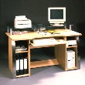

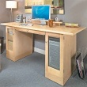

Prior Knowledge
Prior Knowledge
Notes:
Our key insight, which is related to how people judge variety, is that when people create input examples they do so in the context of a lot of prior knowledge about the type of scene they are thinking of. People have a great many experiences of the real world, which they use in order to interpret plausibility and variety. But since we do not have access to the prior experience in people’s heads, what can we do?

Slide 9

Prior Knowledge
Scene Database
Prior Knowledge
Notes:
As a replacement for this human prior knowledge, we can use a database of scenes that people have built before. By finding the scenes that are most similar to the input examples in a scene database, we can leverage additional observations of what types of objects and arrangements are appropriate to use for enriching our output scenes.

Slide 10
Database
…
130 scenes: study rooms, living rooms, entertainment centers, kitchens, bedrooms, utility rooms
Contain 3461 objects instances, 1723 unique models
url: stanford.io/scenesynth/
Notes:
Here are some details about the database we used for the results we present.
In order to obtain the actual scene data we distributed a simple scene design interface backed by Google 3D warehouse models and asked people to create a variety of indoor scenes.
The resulting scene database contains a total of 130 scenes with approximately 3400 models. There are a variety of room types, including study rooms, living rooms, entertainment centers, kitchens and bedrooms. We will make this dataset available as a resource to the research community at the project’s website very soon.

Slide 11
Database
…
130 scenes: study rooms, living rooms, entertainment centers, kitchens, bedrooms, utility rooms
Contain 3461 objects instances, 1723 unique models
url: stanford.io/scenesynth/
floor
…
table
chair
chair
…
plate
mug
laptop
sandwich
Notes:
One novel aspect of this scene database is that each scene comes with a static support hierarchy telling us how each object is supported by other objects. This constraint is enforced by the interface which only allows simple operations such as translation, scaling and rotation and requires that all objects are statically supported by the surface of another parent object. These static support hierarchies will be very useful for our system later on.

Slide 12
Object Variety
What objects can go here?
Notes:
Ok, so now that we have a scene database how do we use it to obtain more object variety in our output scenes without sacrificing their plausibility? We clearly need to address a fundamental question which is: <C> what objects can we use in place of objects seen in an example. Maybe the presence of a notepad indicates that this is a good place for stationery, books and other reading material. You can see that answering this question requires that we come up with groups of objects that are interchangeable.
These objects can come from both the examples and the database, but what groups should we make, and how?

Slide 13
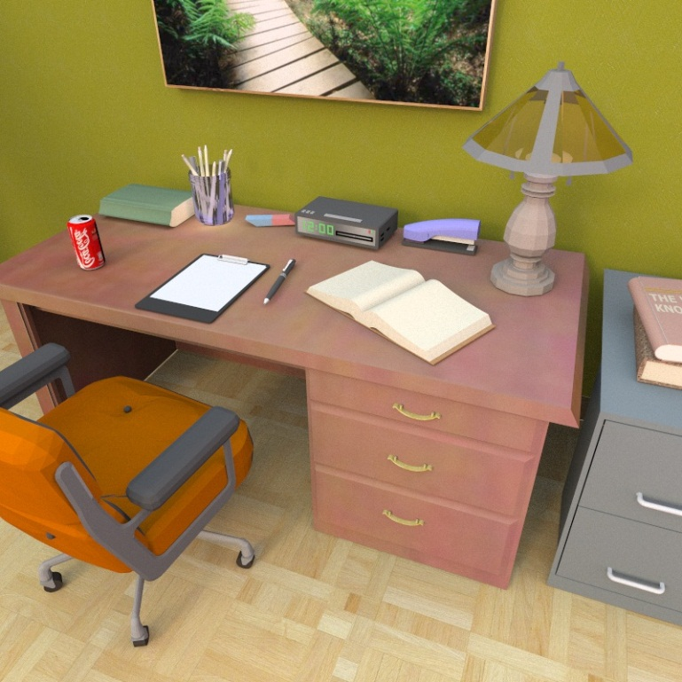
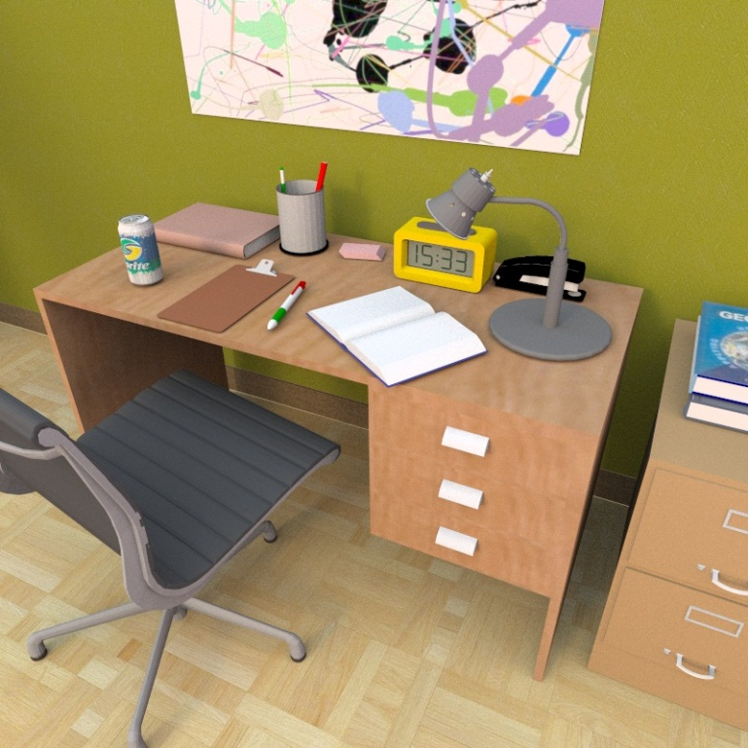
Object Variety: Basic Categories
Notes:
One simple approach is to assume that each object can be replaced by objects of the same basic category, such as for example ‘table’, ‘chair’, or ‘apple’. All the models in our database are annotated with such a basic category tag.
By swapping input example models with other models of the same basic category we can clearly get a lot of variety.

Slide 14
Object Variety: Basic Categories
Notes:
However, this is sometimes overly restrictive. Just because a user put a coca cola can on the table, does that mean that we only accept coca cola cans in that location? What about other types of drinks or other types of food?
Replacing within basic categories can also be overly general: for example …

Slide 15
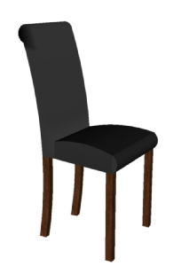
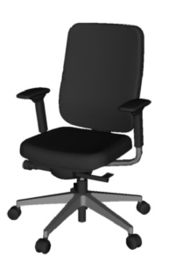
Object Variety: Basic Categories
Notes:
not every object labeled with a basic category of ‘chair’ is equivalent. The chair to the left can clearly belong in front of a dining table, whereas the chair to the right would be strange in the same position.
Clearly, we need a more flexible grouping criterion which is driven by the context of each model’s observation.

Slide 16

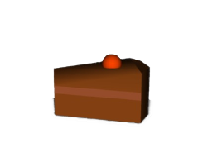
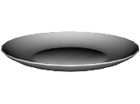
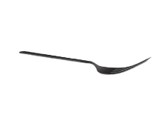
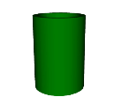
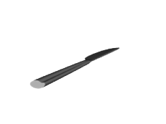

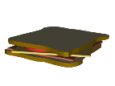
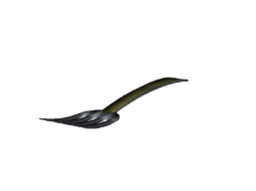
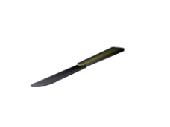
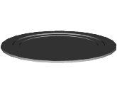

Contextual Categories
Good neighborhood match
Notes:
So how should we determine these contextual categories of objects? Let’s look at a simple example with a cake and a sandwich.
Should these two food items be in the same group or not? How might we answer this question? <C> We can look at their ‘local neighborhoods’ -- the arrangements of objects surrounding them -- and ask how similar these neighborhoods are.
We’ll make the claim that two objects with similar neighborhoods are likely to be interchangeable: if you take an object out of its neighborhood and place it in a similar one, that’s likely to be acceptable.

Slide 17
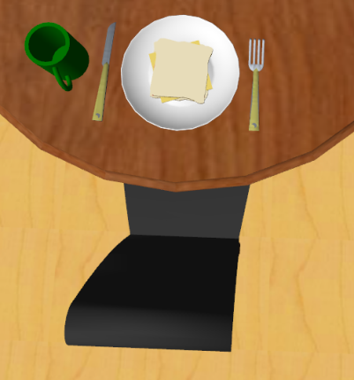
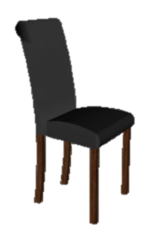
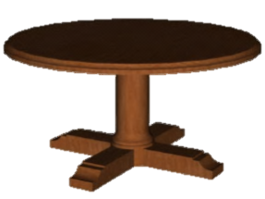
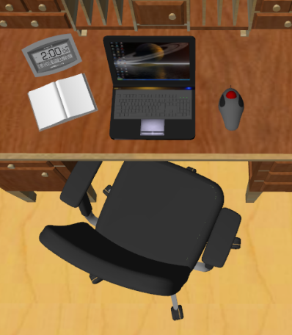
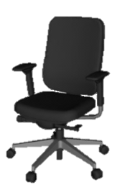
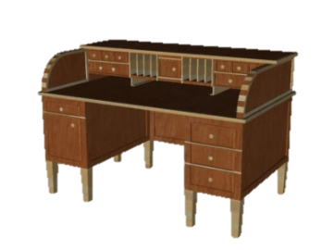
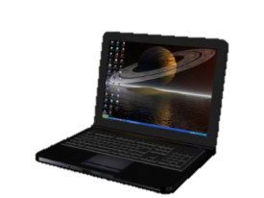
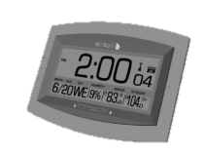
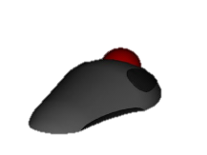
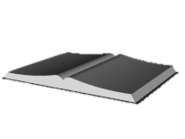
Contextual Categories
?
Bad neighborhood match
Notes:
Now let’s look at these two chairs. <C> Their neighborhoods are quite different, so we might argue that they should *not* be interchangeable.

Slide 18
Contextual Categories
Neighborhood Similarity Function
Notes:
So how does our clustering algorithm implement this intuitive notion? <C> We compare the neighborhood similarity of two objects as illustrated in the previous examples. More concretely, how do we do this algorithmically? …

Slide 19










Contextual Categories
Neighborhood Similarity Function
Hierarchical Agglomerative Clustering
Contextual Categories
Notes:
… Much like we illustrated before, we find a maximum weight bipartite matching between the objects in one neighborhood and the objects in the other. The weight of each edge connecting two objects is assigned by the similarity of the two objects. <C> We then use hierarchical agglomerative clustering to determine the clusters over object models <C> which finally give us the contextual categories. Please refer to the paper for more details.

Slide 20
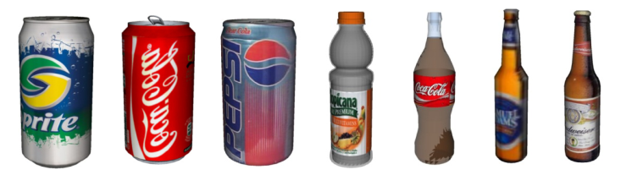
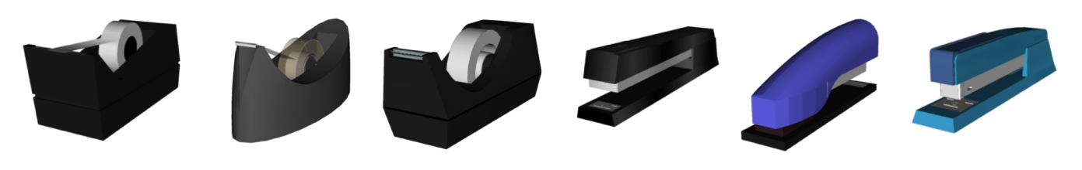
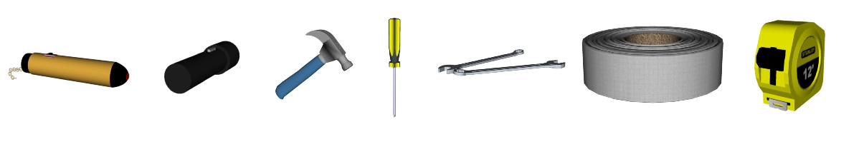
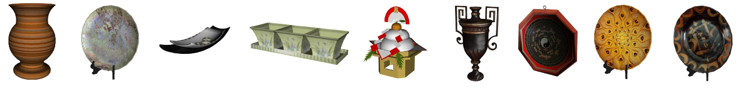
Contextual Categorization Results
Notes:
So what do the resulting contextual categories look like? Here are some examples. Note how in the top box, soda cans and drink bottles are clustered into the same category since they are likely to occur in similar environments. A variety of stationery supplies you would find on a desktop are clustered together in the middle box. The 3rd box from the top groups together many different kinds of tools that you would find in a home toolkit. And the bottom box is a cluster of a variety of decorative pieces that you find on side shelves.
/* An interesting point to consider is that an object can actually be in more than one contextual category (for example some types of chairs are observed both in front of study desks as well as dining tables, and can therefore belong to two different contextual categories). */

Slide 21
Where are we now?
?
Scene Variety
Basic Categories
Contextual Categories
Object Variety
Notes:
Ok. We’ve seen how contextual categories use the scene database to add object variety to our scenes.
<C> Now how can we use the database to increase scene variety? I’ll hand over the presentation to Daniel who will talk about what we do to introduce more scene variety.

Slide 22
Scene Variety
Additional categories?
Additional arrangements?
Notes:
By way of example, suppose we’d like to add more content variety to this entertainment room scene.
With contextual categories, we can swap out objects in the scene for other objects in the same category.
<C> Now we’d like the database to tell use what are some *additional* object categories that might fit well in this scene…
<C>…as well as some additional arrangements of objects in the scene.

Slide 23
Naïve Scene Variety
Additional categories?
Additional arrangements?
Notes:
Now, recall that our scene database has quite a diverse variety of scene types: bedrooms, kitchens, living rooms, and so on.
If we naively reach into the scene database to look for variety, we might draw out…this scene.
…which would suggest that the category ‘toilet’ is a perfectly fine thing to add to our scene.

Slide 24
Naïve Scene Variety
Additional categories?
Additional arrangements?
Notes:
Obviously, this toilet does *not* belong here.
So clearly, we can’t just extract information about which categories to insert and how to arrange them from just *any* scene in the database.
We need a way to identify only the subset of scenes that are sufficiently similar to our examples, so that we can feel confident that they’ll give us relevant information.

Slide 25

Relevant Scene Retrieval
$$ℜ$$
…
graph kernel query
[Fisher et al. 2011]
threshold results
Notes:
The way we do this is as follows:
Given a set of input examples, we query into the database using a recently-developed graph kernel method for computing the similarity between two 3D scenes.
By retaining only the scenes above a threshold similarity value, we can retrieve a set of scenes that we can be reasonably confident will be relevant to the type of scene we’re trying to synthesize.
We’ll call this set the ‘relevant set’ of database scenes.

Slide 26


What Do We Do With All This Data?
$$ℜ$$
model
$$P( ⋅ )$$
sample
Notes:
So great. We’ve got our user-provided input examples and our relevant scenes from the database—now what do we do with all of this data? How do we combine it all into a scene synthesis process?
We propose taking a probabilistic approach: there is some probability distribution over scenes that the user would like to synthesize. Our goal is to model this distribution, using the data we have available, and then sample from the model to generate new scenes.
We’ll see that this is a powerful framework that also makes it easy to incorporate our multiple data sources.

Slide 27



Probabilistic Model
$$P$$
:
?
?
?
what?
how many?
where?
Definition
$$P_{o}\left( \right)$$
table
plate
fork
cake
Notes:
The probabilistic model that we designed has two parts:
The first, which we call the “occurrence model,” governs which object categories, and how many objects from those categories, will be in a synthesized scene.
The second, which we call the “arrangement model,” determines where those objects will be placed and oriented with respect to one another.
Let’s take a look at these components in a little more detail.
The occurrence model is a probability distribution function over ‘support hierarchies,’ which are the hierarchical arrangements of object categories that were mentioned earlier when describing the database. Given such a hierarchy, the model can evaluate how likely that hierarchy is under the distribution that it models.

Slide 28
Probabilistic Model
$$P$$
:
?
?
?
what?
how many?
where?
Implementation
Table
Cup
Plate
Plate | Steak | P(Steak | Plate)
0 | 0 | 1
0 | 1 | 0
1 | 0 | 0.3
1 | 1 | 0.7
Steak
Fork
Knife
Notes:
We implement this part of the model using a Bayesian Network that captures the co-occurrence relationships between different object categories. In this simplified example, the part of the model I’ve expanded is capturing the fact that a Steak only exists in the scene if it has a Plate to go on.

Slide 29
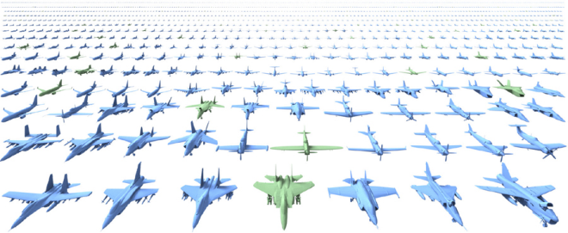
Probabilistic Model
$$P$$
:
?
?
?
what?
how many?
where?
Related Work
Component-based object modeling
[Kalogerakis et al. 2012; Chaudhuri et al. 2011]
Notes:
This choice of implementation was inspired by recent work on component-based object modeling by our colleagues Vangelis Kalogerakis and Sid Chaudhuri. They used a Bayes net to model the correlations between sub-parts of different 3d shape classes, such as airplanes.

Slide 30
Probabilistic Model
$$P$$
:
?
?
?
what?
how many?
where?
Notes:
Now let’s drill down into the arrangement model. Recall that this component determines how objects will be placed and oriented with respect to each other.

Slide 31
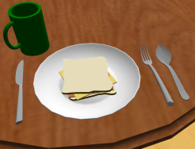

Probabilistic Model
$$P$$
:
?
?
?
what?
how many?
where?
Definition
$$P_{A}\left( \right)$$
Notes:
Now let’s drill down into the arrangement model. Recall that this component determines how objects will be placed and oriented with respect to each other.
Very much like the occurrence model, it’s a probability distribution function over the possible placements and orientations of a single object given the objects surrounding it. The example here is a sandwich on a dining table.

Slide 32
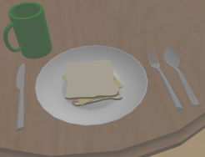
Probabilistic Model
$$P$$
:
?
?
?
what?
how many?
where?
Definition
$$P_{A}\left( \right)$$
Notes:
This model is defined with respect to the local coordinate frame of the object in question.

Slide 33
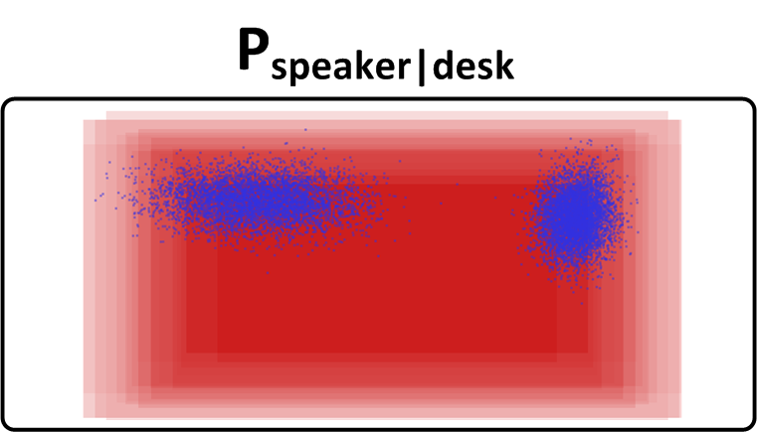
Probabilistic Model
$$P$$
:
?
?
?
what?
how many?
where?
Implementation
Notes:
This model component is implemented as a mixture of Gaussians describing how likely it is for an object to be found at a particular location and orientation relative to the other objects around it.
In this figure, the red boxes are bounding boxes of several desk models, aligned in their common coordinate frame.
The blue clusters show where the probability mass is concentrated for the position of speakers relative to these desks.
So, this particular arrangement would receive a high probability under this model…
…whereas this one would have a low probability.

Slide 34
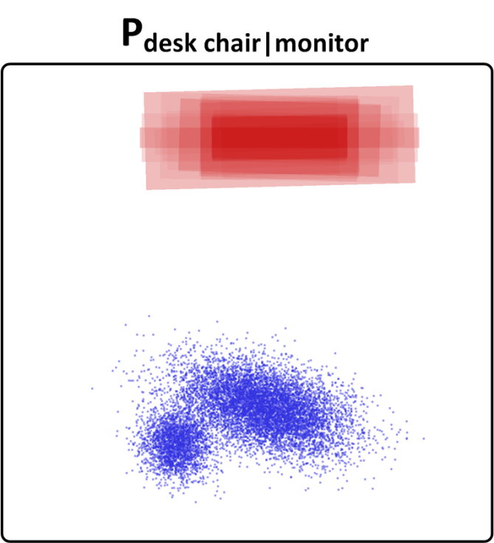
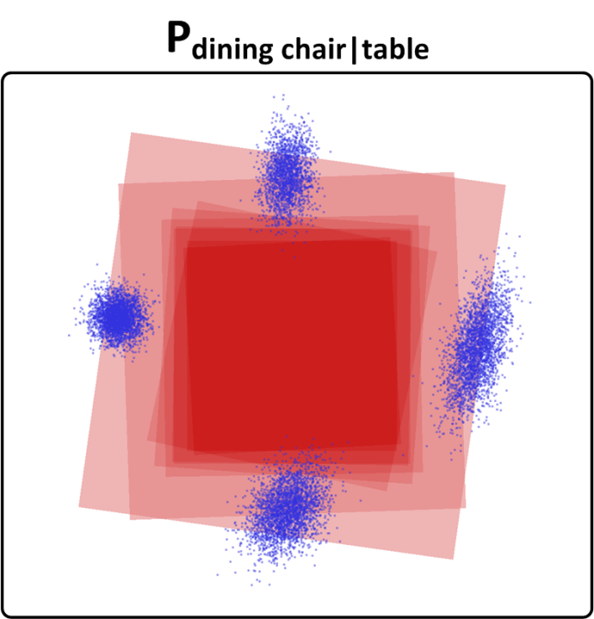

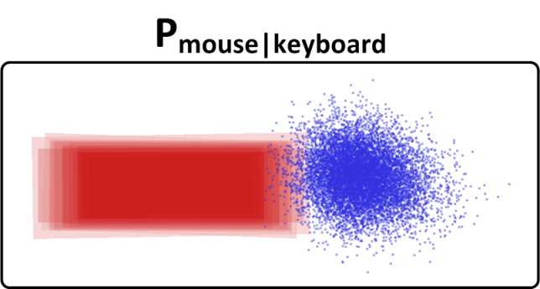
Probabilistic Model
$$P$$
:
?
?
?
what?
how many?
where?
Implementation
Notes:
Here, I’ve visualized a few more of the mixtures we learned, such as the position of chairs with respect to tables.

Slide 35
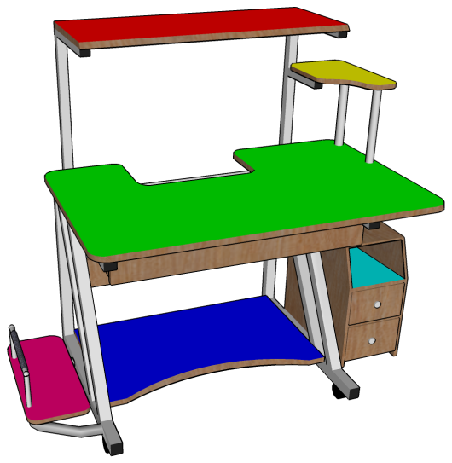
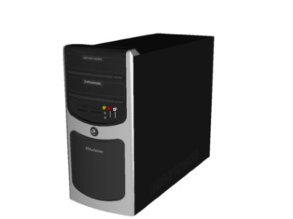
Probabilistic Model
$$P$$
:
?
?
?
what?
how many?
where?
Implementation
what surface?
2
3
1
1
2
3
Notes:
Since we’re arranging objects that can be placed on top of other objects, such as desks, that might have multiple supporting surfaces, we also need the arrangement model to tell us which of these surfaces are the most likely ones.
For example, while it is possible to place a CPU on any of the colored surfaces of this desk, the choices are not equally likely or desirable.
Just going by intuition, we would probably say that the violet surface—the computer tray—is the most likely supporting surface for this object, followed by…probably the green surface, and then maybe the dark blue one.
And in fact, these likelihoods are exactly what our arrangement model captures, using Gaussian kernel density estimation on some simple features of these surfaces. The specifics are in the paper.

Slide 36
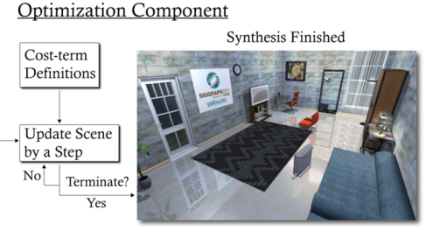
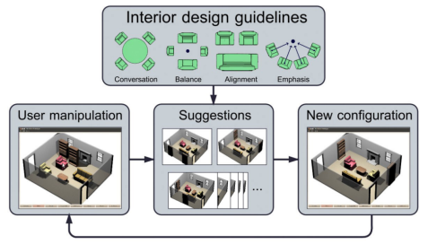
Probabilistic Model
$$P$$
:
?
?
?
what?
how many?
where?
Related Work
Automatic furniture layout
[Yu et al. 2011]
[Merrell et al. 2011]
Notes:
This implementation is similar to recent work on Automatic furniture layout that was presented at SIGGRAPH two years ago.
Whereas the work by Yu and colleagues models pairwise spatial relationships using a single Gaussian, our implementation uses a mixture of Gaussians to capture multimodal object arrangements.
The ability to model the likelihood of different supporting surfaces is also a new feature of our implementation, as both of these previous works only considered laying out objects on a single, fixed support surface (which was typically the floor).
And as we’re about to see, like both of these previous works, our system uses an iterative layout optimization process guided by this probabilistic model.

Slide 37



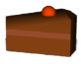
Synthesis By Sampling
?
?
?
table
Iterative Layout Optimization
what?
how many?
plate
fork
cake
where?
Notes:
Given this model, we can synthesize a new scene by biased sampling—biased in the sense that we skew towards the highest-probability samples.
The process starts by forward sampling a new support hierarchy from the occurrence model.
The nodes of the hierarchy are categories, so the next step is to choose an actual model from each of these categories to form the set of objects in our new scene.
We then pass this model hierarchy off to the arrangement model, which iteratively optimizes the layout of all objects to improve their arrangement probability.

Slide 38





Synthesis By Sampling
?
?
?
table
Iterative Layout Optimization
what?
how many?
plate
fork
cake
where?
…
Notes:
In our implementation, we use a simple hill-climbing optimizer that makes small perturbations to the scene and accepts those that improve the scene’s overall probability.

Slide 39









Scene Variety by Model Mixing
$$ℜ$$
?
?
?
?
?
?
what?
how many?
what?
how many?
where?
where?
$$(1−λ_{o})$$
$$λ_{o}$$
$$(1−λ_{A})$$
$$λ_{A}$$
$$P$$
?
?
?
what?
how many?
where?
Notes:
With this probabilistic approach, it’s very easy to incorporate information from both our examples and the database to increase scene variety.
Given our two sources of input scenes…
…We first train an occurrence and arrangement model on the examples…
…and then we train occurrence and arrangement models on the relevant set of database scenes…
We then linearly combine the probability density functions represented by these models using user-provided blending weights…
…which form the final components of our model
(Details of how exactly to do this are a little more complicated; see the paper)

Slide 40





Model Mixing Results
INPUT
OUTPUT
$$λ_{o}=λ_{A}=0.5$$
Notes:
Here are some of the scenes we can synthesize using 4 input scenes, and incorporating relevant scenes from the database with mixing weights set to 0.5
They all achieve a high degree of plausibility, and there’s also some interesting diversity in the objects used and their arrangements.
Let me point out a few examples:

Slide 41
Model Mixing Results
INPUT
OUTPUT
Notes:
These two scenes both contain alarm clocks, even though none of the four inputs do.
This is an example of the database contributing plausible new object categories to the synthesized scenes.

Slide 42
Model Mixing Results
INPUT
OUTPUT
Notes:
This scene features a left-handed mouse-and-keyboard setup, which does not occur in the input scenes but does occasionally occur in the database.
Here, the database is providing novel *arrangement* information to increase variety. The system essentially swapped in a small piece of an arrangement that was found in a relevant database scene.

Slide 43
Model Mixing Results
INPUT
OUTPUT
Notes:
These two scenes both use a desk with a clear slot for a desktop computer, and indeed, the computer is placed inside this slot in both cases.
While the desk in the left output scene is also used in one of the examples, the desk in the scene on the right is not. Still, the arrangement model was able to correctly deduce that this is the most likely position for the CPU, generalizing from the related examples that it was given.

Slide 44







Model Mixing Results
Input Scene
$$λ_{A}=0$$
$$λ_{A}=0.5$$
$$λ_{A}=1$$
Notes:
As it turns out, mixing models can have benefits beyond increasing variety.
Here, we’re giving the system just one input scene. It has a desk with only one supporting surface: the desk top.
One of our goals is to do well in the presence of minimal input—so how will our system perform in this case?
If we train on just this input, then if we then attempt to lay out objects on a desk with multiple support surfaces, such as the desk with shelves on the right, we’ll still be restricted to using the main desk-top surface.
This can result in overcrowding.
If we instead pull from the database by increasing the value of the mixing parameter, then we can incorporate information from scenes that have more varied support surfaces, allowing the system to make use of the shelves on this desk in a way that is plausible.

Slide 45






Model Mixing Results
Input Scene
$$λ_{o}=0$$
$$λ_{o}=0.5$$
$$λ_{o}=1$$
Notes:
Here, we’ll again use just one input, but this time we’ll look at what happens if we restrict the occurrence model.
When we have a single input scene with a table, two chairs, and a bowl of soup, synthesis with the mixing parameter set to 0 is restricted to exactly reproducing the object categories in the input.
As we increase the value of the mixing parameter, the system pulls in data from other, similar scenes in the database, increasing the variety of objects in the synthesized results.
Essentially, model mixing allows us to use an extremely sparse ‘sketch’ of a scene to synthesize fully fleshed-out scenes. It functions somewhat like an ‘auto-complete’ function for 3D scenes.

Slide 46











Model Mixing Results
Input Scene
$$λ_{o}=0$$
$$λ_{o}=0.5$$
$$λ_{o}=1$$
Notes:
Here’s another example demonstrating the same phenomenon with a computer desk scene and an office desk scene.
What’s interesting here is that both of these scenes prominently feature a desk, and are only differentiated by the presence of two other object categories. Still, these extremely minimal ‘sketch’ scenes are enough to guide the system to retrieve relevant content from the database and flesh out the occurrence model.

Slide 47
Where are we now?
Model Mixing
Scene Variety
Basic Categories
Contextual Categories
Object Variety
Notes:
So, to recap, we took a system that could achieve good object variety using contextual categories, and we added model mixing to increase scene variety.

Slide 48



Evaluation
How plausible are synthesized scenes?
Dining Tables
Gamer Desks
Office Desks
Notes:
We also wanted to stress-test our system and verify that when generating large numbers of scenes, most of those scenes are plausible enough for people to use.
So, we ran a study where we asked people to judge the plausibility of synthesized Dining Table, Gamer Desk, and Office Desk scenes.

Slide 49
Evaluation
Dataset
 | Manual | Synthesized
Dining Tables | 4 | 50
Gamer Desks | 4 | 50
Office Desks | 4 | 50
30 participants on Mechanical Turk
Each rated all manual and 13 randomly sampled synthesized scenes from each scene type
30 ratings per manual scene
~8 ratings per synthesized scene
Notes:
We manually built 4 scenes of each type, and then also used these scenes as inputs to generate 50 synthesized scenes.
We then recruited 30 participants on Mechanical Turk, and asked them to rate the plausibility of all of the Manual scenes and 13 randomly sampled synthesized scenes of each type, presented in random order.
This resulted in 30 ratings for each manual scene, and approximately 8 ratings for each synthesized scene.

Slide 50

Evaluation
Notes:
Here’s a screenshot of the web interface we used for the study, where participants were asked to rate scene plausibility on 5-point Likert scale.

Slide 51




Notes:
We found that, overall, ratings for synthesized scenes were very similar to those of manual scenes.
Manual scenes were rated a little higher on average, and this difference was significant…

Slide 52

80% of synthesized scenes as plausible as hand-created scenes
Notes:
…but, we found that the top 80% of synthesized scenes were *not* rated significantly differently from manual scenes.
So, for an artist choosing from among a list of synthesized results, having 80% of the results be as plausible as hand-crafted scenes should be more than sufficient for practical use.

Slide 53






Dining Tables
Gamer Desks
Office Desks
2.4
2.75
2.71
Lowest Rated
4.40
5.00
4.38
Highest Rated
Notes:
Here, we visualize the scenes from each type that received the lowest and highest average ratings.
While we didn’t collect rationale from the participants on *why* they rated each scene they way they did, it’s nevertheless interesting to look at these scenes and speculate as to what characteristics led to their scores.
In the case of the poorly-rated scenes, a couple of them prominently display a large chunk of empty space. This might be perceived as functionally bad, as it’s wasted space, or aesthetically bad, as it throws off the visual balance of the image.
It might be interesting to look at adding ‘empty space’ as an entity in our probabilistic model to try and avoid generating scenes like this.
A totally different approach would be to start looking at 2D image composition principles applied to renderings of the scene.

Slide 54



Future Work
Stylistic Consistency
Notes:
(Pause here for a bit to let the audience digest)
There are several other avenues for future work that suggest themselves after working on this project. <C>
While our system generally does quite well at generating functionally plausible scenes, it may synthesize content that is stylistically objectionable.
<C>In this office scene, the painting and the chair are perhaps too bright and garish when compared to the rest of the scene.
<C>And in this scene, while a clock is a functionally valid object to have here, <C> this pink Barbie clock might not be.
It will be valuable in future work to look at shape, material, or even natural language annotations on these objects to also model stylistic compatibility.

Slide 55

Future Work
Larger Scale
Notes:
We’d also like to scale our system up from generating small scenes such as this…
…to larger scenes such as this.
One promising way to approach this problem is to represent large scenes as hierarchies of scenes at smaller scales.

Slide 56
Future Work
New Interactive Tools
“add table”
Notes:
Finally, we’d also like to look at embedding scene synthesis technology into interactive modeling tools.
In particular, making ‘automatically generated object arrangements’ primitive entities in a modeling package could be very valuable.
For example, a user modeling a kitchen scene could simply ask the modeling system to ‘insert a complete kitchen table.’
She might tweak the result to taste, but such a tool could save hours of painstaking labor and, we think, fundamentally change how people model 3D environments.

Slide 57
Questions?
Support for this research was provided by:
The Fannie and John Hertz Foundation
SAP (Stanford Graduate Fellowship)
The Akiko Yamazaki and Jerry Yang Engineering Fellowship Fund
The National Science Foundation (CCF-0937139, CNS-0831374)
Intel (ISTC-VC)
Adobe
Google
Notes:
And that’s it.
Thanks for listening, and we’d be happy to take questions.

Slide 59


?
?
?
what?
how many?
Model
where?
?
?
?
Basic Categories
Contextual Categories
what?
how many?
where?

